Slide 1

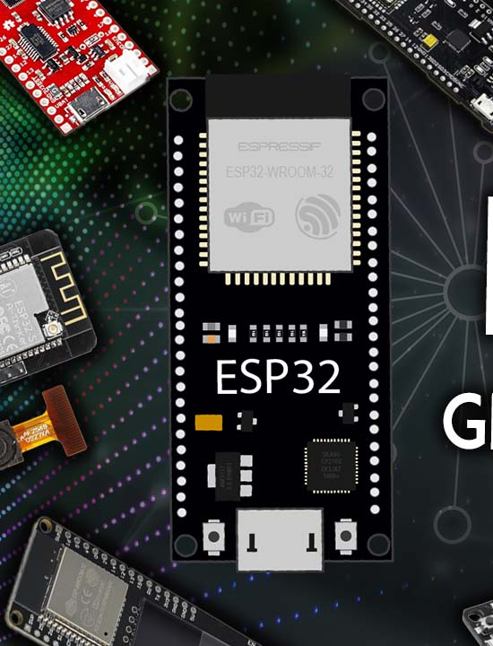
SmartTrack: IoT Vehicle Monitoring and Control System for Rent-a-Car Service Owners
Mid semester
Presentation – Group 28
GROUP MEMBERS:
H.M.D.S.DHARMADASA - 2021/E/046
K.M.P.S.KULATHUNGA – 2021/E/078
P.G.P.M.CHANDRASIRI – 2021/E/108
H.M.S.A.BANDARA – 2021/E/187

Slide 2
Table Of Contents
01
Introduction
06
Progress So Far
02
07
Hardware Implementation
Problem Statement
03
Scope
08
Mobile App
Progress
04
Methodology
09
What’s Next?
05
Challenges & Solutions
10
Conclusion

Slide 3
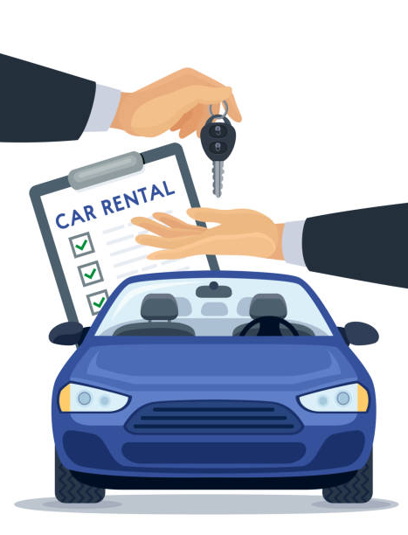
Introduction
Presentation Overview
What is SmartTrack?
Embedded system for rental car monitoring using ESP32.
Key features:
Real-time GPS tracking
Speed limit alerts
Fire detection & temperature monitoring
Remote buzzer control (driver)
Target Users:
Owners - Monitoring dashboard (speed, fire, location, temperature).
Drivers - Control features (buzzer, emergency alerts).
Components:
Hardware (ESP32, sensors), Mobile App (Android), Web Portfolio.

Slide 4


Problem Statement
Current Issues in Car Rentals:
How SmartTrack Solves This:
No real-time monitoring for theft/unauthorized use.
Difficulty enforcing speed limits.
Delayed emergency response (fire, accidents).
IoT sensors + cloud connectivity for instant alerts.
Dual-panel app for owner control and driver safety.

Slide 5
Scope
ESP32 Module:
Sensors: GPS, fire, temperature, buzzer.
Direct vehicle battery power.
Mobile App:
Owner: Speed alerts, live tracking, fire/temperature alerts.
Driver: Buzzer control, emergency button.
Web Portfolio:
Project showcase, Play Store link, QR setup guide.

Slide 6

Methodology
How The Project Is Implementing?
Development Phases:
Research: Component selection, use-case analysis.
Hardware Setup: ESP32 wiring, sensor integration.
Firmware: AVR C code for sensor data collection.
Mobile App: UI/UX design (Figma), backend integration.
Testing: Sensor accuracy, app-cloud communication.
Deployment: Play Store, QR onboarding.

Slide 7




Challenges & Solutions
Challenge:
Component shortages.
Solution:
Sourced alternatives (e.g., simulators for testing).
Challenge:
Power consumption
Solution:
ESP32 sleep modes + battery optimization.
Challenge:
Complex sensor integration
Solution:
Iterative testing + online forums.

Slide 8
Driver Features
Buzzer Control:
Trigger via app to deter theft or locate the parked vehicle.
Emergency Button:
Sends instant SMS alert to owner (e.g., "EMERGENCY – Driver ID: 01").
Progress So Far
Owner Features
Speed Monitoring:
Alerts if driver exceeds preset limit (e.g., SMS: "ALERT: Speed Limit Exceeded!").
Live Tracking:
Real-time GPS coordinates on app map.
Temperature Alerts:
Notifications for extreme in-vehicle temperatures.
Mobile App Status
Under Construction:
Basic UI/UX ready (Figma mockups).
Serial Monitor Demo.

Slide 9
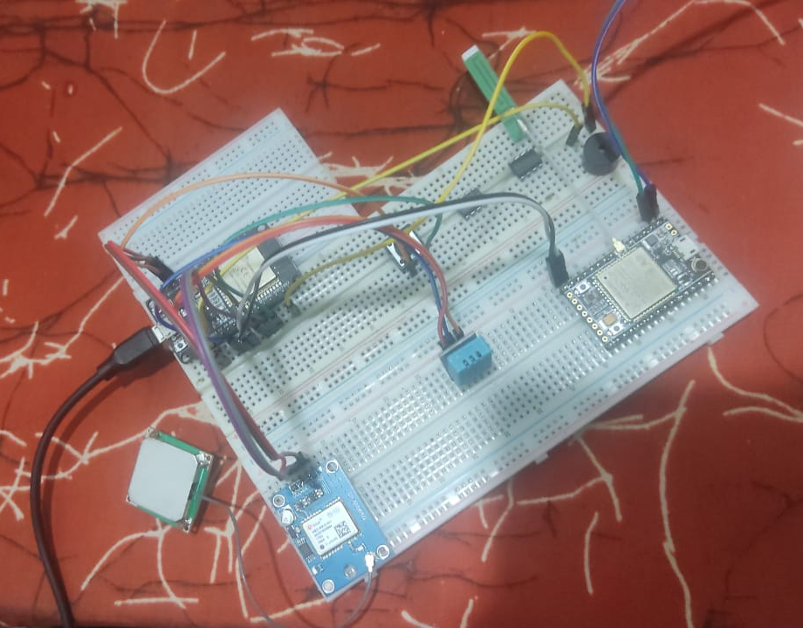
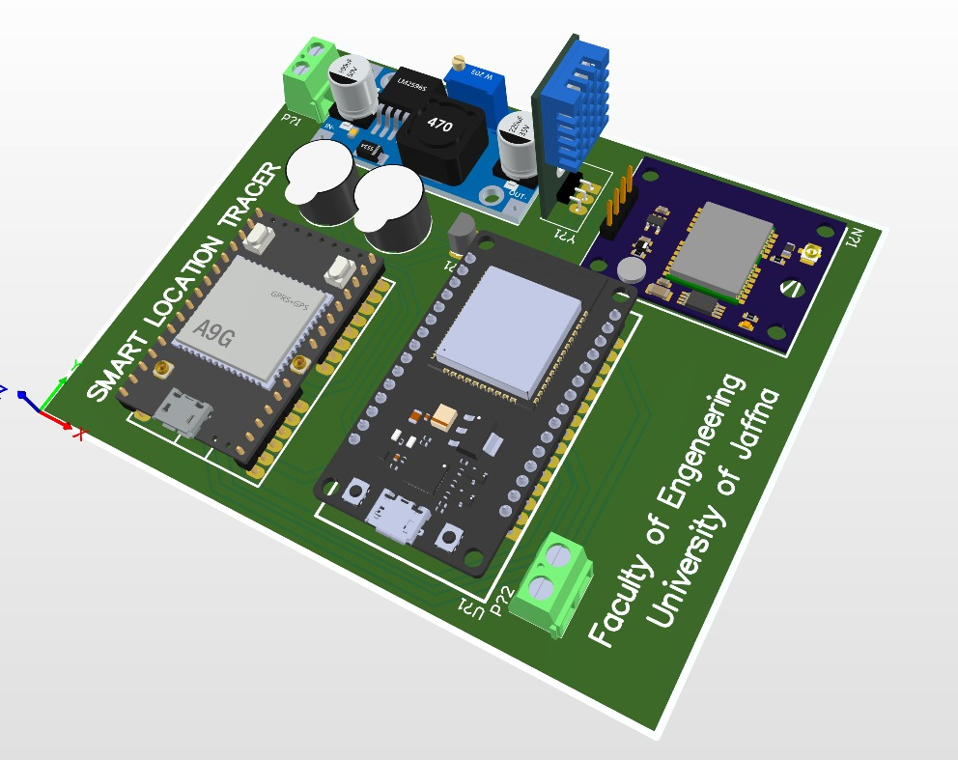
Hardware Implementation
3D Modal Circuit Diagram:
Prototype Images:

Slide 10
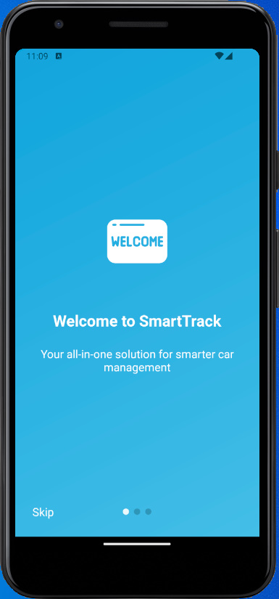
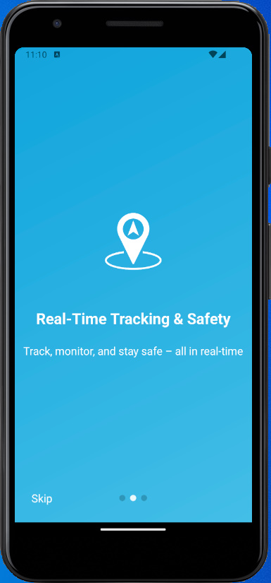
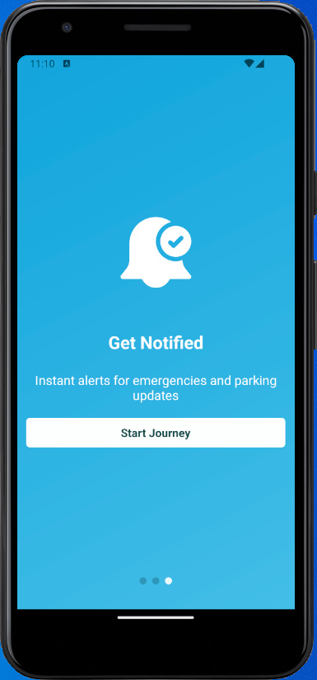
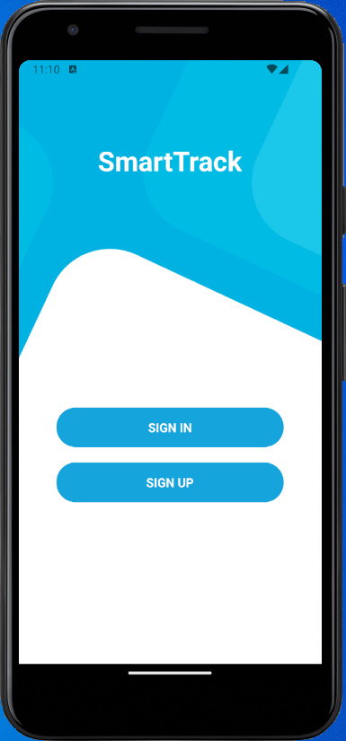
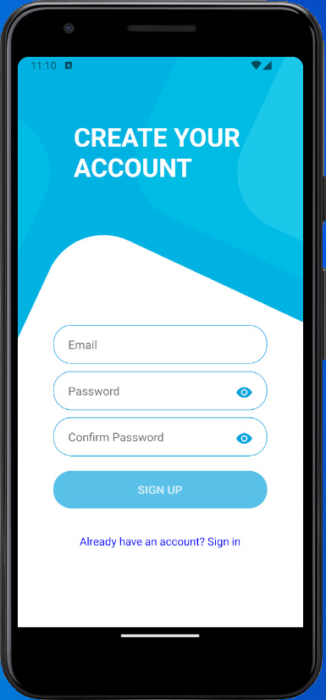
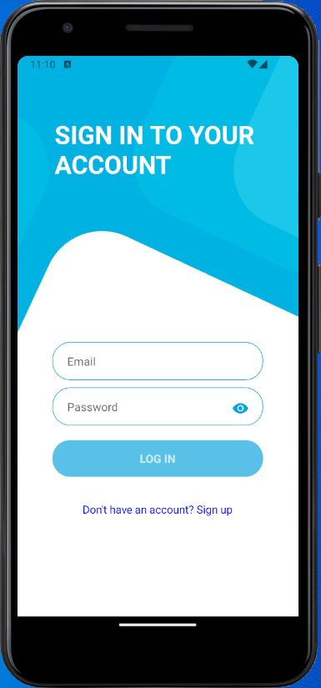
Mobile App
Progress
UI/UX Designs:

Slide 11
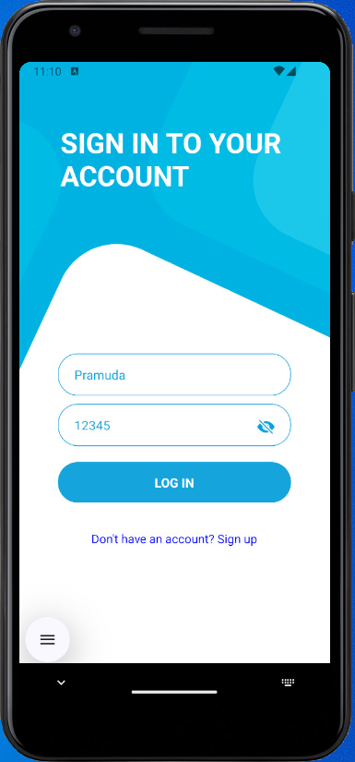
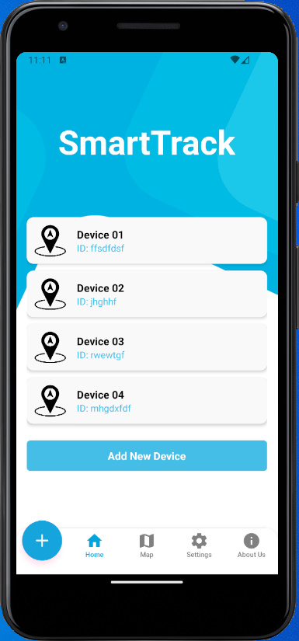
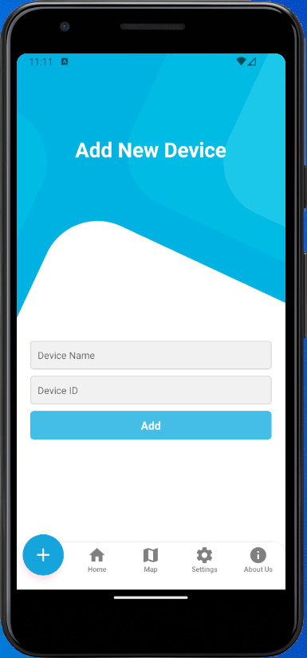
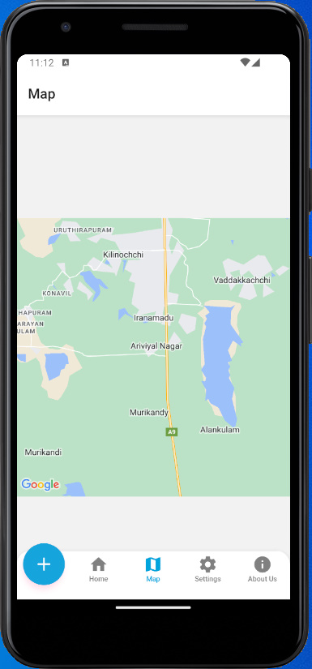
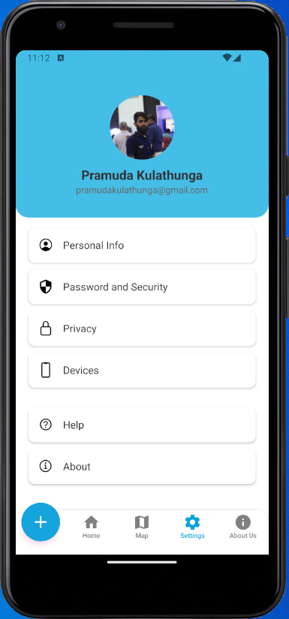
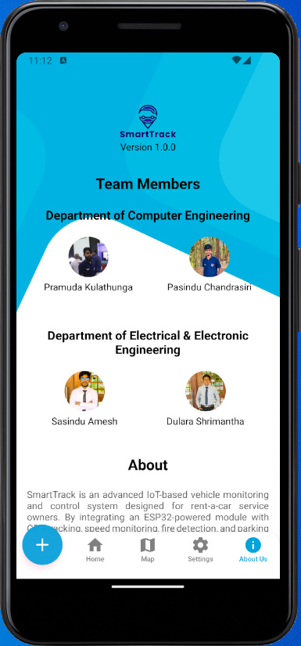
Mobile App
Progress
UI/UX Designs:
Next Steps:
Firebase integration, Play Store submission.

Slide 12
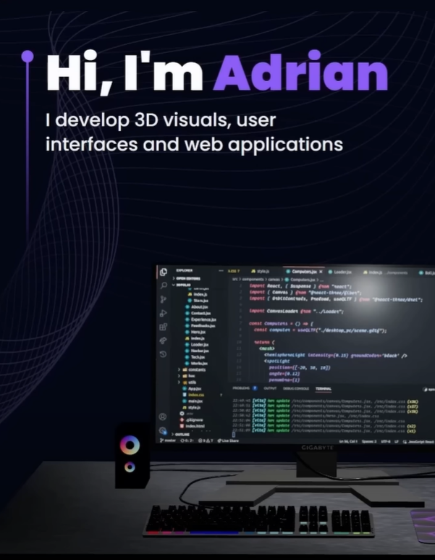
What’s Next?
Finalize Design: Hardware casing + app/website UI.
Integrate Code: Upload C firmware to ESP32.
Test & Debug: Identify sensor/communication errors.
Build Final Product: Compact module + compliance checks.
Launch Website: One page portfolio with features, modal images of the design and components what we used to implementation, and QR code to download mobile application through App Store.

Slide 13


Conclusion
Track Smarter, Rent Safer
"SmartTrack" is an IoT-based embedded system using ESP32 modules to enhance rental vehicle management. The hardware, installed discreetly in vehicles and powered by the car battery, enables real-time tracking of speed, location, temperature, and fire hazards. Owners receive instant alerts via a dedicated mobile app, while drivers can trigger a buzzer or send emergency notifications. Each pre-built module includes a QR code for quick app pairing, available on the Play Store or our project portfolio website. Designed for scalability, SmartTrack empowers rental businesses with secure, centralized control over their fleets.

Slide 14
Thank You
Faculty of Engineering
University of Jaffna

