Slide 1
💧
AQUAGUARD
Community Water Quality & Usage Monitor
Monitor water. Detect problems. Encourage conservation.
HACK-AI-THON 2026
SDG 6 • SDG 12
Python Fundamentals + Object-Oriented Programming
NATIONAL LEVEL GROUP PROJECT • PYTHON + OOP + SDGs

Slide 2
THE CHALLENGE
02
Why AquaGuard?
Water problems are often invisible until they become serious.
💧
🧪
📈
Excessive usage
Quality changes
Changing trends
Daily water use can rise without users noticing.
Unusual pH or turbidity can signal a problem.
A simple trend can reveal possible wastage.
AquaGuard's goal: turn simple observations into clear alerts, trends and actions.
HACK-AI-THON 2026 • AQUAGUARD

Slide 3
THE SOLUTION
03
What AquaGuard does
01
RECORD
02
CHECK
Location, user and daily water readings
pH, turbidity and consumption against selected limits
03
FLAG
04
REPORT
Unsafe or abnormal conditions
Trends, alerts and conservation recommendations
SIMPLE INPUT → CLEAR DECISION → ACTIONABLE REPORT
HACK-AI-THON 2026 • AQUAGUARD

Slide 4
SDG IMPACT
04
Built around SDG 6 + SDG 12
SDG 6
SDG 12
Clean Water & Sanitation
Responsible Consumption
Monitors basic water-quality observations
Tracks daily water consumption
Flags potentially unsafe pH and turbidity readings
Flags excessive use using a selected limit
Encourages further testing when readings are abnormal
Suggests conservation actions and leak checks
The challenge explicitly aligns AquaGuard with SDG 6 and SDG 12.
HACK-AI-THON 2026 • AQUAGUARD

Slide 5
SYSTEM DESIGN
05
Simple OOP architecture
Location
User
name • address • location_type
user_id • name • role
WaterReading
MonitoringReport
date • location • user • consumption • pH • turbidity
readings • trends • alerts • recommendations
Four focused classes keep the prototype understandable and aligned with the OOP requirement.
HACK-AI-THON 2026 • AQUAGUARD

Slide 6
WORKFLOW
06
From reading to report
📍
Location
→
👤
User
→
💧
Water Reading
→
🔍
Threshold Check
↓
⚠️
Alerts
→
📈
Trend
💡
Recommendations
📋
Report
→
→
→
→
→
INPUT → ANALYSIS → ALERTS → CONSERVATION ACTION
HACK-AI-THON 2026 • AQUAGUARD

Slide 7
LOGIC
07
How abnormal readings are detected
pH
Turbidity
Consumption
6.5 – 8.5
≤ 5.0 NTU
≤ 500 L/day
Safe range
Selected limit
Selected limit
If a reading crosses a selected threshold:
→ abnormal condition → alert → recommendation
Note: threshold values are project-defined demonstration values, not numbers supplied by the challenge.
HACK-AI-THON 2026 • AQUAGUARD

Slide 8
DEMO DATA
08
Representative sample readings
House 12B • Green Park Colony • Household
Recorded by: Priya Sharma (U101)
DATE
CONSUMPTION
pH
TURBIDITY
QUALITY
DEMO
2026-09-10
320 L
7.1
2.3 NTU
SAFE
3 readings
2026-09-11
450 L
6.2
6.8 NTU
UNSAFE
1 unsafe quality reading
1 excessive-use reading
2026-09-12
510 L
7.4
3.1 NTU
SAFE
The sample data is designed to demonstrate both normal and abnormal conditions.
HACK-AI-THON 2026 • AQUAGUARD

Slide 9
RESULTS
09
What the prototype reports
ATTENTION NEEDED
426.7 L/day
Increasing
Overall status
Average use
Consumption trend
Detected alerts
• Low pH (6.2) • High turbidity (6.8 NTU) • High consumption (510 L)
Recommended actions include leak checking, reducing usage, further water testing and filtration consideration.
HACK-AI-THON 2026 • AQUAGUARD

Slide 10
EXPECTED OUTPUT
10
The monitoring report
AQUAGUARD MONITORING REPORT
WR-001
Location
House 12B (Green Park Colony)
Status
ATTENTION NEEDED
Total readings
3
Average use
426.7 litres/day
Trend
Increasing (possible wastage)
ALERTS
Low pH • High turbidity • High consumption
HACK-AI-THON 2026 • AQUAGUARD

Slide 11
DEMONSTRATION
11
What to show the judges
Run the program
Execute main.py and display the generated report.
01
Explain the classes
Briefly explain Location, User, WaterReading and MonitoringReport.
02
Point out alerts
Show the low pH, high turbidity and high consumption alerts.
03
Connect to SDGs
Explain how monitoring quality supports SDG 6 and conservation supports SDG 12.
04
KEEP THE DEMO SIMPLE • SHOW THE WORKING PROTOTYPE • EXPLAIN THE LOGIC
HACK-AI-THON 2026 • AQUAGUARD

Slide 12
TESTING
12
Normal + abnormal cases
NORMAL
320 L • pH 7.1 • 2.3 NTU
Safe water quality
QUALITY ALERT
450 L • pH 6.2 • 6.8 NTU
Unsafe + pH/turbidity alerts
USAGE ALERT
510 L • pH 7.4 • 3.1 NTU
High consumption alert
Testing uses representative sample data as required for the working prototype demonstration.
HACK-AI-THON 2026 • AQUAGUARD

Slide 13
SCOPE
13
Current prototype vs. future scope
CURRENT PROTOTYPE
FUTURE IMPROVEMENTS
Python + OOP
Graphical user interface
Sample data
Database storage
pH + turbidity
Real-time sensors
Consumption + trend
More water-quality parameters
Alerts + recommendations
Charts and dashboards
Monitoring report
Automatic data collection
Future features are intentionally outside the scope of the current prototype.
HACK-AI-THON 2026 • AQUAGUARD

Slide 14
CLOSING
14
Why AquaGuard matters
A small monitoring system can make water use and water quality easier to understand.
💧
⚠️
🌱
MONITOR
DETECT
CONSERVE
Record water use and quality.
Flag abnormal conditions.
Turn alerts into responsible action.
SDG 6 • SDG 12 • PYTHON + OOP
THANK YOU
HACK-AI-THON 2026 • AQUAGUARD • THANK YOU

Slide 15
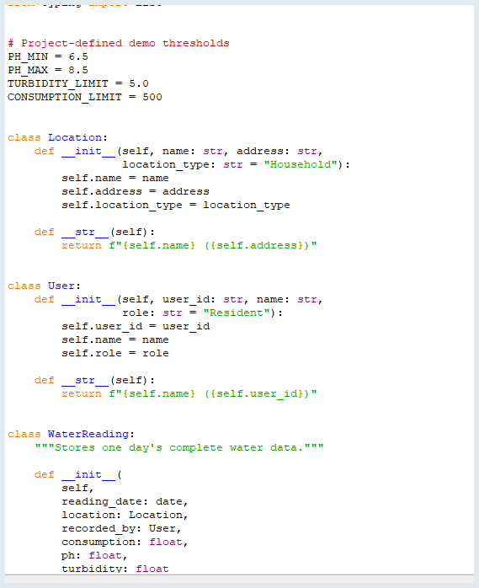
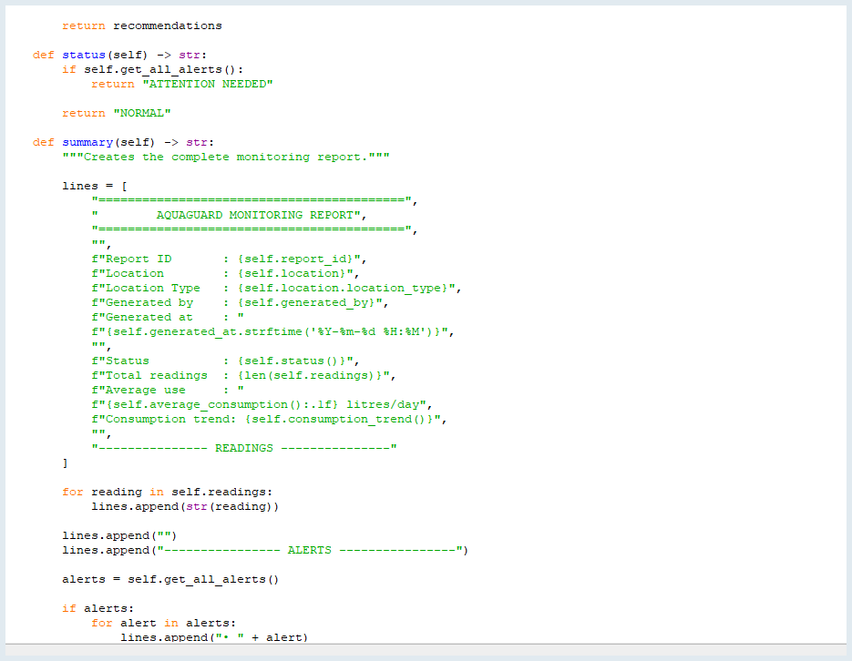
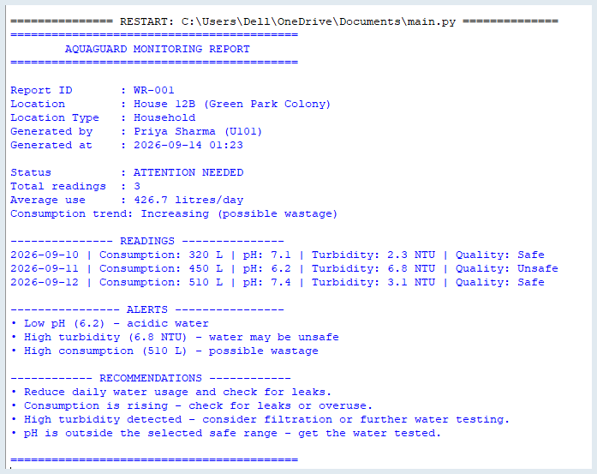
CODE & OUTPUT — IMPLEMENTATION SNAPSHOT
Essential screenshots from the working AquaGuard prototype
1 OOP CLASSES & THRESHOLDS
2 REPORT GENERATION LOGIC
3 SAMPLE RUN / OUTPUT
The prototype takes water readings, checks thresholds, identifies alerts, and produces a monitoring report.

Slide 16
💧
THANK YOU
AquaGuard – Community Water Quality & Usage Monitor
Project by
Sanskriti Patel — Grade 8
Pramveer Kumar — Grade 9
Agrima Jin — Grade 8
Dhanvith J Patel — Grade 7
SDG 6 • SDG 12

