Slide 1
AQUA
GUARD
Community Water Quality
& Usage Monitor
Python • OOP • Data Analytics • Sustainable Water Use
HACK-AI-THON 2026
NATIONAL LEVEL
SDG 6 + SDG 12
Sanskriti Patel • Pramveer Kumar • Agrima Jin • Dhanvith J Patel

Slide 2
01 / THE PROBLEM
02
Water data is only useful when people can act on it.
A reading is just a number.
AquaGuard turns it into a decision.
WASTAGE
QUALITY
CONTEXT
Excessive daily use can point to avoidable loss or leaks.
Unusual pH or turbidity deserves attention and further testing.
Trends, locations and alerts make raw observations understandable.
AQUAGUARD • HACK-AI-THON 2026

Slide 3
02 / THE CHALLENGE
03
What the brief asks us to build
FUNCTIONAL PROTOTYPE
01
Record
Not just an idea.
A working monitoring system.
Consumption + pH + turbidity
02
Detect
Threshold-based abnormal readings
03
Alert
Unsafe or excessive conditions
04
Summarize
Location-wise reports + trends
AQUAGUARD • HACK-AI-THON 2026

Slide 4
03 / OUR SOLUTION
04
One flow. Five outcomes.
INPUT
STORE
ANALYZE
EXPLAIN
ACT
Readings
SQLite
Rules + trends
Alerts
Report + advice
The product story
ENTER → SAVE → ANALYZE → ALERT → UNDERSTAND
The GUI is the visible layer. Python/OOP + SQLite + analytics power what happens underneath.
AQUAGUARD • HACK-AI-THON 2026

Slide 5
04 / PRODUCT
05
Designed like a real monitoring tool
01
Dashboard
02
Add Reading
03
Analytics
See locations, readings, quality and alerts at a glance.
Capture date, consumption, pH, turbidity and notes.
Visualize consumption and quality patterns.
04
Alerts
05
Locations
06
Monitoring Report
Turn abnormal values into clear actions.
Manage monitored households, schools and community sites.
Generate a location-wise summary with trends and recommendations.

Slide 6
05 / ENGINEERING
06
Modular architecture keeps the project clean.
GUI
main_window • dashboard • add_reading • analytics • alerts • locations • report • thresholds
LOGIC
analytics_engine • validators • thresholds • report generation
DATA
database_manager • SQLite • demo data
MODELS
Location/User • WaterReading • MonitoringReport
Separation of concerns • reusable classes • maintainable modules
AQUAGUARD • HACK-AI-THON 2026

Slide 7
06 / OOP
07
The code is structured around real-world objects.
Location / User
WaterReading
MonitoringReport
DatabaseManager
AnalyticsEngine
Who + where
One observation
Meaningful summary
Persistence
Reasoning
OOP PRINCIPLES
Classes & objects
Encapsulation
Composition
Methods
This directly supports the mandatory Python + OOP focus of the challenge.
AQUAGUARD • HACK-AI-THON 2026

Slide 8
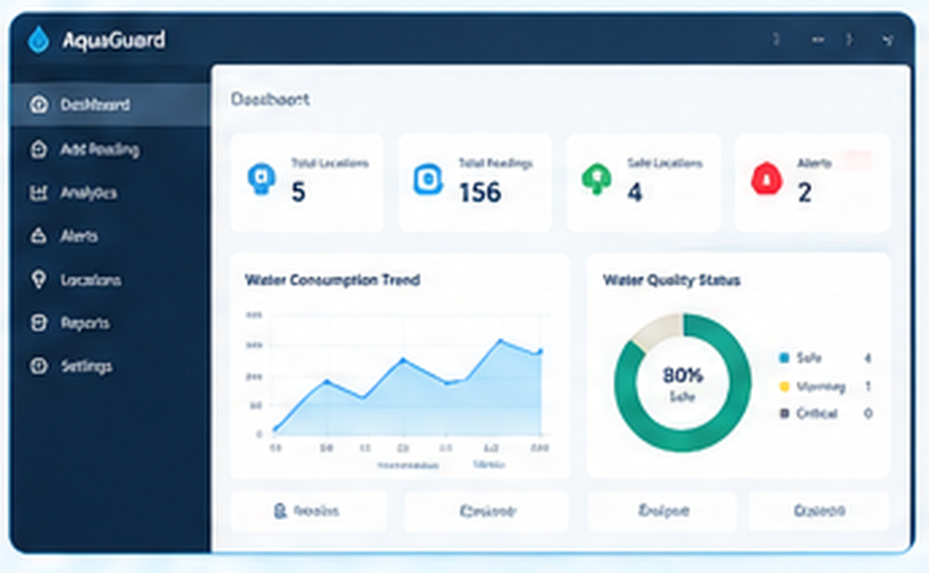
07 / LIVE UI
08
Dashboard — the command center
DASHBOARD
AT A GLANCE
Locations
Readings
Safe sites
Alerts
One screen to understand what is happening across the monitored system.
GUI / OVERVIEW
AQUAGUARD • HACK-AI-THON 2026

Slide 9
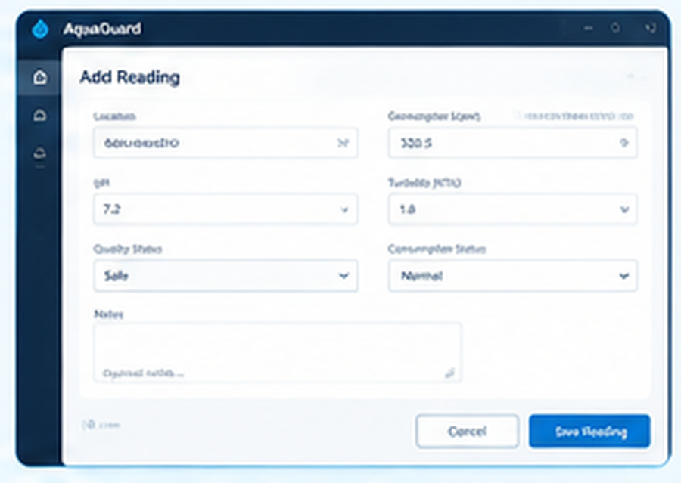
08 / LIVE UI
09
Add Reading — capture the evidence
ADD READING
REQUIRED DATA
Consumption
Litres / day
pH
Water acidity / alkalinity
Turbidity
NTU observation
Notes
Optional context
After saving, the same reading becomes available to the analytics, alerts and report layers.
AQUAGUARD • HACK-AI-THON 2026

Slide 10
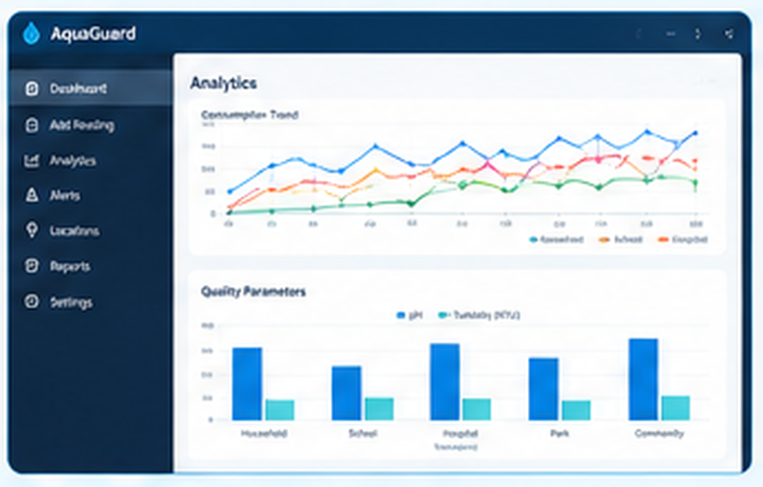
09 / LIVE UI
10
Analytics — from readings to patterns
ANALYTICS
TREND + QUALITY
See change.
Spot patterns.
Explain the alert.
Matplotlib-based visualizations help the judge understand that the project is doing more than storing values.
DATA → INSIGHT
AQUAGUARD • HACK-AI-THON 2026

Slide 11
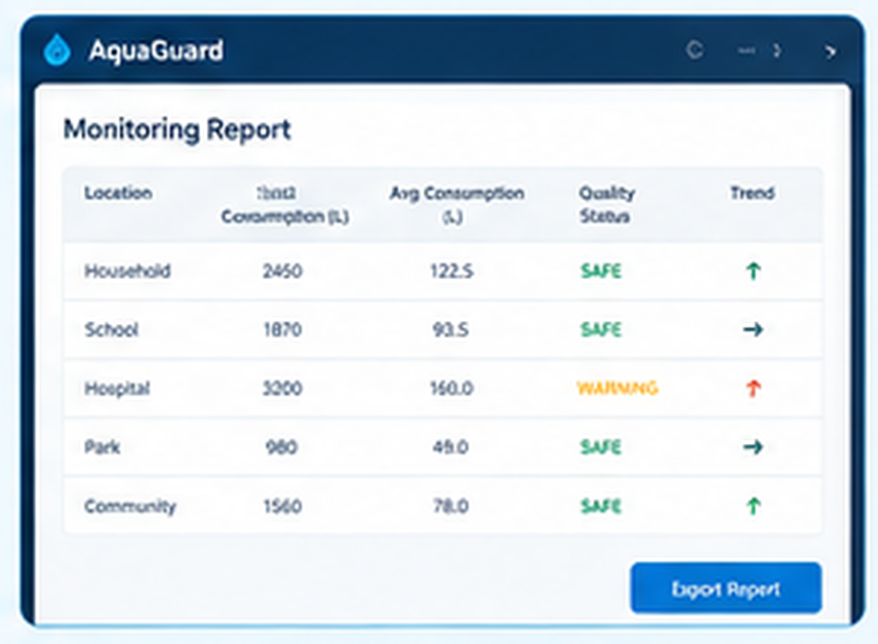
10 / LIVE UI
11
Monitoring Report — the final answer
REPORT
EXPECTED OUTPUT
Consumption
daily / average + trend
Quality status
safe / attention
Alerts
what needs attention
Recommendations
what the user can do
The report connects every required feature into one understandable result.
AQUAGUARD • HACK-AI-THON 2026

Slide 12
11 / DECISION ENGINE
12
When a value crosses a rule, the system explains why.
pH
Turbidity
Consumption
6.5 — 8.5
≤ 5.0 NTU
≤ 500 L/day
Outside range → quality attention
Above limit → quality attention
Above limit → usage alert
RULE-BASED, TRANSPARENT, CONFIGURABLE
The prototype uses project-defined demonstration thresholds. They are monitoring rules — not a replacement for certified laboratory or regulatory testing.
AQUAGUARD • HACK-AI-THON 2026

Slide 13
12 / IMPACT
13
Built around two sustainability goals.
SDG 6
SDG 12
Clean Water
& Sanitation
Responsible
Consumption
Monitor basic quality observations and flag potentially unsafe sample conditions.
Track excessive use and encourage practical conservation actions.
MEASURE → UNDERSTAND → ACT → CONSERVE
AQUAGUARD • HACK-AI-THON 2026

Slide 14
13 / LIVE DEMO
14
The strongest 90-second story
01
Load demo data
02
Open Dashboard
Start with representative locations and readings.
Show the overall state.
03
Enter / inspect reading
04
Trigger an alert
Demonstrate the input workflow.
Show abnormal pH / turbidity / consumption.
05
Open Analytics
06
Generate Report
Explain the trend.
Finish with the required monitoring output.
A short story beats a long feature list.
ENTER → ANALYZE → ALERT → EXPLAIN → REPORT
AQUAGUARD • HACK-AI-THON 2026

Slide 15
14 / TESTING
15
We test the system by scenario, not just by button.
NORMAL
QUALITY ALERT
USAGE ALERT
320 L • pH 7.1 • 2.3 NTU
450 L • pH 6.2 • 6.8 NTU
510 L • pH 7.4 • 3.1 NTU
Expected: safe
Expected: quality warning
Expected: consumption alert
Functional checks
Valid input • invalid input • SQLite save/load • alerts • trends • multiple locations • report generation
AQUAGUARD • HACK-AI-THON 2026

Slide 16
15 / NEXT
16
Prototype today. Scalable tomorrow.
IoT sensors
Cloud sync
Automated readings
Multi-location access
Advanced anomaly detection
Notifications
Smarter historical analysis
Email / SMS / app alerts
AQUAGUARD
THANK YOU
Monitor water. Understand the data. Act before problems grow.
Questions • Live Demonstration
AQUAGUARD • HACK-AI-THON 2026

