Slide 1
AquaGuard
COMMUNITY WATER QUALITY & USAGE MONITOR
WATER INTELLIGENCE
ONE VIEW.
CLEAR ACTION.
Measure water.
Understand the signal.
Act before it becomes a problem.
DAILY USAGE
406.2 L
trend • increasing
WATER QUALITY
Python • OOP • SDG 6 • SDG 12
ATTENTION
alerts detected
HACK-AI-THON 2026
National Level Team Project
PROTOTYPE
WORKING
Python desktop app
AQUAGUARD • HACK-AI-THON 2026
01

Slide 2
01 • THE CHALLENGE
The problem: raw water data needs a decision layer.
The challenge requires a functional Python prototype — not just a concept.
WHAT MUST THE SYSTEM DO?
THE AQUAGUARD IDEA
01
RECORD
Daily consumption, pH and turbidity
Input → Logic → Insight → Action
02
DETECT
Abnormal readings using thresholds
A reading is not the end of the workflow.
03
ALERT
Excessive use and unsafe values
INPUT
usage • pH • turbidity
04
SUMMARIZE
Location / household insights
LOGIC
threshold checks
INSIGHT
trend + status
05
RECOMMEND
Conservation actions
ACTION
alerts + recommendations
AQUAGUARD • HACK-AI-THON 2026
02

Slide 3
02 • SDG ALIGNMENT
Two SDGs. One practical monitoring loop.
AquaGuard follows the challenge's stated alignment with SDG 6 and SDG 12.
SDG 6
Clean Water & Sanitation
SDG 12
Responsible Consumption
QUALITY VISIBILITY
USAGE VISIBILITY
✓
Track pH and turbidity
✓
Record daily consumption
✓
Flag potentially unsafe samples
✓
Detect excessive use
✓
Generate recommendations
✓
Encourage conservation
AQUAGUARD • HACK-AI-THON 2026
03

Slide 4
03 • SOLUTION
AquaGuard turns a daily entry into a useful decision.
A modern Python desktop prototype using the supplied CustomTkinter implementation.
01
INPUT
02
CHECK
03
ANALYZE
04
RESPOND
Location + user
Date + water data
→
Threshold rules
Abnormality detection
→
Average + trend
Status + alerts
→
Report + recommendations
DESIGN PRINCIPLE
Raw data → meaningful insight → visible action
AQUAGUARD • HACK-AI-THON 2026
04

Slide 5
04 • OOP ARCHITECTURE
Clear objects keep the monitoring logic explainable.
The source defines Location, User, WaterReading and MonitoringReport classes.
Location
User
WaterReading
name
address
location_type
user_id
name
role
reading_date • location • recorded_by
consumption • ph • turbidity
is_abnormal() • get_alerts()
MonitoringReport
readings • generated_at
average_consumption() • consumption_trend()
status() • get_all_alerts() • recommendations()
AQUAGUARD • HACK-AI-THON 2026
05

Slide 6
05 • DECISION ENGINE
Every alert has a visible rule behind it.
The supplied code uses explicit limits and turns exceptions into readable messages.
PH RANGE
TURBIDITY
CONSUMPTION
TREND
6.5 – 8.5
5.0 NTU
450 L
±15%
outside → alert
above → alert
above → alert
first vs last
READING
is_abnormal()
get_alerts()
recommendations()
usage • pH • NTU
→
threshold check
→
explain the exception
→
suggest an action
Transparent rule-based logic makes the prototype easy to demonstrate and extend.
AQUAGUARD • HACK-AI-THON 2026
06

Slide 7
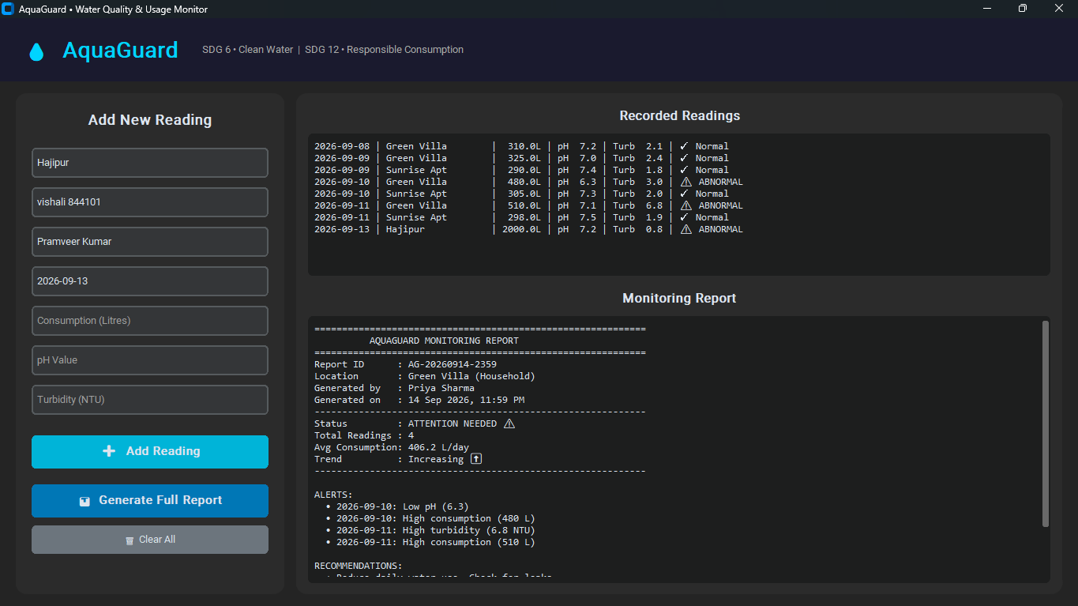
06 • LIVE PROTOTYPE
The real interface: input, readings and reporting in one screen.
The supplied screenshot demonstrates the working desktop UI.
DEMO HIGHLIGHTS
Recorded readings
Date • location • litres • pH • turbidity
Instant status
Normal or abnormal
Monitoring report
Average • trend • alerts
Recommendations
Actions generated from findings
AQUAGUARD • HACK-AI-THON 2026
07

Slide 8
07 • RESULTS
Seven sample readings already tell a story.
Using the representative values present in the supplied Python source.
READINGS
ABNORMAL
SAMPLE DAILY CONSUMPTION
7
2
sample records
at least one limit crossed
480
510
AVERAGE
PEAK
359.7 L
510 L
310
325
305
298
290
across uploaded data
consumption threshold crossed
WHAT THIS SHOWS
The system turns raw rows into exceptions, trends and actions.
08
09
10
11
09
10
11
AQUAGUARD • HACK-AI-THON 2026
08

Slide 9
08 • REPORTING
A report should answer the judge's next question.
MonitoringReport combines status, averages, trend, alerts and recommendations.
AQUAGUARD MONITORING REPORT
FOUR QUESTIONS
STATUS
ATTENTION NEEDED
✓
Is usage rising?
TOTAL READINGS
4
✓
Is quality normal?
AVG CONSUMPTION
406.2 L/day
✓
What triggered the alert?
TREND
Increasing ↑
✓
What should we do next?
ALERTS
Low pH • high consumption • high turbidity
RECOMMENDATIONS
Reduce use • check leaks • test out-of-range water • address turbidity
AQUAGUARD • HACK-AI-THON 2026
09

Slide 10
09 • DEMO FLOW
A 90-second demo with a clear beginning, middle and payoff.
Keep the live demonstration focused on one abnormal reading and the report it creates.
01
ENTER
02
DETECT
03
ANALYZE
04
ACT
Add a reading
Show the flag
Generate report
Explain action
→
→
→
location • date • usage
pH • turbidity
Normal / abnormal
threshold explanation
average • trend
alerts • recommendations
conserve • inspect
filter / test
DEMO LINE
“AquaGuard does not just store the reading — it explains what the reading means.”
AQUAGUARD • HACK-AI-THON 2026
10

Slide 11
10 • FUTURE SCOPE
Today: a functional prototype. Next: a connected water intelligence platform.
The challenge asks for a prototype; these extensions show a credible path beyond the demo.
WHAT IS WORKING IN THE PROTOTYPE
NEXT EVOLUTION
✓
Python desktop GUI
+
IoT / real sensor integration
✓
OOP classes + reusable logic
+
Persistent database storage
✓
Threshold-based anomaly detection
+
Interactive trend dashboards
✓
Alerts + recommendations
+
Multi-location analytics
✓
Monitoring report
+
Notifications and mobile access
✓
Representative sample data
+
Predictive leak / usage insights
AQUAGUARD • HACK-AI-THON 2026
11

Slide 12
AquaGuard
MEASURE • UNDERSTAND • ACT
?
Better water decisions
start with better visibility.
Python + OOP • SDG 6 • SDG 12 • Functional prototype
What does today's
water data say about tomorrow?
WATER
INSIGHTS
ACTION
MONITORED
GENERATED
RECOMMENDED
quality + usage
trends + status
conservation
THANK YOU
AQUAGUARD • HACK-AI-THON 2026
12

