Slide 1
TITLE: Tracing the link between Education and Development: Global Inequalities through the Lens of PISA Scores (2022)
Prantika Mukherjee Ritobhash Daw Ivan Das Annwesha Pal
Department of Economics, Presidency University (3rd Year)
Understanding the intricacies of the relationship between education and the dynamics of development, has triggered a great deal of academic inquiry and policy discussions. In this paper, we exploit the PISA scores obtained until the year 2022.
Research Objectives:
Analyze whether and how such scores capture the impact of education on various demand and supply-side factors
Establish the impact of education on the nature of development across regions
Observe how inequalities in educational outcomes vary across and within countries

Slide 2
The research methodology involves applying regression techniques, while ensuring the accuracy of the specified models through diagnostic corrections, and using scatter plots to visually assess the relationships between variables. Confidence intervals are also used to quantify and understand deviations in the distribution of a curated inequality indicator for PISA scores.
Hypotheses…(based on existing literature)
Scores correlate positively to per capita income and this relation is consistent across regions
Scores depend inversely on pupil-teacher ratio, while directly on government expenditure on education and access to facilities like internet
Gender equality and higher standards of living are reflected positively in scores, while societal inequality is reflect negatively
High PISA scores correlate with increasing dominance of the service sector at the cost of other sectors

Slide 3
Literature Review…
It is reasonably believed by researchers that the PISA project is grounded in Human Capital Theory, which views education as a crucial investment in economic growth. High PISA scores in science and mathematics are often seen as indicators of national competitiveness. (Sjøberg & Jenkins, 2022)
Past research in this area has examined how non-educational factors, such as socio-economic status, cultural values and social capital, significantly influence PISA outcomes, challenging the conventional assumption that school quality alone determines performance. Two distinct paths to high PISA rankings have also been highlighted: individualistic and egalitarian cultures (eg. Finland, Canada) and collectivist, hierarchical societies (eg. South Korea, Singapore). (Meyer & Schiller, 2013)
An exploration of the relationship between PISA scores, economic growth and employment across various sectors, has earlier found that higher scores in mathematics, science and reading are linked to increased economic productivity and workforce distribution. This study aligns with endogenous growth theories, suggesting that investment in education fosters innovation and technological advancement. (Cheung & Chan, 2003)
Another wing of research has analysed PISA data using network theory, identifying clusters of countries with similar student performance and socio-economic backgrounds. The findings state that in some countries less privileged students perform well, while in others private schools with more privileged students achieve higher results, highlighting issues of educational inequality. (Neuman, 2022)

Slide 4

Why PISA?
~Programme for International Student Assessment
Created by the Organisation for Economic Co-operation and Development (OECD), PISA tests the skills and knowledge of 15-year-old students in mathematics, reading and science. Eighty-one countries and economies took part in the 2022 assessment.
Why 15-year olds? - It is when young people in most OECD countries are nearing the end of compulsory education.
Key Features:
Does not prescribe or promote any one curriculum
Assesses skills such as collaborative problem solving, global competence and creative thinking ("learning in a digital world“, "critical media literacy“, “financial literacy”)
What makes PISA unique?
Only international education survey to measure the knowledge and skills of 15-year-olds - Surveys are usually carried out every three years, allowing participating countries and economies to track their progress in meeting key learning goals
Public policy issues - "Are our schools adequately preparing young people for the challenges of adult life?", "Are some kinds of teaching and schools more effective than others?“, "Can schools contribute to improving the futures of students from immigrant or disadvantaged backgrounds?"

Slide 5

Literacy - Rather than examining mastery of specific school curricula, PISA looks at students’ ability to apply knowledge and skills in key subject areas
Lifelong learning - In addition to measuring student performance in reading, mathematics and science literacy, PISA also asks students about their motivations, beliefs about themselves and learning strategies

Slide 6
Description of Variables…

Slide 7
Summary Statistics…

Slide 8
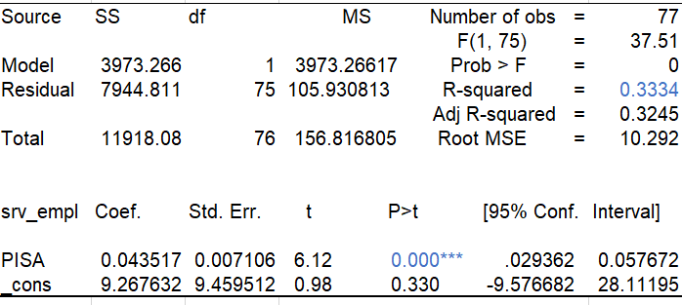
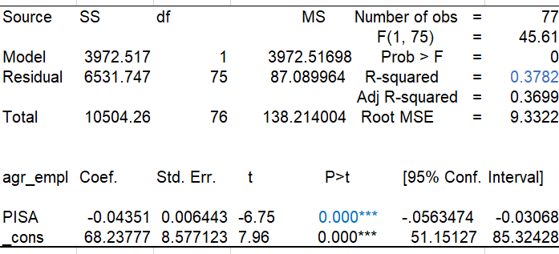
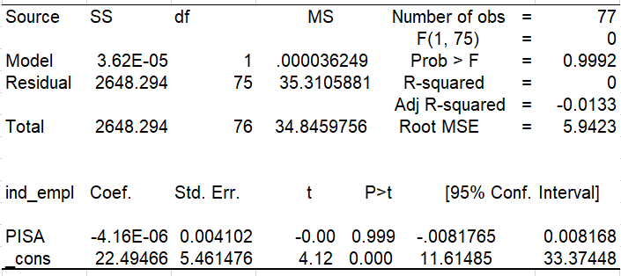
Impact of education on the nature of economic development:
We analysed the impact of PISA scores on sectoral employment and found that an increase in PISA scores is associated with a rise in employment in the service sector and a decline in employment in the agricultural sector, while impact on employment in the industrial sector remains inconclusive.

Slide 9
PISA includes assessment of students’ employability skills alongside vocational education and training
Intangible services like health, education and finance, require specialized skills and knowledge- thus, the positive statistically-significant relationship
Although education should increase agricultural productivity as well (ensuring higher returns from agriculture), we find the % employed in this sector declining with improved educational performance- may be due to wage differences across sectors (educated individuals do not find farm work equally remunerative)
Impact on industrial employment is inconclusive- while some industries may be labour-intensive (not requiring very high educational qualification), others may be knowledge-based and capital-intensive that require educated individuals (eg. semi-conductor & chip-making industries requiring substantial R & D)
With increasing number of high-skilled workers, middle and low-skilled workers are being pushed down the job ladder to occupy the less-attractive and less well-paid jobs

Slide 10
References…
Hillman, A. L., & Jenker, E. (2004). Economic Issues No. 33 - Educating Children in Poor Countries. International Monetary Fund.
Meyer, H. D., & Schiller, K. (2013). Gauging the Role of Non-educational Effects in Large-scale Assessments: Socio-economics, Culture and PISA Outcomes. PISA, Power, and Policy: The Emergence of Global Educational Governance.
Neuman, M. (2022). PISA data clusters reveal student and school inequality that affects results. PLoS ONE, 17(5 May). https://doi.org/10.1371/journal.pone.0267040
Sjøberg, S., & Jenkins, E. (2022). PISA: a political project and a research agenda. In Studies in Science Education (Vol. 58, Issue 1). https://doi.org/10.1080/03057267.2020.1824473

