Slide 1

Efficient adaptive step size control
for exponential integrators
Pranab Jyoti Deka
with
Lukas Einkemmer

Slide 2
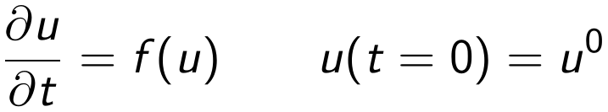
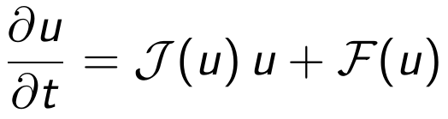
Exponential Rosenbrock Schemes
Initial Value Problem (1D)
Linear term
Nonlinear remainder

Slide 3
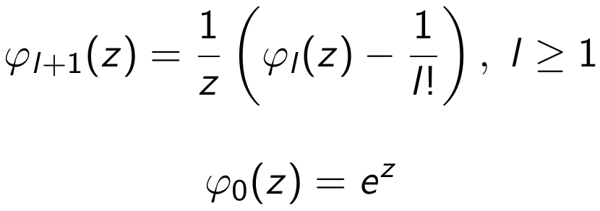
Exponential Rosenbrock Schemes
Rosenbrock-Euler scheme (2nd order)(Hochbruck 2006)
Matrix Exponential

Slide 4
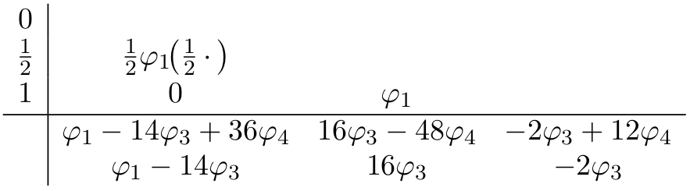
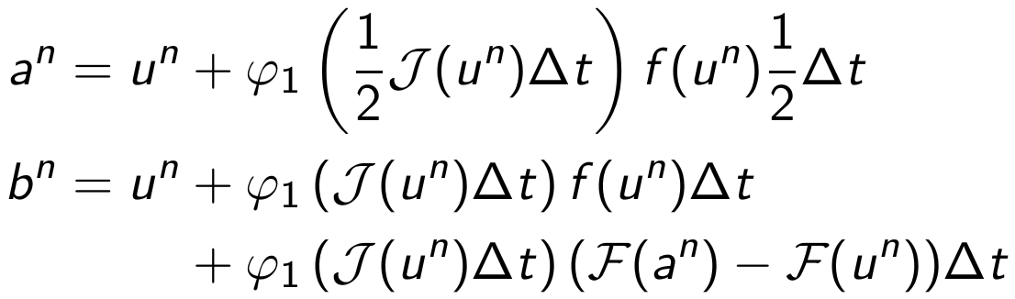
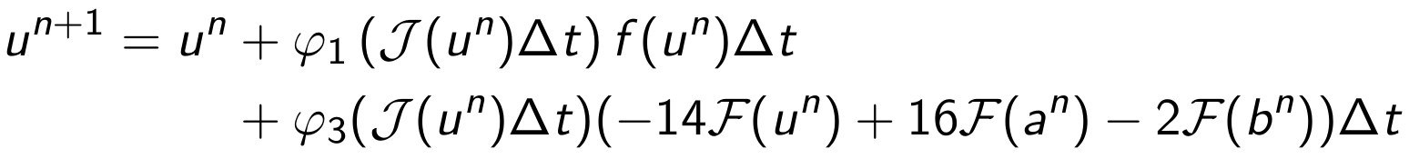
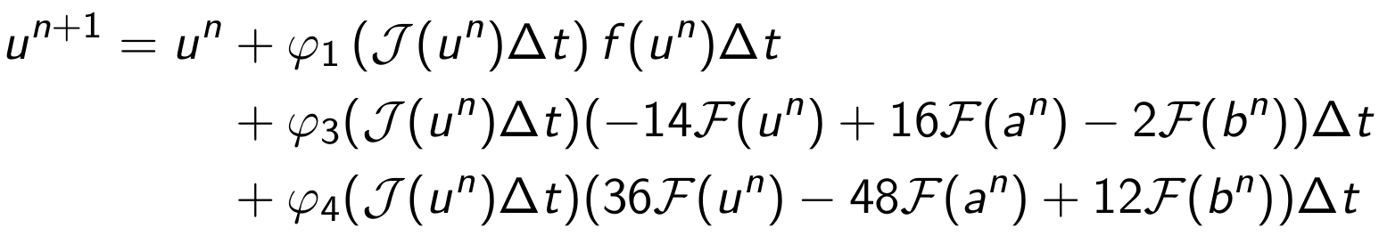
Exponential Rosenbrock Schemes
EXPRB43 (3rd order error estimate)
Internal Stages
Butcher Tableau
(Hochbruck & Ostermann 2010)
3rd order solution
4th order solution

Slide 5
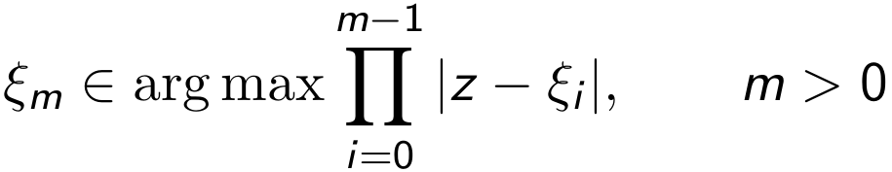

Leja Polynomial Interpolation
Leja points are defined
recursively in a sequence
Advantages:
1. Computation of a polynomial at ‘m+1’ points does not require the re-computation at ‘m’ points (unlike Chebyshev points)
2. Modest memory requirements

Slide 6
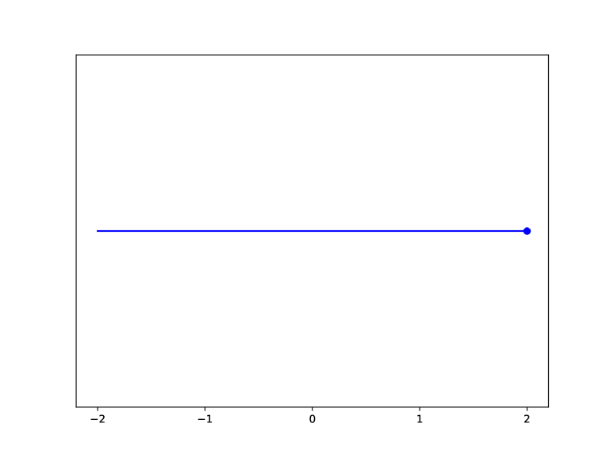
Leja Polynomial Interpolation

Slide 7
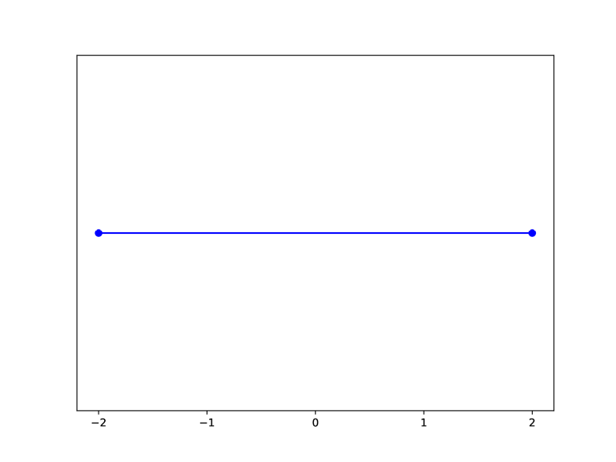
Leja Polynomial Interpolation

Slide 8
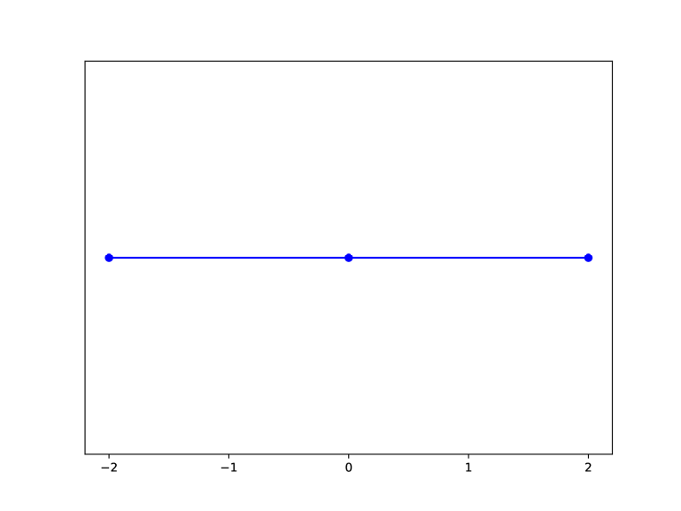
Leja Polynomial Interpolation

Slide 9
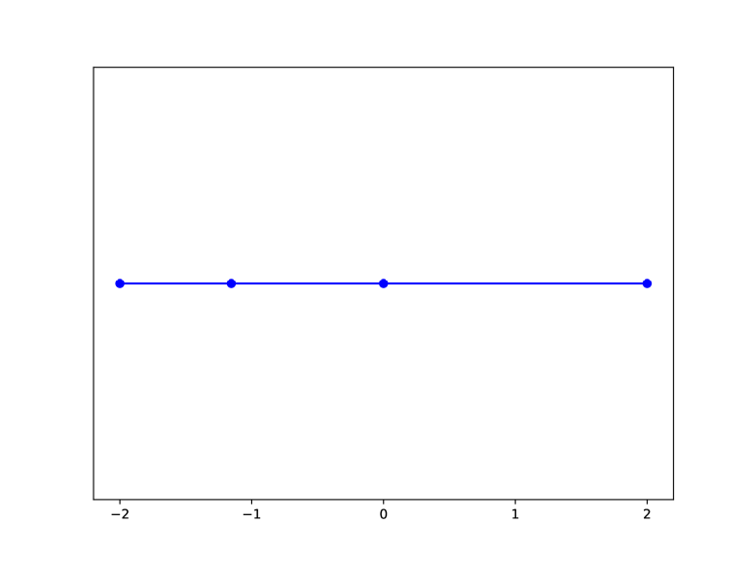
Leja Polynomial Interpolation

Slide 10
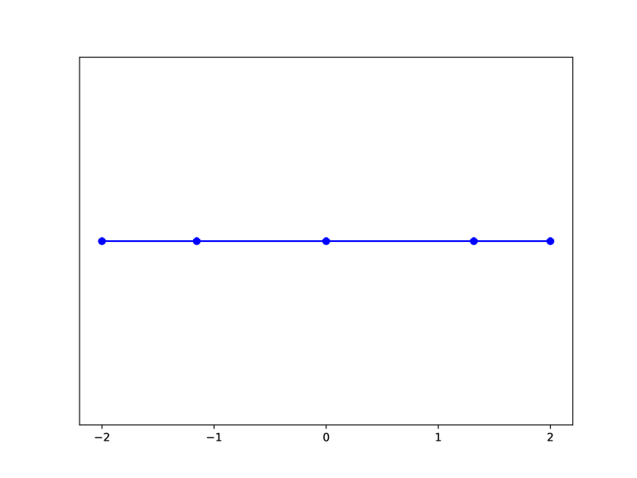
Leja Polynomial Interpolation

Slide 11
Step Size Controller
Why do we need them?
Adapt step size depending on the needs
(if characteristic time scales vary drastically)
Free users from selecting suitable step size
Free users from having to determine the accuracy
at every time step
Able to detect onset of numerical instabilities and
prevent them
Increase computational efficiency

Slide 12
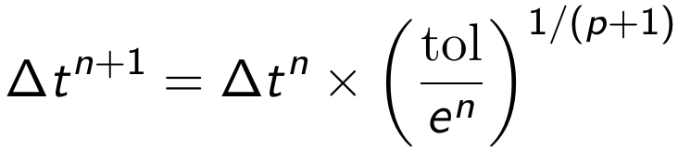
Step Size Controller
Traditional Step Size Controller
tol user-prescribed tolerance
e^{n} error incurred at time step ‘n’
p order of the integration method
Step size for the next time step is chosen based on the
error incurred and the step size
at the present time step.

Slide 13
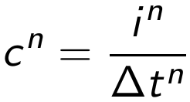
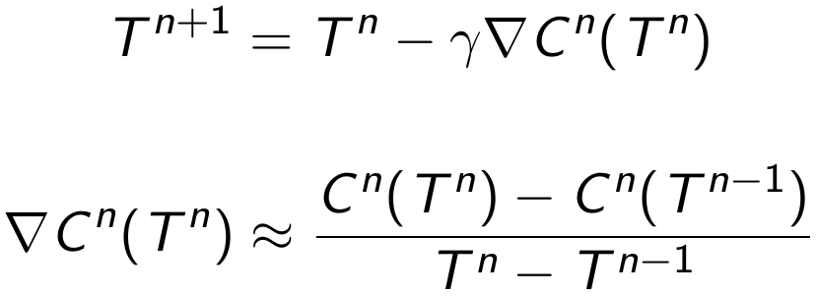
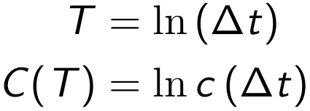
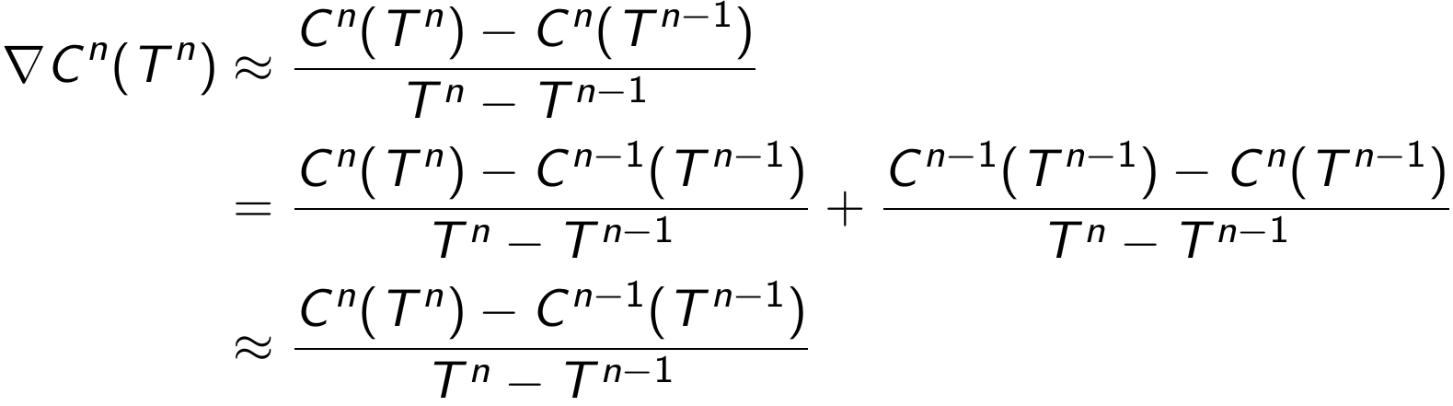
Step Size Controller
Proposed Step Size Controller
Einkemmer (2018)
Computational Cost
No. of
matrix-vector products
Principle: for iterative methods
Large step size Higher cost
Small step size Lower cost
Advantages of using a smaller step size:
Computationally cheap
More accurate solution
Global error:
Proposed Cont. ≤ Traditional Cont.

Slide 14
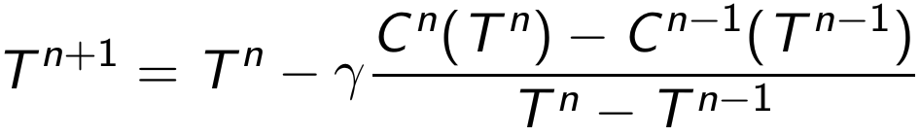

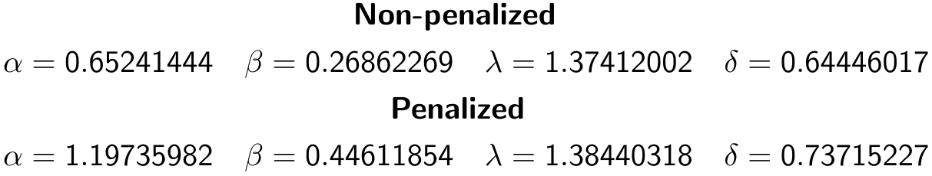
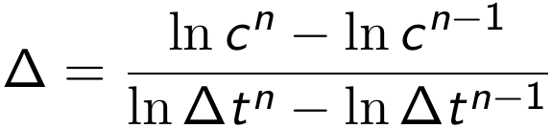
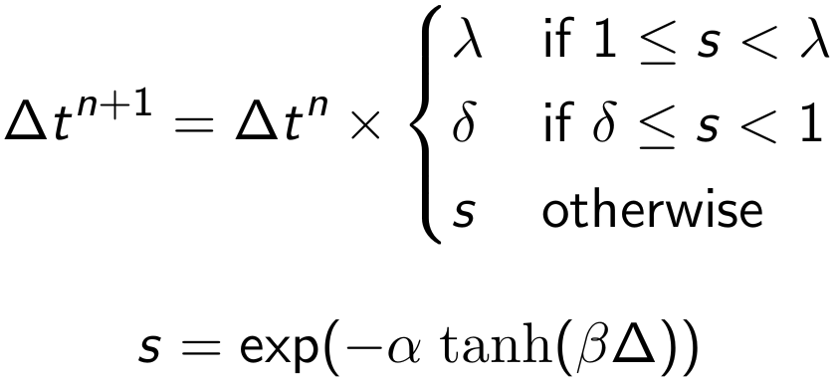
Step Size Controller
Non-penalized: parameters have been chosen to incur the minimum possible cost
Penalized: if trad. cont. performs better than non- penalized – penalty is imposed!
Proposed Step Size Controller
Factors δ and λ have been incorporated to ensure that step size changes by atleast
δΔt or λΔt.

Slide 15
Application of the proposed step size controller on a few nonlinear problems
Our Work
Viscous Burgers’ Equation
Inviscid Burgers’ Equation
Porous Medium Equation
Periodic boundary conditions:
1D - [0, 1]
2D - [0, 1] x [0, 1]
Peclet Number (η): Ratio of advection to diffusion

Slide 16
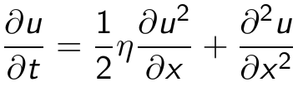

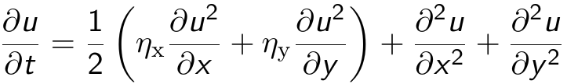
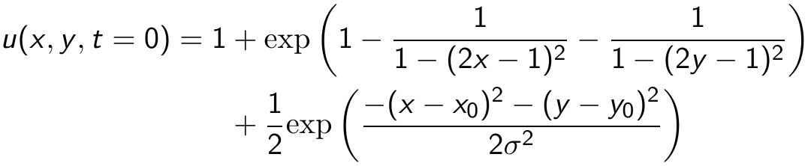

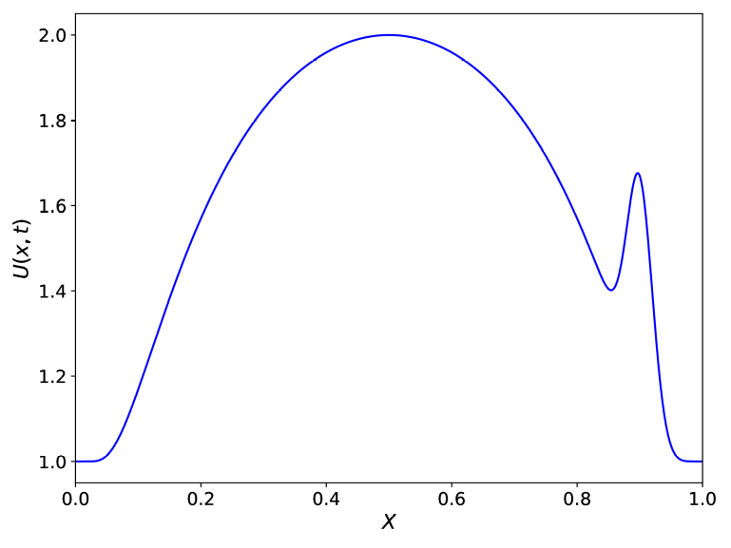
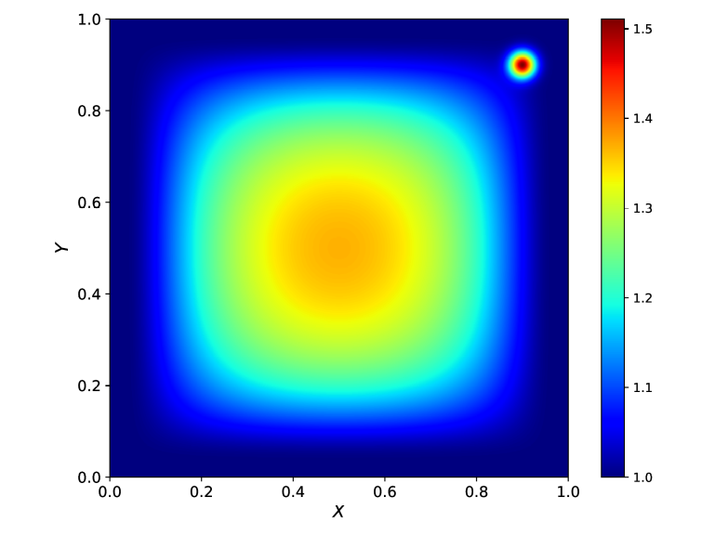
Viscous Burgers’ Equation
1D 2D

Slide 17
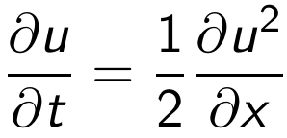

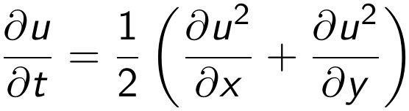
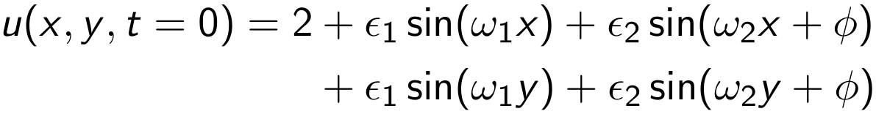

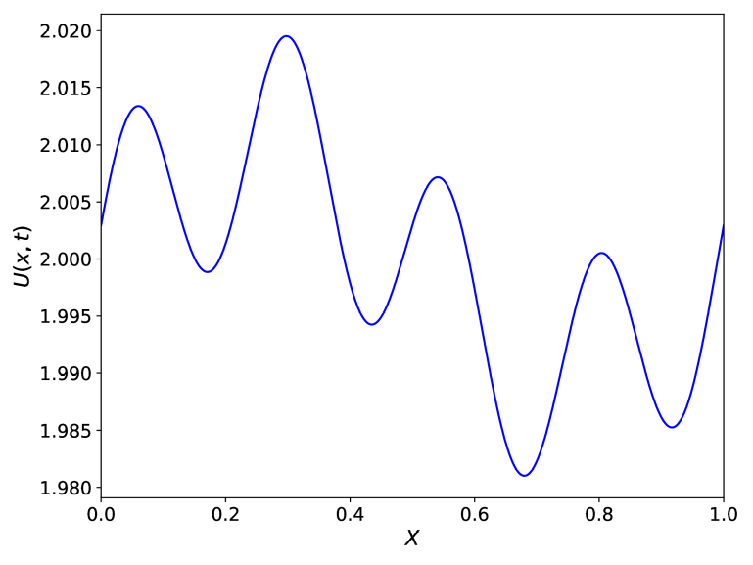
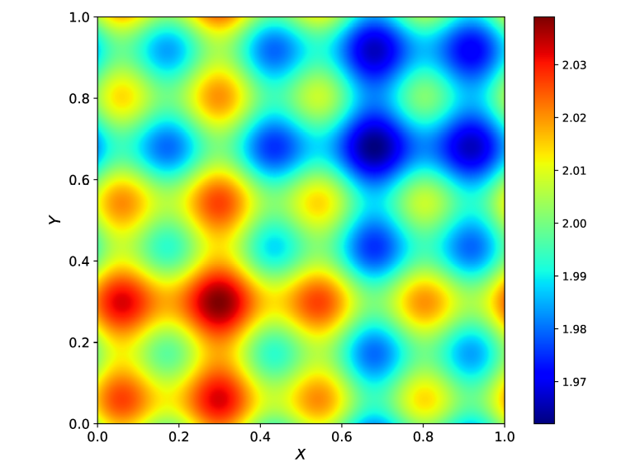
Inviscid Burgers’ Equation
1D 2D

Slide 18
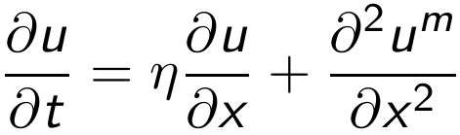
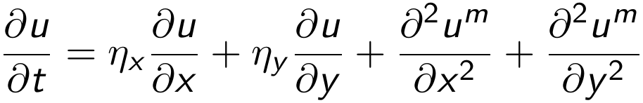
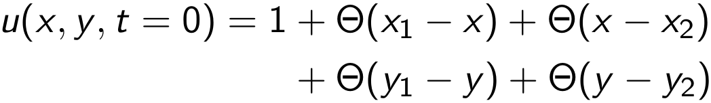


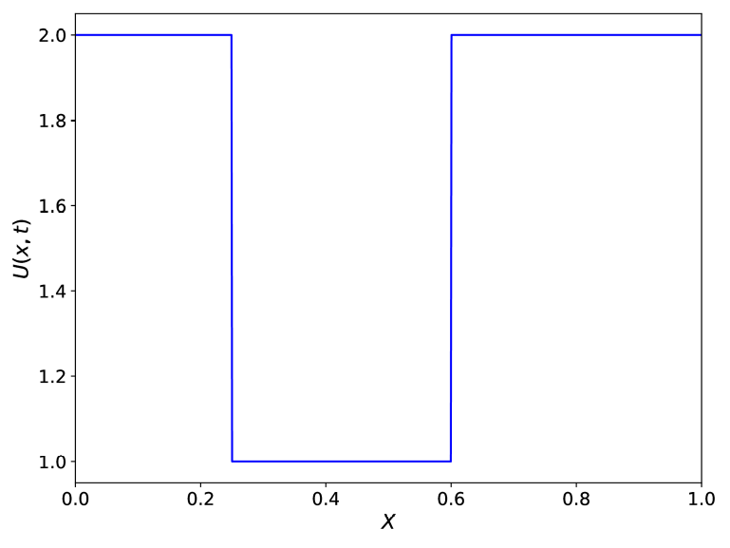
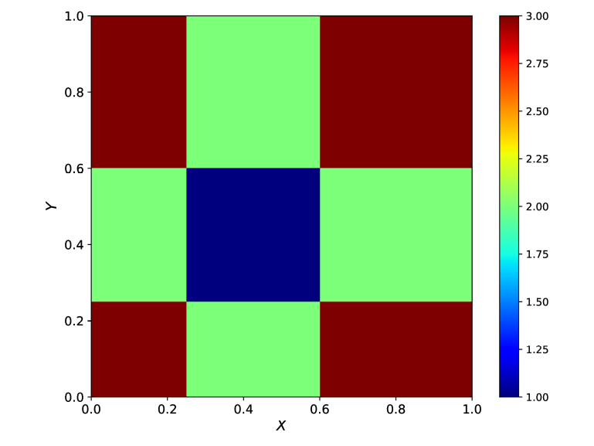
Porous Medium Equation
1D 2D

Slide 19
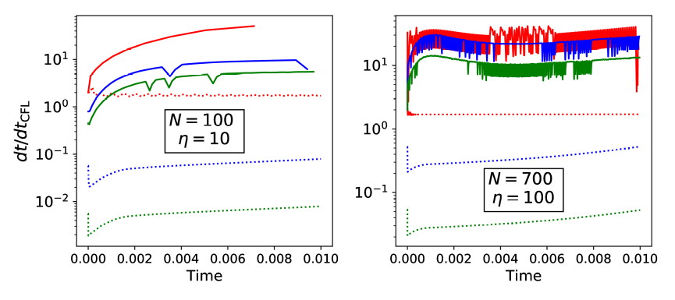
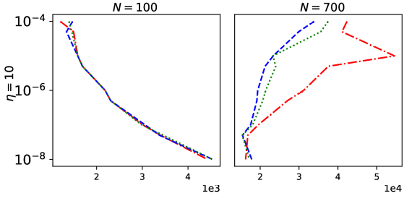
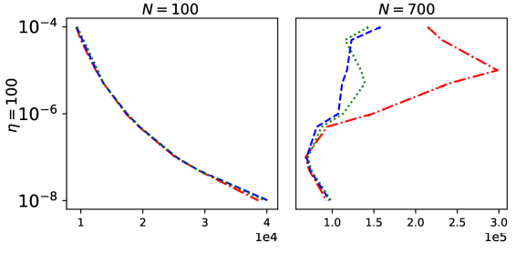
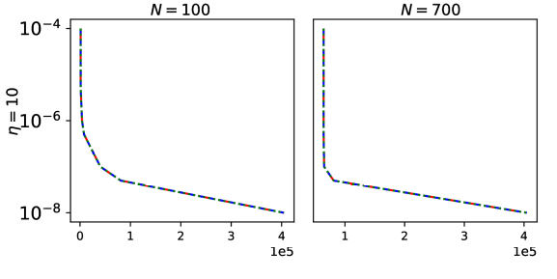
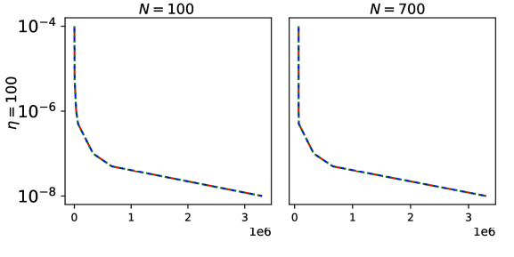
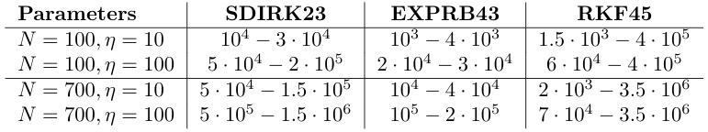
Viscous Burgers’ Equation
(EXPRB43 vs. RKF45)
EXPRB43
dashed lines – EXPRB43, dotted lines – RKF45
tol: 10⁻⁴, 10⁻⁷, 10⁻⁸
RKF45
SDIRK23
(Einkemmer 2018)
Traditional; Non-penalized; Penalized

Slide 20
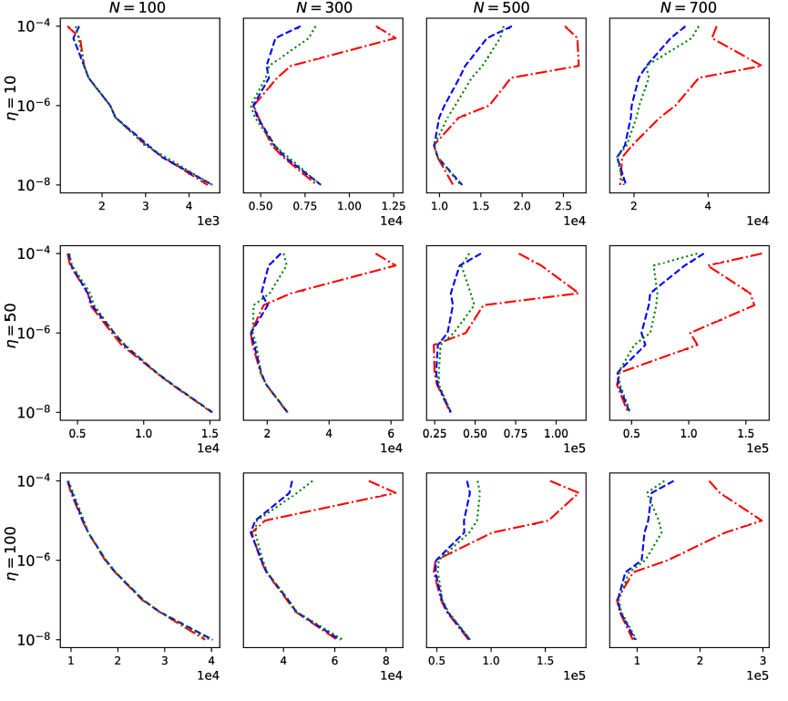
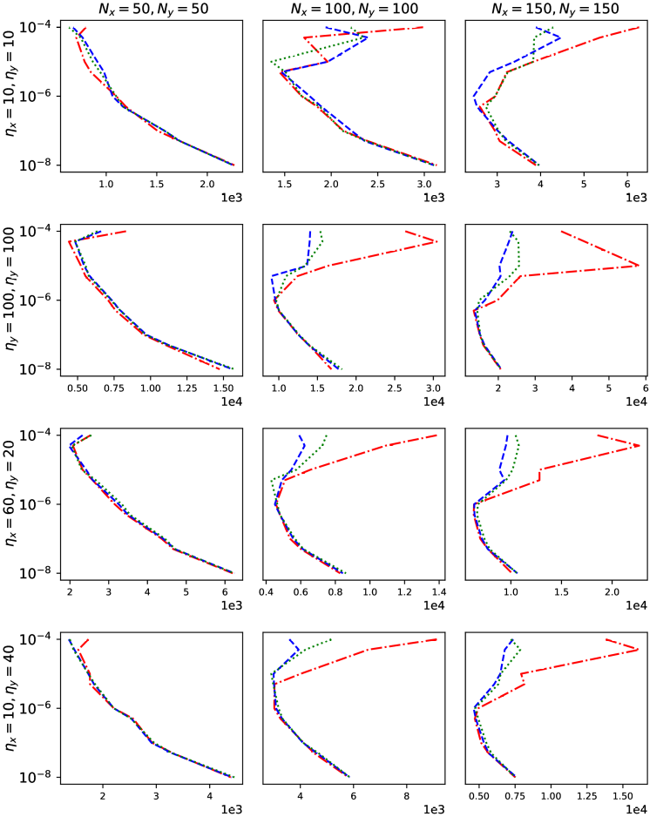
Viscous Burgers’ Equation
1D 2D
Traditional; Non-penalized; Penalized

Slide 21
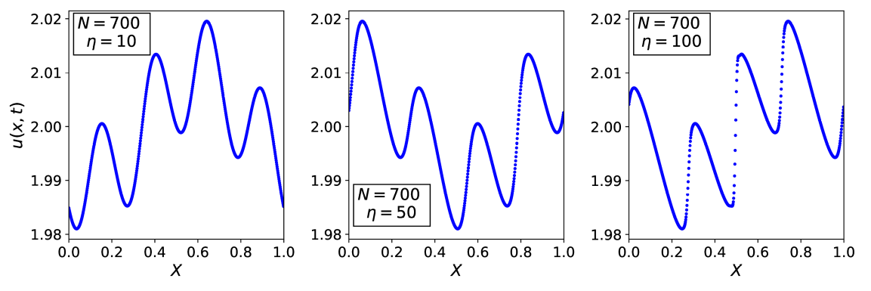
Inviscid Burgers’ Equation
1D
Results not yet available!

Slide 22
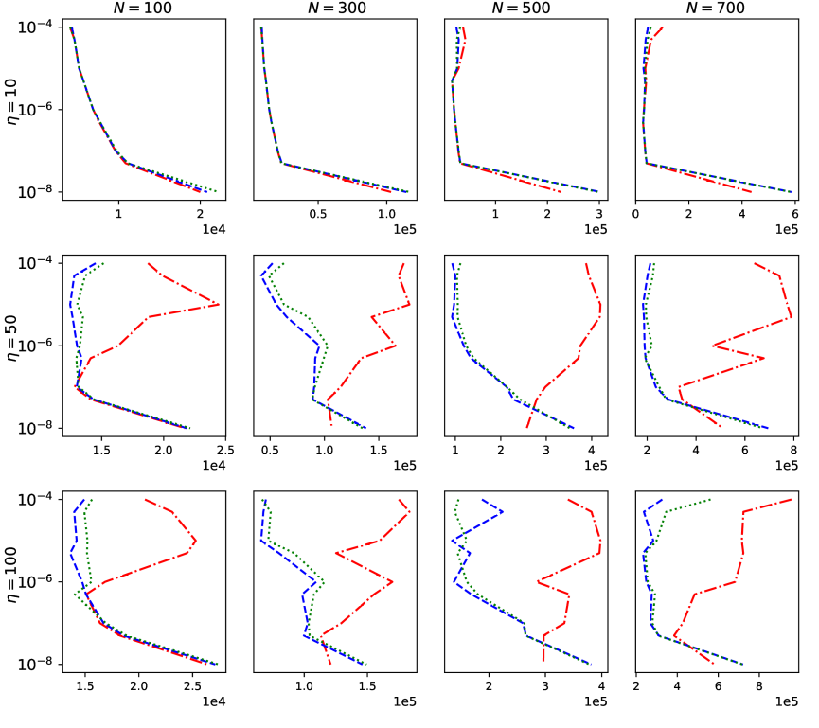
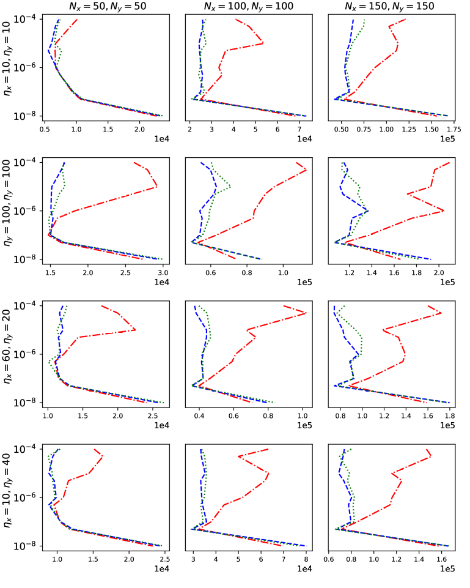
Porous Medium Equation
1D 2D
Traditional; Non-penalized; Penalized

Slide 23
Conclusions
Proposed step size controller has better performance than traditional controller in majority of the cases (lenient to intermediate tolerance)
Multiple small step sizes incur less computational effort than 1 large step size
‘Similar shapes’ in 1D and 2D Proposed controller is reliable and effective
EXPRB43 has superior performance than (explicit) RKF45 and (implicit) SDIRK23

