Slide 1
AEPS using Blockchain with Visual Cryptography
Mentor:Mr. Kalyan Das
Team Members: Digbijoy Dutta || Abhijan Mallick
Pranab Saha || Mahan Brata Raha

Slide 2
Objective
The primary objective of implementing an Aadhaar-enabled payment system (AEPS) using blockchain with visual cryptography is to enhance the security, privacy, and efficiency of digital financial transactions. By adopting a decentralized blockchain framework, the project aims to eliminate vulnerabilities associated with centralized data storage in traditional AEPS, minimizing the risks of fraud and unauthorized access. Seamless integration with the existing Aadhaar infrastructure ensures compatibility and efficient information exchange. The project emphasizes scalability to handle the high volume of transactions inherent in a payment system, promoting swift and cost-effective financial interactions. Visual cryptography techniques contribute to privacy enhancement by securing Aadhaar data during transactions. User empowerment is facilitated through intuitive interfaces, allowing individuals greater control over their information and transaction authorizations. Regulatory compliance ensures alignment with financial regulations and data protection laws, fostering trust and widespread acceptance. Continuous research and adaptation to technological advancements position the project at the forefront of innovation in the evolving fintech landscape.

Slide 3
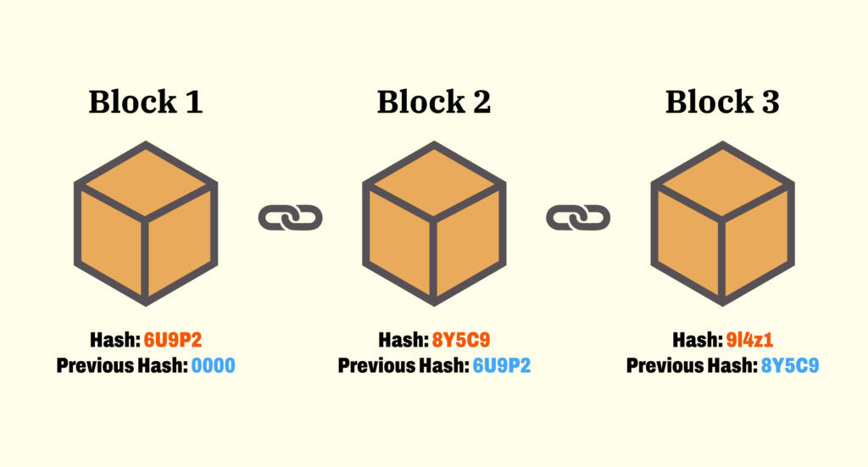
Project Ideation
Blockchain: A distributed decentralized ledger which is transparent in nature to all the nodes in the network and any alteration is not possible after deployment.
Advantages:
Shared.
Immutability.
Integrity.
Verifiable, Visibility.
Control of data.
Security & Privacy.

Slide 4
Component of Blockchain
Node
Ledger
Wallet
Full Node: Contains full copy of transaction. Able to validate, reject, accept transactions.
Partial Node: Lightweight node. Contains hash. Transactions accessed using hash.
Digital Database of information.
Public Ledger
Distributed Ledger.
Decentralized Ledger.
It is a digital wallet that allows user to store their cryptocurrency. Privacy of a wallet in a blockchain network is maintained using public and private key pairs.
Nonce
Hash
The Nonce is a random whole number, which is a 32-bit (4 byte) field, which is adjusted by the miners, so that it becomes a valid number to be used for hashing the value of block. Nonce is the number which can be used only once.
The data is mapped to a fixed size using hashing. It plays a very important role in cryptography. In a blockchain network hash value of one transaction is the input of another transaction.

Slide 5
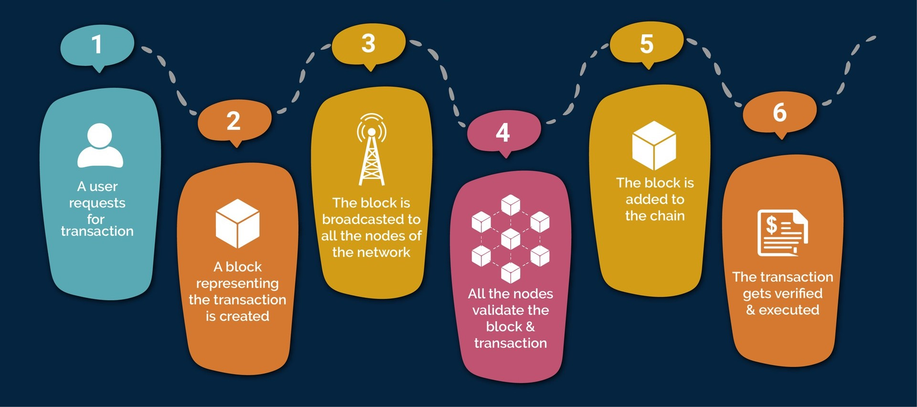
How transactions works in blockchain?

Slide 6
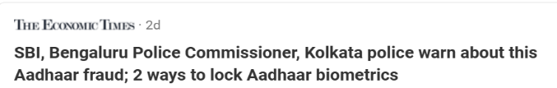

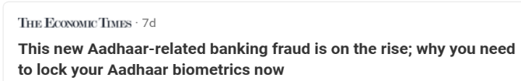
Securing AEPS through Blockchain Technology
AEPS(Aadhaar Enabled Payment System) is a revolutionary technology that has the potential to transform ﬁnancial inclusion in India. This presentation explores the beneﬁts of integrating blockchain technology with AEPS to enhance security, transparency, and efﬁciency in the ﬁnancial ecosystem.
AEPS is a biometric-based payment system that allows individuals to access their bank accounts, make transactions, and withdraw cash using their Aadhaar number and ﬁngerprint authentication. With over 1.2 billion Aadhaar enrollments, AEPS has the potential to reach the unbanked population and provide them with easy access to ﬁnancial services.

Slide 7

Continuation…
Several frauds are led out across the country using the fingerprints collected. Such frauds, Man in the Middle attacks, all this could be easily handled by securing the transactions using Blockchain.
The transactions would be secured since just getting the fingerprints would not help the attackers. They would require a private key along with the fingerprints to carryout the frauds.
The hash of the fingerprint data would be used for the transactions, so even if there is slightest of chance of Man in the Middle attack, and the attacker getting the hash but there is no chance of getting the original data since hash is irreversible.

Slide 8

Encryption Concepts
Public key cryptography
Digital signatures to authenticate owner.
Hash
Biometric Template
Authentication(Identity) + Authorization(Access management)

Slide 9
ENHANCING AEPS WITH BLOCKCHAIN: A REVOLUTIONARY SOLUTION
Addressing Fraud Challenges
Secure Transactions with Hashing
Encrypted Connections for Data Transfer
Blockchain Security Measures
Smart Contracts Security Aspects
IPFS Decentralized Storage
Best Practices for Key Management

Slide 10
Flowchart of the System
Start
User Registration
Biometric Authentication
Transaction Initiation
Blockchain Transaction Request
Consensus Mechanism
Finish
Notification to Users
Update Blockchain Ledger
Payment Confirmation
Smart Contract Execution

Slide 11
Flowchart of User Registration
Points to be checked:
Whether the user already has registered.
Authenticity of the registration using digital signature.
Wallet creation & key pair generation
Input of user thumb impression
Biometric template creation
Start
Smart Contract to map public address to the stored hash.
Store data in IPFS
Hash generation

Slide 12
Flowchart of Transaction
Start
Set up your wallet, set up keys, password, passphrase.
Amount, to whom as input
Thumb impression as input
Abort
Check the password
false
Password to access private key
Biometric template creation, hash generation
true
Call the smart contract function for transaction
Abort
Digitally sign the transaction data on client side.
Check the sign
false
true
Owner Verified
Success
Abort
Check the fingerprint template hash with the hash stored in IPFS
Not matched
Execute the payment Logic
matched

Slide 13
FINGERPRINT TEMPLATE GENERATION
Image Preprocessing
Minutiae Extraction
Template Encoding

Slide 14
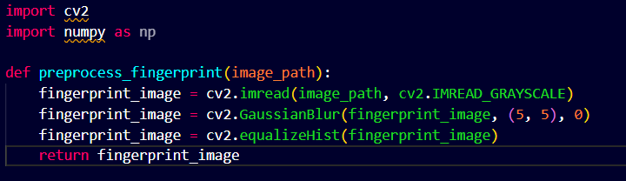
Image Preprocessing
Read the fingerprint image.
Convert the image to grayscale.
Apply noise reduction techniques (e.g., Gaussian blurring).
Enhance the image contrast (e.g., histogram equalization).

Slide 15
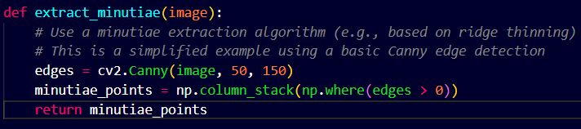
Minutiae Extraction
Identify ridge and valley structures.
Extract minutiae points, such as ridge endings and bifurcations.
Filter and refine minutiae points.

Slide 16
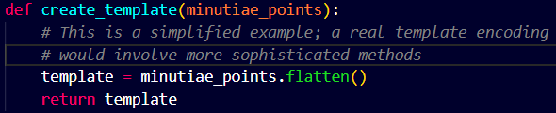
Template Encoding
Encode the extracted minutiae points into a compact template.
Consider the type of features to include, their ordering, and any additional information needed for matching.

Slide 17

Key Management
To access the private key, Multi Factor Authentication should be used. (Password or Pin and OTP)
Password should be changed at regular interval.
A long security phrase (10-12 words long) can be used to recover wallet, this should be kept offline.
Software should be updated regularly.
If passwords or keys or phrases are stored locally, better to encrypt them with strong algorithms and store the encryption key offline.

Slide 18
Technologies in use
Solidity
JavaScript
React.js
Web3.js
Node.js
Express.js
Truffle
Ganache
Metamask

Slide 19
Gantt Chart
Topics \ Timeline | Topics \ Timeline | 07-23 | 08-23 | 09-23 | 10-23 | 11-23 | 12-23 | 01-24 | 02-24 | 03-24 | 04-24 | 05-24 | 06-24
Requirement Gathering
 | Research Blockchain Technology
 | Study Encryption Method
 | Learn about visual cryptography
 | Understand smart contract implementation
Project Planning
 | Define project scope
 | Identify project objectives
 | Develop a project plan
Design Phase
 | Create system architecture
 | Develop a flowchart of the payment system

Slide 20
Gantt Chart
Topics \ Timeline | Topics \ Timeline | 07-23 | 08-23 | 09-23 | 10-23 | 11-23 | 12-23 | 01-24 | 02-24 | 03-24 | 04-24 | 05-24 | 06-24
Execution Phase
 | Developing Blockchain Component & Smart Contracts
 | Integrate Visual Cryptography
 | Implement frontend
 | Implement Backend
Testing Phase
 | Unit Testing
 | Integration Testing
 | Ensure security and data privacy
Deployment Phase

Slide 21
Individual Contribution
Digbijoy Dutta
Abhijan Mallick
Mahan Brata Raha
Pranab Saha
Visual Cryptography
Transaction Design
Back End Design
Smart Contract
Workflow of the System
Background Study on AEPS
Gantt Chart
Encryption
User Registration Design

Slide 22
Thank You!

