Slide 1
RAW Mac analysis
04/11/2020

Slide 2
Table of Contents
Required actions
Overview

Slide 3
Remaining required actions
Need to cite used softwares:
Snakemake:
How to cite
https://snakemake.readthedocs.io/en/stable/project_info/citations.html
Article to reference
Köster, Johannes and Rahmann, Sven. “Snakemake - A scalable bioinformatics workflow engine”. Bioinformatics 2012.
biomaRt
volcanoe plot
DESeq2

Slide 4
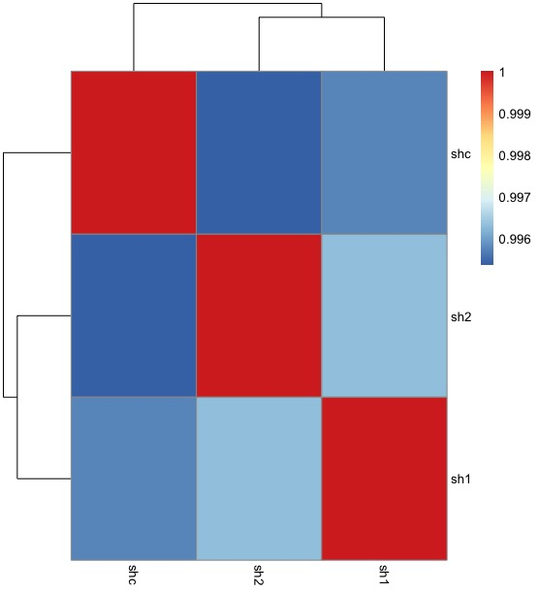
Correlation of Vst transformed Counts

Slide 5
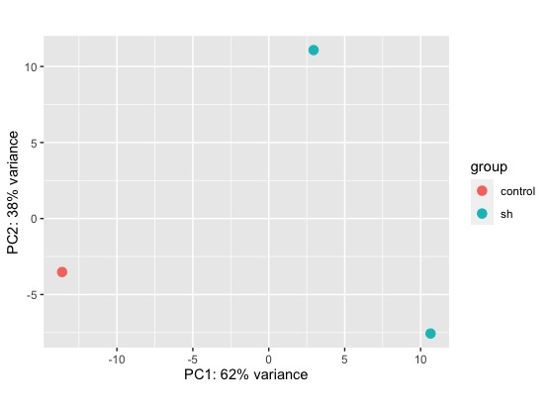
PCA

Slide 6
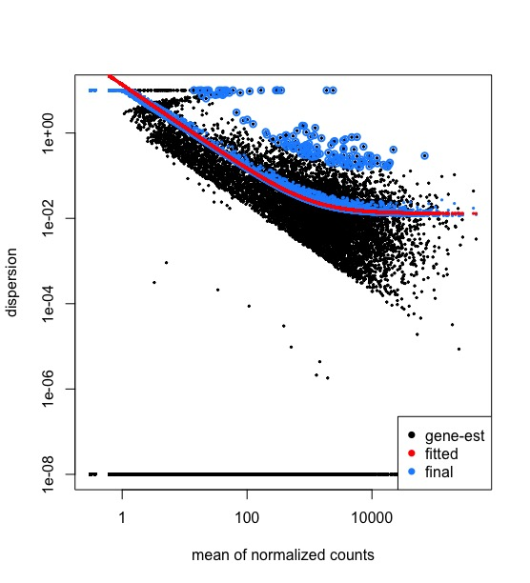
Dispersion

Slide 7
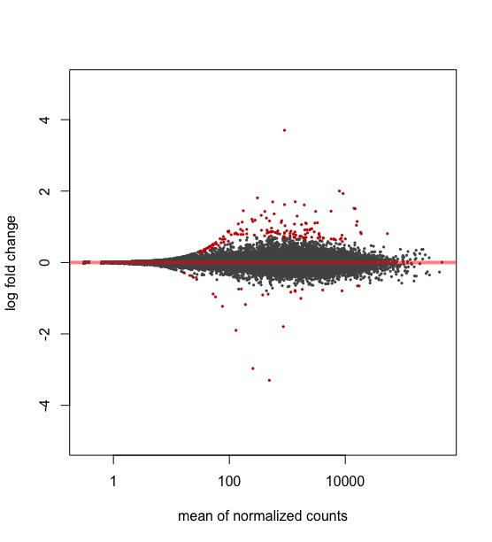
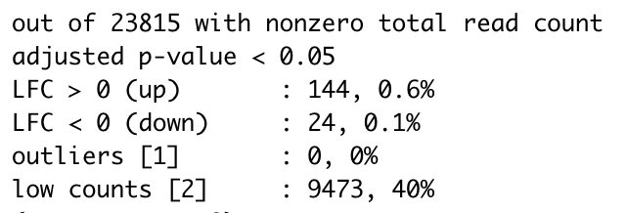
Results and MA plot
Note: results (DE genes lfc, is sh value relative to control)

Slide 8
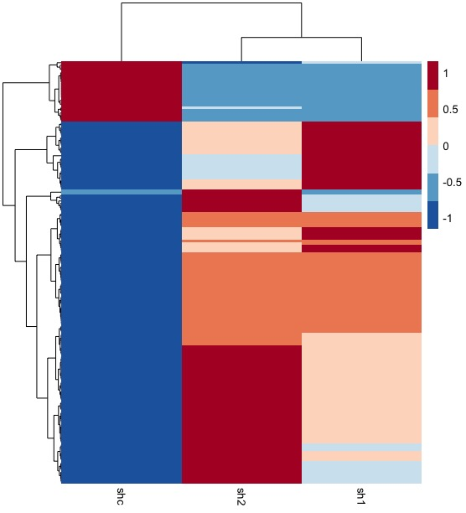
Heatmap of Normalized counts of Significant DE genes

Slide 9
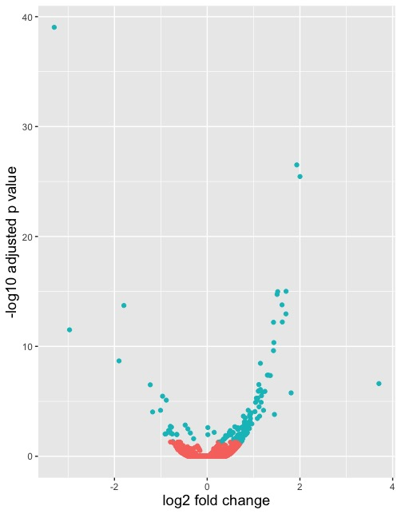
Volcano Plot
Log2 fold change = Log2(sh/control)

Slide 10
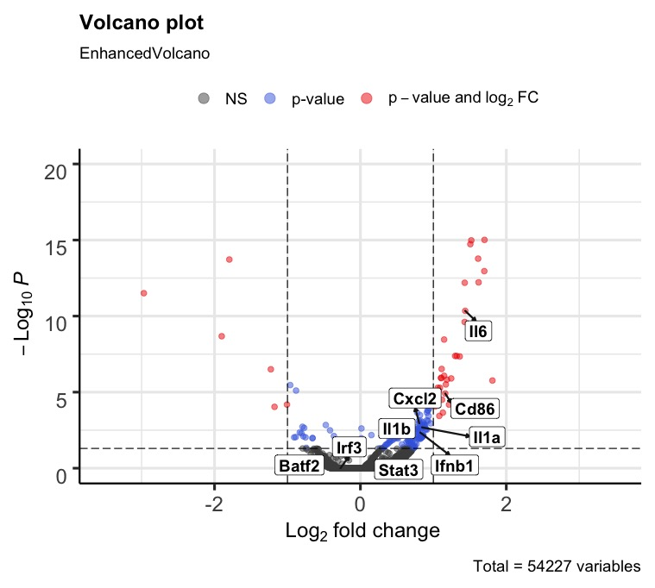
Enhanced Volcano

Slide 11
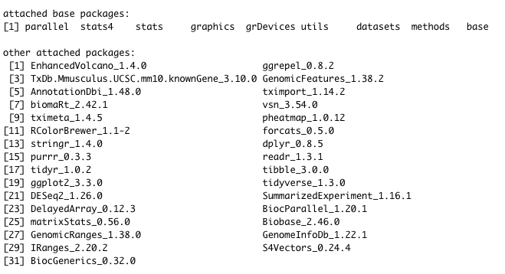
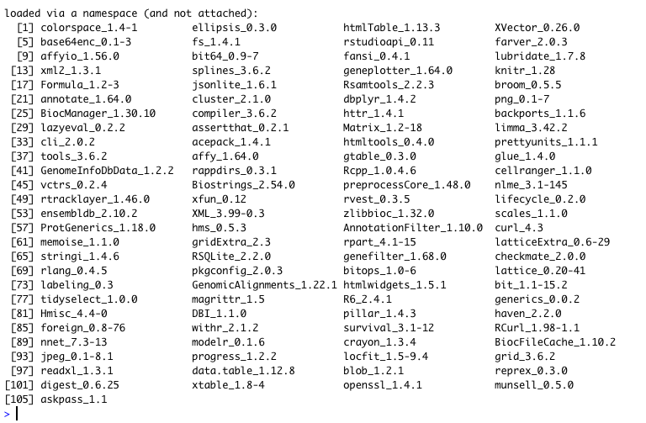
R Session Info

