Slide 1
BANK ANALYTICS
PROJECT

Slide 2
The Analytics Team
MR. Mayur Kothawade
MS. Ankita Mishra
MS. Shreya Rani
MS. Shravani Walunj
MS. Pranali Salgaonakar

Slide 3
ABOUT Banking Analytics is a leading financial institution that partners with individuals, small- and middle-market businesses, large corporations, and governments to help them achieve their financial goals. We offer a full range of banking, investment management, and other financial and risk management products and services.
OBJECTIVE
To develop a data-driven understanding of the seasonal patterns in financial data from 2007 to 2011, and to create strategies to improve loan recovery and annual loan volume.

Slide 4
Data Information
Domain : Finance
Project: Bank loan of customers
Datasets: Finance_1.xlsx & Finance_2.xlsx
Dataset Type: Excel Data
Dataset Size: Each Excel file has 39k+ records

Slide 5
Process
Data Understanding
Data Cleaning
Data Modeling
Data Analysis
Uncover Insights

Slide 6
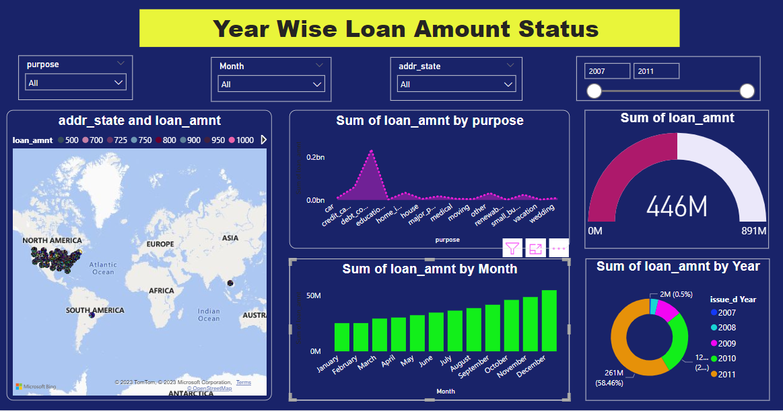
KPI-1 : Year wise Loan Status
"In 2011, loans amounted to 261M, with California (CA) leading at 80M and Oklahoma (OK) at 3M."
"Considering yearly loan amount is important as it helps bank to decide interest rate, credit policy, loan recovery method etc."
"Looking at increasing loan amount year by year bank should take necessary steps to manage it properly."

Slide 7
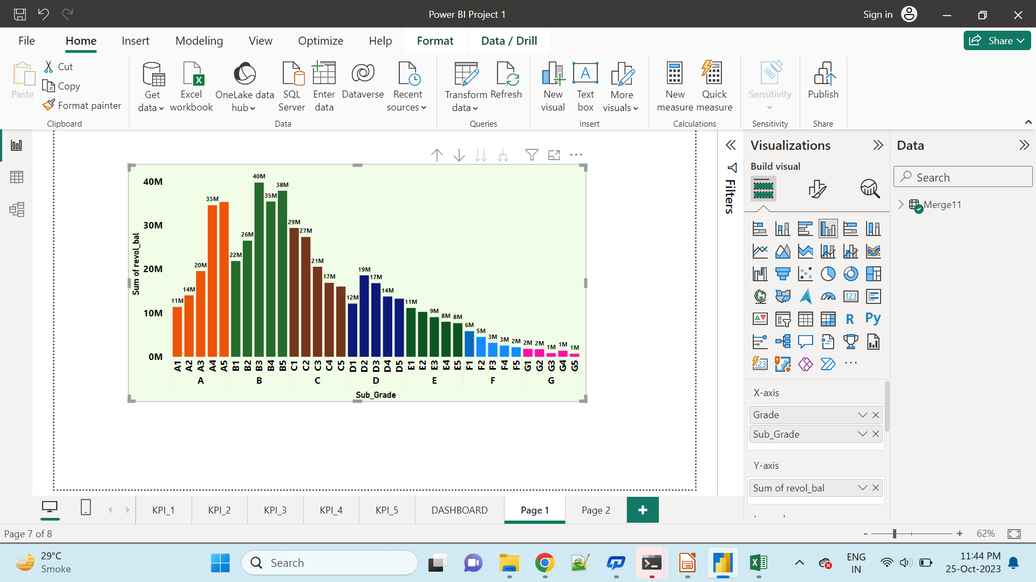
KPI-2 : Grade And Sub-Grade wise Revolving Balance
Analysis of Grade, Subgrade & Revolving balance is essential for assessing the credit risk associated with borrowers.
Here higher-risk borrowers may be charged higher interest rate to compensate for the increased risk & vice versa.
This analysis can inform risk mitigation strategies.

Slide 8
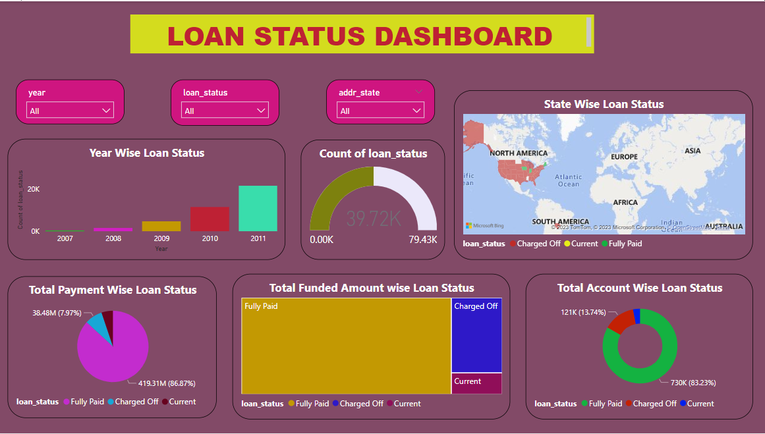
KPI 3 State-wise And Last Credit Pull d wise Loan Status
Loan status: The majority of loans are fully paid, with a small number charged off.
Loan growth: The number of loans issued has increased steadily over the past few years.

Slide 9
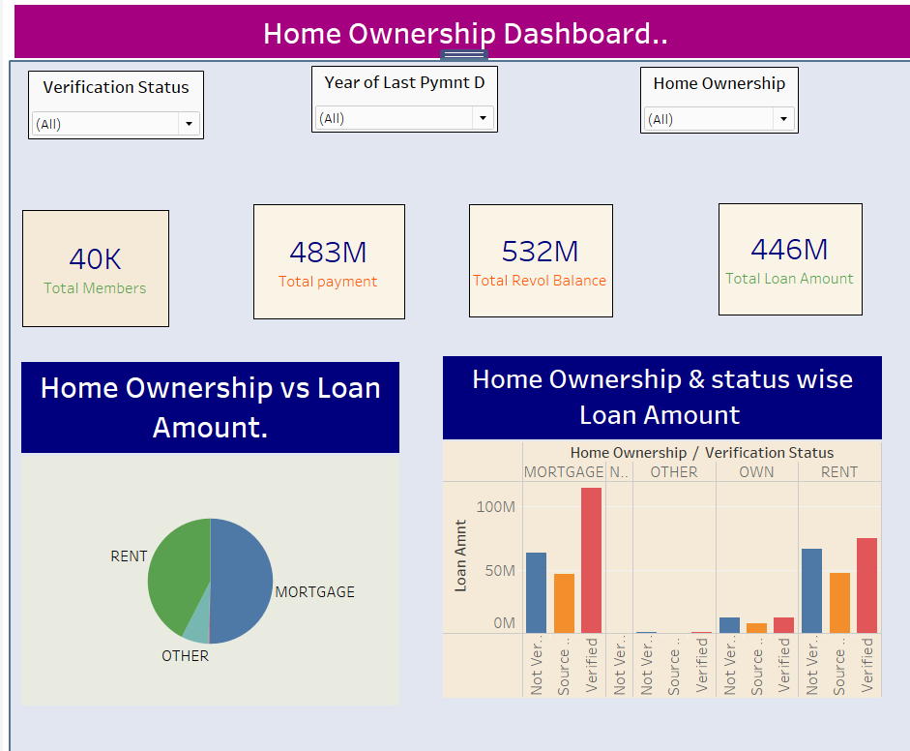
KPI- 4 Home Ownership Vs Last Payment Date Status
Home ownership is increasing, but the rate of growth is slowing. The pie chart shows that home ownership has increased from 40% to 44% in the past year. However, the rate of growth has slowed from 2% to 1% in the past year.
Mortgage debt is increasing faster than home ownership. The bar chart shows that mortgage debt has increased from 483M to 532M in the past year. This represents a 10% increase, while home ownership has only increased by 4%.

Slide 10
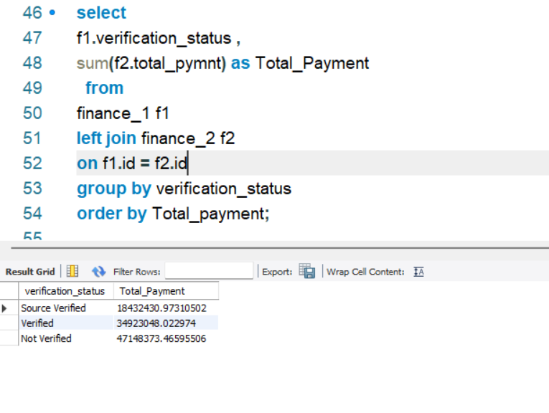
KPI-5 Total Payment for Verified vs Non-Verified Status
This KPI compares the total amount payments made by customers who successfully completes this verification process and are granted as a Verified Status.
Customers who have not completed the verification process or failed to meet the requirements for verifications are assigned as a Non – Verified status.

Slide 11
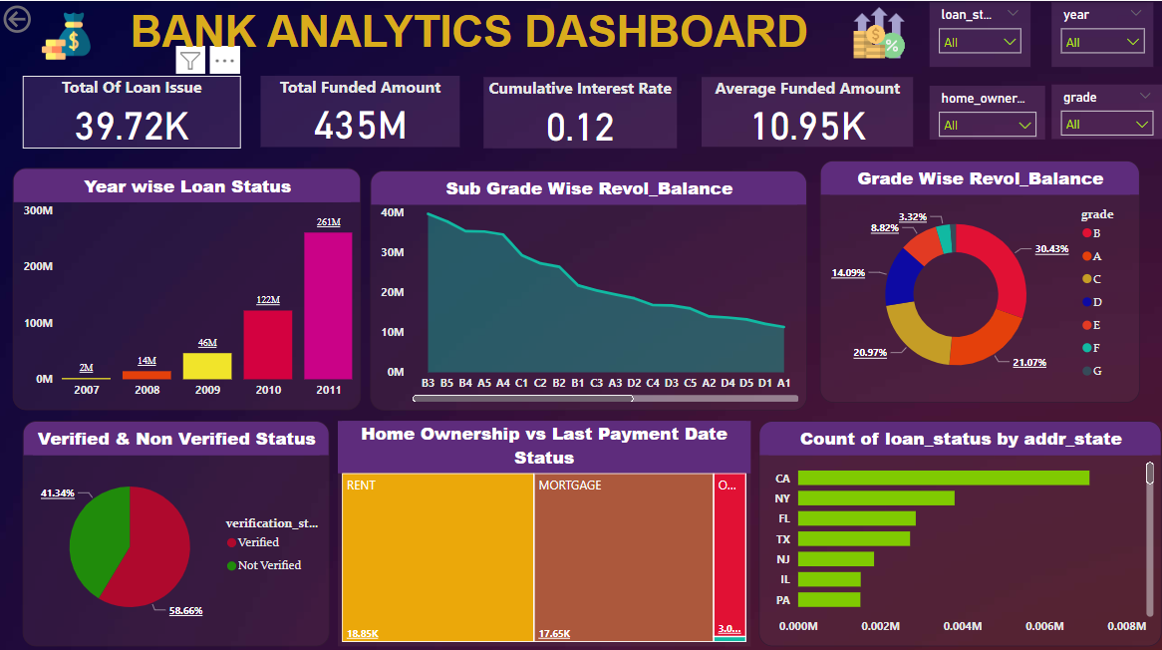

Slide 12

Summary
The dashboard shows that the bank's loan portfolio is performing well overall. However, there are some areas where the bank could improve, such as reducing the number of delinquent and charged-off loans, increasing the average loan size, and improving customer satisfaction. By following the suggestions below, the bank can make its loan portfolio even stronger and more profitable.

Slide 13
Suggestions
Focus on reducing the number of loans that are delinquent or charged off. This can be done by improving the underwriting process, providing more support to borrowers who are struggling to make their payments, and offering more flexible repayment options.
Increase the average loan size. This can be done by targeting higher-income borrowers, offering loans for larger projects, and bundling loans together.
Improve customer satisfaction. This can be done by making the loan process easier and more transparent, providing excellent customer service, and offering competitive rates and terms.

Slide 14

Thank you

