Slide 1
Responsive Website to create meme template
Name:-Pranali Shivale.
College:-Trinity academy of engineering pune.
Branch:-computer
Year:-Third year

Slide 2
1. INTRODUCTION.
What is meme ?
1. Today memes plays very important role in our daily lives.
2. Basically, memes are cultural ideas and social norms that can be packed into little nuggets of information and shared from person to person in seconds.
3.Memes can duplicate, grow and arguably shape certain corners of the online world.
4.It is very easy to access and catches attention in less time.

Slide 3
REQUIREMENTS
Languages used in building website:
1.Html
2.Css
3.Javascript
IDE used:
Visual studio code

Slide 4
WORKING
How it used In website ?
1.In this website we can accept an image add text to its upper part and lower part.
2.Generate and meme and download it.
3. We can share that generated memes to other people.

Slide 5
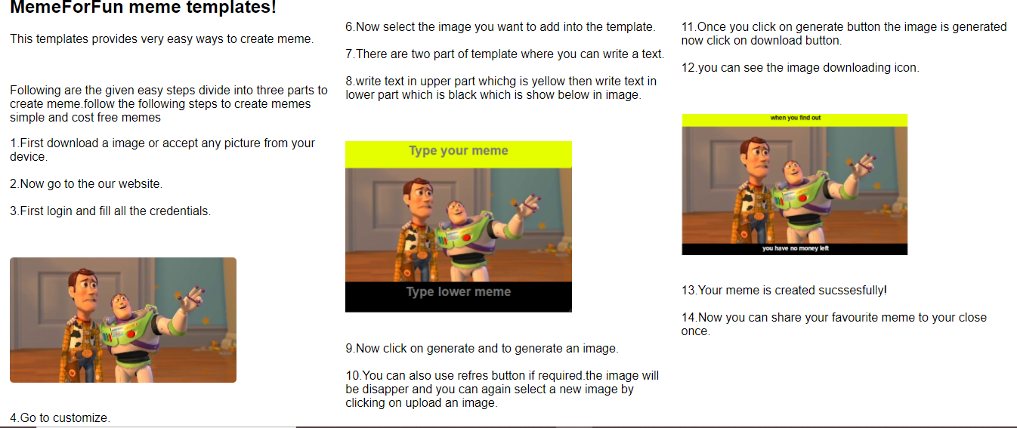
implementation

Slide 6
CONCLUSION
Thus, This website helps to create a memes. With the help of given templates you can add text and humor and make funny memes according to that. here is also most trending memes are available in website to share it with your close people.

