Slide 1
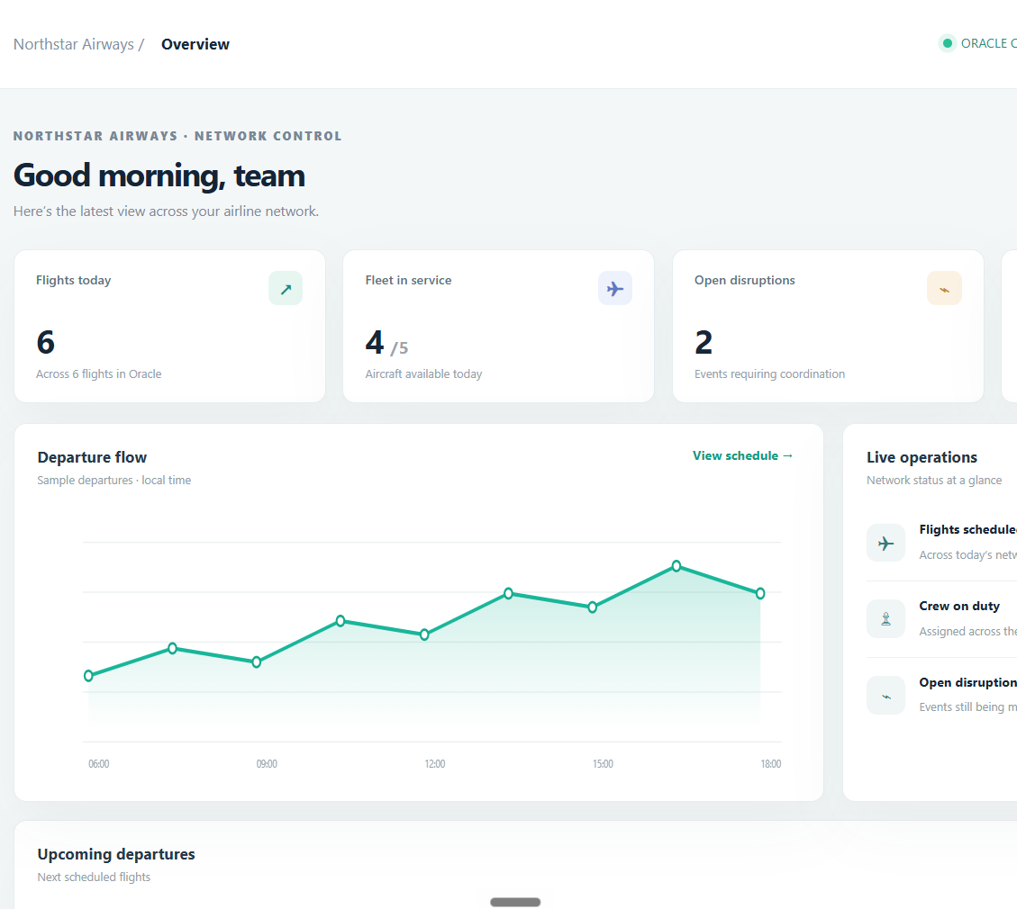
VIT • SCHOOL OF COMPUTER SCIENCE AND ENGINEERING
MODERN AIRLINE
LOGISTICS &
SUSTAINABILITY
MANAGEMENT SYSTEM
Database project
Pranali Paygonda Patil
25BCE2957 | B.Tech Computer Science and Engineering
School of Computer Science and Engineering • AY 2026–27
REVIEW PRESENTATION
Flights • fleet • crew • cargo • sustainability
Notes:
Introduce yourself and state the project name. In one sentence: this project uses a relational database and a browser console to connect airline operations records. Mention that this is a local coursework prototype.

Slide 2
NORTHSTAR / AIRLINE OPERATIONS
Project overview
Abstract
A relational database and browser console that connect airline operations records around the flight, making schedules, resources, cargo conditions, disruptions and emissions easier to review together.
WHY THIS PROJECT
One linked view
Better data quality
Sustainability visibility
Flights connect to aircraft, crew assignments, cargo, passengers, disruption events and fuel / CO₂ logs.
Primary and foreign keys, required values and checks help prevent broken links and invalid records.
Flight-level fuel and CO₂ fields create a starting point for operational comparison and reporting.
9
AIRCRAFT • FLIGHT • CREW • FLIGHT_CREW • PASSENGER • LOYALTY_TIER • SPEC_CARGO • DISRUPTION • EMISSIONS
relational entities
Current build: FastAPI + python-oracledb (Thin mode) + Oracle XE.
02
Notes:
Explain the abstract in plain language. Separate teams often need related flight information. This project links the records and focuses on operational visibility, data integrity and sustainability tracking. The schema has nine entities. The original Review 0 lists MySQL, while the runnable application code uses Oracle XE.

Slide 3
NORTHSTAR / AIRLINE OPERATIONS
How the system works
REQUEST PATH
Browser console
FastAPI service
Oracle driver
Oracle XE
›
›
›
HTML · CSS · JavaScript
Python routes + validation
python-oracledb • Thin
Tables + keys + checks
Sign in • browse • edit
JSON API • sessions
Bound SQL values
Committed records
DATA LIFECYCLE
1
Sign in
2
Read
3
Change
4
Refresh
Local account protects operational routes
Console requests records from Oracle
Create, update or delete through mapped API routes
Changes commit; views refresh from database
Operational data routes require sign-in; this coursework prototype runs locally at 127.0.0.1:8001.
03
Notes:
Walk left to right through the request path: browser, FastAPI, Oracle driver, Oracle XE. Then describe the user flow: sign in, read data, create or update a record, commit the change and refresh. Keep the point clear: the browser does not connect directly to the database.

Slide 4
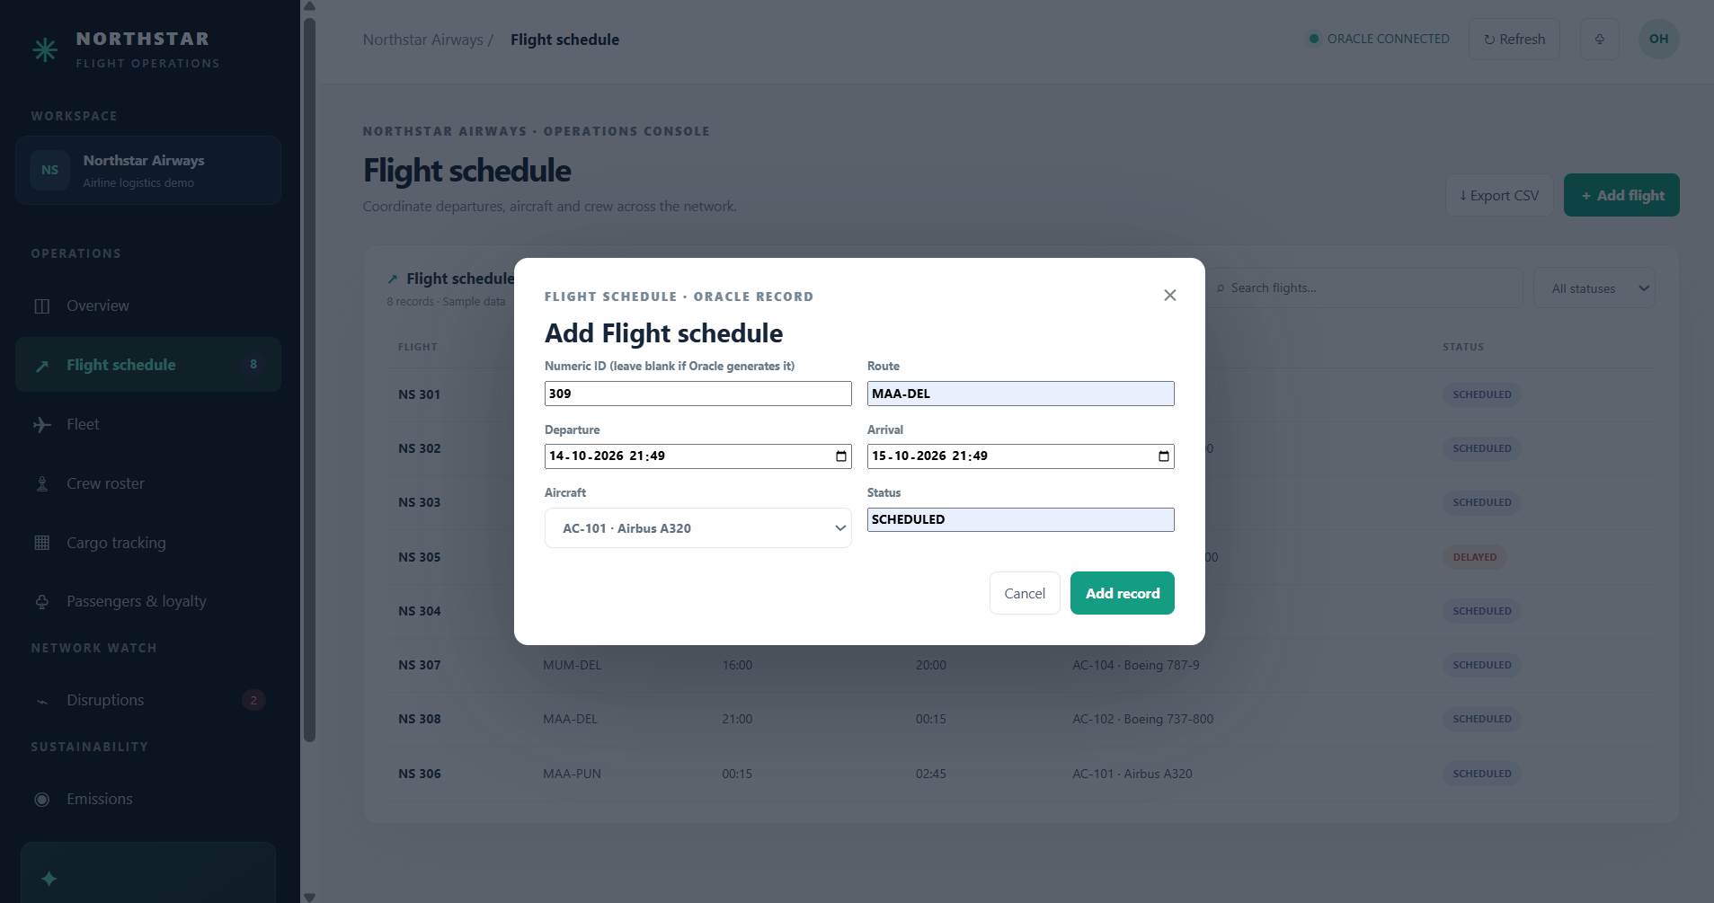
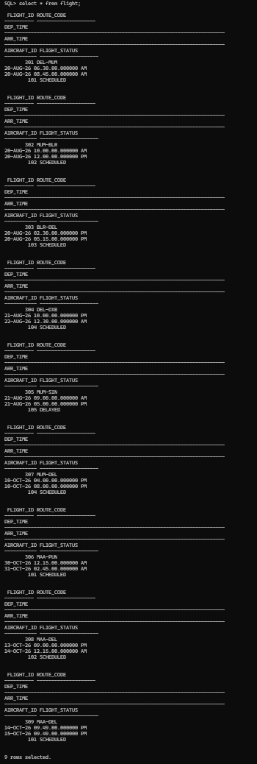
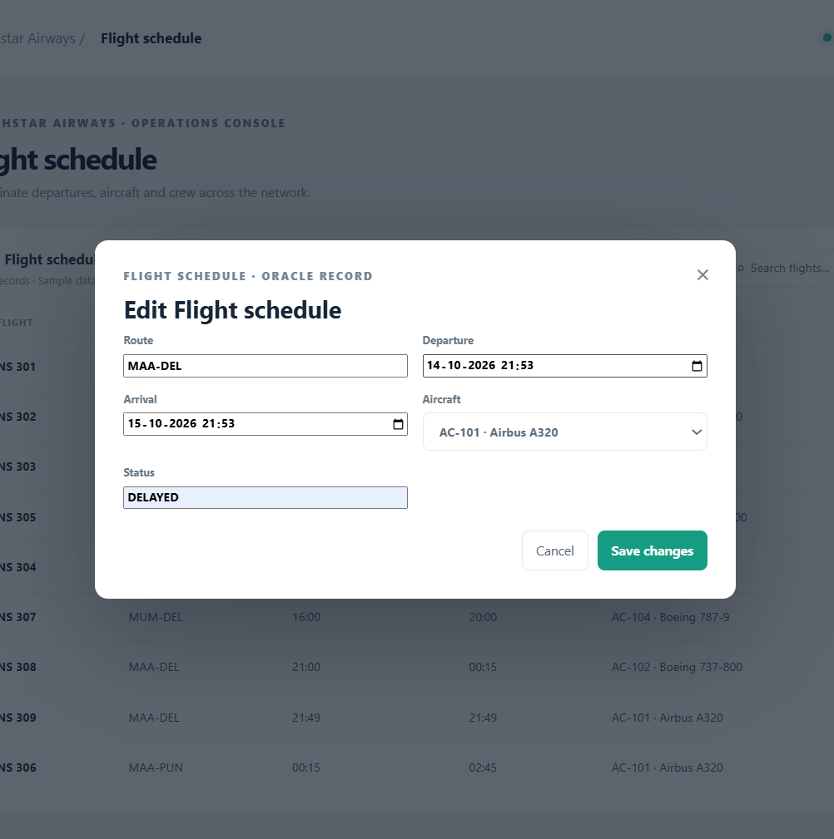
NORTHSTAR / AIRLINE OPERATIONS
Implementation and practical value
BUILT AND DEMONSTRATED
BUSINESS USE
Flight CRUD
Shared flight-linked records can reduce lookup across separate lists, help cargo teams spot temperature exceptions, and give analysts a base for route and fleet comparisons.
A flight was added and updated in Oracle. The delete screenshot shows the confirmation prompt, not the completed deletion.
Operations modules
Overview, flight schedule, fleet, crew, cargo, passengers, disruptions and emissions views.
Local implementation
FastAPI serves the browser console; python-oracledb connects the service to Oracle XE.
ADD RECORD
UPDATE RECORD
SUSTAINABILITY INSPIRATION
Make impact visible where operations are recorded: fuel and CO₂ per flight, plus temperature requirements and readings for sensitive cargo.
ORACLE ROWS
Potential value is a project hypothesis, not a measured financial or emissions outcome. Demo data is illustrative.
04
Notes:
Point to the add form and the Oracle query evidence. The project also shows a flight update reflected in Oracle. Be precise about deletion: the screenshot captures the confirmation prompt, not proof that the record was deleted. The broader practical value is shared flight-linked information; financial and environmental benefits have not been measured.

Slide 5
NORTHSTAR / AIRLINE OPERATIONS
Future implementation roadmap
The next steps move from a safer prototype to monitored operations and validated reporting.
NEAR TERM
OPERATIONS
SCALE + REPORT
Harden the prototype
Connect live workflows
Prove business outcomes
Role-based access and audit trail
Crew assignment with duty/rest checks
Validated emissions factors and boundaries
Stronger validation + explicit ID strategy
Cargo sensor feeds + threshold alerts
Route/load-normalized fuel reporting
Verify delete and access-control tests
Disruption history and response tracking
Approved airport and maintenance links
Backups, monitoring and error handling
Pilot with operations and cargo users
Cloud deployment and recovery plan
Before claiming impact, establish a baseline and validate data completeness, emission factors, fuel units and cargo temperature records.
05
Notes:
Present the roadmap in three stages. First secure and validate the current prototype. Then connect live workflows such as crew assignments and cargo sensors. Finally, validate emissions data and test integrations. These are proposed enhancements, not features already implemented.

Slide 6
NORTHSTAR / AIRLINE OPERATIONS
Database relationships and integrity
The flight is the operational hub. Keys connect each record to the right parent.
AIRCRAFT 1 → MANY FLIGHT
WHY KEYS MATTER
Each flight stores an Aircraft_ID foreign key.
PRIMARY KEY
CREW ↔ FLIGHT via FLIGHT_CREW
Uniquely identifies one row.
The junction table resolves the many-to-many assignment.
FOREIGN KEY
Prevents links to missing parent records.
FLIGHT 1 → MANY CARGO / EMISSIONS / DISRUPTION
Operational records reference a valid flight.
NORMALIZATION
Stores reusable facts once and reduces inconsistent duplicates.
LOYALTY_TIER 1 → MANY PASSENGERS
Passenger records reference a reusable tier.
Example query: join FLIGHT with EMISSIONS, then group by route to compare logged CO₂.
06
Notes:
Explain each relationship and why the junction table is needed for crew and flight assignments. Define primary key and foreign key briefly. Use the example query to show how a relational design supports practical questions with joins and grouping.

Slide 7
✦
THANK YOU
Questions and discussion
MODERN AIRLINE LOGISTICS & SUSTAINABILITY MANAGEMENT SYSTEM
Pranali Paygonda Patil • 25BCE2957
Notes:
Summarize the project: it connects operational records, demonstrates a working local interface and database workflow, and creates a foundation for more reliable sustainability reporting. Invite questions.

