Slide 1
Easy Shopper: Path planning for shopping robot
Pranali Desai (116182935)
Raghav Nandwani (116321549)
Sanket Goyal (116155144)
Group 23
ENPM661 – Project 5
Phase IV

Slide 2
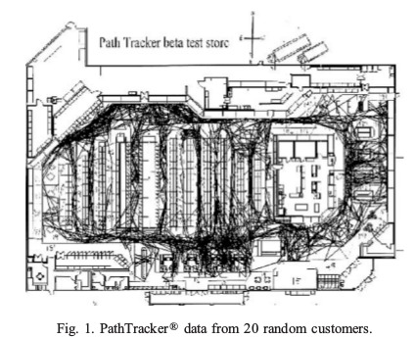
Motivation
High time consumption to find the products in big shopping complexes
Making the process of shopping less troublesome for the elderly and people with physical disabilities

Slide 3
Introduction
This paper presents a novel method to calculate the path
It is a combination of A* and dynamic A* and its comparison with Dijkstra, which is implemented on the common task of the shopping cart.
A* is being used for the non-dynamic system which is thought so for the initial stages
Later on, a dynamic system is taken into consideration and thus dynamic A* - D* has been implemented

Slide 4
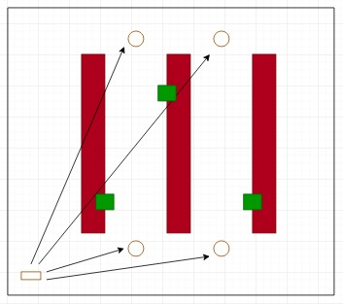
Path Planning

Slide 5
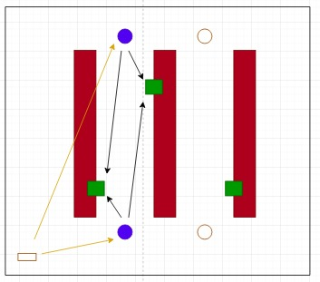
Path Planning (contd.)

Slide 6
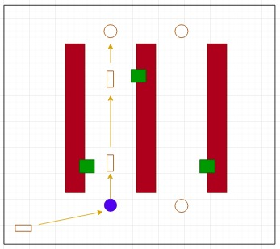
Path Planning (contd.)

Slide 7
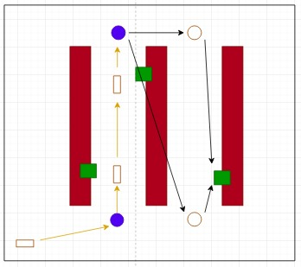
Path Planning (contd.)

Slide 8
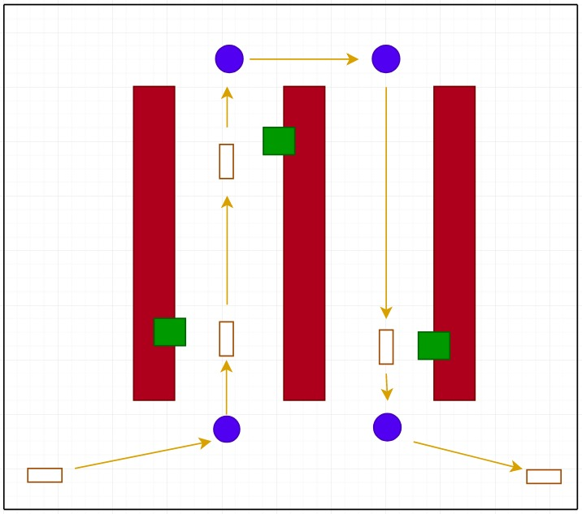
Path Planning (contd.)

Slide 9
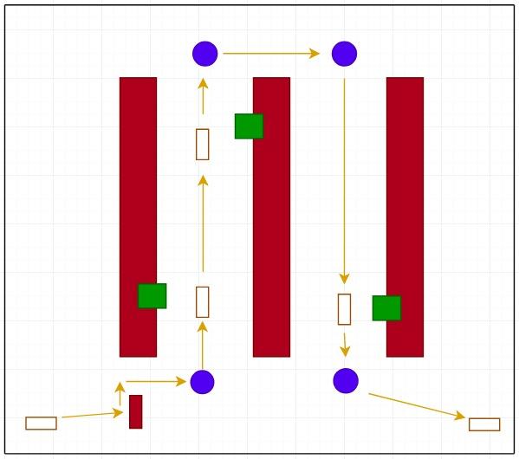
Path Planning (contd.)

Slide 10
Methodology outline
Initially, sorting the aisles based on the distance from the current position
Checking for the lowest cost to go of the item from the selected aisle’s endpoints, as well as the current position of the robot
Now implementing conventional A* path planning to the endpoints with the lowest cost to go
Then stop at each item present in the current aisle before reaching the end of aisle
Repeat it again when going to other aisle to pick the stuff i.e. calculate cost to go and then implementing path planning for the item location
After covering all the items one last time A* will be implemented to reach the end location.

Slide 11
Results
Parameters | Dijkstra | A* | D*
Number of nodes | 79982 | 896 | 500 more than Non-Dynamic
Computation time | 17 minutes | 3 minutes | 5 minutes
State space exploration | Approx. 50% of the workspace | Less than 1% of the workspace | Less than 1.5% of the workspace

Slide 12
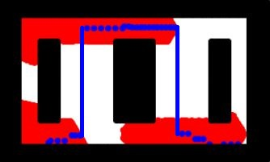
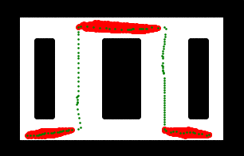
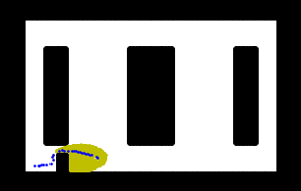
Results (contd.)
Dijkstra Output
A* Output
D* Output

Slide 13
Results (contd.)
The results shown in the tabular column showcases the comparison between Dijkstra and A* algorithm followed by application of D* for a certain region.
There is a significant decrease in the number of nodes being explored for the second algorithm compared to the first one.
The second algorithm is applied with dynamic obstacle, the output, although slow, is optimal and avoids this random obstacle.

Slide 14
Future scope
Increasing number of actions i.e. introducing backward motion
Having multiple carts connected to each other to have better understanding of the environment i.e. rapidly updating obstacle space for all the carts
Introduction of robotic arm and a barcode scanner to pick, scan and drop the item in the basket to make the system more convenient and have faster checkouts

Slide 15
References
Torvald Ersson and Xiaoming Hu - “Path Planning and Navigation of Mobile Robots in Unknown Environments” IEEE International Conference on Intelligent Robots and Systems (IROS)
Likhachev, M., Ferguson, D.; Gordon, G.; Stentz, A : “Anytime Dynamic A*: An Anytime, Replanning Algorithm” International Conference on Automated Planning and Scheduling
Koenig, S., Furcy, D. and Bauer, C.:“Heuristic search based replanning” International Conference on Artificial Intelligence Planning and Scheduling

