Slide 1

VENTILATION
DUCTING WORKING NOTES
By Triune Solutions

Slide 2
LINE CARD ITEMS FOR DUCTING
DUCTING TAKEOFF TO INCLUDE:
SPIRAL DUCTS
RECTANGULAR DUCTS
ELBOWS (45/ 90 DEGREES)
FLEXIBLE DUCTS
RISER (FLOOR UP/FLOOR DOWN)
USE STANDARD UNITS AS PER GIVEN IN FILE
(INCHES/MM)
ROUND RIGID DUCTS

Slide 3
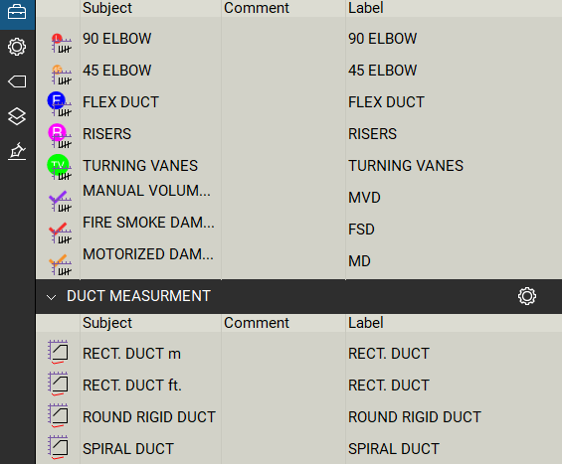
TOOLCHEST SYMBOLS FOR DUCTING
RECTANGULAR DUCT
SPIRAL DUCT
RISER-10 feet/15 feet
FLEX DUCT-Max. 5 Feet
45 ELBOW-Spiral Ducts
90 ELBOW-Spiral Ducts
TURNING VANES-Rectangular Ducts
DAMPERS (ALL TYPES)-Spiral/Rectangular Ducts

Slide 4
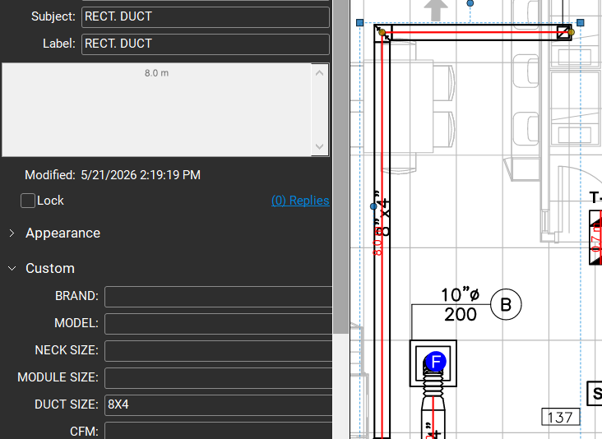

RECTANGULAR DUCT TAGGING
INCLUDE DUCT SIZE AS SHOWN (AXB)
ELBOWS ARE NOT REQUIRED IN RECTANGULAR DUCTS.
IF SIZES ARE GIVEN IN “MM”, THEN USE FROM TOOLBOX (RECT. DUCT m) TAG.
IF SIZES GIVEN IN “INCHES” THEN USE FROM TOOLBOX (RECT. DUCT ft.) TAG.
IF T-VANE SYMBOL IS GIVEN, THEN USE THAT SYMBOL FROM TOOLBOX.

Slide 5
QUICK NOTES
ADD CANEVAS TO UNITS EVEN IF NOT DENOTED OR MENTIONED
ADD MANUAL BALANCING DAMPER IN DUCT EVEN IF NOT GIVEN.
ADD FLEX DUCTS TO ERV WHICH ARE 10 FEET LONG EVEN IF NOT SHOWN ON PLAN
NO CANEVAS DUCTS CONNECTED TO KITCHEN HOOD AND DRYER IN UNITS
WHEN ENTERING RECTANGULAR DUCT SIZE IN VJR EXCEL, ENSURE THAT THE VALUE OF DUCT SIZE IS ON LEFT SIDE IS ALWAYS GREATER THAN VALUE ON RIGHT SIDE AS SHOWN IN IMAGE
CORRECT
INCORRECT

Slide 6
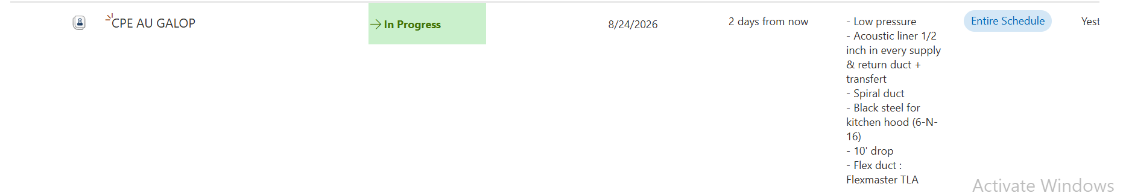
QUICK NOTES
FOR CERTAIN PROJECTS AS SHOWN IN ATTACHED IMAGE, THE SPECIFICATION FOR DUCT CONNECTED TO KITCHEN HOOD AS INSTRUCTED CAN BE INTERPRETED AS A RECTANGULAR DUCT WITH CODES: 6, TYPE: N AND INSTALLATION:16.

Slide 7
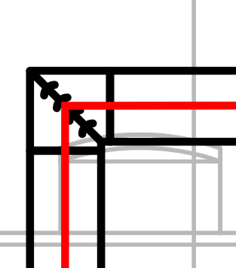
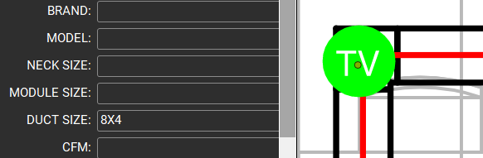
T-VANE
TURNING VANES:
USED FOR SMOOTH AIRFLOW AND REDUCED
RESISTANCE IN THE DUCT.
ADD T-VANE SYMBOL WITH DUCT SIZE FOR BOTH 90- AND 45-DEGREE TURN
THIS IS ONLY FOR A RECTANGULAR DUCT.
INCLUDE DUCT SIZE (X”/X mm)

Slide 8
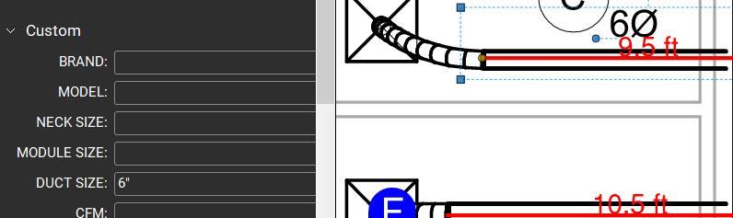
SPIRAL DUCT TAGGING
INCLUDE DUCT LENGTH AND DIAMETER
GIVE DUCT SIZE (MM/ INCHES)
TAG DUCTS AS SHOWN:
INCLUDE DUCT SIZE (DIA.) AS SHOWN (A”)
INCLUDE ELBOWS IF GIVEN:

Slide 9
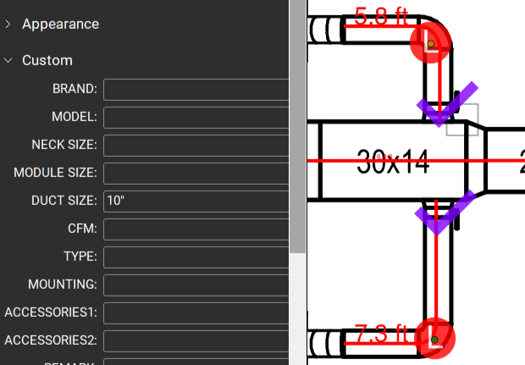
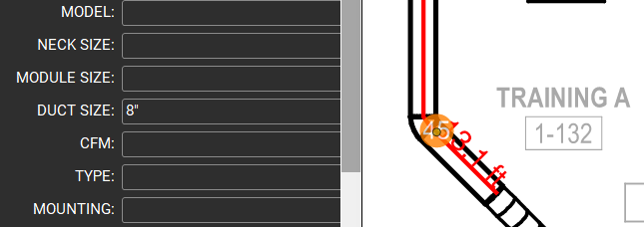
ELBOWS TAGGING
TYPES: 45° ELBOW / 90° ELBOW
ELBOWS ARE USED ONLY FOR SPIRAL DUCTS.
TAG 45° AND 90° ELBOWS IF SPECIFIED IN THE DUCT LAYOUT, AND USE SEPARATE SYMBOLS FOR EACH.
90° ELBOW: USE WHEN THE DUCT CHANGES DIRECTION PERPENDICULARLY.
45° ELBOW: USE WHEN THE DUCT CHANGES DIRECTION BY 45 DEGREES.
INCLUDE ONLY THE DUCT SIZE (X” / X MM).

Slide 10
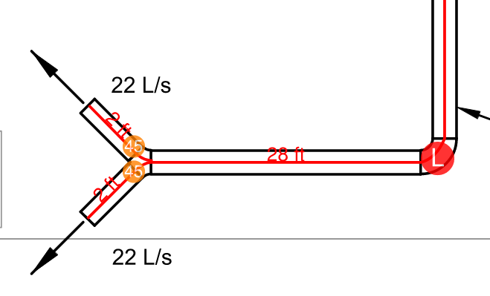
ELBOWS TAGGING
Y-TYPE DUCT
PROVIDE TWO DUCTS TO CONNECT TO THE GIVEN DUCT, AND INCLUDE TWO 45° ELBOWS.
GIVE DUCT SIZE OF EACH DUCT & 45° ELBOWS.

Slide 11
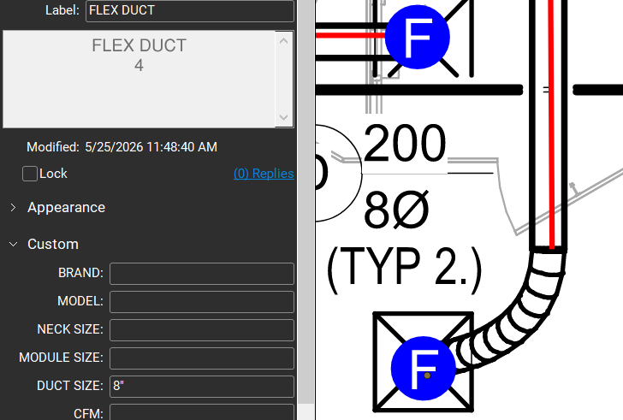
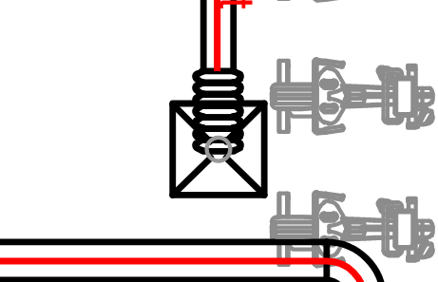
FLEXIBLE DUCT
MENTION ONLY THE DUCT SIZE (X” / X mm)
USED FOR FLEXIBILITY IN TIGHT SPACES AND FOR EFFICIENCY.
USE THIS SYMBOL FOR FLEX DUCTS.
IDENTIFY AND TAG FLEX DUCTS AS SHOWN:

Slide 12
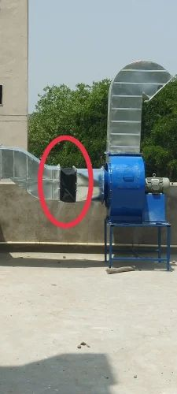
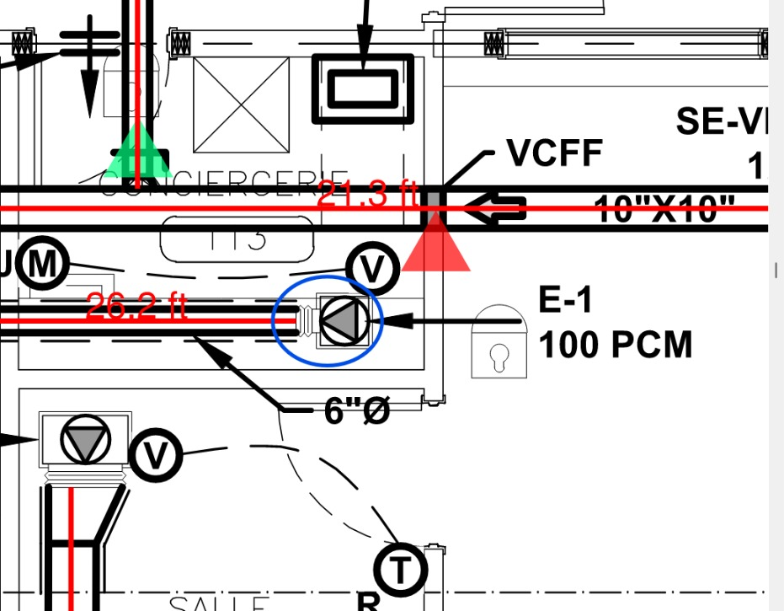
FLEXIBLE DUCT- CANEVAS
CANEVAS:
Canvas duct connectors isolate fan vibrations, suppress system noise, and prevent mechanical fatigue in HVAC setups. These flexible joints act as an airtight bridge between the rigid metal ductwork and moving equipment like centrifugal fans, axial fans, or heavy-duty industrial blower.
Canevas Accessory 8 in VJR Excel Chart is added to every duct directly connected to system(Fan,AHU,RTU)

Slide 13
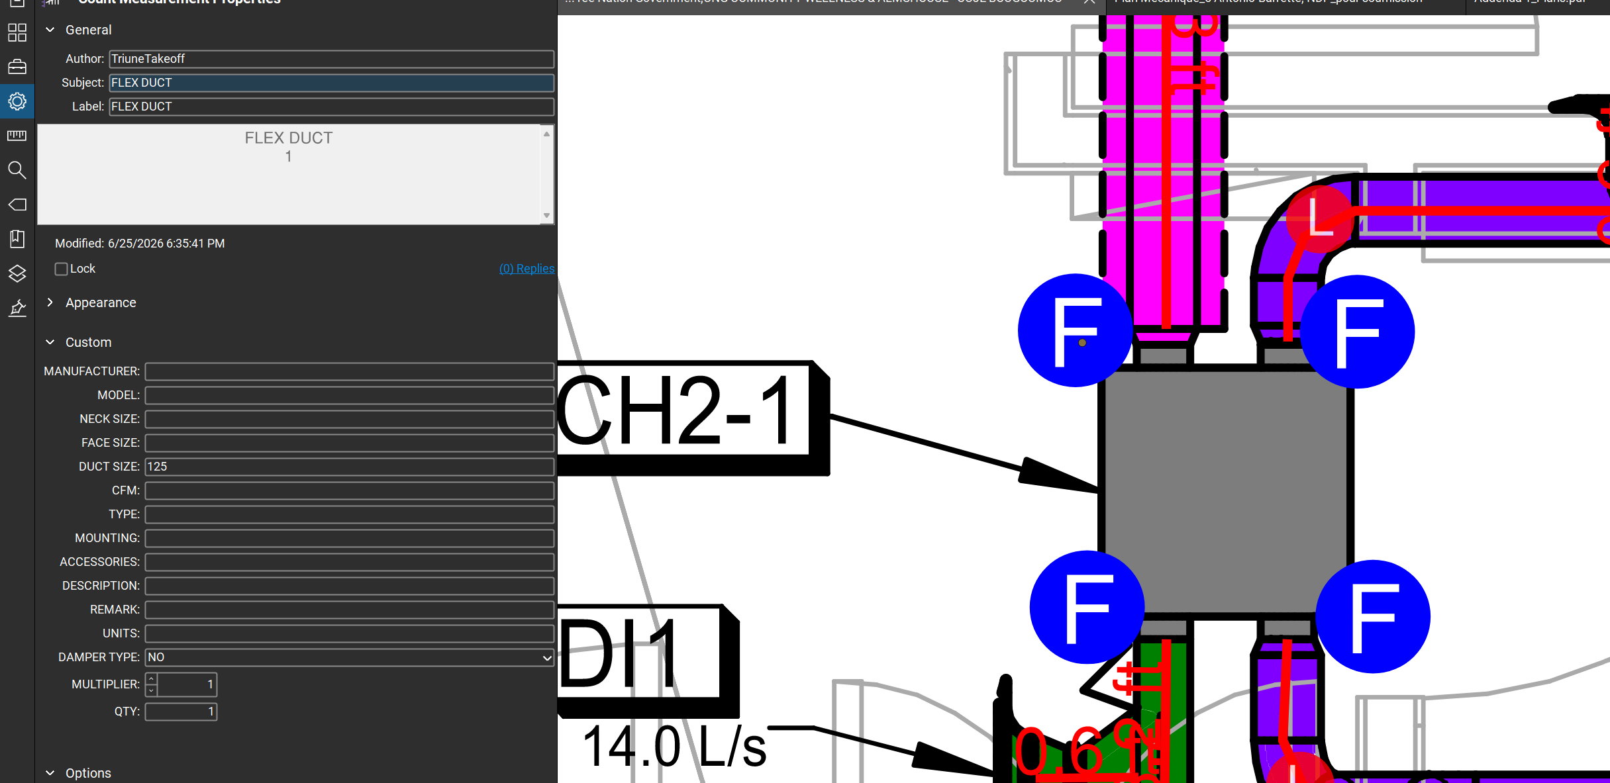
FLEXIBLE DUCT- ERV
NOTE:
WHEN SPIRAL DUCTS ARE CONNECTED TO ERV AFTER CONFIRMING WITH CLIENT ADD FLEX DUCTS FOR CONNECTION.
THE LENGTH OF THESE FLEX DUCTS IS 10 FEET EACH.

Slide 14
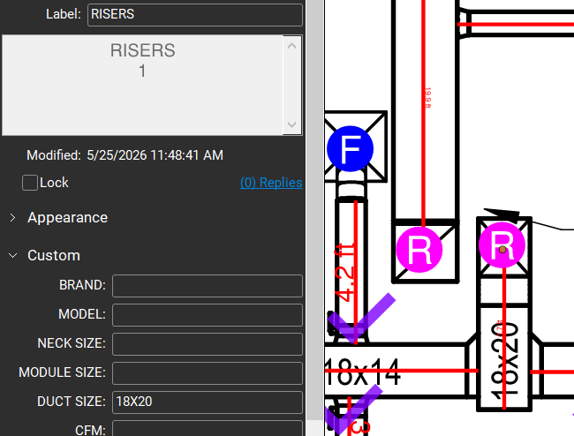
DUCT RISER
WHAT IS RISER?
A DUCT RISER IS A VERTICAL AIR PASSAGE CONNECTING ONE FLOOR TO ANOTHER.
PROVIDE A SEPARATE TAG FOR THE RISER.
SPECIFY THE DUCT SIZE.
CHECK THE SCOPE OF WORK FOR RISER DROP.
E.H. = GOES UPWARD
E.B. = GOES DOWNWARD

Slide 15
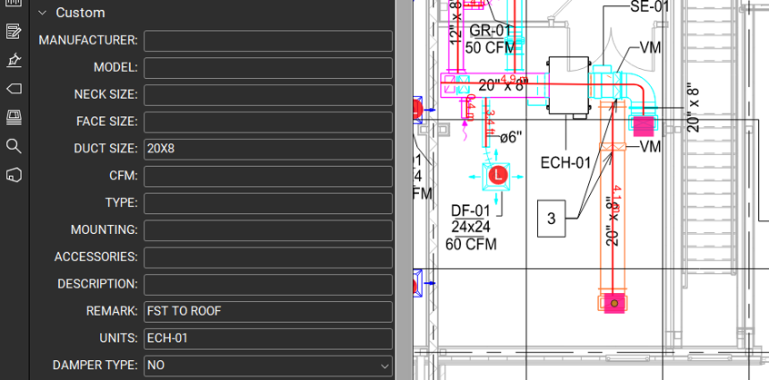
DUCT RISER
CHECK AND CONFIRM THE RISER OUTLET ON BOTH FLOORS, AND INCLUDE THE RISER FOR ONLY ONE FLOOR TO AVOID DUPLICATE COUNTING.
IN THE REMARKS, MENTION IF THE RISER GOES UP OR DOWN TO A FLOOR OR ROOF.

Slide 16
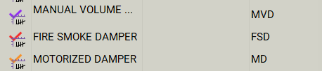
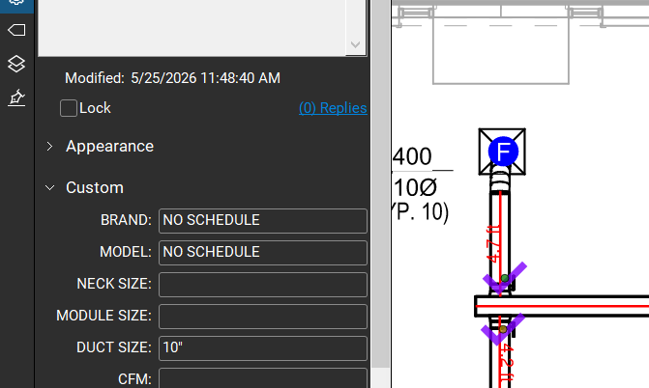
DAMPERS
TAG ALL AVAILABLE DAMPER TYPES IN THE SCHEDULE AND PLANS.
PROVIDE DUCT SIZE FOR ALL DAMPERS.
FIRE / FIRE SMOKE DAMPERS (FD/FSD); SMOKE DAMPERS (SD).
MOTORIZED DAMPERS (MD)/ MOTOR-OPERATED DAMPERS (MOD).
VOLUME & BALANCING DAMPERS (VD, MVD)
ZONE DAMPER (ZD); BACKDRAFT DAMPER (BD)

Slide 17
DAMPERS
ADD THESE TAG ACCESSORIES IN THE VJR EXCEL SHEET:
FIRE/ FIRE SMOKE DAMPER (FD/FSD) – (10/100)
GRAVITY DAMPER (12)
MOTORIZED DAMPER (MD) (11/111)
VOLUME/BALANCING DAMPERS (MBD/MVD) – (13/131)
IF DAMPERS(OTHER THAN BALANCING DAMPERS ) ARE IN SPIRAL DUCTS, THEN CONVERT IT TO RECTANGULAR AND ADD 0 IN LENGTH OF DUCT AND ADD DAMPER ACCESSORIES TO IT
TAG SPECIFICATIONS
RCF/VCF = FIRE DAMPER
RCFF/VCFF = FIRE SMOKE DAMPER
RE = SPIN IN DAMPER/ MANUAL VOLUME/BALANCING DAMPER
RM/RMO = MOTORIZED DAMPER

Slide 18
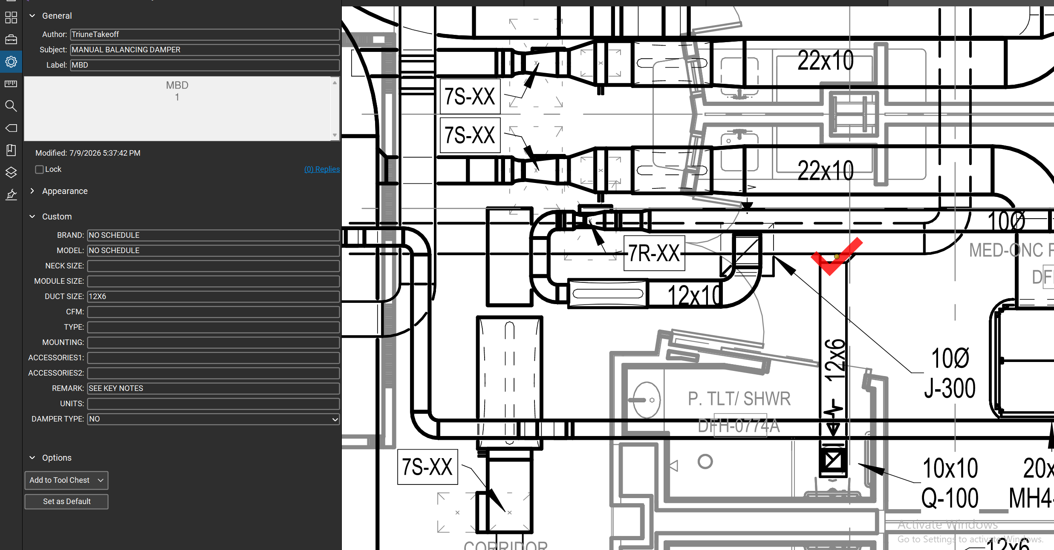
DAMPERS-MANUAL BALANCING DAMPER
ADD MANUAL BALANCING DAMPER WHENEVER THE DUCT IS BRANCHED TO CONNECT TO GRD EVEN IF NOT INDICATED.
AS SHOWN IN ATTACHED IMAGE, MBD IS ADDED FOR GRD TAG Q.
NOTE THAT IF THERE IS VAV BOX/VALVE CONNECTED TO GRD SIMILAR TO TAG J, THEN MBD IS NOT NEEDED.
THE MBD CONNECTED TO SPIRAL DUCTS ARE ADDED IN SPIRALE WORKSHEET OF VJR EXCEL.
IF MBD IS CONNECTED TO RIGID(METAL) ROUND DUCT, THEN ASSUME IT AS RECTANGULAR DUCT ACCESSORY WITH CODE 9. NOTE THAT THIS DAMPER IS COST EFFICIENT DUE TO LOWER PRICE.

Slide 19
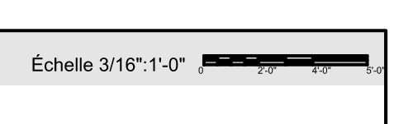


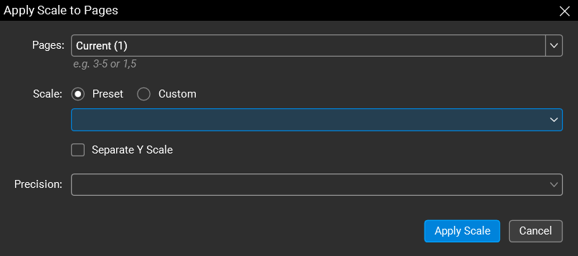
IMPORTANT DUCTING POINTS
SCALE SETTING:
CHECK THE PLAN DETAILS FOR SCALE.
(USUALLY AT THE TOP/BOTTOM OF PAGE)
TO SET THE SCALE, CLICK “SCALE NOT SET” IN
THE BOTTOM RIGHT OF BLUEBEAM APP
A POPUP WILL APPEAR WITH THE SCALE
SETTINGS WIZARD, REF. IMAGE:

Slide 20
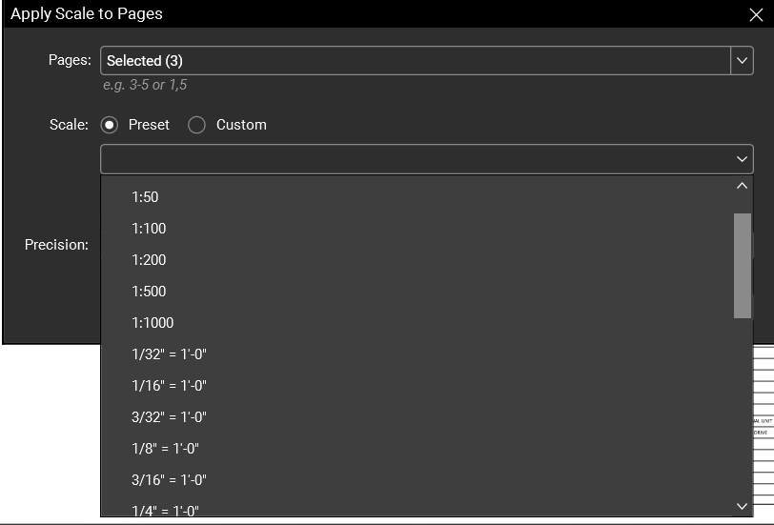
IMPORTANT DUCTING POINTS
IF SCALE IS PROVIDED IN THE DRAWING,
SELECT THE SCALE FROM THE PRESET
OPTION.
YOU CAN CHOOSE THE PRESET FROM THE DROP
DOWN LIST:
FOR SI/METRIC SYSTEM–
1:10, 1:50, 1:100, etc.
FOR IMPERIAL SYSTEM-
1/32" = 1'-0"1/16" = 1'-0"3/32" = 1’-0”, etc.

Slide 21
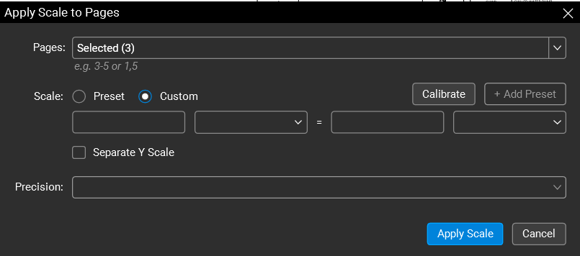
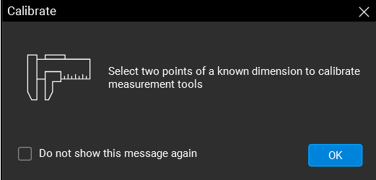
IMPORTANT DUCTING POINTS
IF SCALE IS NOT PROVIDED IN THE DRAWING,
WE WILL FIND THE SCALE BY CALIBRATION.
SELECT THE CUSTOM OPTION NEXT TO PRESET,
AND SELECT THE CALIBRATE OPTION:
A CALIBRATION POPUP WILL OCCUR EXPLAINING
HOW TO CALIBRATE; SELECT OK.

Slide 22
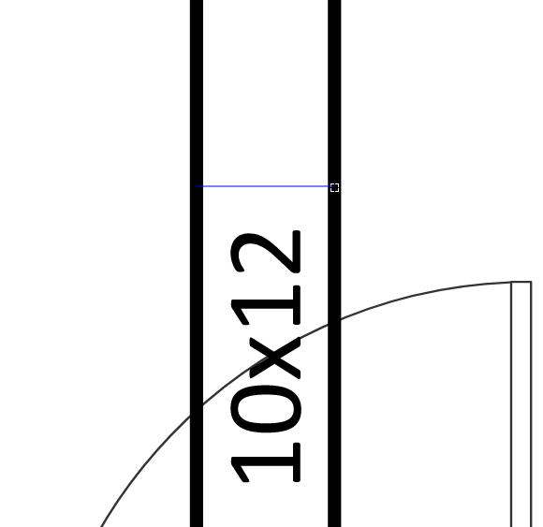
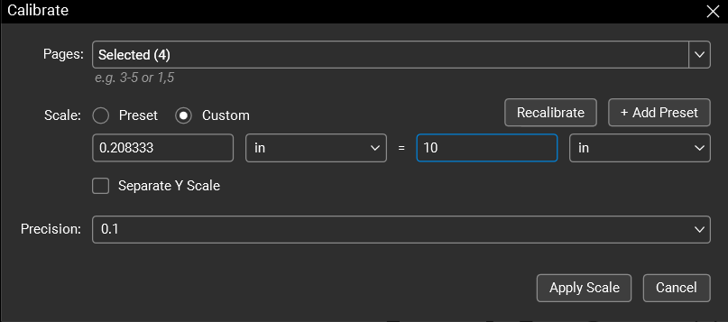
IMPORTANT DUCTING POINTS
FOR CALIBRATION SELECT A DUCT WITH GIVEN DIMENTIONS &
MARK A LINE SEGMENT ALONG ITS DIAMETER. SEE IMG1:
AFTER SELECTING THE TWO END POINTS, A POPUP
WILL APPEAR ON THE SCREEN. SEE IMG2:
LEFT SIDE OF THE EQUATION COMES PRE-FILLED.
ON THE RIGHT SIDE OF THE EQUATION, WE ENTER
THE GIVEN WIDTH OF THE SELECTED DUCT AND ITS
UNIT (MM/IN). CLICK APPLY SCALE.

Slide 23
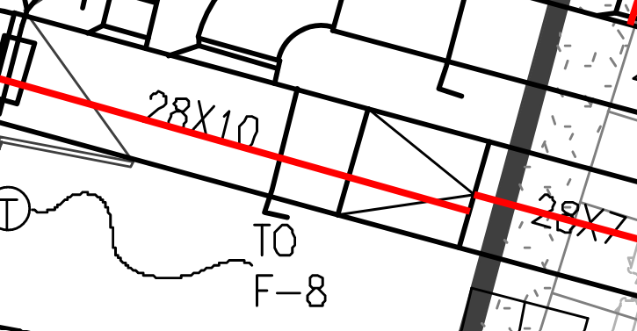
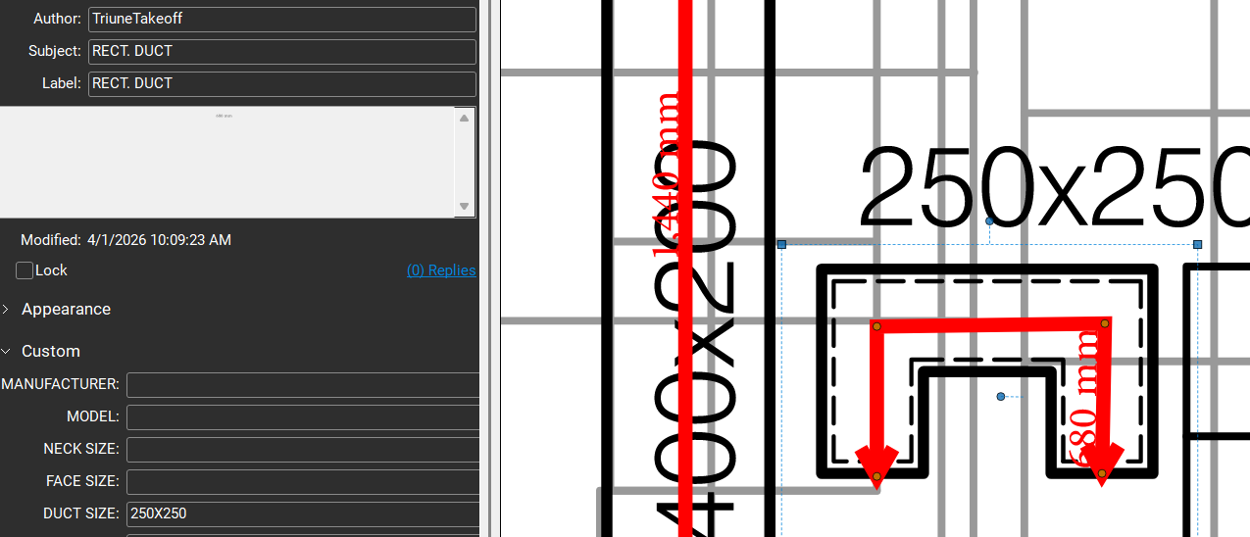
IMPORTANT DUCTING POINTS
DUCT REDUCER:
IN CASE OF DUCT REDUCER, INCLUDE THE REDUCER
SECTION AS PART OF THE LARGER DUCT AS SHOWN:
TRANSFER DUCT:
FOR TRANSFER DUCT, USE RECT. DUCT TAG
DUCT SIZE TO BE SPECIFIED.

Slide 24
IMPORTANT DUCTING POINTS
ACOUSTIC LINER/ ACOUSTIC INSULATION:
ACOUSIC INSULATION IS USED IN DUCTS AS A DUCT-
LINING TO REDUCE NOISE AND VIBRATIONS.
CHECK FOR LINEAR THICKNESS IN SCOPE OF WORK:
½” OR 1” THICKNESS

Slide 25
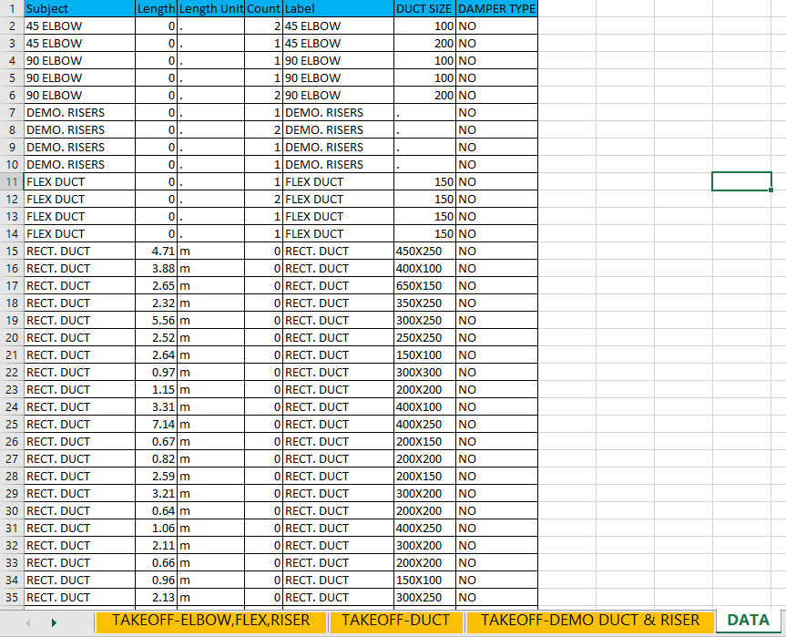
EXCEL TAKEOFF
MAKE CSV OF OUR FILE.
MAKE IN EXCEL FORMAT.
MAKE 3 DIFFERENT SHEETS IN EXCEL FOR
DUCTS
ACCESSORIES-RISER, ELBOW, T-VANES, FLEX DUCT, DAMPERS
DEMOLITION DUCT & RISER

Slide 26
EXCEL TAKEOFF
CODES AND ACCESSORIES
CODE 1 = 1/2 INCH ACOUSTICAL INSULATION.
CODE 21 = 1 INCH ACOUSTICAL INSULATION.
ACCESSORY 7 = T VANES
ACCESSORY 71 = T VANES DUCT SIZE FOR GREATER THAN 30”
ACCESSORY 8 = CANVAS ACCESSORY 81 = CANEVAS ABOVE 30 INCH / 750MM
ACCESSORY 10 = FIRE DAMPER
ACCESSORY 100 = FIRE SMOKE DAMPER
ACCESSORY 11 = MOTORIZED DAMPER ACCESSORY 111 = MOTORIZED DAMPER ABOVE 30 INCH(DIMENSION)
ACCESSORY 12 = GRAVITY DAMPER
ACCESSORY 13 = MANUAL BALANCING DAMPER
ACCESSORY 131 = MANUAL BALANCING DAMPER FOR DUCT SIZE GREATER THAN 30”
ACCESSORY 14 = WIRE MESH/ BIRDSCREEN

Slide 27
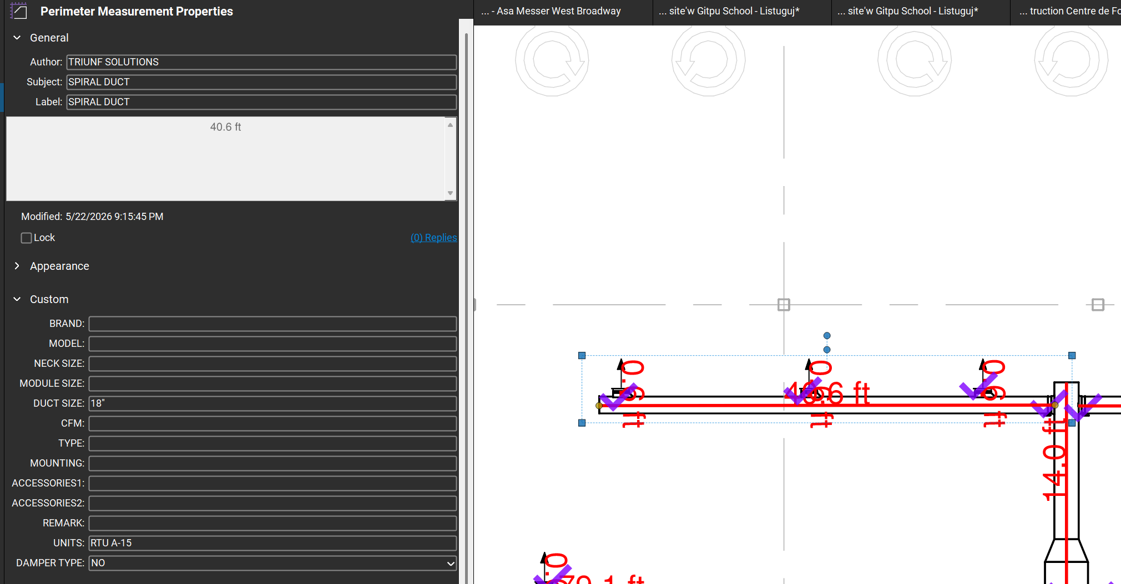
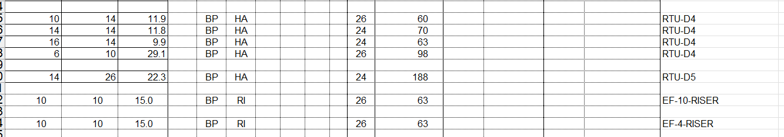
EXCEL TAKEOFF
SYSTEM
IF THE PROJECT HAS MULTIPLE SYSTEMS LIKE FANS, ROOFTOP UNITS, HEAT EXHANGES WE HAVE TO ADD THEIR NAME IN THE UNITS OF CUSTOM SECTION OF BLUEBEAM.
IN VJR EXCEL WE HAVE TO PROVIDE SEPARATE SYSTEMS IN RECTANGULAR DUCTS ALONG WITH THEIR CORRESPONDING ACCESSORIES

Slide 28
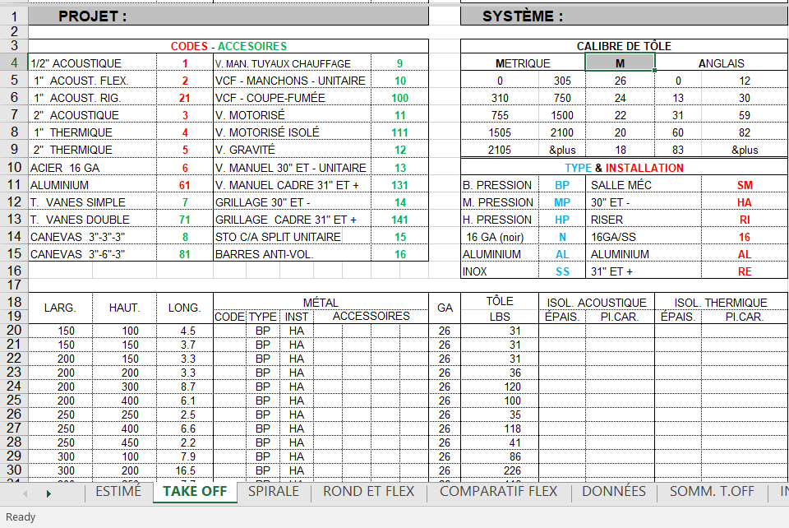
EXCEL TAKEOFF
(VJR EXCEL SHEET)
RECTANGULAR DUCT
FOR RECTANGULAR DUCT
REFER TO OUR CSV EXCEL FILE.
FOR RECTANGULAR DUCTS, PROVIDE BOTH DIMENSIONS (LENGTH X WIDTH) AND THE DUCT LENGTH.
IF THE SIZE IS GIVEN IN MM, SELECT “M” (LENGTH IN METERS).
IF THE SIZE IS GIVEN IN INCHES, SELECT “A” (LENGTH IN FEET).
CALIBRE DE TÔLE
METRIQUE |  | M | ANGLAIS
0 | 305 | 26 | 0 | 12
310 | 750 | 24 | 13 | 30
755 | 1500 | 22 | 31 | 59
1505 | 2100 | 20 | 60 | 82
2105 | &plus | 18 | 83 | &plus

Slide 29
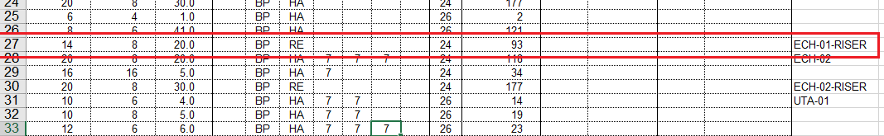
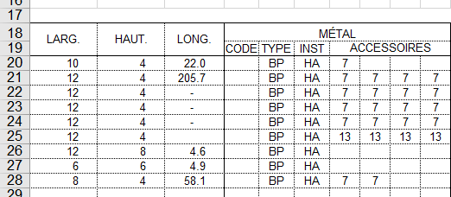
EXCEL TAKEOFF
(VJR EXCEL SHEET)
RISER - HOW TO ADD RISER DETAILS IN VJR SHEET
ADD RISER DETAILS IN RECTANGULAR DUCT COLUMN & ADD "RI" AS INSTALLATION TYPE COLUMN
RISER LENGTH TO BE IN METERS (SAME AS RECTANGULAR)
ACCESSORIES :
IF THE NUMBER OF ACCESSORIES EXCEEDS THE FOUR COLUMNS, REPEAT THE SAME DUCT SIZE IN THE NEXT ROW, KEEP THE DUCT TOTAL LENGTH AS ZERO, AND CONTINUE ADDING THE REMAINING ACCESSORIES.

Slide 30
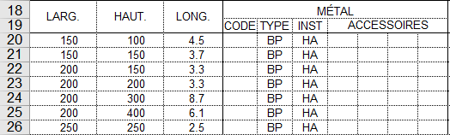
EXCEL TAKEOFF
(VJR EXCEL SHEET)
WHILE SELECTING THE DUCT TYPE, REFER TO THE CUSTOMER NOTES, WHICH INDICATE THE PRESSURE TYPE OF THE DUCT,
E.G.,
BP: LOW PRESSURE
MP: MEDIUM PRESSURE.
HP: HIGH PRESSURE
IN THE INSTALLATION COLUMN:
IF ALL DUCT SIZES ARE LESS THAN 36 INCHES, SELECT HA.
IF ANY DUCT PARAMETER (WIDTH OR HEIGHT) EXCEEDS 36 INCHES, SELECT RE.
FOR RISERS, SELECT RI.

Slide 31
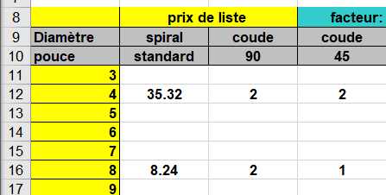
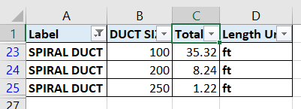
EXCEL TAKEOFF
(VJR EXCEL SHEET)
SPIRAL DUCT
FOR SPIRAL DUCT :
GIVE TOTAL LENGTH OF DUCT IN VJR SHEET AS PER DIAMETER.
IF SIZE IS GIVEN IN MM OR M, CONVERT IT INTO INCHES OR FEET FIRST, AND THEN ADD THE LENGTH.

Slide 32
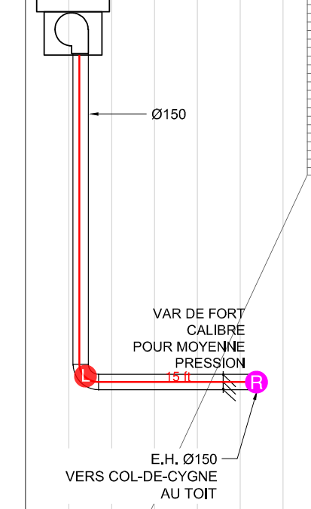
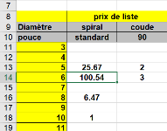
EXCEL TAKEOFF
(VJR EXCEL SHEET)
HOW TO ADD RISER-SPIRAL DUCT DETAILS IN THE VJR SHEET?
ADD DROP (FEET) OF RISER IN THE SPIRAL DUCT COLUMN FOR THE GIVEN DUCT SIZE IN THE VJR EXCEL.
ADD RISER SIZE IN FEET
[EG. 55.54+45(3 COUNTS OF 15 FEET)]
UNITS | Label | DUCT SIZE | REMARK | Total
ECH-02 | RISERS | 300X200 | GR TO 1ST FLR | 1
ECH-02 | RISERS | 400X200 | GR TO 1ST FLR | 1
TRANSFER DUCT | RISERS | 150 | GR TO 1ST FLR | 3
VE-1 | RISERS | 600X500 | GR TO 1ST FLR | 1

Slide 33
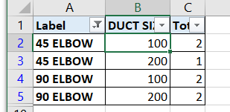
EXCEL TAKEOFF
(VJR EXCEL SHEET)
FOR 45° AND 90°:
ADD THE COUNT OF EACH ELBOW IN THE VJR EXCEL SHEET.

Slide 34
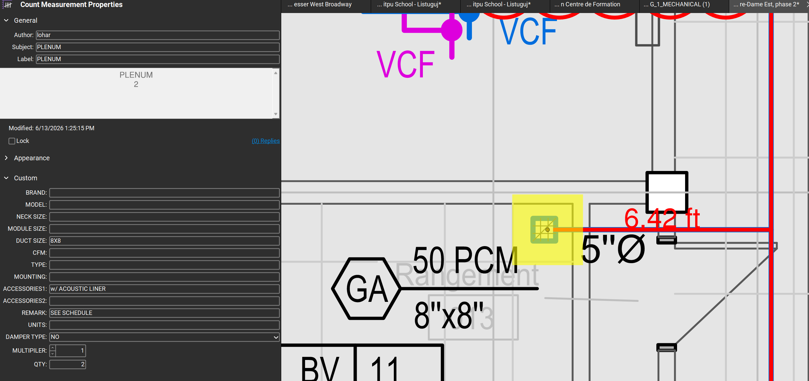
EXCEL TAKEOFF
(VJR EXCEL SHEET)
FOR PLENUM
PLENUMIN CEILING IS RECTANGULAR DUCT ADDED VERTICALLY CORRESPONDING TO GRD NECK SIZE
IT IS CONSIDERED AS 1 FEET
PLENUM IS GENERALLY ADDED IN CASES WHERE HORIZONTAL SPIRAL DUCTS ARE TO BE DIRECTLY CONNECTED WITH RECTANGULAR GRD WITHOUT ANY FLEX DUCT

Slide 35
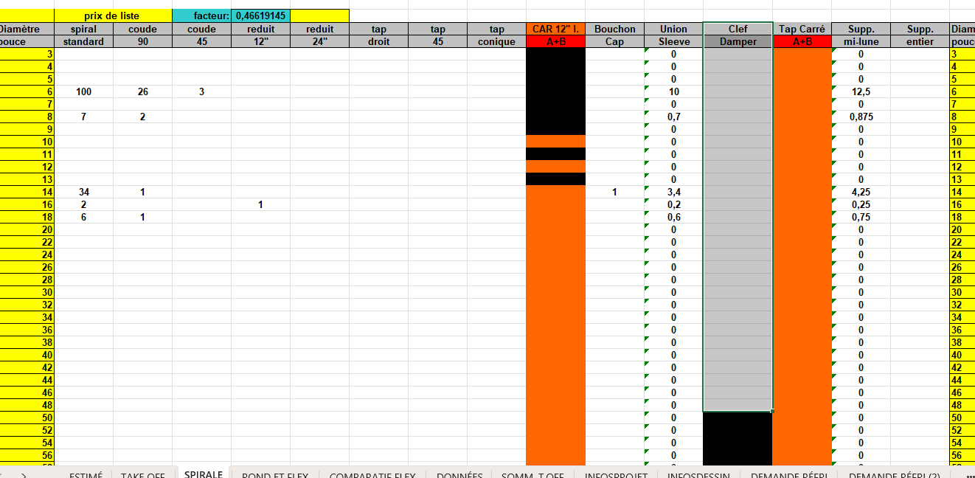
EXCEL TAKEOFF
(VJR EXCEL SHEET)
FOR BALANCING DAMPER:
ADD THE COUNT OF BALANCING DAMPER FOR SPIRAL DUCT IN THE VJR EXCEL SHEET.

Slide 36
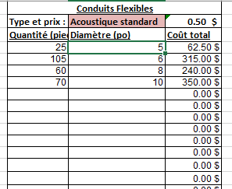
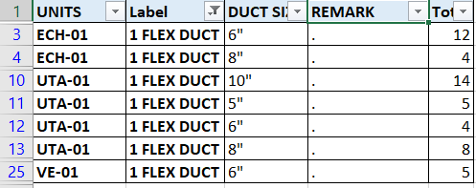
EXCEL TAKEOFF
(VJR EXCEL SHEET)
FLEX DUCT
FOR FLEX DUCT:
WE PROVIDE THE TOTAL QUANTITY OF FLEX DUCTS.
EACH FLEX DUCT IS 5 FEET LONG.
FOR A GIVEN DUCT SIZE, NOTE THE TOTAL NUMBER OF FLEX DUCTS AND MULTIPLY IT BY 5 TO GET THE TOTAL FLEX DUCT LENGTH, AND ADD IT AS SHOWN IN THE IMAGE.
EXAMPLE:
FOR 10” DIAMETER, TOTAL QUANTITY = 14
14 × 5 = 70

Slide 37
EXCEL TAKEOFF
(VJR EXCEL SHEET)
FLEX DUCT
FOR FLEX DUCT:
WE PROVIDE THE TOTAL QUANTITY OF FLEX DUCTS.
EACH FLEX DUCT IS 5 FEET LONG.
FOR A GIVEN DUCT SIZE, NOTE THE TOTAL NUMBER OF FLEX DUCTS AND MULTIPLY IT BY 5 TO GET THE TOTAL FLEX DUCT LENGTH, AND ADD IT AS SHOWN IN THE IMAGE.
EXAMPLE:
FOR 10” DIAMETER, TOTAL QUANTITY = 14
14 × 5 = 70

Slide 38
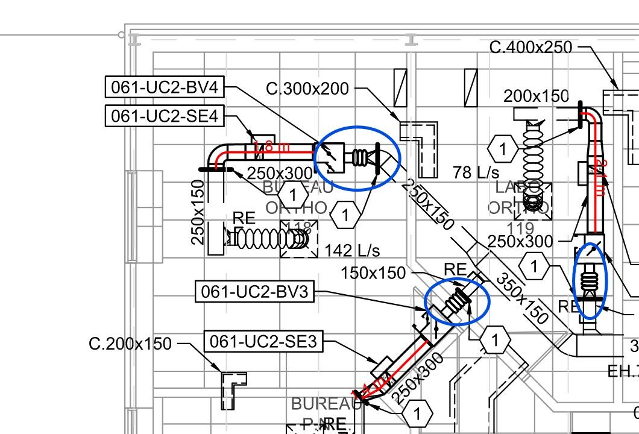
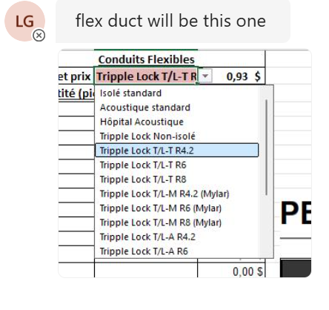
EXCEL TAKEOFF
(VJR EXCEL SHEET)
FLEX DUCT
FOR FLEX DUCT CONNECTED TO EQUIMENT:
WE ASK VJR ABOUT THE TYPE OF FLEX DUCT TO BE CONNECTED TO EQUIPMENT OTHER THAN GRD.
FOR THE ILLUSTRATED EQUIPMENT VJR ADVISED TO ADD FLEX DUCT ‘TRIPLE LOCK T/L-T R4.2’

Slide 39
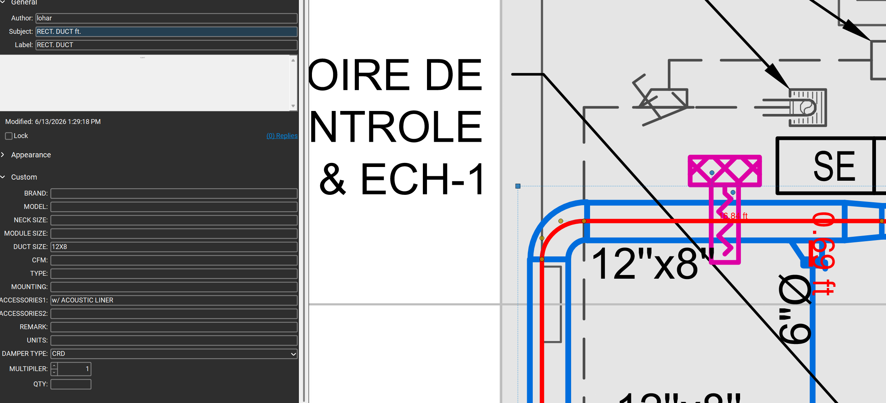
EXCEL TAKEOFF
(VJR EXCEL SHEET)
FLEX DUCT
FOR ACOUSTIC INSULATION:
WEACOUSTIC INSULATION DATA IS EITHER PROVIDED FROM VJR BY ADDITIONAL NOTES OR BY DRAWING KEYNOTES AND LEGENDS
THE ACOUSTIC INSULAION CAN ONLY BE APPLIED TO RECTANGULAR DUCTS AND PLENUM.

Slide 40
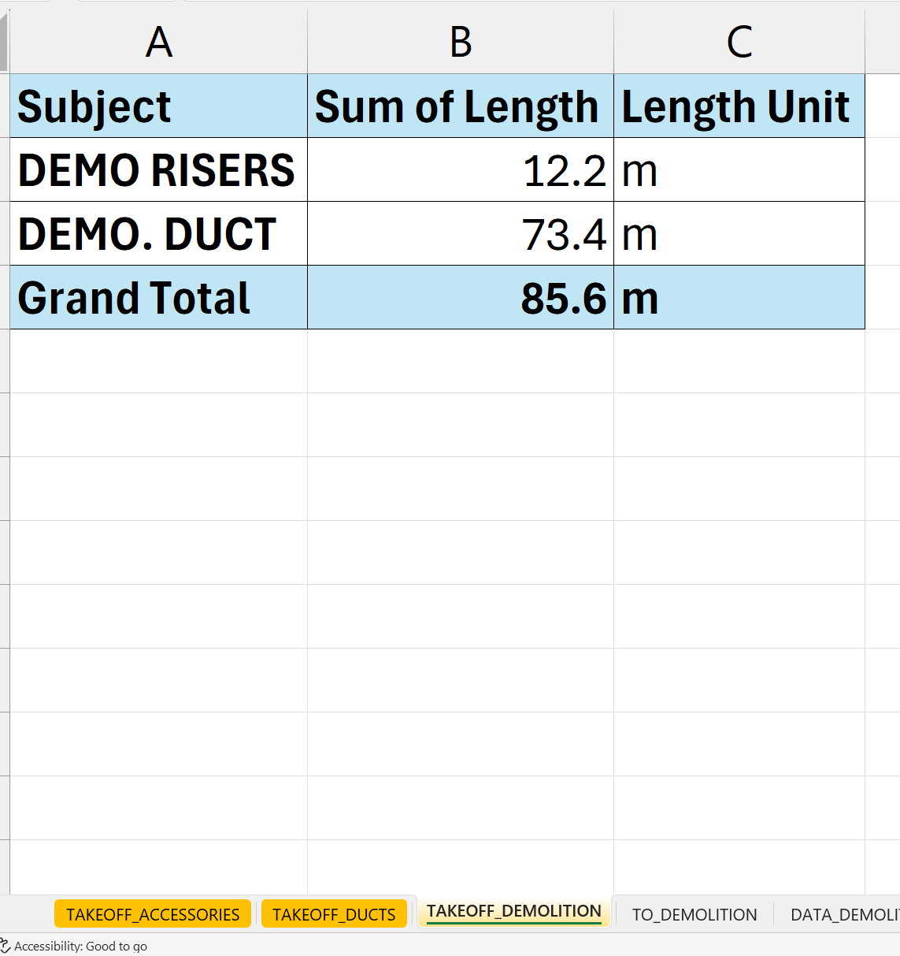
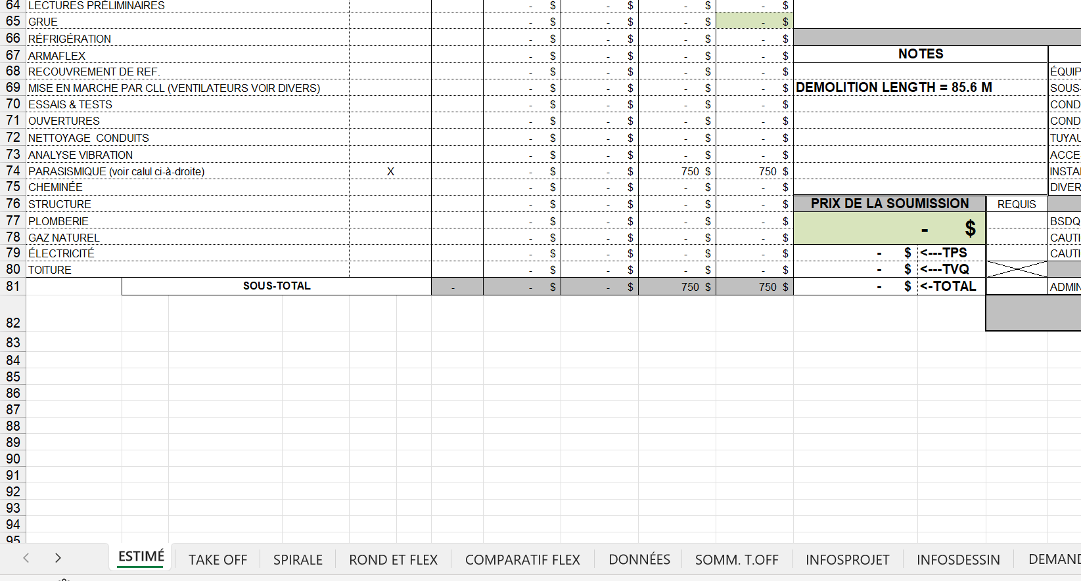
EXCEL TAKEOFF
(VJR EXCEL SHEET)
DEMOLITION
FOR DEMOLITION:
USE DEMO DUCT AND DEMO RISER FROM TOOLBOX FOR DEMOLISHED DUCTS TAGGING.
DON’T ADD DUCT SIZE AND ADD THE TOTAL LENGTH IN VJR EXCEL AS SHOWN

Slide 41
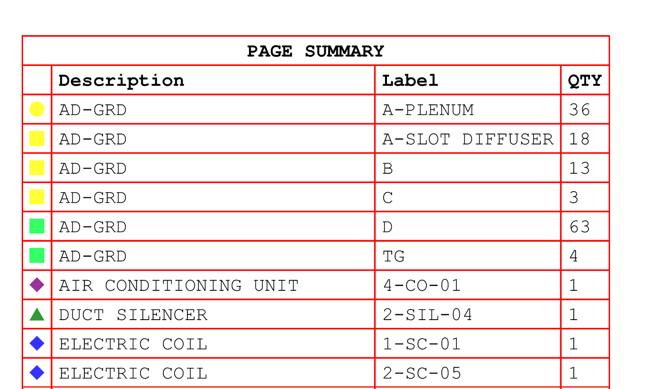

LEGENDS
EQUIPMENT TAKEOFF
DUCTING TAKEOFF
IF THERE ARE MULTIPLE UNITS IN DUCTING TAKEOFF, THEN TAKE UNITS AS THE 1ST COLUMN IN LEGENDS

