Slide 1

PROJECT ON
Movie Sales Analysis
Shinde Pranali Vishnu

Slide 2
CONTENTS
1.OBJECTIVE
2.KEY VISUALS
3.FINAL DASHBOARD
4.OVERALL INSIGHTS
5.PROJECT LINK
6.CONCLUSION

Slide 3
OBJECTIVES
The objective of this project is to analyze movie sales data using Power BI.
It aims to track revenue, ratings, and audience trends across different years and genres.
The dashboard helps identify top-performing movies and key business patterns for decision-making.

Slide 4
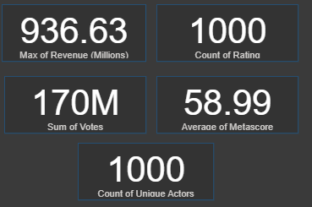
KEY VISUALS
The Heights Earning movie made around 936 Million.
Data includes 1000 movies that were rated.
All Movies together receive 170 million votes (from Viewers and Users)
Average critic score (Metascore) is about 5 out of 100
There are 1000 unique actor across all Movies

Slide 5
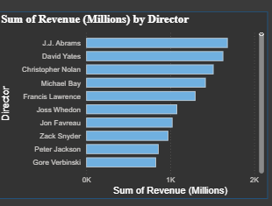
J. J. Abrams and David Yates are the top-grossing directors on this list, both generating a sum of revenue close to $2(Millions).

Slide 6
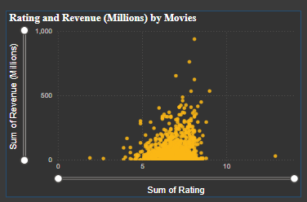
Movies with ratings between 5–9 tend to have higher revenues.
Movies with higher ratings generally earn higher revenue.

Slide 7
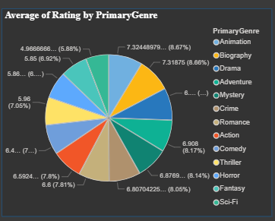
Genres like Animation, Biography, Drama have higher ratings.
Viewers prefer story-driven or exciting films.

Slide 8
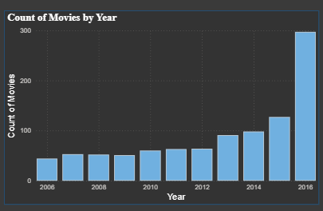
It Shows number of movies released increase from 2006 to 2016.
Their is Big increase in movie Production after 2015.
297 movie Released in 2016.

Slide 9
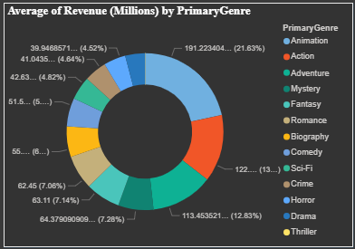
Animation,Action, Adventure movies earn higher revenue.
Comedy, Drama movies have good votes but slightly lower revenue.

Slide 10
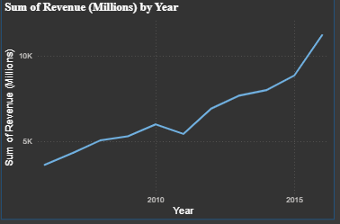
Revenue gradually increased from 2006 to 2015, with a big jump at the end.

Slide 11
DASHBOARD LINK
Click here:-
Page 5 - IMDB_Dashboard - Power BI

Slide 12
OVERALL INSIGHTS
The movie industry has grown rapidly after 2015.
Rating are stable (Around 7/10)
Action and Adventure movies bring the heights revenue.
J. J. Abrams and David Yates leads in total revenue among Directors.
Drama and Comedy genres attract more audience voting and rating.

Slide 13
CONCLUSION
The dashboard shows top movies, yearly trends, and helps understand audience choices.
It gives clear insights for better movie business planning and decisions.

Slide 14

THANK YOU

