Slide 1
OVERVIEW of the .NET FOUNDATION

Slide 2

Software Engineer , ABB
Internet of EV Chargers
.NET / Azure / DevOps
Gurucharan
(www.gurucharan.in)
Azure User Group, Bangalore
Code | Ship | Blog | Speak

Slide 3
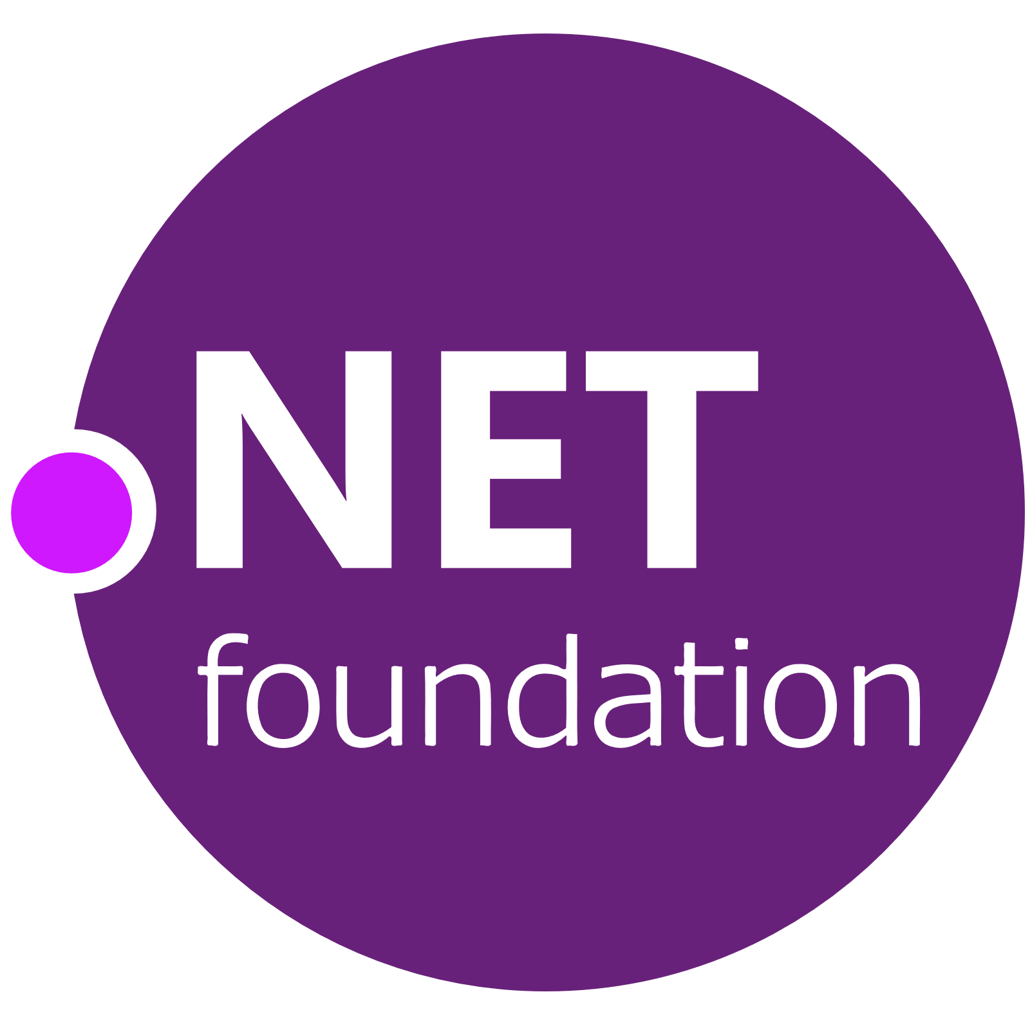
Build a STRONG
.NET COMMUNITY

Slide 4
COMMUNITY
What / Who / Why ??

Slide 5
You DON’T BUY
the SOFTWARE
You “BUY” the
COMMUNITY
- Jeff Atwood

Slide 6
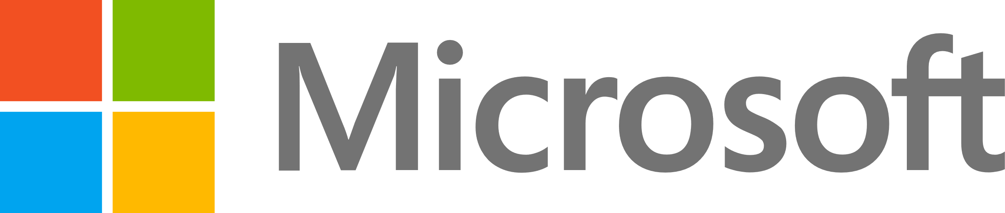
2014

Slide 7
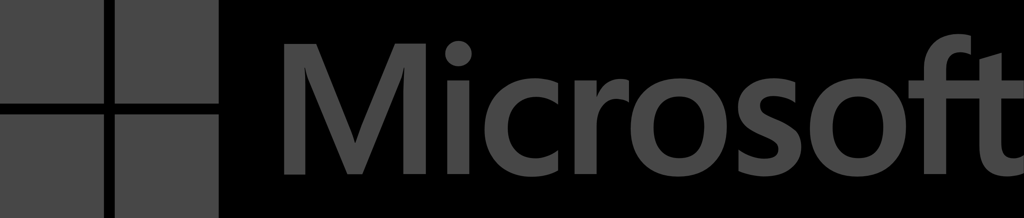
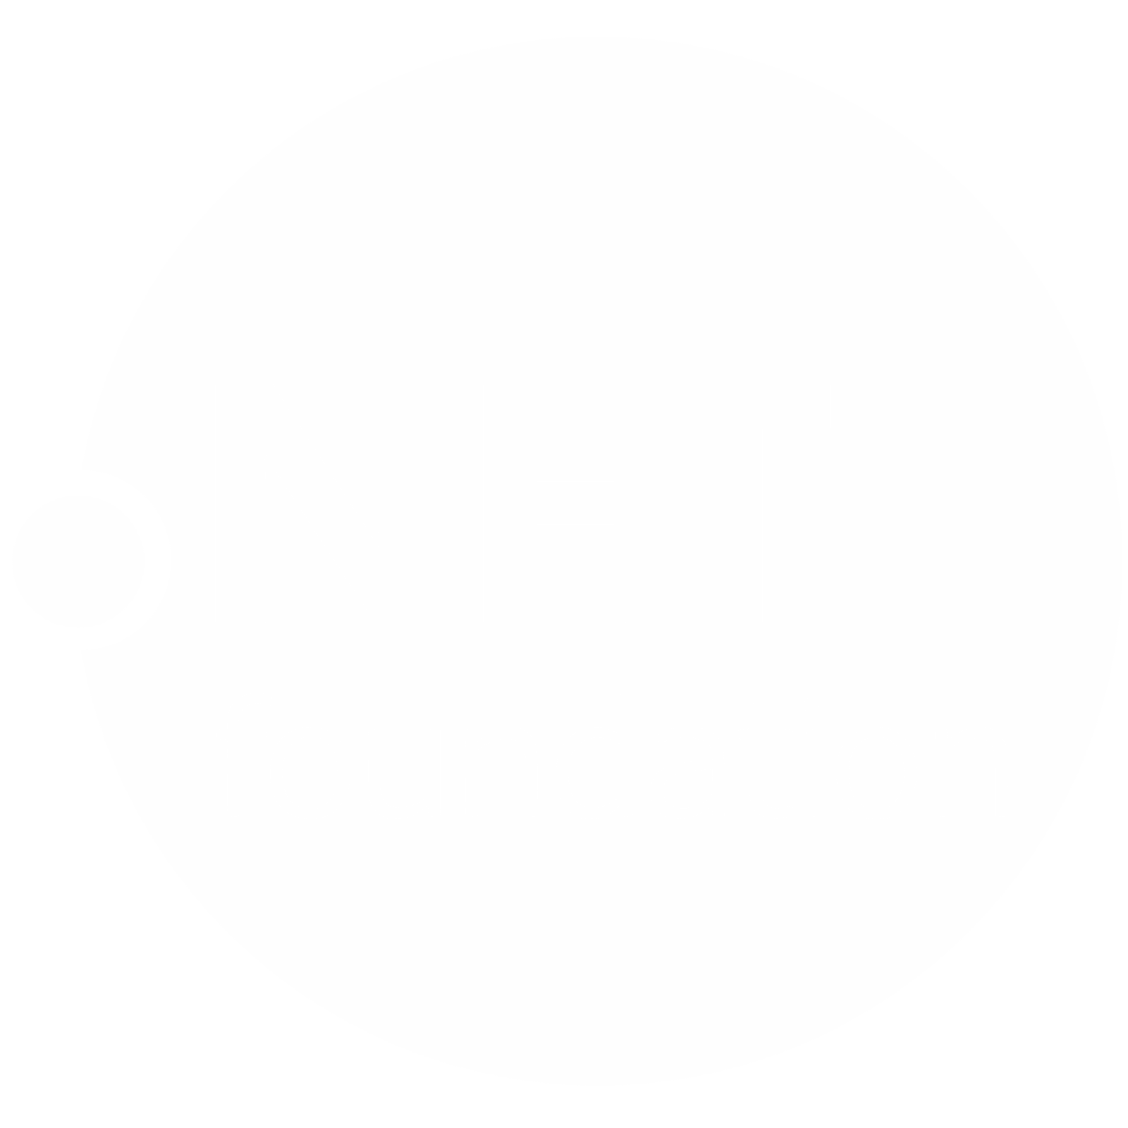
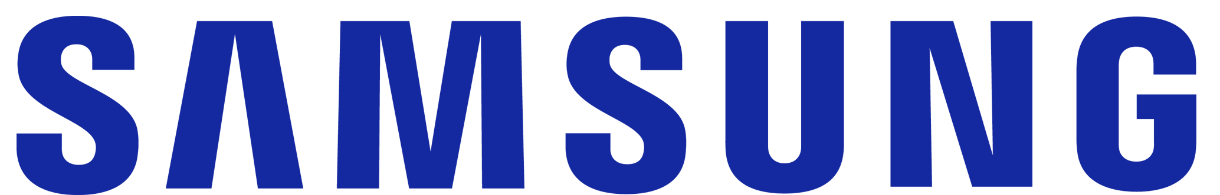

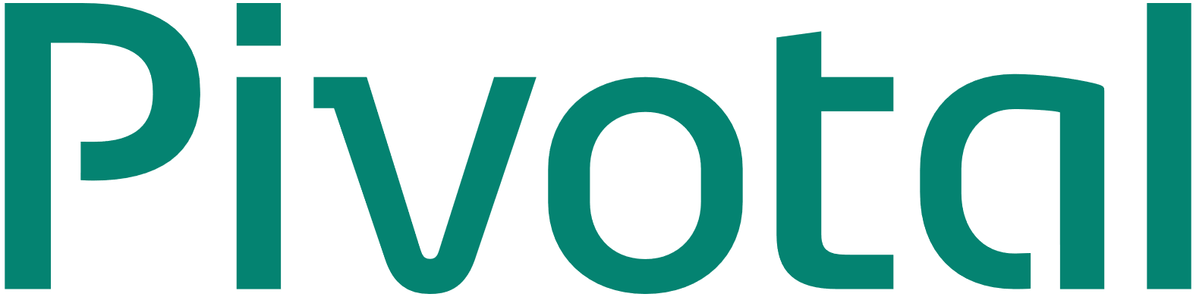

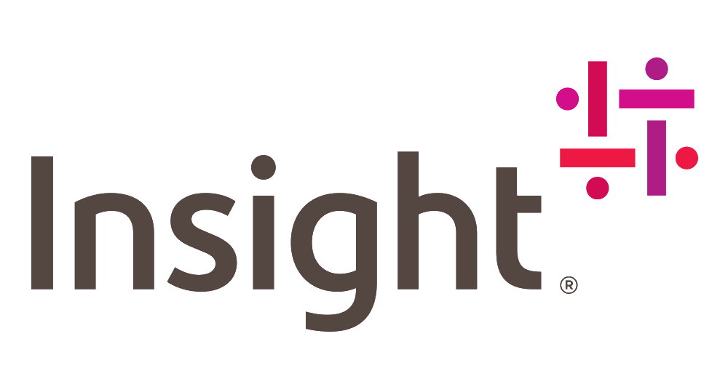

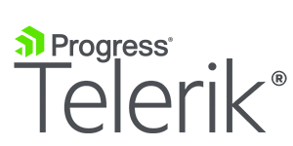

2014
2019
Notes:
The .NET Foundation needed to be an independent organization, but it also needed heavy Microsoft backing so our customers would feel safe. We also wanted to bring in commercial partners to help us modernize the platform. Initially, Samsung and Red Hat joined us in those efforts, and then eventually we expanded these partners to form the technical steering group we have today.

Slide 8
.NET FOUNDATION OFFERINGS / SERVICES
Notes:
What is a community ?

Slide 9

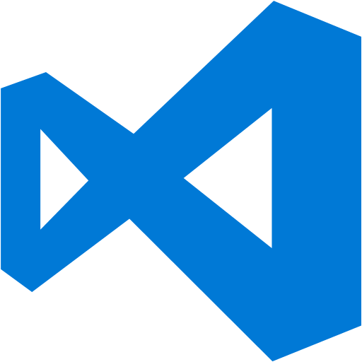

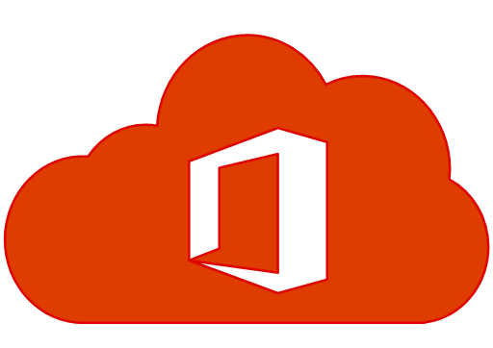
IP / Legal Licensing
Software Licenses
Domain / Certs
Code Signing

Slide 10
SCALING up the EFFORTS
Notes:
Growing up
But there’s still only so much the foundation can do right now. The next step for the .NET Foundation is to scale. At the moment, Microsoft is the only company providing funding for the .NET Foundation and has two of the three board seats. Although one seat out of the three board seats is a community held position, and advisory council and technical steering group consist of strategic non-Microsoft partners, it’s time to go broader and get fresh ideas. It’s time to grow up.
Over the course of Jon’s tenure, we’ve worked to make the vision Martin laid out for an open membership model a reality. This week we announced membership model changes so that the community will directly guide foundation operations.
The Board of Directors will be expanded to 7 members, one seat appointed by Microsoft and the other 6 to open to the wider .NET community
The Board of Directors will be expanded to 7 members, one seat appointed by Microsoft and the other 6 to open to the wider .NET community for people to volunteer for a seat on the Board.

Slide 11
Corporate Sponsors

Slide 12

Open Membership
And Board Election
500+ Members
45 Candidates
Notes:
Growing up
But there’s still only so much the foundation can do right now. The next step for the .NET Foundation is to scale. At the moment, Microsoft is the only company providing funding for the .NET Foundation and has two of the three board seats. Although one seat out of the three board seats is a community held position, and advisory council and technical steering group consist of strategic non-Microsoft partners, it’s time to go broader and get fresh ideas. It’s time to grow up.
Over the course of Jon’s tenure, we’ve worked to make the vision Martin laid out for an open membership model a reality. This week we announced membership model changes so that the community will directly guide foundation operations.
The Board of Directors will be expanded to 7 members, one seat appointed by Microsoft and the other 6 to open to the wider .NET community
The Board of Directors will be expanded to 7 members, one seat appointed by Microsoft and the other 6 to open to the wider .NET community for people to volunteer for a seat on the Board.

Slide 13
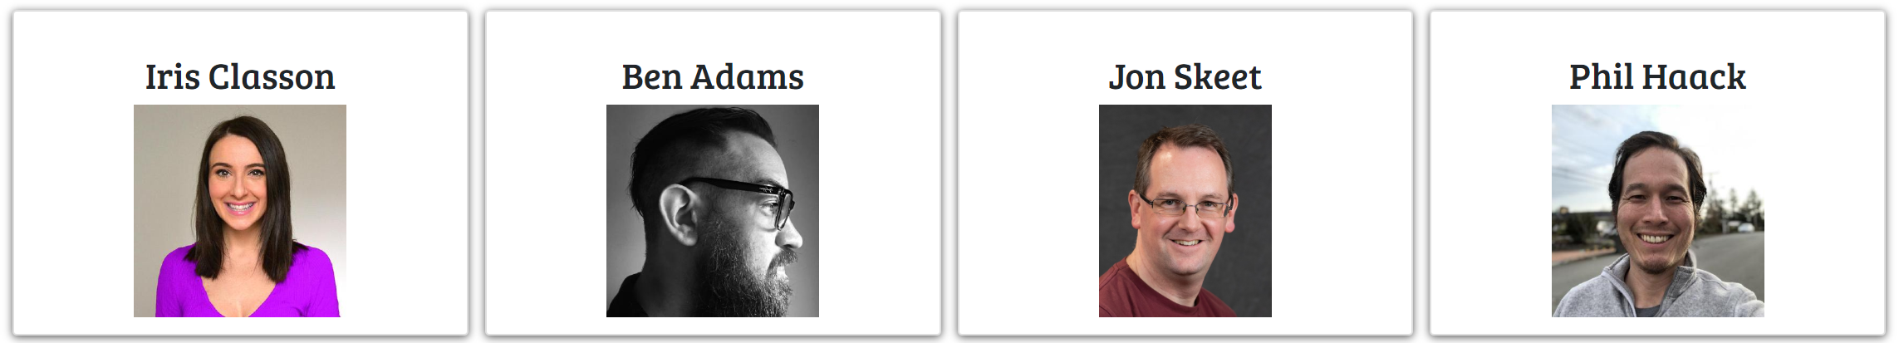
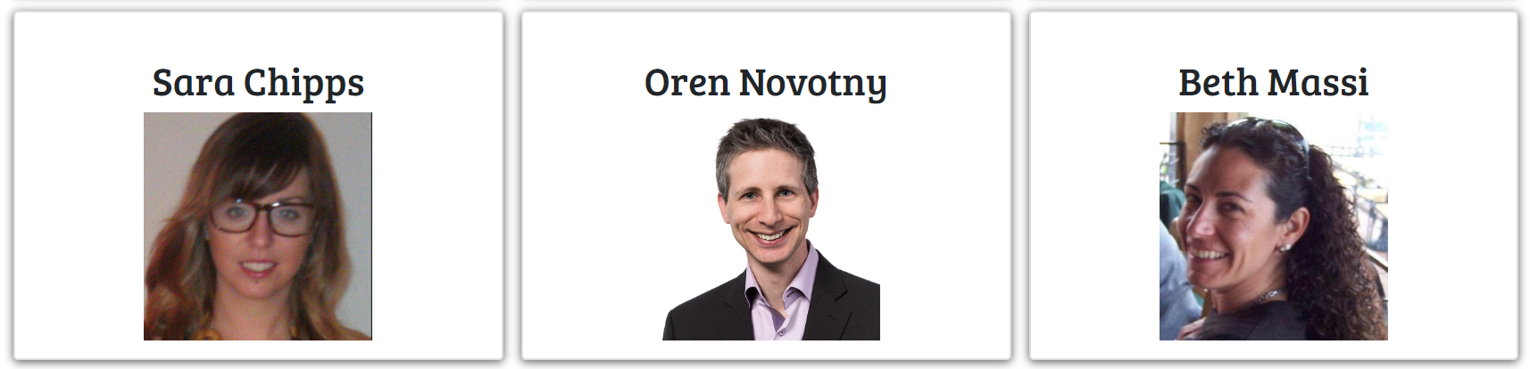
Board 2019 -2020

Slide 14

Action Groups
Project Support
Speaker / Meetups
Outreach
Programs
and few others…

Slide 15
GET INVOLVED

Slide 16
Contribute to Open Source .NET
https://discoverdot.net/
https://up-for-grabs.net/
https://www.firsttimersonly.com/

Slide 17
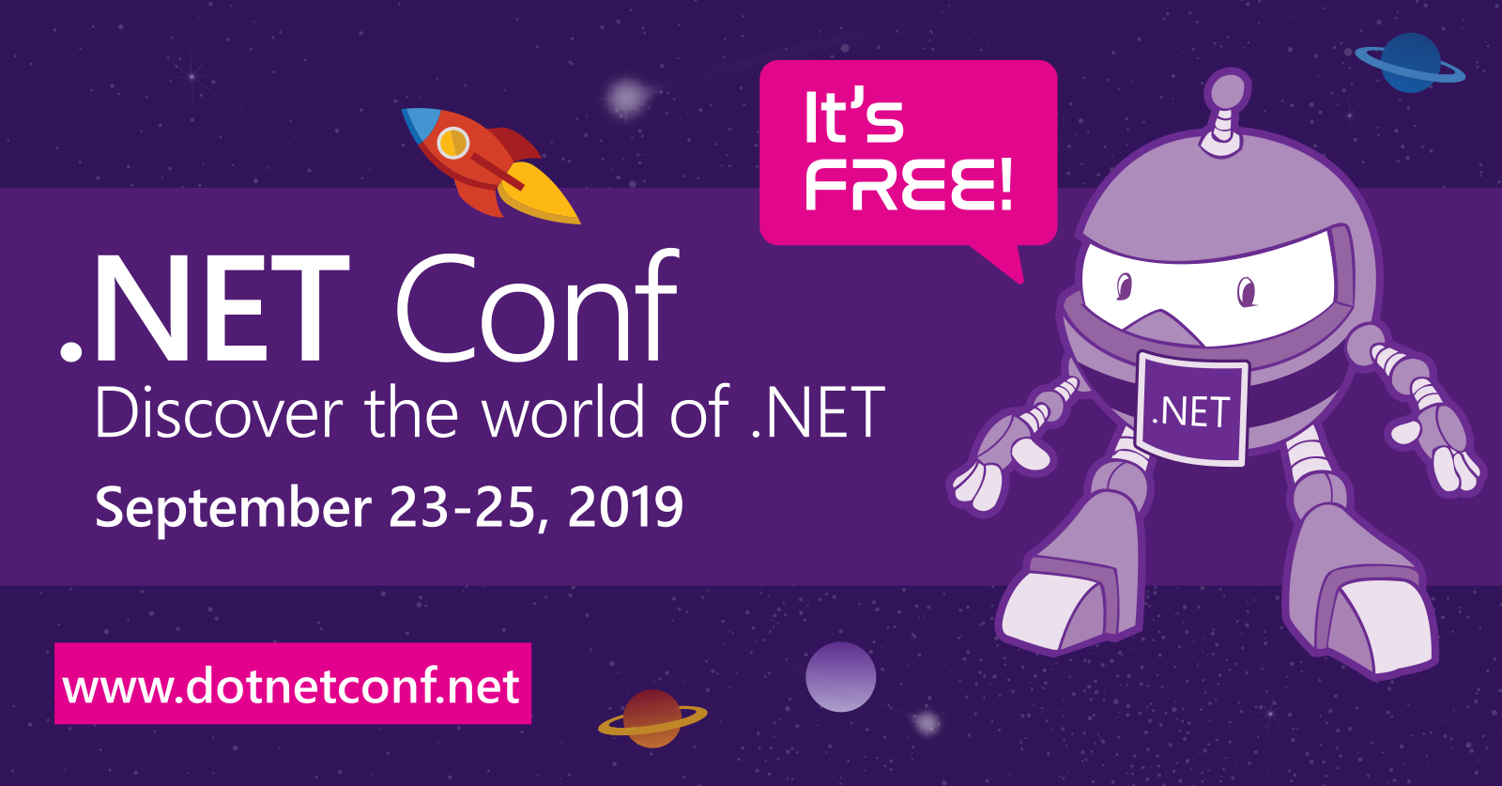
Speak at / Organize meetup & events

Slide 18
https://dotnetfoundation.org

Slide 19
Thank You

