Slide 1
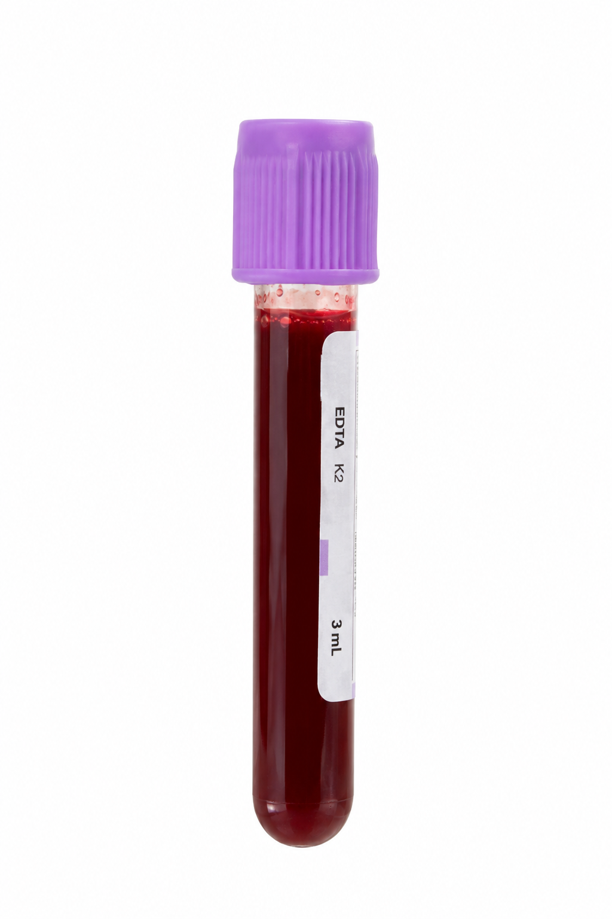
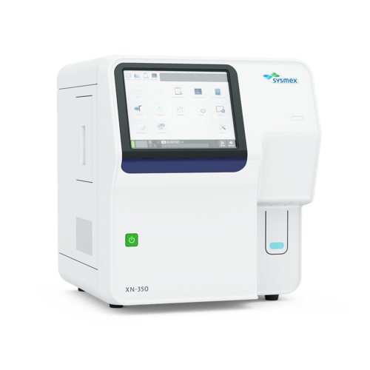
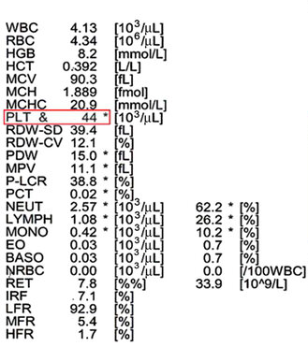


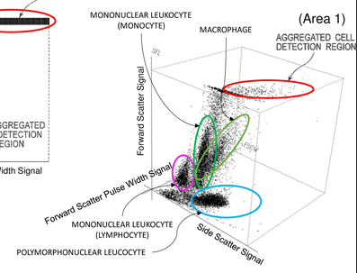

Hidden in every blood count
Analysers measure thousands of individual cells per sample – but only summary averages reach the clinician
TODAY
The gap
Subtle changes in small cell subsets are averaged away
Routine blood count
Summary values only
Clinician sees averages
OUR APPROACH – SAME SAMPLE, ALL OF THE DATA
Detection of disease signatures currently invisible
From a test the NHS already runs every day
Event | SSC | FSC | SFL | FSCW
1 | 60 | 41 | 57 | 105
2 | 167 | 200 | 175 | 189
3 | 100 | 78 | 123 | 101
4 | 111 | 126 | 154 | 98
Machine learning pairing raw cell data with clinical observations
Raw per-cell scatter data
Every cell, every channel

Slide 2



What we did
A proof of concept: can machine learning find a disease signature hidden in raw analyser data?
01
02
03
04
Real Sysmex data
Synthetic cohort
MDS signature
Model training
Existing body-fluid dataset (Ai et al. 2018), run on the same Sysmex analysers used in the NHS
Hundreds of synthetic datasets generated from it, modelling natural biological variation
A myelodysplastic syndrome (MDS) signature added at a range of strengths
Histogram gradient boosting model trained to predict which samples carry the signature
SIGNATURE STRENGTH
KEY QUESTION
How subtle can the signature get and still be detected?
Strong
Subtle

Slide 3
Cell Bench in the Real World
In the context of the 10 Year Health Plan
TODAY
THE OPPORTUNITY
Fragmented
patient data
A single patient record
More connected data could improve models.
Synthetic data could benefit the wider ecosystem
and reduce regulatory friction.
Data sits in separate systems.
CELL BENCH IN PRACTICE
AI hosted locally within each trust
Tailored experiences for clinicians and researchers
Notes:
Source: user-provided draft. Potential benefits of a single patient record and synthetic data are presented as opportunities. Local hosting and distinct clinician/researcher experiences reflect the proposed Cell Bench approach.

