Slide 1

Department of Computer Science and Engineering
(Cyber Security)
PROJECT DOMAIN: Web-Based Smart Energy Management
PROJECT TITLE: WattWise – Smart Energy Companion
ACADEMIC YEAR:2026-27
NAME: PRANATHEE H
REG NO: 241901078

Slide 2
ABOUT THE PROJECT
WattWise – Smart Energy Companion: a web application that helps households and small businesses understand, track and reduce their electricity consumption.
Domain: Smart energy management, ready to analyse and sustainable living.
Why it matters: Rising electricity costs and carbon emissions demand simple, data-driven tools for everyday users.
Approach: Converts raw usage data into clear dashboards, insights and actionable saving tips.
Users: Home owners, tenants, students and small offices.

Slide 3
PROBLEM STATEMENT / OBJECTIVE
Problem: Consumers see only a monthly bill, with no visibility into which appliances or habits drive their energy cost.
Gap: Existing tools are complex, costly or require dedicated hardware.
Objective 1: Provide real-time and historical visualisation of energy usage.
Objective 2: Estimate cost and carbon footprint from consumption.
Objective 3: Deliver personalised tips and alerts to cut wasted energy.
Objective 4: Offer a responsive, easy-to-use interface on any device.

Slide 4
TOOLS, TECHNOLOGIES AND IMPLEMENTATION
□ Frontend: React with Vite, HTML5, CSS3 and JavaScript for a responsive, interactive user interface.
□ Visualisation: Dashboard cards and an energy consumption bar chart to display estimated usage, electricity bills and appliance-wise consumption.
□ Data Layer: Browser LocalStorage to save appliance records and Energy Challenge progress. PHP and MySQL backend components are available for further integration.
□ Logic: Electricity consumption and cost estimation using appliance wattage, quantity, usage hours, number of days and tariff per kWh. Includes usage history and energy-saving recommendations.
□ Tools: Visual Studio Code, Node.js, npm, Git, GitHub and Vercel.
□ Implementation: Requirement analysis → UI design → React component development → calculation logic → local data storage → testing → deployment.

Slide 5
PROJECT OUTCOME
□ Working prototype of WattWise as a responsive web application for estimating household electricity consumption and cost.
□ Interactive dashboard displaying total estimated energy usage, electricity bill, tracked appliances and potential savings.
□ Appliance calculator that estimates energy consumption based on wattage, quantity, usage hours, days and electricity tariff.
□ Usage history, energy-saving tips and an interactive Energy Challenge to encourage energy awareness.
□ Future scope: Secure user authentication with PHP and MySQL, individual user data storage, detailed usage reports and smart-meter integration.

Slide 6
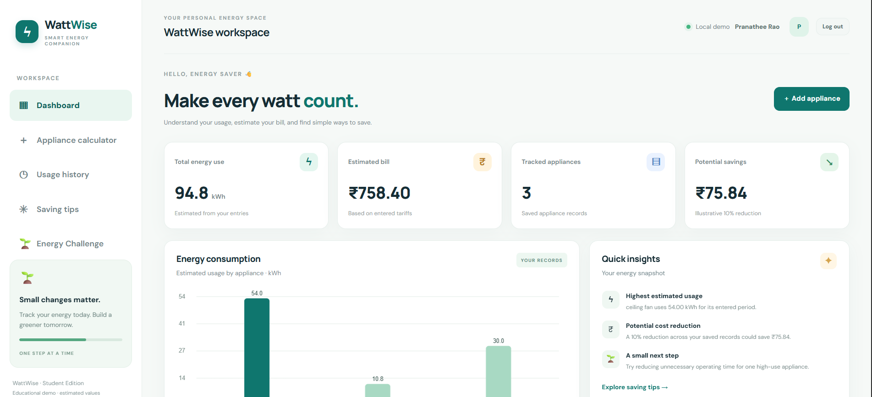
PROJECT OUTPUT

