Slide 1
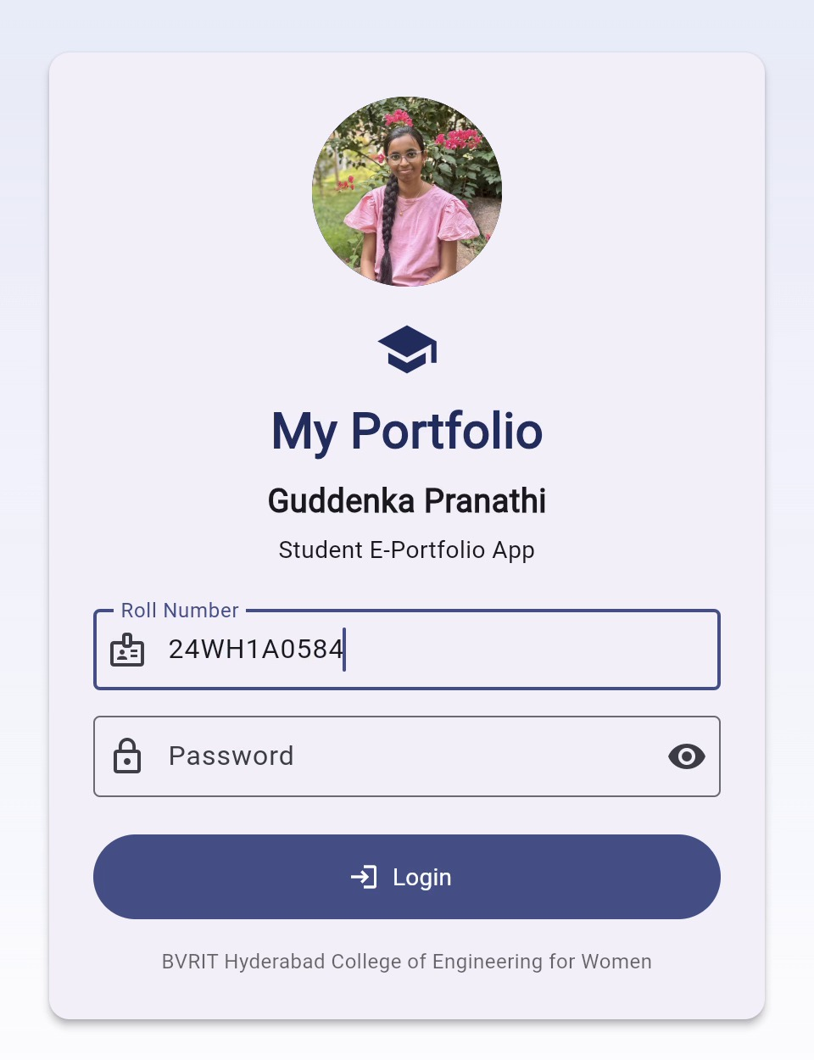
Student E-Portfolio Application
A Flutter-Based Student Portfolio
G. Pranathi
Roll No. 24WH1A0584
BVRIT Hyderabad College of Engineering for Women
Notes:
Good morning. This is my project, the Student E-Portfolio Application, built with Flutter. The screen on the right is the login screen of my running application.

Slide 2
Introduction
A student e-portfolio is a digital record of a student's learning journey: marks, skills, certificates and projects, kept in one place.
This application presents that information in a single organized interface. After logging in, a bottom navigation bar lets the viewer move between academic details, certifications, activities, achievements and projects.
Student E-Portfolio
Academic Details
Course Certifications
Activities
Achievements
Projects
Notes:
An e-portfolio is simply a digital collection of a student's work and records. My app brings five sections together so that anyone reviewing it does not have to open separate files.

Slide 3
Problem Statement and Objectives
The problem
Objectives
A student's information is usually scattered across mark sheets, certificate files, documents and separate project links. Reviewing it all takes time and is easy to get wrong.
Organize student information in one place.
1
Make academic and technical details easy to review.
2
Present achievements and projects clearly.
Mark sheets
Certificates
3
Documents
Project links
Provide straightforward navigation between portfolio sections.
4
Notes:
The problem is simple: my records are in many places. The four objectives on the right are what I wanted this app to achieve.

Slide 4
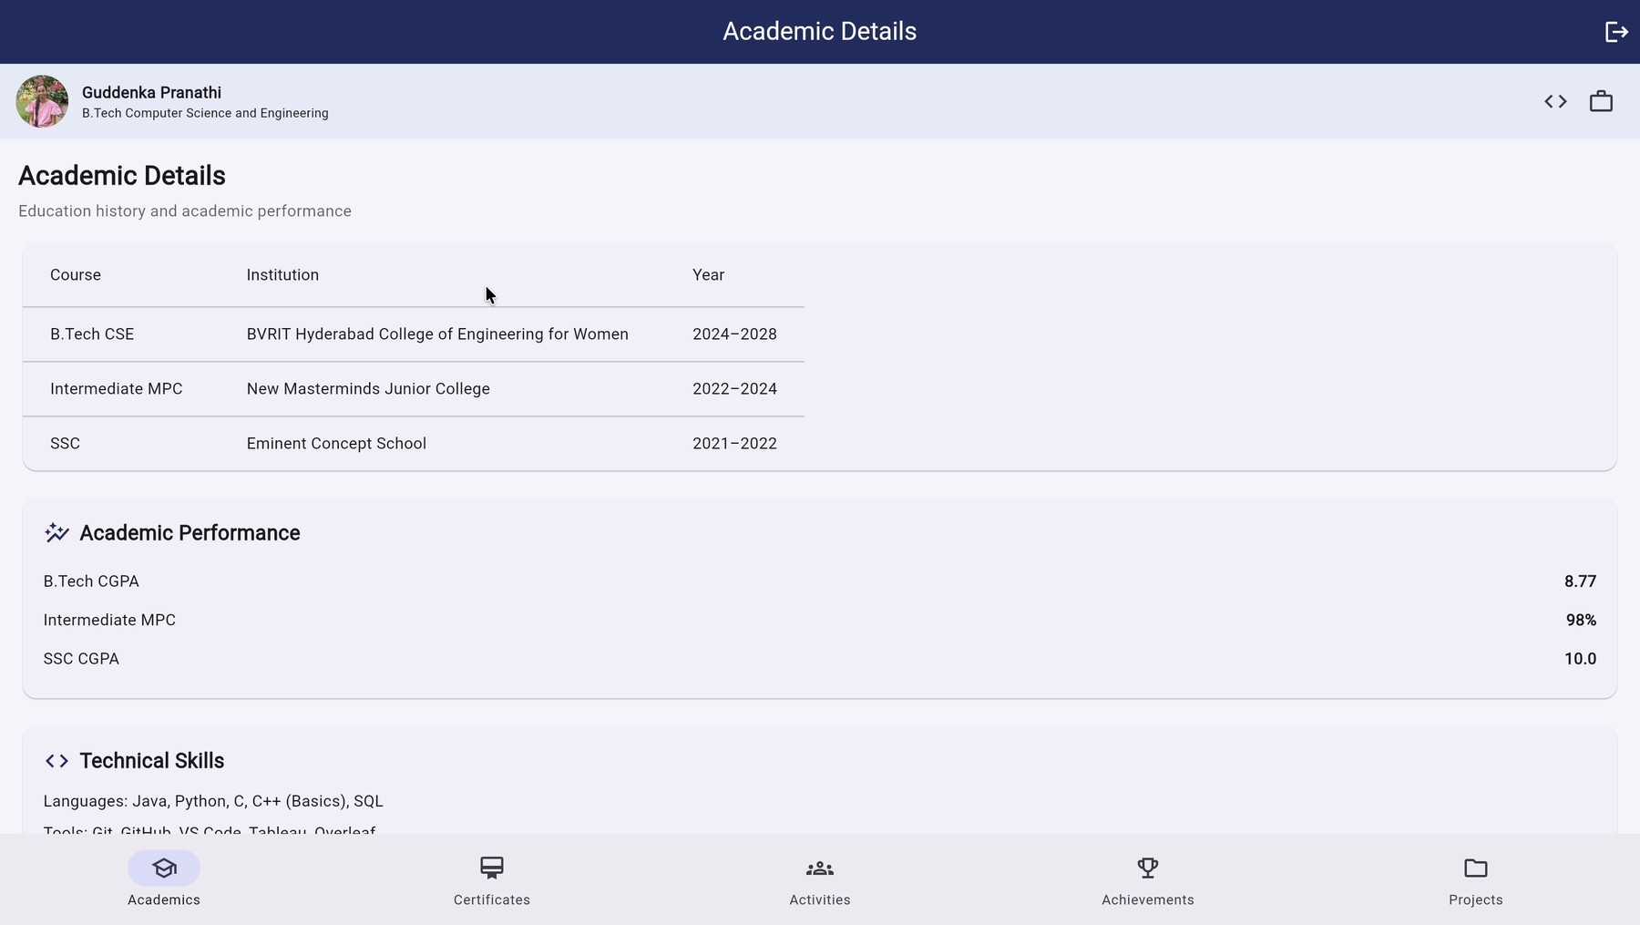
Main Features
Login
Roll number and password screen
Academic Details
Education, results and skills
Course Certifications
Course list with View action
Activities
Mentorship and technical events
Achievements
Highlights in a slide carousel
Landing page after login, with the bottom navigation bar
Projects
Projects with GitHub and report links
Each section has its own page, so information stays organized and easy to find.
Notes:
These are the six parts of the app. The login screen simply asks for a roll number and password before showing the portfolio. The other five sections are reached through the bottom navigation bar.

Slide 5
Technology Stack
Flutter
Dart
Visual Studio Code
UI framework used to build all screens with widgets.
Programming language in which the app logic is written.
Development environment used to write and run the code.
Chrome / Flutter Web
url_launcher
Assets
The app runs in the browser (localhost) for testing and demo.
Opens external links such as GitHub and project reports.
Local files such as the profile image and certificate files.
Notes:
Flutter and Dart build the app. I wrote the code in VS Code and tested it in Chrome as a Flutter web app. url_launcher opens the GitHub and report links, and the assets folder holds my photo and certificate files.

Slide 6
Development Process and Workflow
1
2
3
4
5
Identify
Organize
Build
Connect
Run & Review
Decide the portfolio sections needed
Collect and arrange the student information
Create the interface with Flutter widgets
Add navigation, content and relevant links
Run the app and check the output
Notes:
I followed five simple steps, from deciding the sections to running the app and reviewing the output.

Slide 7
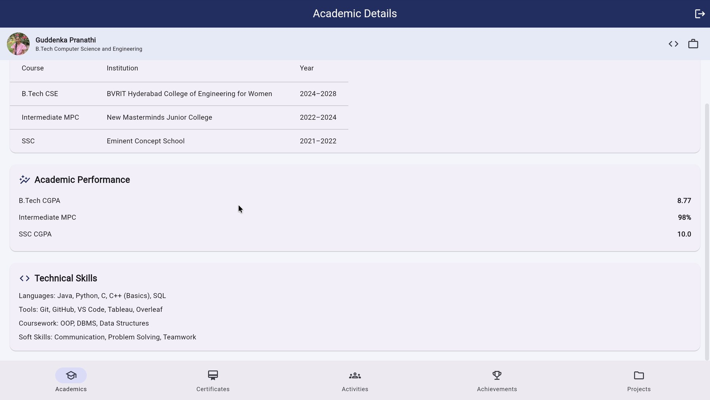
Output Screen: Academic Details
Education history
B.Tech CSE (2024–2028), Intermediate MPC, SSC
Academic performance
B.Tech CGPA 8.77, Intermediate 98%, SSC CGPA 10.0
Technical skills
Languages, tools, coursework and soft skills
Academic Details page: education, performance and technical skills
Notes:
This page shows my education history in a table, my results, and my technical skills: languages like Java, Python, C, C++ and SQL, and tools like Git, GitHub, VS Code, Tableau and Overleaf.

Slide 8
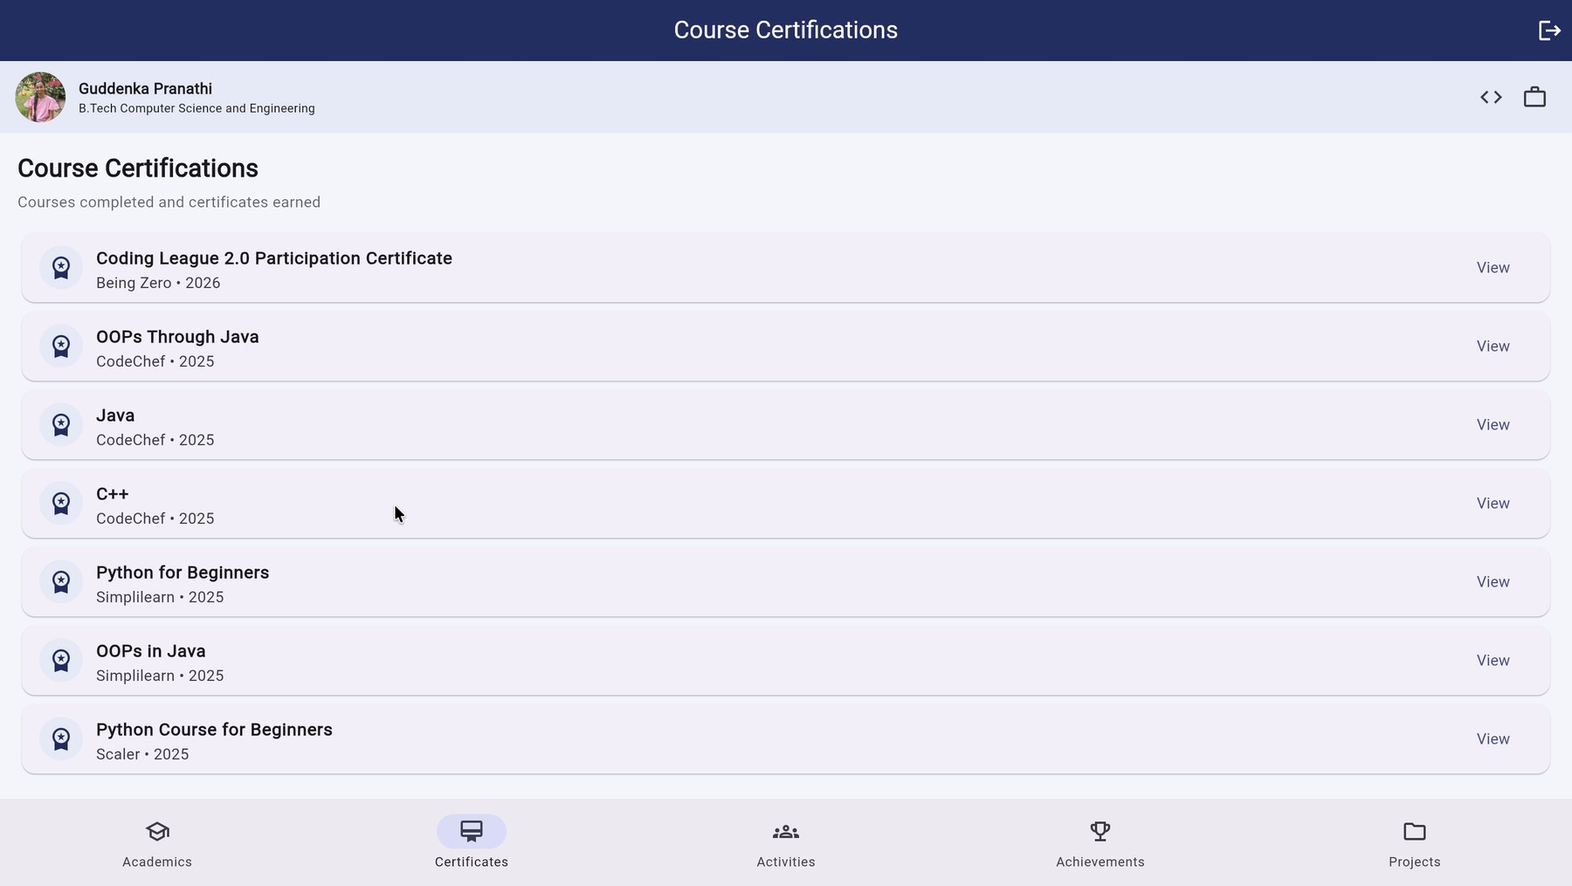
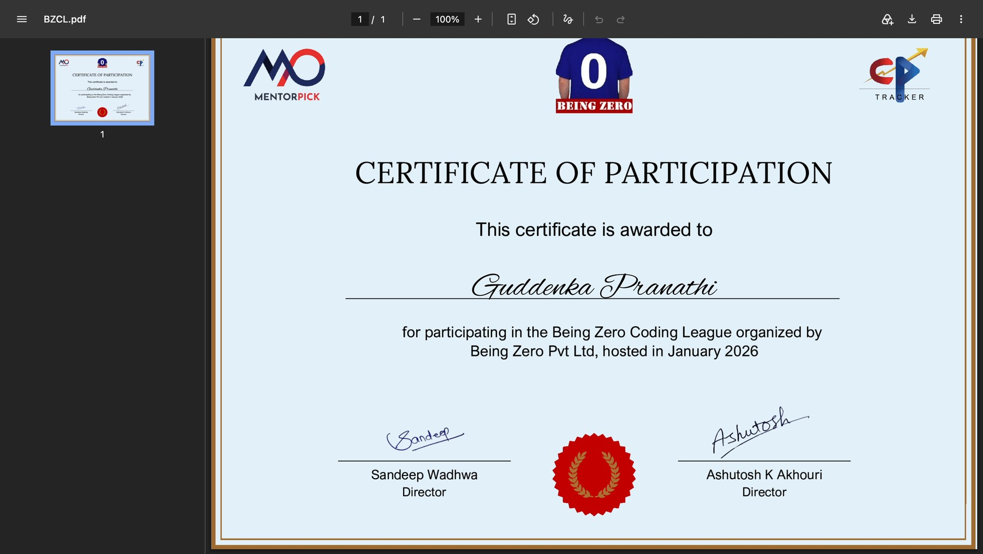
Output Screen: Course Certifications
Seven course entries with provider, year and a View action
View opens the certificate file in a new browser tab
Each entry shows the course name, the provider (Being Zero, CodeChef, Simplilearn, Scaler) and the year, so certificates can be checked quickly without searching through files.
Notes:
Every row is one course or certificate. When I tap View, the actual certificate opens in a new tab. Here it is the Being Zero Coding League participation certificate.

Slide 9
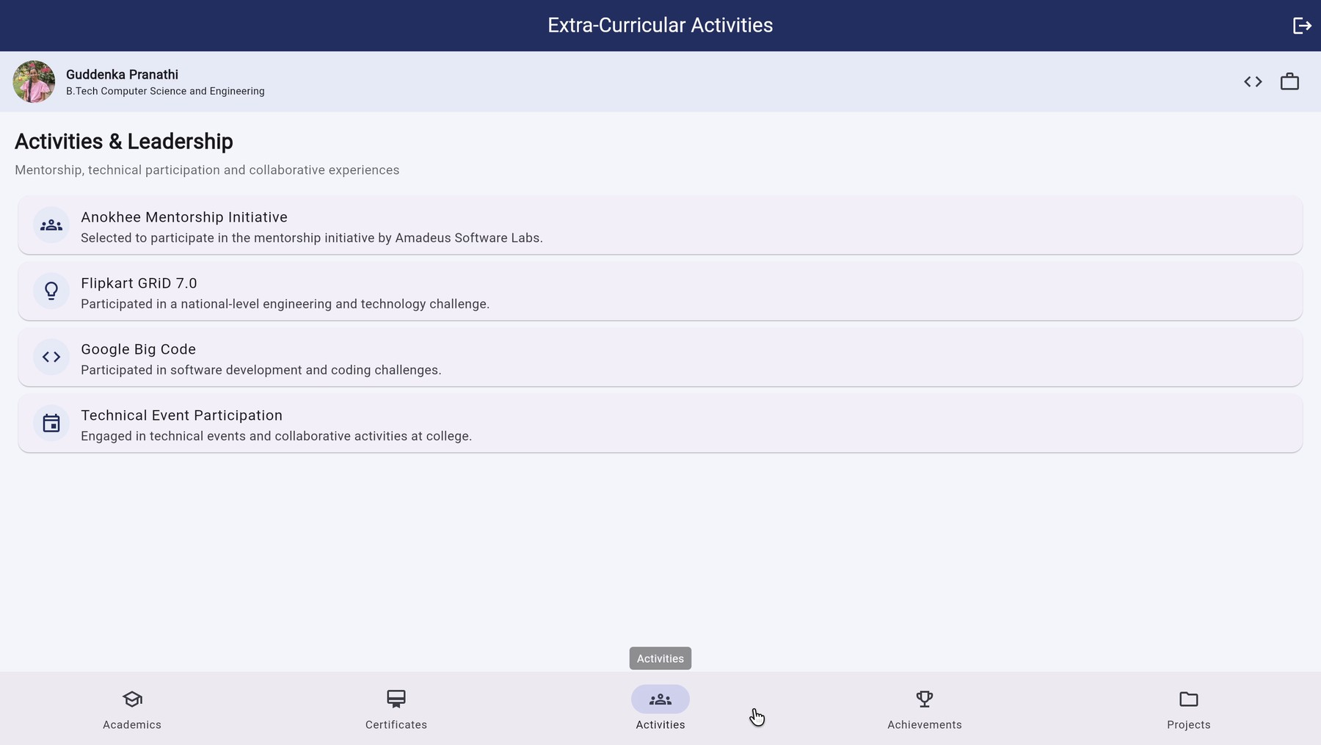
Output Screen: Activities
Activities & Leadership
Anokhee Mentorship Initiative
Flipkart GRiD 7.0
Google Big Code
Technical Event Participation
This section shows mentorship, competitions and technical events, going beyond marks and certificates.
Activities page with a short description for each entry
Notes:
The app lists four activities, each with a one-line description. These show what I did outside the classroom.

Slide 10
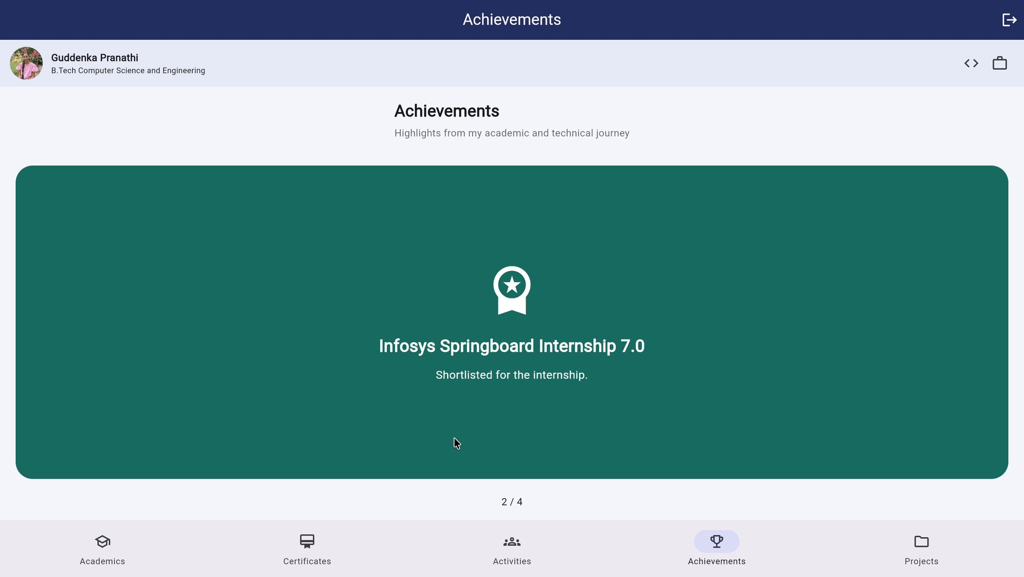
Output Screen: Achievements
Achievement cards (1 to 4)
Flag Quest: 2nd Place
Technical event at Synergia, BVRIT Hyderabad
Infosys Springboard Internship 7.0
Shortlisted for the internship
Anokhee Mentorship
Selected for the Amadeus Software Labs initiative
Achievements carousel, showing card 2 of 4
500+ Coding Problems
Solved across competitive programming platforms
Each highlight appears as a large colored card that the viewer slides through.
Notes:
The achievements page is a slideshow. There are four cards: Flag Quest second place, Infosys Springboard Internship shortlisting, Anokhee Mentorship selection, and over 500 coding problems solved.

Slide 11
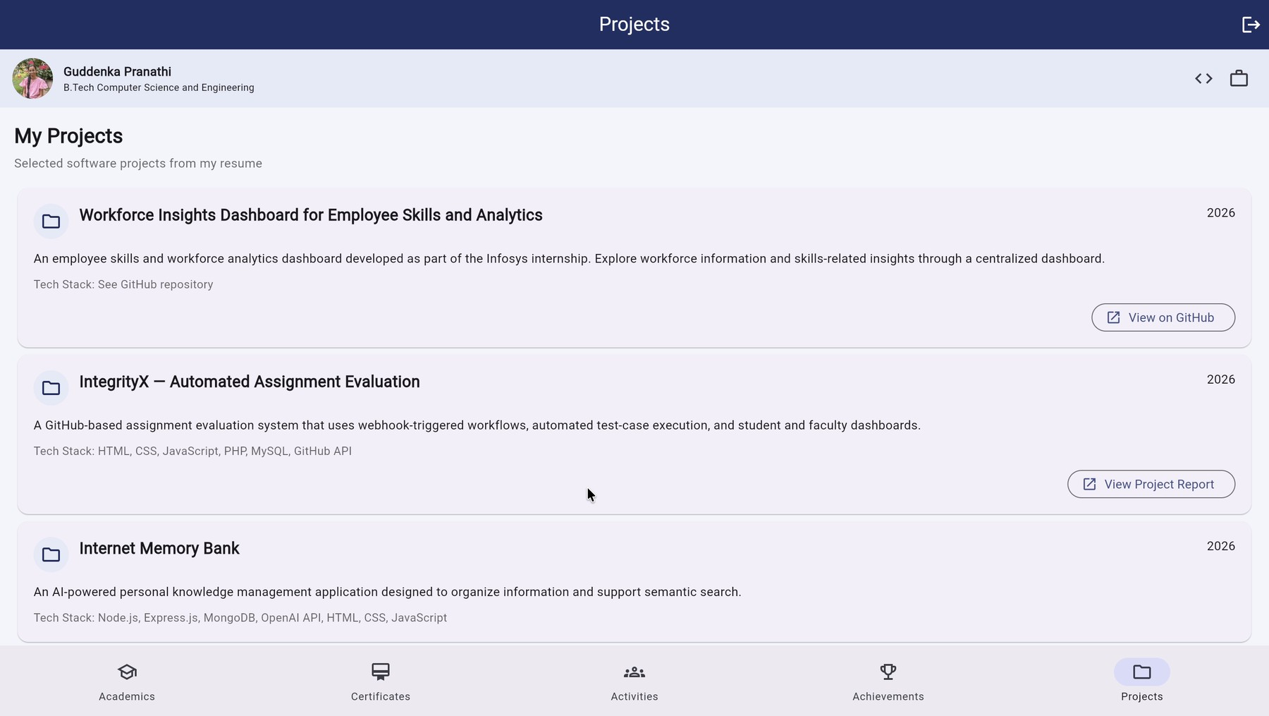
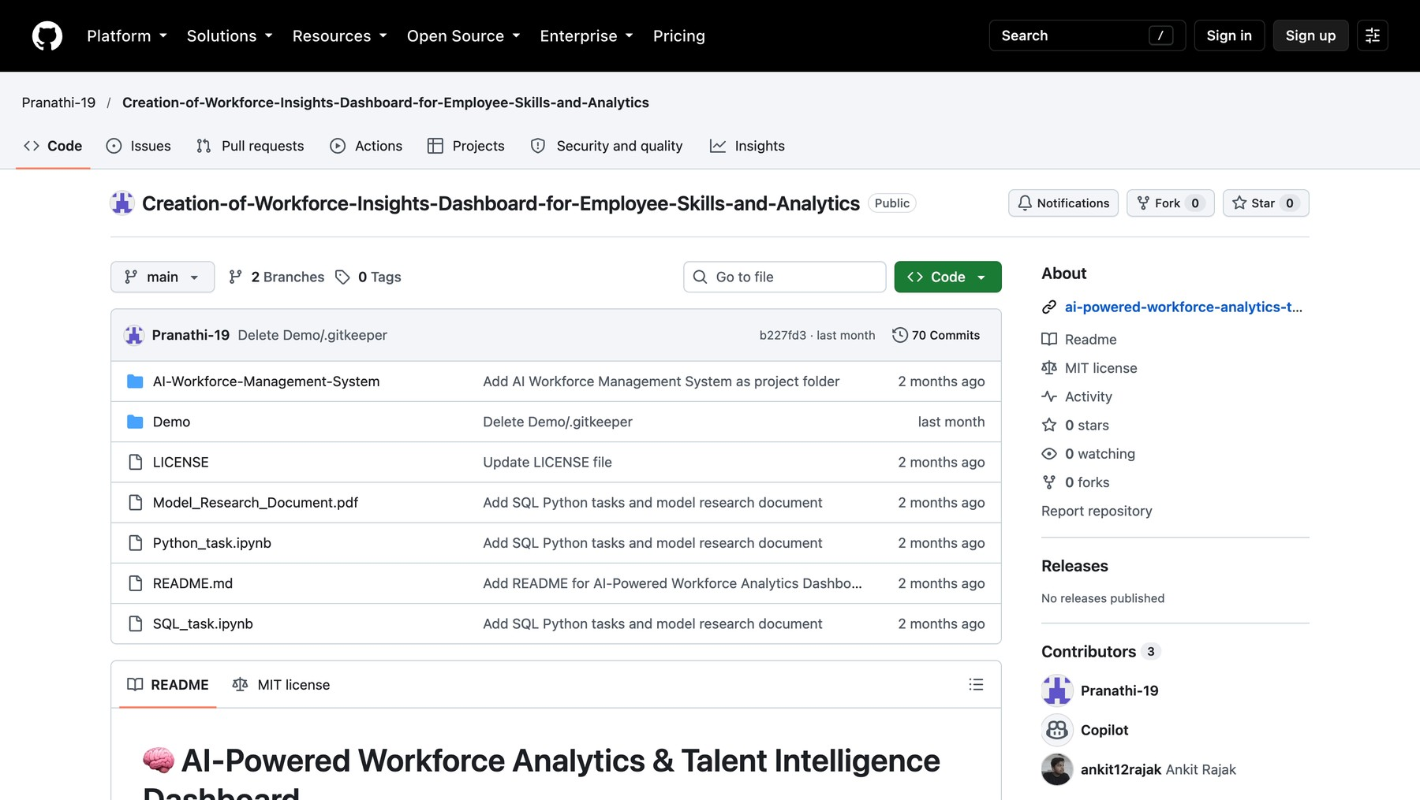
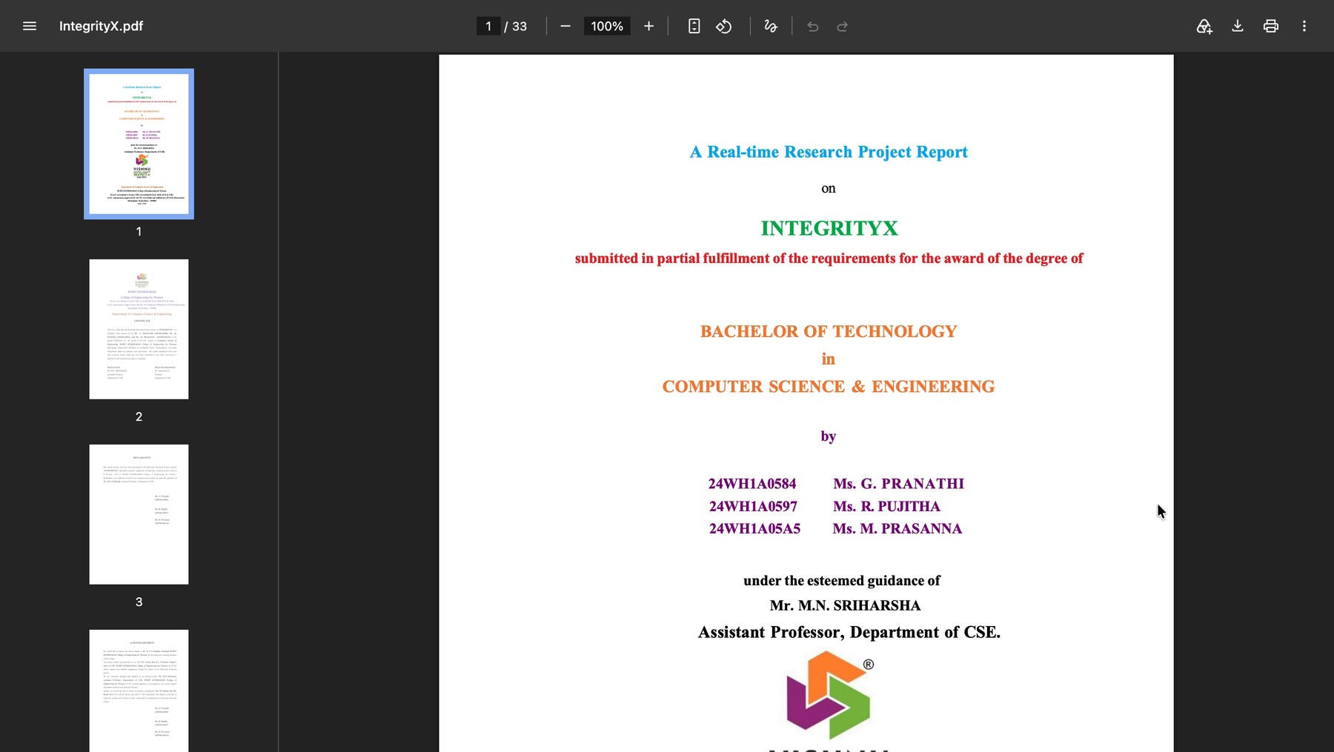
Output Screen: Projects
View on GitHub opens the repository
Projects page with GitHub and report buttons
Workforce Insights Dashboard: employee skills and analytics
IntegrityX: GitHub-based programming assignment evaluation
Internet Memory Bank: Node.js, Express, MongoDB, OpenAI API
View Project Report opens the report
Notes:
These three projects are showcased by the portfolio; they are not built inside it. View on GitHub opens the Workforce Insights repository, and View Project Report opens the IntegrityX report PDF.

Slide 12
Thank You!
G. Pranathi
Roll No. 24WH1A0584

