Slide 1
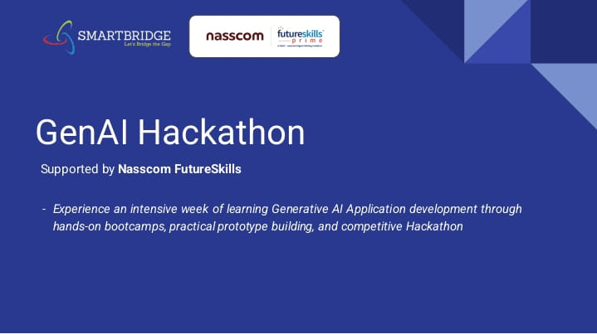

Slide 2
DATA QUERY AI
Batch Name: Pioneer
Presented by:
L. Pranathi
B. Shivani
B.Kavya
G. Saranya

Slide 3
INTRODUCTION TO DATAQUERY AI
Data Query AI refers to the use of artificial intelligence models to analyze and interpret datasets based on user queries. By leveraging natural language processing (NLP) and machine learning, AI can process structured data, extract insights, and generate meaningful responses. This allows users to interact with their data using simple language instead of complex SQL or manual analysis. AI-powered data querying is widely used in business intelligence, research, and automation to enhance decision-making and data accessibility.

Slide 4
PROBLEM STATEMENT
DataQueryAI is to simplify data querying by enabling users to ask questions in natural language, automatically uncover insights from data.
provide real-time, visual, and secure access to information.
It aims to integrate data from various sources, making it easy for users of all skill levels to analyze. Additionally.
it leverages AI for advanced analytics and predictions.

Slide 5
PROPOSED SOLUTION
Install pandas and pipline from transformers and import required modules
Upload a CSV file in google collab ,read into a Data frame and display a preview
Generate hugging phase API keys and paste on google collab.
Take user input as a query ,generate a response.

Slide 6
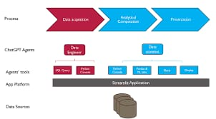
REQUIREMENTS
Programming language: Python
Backend: Pandas, pipeline from transformers
Frontend: Google Collab
Database: Google Big query

Slide 7
EXPECTED OUTCOME
Enhanced user experience
Better decision making
Increased data accessibility

Slide 8
CONCLUSION
DataQueryAI holds great promise in transforming how we interact with data. The expected outcomes, such as enhanced user experience, increased efficiency, improved accuracy, and better decision-making, highlight its potential to revolutionize data management across various sectors. As the technology continues to evolve, it will likely become an indispensable tool for businesses and individuals seeking to leverage data effectively. Overall, DataQueryAI represents a significant step towards making data more user-friendly and actionable.

Slide 9
THANK YOU

