Slide 1
‘HANDY WEATHER STATION’
TEAM MEMBERS :
NAME | PIN NUMBER | YEAR
PRANATHI MANDAVA | 19L61A0528 | 4-2
B HIMJA RAMANI | 19L61A0529 | 4-2
U LAVANYA | 19L61A0534 | 4-2
K PRASANTH | 19L61A0532 | 4-2
U SAI JAGADEESH | 19L61A0539 | 4-2
AKHIL | 17L61A0507 | 4-2
TEAM LEADER:
PRANATHI MANDAVA
GUIDED BY:
Dr. CH PAVAN SATISH Ph.D

Slide 2
PROBLEM STATEMENT IS CHOSEN FROM HACTHON PROBLEM STATEMENTS
PROBLEM STATEMENT-ID : PH23-SW/HW-120
PROBLEM STATEMENT: Develop a handy weather station which can measure temperature, humidity, pressure, wind speed and other parameters. (The device should be able to send data remotely over the internet using GSM or WiFi with battery backup as optional. The device should be recharged via solar panel as an option. The device should also be able to withstand harsh weather conditions and should be portable.)

Slide 3
CONTENTS
ABSTRACT
EXISTING MODELS
DRAWBACKS IN EXISTING MODEL
SOLUTION AND PROPOSED IDEA
TECHNICAL STACK
CONCLUSION
USECASE OF PROPOSED SYSTEM

Slide 4
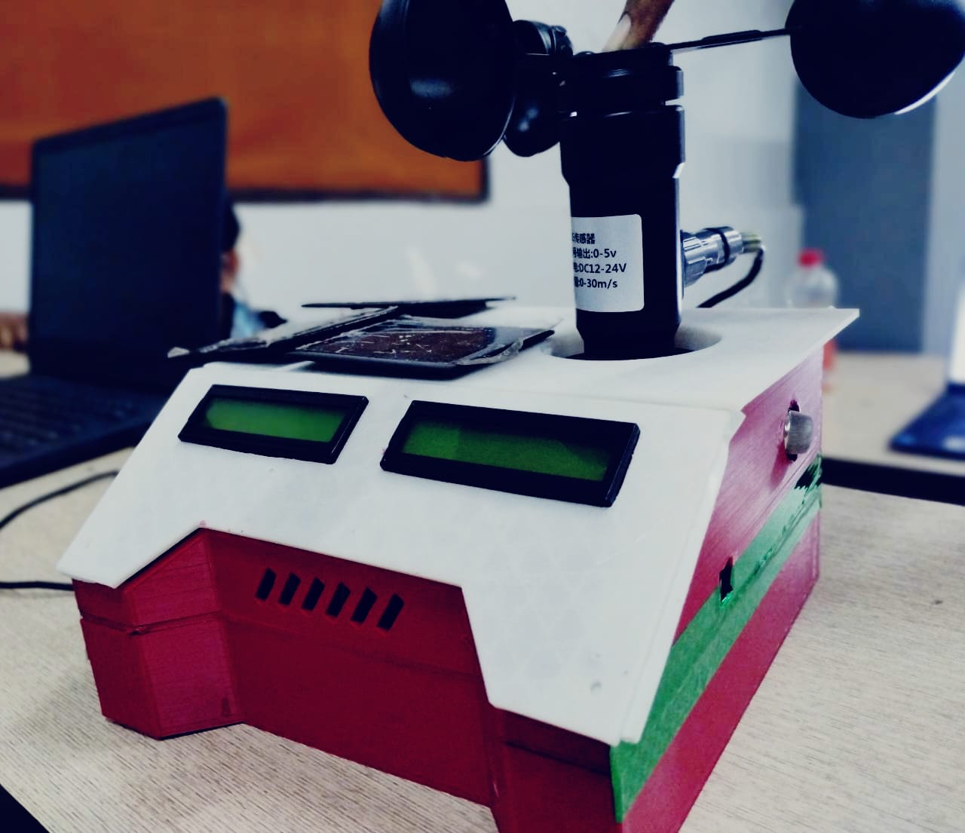
ABSTRACT
A Handy Weather Station is a device that measures various meteorological parameters such as temperature, humidity, pressure, wind speed.
These measurements can be displayed on a digital screen or sent wirelessly to a computer or smartphone for analysis and forecasting.
A solar-based Handy Weather Station is a type of weather station that uses solar energy to power its sensors and electronic components.
This WILL BE A BENEFICIARY for the station to be placed in remote locations where access to electricity may be limited.
It's important to note that the accuracy and reliability of a solar-based Handy Weather Station will depend on the quality of the sensors and electronic components used as well as the solar panel's ability to provide sufficient power to the station.

Slide 5
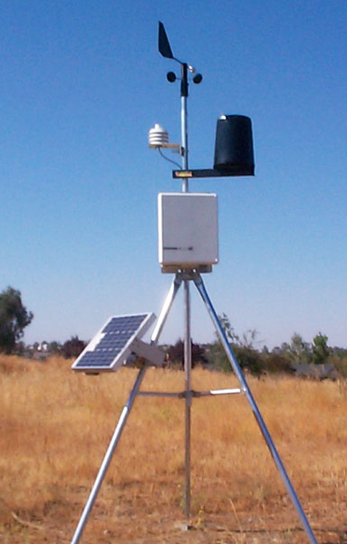
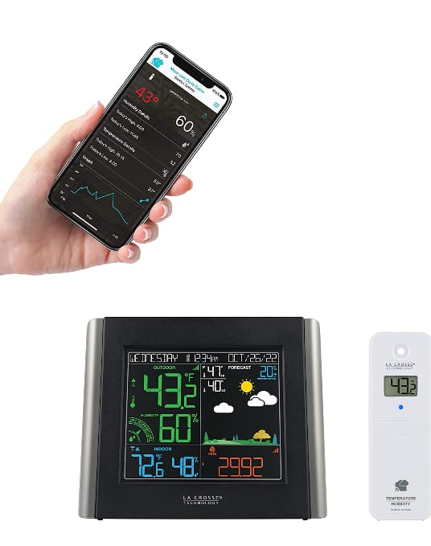
EXIsTING MODELS
WHAT IS A WEATHER STATION?
WHAT IS A HANDY WEATHER STATION?
It is a device or station that sense or study the weather/atmospheric conditions and helps in the process of weather forecasting and weather estimation.
A ‘Handy Weather Station’ is also same as regular weather station but when we compare we face few pros and cons between them such as PORTABILITY, ACCESSIBILITY, etc.

Slide 6
DRAWBACKS IN EXISTING MODELS
DURABILITY -
In robust environment conditions the system/device fails.
ACCESSIBILITY -
In the aspect of information transmission many designs are with wi-fi connection oriented so in few areas wi-fi is not possible.

Slide 7
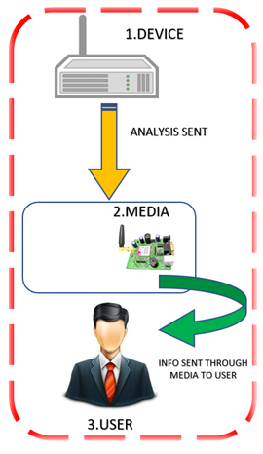
SOLUTION AND PROPOSED IDEA
A Handy Weather Station is a device that measures various weather parameters such as temperature, humidity, pressure, wind speed using respective sensors.
We mainly concentrated on the drawbacks of existing system and designed with
All the captured or measured data is given by device as output. The output is also displayed on LCD display module of device and also through message to respective mobile number using GSM module or through Wi-Fi module if available.
This is a Solar based weather station the solar energy is charge the lithium-ion rechargeable batteries so that the device can stand by with out any external power source
ADVANTAGES:
PORTABLITY - Can be moved easily.
DURABILITY - Capable in all outdoor conditions.
SOURCE OF POWER - Station can stand by solar as well as with battery.

Slide 8
TECHNICAL STACK
HARDWARE
SOFTWARE
SOLAR PANELS & LI-ION BATTERIES
DHT11 SENSOR
BMP280 SENSOR
ANEMOMETER
ARDUINO UNO
GSM MODULE 900A
DISPLAY MODULE
ARDUINO IDE
It is common Arduino web editor for all Arduino boards
It is a integral development program/programming.

Slide 9
Real-time usage OF PROPOSED SOLUTION
INDUSTRY:
Many industries are using weather monitoring systems for monitoring every sector temperature, humidity etc [power-plants].. Because they having requirement of ensuring the room temperature conditions to keep the machinery space safe.
R&D:
The Research & development people use this device to monitor specific region where they are going to research and get resulted with accuracy.
AGRICULTURE: The data given from this device is used for farmers to know the weather conditions to protect the crops from harsh conditions and soil moisture farming fields, this help farmers to optimize their work.

Slide 10
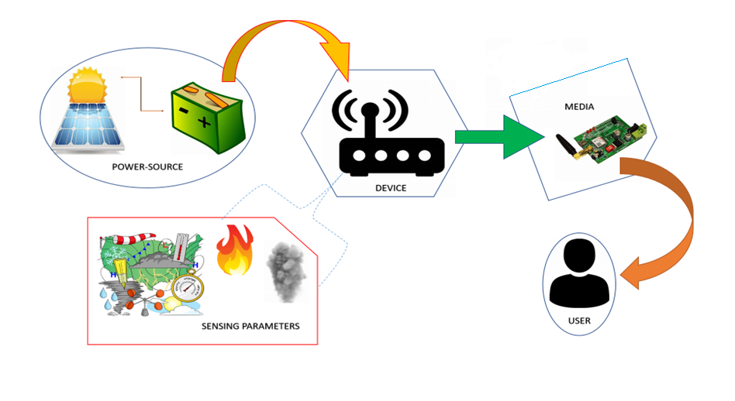
Working function OF PROPOSED SYSTEM
3
4
1
2
5

Slide 11
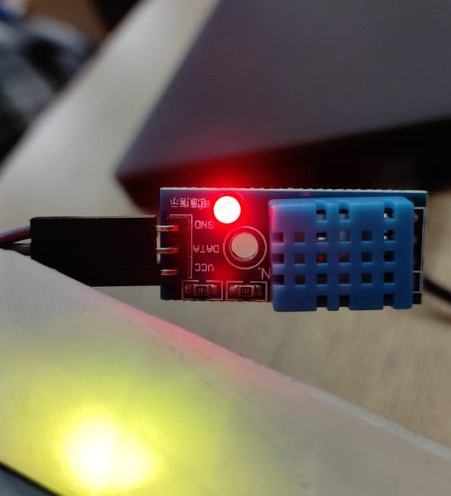
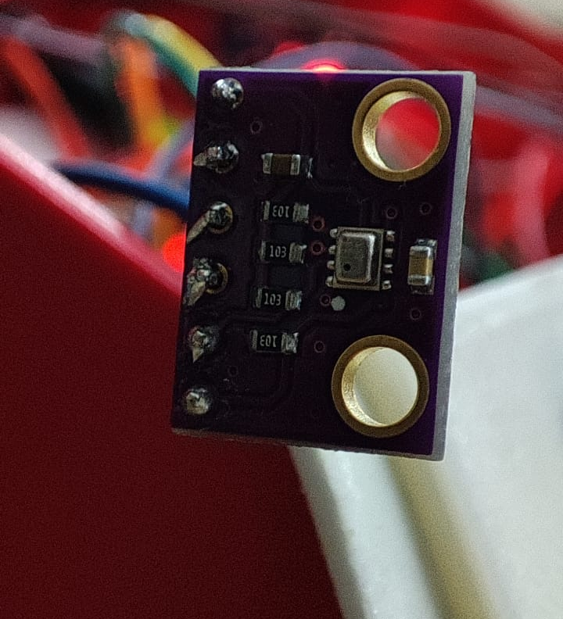
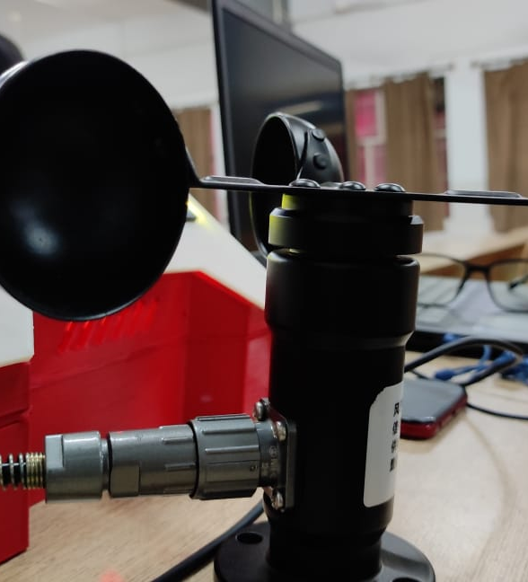
INPUT
DHT-11
BMP-280
ANEMOMETER

Slide 12
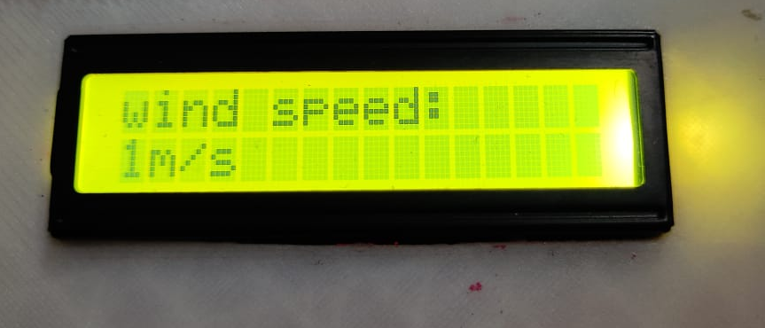
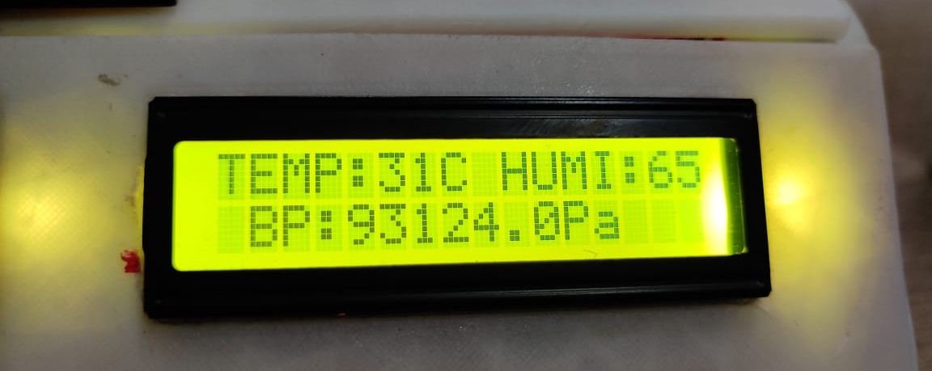
OUTPUT

Slide 13
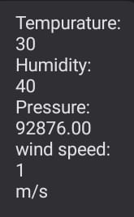
GSM OUTPUT

Slide 14
Main dependencies of proposed IDEA
1.SOURCE OF POWER :
In this proposed system we use solar energy to charge the rechargeable lithium ion battery.
2.SENSORS :
All the weather parameters are detected by using respective sensors, in this system all the sensors are highly efficient in working on perspective parameter.
3.MEDIA :
Here the media is for transferring captured data from device to respective user using GSM module.
4.MICRO-CONTROLLER :
The Arduino uno microcontroller board is used for all the sensors and modules to manage every component involved in device.

Slide 15
CONCLUSION
The handy weather station is designed for the beneficiary for sensing all parameters and risky factors in both indoor and outdoor areas.
All the drawbacks of existing system are underwent by using this.
The sensors of each parameter is highly fit for robust conditions.
The entire station is effective than existing system.

Slide 16
THANK YOU

