Slide 1
23CSE452 BUSINESS ANALYTICS
Weather-Aware Taxi Demand Prediction and Forecasting in New York City
Final Project Presentation
Team number - 12
Roll No | Name
CB.SC.U4CSE23102 | Adithya Ajay
CB.SC.U4CSE23105 | Amrith B
CB.SC.U4CSE23406 | Arun N
CB.SC.U4CSE23441 | SADHANA T P
CB.SC.U4CSE23643 | Pranathi Nibhanipudi
Guide / Faculty - Ms. Rohini S
18/10/2026
01
Notes:
Suggested time: 20 seconds. Replace bracketed prompts with your project evidence. Present actual results only. Target 15 minutes including the live demonstration. Cover the whole project. Review 2 assessment primarily focuses on two Unit 3 methods.

Slide 2
PROJECT OVERVIEW
Business problem and objectives
Business problem:
Who: NYC taxi fleet operators and dispatchers.
Problem: Large demand variations across zones, hours, and weather conditions cause vehicle shortages in busy areas and idle taxis in slow areas.
Objectives:
Forecast zone-level hourly demand across 24-hour and weekly horizons by capturing recurring daily cycles, weekly patterns, and localized pickup trends.
Identify the specific combinations of weather conditions, time windows, and location types that reliably trigger demand surges or low-demand periods.
Business decision:
Fleet positioning: Deciding when and where to stage empty taxis ahead of peak demand.
Shift scheduling: Sizing active driver shifts to match expected hourly demand and weather conditions.
Expected output:
Prediction: Hourly pickup counts per zone for day-ahead and week-ahead horizons.
Insight: Identification of primary demand drivers, including prior demand trends, location, time, and weather.
Recommendation: Dispatch rules mapping time and weather conditions to expected demand levels.
02
Notes:
Suggested time: 40 seconds. Replace bracketed prompts with your project evidence. Present actual results only.

Slide 3
UNITS 1 TO 3
Complete project workflow
Stage | Your implementation
Unit 1 | Collection, validation, preprocessing, feature engineering and EDA
Unit 2 | Linear Regression, Random Forest Regressor, and HistGradientBoosting Regressor — evaluated using MAE, RMSE, R², and MAPE.
Unit 3 | Time Series Analysis and Association Rule Mining
Final application | Interactive dashboard and business recommendations
Completion status: 100%
03
Notes:
Suggested time: 30 seconds. Replace bracketed prompts with your project evidence. Present actual results only.

Slide 4
Data sources, collection & supporting files
NYC TLC Trip Records
Open-Meteo Historical Forecast API
Official records of every yellow and green taxi trip in NYC.
Python HTTP requests fetch monthly files from TLC's trip-data endpoint.
TLC zone lookup + boundary map cover 265 zones.
REST API returns hourly weather for any latitude/longitude.
Queried at the centre point of each of our 138 taxi zones.
1 Identify pickup zones | 2 Get weather | 3 Filter trips | 4 Join datasets
138 Manhattan + Queens zones (69 each), using zone centre points | Hourly Open-Meteo weather for every zone | Keep trips picked up in these zones, Sep 2025 – Feb 2026 | Match each trip to weather at its pickup zone and pickup hour
Three supporting files included with the main trip dataset
File | Rows × cols | Contents and purpose
taxi_zones_manhattan_queens.csv | 138 × 6 | 69 Manhattan + 69 Queens zones: name, borough, service area and centre lat/lon sent to the weather API.
weather_hourly_by_zone.csv | 599,472 × 9 | Every zone and hour (138 × 4,344 hours), including hours with no trips. Needed for zone-by-hour demand.
taxi_collection_summary.csv | 12 × 14 | One row per monthly TLC file (6 yellow, 6 green): trips in the file, trips kept and data-quality counts for cleaning.
24,562,021 | 23,319,012 | 23,318,979
All NYC trips in the 12 TLC files | Pickups in Manhattan or Queens | Final dataset: 33 outside-period trips removed
1 / 3
Notes:
Sources: the four Review 1 screenshots supplied by the presenter. Supporting collection context: data/dataset-documents/data_collection.md.
NYC TLC provides the official monthly yellow and green taxi records, downloaded programmatically using Python HTTP requests to the TLC trip-data endpoint. The TLC zone lookup and boundary map cover 265 zones. Open-Meteo Historical Forecast API supplies hourly weather at the centre point of each selected taxi zone.
There are 138 selected pickup zones: 69 Manhattan and 69 Queens. The study period is September 2025 through February 2026. Join each trip to weather by pickup zone and pickup hour, in Python.
Supporting files: taxi_zones_manhattan_queens.csv (138 rows × 6 columns), weather_hourly_by_zone.csv (599,472 rows × 9 columns = 138 zones × 4,344 hours), and taxi_collection_summary.csv (12 rows × 14 columns). The weather table includes hours with no trips and supports zone-by-hour demand. The audit table has one row per monthly taxi file, six yellow and six green, recording source trips, kept trips and quality counts for cleaning.
Collection counts: 24,562,021 all-NYC source trips, 23,319,012 Manhattan/Queens pickups, 23,318,979 final trips after removing 33 whose dates were outside the study period.

Slide 5
Field selection for demand forecasting
We selected variables that capture taxi demand and the weather conditions that may influence it.
Taxi trips (NYC TLC): 5 of 20 columns
Weather (Open-Meteo): 4 of 50+ variables
Kept | Why
Taxi type | Yellow or green
Pickup time | When demand happens
Dropoff time | Trip duration helps spot bad records
Pickup zone (PULocationID) | Where demand happens and links to weather
Dropoff zone (DOLocationID) | Where cabs end up after a trip
Kept | Why
Apparent temperature | How cold or hot it feels, including wind and humidity
Rain | People may avoid walking and waiting in the rain
Snowfall | Different effect from rain, and it can slow traffic
Precipitation probability | What the forecast said, which people may plan around
Left out of the taxi data
Left out of the weather data
Fares, tips, tolls and surcharges (revenue rather than demand), passenger count (often missing), trip distance, payment type, vendor and technical fields.
Plain temperature, humidity and wind (already in apparent temperature), total precipitation (repeats rain + snow), cloud cover, pressure, soil and solar variables.
2 / 3
Notes:
Source: the original Review 1 field-selection screenshot. The original slide states 5 of 20 taxi columns and 4 of 50+ weather variables.
All five taxi fields, all four weather variables, their selection rationales, and the full original exclusion lists appear on this slide. The weather motivations describe why the team selected the variables, rather than measured causal effects.
The notebook reads pickup_datetime, dropoff_datetime, PULocationID and DOLocationID from TLC and adds taxi_type when combining yellow and green fleets.

Slide 6
Dataset description
Dataset: NYC-taxi-demand-Manhattan-Queens.csv
23.3M
14
3.18 GB
6 months
trips (rows): Manhattan 21.0M,
Queens 2.3M
features (columns)
CSV, shared as a private
Kaggle dataset
1 Sep 2025 – 28 Feb 2026
Key variables
Source and method
Group | Variables | Type
Trip | taxi_type, pickup_datetime, dropoff_datetime, PULocationID, DOLocationID | text, datetime, zone ID
Pickup zone | pickup_borough, pickup_zone, pickup_zone_latitude, pickup_zone_longitude | text, decimal degrees
Weather | pickup_hour, apparent_temperature (°C), rain (mm), snowfall (cm), precipitation_probability (%) | datetime, numeric
NYC TLC trip records (yellow + green) and Open-Meteo weather for each zone, joined in Python.
Target variable
Taxi pickups per zone per hour, counted from pickup zone and pickup hour in the next stage.
Limitations at Review 1
Not cleaned yet (~1.4% invalid trip times, ~1.2% possible duplicates). Weather is per zone centre. Autumn and winter only.
Data sample (3 of 23.3M rows, selected columns)
taxi_type | pickup_datetime | pickup_zone | apparent_temperature | rain | snowfall | precipitation_probability
yellow | 2025-09-01 00:00:00 | Midtown Center | 17.8 | 0.0 | 0.00 | 0
yellow | 2025-09-01 22:00:19 | Manhattanville | 19.5 | 0.7 | 0.00 | 0
green | 2026-01-11 18:00:00 | East Harlem North | -2.2 | 0.6 | 0.35 | 6
3 / 3
Notes:
Source: the original Review 1 Dataset Description screenshot. All original dataset summary figures, variable groups, column names, data types, units, source and method, target, limitations, sample columns and all three sample rows appear on this slide.
The main dataset is NYC-taxi-demand-Manhattan-Queens.csv: 23.3M trip rows (Manhattan about 21.0M and Queens about 2.3M), 14 columns, 3.18 GB, six months from 1 September 2025 to 28 February 2026, shared as a private Kaggle dataset.
All 14 column names: taxi_type, pickup_datetime, dropoff_datetime, PULocationID, DOLocationID, pickup_borough, pickup_zone, pickup_zone_latitude, pickup_zone_longitude, pickup_hour, apparent_temperature, rain, snowfall, precipitation_probability.
Types: trip fields use text, datetime and zone ID. Pickup-zone attributes use text and decimal degrees. Weather uses datetime and numeric values. Weather units: apparent_temperature °C, rain mm, snowfall cm, precipitation_probability %.
At Review 1, the collection dataset was not cleaned yet: about 1.4% invalid trip times and about 1.2% possible duplicates. Weather represents each zone centre, and the study period covers autumn and winter only.
The three sample rows are the values in the supplied slide. The source-and-method description and the next-stage pickup-count target are also retained on the slide.

Slide 7
Data Cleaning and Preprocessing
Raw Input: 23,318,979 records.
Rows Removed: 739,186 invalid records dropped acrross 4 quality rules:
  276,749 exact duplicate trips
  329,654 trips with non-positive duration (dropoff before or at pickup)
  6,826 trips lasting over 6 hours (unclosed meters and hardware anomalies)
  125,957 trips with unknown or out-of-NYC dropoff locations
Cleaned Trip Dataset: 22,579,793 verified trips (96.83% retention rate).
Daylight Saving Time Handling: Kept all 9,166 trips recorded during the repeated 01:00 hour on Nov 2, 2025 fall-back to preserve true passenger demand.
Hourly Aggregation: Aggregated clean trips by pickup hour and zone into a complete space-time grid of 138 zones across 4,344 hours.
Zero-Fill Imputation: Imputed silent hours with trip count equal to 0.
Weather Integration: Aligned zone-hourly meteorological features onto final grid.
Size after cleaning and preprocessing: 599,472.
Notes:
Suggested time: 45 seconds. Replace bracketed prompts with your project evidence. Present actual results only.

Slide 8
Feature Engineering
Calendar Features: Hour of day (0-23), day of week (0-6), and month (1-12).
Weekend Indicator: Created a binary flag identifying Saturday and Sunday.
Holiday Indicator: Flagged official US federal holidays using the Python holidays library.
Lag Demand Features: Computed 1-hour, 24-hour, and 168-hour demand lags per zone to capture immediate momentum, daily, and weekly cycles.
Rolling Window Features: Computed 3-hour and 24-hour shifted rolling averages per zone to measure localized short-term and daily demand trends without data leakage.
Warm-Up Rows Dropped: Dropped 23,184 initial rows (168 hours across 138 zones, or 3.9% of the grid) to remove NaN values from the 7-day lag.
Final Dataset Size: 576,288 rows across 17 features, exported into combined, Manhattan (288,144 rows), and Queens (288,144 rows) files.
Notes:
Suggested time: 45 seconds. Replace bracketed prompts with your project evidence. Present actual results only.

Slide 9
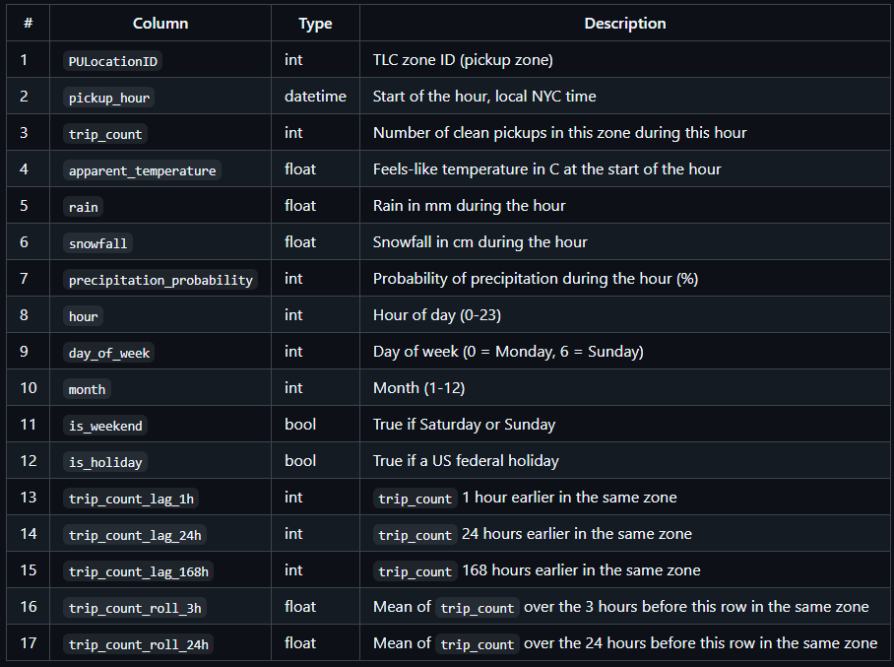
Final Feature Set
Final validated dataset: features.csv
Notes:
Suggested time: 45 seconds. Replace bracketed prompts with your project evidence. Present actual results only.

Slide 10
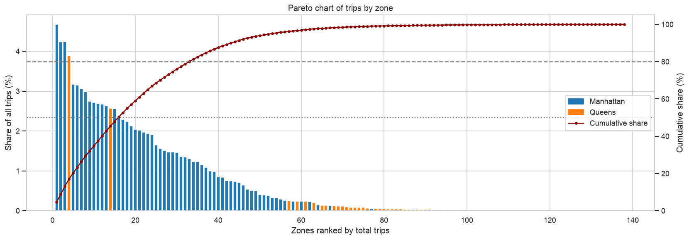
WHERE IS DEMAND
Half the trips come from 16 zones
16 of 138
zones make up 50% of all trips
Manhattan has 90.6% of trips
33 zones cover 80% of trips
JFK is the only Queens zone in the top 10
Gini 0.71: very uneven, most of all inside Queens
10

Slide 11
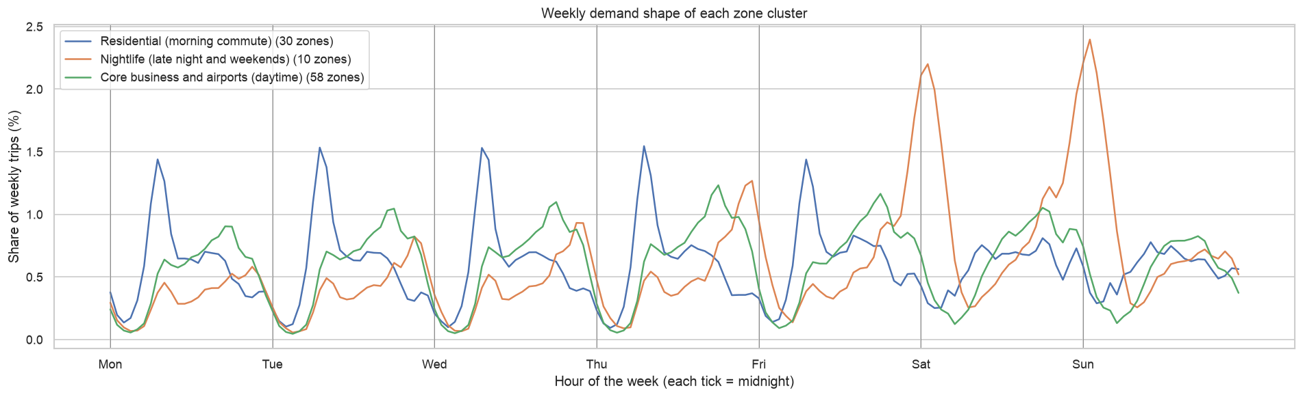
WHERE IS DEMAND
Three kinds of zones
Core business + airports
Nightlife
Residential
58 zones · 84% of trips · busy in the daytime
10 zones · 11% of trips · huge Fri and Sat nights
30 zones · 5% of trips · sharp 7–9 am peak

Slide 12
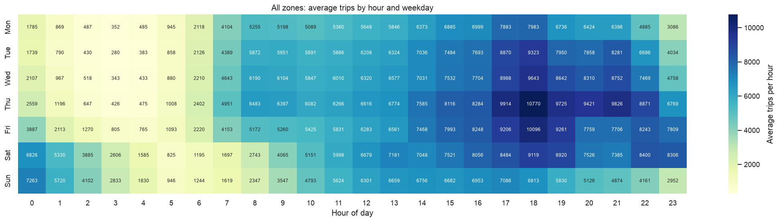
WHEN DOES IT HAPPEN
Thursday 6 pm is the busiest hour
10,770
4.7×
280
trips per hour, Thursday at 18:00
busier weekend nights (00–03) vs weekday nights
trips per hour, the quietest slot (Tue 03:00)

Slide 13
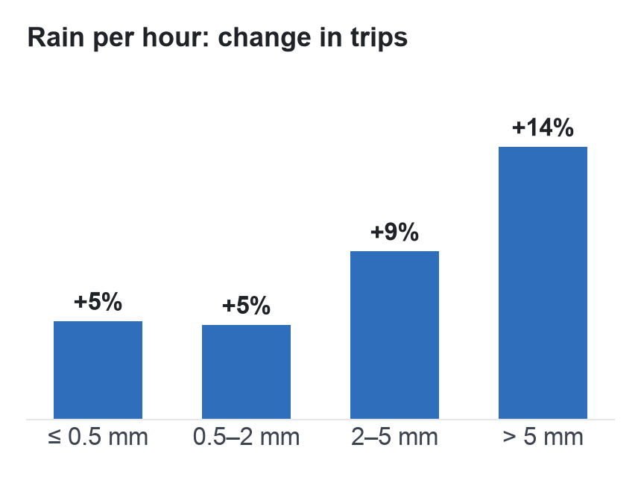
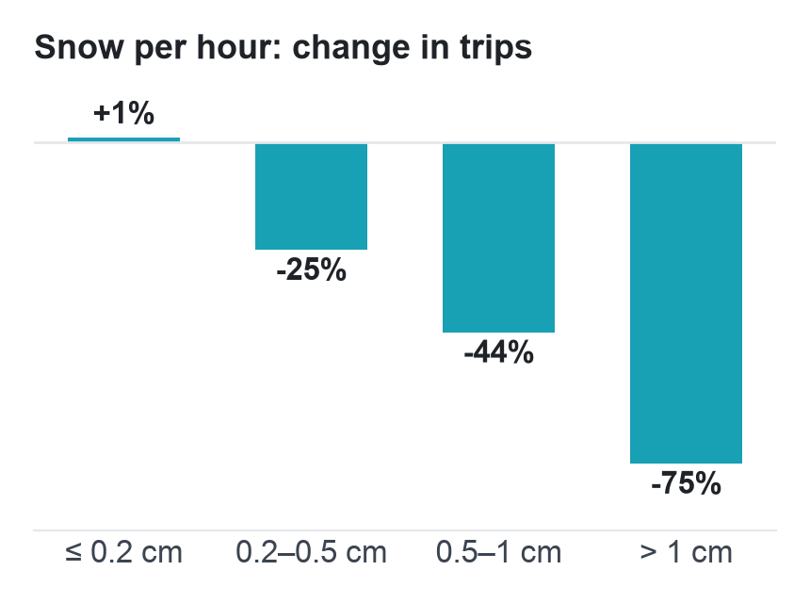
WEATHER
Snow cuts trips, rain adds a few
Compared with a normal dry hour in the same zone, hour, weekday/weekend and month. Temperature alone changes demand by less than 3%.

Slide 14
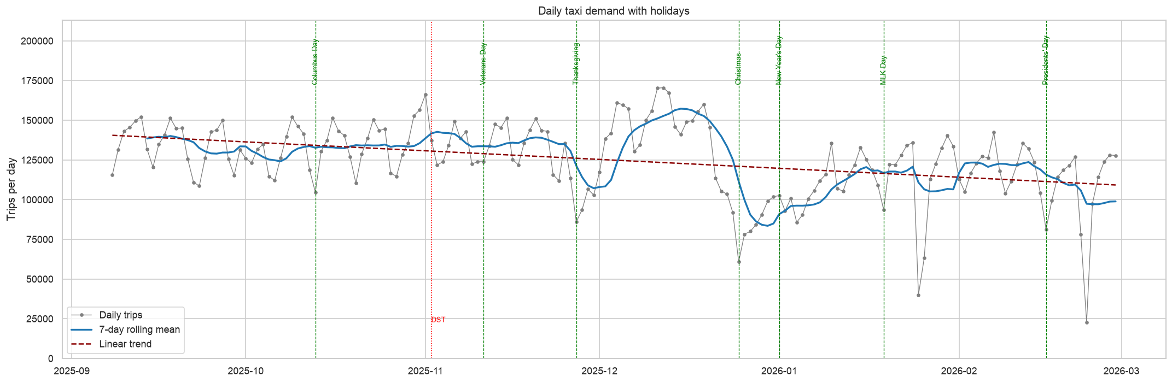
WHEN DOES IT HAPPEN
Demand drops into winter
−15%
170 K
23 K
last 4 weeks vs first 4 weeks
trips a day at the mid-December peak
trips on 23 Feb, the worst snow day

Slide 15
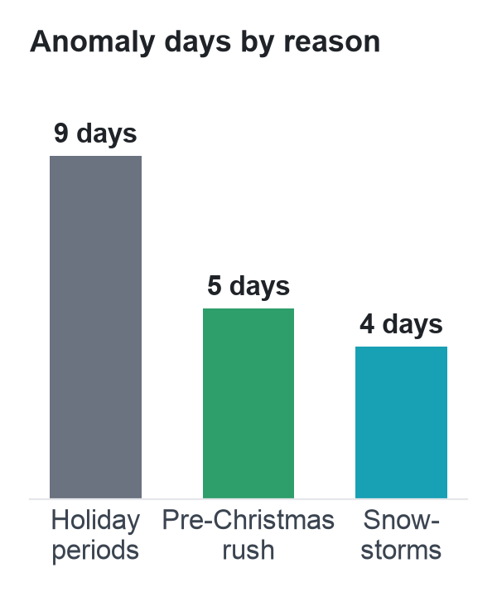
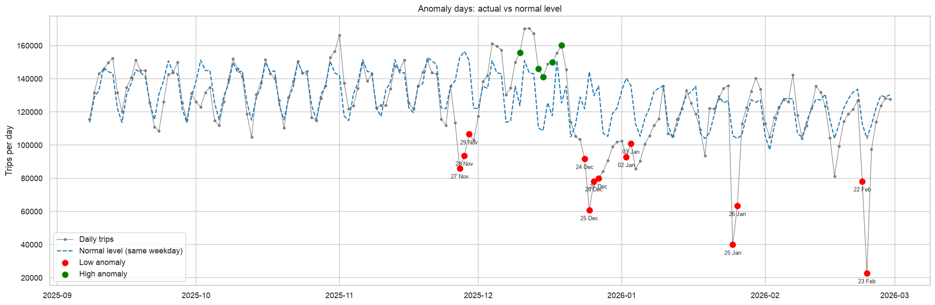
WHEN DOES IT HAPPEN
Every unusual day has a reason
−78%
−58%
+32%
23 Feb snowstorm
Christmas Day
pre-Christmas peak

Slide 16
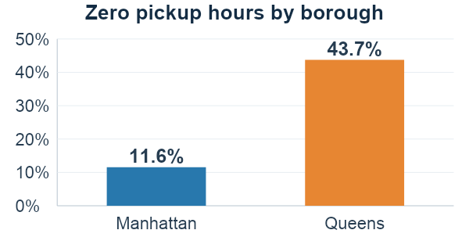
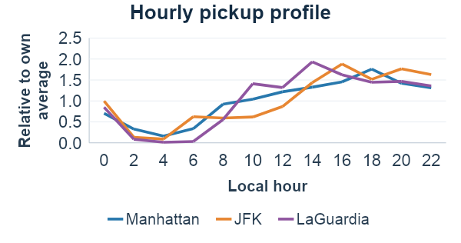
Data quality and demand patterns
27.7% of zone-hours have zero pickups. We kept these quiet periods in the data.
Manhattan: 90.6% of pickups.
Peak hours: LaGuardia 2 PM, JFK 4 PM, Manhattan 6 PM.

Slide 17
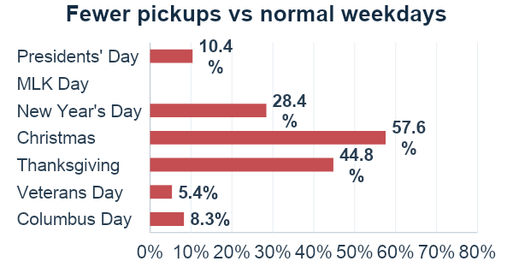
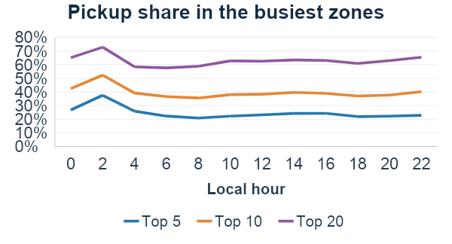
Holiday comparisons and fleet planning
Christmas: 57.6% fewer pickups whereas New Year's Eve night: 62.0% more pickups.
Top 20 zones cover 55–73% of pickups.
East Village leads weekend nights.
Model inputs to test: location with hour/weekday, and event periods.

Slide 18
Exploratory Analysis and Visualization
Pickup counts are highly uneven: The mean is 37.7 pickups per zone-hour, while the median is only 4. Busy hours pull the average upward. (Half the zone-hours have 4 pickups or fewer)
Weekend patterns depend on location: Average hourly pickups are 2.55× higher in Lower East Side and 2.14× higher in East Village on weekends than weekdays.
Demand levels change across months: Average daily pickups fall from approximately 134,000 in the observed September period to 112,000 in January. September’s average uses its 23 available days.
Weekly patterns often repeat: Across 24 complete weeks, zones averaging at least one pickup per hour have a median profile correlation of 0.90. This measures historical similarity, not forecast accuracy.
Averages can underestimate busy periods: Upper East Side South averages 243 pickups/hour, compared with 537 at P95 and approximately 613 at P99.

Slide 19
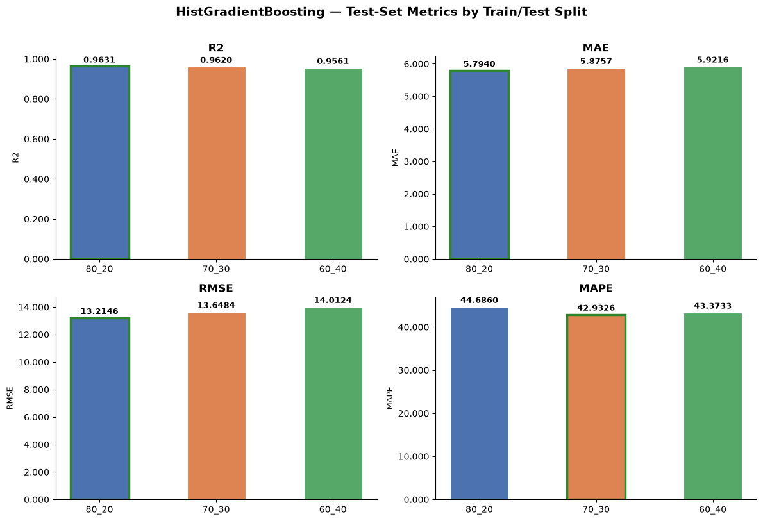
Predictive Model Development – Prediction Setup
Prediction Task – Regression: Hourly Taxi Demand Prediction
Predict the number of taxi trips originating from each pickup zone for a given hour.
Target Variable – trip_count (Number of taxi trips originating from a PULocationID during an hour)
Data Split
Chronological 80:20 split
Training: 460,920 observations
Testing: 115,368 observations
No random shuffling was used because taxi demand is
time-dependent.

Slide 20

Predictive Model Development – Models
Model | MAE | RMSE | R² | MAPE
Linear Regression | 7.4861 | 15.7036 | 0.9478 | 87.4504
Random Forest | 6.7993 | 15.2593 | 0.9507 | 54.5220
HistGradientBoosting | 5.7841 | 13.1632 | 0.9633 | 44.8381
Model Interpretation
HistGradientBoosting performed better than both Linear Regression and Random Forest.
The model improved substantially over the naive weekly baseline.
Test performance remained close to training performance, indicating no major overfitting.

Slide 21
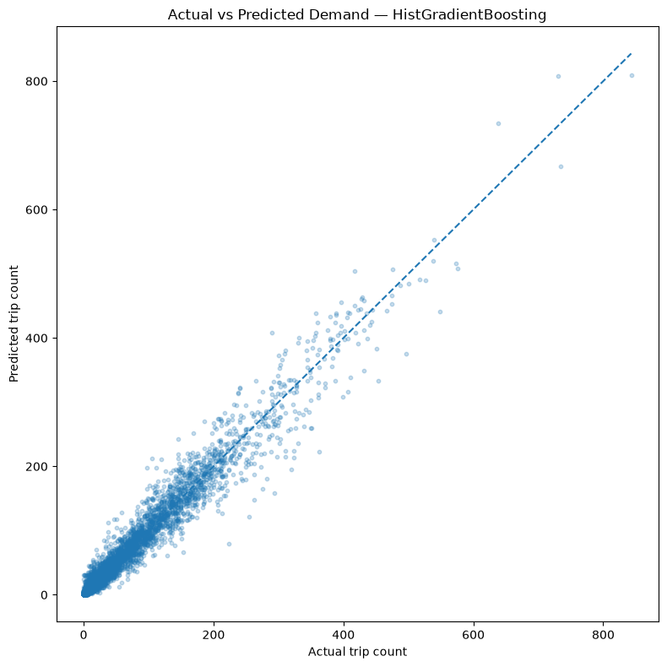
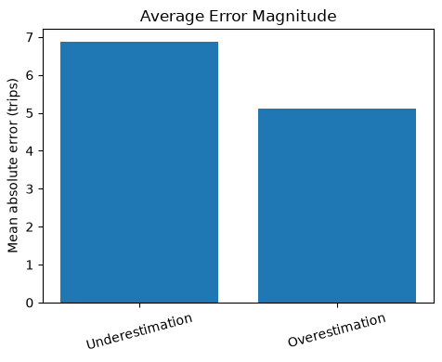
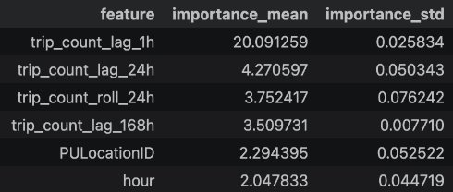
Model Evaluation – Interpretation
The highly right-skewed target distribution (mean = 37.7, median = 4) contains many low-demand observations but few extreme peaks, encouraging predictions toward typical demand and contributing to underestimation during high-demand periods.

Slide 22
UNIT 3
Selected advanced analytics methods
Selected method | Business question | Data used
Time Series Analytics | Forecasting future hourly taxi demand in Manhattan and Queens to support demand planning and efficient taxi fleet allocation. | Pickup zone (PULocationID), timestamp (ds), hourly pickup count (trip_count_adj), day of week (day_of_week), and daily/weekly Fourier seasonal terms.
Association Rule Mining | Which specific combinations of time, location, and operating conditions reliably trigger surge or off-peak taxi demand? | time_band, day_type, holiday, rain, snow, temperature, zone_cluster, and demand (target).
Notes:
Suggested time: 30 seconds. Replace bracketed prompts with your project evidence. Present actual results only.

Slide 23
Time Series Analytics
Notes:
Suggested time: 45 seconds. Replace bracketed prompts with your project evidence. Present actual results only. For time series, explain frequency and time split. For text, explain cleaning and representation. For association rules, explain transactions and thresholds.

Slide 24
Preparing a full time series from the cleaned data
Goal: forecast completed pickups for 138 Manhattan and Queens zones, 24 hours or 7 days ahead.
01
Restore 1–7 September
features.csv starts on 8 Sep after a 168-hour lag warm-up. Recover 23,184 zone-hours from its one-week lag column, then cross-check the counts.
02
Build a complete zone-hour grid
138 zones × 4,344 hourly labels = 599,472 rows from Sep 2025 to Feb 2026. Genuine zero-pickup hours remain zero; no timestamp is missing or repeated.
03
Handle daylight-saving time
On 2 Nov 2025, clocks went back and 01:00 occurred twice. Keep observed counts; halve only that hour in trip_count_adj (pickups per physical hour).
04
Create modelling levels
Hourly and daily zone series plus six aggregates: all zones, Manhattan, Queens, Yellow Zone, Boro Zone and Airports.
Verified total: 22,579,793 cleaned trips; zone, daily and aggregate counts reconcile exactly.
Notes:
Sources: data/dataset-documents/time_series_preparation.md and the saved preparation tables. The recovered week is exact, not imputed. All zones means Manhattan and Queens in this project, not every NYC borough. The full panel preserves 22,579,793 cleaned trips; only the modelling target is adjusted at the repeated DST hour.
Clarity: 168 hours is one week. A zone-hour is one zone observed during one hour. The target is completed pickups, which does not measure unserved demand. The first week is recovered from trip_count_lag_168h, cross-checked against the other lags and total cleaned demand.

Slide 25
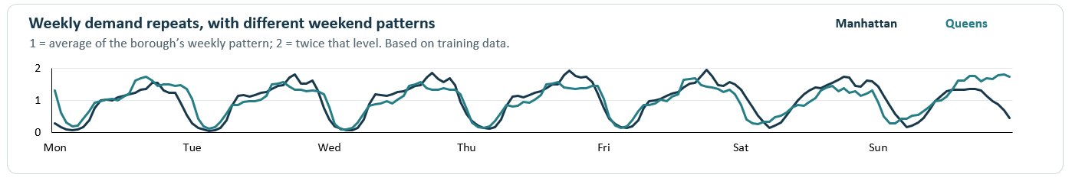

Feature engineering and data quality controls for TSA
These fields support time-series analysis; Model 1 itself forecasts from past pickup counts only.
Calendar and events
Seasonal signals
Forecast-safe roles
Zone behaviour
Added time bands, weekend-night indicators, holiday details, and special-day and night-event flags.
Fourier (sine/cosine) terms encode 24 h and 168 h cycles; hour-of-week groups patterns.
Extended the earlier feature table with calendar, seasonal and DST fields, and created hourly and daily datasets. Each field is labelled by its permitted use.
Training-only profiles: 83 regular, 53 intermittent (many zero hours) and 2 zero-demand zones.
Readiness evidence
Data validated: no missing hours, totals reconciled, and chronological train/test splits verified.
0
4,344
0
missing counts
regular hours
target-leaking inputs (active_zones removed)
Weekly demand repeats, with different weekend patterns
Manhattan
Queens
1 = average of the borough’s weekly pattern; 2 = twice that level. Based on training data.
Notes:
Sources: time_series_preparation.md; ts_feature_catalog.csv; ts_readiness_checks.csv; model_1/tables/training_weekly_profiles.csv. This editable graph contains 168 hourly training means for each borough, divided by its 168-slot profile mean. All 41 readiness checks pass. Calendar and scheduled events are available ahead; observed weather requires a forecast. Same-hour active_zones was removed as it leaks target information. 83/53/2 are training profile classifications, not final model selections.
Model 1 does not use the calendar, weather or Fourier columns as direct predictors. Those are preparation outputs for broader time-series analysis. The 53 intermittent zones are a training classification; TSB wins model selection in 17 zones. Relative scaling compares the shapes of demand, not the absolute volumes of the two boroughs.

Slide 26
Model 1: four forecasting methods
Each zone chooses the lowest-MAE method across four earlier weekly tests.
F(h): predicted pickups h hours ahead. y₁–y₄: matching weekday/hour in the previous 1–4 weeks.
1. Adaptive seasonal
2. Four-week mean
Weekly pattern adjusted to recent demand
Average matching hours from the last four weeks
F(h) = B(h) × [1 + (r − 1) exp(−h / 48)]
F(h) = B(h) = (y₁ + y₂ + y₃ + y₄) / 4
r = clip((L + 1) / (E + 1), 0.5, 1.5)
L = latest 24-hour mean. E = mean of matching 24-hour
windows in four prior weeks. Decay scale = 48 h.
Recent demand raises or lowers the weekly pattern; this adjustment gradually fades.
Weekly period = 168 h History = 4 weeks
Smooths unusual weeks using a four-week average
3. TSB
4. Weekly naive
For intermittent demand with many zero-pickup hours
Repeat the same weekday and hour from last week
F(h) = p × z
p: probability of any pickups
z: mean count when pickups occur
F(h) = y₁
β = 0.05: update p each hour
α = 0.10: update z only when pickups occur
Weekly period = 168 h History = 1 week
Selected methods across 138 zones
1. Adaptive seasonal | 2. Four-week mean | 3. TSB | 4. Weekly naive
88 zones | 25 zones | 17 zones | 8 zones
Notes:
Four methods compete separately for every zone using mean MAE over selection folds 1–4. Only observations before each forecast origin enter the forecast. B(h) is the four-week matching-hour profile. L is the latest 24-hour mean. E averages matching 24-hour windows at lags 168, 336, 504, 672. clip limits the ratio to [0.5, 1.5]; adding 1 stabilizes low counts. The adaptive adjustment decays exponentially with a 48-hour time scale, and does not vanish at 48 hours. In TSB, p updates as p + 0.05(I − p), where I = 1 if the observed count is positive and 0 otherwise. For positive counts only, z updates as z + 0.10(y − z). Each forecast block repeats the last p*z. TSB means Teunter–Syntetos–Babai. Sparse zones can select any candidate; TSB is not automatic. Source equations: models/time_series/model_1/tsa/baselines.py. Selection logic: models/time_series/model_1/tsa/zones.py. Verified counts: models/time_series/model_1/tables/zone_selection.csv: adaptive_week 88, mean_4weeks 25, tsb 17, naive_168 8. Total 138.

Slide 27
Demand patterns and forecasting results
Test: 25 Jan 04:00–28 Feb 23:00, 2026. 24-hour forecast blocks. MAE in pickups/hour.
What the demand history showed
Actual and forecast: one test week
Patterns were checked using earlier data only.
8–14 February. Forecast of total pickups across all 138 zones.
Busy and quiet hours repeat each day and week
Demand is strongly similar one day and one week apart.
Similarity scores: 0.88 after 24 h and 0.89 after 168 h.
Some zones have long gaps between pickups
53 zones have many zero hours, with occasional pickups.
That is why TSB was included as a forecasting option.
Week-to-week changes have a steadier pattern
We compared each hour’s demand with the same hour last week.
This reduced the repeating weekly pattern and produced steadier changes.
Two statistical tests supported this finding.
Average forecast error: lower is better
Evaluation level | Last week | Model 1 | Less error
Each zone, each hour | 9.31 | 7.82 | 16.0%
Total forecast directly | 777.71 | 678.21 | 12.8%
Total from zone forecasts | 777.71 | 649.37 | 16.5%
The orange forecast follows most daily peaks and quiet hours.
The blue band shows the range of uncertainty around it.
Adding zone forecasts gives the lowest total error.
Limitations: six months of data. During heavy snow, error in the direct total forecast was about four times higher.
Notes:
Plain-language presentation notes: Earlier data means the training period, before validation and test. Combined demand means the sum across the 138 Manhattan and Queens zones. Log scaling here is log(1+pickups), which compresses large values while preserving zero. Weekly differencing subtracts the log value at the same hour 168 hours earlier. This transformation was used for statistical analysis, not as the fitted target in the active forecasting methods.
ADF means Augmented Dickey–Fuller. It tests a unit-root null hypothesis. KPSS means Kwiatkowski–Phillips–Schmidt–Shin. Here it tests a level-stationarity null hypothesis. The tests start from different assumptions, so using both gives complementary evidence. After weekly log differencing, ADF p=0.0006246 and KPSS p is at least 0.10. These results support stationarity of the transformed series and do not prove that the original pickup counts are stationary.
Official method references: https://www.statsmodels.org/stable/generated/statsmodels.tsa.stattools.adfuller.html and https://www.statsmodels.org/stable/generated/statsmodels.tsa.stattools.kpss.html
This slide makes the time-series analysis visible alongside forecast evaluation. All three TSA findings use training data, not the test period.
Seasonality: on the training All zones log1p series, autocorrelation is 0.8781659626 at lag 24 and 0.8914295847 at lag 168. Strong daily and weekly repetition motivates matching-weekday/hour seasonal profiles and the weekly-naive baseline.
Zone heterogeneity: training zone profiles label 43 zones intermittent and 10 lumpy, for 53 of 138. There are also 48 smooth, 35 erratic and 2 no-demand zones. This motivates including TSB as a candidate. It does not mean 53 zones selected TSB; only 17 actually selected it after earlier-week validation.
Stationarity: on the All zones log1p series ADF rejects a unit root while KPSS rejects stationarity, so the tests do not agree on level stationarity. After 168-hour log differencing ADF p=0.0006245886 and KPSS p is at least 0.10, supporting stationarity by both tests. This is a diagnostic result. The active model forecasts pickup counts and does not fit the differenced series or use the decomposition as an input.
The table uses the full 836-hour test, with next-day predictions in 24-hour blocks. MAE units are pickups/hour; the first row is per zone-hour and the other rows are combined hourly totals. Compare methods within each row. Direct forecasts use the aggregated history. Bottom-up forecasts sum the selected individual-zone predictions. The weekly-naive baseline repeats the same hour of the previous week. The reductions are about 16.0%, 12.8% and 16.5% respectively.
The native chart preserves the original forecast data, embedded workbook and uncertainty interval. It illustrates 8–14 February, not the full test. The transparent band-base helper is excluded from the legend. The uncertainty bands are empirical prediction intervals, not 95% point accuracy.
Limitation: six months cannot establish annual seasonality. Direct combined-demand MAE is 2180.8875 on heavy-snow hours versus 545.1556 otherwise, around four times higher. This is a held-out error analysis, separate from training TSA. The historical holdout was inspected in earlier project development, so the results should not be described as newly blind.
Sources: models/time_series/model_1/tsa/diagnostics.py; tables/acf_pacf.csv; tables/stationarity.csv; data/processed/time_series/ts_zone_profile.csv; tables/hourly_test_metrics.csv; tables/zone_test_metrics.csv; tables/bottom_up_metrics.csv; tables/event_hour_errors.csv. Source chart: review2_time_series_preparation_model1_with_forecast_graph.pptx, slide 5.

Slide 28
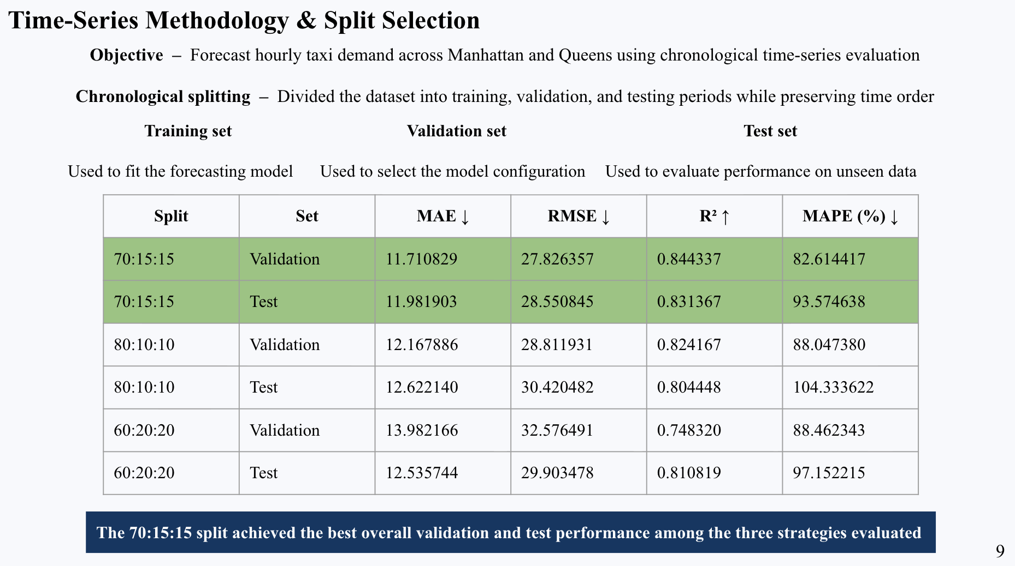

Slide 29
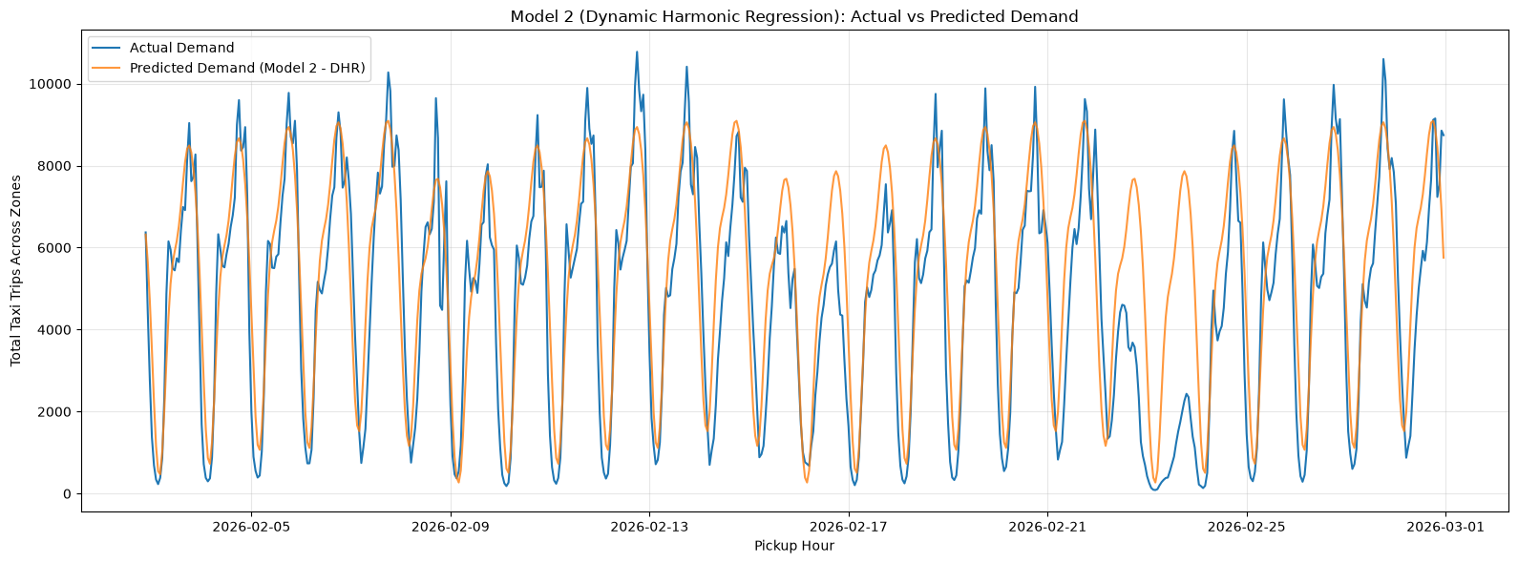
Time-Series Models
Dynamic Harmonic Regression
MSTL + ETS
Metric | Validation | Test
MAE ↓ | 11.7108 | 11.9819
RMSE ↓ | 27.8264 | 28.5508
R² ↑ | 0.8443 | 0.8314
MAPE (%) ↓ | 82.6144 | 93.5746
WAPE (%) ↑ | 37.0965 | 30.5064
Metric | Validation | Test
MAE ↓ | 12.8577 | 11.3502
RMSE ↓ | 31.5040 | 29.5141
R² ↑ | 0.8005 | 0.8198
MAPE (%) ↓ | 84.6265 | 95.1617
WAPE (%) ↑ | 36.8859 | 33.2407

Slide 30
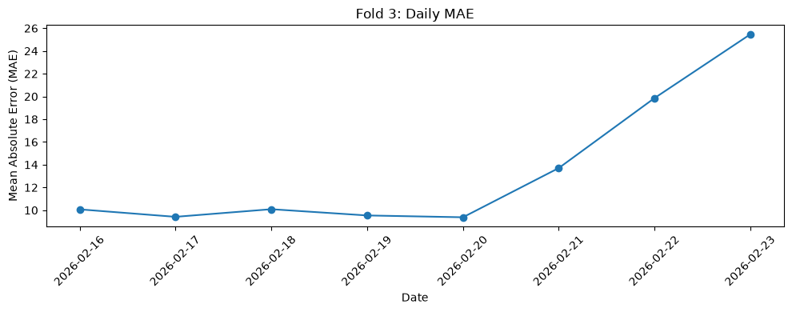
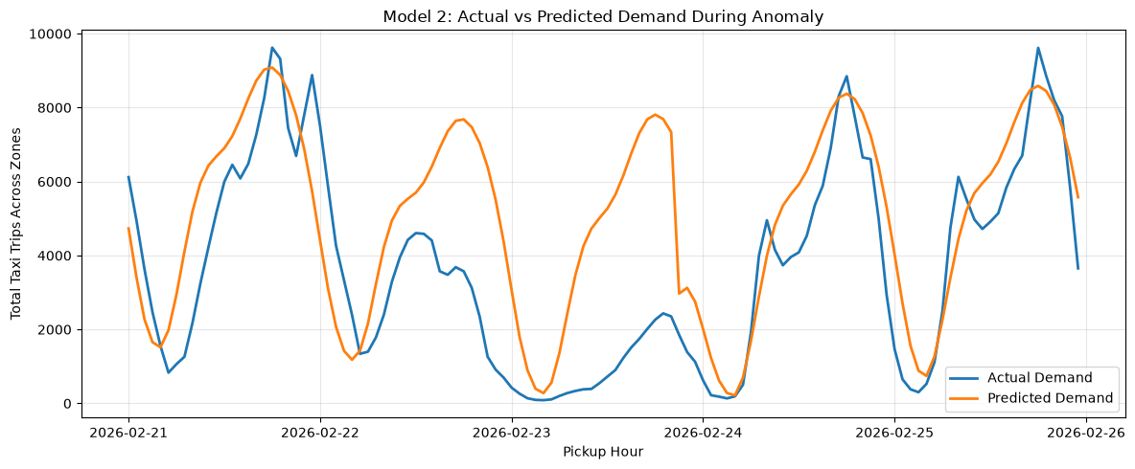
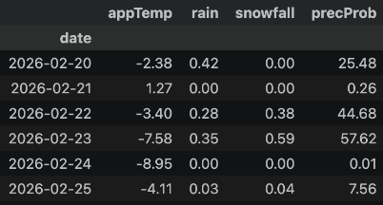
DHR — Rolling-Origin Error Analysis
Key Findings
Rolling-origin evaluation was performed across four consecutive test folds.
Fold 3 (February 16–23) showed the weakest performance (MAE: 13.65;
R²: 0.7146).
Daily MAE rose sharply from 13.71 on February 21 to 25.47 on February 23.
The model captured recurring demand patterns but struggled with unusual demand changes.
Investigation of Unusual Forecast Errors
The NYC blizzard and travel ban on February 22–23, 2026, coincided with a sharp drop in actual taxi demand, causing the model to overestimate demand and highlighting the impact of extreme weather on forecasting accuracy.

Slide 31
Association Rule Mining
Notes:
Suggested time: 45 seconds. Replace bracketed prompts with your project evidence. Present actual results only. For time series, explain frequency and time split. For text, explain cleaning and representation. For association rules, explain transactions and thresholds.

Slide 32
ARM - Data Preparation
One transaction = one zone in one hour, with eight category items.
Input: features.csv, 576,288 rows across 138 zones
Training-only definitions
Item group | Categories
Time band | 6 periods: late night to evening
Calendar (2) | Weekday/weekend + holiday flag
Rain/snow (2) | Separate present/absent flags
Temperature | Lower / middle / upper
Zone pattern | Daytime / commute / nightlife
Demand | Low / Medium / High per zone
Fit bins and zone clusters on training rows.
Measure demand against each zone’s own history.
Apply unchanged definitions to the test period.
This leads to a total of 8 item groups.
Training cutoffs: zone-specific demand terciles, temperature -0.9°C / 9.9°C
32

Slide 33
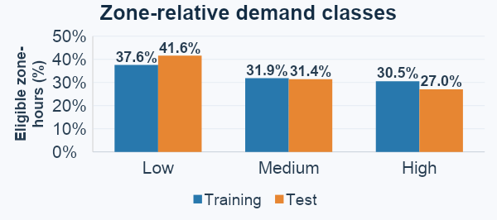
ARM - Data Preparation (continued)
320,544 training transactions + 80,256 test transactions
Mining population
96 zones with training mean ≥1 pickup/hour.
42 sparse zones remain in the full audit.
Exclude the combined DST hour from mining.
Keep zeros in active zones.
Outputs: categorised audit, Boolean matrices, frozen definitions and frequencies
Readiness: 29 saved-file checks and 9 unit tests passed
Handoff: training for rule discovery, held-out test for stability checks

Slide 34
ARM - Methodology and Findings
Target Consequent: Single demand tier (demand=High/Medium/Low)
Antecedent Inputs: Contextual features only (time_band, zone_cluster, day_type, temperature, rain, snow, holiday)
Thresholds Selected:
    Min Support: 0.005 (Captures niche peaks (nightlife clusters); 0.05 and 0.01 missed key clusters)
    Min Confidence: 0.50 (Guarantees at least 50% conditional probability)
    Min Lift: 1.20 (Filters out independent baseline co-occurrences (minimum 20% gain))
Algorithms used: Apriori, FP-Growth
Notes:
Suggested time: 65 seconds. Replace bracketed prompts with your project evidence. Present actual results only. Compare alternatives within the same task using consistent data and conditions. Forecasting: MAE / RMSE on future held-out periods. Text classification: precision, recall, F1 and confusion matrix on test messages. Association rules: support, confidence and lift on final transaction data. Explain any threshold comparison. Do not compare unrelated tasks directly.

Slide 35
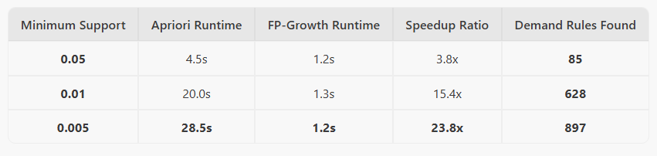
ARM - Methodology and Findings
Benchmark Results (Training Partition: 320,544 rows)
Both algorithms discovered the exact identical frequent itemsets and rules
Apriori Bottleneck: Candidate generation (join/prune) and repeated full-matrix scans; runtime scaled exponentially from 4.5s to 28.5s
FP-Growth Mechanism: Builds a compact FP-Tree in 2 database passes; mines patterns recursively without candidate generation
Selection: FP-Growth at support 0.005 selected; 897 candidate demand rules produced.
Notes:
Suggested time: 65 seconds. Replace bracketed prompts with your project evidence. Present actual results only. Compare alternatives within the same task using consistent data and conditions. Forecasting: MAE / RMSE on future held-out periods. Text classification: precision, recall, F1 and confusion matrix on test messages. Association rules: support, confidence and lift on final transaction data. Explain any threshold comparison. Do not compare unrelated tasks directly.

Slide 36
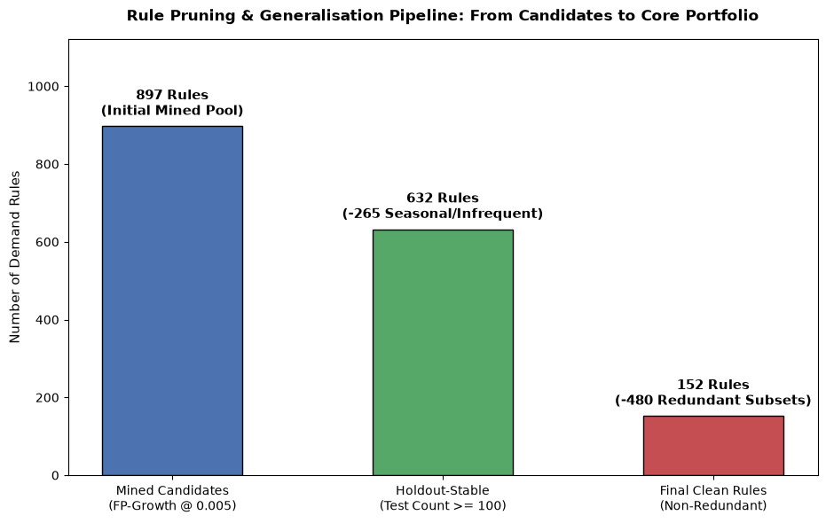
ARM - Methodology and Findings
Holdout Validation Criteria (Jan–Feb 2026 Test Split: 80,256 rows)
Test Count >= 100: Eliminates seasonal starvation (e.g., warm weather terciles absent in deep winter)
Test Confidence >= 0.50
Test Lift >= 1.20
Validation Outcome: 632 stable rules retained; 265 seasonal/low-volume rules dropped
Redundancy Pruning (Proper Subset Elimination)
Criterion: Prune rule R2: A2 -> C if general rule R1: A1 -> C exists where A1 is a strict subset of A2 and conf(R2) <= conf(R1)
Pruning Outcome: 480 redundant permutations removed; 152 rules retained (83.1% total reduction).
Notes:
Suggested time: 65 seconds. Replace bracketed prompts with your project evidence. Present actual results only. Compare alternatives within the same task using consistent data and conditions. Forecasting: MAE / RMSE on future held-out periods. Text classification: precision, recall, F1 and confusion matrix on test messages. Association rules: support, confidence and lift on final transaction data. Explain any threshold comparison. Do not compare unrelated tasks directly.

Slide 37
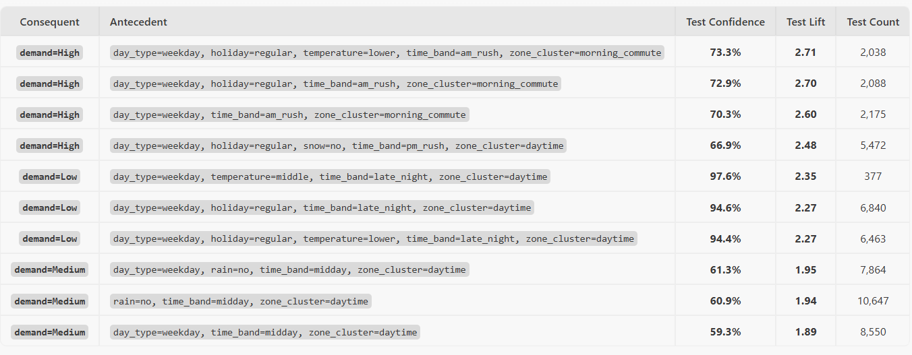
ARM - Methodology and Findings
Top Non-Redundant Rules (By Lift)
Notes:
Suggested time: 65 seconds. Replace bracketed prompts with your project evidence. Present actual results only. Compare alternatives within the same task using consistent data and conditions. Forecasting: MAE / RMSE on future held-out periods. Text classification: precision, recall, F1 and confusion matrix on test messages. Association rules: support, confidence and lift on final transaction data. Explain any threshold comparison. Do not compare unrelated tasks directly.

Slide 38
BUSINESS OUTCOMES
Combined insights and recommendations (Units 1-2)
Evidence from the project | Recommended action | Expected benefit / limitation
Spatial concentration: Manhattan drives 90.6% of pickups (19.7M trips; mean 68.3/zone-hr); 55 Yellow Zones capture 86.3% of volume (from EDA). | Station 85%–90% of active vehicles in core Manhattan/Yellow zones; halt cruising in 42 near-zero outer zones. | • Benefit: Cuts unbilled fuel and idle miles by focusing on 90% of revenue corridors. • Limitation: Misses latent demand in outer boroughs.
Airport peaks: 2 airport zones drive 6.5% of pickups (1.4M trips); LGA peaks at 14:00 (258.6/hr), JFK at 16:00 (380.9/hr) (from EDA). | Stage airport vehicles 30–60 mins prior to 14:00 (LGA) and 16:00 (JFK) arrival surges. | • Benefit: Captures high-fare airport trips with lower passenger wait times. • Limitation: Subject to flight delays and empty return trips.
Weather shocks: Rain increases morning demand by +14.6% to +22.1%; heavy snow (>0.5 cm) cuts demand by -40% to -70% (from EDA). | Call in extra drivers during morning rain; cut active fleet by 50% during heavy snow warnings. | • Benefit: Captures rain surges while avoiding collision risks and idle losses in snow. • Limitation: Shifting forecasts cause brief staffing mismatches.
Notes:
Suggested time: 55 seconds. Replace bracketed prompts with your project evidence. Present actual results only.

Slide 39
BUSINESS OUTCOMES
Combined insights and recommendations (Unit 3)
Evidence from the project | Recommended action | Expected benefit / limitation
Forward shift planning (from TSA): Strong 168-hour (weekly) and 24-hour (diurnal) seasonal cycles allow demand to be projected across 24-hour and 168-hour operational horizons. | Plan driver shift rosters and fleet maintenance 1 to 7 days ahead based on forward time-series cycles rather than reactive daily guesswork. | • Benefit: Optimizes multi-day vehicle availability and scheduled maintenance downtime. • Limitation: Cannot anticipate sudden unscheduled disruptions (e.g. flash transit strikes).
Commute surge rules (from ARM): Weekday AM rush in morning commute zones yields 70.3%–73.3% confidence of High demand (2.60–2.71× lift over baseline). | Pre-position morning fleet in outer-commute and residential hubs before 07:00 on weekdays. | • Benefit: Places vehicles in high-demand zones when surge likelihood is 2.6×–2.7× above average. • Limitation: Captures directional demand tier (High/Low) rather than exact vehicle counts.
Nightlife surge rules (from ARM): Weekend late-night in nightlife clusters yields 54.1% confidence of High demand (2.38× lift over baseline). | Re-deploy evening cabs to nightlife zones (Lower Manhattan/Williamsburg) from 23:00 to 04:00 on Friday/Saturday. | • Benefit: Captures late-night recreational fares when regular transit frequency drops. • Limitation: High competition from rideshare services in nightlife clusters.
14
Notes:
Suggested time: 55 seconds. Replace bracketed prompts with your project evidence. Present actual results only.

Slide 40
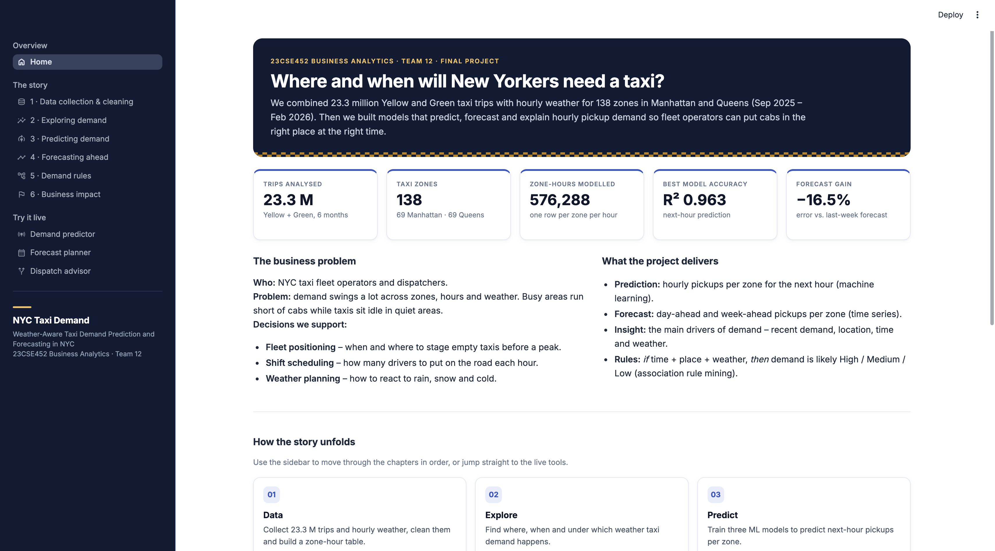
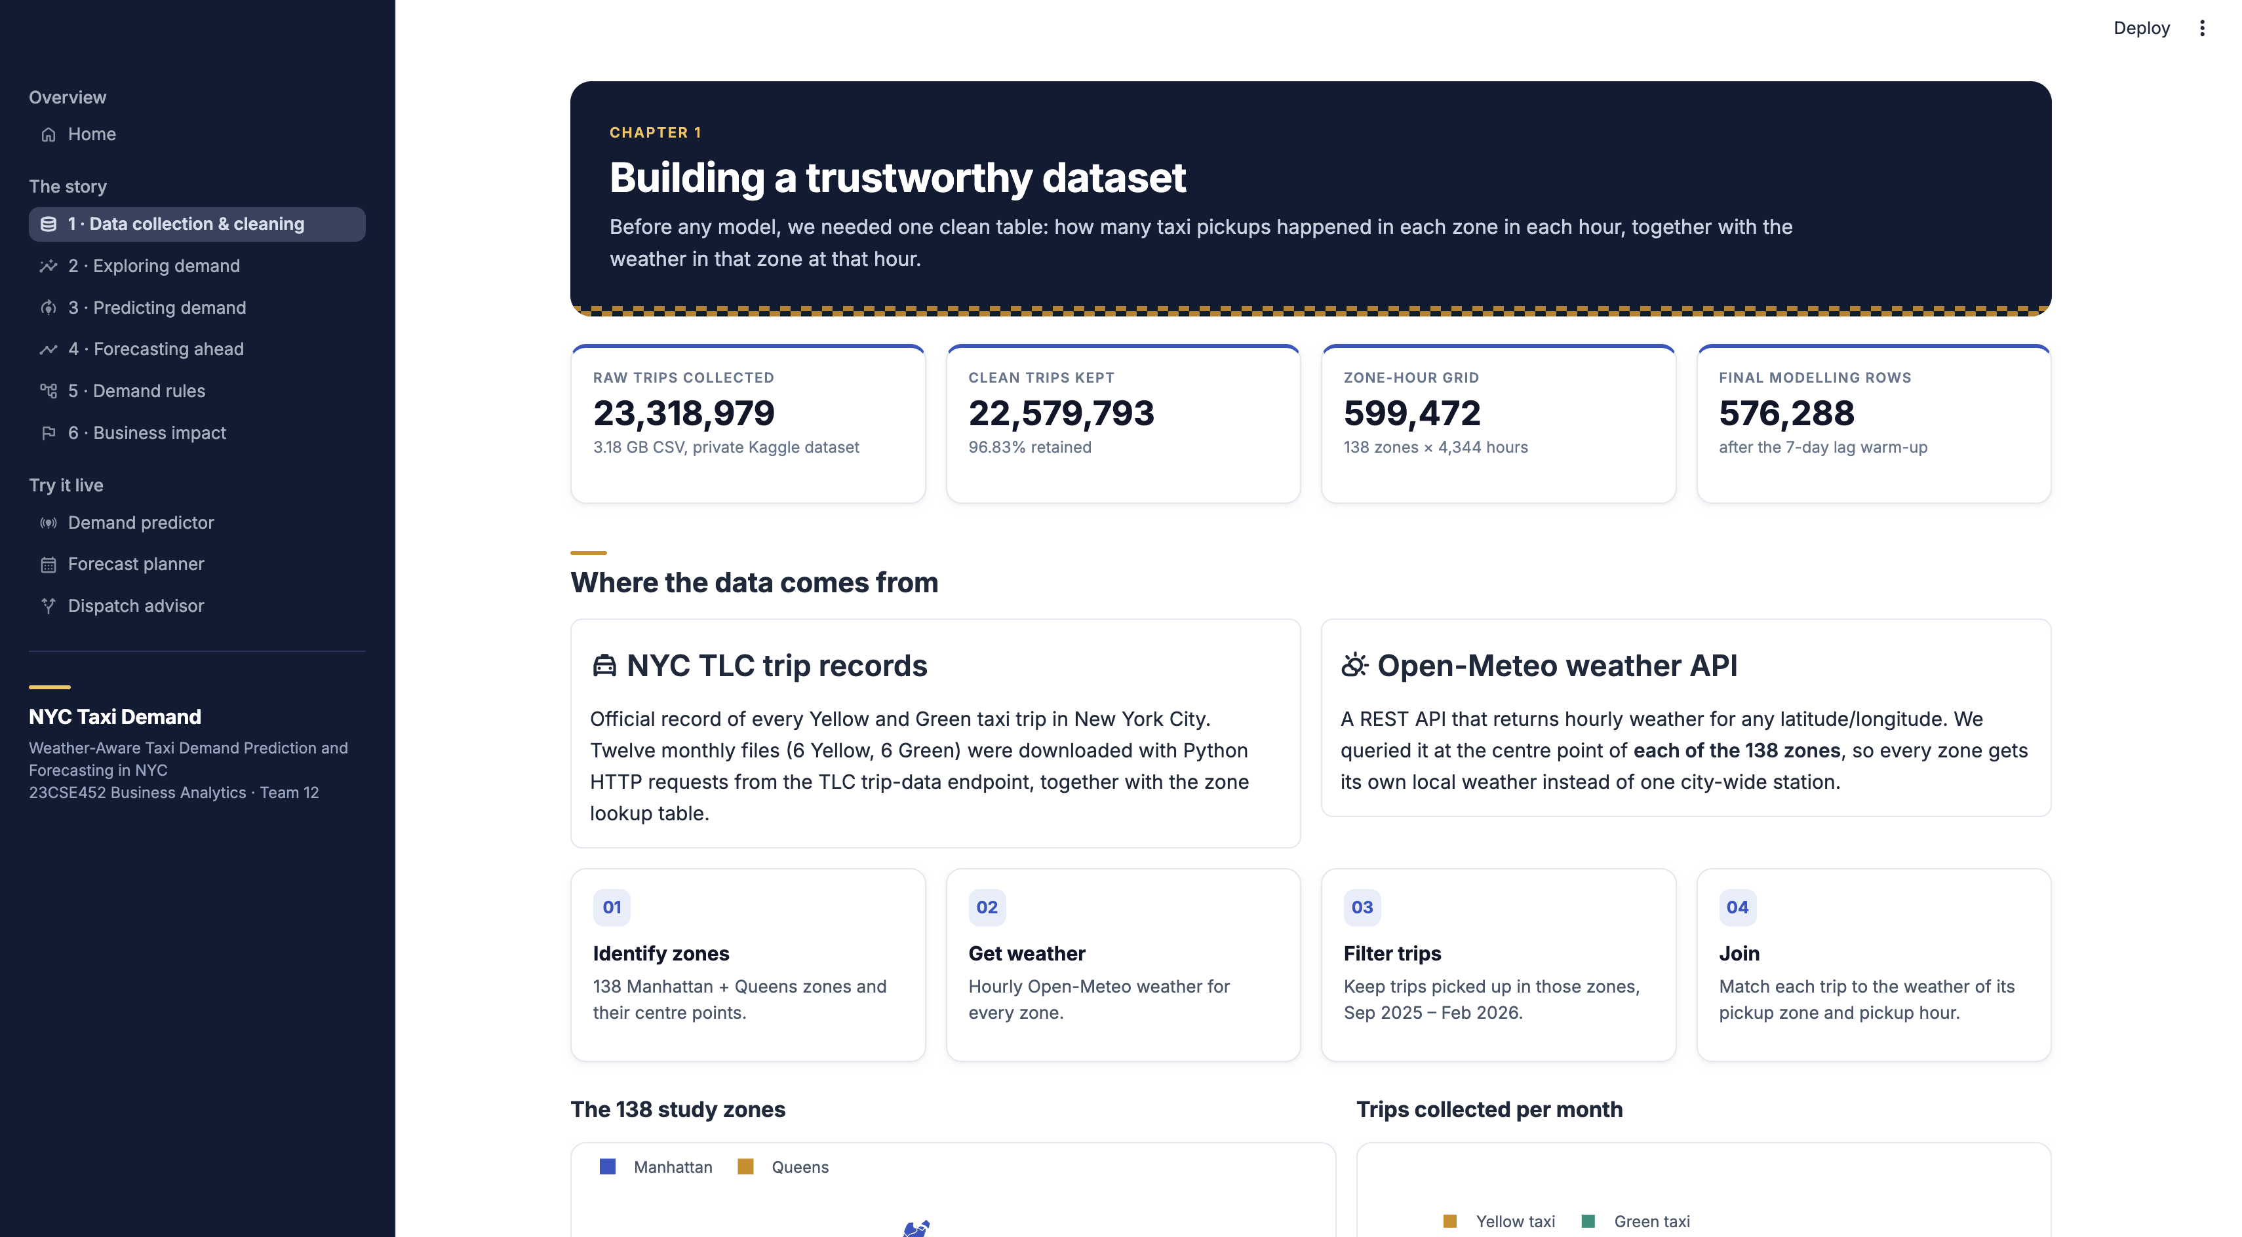
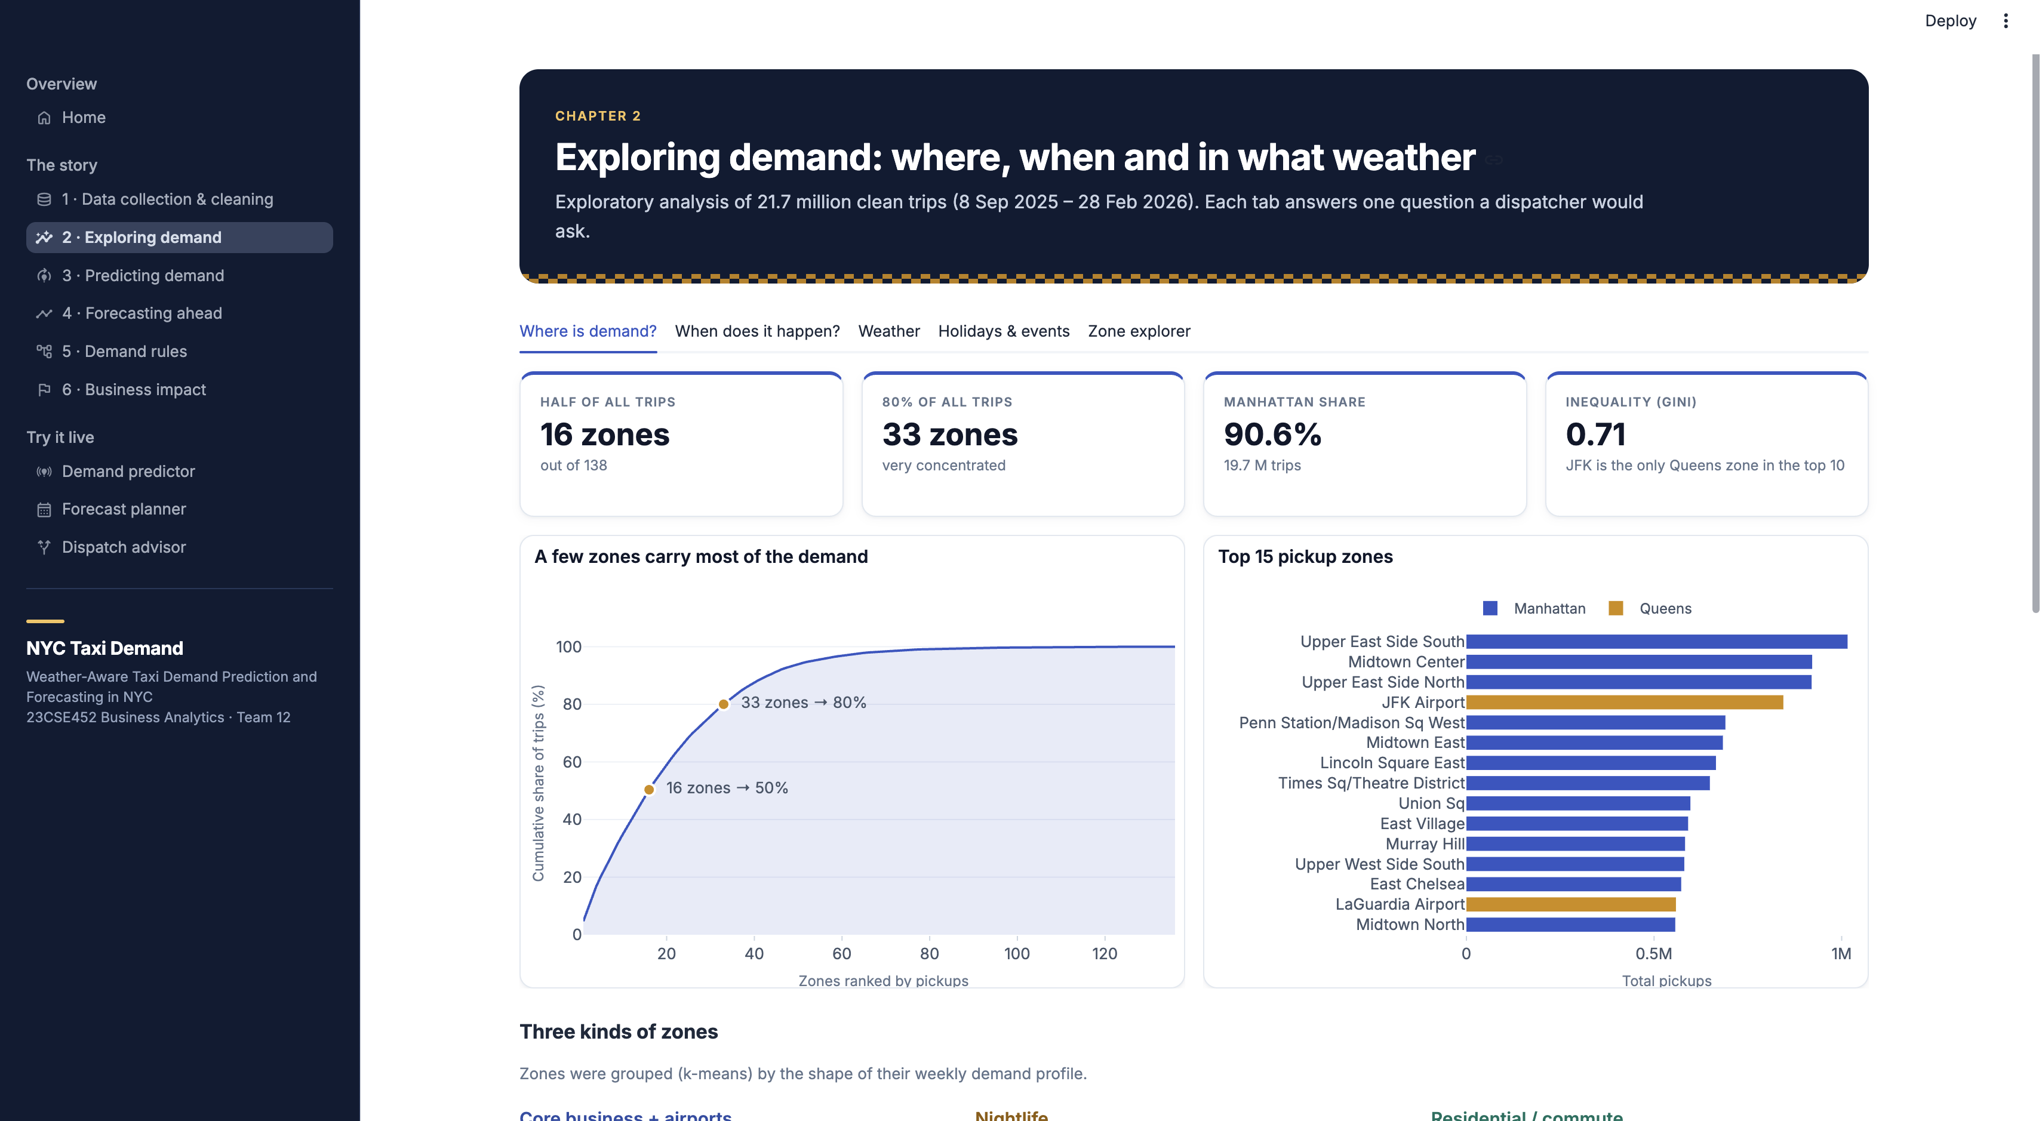
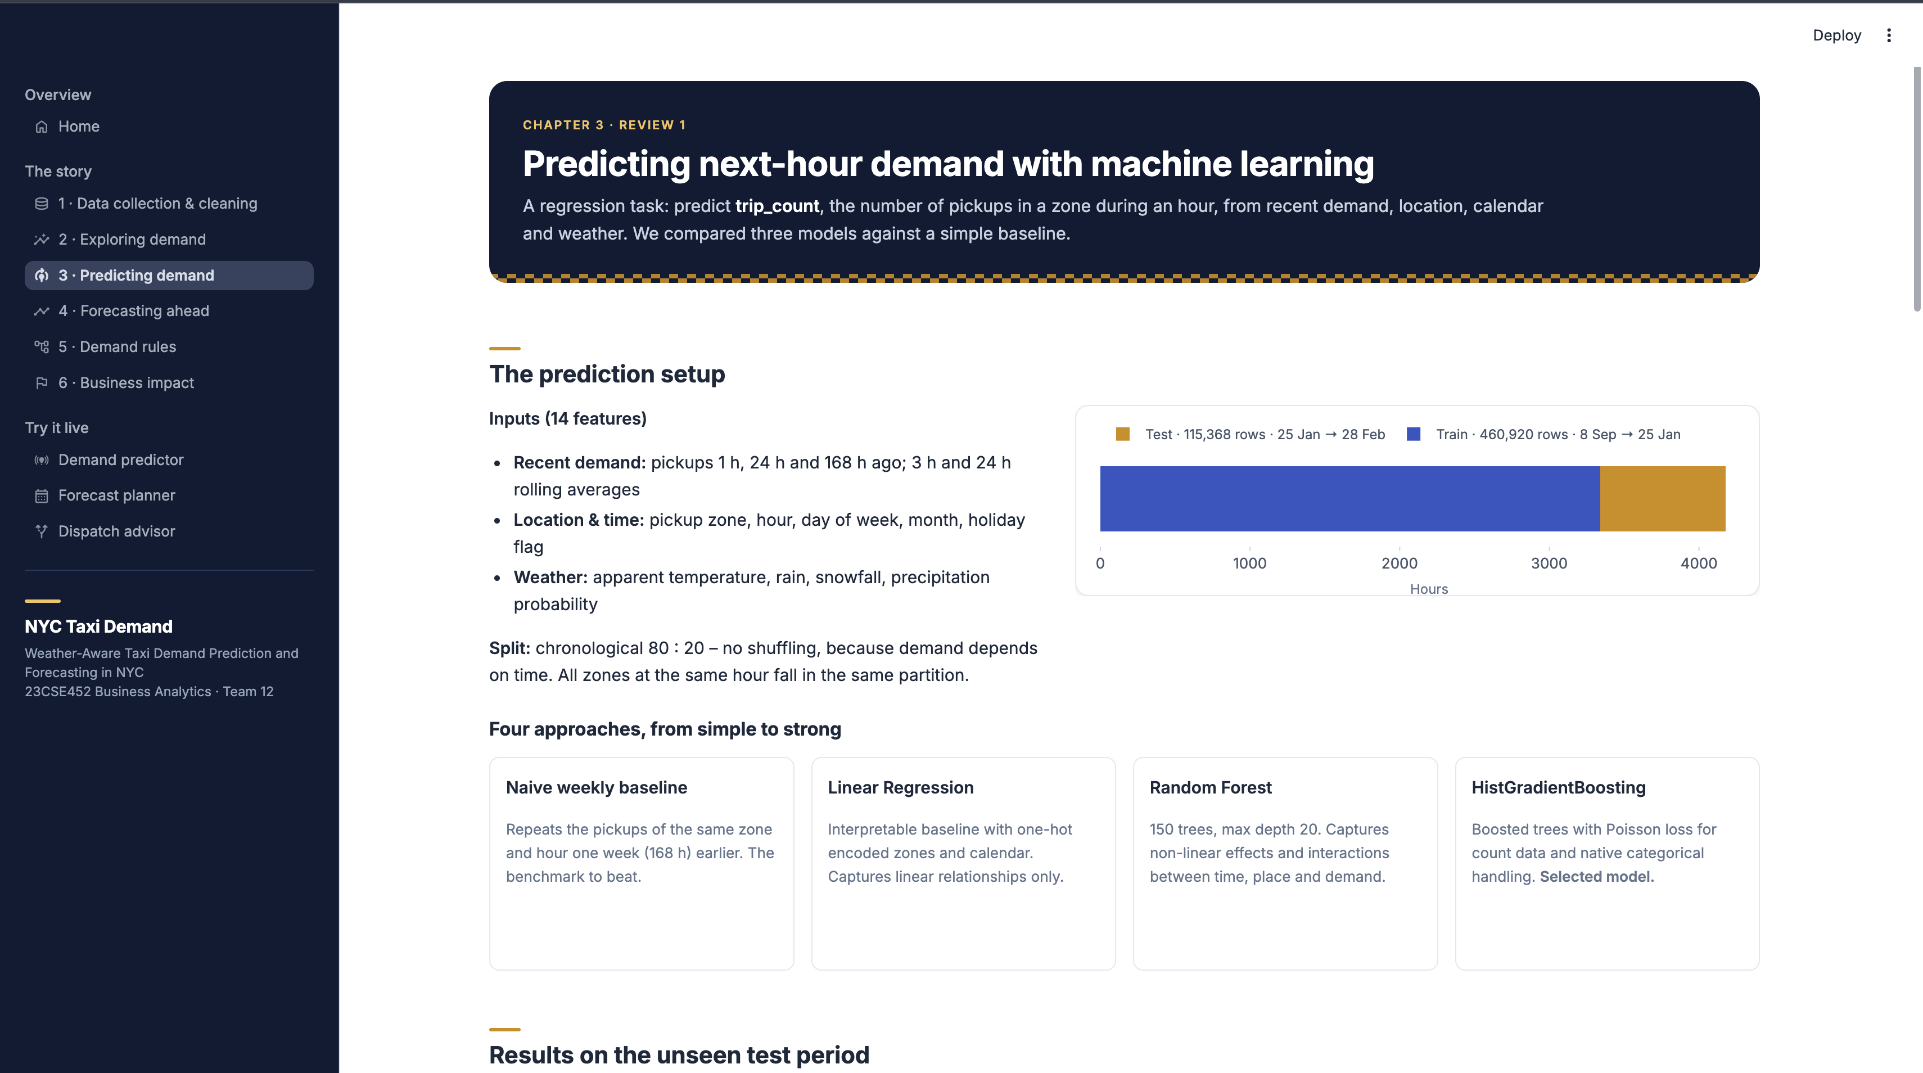
MANDATORY LIVE DEMONSTRATION
Interactive dashboard or website
Notes:
Suggested time: 120 seconds. Replace bracketed prompts with your project evidence. Present actual results only. Switch to the working application. Demonstrate meaningful interaction using the final project data and results. Show relevant findings from the complete project. A screenshot supports the presentation but does not replace the live demonstration. Test the application before the panel.

Slide 41
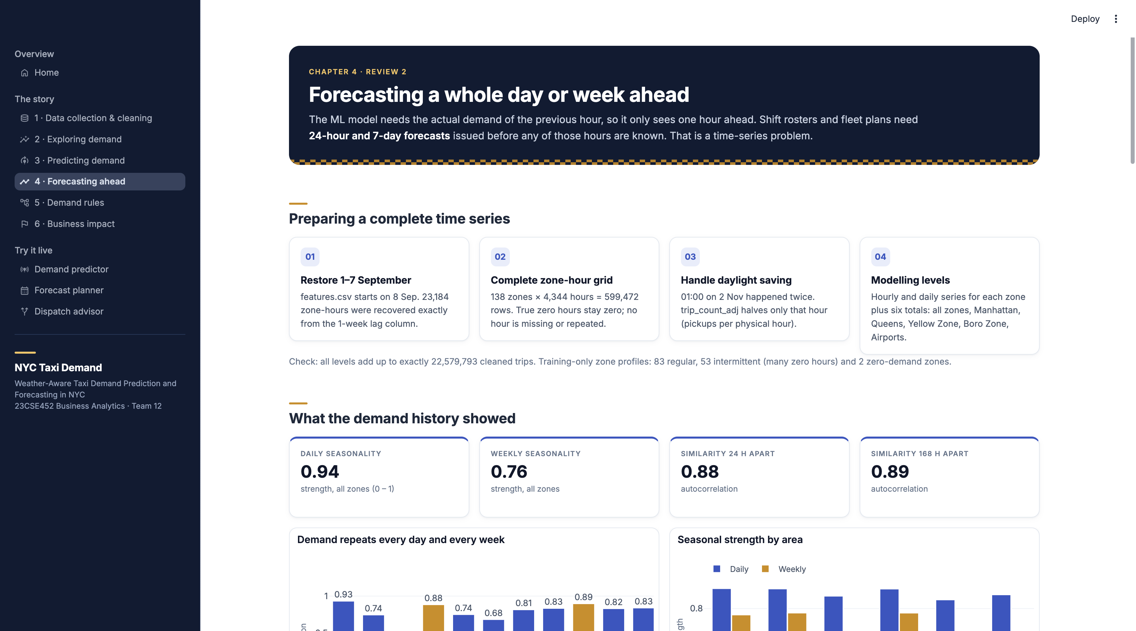
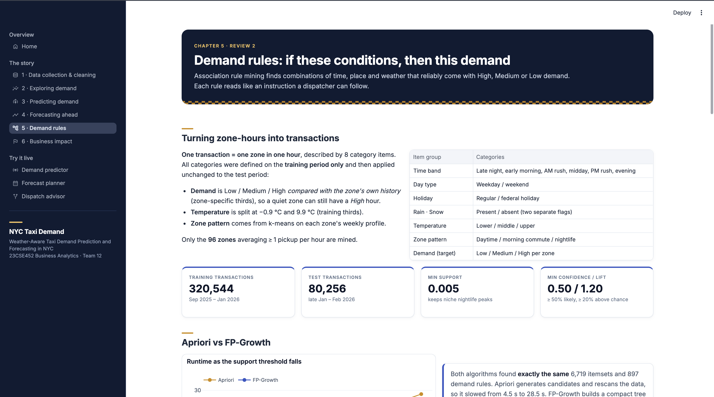
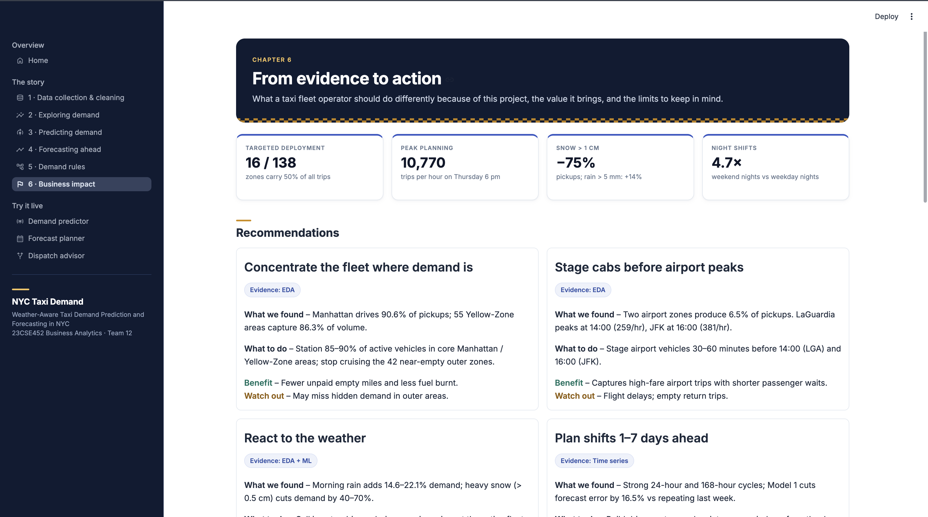
MANDATORY LIVE DEMONSTRATION
Interactive dashboard or website
Notes:
Suggested time: 120 seconds. Replace bracketed prompts with your project evidence. Present actual results only. Switch to the working application. Demonstrate meaningful interaction using the final project data and results. Show relevant findings from the complete project. A screenshot supports the presentation but does not replace the live demonstration. Test the application before the panel.

Slide 42
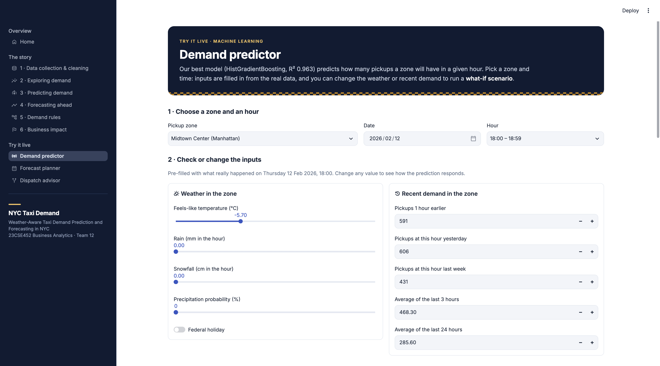
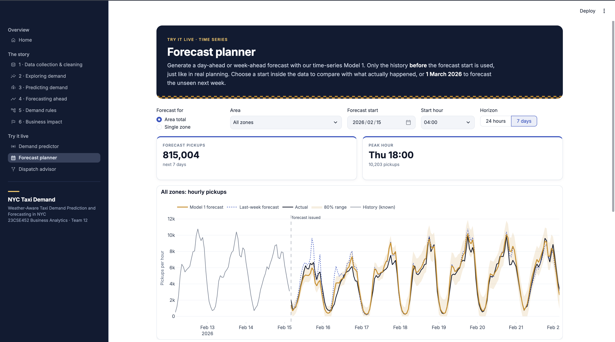
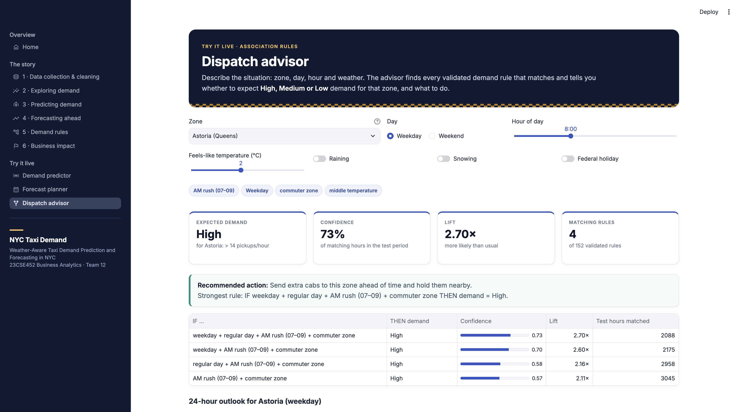
MANDATORY LIVE DEMONSTRATION
Interactive dashboard or website
Notes:
Suggested time: 120 seconds. Replace bracketed prompts with your project evidence. Present actual results only. Switch to the working application. Demonstrate meaningful interaction using the final project data and results. Show relevant findings from the complete project. A screenshot supports the presentation but does not replace the live demonstration. Test the application before the panel.

Slide 43
Comparative Analysis
Criterion | Correa and Moyano [1] | Rajendran [2] | Current project
Data and setting | 90 M Yellow, Green and Uber trips; five boroughs; 2014 | NYC taxi and air-taxi demand with time and weather factors | 23.3 M Yellow and Green trips; Manhattan and Queens; 2025–26
Prediction approach | Hourly demand prediction | Classification of air-taxi demand | Zone-level hourly demand regression and time-series forecasting
Machine learning methods | Regression, Random Forest, XGBoost | Logistic Regression, Neural Network, Random Forest, Gradient Boosting | Linear Regression, Random Forest, HistGradientBoosting
Best reported ML result | XGBoost best; RMSE 38.51, R² 0.97 | Gradient boosting best; location, time, weekday key | HistGB best; RMSE 13.16, R² 0.963; lags, zone, hour key
Time-series methods | Not reported in the cited study | Not reported in the cited study | Dynamic Harmonic Regression (DHR), MSTL + ETS, seasonal/TSB forecasting
Temporal modelling | Hourly demand patterns | Time and weekday factors | Chronological validation, daily and weekly seasonality, lag features and rolling-origin evaluation
Additional forecasting evaluation | — | — | DHR: test MAE 11.98, WAPE 30.51%; MSTL + ETS: test MAE 11.35, WAPE 33.24%
Notes:
Suggested time: 120 seconds. Replace bracketed prompts with your project evidence. Present actual results only. Switch to the working application. Demonstrate meaningful interaction using the final project data and results. Show relevant findings from the complete project. A screenshot supports the presentation but does not replace the live demonstration. Test the application before the panel.

Slide 44
100% PROJECT IMPLEMENTATION
Completion and individual contribution
Team member | Completed responsibility | Evidence / project-board task
Adithya Ajay CB.SC.U4CSE23102 | Data Collection and Dataset Preparation, Time Series Data Preparation, Time Series Analysis – Model 1 | Data Collection Time Series Dataset Branch TSA Model 1 Branch
Amrith B CB.SC.U4CSE23105 | Exploratory Data Analysis – 1, Developed Interactive Dashboard on Tableau | EDA Branch Tableau Link
Arun N CB.SC.U4CSE23406 | Exploratory Data Analysis – 2, Data Preparation for Association Rule Mining | EDA Branch DataPrep for ARM DataPrep commit
Pranathi Nibhanipudi CB.SC.U4CSE23643 | Data preprocessing and feature engineering, Association Rule Mining | data_processing.md association_rule_mining.md
SADHANA T P CB.SC.U4CSE23441 | Predictive Modeling and Time Series Analysis | CSE23441
Project board: GitHubBoard
Repository / deliverables: nyc-taxi-demand-forecasting.git
Tableau : nyc-taxi-demand-forecasting-dashboard
Notes:
Suggested time: 45 seconds. Replace bracketed prompts with your project evidence. Present actual results only. Delete the fifth member row for a four-member team. Confirm all Units 1–3 components, final evaluation and interactive application are complete. Use activity history and task evidence to support individual contribution.

Slide 45
FINAL PROJECT OUTCOME
Conclusion and limitations
Main outcome
Developed an end-to-end taxi demand forecasting workflow for 138 zones across Manhattan and Queens using NYC TLC trip records and hourly weather data.
Business value
Targeted fleet deployment: 16 of 138 zones account for 50% of all trips, enabling operators to prioritize high-demand zones when positioning taxis.
Peak-hour planning: Thursday at 6 PM records 10,770 trips per hour, helping dispatchers plan driver availability around peak demand.
Weather-responsive operations: Snowfall above 1 cm is associated with a 75% reduction in pickups, while rainfall above 5 mm is associated with a 14% increase, supporting weather-aware fleet planning.
Demand-based scheduling: Weekend nights (12–3 AM) are 4.7 times busier than weekday nights, indicating where additional night-shift coverage may be needed.
Limitations
Only six months of data (September 2025–February 2026) were available.
Unusual events can cause substantial forecasting errors.
MAPE is difficult to interpret when actual demand is zero or very low.
Future scope
Incorporate multiple years of data and additional special-event information.
Improve forecasts during sudden demand changes due to unusual events.
Deploy a live dashboard with regularly updated forecasts and actionable fleet-allocation recommendations.
Notes:
Suggested time: 40 seconds. Replace bracketed prompts with your project evidence. Present actual results only. Core implementation must be complete. Future scope should describe extensions, not unfinished mandatory components. Keep detailed references, additional charts and code explanations in optional backup slides. Reserve panel questions for after the presentation.

