Slide 1

Fake News Detection using GNN
Under the Guidance of
Ms. T N SriRanjani
Team members:
A Sai Vijaya - 23BD1A1203
B Aditya - 23BD1A1212
K Abhignya Shanthi Durga - 23BD1A1228
B Pranathi - 23BD1A1253

Slide 2
Abstract
The rapid spread of fake news across digital platforms has become a major societal concern, influencing public opinion and decision-making. Existing fake news detection models primarily rely on textual analysis or multimodal content understanding but often fail to perform logical fact verification and explain their decisions. Recent Retrieval-Augmented Generation (RAG) based systems improve verification by retrieving external evidence before making predictions.
However, these systems treat retrieved documents independently and fail to capture relationships among entities, events, and evidence.
This project proposes a Multimodal Fake News Detection System that combines Retrieval-Augmented Generation (RAG), Knowledge Graphs (KG), Graph Neural Networks (GNNs), and Large Language Models (LLMs) to perform explainable and accurate fake news detection. The system retrieves evidence from trusted sources, constructs a knowledge graph representing relationships among claims and retrieved evidence, applies a Graph Attention Network (GAT) to learn contextual relationships, and finally uses an LLM for reasoning and explanation generation. The proposed model aims to improve classification accuracy, explainability, and real-time verification capabilities over existing approaches.

Slide 3
Literature Survey
Paper | Method | Key limitation
BERT-based fake news detection (2023) | BERT text classification | No external evidence verification
Graph-FakeNewsNet (ECIR 2023) | Graph Attention Network (GAT) | No explainability or evidence retrieval
GNN-based fake news detection (2024) | GCN / GAT models | Limited factual reasoning
RAG-based verification (2025) | Retrieval-Augmented Generation | No graph-based relationship modeling
Multimodal RAG + LLM (Springer 2026) | RAG + LLM | No integration with graph reasoning
Proposed system | GAT + RAG + LLM | Graph learning + evidence verification + explainable prediction
Research gap: Existing methods either perform graph-based classification or evidence-based verification. The proposed system integrates GAT with RAG and LLM for accurate, explainable fake news detection.

Slide 4
Existing System
The existing fake news detection system uses Retrieval-Augmented Generation (RAG) integrated with
Large Language Models (LLMs) for multimodal misinformation detection.
Workflow
Accepts text and image as input.
Generates multimodal embeddings using a Vision-Language Model.
Retrieves relevant evidence from trusted sources using a vector database.
Passes the retrieved evidence along with the claim to an LLM.
The LLM classifies the news as Fake or Real and generates a textual explanation.
Technologies Used
Retrieval-Augmented Generation (RAG)
Large Language Models (LLMs)
Vision-Language Models (Qwen2-VL/LLaVA)
Vector Database
Multimodal Embeddings

Slide 5
Disadvantages of Existing System
Retrieved documents are processed independently, without modeling relationships.
Does not use Knowledge Graphs for structured representation of entities
and events.
Lacks graph-based reasoning between claims and evidence.
Explanations are generated by the LLM but do not provide explicit evidence
paths.
No reusable knowledge structure, requiring fresh retrieval for every query.
Performance depends heavily on the quality of retrieved documents.

Slide 6
Proposed System
The proposed system combines GAT, RAG, and LLMs for explainable fake news detection. It extracts text and image features, constructs a Knowledge Graph, and uses a Graph Attention Network to learn relationships among entities. RAG retrieves relevant evidence from trusted sources, and the LLM verifies the prediction to generate a reliable Fake/Real classification with confidence and supporting evidence.
Accepts news text and images as input.
Uses BERT for text embeddings and a Vision Model for image feature extraction.
1. Input Layer
Accepts news text and images as input.
2.Knowledge Graph & GAT Analysis
Extracts entities and constructs a Knowledge Graph.
3.RAG-Based Evidence Retrieval
Retrieves relevant evidence from trusted sources using FAISS Vector Database and RAG.
The LLM combines graph insights with retrieved evidence.
Generates the final Fake/Real prediction, confidence score, and an explainable verification report.
4. LLM Verification & Explainable Output
Provides factual context to support or contradict the news claim.
A Graph Attention Network (GAT) learns semantic relationships between nodes to predict news credibility.
Uses BERT for text embeddings and a Vision Model for image feature extraction.
Extracts entities and constructs a Knowledge Graph.
A Graph Attention Network (GAT) learns semantic relationships between nodes to predict news credibility.
Retrieves relevant evidence from trusted sources using FAISS Vector Database and RAG.
Provides factual context to support or contradict the news claim.
The LLM combines graph insights with retrieved evidence.
Generates the final Fake/Real prediction, confidence score, and an explainable verification report.

Slide 7
Advantages of Proposed System
Enhanced Contextual Understanding : By constructing a Knowledge Graph, the system captures semantic relationships between claims, entities, events, and evidence instead of analyzing documents independently.
Improved Detection Accuracy : The Graph Attention Network (GAT) learns important relationships among graph nodes, resulting in more accurate fake news classification compared to text-only or traditional RAG-based approaches.
Evidence-Grounded Reasoning : The integration of RAG enables retrieval of real-time, trustworthy evidence from external knowledge sources, reducing reliance on the LLM's internal knowledge.
Explainable Predictions : The Knowledge Graph provides reasoning paths (e.g., Claim → Entity → Evidence → Verdict), making predictions transparent and easier to interpret.

Slide 8
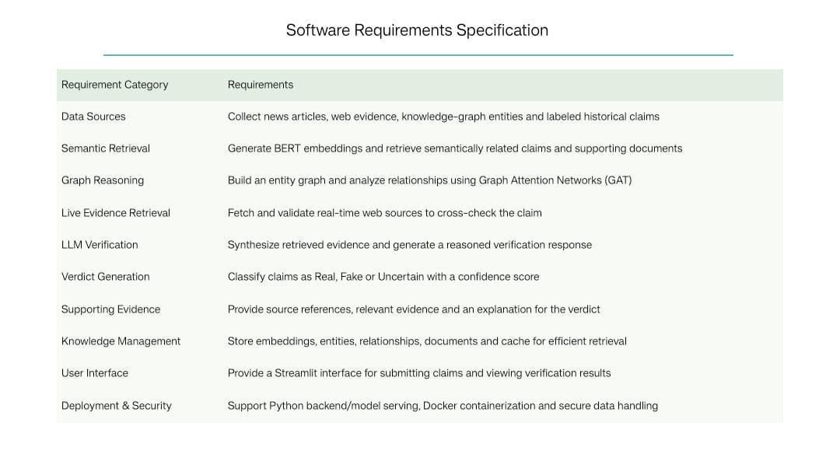

Slide 9
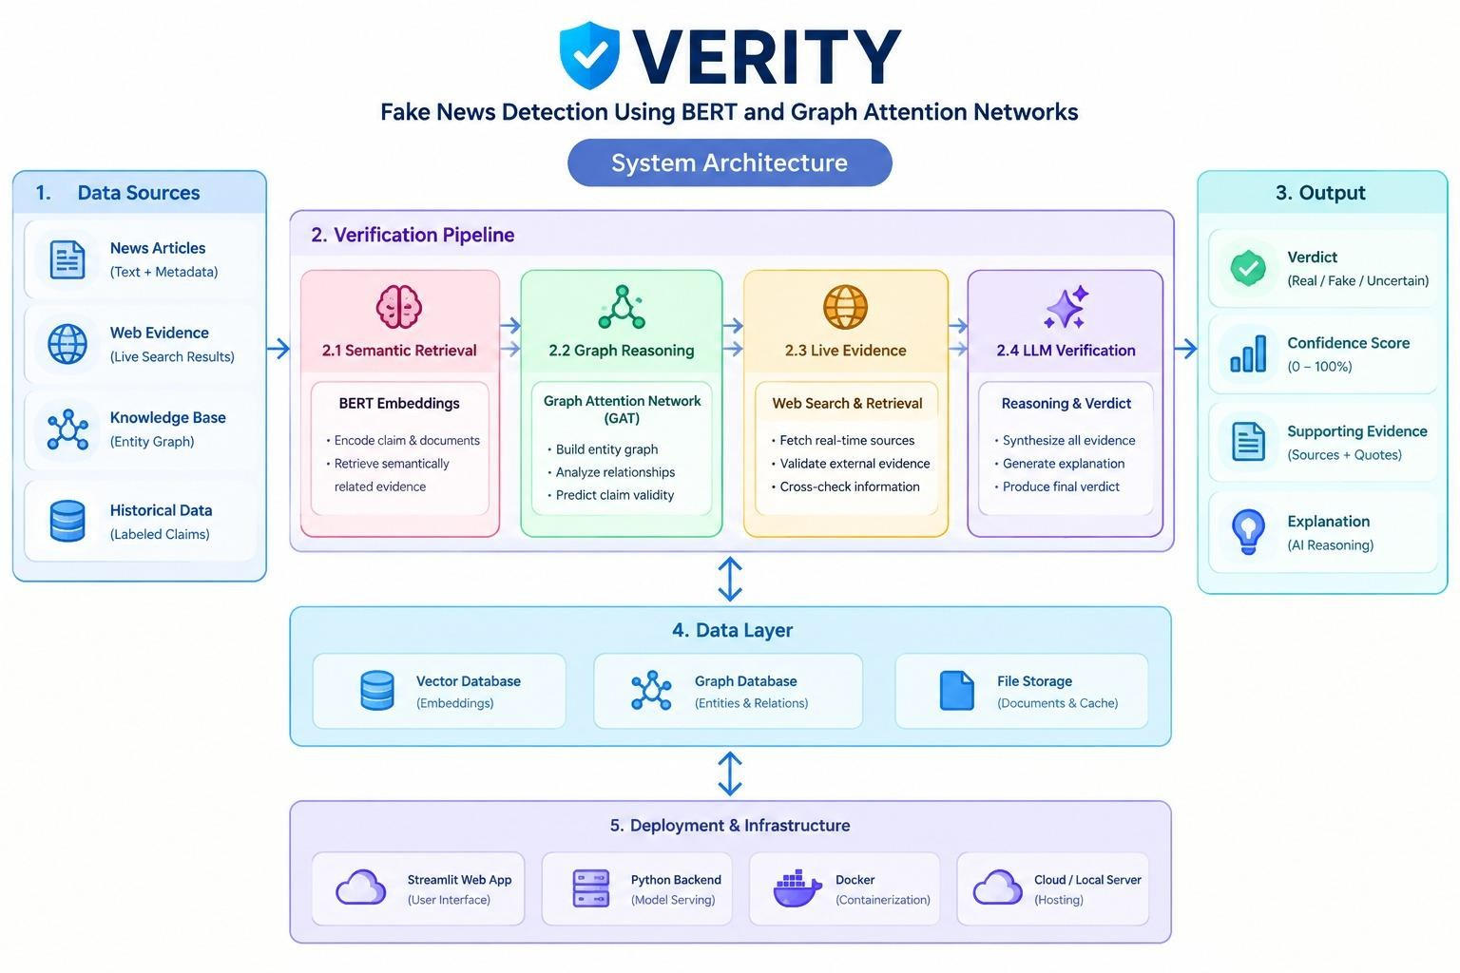
System Design

Slide 10
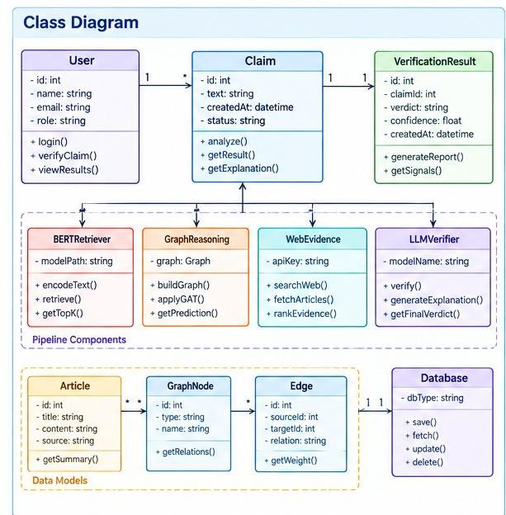
Class Diagram

Slide 11
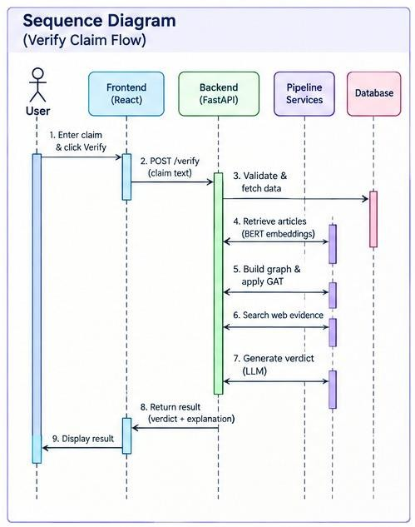
Sequence Diagram

Slide 12
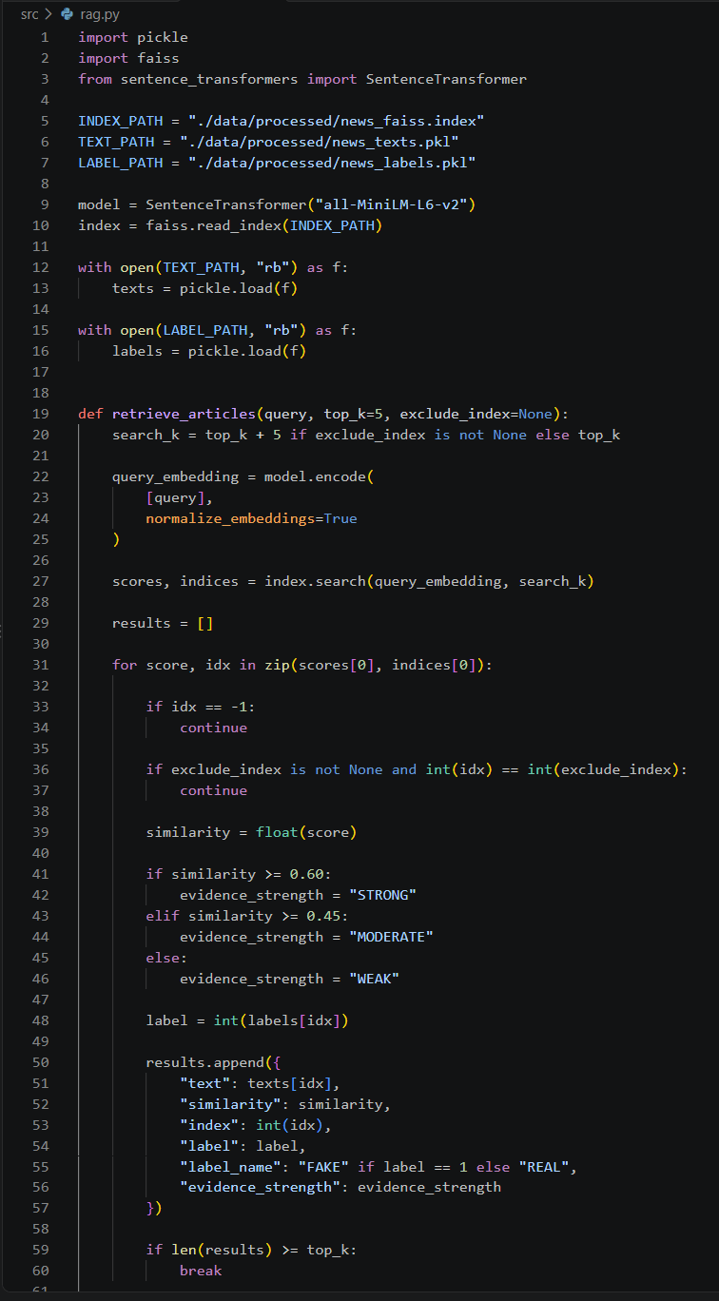
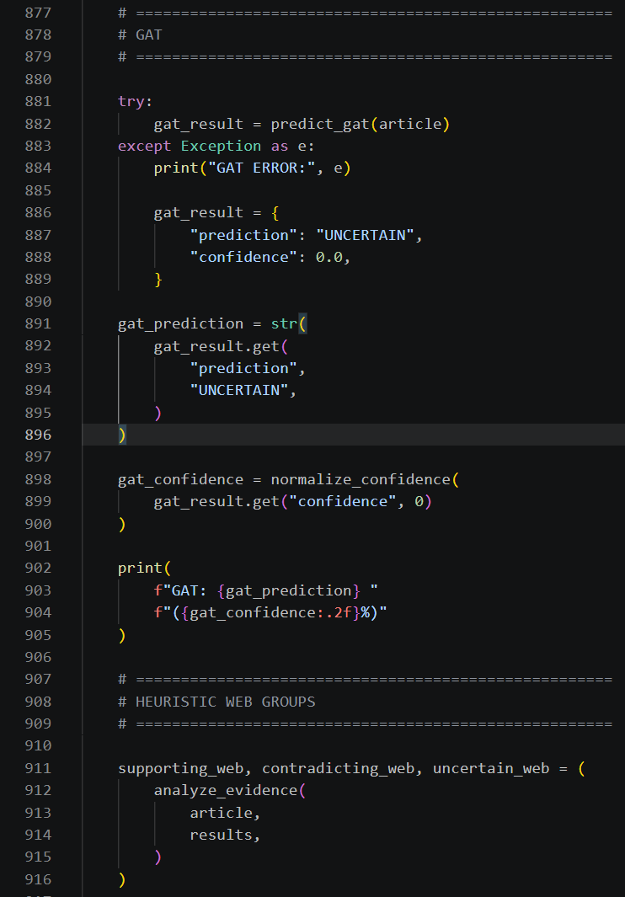
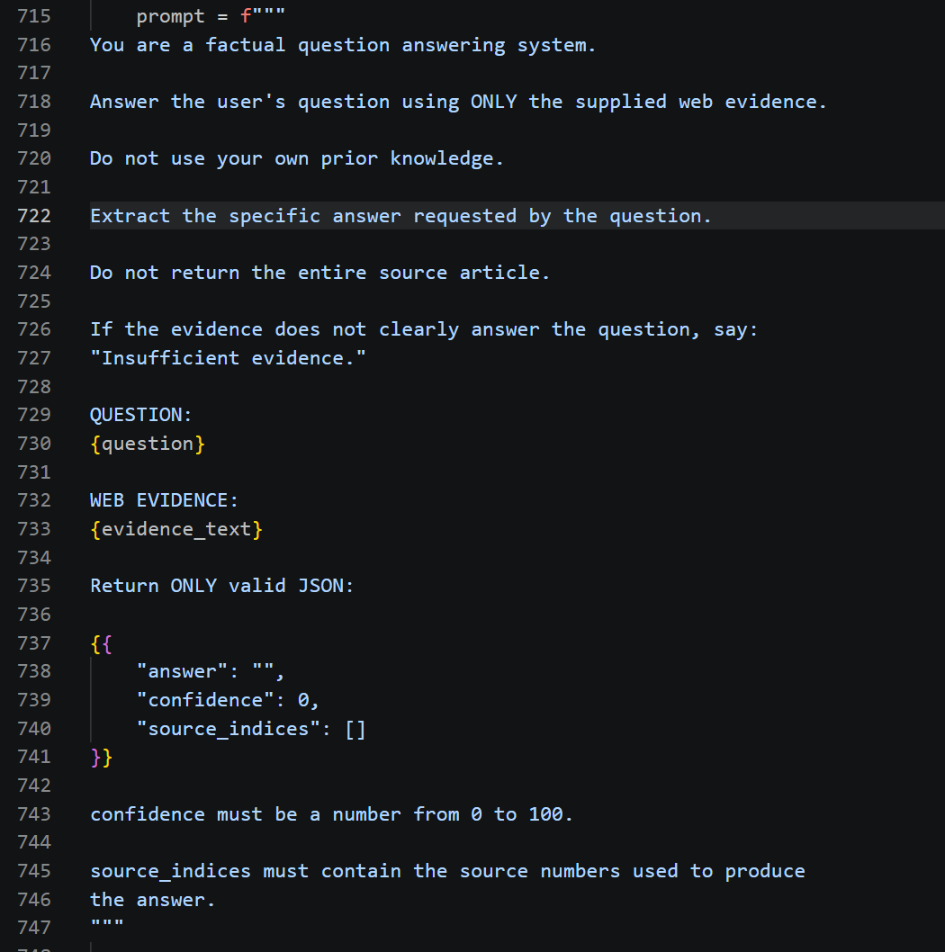
Code Snippet

Slide 13
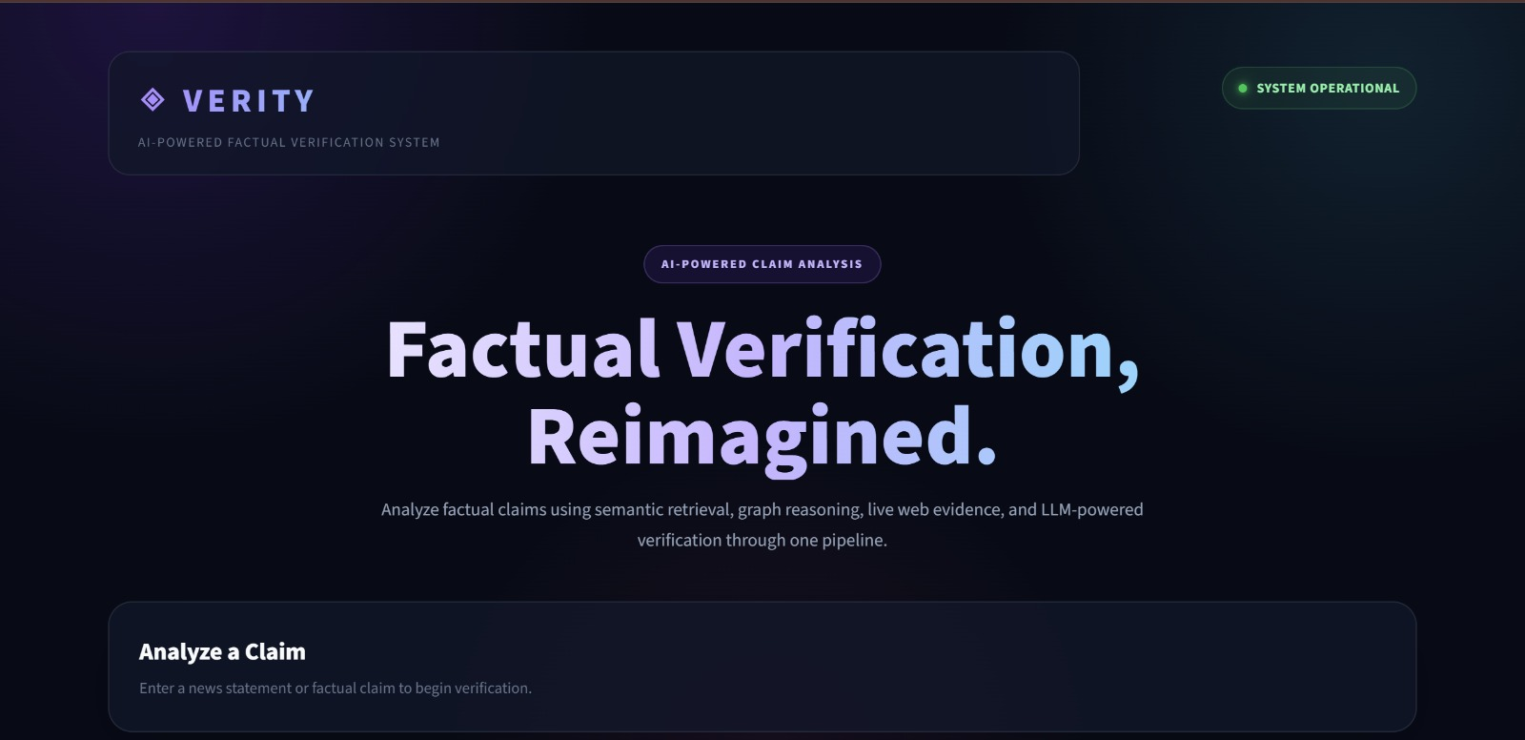
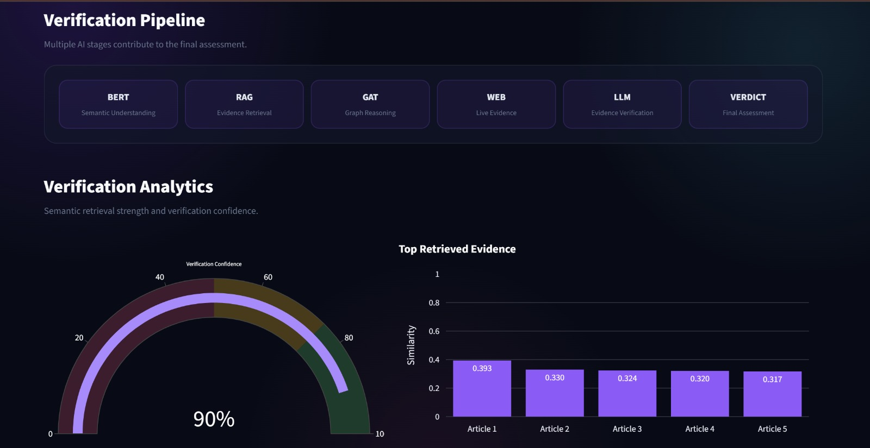
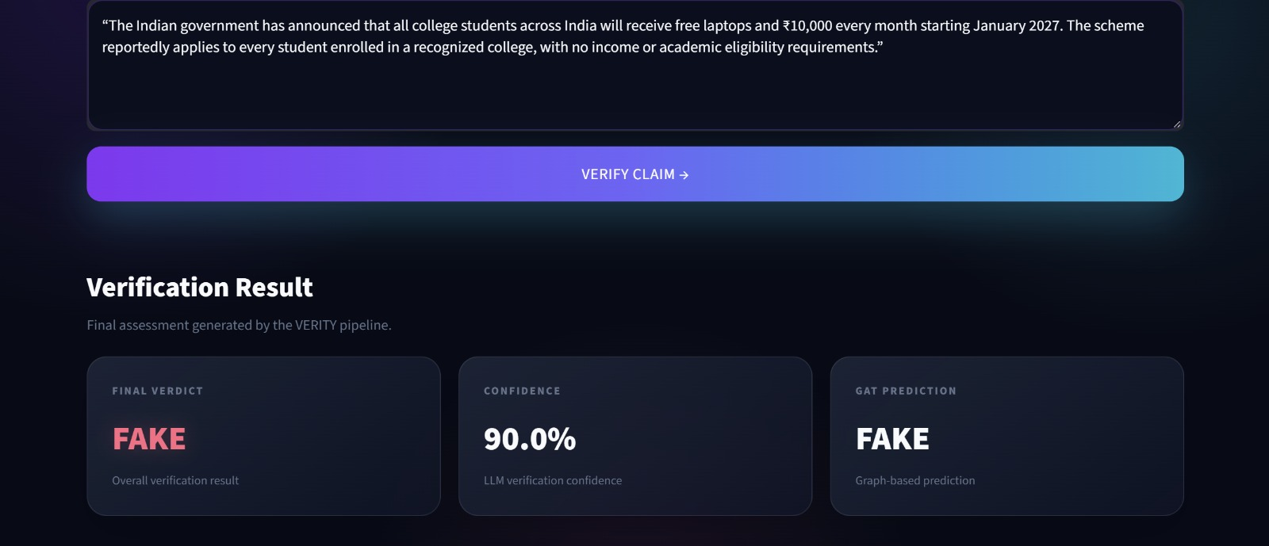
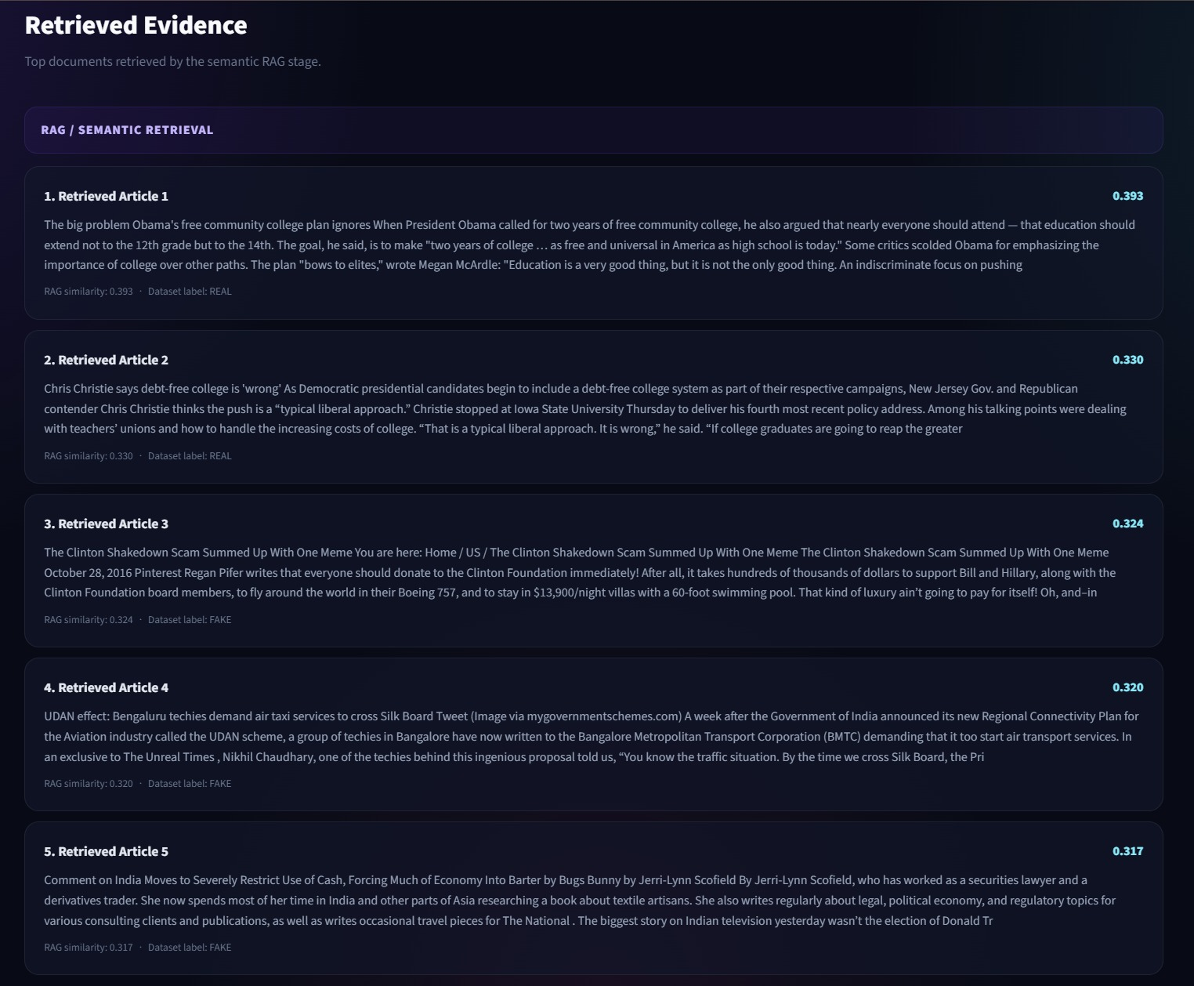
Output Screens

Slide 14
References
1. Shu, K., Sliva, A., Wang, S., Tang, J., & Liu, H. (2017). Fake News Detection on Social Media: A Data Mining Perspective. ACM SIGKDD Explorations, 19(1), 22–36. https://doi.org/10.1145/3137597.3137600
2. Shu, K., Mahudeswaran, D., Wang, S., Lee, D., & Liu, H. (2020). FakeNewsNet: A Data Repository with News Content, Social Context, and Spatiotemporal Information. Big Data, 8(3), 171–188. https://doi.org/10.1089/big.2020.0062
3. Deng, L., & Liu, Y. (Eds.). (2018). Deep Learning in Natural Language Processing. Springer. (Background for neural text representations.)
4. Veličković, P., et al. (2018). Graph Attention Networks. International Conference on Learning Representations (ICLR). https://arxiv.org/abs/1710.10903
5. Monti, F., et al. (2019). Fake News Detection on Social Media using Geometric Deep Learning. arXiv:1902.06673. https://arxiv.org/abs/1902.06673
6. Lewis, P., et al. (2020). Retrieval-Augmented Generation for Knowledge-Intensive NLP Tasks. NeurIPS. https://arxiv.org/abs/2005.11401
7. Johnson, J., Douze, M., & Jégou, H. (2019). Billion-scale similarity search with GPUs. IEEE Transactions on Big Data, 7(3), 535–547. https://arxiv.org/abs/1702.08734
8. Devlin, J., Chang, M.-W., Lee, K., & Toutanova, K. (2019). BERT: Pre-training of Deep Bidirectional Transformers for Language Understanding. NAACL-HLT. https://arxiv.org/abs/1810.04805
9. Radford, A., et al. (2021). Learning Transferable Visual Models From Natural Language Supervision. ICML. https://arxiv.org/abs/2103.00020
10. PyTorch Geometric. UPFD dataset documentation (Politifact and GossipCop propagation graphs). https://pytorch-geometric.readthedocs.io/
11. Hugging Face. Transformers documentation. https://huggingface.co/docs/transformers
12. Groq. API documentation. https://console.groq.com/docs

Slide 15
Thank You

