Slide 1

PREDICTION OF RAINFALL USING LOGISTIC REGRESSION
Project Supervisor: Dr. A. Jemshia Miriam
Name of the Student: Kantipudi Pranathi
Register Number: 39110448

Slide 2
Presentation Outline
Course Certificate
Introduction
Objectives
System Architecture
Module Implementation
Methodology- Snapshots
Results and Discussions
Conclusion & Future work
References

Slide 3
Course Certificate

Slide 4
Introduction
Prediction of Rainfall using Machine Learning algorithm which gives the best results for people to predict the rainfall.
Logistic Regression - Logistic regression is a statistical analysis method to predict a binary outcome, such as yes or no, based on prior observations of a data set.
For the dataset which is collected by me from Kaggle, on comparing accuracy of different algorithms like random forest and logistic regression, it is shown that logistic regression gives best accuracy and result for that dataset.

Slide 5
Objectives
To use Logistic Regression for predicting best and accurate results.
Using python programming language and NumPy, pandas, matplotlib, sklearn as the libraries used to pre-process, visualize and train the models for prediction.
Logistic regression aims to measure the relationship between a categorical dependent variable and one or more independent variables (usually continuous) by plotting the dependent variables' probability scores.

Slide 6
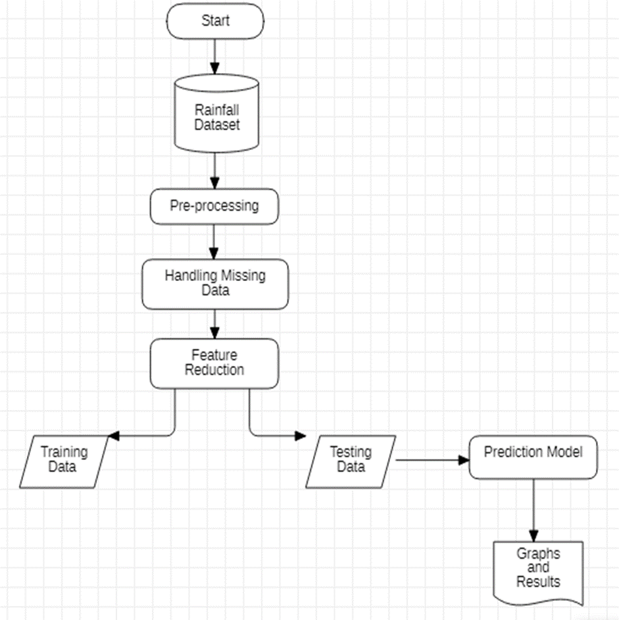
System Architecture

Slide 7

Project Implementation
LOGISTIC REGRESSION - It is used for predicting the categorical dependent variable using a given set of independent variables. Therefore, the outcome must be a categorical or discrete value. It can be either Yes or No, 0 or 1, true or False.
EQUATION FOR LOGISTIC REGRESSION

Slide 8
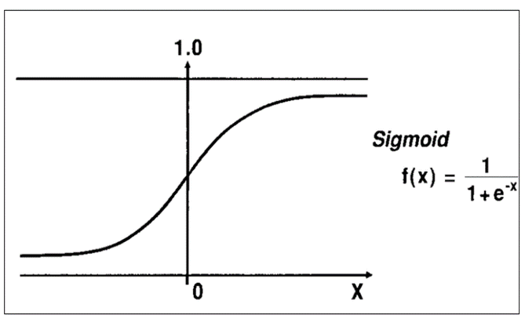
Logistic Regression
We have a concept called Decision Boundary(db) in Logistic regression. This is a line which splits from one class to other class. By default db will be 0.5 , the process goes like if the resultant data are less than (db)0.5 it can be classified as 0 & if data are greater than (db)0.5 it is 1 and vice versa.

Slide 9
Module Implementation
Pandas: Used for data wrangling and analysis.
NumPy: Stands for Numerical Python.
Matplotlib: Matplotlib is a plotting library for the python programming.
Sklearn: The sklearn library contains a lot of efficient tools for machine learning and statistical modeling including classification, regression, clustering and dimensionality reduction.
Logistic Regression: Performs the task to predict values based on the given data.
Metrics: Metrics influences how the performance of machine learning algorithms is measured and compared.

Slide 10
Methodology
Import Libraries
Load the Dataset
Cleaning the Data
Data Visualization
Divide the Dataset into Independent and Dependent Variables
Splitting the Data into Training and Testing data
Fit the Logistic Regression Model
Predict the Output
Get the Accuracy Score.

Slide 11
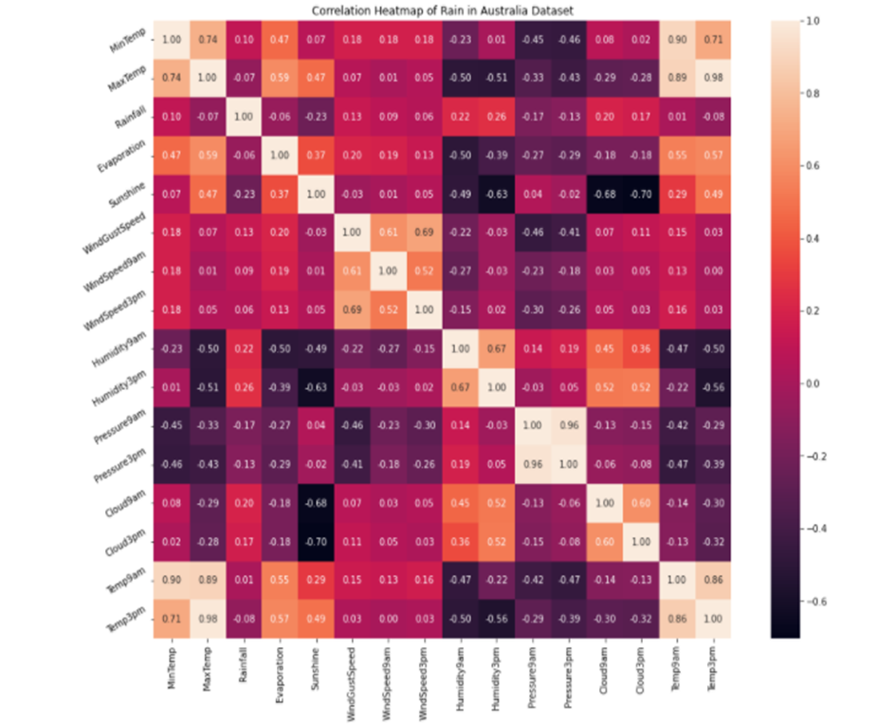
Heat Map

Slide 12
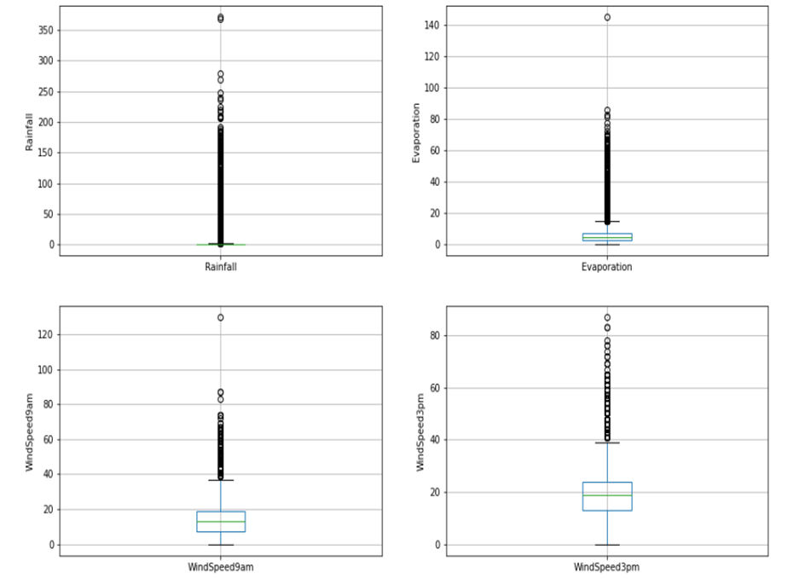
Data Visualization Graphs

Slide 13
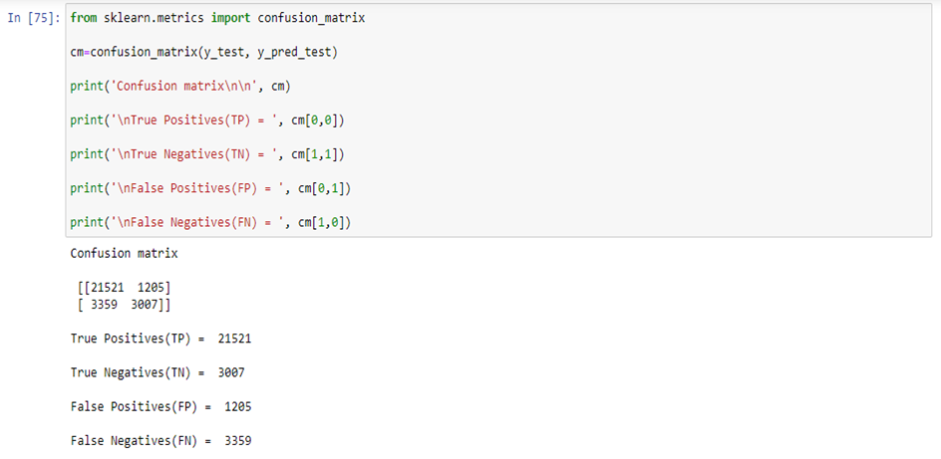
Performance Analysis
In statistics, the actual value is the value that is obtained by observation or by measuring the available data. It is also called the observed value. The predicted value is the value of the variable predicted based on the regression analysis.

Slide 14
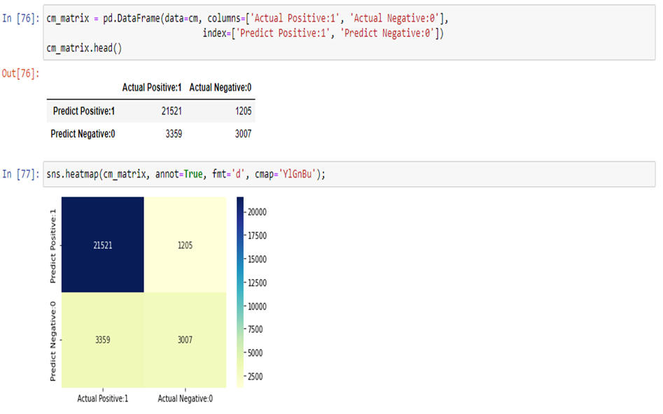
Performance Analysis
By comparing the predicted value and provided value one can identify how exactly Is machine learning working. And can also plot that difference between the test value and predicted value using seaborn.

Slide 15
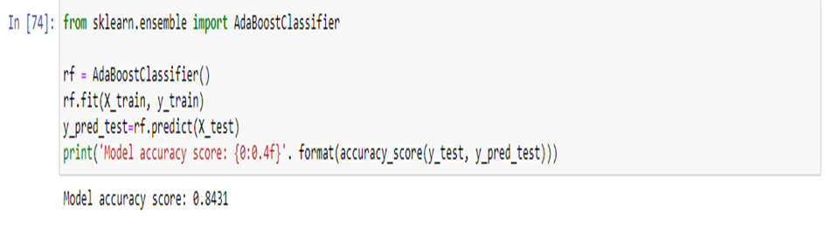
Result and Discussion
In this project core motive is to finding out the algorithm which gives us the good prediction of rainfall. Here we took the rainfall data of Australia from the Kaggle. Below is the information of the accuracy of the algorithms.

Slide 16
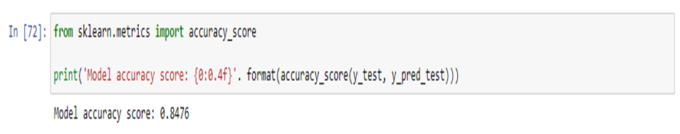
Result and Discussion
Here we can see that the Logistic Regression comes up as the best algorithm for the rainfall prediction.

Slide 17
Conclusion
This Project has presented a supervised rainfall learning model which used machine learning algorithms to classify rainfall data. We used different machine learning algorithm to check the accuracy of rainfall prediction.
As the data increases the complexity of that data will increase and for that we are using machine for the better understanding of that data.
In Weather predictions it’s pretty helpful with good accuracy score and in rainfall also its gives pretty good predictions.

Slide 18
References
https://ukdiss.com/examples/rainfall-prediction-machine-learning.php
https://www.kaggle.com/code/ziadshamndy/rain-prediction-analysis-with-85-45-accuracy/notebook
https://github.com/Vasanthengineer4949/Rain-Prediction
https://www.google.com/search?q=python+modules&rlz=1C1CHBF_enIN914IN914&oq=python+modules&aqs=chrome..69i57j0i433i512j0i512l4j0i10i512j0i512l3.7884j0j7&sourceid=chrome&ie=UTF-8

Slide 19

Prediction of Rainfall

Slide 20

Prediction of Rainfall

