Slide 1
What is TLS Vulnerability?
A TLS (Transport Layer Security) vulnerability is a weakness or flaw in the TLS protocol or its implementation that can be exploited by attackers to compromise the security of communications over the internet.
What is SSL Vulnerability?
SSL (Secure Sockets Layer) vulnerability is a weakness or flaw in the SSL protocol or its implementation that can be exploited by attackers to compromise the security of communications over the internet.
TLS/SSL vulnerabilities can include weaknesses in encryption algorithms, key exchange mechanisms, and protocol design, among others.

Slide 2
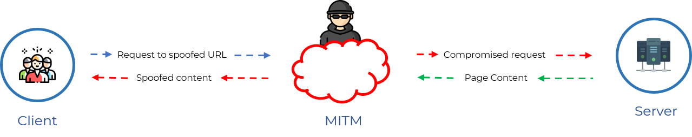
Freak Attack:
An SSL/TLS implementation exploit called FREAK ("Factoring RSA Export Keys") occurs when RSA key exchange is used to safely negotiate pre-master-secret.
This vulnerability, which is currently known as "FREAK," allows attackers to intercept HTTPS connections between affected clients and servers and force them to utilise "export-grade" cryptography. Its CVE number is 2015-0204.
This high-security encryption uses outdated encryption key lengths that are simple to decrypt.

Slide 3
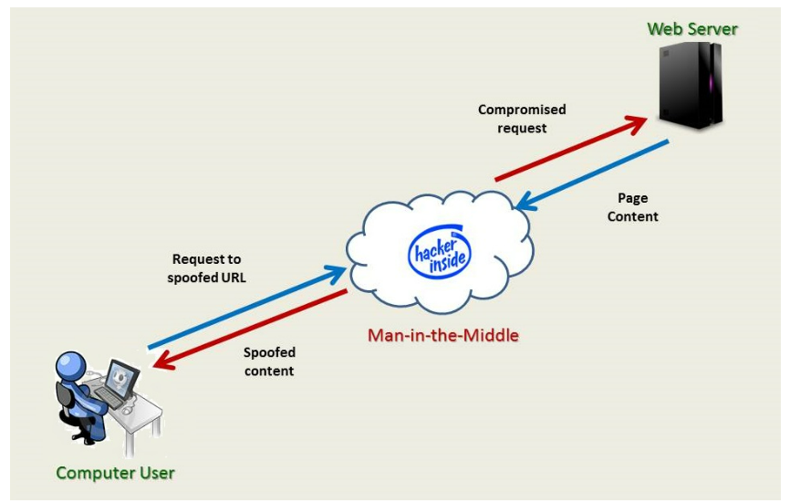
Working:
The FREAK vulnerability works by exploiting the fact that some SSL/TLS implementations support weak, export-grade ciphers that were required by US law in the 1990s.
These ciphers use short, 512-bit RSA keys that can be factored relatively easily with modern computing power.
An attacker can intercept the initial SSL/TLS handshake between a client and server and force them to use an export-grade cipher, which the attacker can then use to factor the RSA key and potentially decrypt the traffic.

Slide 4
How to avoid this attack?
Server side:Turn off server support for all export-grade cypher suites. Also, we advise eliminating support for cyphers with 40- and 56-bit encryption, forward secrecy, and support for all known unsafe cyphers (not only RSA export ciphers).
Client side:Client software that utilises OpenSSL, Apple's Secure Transport, Windows Secure Channel/Schannel, Chrome, Safari, Opera, Android, and BlackBerry stock browsers are examples of vulnerable clients (i.e. Internet Explorer). The most recent releases of OpenSSL should be installed immediately on older versions.

Slide 5
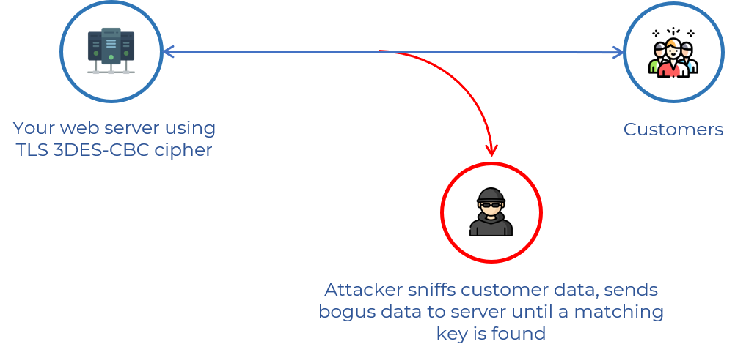
Sweet32 (Birthday Attack):
The Sweet32 birthday attack is a cryptographic vulnerability that affects 64-bit block ciphers, such as Triple-DES and Blowfish, when used in Cipher Block Chaining (CBC) mode.
It was first disclosed in 2016 and has been addressed by most modern web browsers and other applications that use encryption.

Slide 6
Mitigation Techniques:
The Sweet32 attack can be mitigated by using block ciphers with larger block sizes, such as AES, or by using alternative encryption modes, such as Galois/Counter Mode (GCM) or CCM.
The attack can also be mitigated by limiting the amount of data encrypted with the same key in CBC mode, or by using random IVs (initialization vectors) for each message to ensure that the same plaintext block is not encrypted with the same key and IV combination.
It is important to keep software up-to-date to ensure that it is not vulnerable to the Sweet32 attack.

Slide 7
BEAST Attack:
(Browser Exploit Against SSL/TLS)
A Beast vulnerability is a type of security flaw that can be exploited by attackers to intercept and decode encrypted data transmitted over the internet.
The vulnerability allows an attacker to intercept and decrypt data by exploiting weaknesses in the way SSL/TLS encrypts data.
A Beast attack can allow an attacker to access sensitive information such as credit card numbers, login credentials, and other personal data.

Slide 8
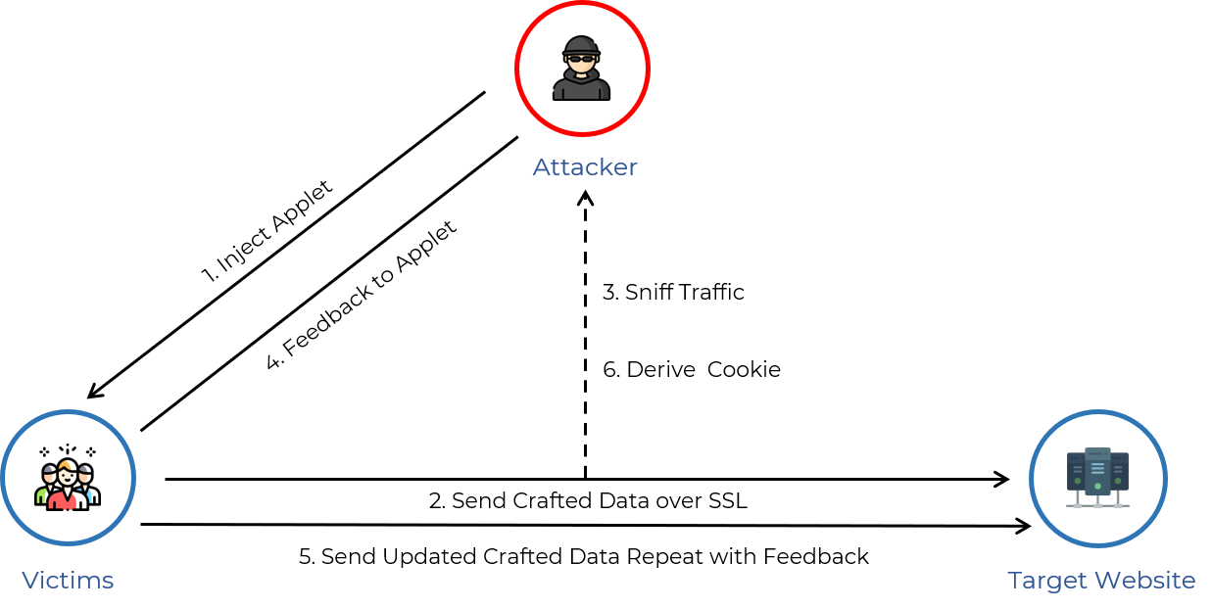
Mitigation:
Implementing the latest SSL/TLS encryption protocols that are not vulnerable to Beast attacks.
Configuring web servers and applications to use secure encryption protocols and disabling older protocols that are vulnerable to Beast attacks.
Regularly updating software and security patches to prevent known vulnerabilities from being exploited.
Encouraging the use of strong passwords and two-factor authentication to prevent unauthorized access to accounts.
Developing and enforcing security policies that outline best practices for data protection and incident response.

Slide 9
CRIME Attack:
(Compression Ratio Info-leak Made Easy)
The CRIME attack is a vulnerability in the compression of the Secure Sockets Layer (SSL)/Transport Layer Security (TLS) protocols and the SPDY protocol.
SSL/TLS and SPDY use a compression algorithm called DEFLATE, the most common compression algorithm used, which compresses HTTP requests by eliminating duplicate strings.
CRIME takes advantage of the method in which duplicate strings are eliminated to guess session tokens by systematically brute-forcing them.

Slide 10
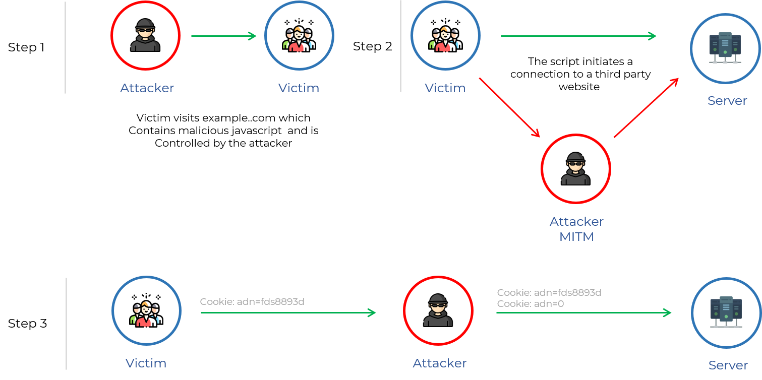
Figure of CRIME attack:

Slide 11
Mitigation techniques:
The CRIME vulnerability can be mitigated by disabling TLS/SSL compression, which reduces the attack surface and prevents attackers from using the compression ratio to their advantage.
Another mitigation technique is to implement HTTP Strict Transport Security (HSTS), which forces the use of HTTPS for all connections and prevents attackers from downgrading the connection to HTTP.
Finally, it is important to keep software and web browsers up-to-date to ensure that they are not vulnerable to the CRIME attack.

Slide 12
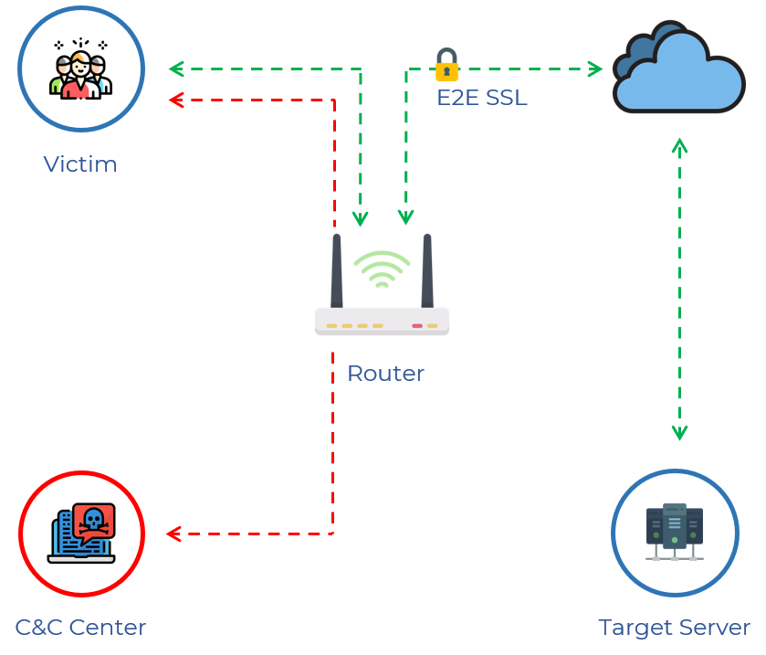
Breach Attack:
Attacks such as BREACH target HTTP answers that have been compressed with the more widespread HTTP compression, also known as content encoding and more frequently than TLS-level compression.
To be vulnerable to a BREACH attack, a web application must:
Be hosted on an HTTP-level compression-capable server.
User input is reflected in HTTP response bodies.
Reflect a secret (such as a CSRF token) in HTTP response bodies.

Slide 13
How to avoid this attack?
Secrets separation from user input.
Disabling Http compression.
Randomizing secrets per request.
Protecting vulnerable pages with CSRF.
Length Hiding(by adding a random number of bytes to the responses)
Rate-limiting the requests.

Slide 14
DROWN Attack:
DROWN was a vulnerability in SSL and TLS protocols that allowed attackers to decrypt encrypted traffic between a client and a server.
The abbreviation stands for Decrypting RSA with Obsolete and Weakened eNcryption.
It is a cross-protocol attack that exploits a vulnerability in the SSLv2 protocol version.
Specifically, it is a version of the Bleichenbacher RSA padding oracle attack.

Slide 15
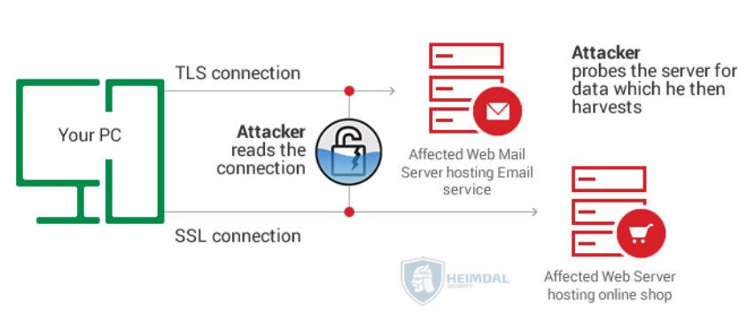
Mitigation techniques:
To protect against DROWN attacks, it is important to disable support for SSLv2 on servers and use newer and more secure encryption protocols such as TLS.
They must also ensure that the server’s private keys are not used anywhere else, such as in web servers, email servers such as SMTP, IMAP, or POP servers, etc., and server software that support SSLv2 connections.
Additionally, it is important to keep software and operating systems up to date with the latest security patches to prevent vulnerabilities that can be exploited in attacks like DROWN.

Slide 16
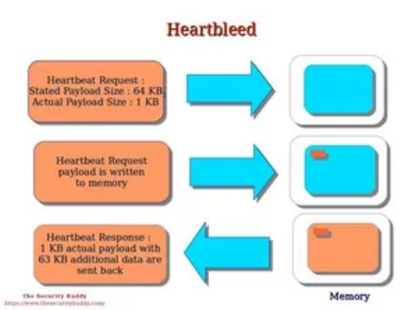
Heartbleed Attack:
Discovered in April 2014 in OpenSSL software library.
Affects the implementation of the TLS protocol's heartbeat extension.
Allows attackers to retrieve up to 64 kilobytes of memory from affected systems.
Exposes sensitive information such as passwords, private keys, and confidential data.
Affects a large number of websites and online services that use OpenSSL for security.

Slide 17
Mitigation Techniques:
OpenSSL software was quickly patched after discovery.
Affected websites and services urged to update OpenSSL software.
Users advised to change passwords on affected websites.
The vulnerability raised concerns about the security of open-source software.
Demonstrated the importance of staying informed about security vulnerabilities and taking steps to protect personal information online.

Slide 18
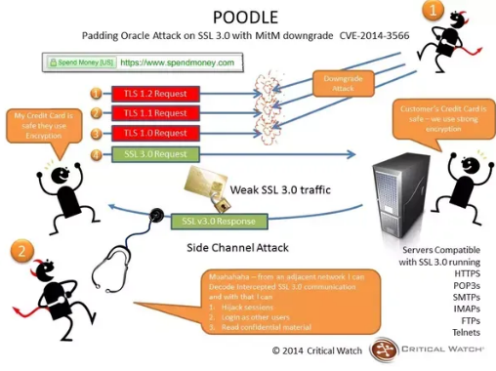
POODLE Attack:
(Padding Oracle On Downgraded Legacy Encryption)
Discovered in 2014 in SSLv3 (Secure Sockets Layer version 3) encryption protocol.
Allows attackers to intercept and read encrypted data.
Exploits a flaw in the block cipher padding of SSLv3.
Poodle stands for Padding Oracle On Downgraded Legacy Encryption.
Affects web browsers and servers that support SSLv3.

Slide 19
Mitigation Techniques:
SSLv3 was deprecated and replaced with TLS.
Web browsers and servers updated to support TLS and disable SSLv3.
Users advised to keep their web browsers updated and disable SSLv3 support.
The vulnerability raised concerns about the security of legacy encryption protocols.
Demonstrated the importance of regularly updating software and using modern encryption protocols.

Slide 20
SSL Stripping Attack:
SSL stripping is a type of man-in-the-middle attack that targets websites and applications that use SSL/TLS encryption protocols to secure communication between clients and servers.
Here's how an SSL stripping attack works:
The attacker intercepts the communication between the client and the server and initiates a connection with the client.
The attacker then downgrades the connection to an unencrypted HTTP connection, stripping away the SSL/TLS encryption.
The attacker then serves a fake webpage that looks like the original webpage, but is actually a phishing webpage that collects sensitive information such as usernames, passwords, and credit card details.
The attacker can then use this information for nefarious purposes, such as stealing money or identities.

Slide 21
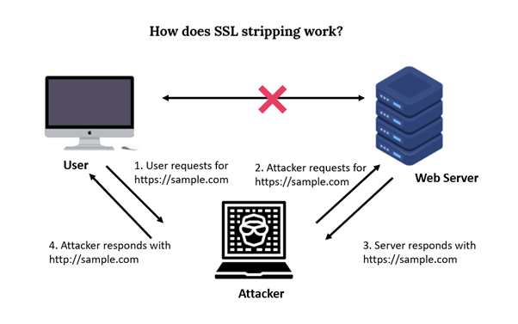
How to avoid this attack?
Use HTTP Strict Transport Security(HSTS):By requiring secure connections, the HSTS protocol, which encourages browsers to only connect to websites through HTTPS, can help prevent SSL stripping attacks.
Use certificate pinning:A website can define which SSL/TLS certificate(s) it should use using a technique called certificate pinning, which stops an attacker from using a bogus certificate.

