Slide 1
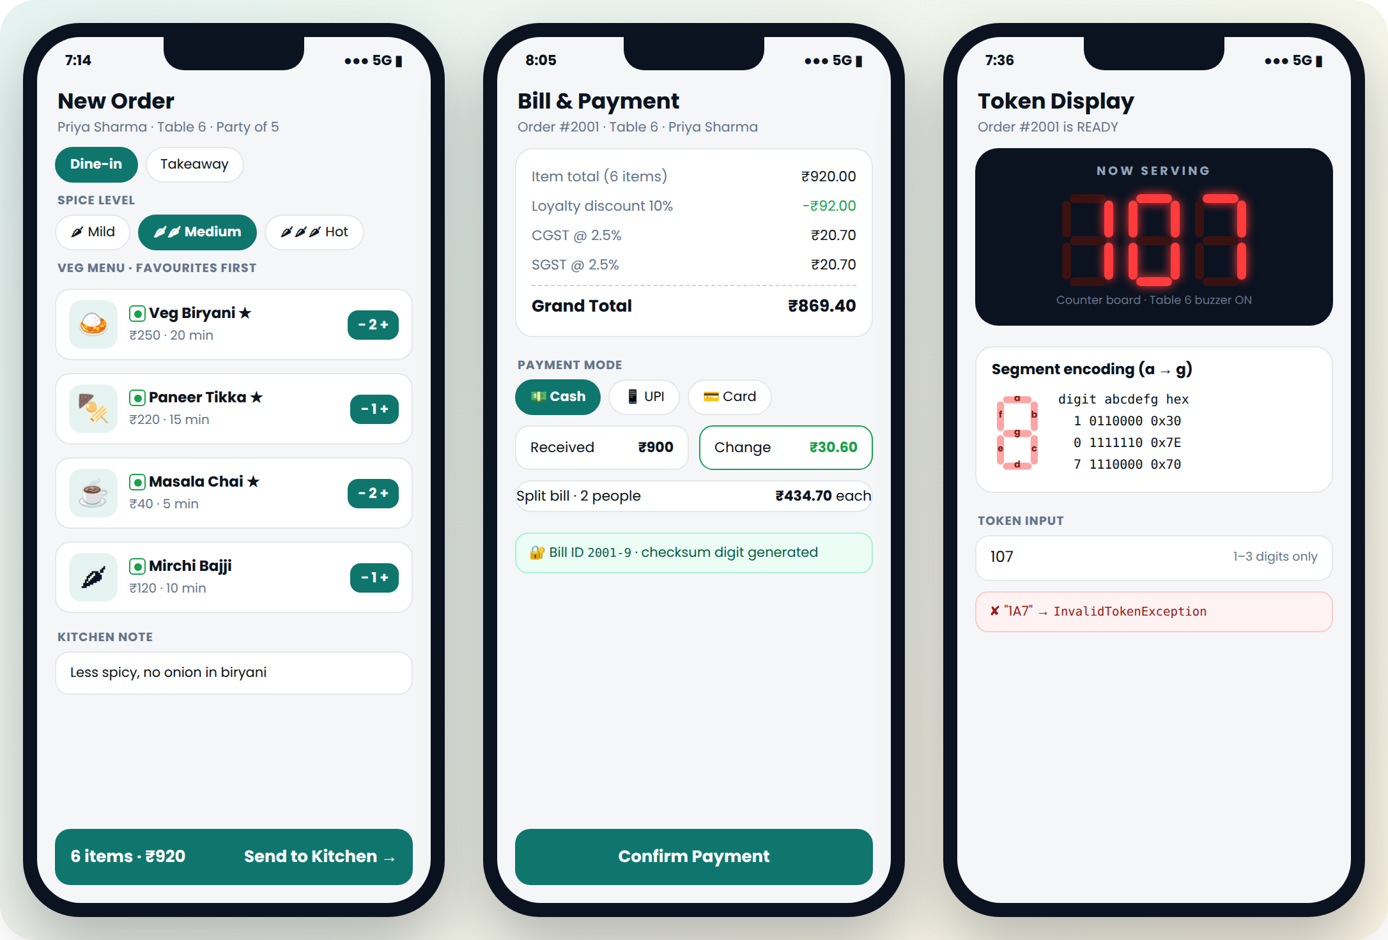
KLH · BACHUPALLY
DineSync
Smart Restaurant Management System with IoT-Based Kitchen Monitoring
JAVA EXPO · PROJECT BASED LEARNING
26SC1101E · Problem Solving Using Programming (Java) · A.Y. 2026-27
Pranathi Kusi
M. Sri Akhil Chowdary
2620040061
2620040112
Notes:
We are presenting DineSync, a smart restaurant management system built in Core Java. It connects the waiter, kitchen, cashier and manager in one order flow, and also simulates kitchen safety monitoring.

Slide 2




Abstract and project overview
Purpose
Problem
Connect waiter, kitchen, cashier and admin in one order flow: an order is entered once and moves to preparation, billing and feedback.
Paper slips and manual calculation cause delays, lost orders, billing mistakes and late detection of kitchen hazards.
Core Java solution
Benefits
13 connected modules, role-based login, automatic GST billing, check-digit bill IDs, simulated sensors, energy meter and daily reports.
Every input is validated, every error is handled without stopping, and reports always match the real bills.
Notes:
DineSync solves a simple everyday problem: restaurants that work on paper make mistakes in orders and bills, and they notice kitchen hazards late. Our Core Java program connects every role in one flow. Every input is validated, every error is caught and shown, and the program never crashes on a wrong input.

Slide 3
Problem statement and motivation
Restaurant challenge
DineSync feature
Slow floor-to-kitchen communication
M05 Kitchen queue: urgent first, ETA, chef assignment
Lost, misread or duplicated orders
M04 Order taking: validated dishes, quantities, unique order IDs
Errors in discount, tax and totals
M06 Billing: 10% loyalty, CGST 2.5%, SGST 2.5% calculated automatically
Fake or mistyped bill numbers
M12 Check digit: 2001-9 detects typing and swapped digits
No record of regular customers
M03 Profiles: visits, veg-only preference, top 3 favourites
Kitchen hazards noticed late
M10 Sensors (simulated): temperature, gas, smoke, humidity alerts
No view of sales and running costs
M08 Reports + M13 Energy meter: revenue, dishes, ratings, kWh, cost
Notes:
Each real problem maps to one module. Communication delays are solved by the kitchen queue. Billing errors are solved by automatic GST calculation. Fake bill numbers are caught by a check digit. Kitchen safety is handled by simulated sensors, and management gets daily reports.

Slide 4
System architecture
Console user interface — Main (role menus) + InputHelper (one Scanner, safe input)
Cluster A
Cluster B
Cluster C
Cluster D
RestaurantSetup
OrderKitchen
BillingFeedbackReports
SmartMonitoring
Login · Menu · Customers · Tables
Orders · Kitchen queue · Token
Bills · Check digit · Feedback · Reports
Sensors (simulated) · Energy meter
Models: Person → Staff, Customer · MenuItem → Veg / NonVeg / Beverage · Order, OrderItem · Bill (Billable) · Feedback · Sensor → KitchenSensor → 4 sensors · Appliance · 35 checked exceptions
Data storage actually used: in-memory arrays (Staff[], MenuItem[30], Customer[100], Order[], Bill[]) + bill history text file data/bills.txt (java.nio.file)
Not used: no database, no web server, no physical hardware, no frameworks
Notes:
Main creates the four cluster objects once and passes them to each other through constructors. OrderKitchen gets RestaurantSetup, and BillingFeedbackReports gets all three, so every module works on the same menu, tables and orders. There is no database or hardware: data lives in arrays in memory, and paid bills are also written to a text file.

Slide 5
13 modules in 4 clusters
Cluster A
Cluster B
Cluster C
Cluster D
Identity, Menu, Customers, Tables
Ordering, Kitchen, Token
Billing, Payment, Checksum, Feedback
Monitoring and Energy
M01 Login & Access Control
M04 Order Taking
M06 Billing & Payment
M10 Kitchen Sensor Monitoring
M02 Menu Management
M05 Kitchen Queue
M12 Bill Checksum Security
M13 Kitchen Energy Meter
M03 Customer Profile & Favourites
M11 Seven-Segment Token Display
M07 Feedback & Ratings
→ results feed M08
M09 Table Occupancy Register
M08 Reports & Analytics *
* The presentation brief lists M08 under Cluster D; the code keeps M08 in BillingFeedbackReports (Cluster C, as in the development plan), and it reads M10 and M13 results.
Notes:
These are the 13 modules from the requirements, grouped into 4 clusters. One note: the presentation brief put Reports, M08, under cluster D, but in our code it is inside BillingFeedbackReports, cluster C, as the development plan said. It reads the alert count and the energy cost from cluster D.

Slide 6
Login, menu, customers and the 8-bit table register
Cluster A
Cluster B
Cluster C
Cluster D
CLUSTER A · RestaurantSetup
Staff ID = role letter + 3 digits (W104); 4-digit PIN; 3 wrong PINs lock the account
M09 Table register: 8 bits = 8 tables
M01
T1
T2
T3
T4
T5
T6
T7
T8
0
1
0
0
1
0
1
0
Waiter, Chef, Cashier and Admin each see only their own menu
M01
0100 1010 = 0x4A T2, T5, T7 busy
0
1
0
0
1
1
1
0
Admin adds, reprices or hides dishes; 30-dish MenuItem[] holding VegItem, NonVegItem, Beverage
M02
0100 1110 = 0x4E party of 5 → T6
Mobile: 10 digits starting 6-9; visit count; loyalty when visits % 7 == 0; top 3 favourites first; veg-only filter
allocate reg |= 1 << (8 - t)
release reg &= ~(1 << (8 - t))
busy? (reg & mask) != 0
M03
Example Priya Sharma, visit #14 → 14 % 7 = 0 → 10% off; Veg Biryani, Paneer Tikka, Masala Chai shown first
Suggests the smallest free table that fits. T3 → TableCapacityException (4 seats); T5 → TableOccupiedException.
Notes:
Cluster A sets up the restaurant. Staff log in by role. The ID letter must match the role, and three wrong PINs lock the account. The admin manages the menu at run time. Customers are found by mobile number; Priya is on her 14th visit, so she gets 10 percent off. The table register stores 8 tables in one integer, one bit each. Allocating table 6 sets bit 2, so 0x4A becomes 0x4E.

Slide 7
Cluster B: ordering and kitchen workflow
PLACED
PREPARING
READY
SERVED
BILLED
Waiter
Chef
Chef + token
Waiter
Cashier
Skipping, reversing or the wrong role → InvalidStatusChangeException (only OrderKitchen.changeStatus changes a status)
Order: dish must be available and allowed by diet; qty 1-10 per dish; max 20 items
Order #2001: 6 items, Rs. 920.00, Medium spice, note to kitchen, token 107
Queue: urgent first, then oldest (Comparable + Collections.sort)
ETA = longest prep + 2 min × orders ahead = 20 + 2 × 2 = 24 min
READY automatically shows the token on the 7-segment display (M11)
[OK] #2001 -> READY - Token 107
+-------------+
| _ _ |
| | | | | |
| | |_| | |
+-------------+
1 = 0110000 (0x30)
0 = 1111110 (0x7E)
7 = 1110000 (0x70)
Actual program output (tests/e2e_output.txt)
Notes:
Every order follows five stages. Only the right role can move it, and only one step at a time; trying to jump from PLACED to SERVED throws InvalidStatusChangeException. Urgent orders go first. The ETA for order 2001 is 24 minutes: 20 minutes of biryani plus 2 minutes for each of the two orders ahead. When the chef marks it READY, token 107 appears on the simulated seven-segment display with the real segment codes.

Slide 8


Cluster C: billing, checksum and feedback
Bill 2001-9 (Priya, loyalty visit)
M12 check digit
Item total
920.00
Loyalty discount (10%)
−92.00
2001 → 1×1 + 0×2 + 0×3 + 2×4 = 9 → 2001-9
2010-9 → "check digit should be 0" (swapped)
2010-0 → valid digit, but bill not found
2001/9 → wrong format
Taxable amount
828.00
CGST 2.5%
20.70
SGST 2.5%
20.70
GRAND TOTAL
869.40
M07 feedback
Cash 900 → change
30.60
Bill ID verified through M12
Ratings 1-5, overall + each dish
One feedback per bill (HashSet)
Average 4.5 stars from 215 reviews
Split between 2
434.70 each
Payment: Cash · UPI (12-digit ref) · Card, all simulated
Notes:
Billing only works for a SERVED order, so no order can be billed twice. The bill uses the exact rules from the requirements: 10 percent loyalty, then CGST and SGST at 2.5 percent each. 920 becomes 869.40. Each bill ID carries a check digit: the digits are weighted 1, 2, 3, 4 from the right, and we calculate this sum with recursion. Feedback must use a verified bill ID, and only once per bill.

Slide 9

Cluster D: kitchen monitoring and energy
Simulated: readings come from Math.random() or a typed test value. No physical sensors are connected.
Temperature
limit 30-80 °C (55)
→ fan ON, burner reduced
Appliance | V × A × PF | h | kWh
Tandoor (highest) | 230 × 8.5 × 1.00 | 6 | 11.73
Induction | 230 × 9.0 × 0.95 | 4 | 7.87
Fridge* | 230 × 1.2 × 0.85 | 24 | 5.63
Fan* | 230 × 0.4 × 0.80 | 20 | 1.47
Total |  |  | 26.70
LPG gas
limit 100-1000 ppm (500)
→ valve closed, exhaust ON
Smoke*
limit 40 %
→ exhaust ON, alarm
20 × Rs.6 + 6.70 × Rs.8 = Rs. 173.60
P(W) = V × I × PF; E(kWh) = P × h ÷ 1000; sent to M08 report
Humidity*
limit 80 %
→ ventilation ON
58.4 °C > 55 → SensorAlertException caught, logged, work continues. *Smoke/humidity limits are assumptions.
*Fridge and Fan readings are assumed so the published 5.63 and 1.47 kWh are reproduced.
Notes:
Cluster D is the smart part, and it is honest about being simulated. Four sensors are stored in one Sensor array, which is polymorphism. A reading above its limit throws SensorAlertException, which is caught immediately so the kitchen keeps working. The energy meter uses real electrical formulas: power is V times I times power factor, and the slab tariff gives 173 rupees 60 paise for 26.7 units.

Slide 10
Java concepts used (with real code locations)
Java fundamentals
Methods and arrays
Object-oriented
Further curriculum
✓ Data types, operators, bitwise
TableRegister.allocate
✓ User-defined methods
calculateEta, checkDigit
✓ Classes, constructors, this
Customer(...) chaining
✓ Strings, StringBuilder
verifyBillId, receiptText
✓ Scanner, console I/O
Main.main, InputHelper
✓ Recursion
weightedSum
✓ Encapsulation
private fields, Order.setStatus
✓ Exceptions (35 checked)
every screen method
✓ if / switch / loops
Main menus, loginScreen
✓ 1-D / 2-D arrays
MenuItem[], String[10][3]
✓ Inheritance, abstract
Person, MenuItem, KitchenSensor
✓ File I/O, try-with-resources
saveBillToFile
✓ Type casting
getAverageRating
✓ Searching, sorting
binarySearch, Collections.sort
✓ Overloading / overriding
pay(...) ×3 / isVegFriendly
✓ Collections, generics
HashMap, HashSet, TreeMap
✓ Interfaces, polymorphism
Billable, Sensor[]
✓ Lambdas, streams
getOrderMenu, reports
Notes:
Every concept on this slide is in the real code, and we can open the file and show it. All nine mandatory concepts are here: data types and operators, Scanner, control structures, methods, arrays, inheritance, strings, exceptions, and both overloading and overriding. For example, pay is overloaded three times: with a double for cash, a String for UPI, and no extra argument for card.

Slide 11
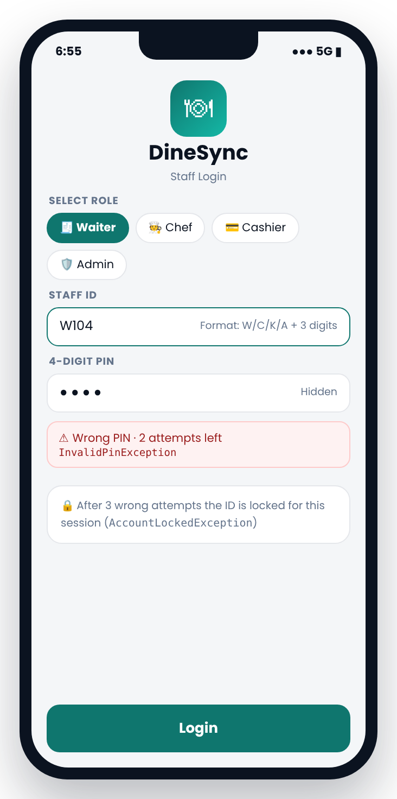
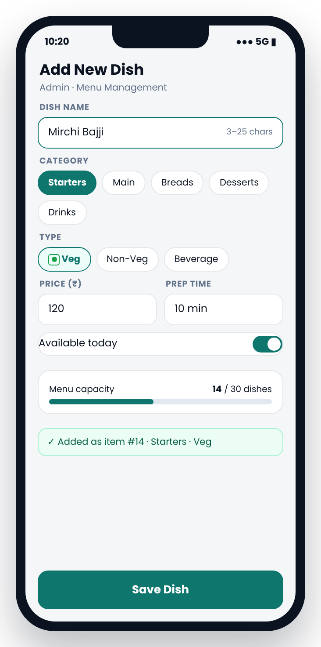
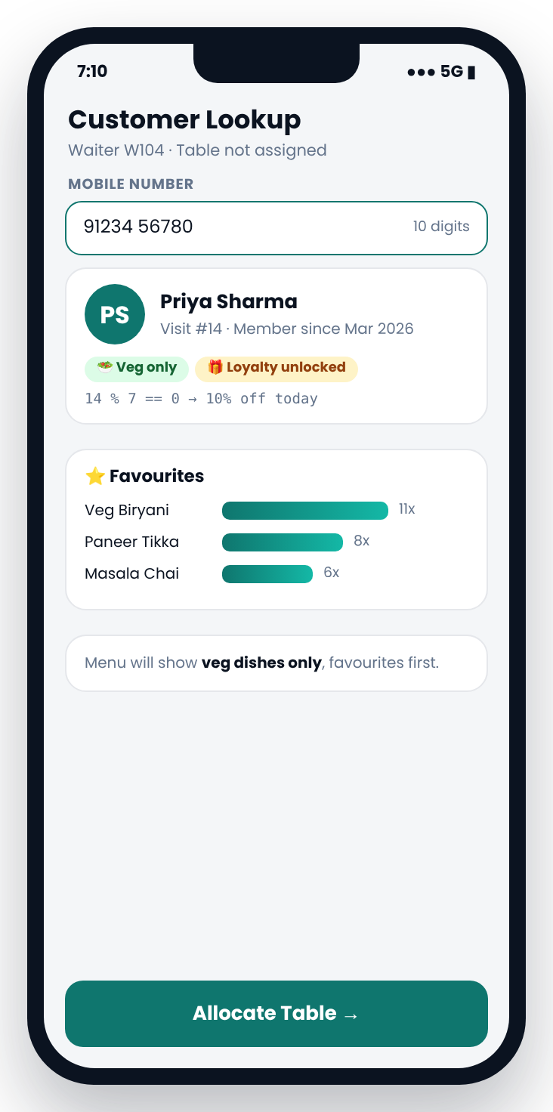
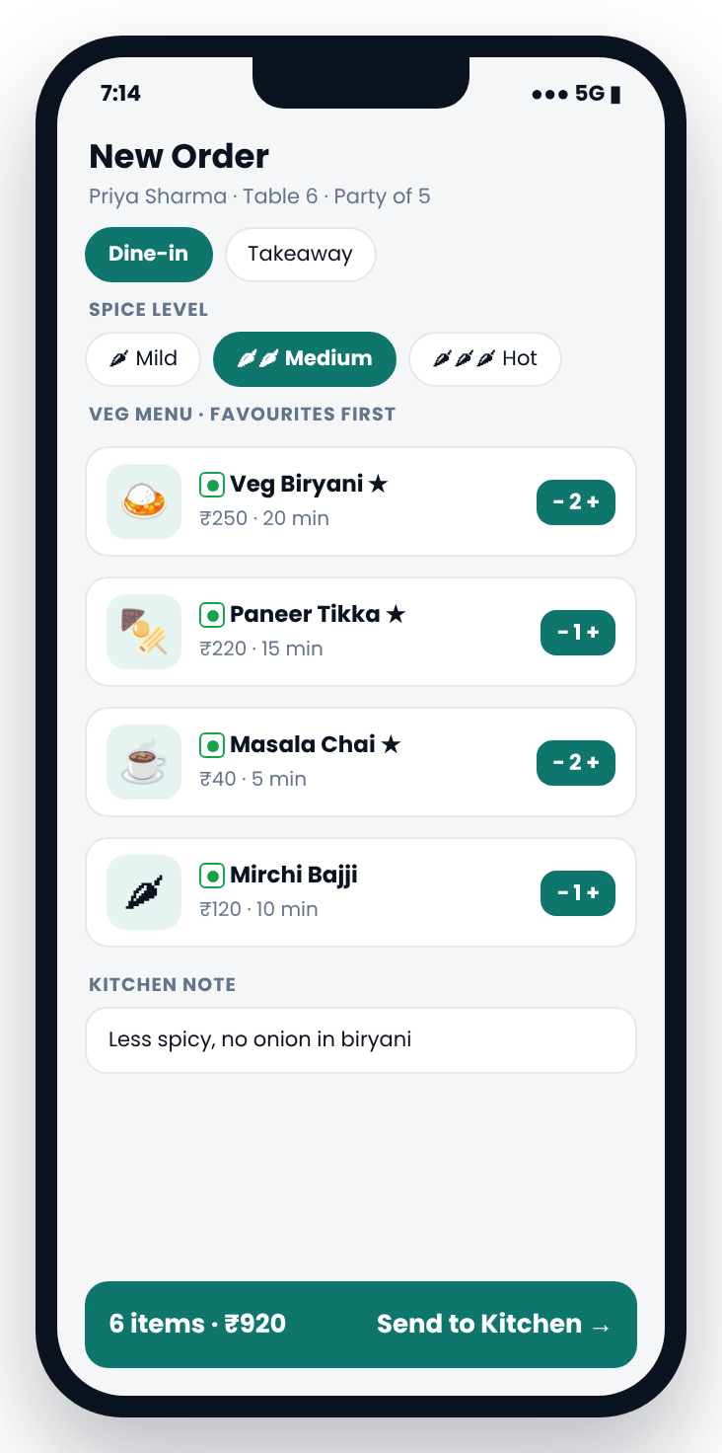
Staff log in, set the menu and greet the customer
Front desk
Kitchen
Billing
Monitoring
FRONT DESK
M01
Staff login
M02
Menu
M03
Customer
M04
New order
Locks after 3 wrong PINs
Add, reprice or hide dishes
Every 7th visit gets 10% off
Veg-only, favourites first
Screens: app concept designs from the DineSync project document
Notes:
Each staff member logs in with a role-specific ID and PIN. The admin manages the menu. The waiter finds the customer by mobile number: Priya is on her 14th visit, so she gets 10 percent off, and as a veg-only customer she only sees vegetarian dishes, with her favourites first. Her order is 6 items worth 920 rupees.

Slide 12
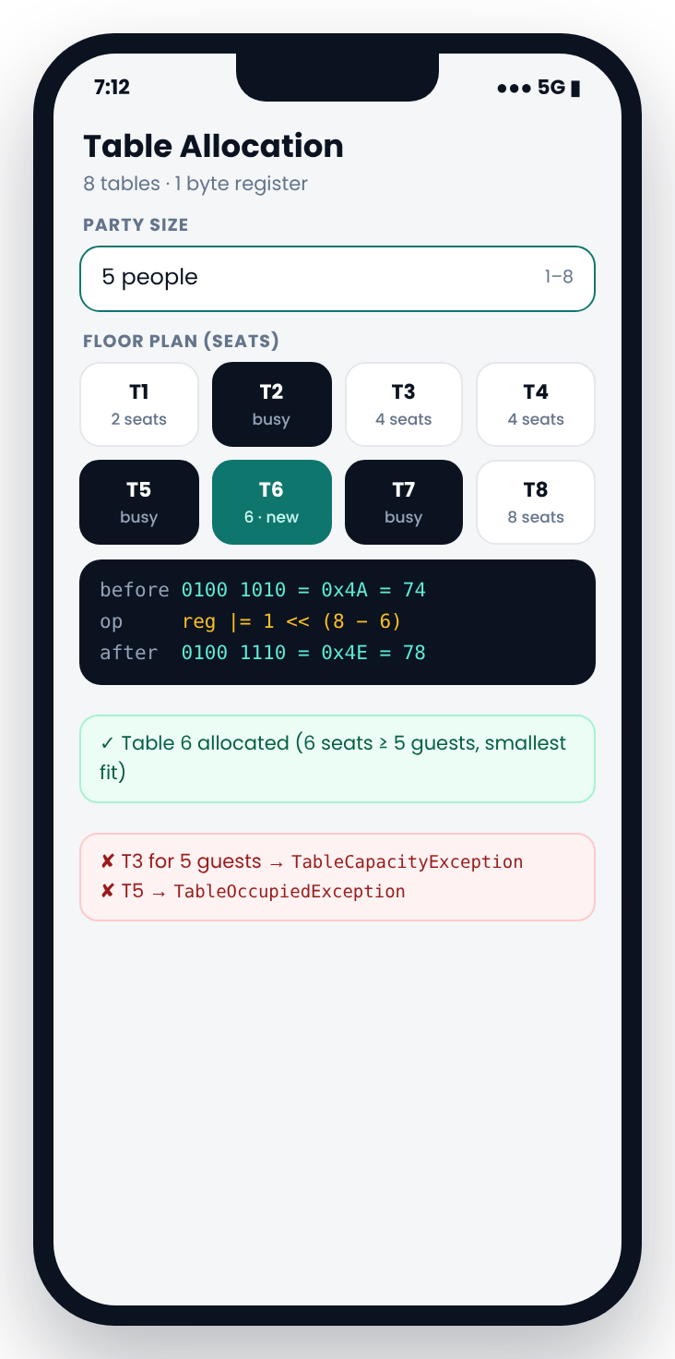
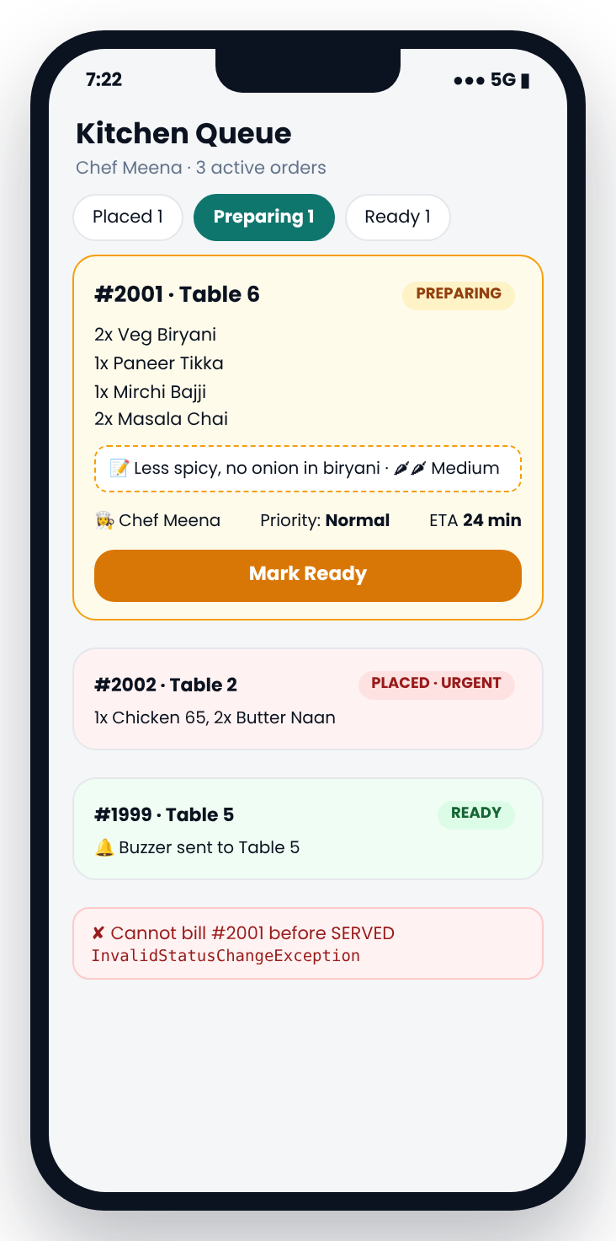
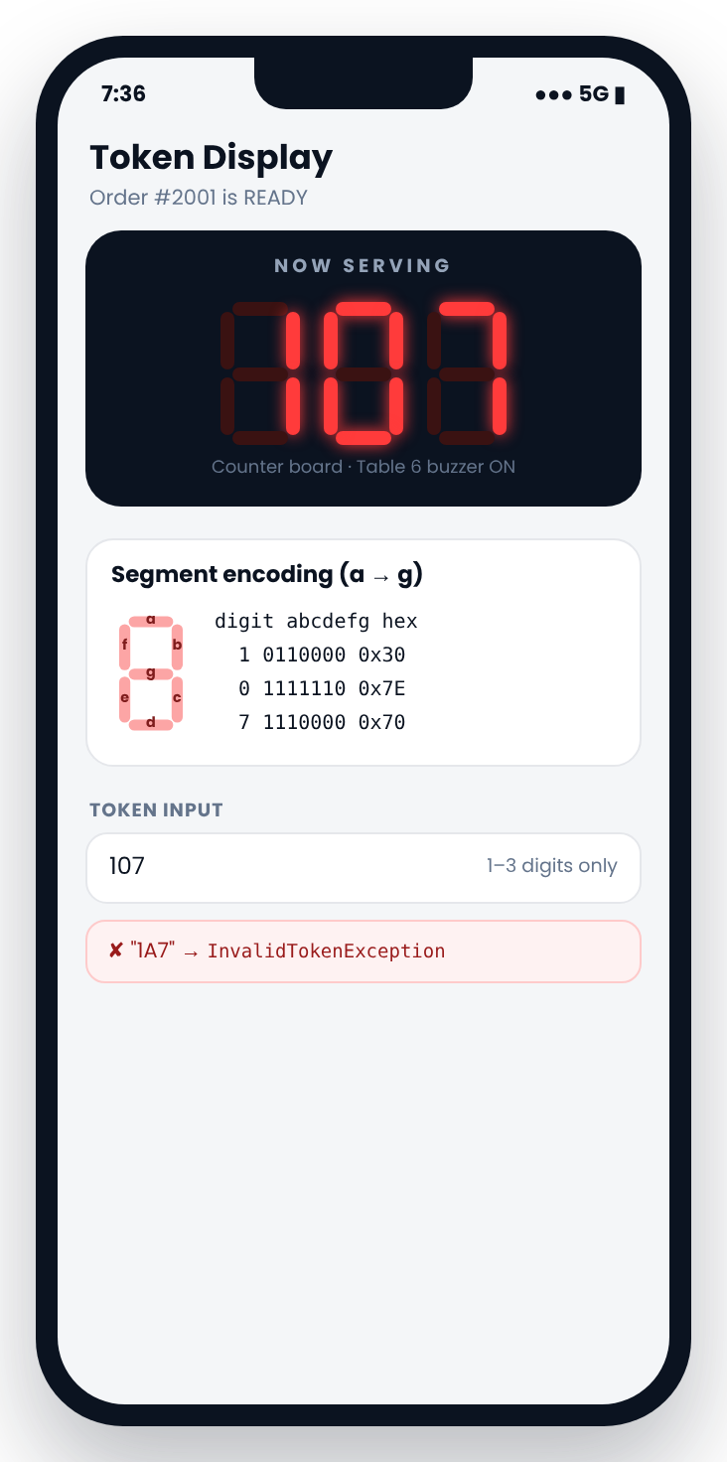
The right table, a clear queue and a ready token
Front desk
Kitchen
Billing
Monitoring
TABLES & KITCHEN
M09
Table allocation
M05
Kitchen queue
M11
Token display
Smallest free table that fits: T6 for 5
Urgent orders first; ETA 24 min
Ready order shown as 107
Screens: app concept designs from the DineSync project document
Notes:
For a party of 5, the system suggests Table 6, the smallest free table that fits. All 8 tables are tracked in one 8-bit register. In the kitchen, urgent orders come first and each order gets an estimated ready time. When food is ready, the token is shown on a seven-segment style display and the table buzzer is triggered.

Slide 13
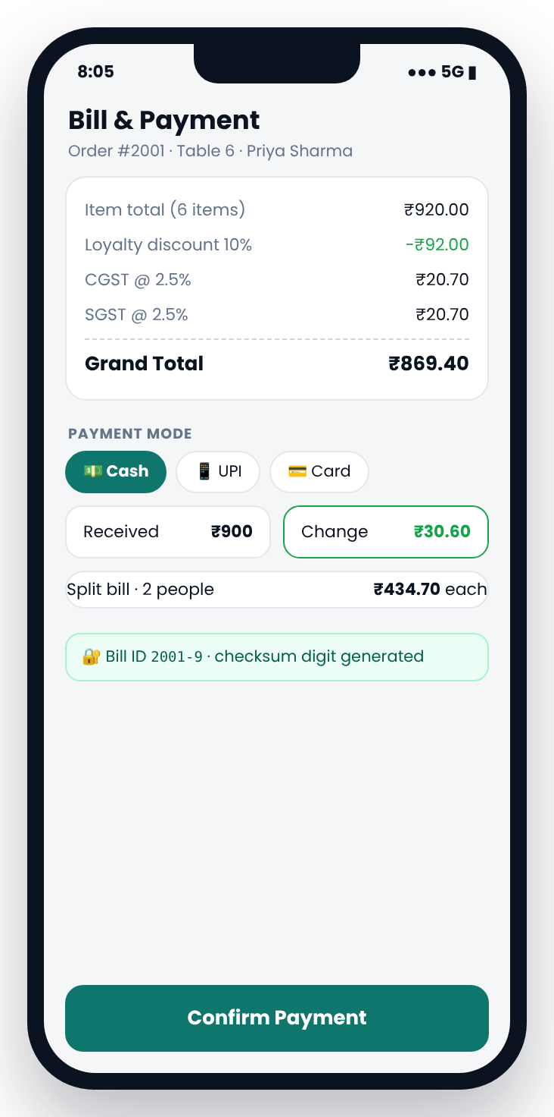
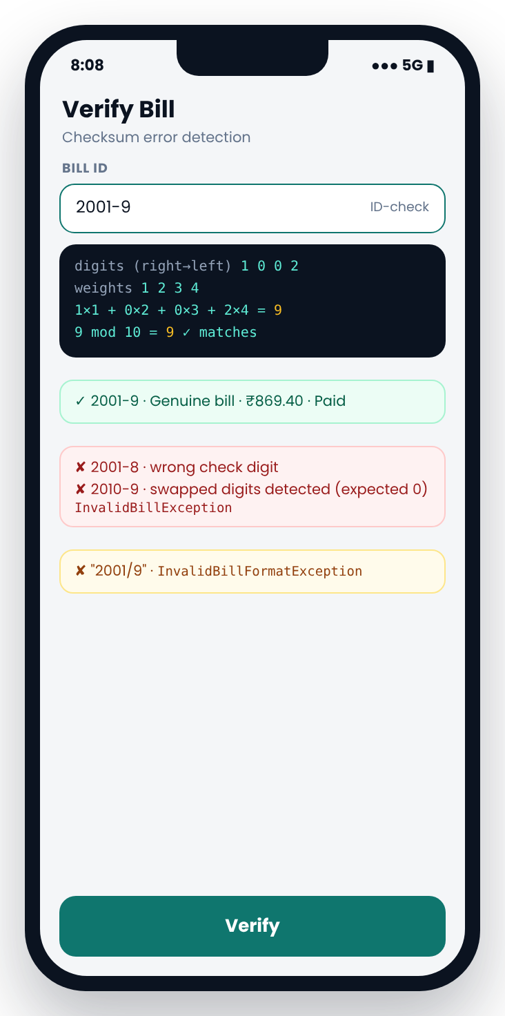
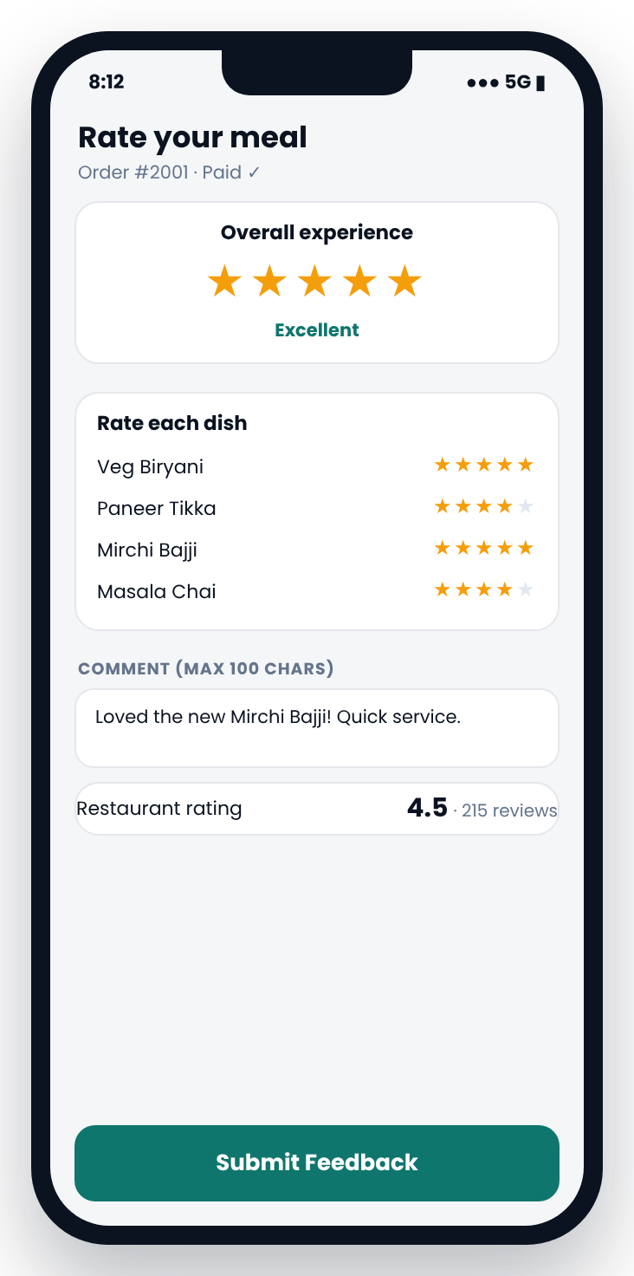
Accurate bills, verified IDs and honest ratings
Front desk
Kitchen
Billing
Monitoring
BILLING & FEEDBACK
M06
Bill & payment
M12
Verify bill
M07
Feedback
₹920 − 10% + GST = ₹869.40
Check digit catches typing mistakes
One rating per bill, 1 to 5 stars
Screens: app concept designs from the DineSync project document
Notes:
The bill is calculated automatically: 920 rupees minus the 10 percent loyalty discount, plus 2.5 percent CGST and SGST, gives 869.40. Payment by cash, UPI or card, with split bills. Every bill ID carries a check digit, so 2001-9 is accepted but a mistyped 2010-9 is rejected. Customers can rate their meal once per bill.

Slide 14
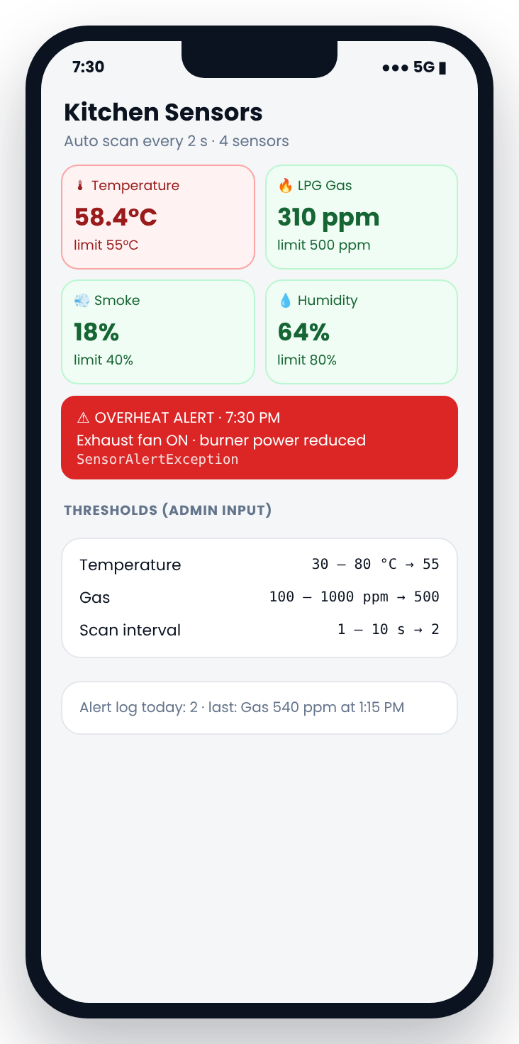
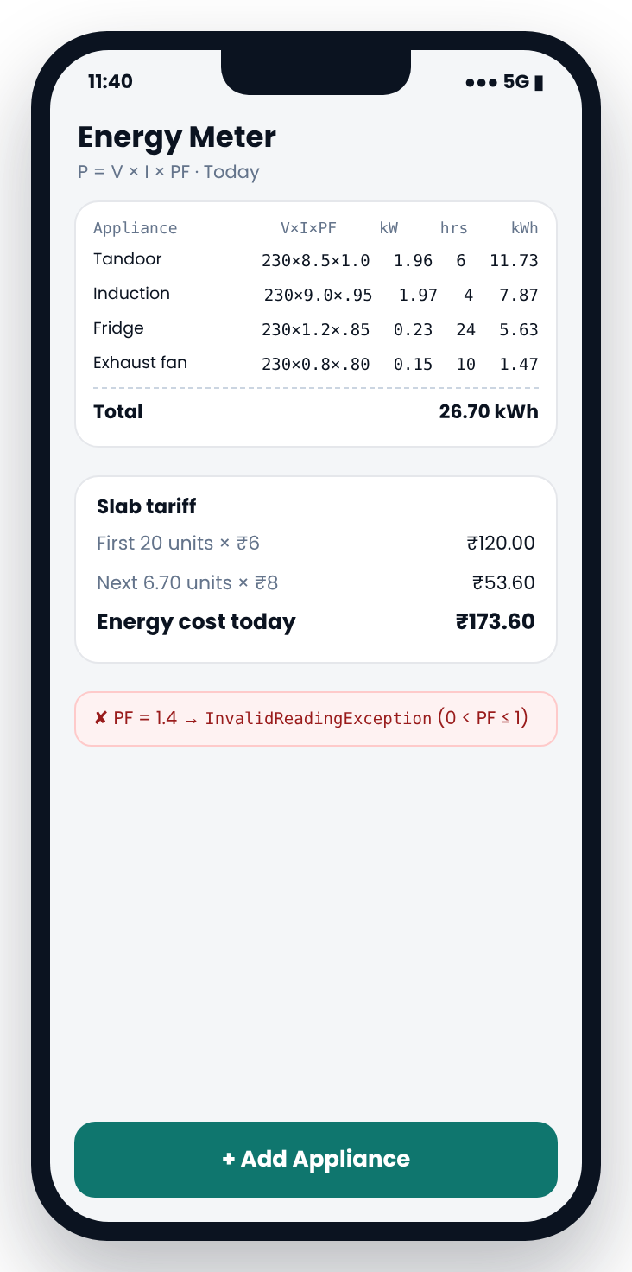
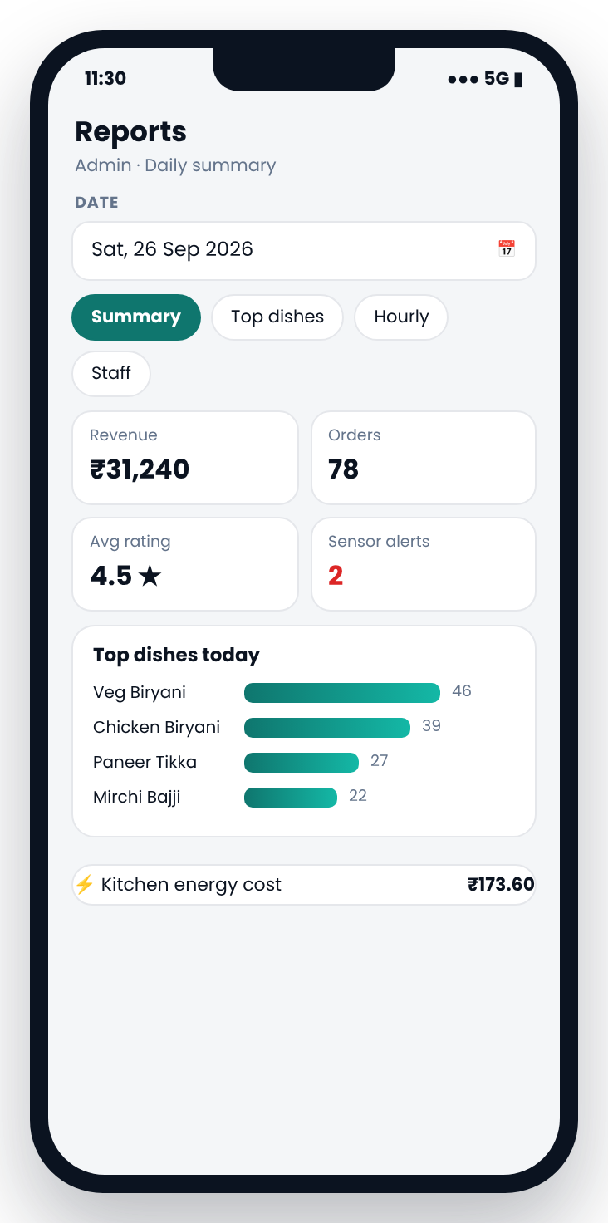
A safer kitchen and a clear daily picture
Front desk
Kitchen
Billing
Monitoring
SMART MONITORING
M10
Kitchen sensors
M13
Energy meter
M08
Daily report
58.4 °C alert: fan switched on (simulated)
26.70 kWh today costs ₹173.60
Revenue, top dishes, rating, alerts
Screens: app concept designs from the DineSync project document
Notes:
The kitchen sensors for temperature, gas, smoke and humidity are simulated in software. When a reading crosses its limit, an alert is raised with an automatic action, and orders keep flowing. The energy meter calculates each appliance's daily use and cost with a slab tariff. The admin gets a daily report of revenue, top dishes, rating, alerts and energy cost.

Slide 15
Priya's visit: party of 5, veg only, 14th visit
ONE ORDER, END TO END
PLACED
PREPARING
READY
SERVED
BILLED
T6
24 min
58.4 °C
₹869.40
2001-9
Best-fit table
Kitchen ETA
Overheat alert, fan on
After loyalty + GST
Verified bill ID
Bill breakdown
₹920.00
− ₹92.00
+ ₹41.40
= ₹869.40
₹30.60
item total
loyalty 10%
CGST + SGST
grand total
change from ₹900
Notes:
Here is one complete visit. Priya's order moves from placed to billed. She gets Table 6, the kitchen estimates 24 minutes, a simulated overheat alert switches the fan on without stopping service, her bill comes to 869.40 rupees, and the bill ID 2001-9 is verified by its check digit. These are the example values from our project document.

Slide 16
Every concept points to real code
JAVA CONCEPTS
Java fundamentals
Methods and arrays
Object-oriented
Further curriculum
✓ Data types, operators, bitwise
TableRegister.allocate
✓ User-defined methods
calculateEta, checkDigit
✓ Classes, constructors, this
Customer(...) chaining
✓ Strings, StringBuilder
verifyBillId, receiptText
✓ Scanner, console I/O
Main.main, InputHelper
✓ Recursion
weightedSum
✓ Encapsulation
private fields, setStatus
✓ Exceptions (35 checked)
every screen method
✓ if / switch / loops
Main menus, loginScreen
✓ 1-D / 2-D arrays
MenuItem[], String[10][3]
✓ Inheritance, abstract
Person, MenuItem
✓ File I/O
saveBillToFile
✓ Type casting
getAverageRating
✓ Searching, sorting
binarySearch, Collections.sort
✓ Overloading / overriding
pay(...) ×3, isVegFriendly
✓ Collections, generics
HashMap, HashSet, TreeMap
✓ Interfaces, polymorphism
Billable, Sensor[]
✓ Lambdas, streams
getOrderMenu, reports
Notes:
Every concept on this slide is in the real code, and we can open the file and show it. All nine mandatory concepts are here: data types and operators, Scanner, control structures, methods, arrays, inheritance, strings, exceptions, and both overloading and overriding. For example, pay is overloaded three times: with a double for cash, a String for UPI, and no extra argument for card.

Slide 17
CO1–CO6 mapped to code and tests
CURRICULUM
CO | Course outcome (handout, shortened) | DineSync evidence | Tests
CO1 | Problem → algorithm → program: primitive types, expressions, console I/O | Bill formula, energy formula, bitwise register, Scanner | T16, T34, T56
CO2 | Selection and iteration; reasoning about termination | Menu while + switch, 3-attempt login, scan loops | T03, T54, T68
CO3 | Methods, recursion, 1-D and 2-D arrays | weightedSum (recursion), top-3 favourites, String[10][3], double[][] | T11, T32, T45
CO4 | Classes, encapsulation, relationships; exception handling | 3 hierarchies, interfaces, 35 checked exceptions, finally, multi-catch | T01–T71
CO5 | Strings/StringBuilder, library search and sort, file I/O | verifyBillId, validateDate, binarySearch, Collections.sort, bills.txt | T41–T44, T65
CO6 | Collections, lambdas, functional interfaces, streams | Predicate menu filter, groupingBy / joining reports, HashSet | T62–T64
Exact CO wording and faculty-form cross-check: docs/CO1_CO6_MAPPING.md. Not used: JUnit/Maven (no third-party tools), Optional, distinct/reduce (no natural use).
Notes:
This table maps each course outcome from the handout to real code and to the tests that prove it. For example, CO3 asks for recursion and two-dimensional arrays: the check digit uses recursion, and the seven-segment digits are a two-dimensional array. We also list what we did not use, such as JUnit, because the project rules do not allow third-party libraries.

Slide 18
From a Java prototype to an intelligent restaurant ecosystem
FUTURE SCOPE
1
2
3
4
5
6
PHASE 1 · NOW
PHASE 2
PHASE 3
PHASE 4
PHASE 5
PHASE 6
Java Prototype
Smart IoT Kitchen
Data & Smart Analytics
Customer Mobile App
Food-Delivery Platform
Restaurant Ecosystem
13 connected modules
Console-based application
Simulated kitchen sensors
Real temperature, gas, smoke and humidity sensors
ESP32/Arduino with Wi-Fi
Live dashboard, alerts and safety actions
Physical 7-segment token display and energy monitoring
Database for customers, orders, bills and feedback
Inventory and sales management
Energy reports and demand forecasting
Restaurant discovery and interactive menus
Dish customization, QR ordering, loyalty rewards
Secure online payments
Personalized recommendations
Real-time kitchen and order tracking
Delivery-partner tracking and ETAs
Reviews, notifications, order history
Inspired by Swiggy and Zomato, with deeper ordering–kitchen–IoT–energy integration
Multiple restaurants and branches
Connected app, kitchen, billing, inventory and delivery
Cloud dashboard, stronger security, business analytics
Current project: Core Java prototype with simulated monitoring. Phases 2–6 are proposed future enhancements.
Notes:
Phase 1 is what we built today: a Core Java prototype with 13 connected modules and simulated kitchen sensors. Phase 2 brings real IoT hardware: real sensors on an ESP32 or Arduino with Wi-Fi, a live dashboard and a physical token display. Phase 3 adds a database, inventory and analytics such as demand forecasting. Phase 4 is a customer mobile app with QR ordering, loyalty and secure payments. Phase 5 grows into a complete food-delivery platform, inspired by Swiggy and Zomato, but with deeper links between ordering, the kitchen, IoT and energy data. Phase 6 scales to many restaurants with a cloud dashboard. Only Phase 1 is built; phases 2 to 6 are proposals.

Slide 19
DINESYNC · JAVA EXPO 2026-27
Thank You
One order. One flow. Zero paper slips.
13
4
1
modules
staff roles
connected flow
Pranathi Kusi
M. Sri Akhil Chowdary
[YOUR NAME]
2620040061
2620040112
[ROLL NO]
Guide: [GUIDE NAME]
Notes:
Thank you for your time. DineSync brings the whole restaurant into one connected flow: one order, one flow, zero paper slips.

