Slide 1
MOVIE BROWSING APP
TEAM:
V PRANAV (21BCE1378)
V J VENKHAT SHRIDHARAN (21BCE1730)
RAGHAV N G (21BCE6199)

Slide 2
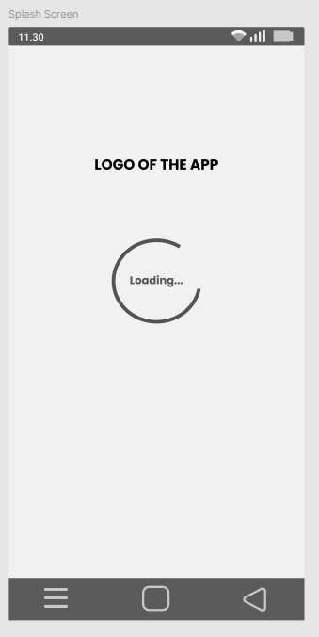

SPLASH SCREEN
Splash screen is the screen which is displayed once the app is launched and while it is loading.
There is a loading indicator and a logo of the app in the centre.

Slide 3
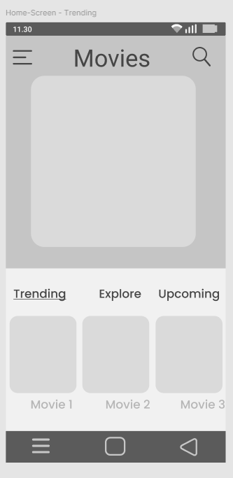
home PAGE with trending movies view
After login, home page is displayed with a horizontally scrollable list of trending movies.
The list of trending movies, their posters are fetched from an API.

Slide 4
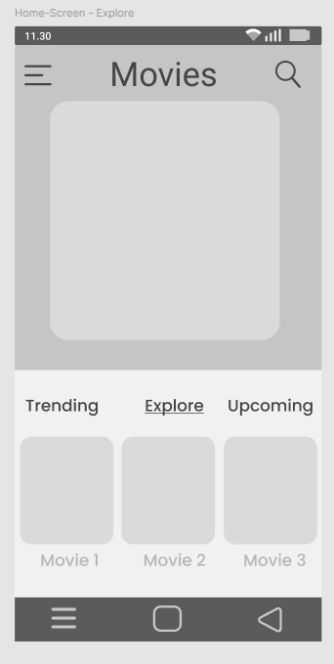
home PAGE with movies TO EXPLORE view
After login, home page is displayed with a horizontally scrollable list of movies to explore.
The list of movies to explore, their posters are fetched from an API.

Slide 5
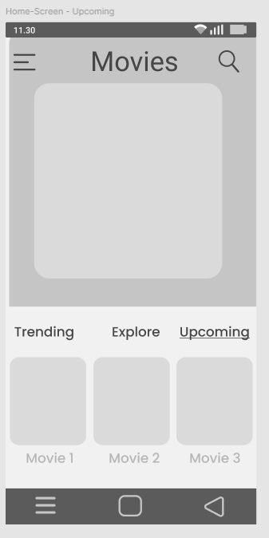
home PAGE with upcoming movies view
After login, home page is displayed with a horizontally scrollable list of upcoming movies.
The list of upcoming movies, their posters are fetched from an API.

Slide 6
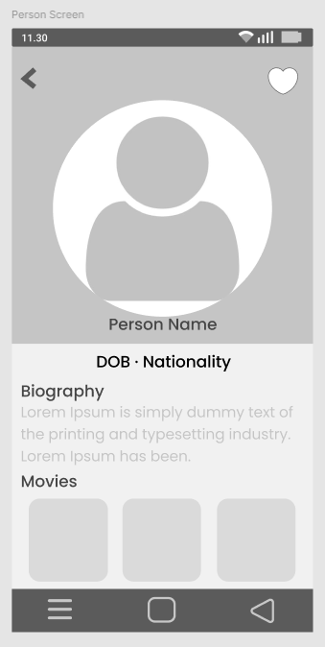
PERSON SCREEN
The full details of cast or crew member of a movie can be viewed in this page by clicking on a person's photo.
It shows the person's photo prominently and has details like their DOB, nationality, biography and a list of other movies the person has worked in.
It also has a heart icon to mark the person as favourite.

Slide 7
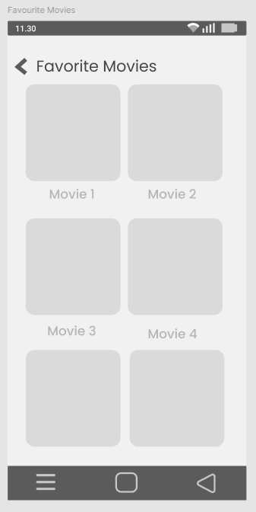
FAVOURITES SCREEN
This page shows the list of movies and their poster that the user has marked as their favourite.
It is displayed as a clean grid.

Slide 8
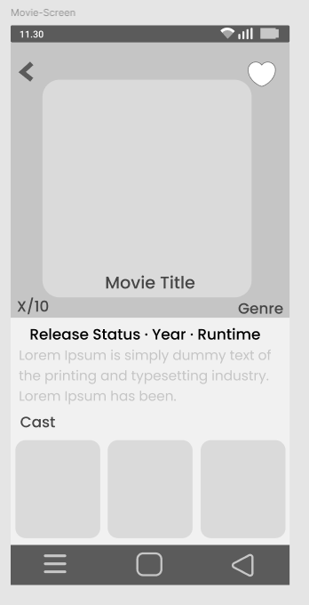
MOVIES SCREEN
The full details of a movie can be viewed in this page by clicking on a movie's poster.
It shows the movie's poster prominently and has details like its rating, main genre, synopsis, runtime, release year and status and a list of the people that has worked in it.
It also has a heart icon to mark the movie as favourite.

Slide 9
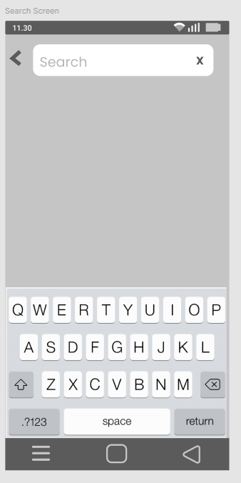
EMPTY SEARCH SCREEN
The search screen has a search bar where the user has to enter the movie that they want to search.
It has an icon on the right to clear current search input.

Slide 10
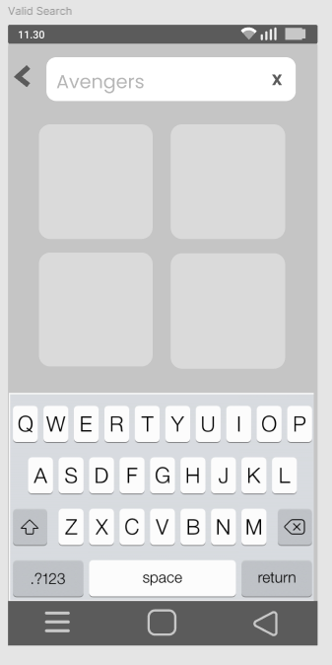
VALID SEARCH SCREEN
The search bar displays the current state of the search input.
If the search input movie name is valid, the matching results are displayed.
The movie posters are displayed in clean grid layout.
The search bar and keyboard are deliberately placed there to ensure that the search results are clearly visible to the user.

Slide 11
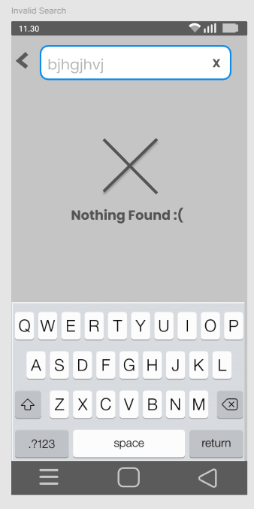
INVALID SEARCH SCREEN
The search bar displays the current state of the search input.
If the search input movie name is valid, the matching results are displayed.
If it is invalid, it shows a graphic – saying that there is no matching result.

Slide 12
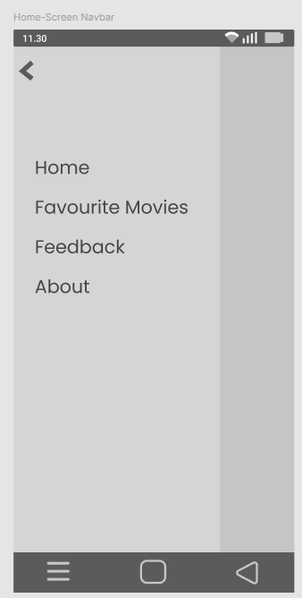
HOME SCREEN NAVIGATION BAR
In the homepage, there is an hamburger icon in top-left.
Clicking that, helps users gain access to the collapsible navigation bar that is used to navigate to various parts of the app.
It is used to navigate to Home, Favourite Movies, Feedback and About us Page.

Slide 13
THANK YOU

