Slide 1

Airbnb Hotel Booking Analysis
Pranav Shelke

Slide 2

PROBLEM STATEMENT
The hospitality and short-term rental market generates large volumes of booking and listing data. Without systematic analysis, it is difficult to identify:
• High-concentration neighbourhood groups
• Room-type distribution and accommodation patterns
• Pricing and service-fee patterns
• Guest engagement through reviews
• Property availability and booking-related trends
This project transforms raw Airbnb data into meaningful insights for data-driven decision making.

Slide 3
Project Description This project performs Exploratory Data Analysis (EDA) on 102,599 Airbnb listings containing 26 attributes. The analysis examines neighbourhood groups, room types, prices, service fees, reviews, cancellation policies and availability. Data cleaning and visualization are used to identify market patterns and generate actionable insights.

Slide 4

WHO ARE THE END USERS?
• Property Owners & Hosts - understand competition, pricing and availability.
• Travelers & Guests - compare room types and accommodation options.
• Airbnb / Hospitality Analysts - monitor demand, reviews and market distribution.
• Business Decision Makers - use insights for pricing and operational planning.
• Researchers & Students - study real-world hospitality and booking data.

Slide 5

Technology Used
Python
• Pandas - data loading, cleaning and analysis
• NumPy - numerical operations
• Matplotlib - data visualization
• Microsoft Excel - dataset source and inspection
• Jupyter Notebook / Python Environment - analysis workflow

Slide 6
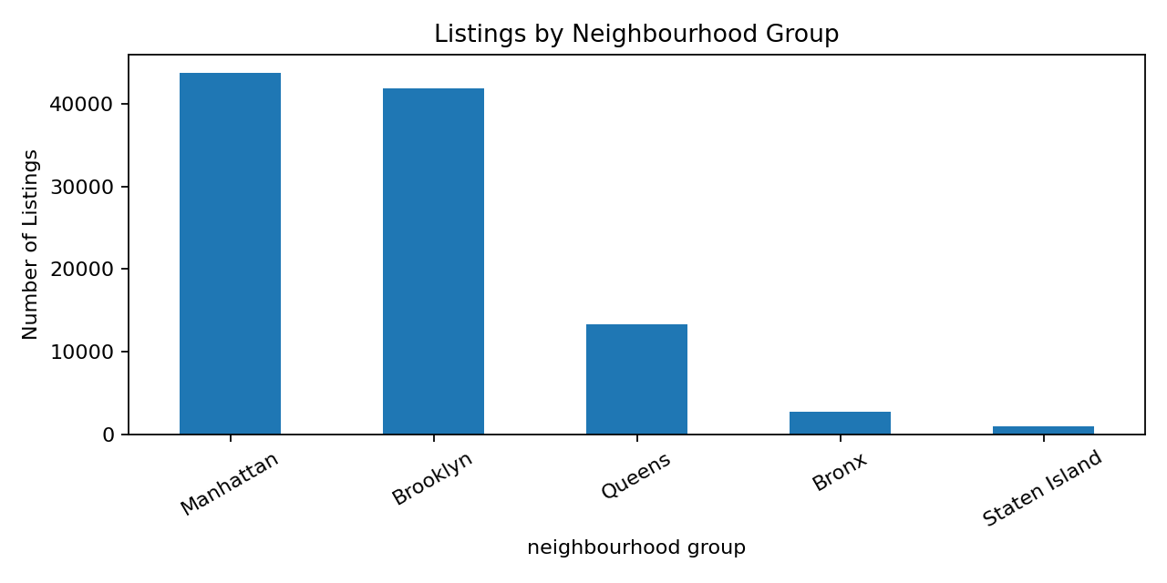
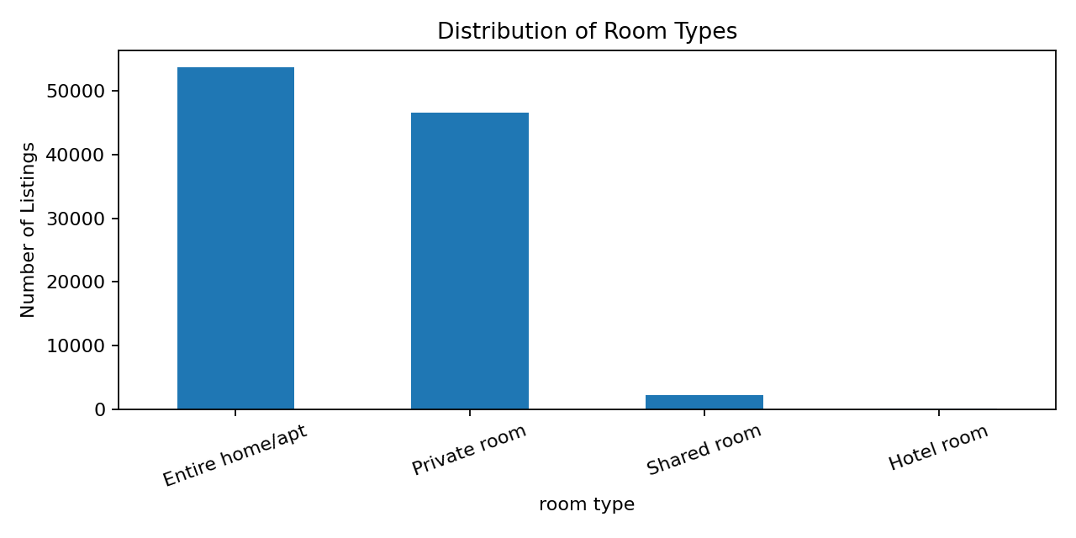
RESULTS & KEY INSIGHTS
Data Visualizations
102,599 listings analyzed | 7 neighbourhood groups | 224 neighbourhoods
Manhattan and Brooklyn have the highest listing concentration. Entire homes/apartments are the most common room type, followed by private rooms. Average price: $625.29 | Average availability: 141 days/year.
Demo Link: https://github.com/Pranav-3003/Assignment/tree/main/Project1

Slide 7
Thank you
.
.

