Slide 1

Car Market Trends Analysis with Car Dekho Data
Pranav Shelke

Slide 2

PROBLEM STATEMENT
The used-car market contains multiple factors that influence vehicle pricing and customer choices.
This project analyzes Car Dekho data to:
• Understand used-car price patterns.
• Examine the influence of fuel type, transmission and seller type.
• Explore the relationship between manufacturing year, vehicle age and selling price.
• Generate data-driven insights that can support pricing and market analysis.

Slide 3
Project Description
This project performs exploratory data analysis on 301 car records containing vehicle and transaction-related information.
The dataset includes car name, manufacturing year, selling price, present price, kilometers driven, fuel type, seller type, transmission type and ownership history.
Python-based data analysis and visualization techniques are used to identify important trends and factors associated with used-car selling prices.

Slide 4

WHO ARE THE END USERS?
• Used-car buyers and sellers
• Automobile dealers
• Car pricing and valuation analysts
• Automotive market researchers
• Data analysts and students
The analysis helps stakeholders understand factors that influence used-car prices and identify meaningful market trends.

Slide 5

Technology Used
Programming & Analysis
• Python
• Pandas
• NumPy
Visualization
• Matplotlib
Development Environment
• Jupyter Notebook / Python Environment
Dataset Format
• CSV – Car Dekho Data

Slide 6
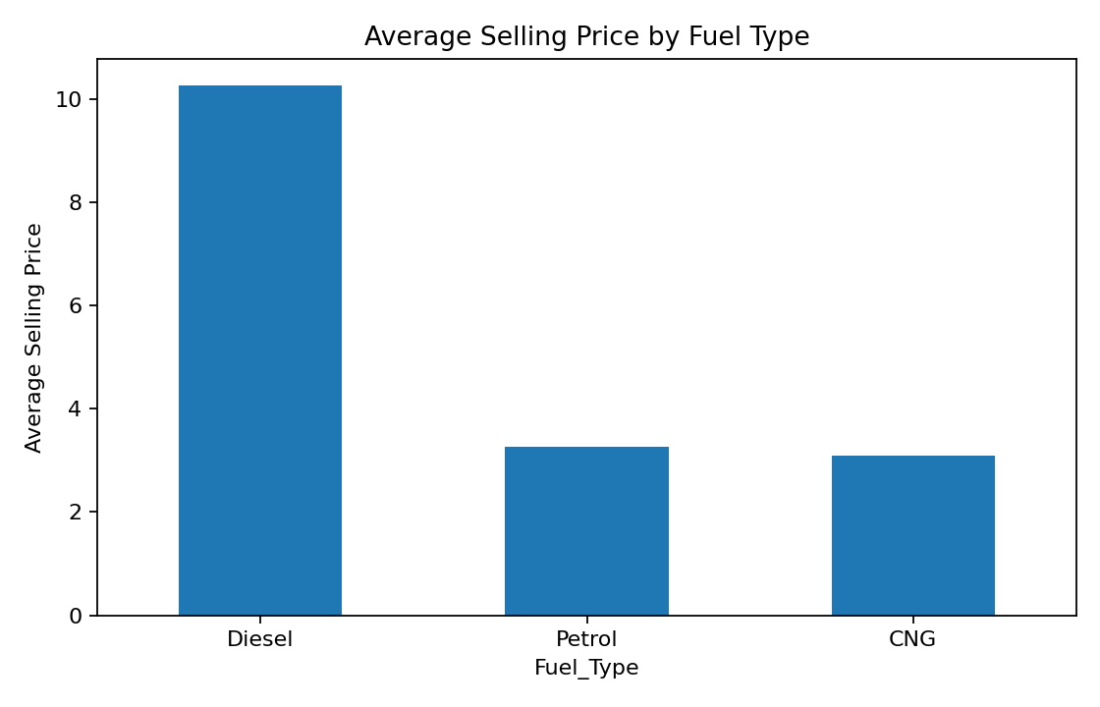
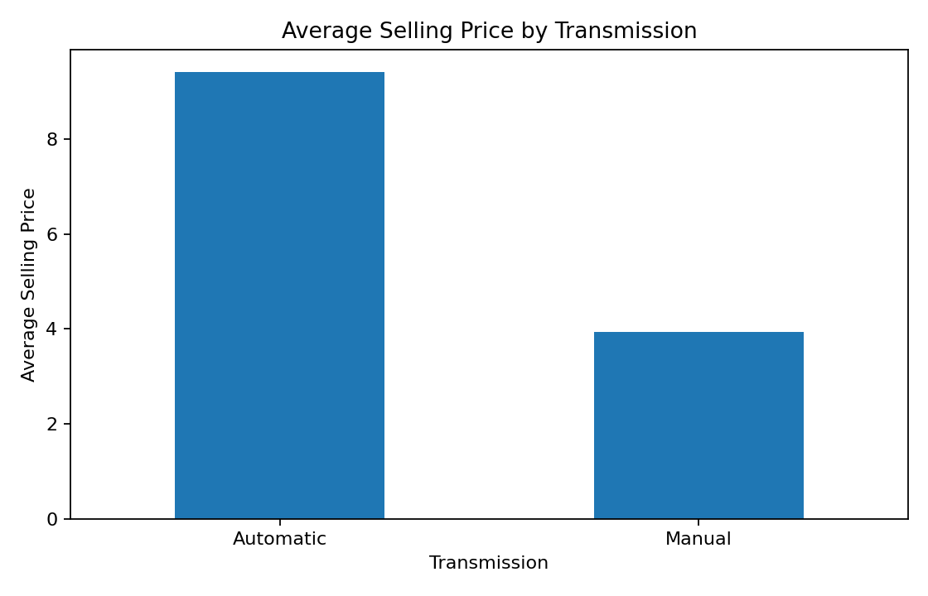
RESULTS
Key Results
• Total car records analyzed: 301
• Average selling price: 4.66
• Highest selling price: 35.00
• Manufacturing years range from 2003 to 2018.
• Fuel type, transmission and seller type show noticeable differences in average selling prices.
• The analysis provides useful insights into used-car market trends and pricing factors.
Demo Link: https://github.com/Pranav-3003/Assignment/tree/main/Project4

Slide 7
Thank you
.

