Slide 1

Exploring Global Terrorism Patterns & Trends
Pranav Shelke

Slide 2

PROBLEM STATEMENT
Terrorism-related data is distributed across countries and years, making it difficult to identify broad patterns and changes over time.
This project analyzes the provided global dataset to:
• Examine recorded incidents, fatalities, injuries and hostages.
• Identify trends across the available years.
• Compare countries based on recorded incident counts and impact.
• Transform raw data into clear visual insights for analytical exploration.

Slide 3
Project Description
This project performs exploratory data analysis on 1,793 country-year records covering the period 2012–2022.
The dataset contains country-level information including terrorism score, rank, incidents, fatalities, injuries and hostages.
Using Python-based analysis and visualization, the project aggregates the data by year and country to explore temporal patterns and compare recorded impacts across countries.

Slide 4

WHO ARE THE END USERS?
• Data analysts and researchers
• Policy and strategic analysis teams
• Academic researchers and students
• International studies and security researchers
• Organizations working with historical risk and trend data
The project provides a structured way to explore country-level and year-wise patterns in the supplied dataset.

Slide 5

Technology Used
Programming & Analysis
• Python
• Pandas
• NumPy
Visualization
• Matplotlib
Development Environment
• Jupyter Notebook / Python Environment
Dataset Format
• Excel (.xlsx) – Global Trends Dataset

Slide 6
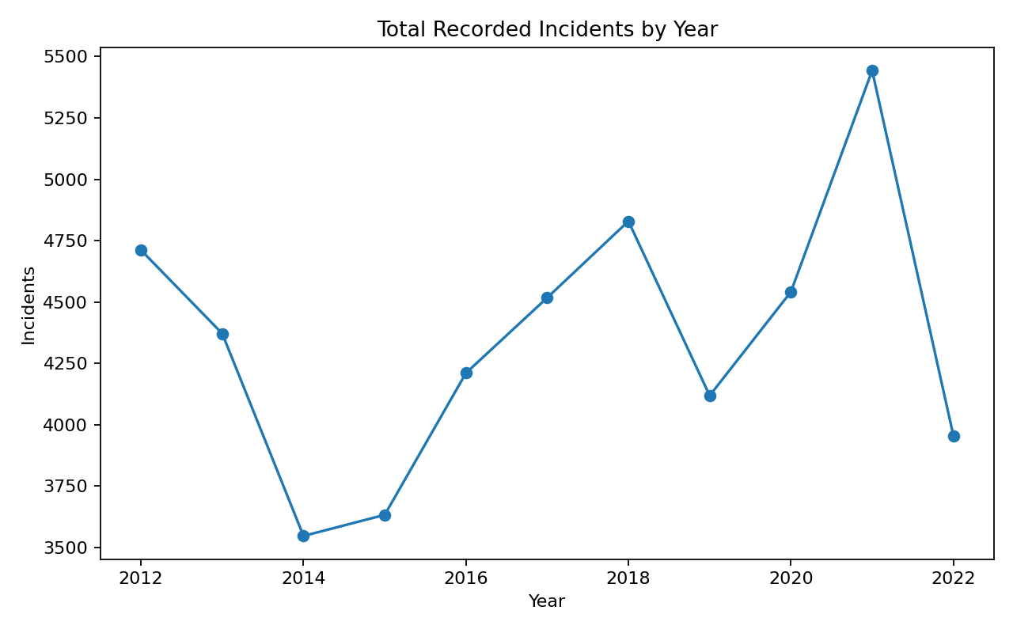
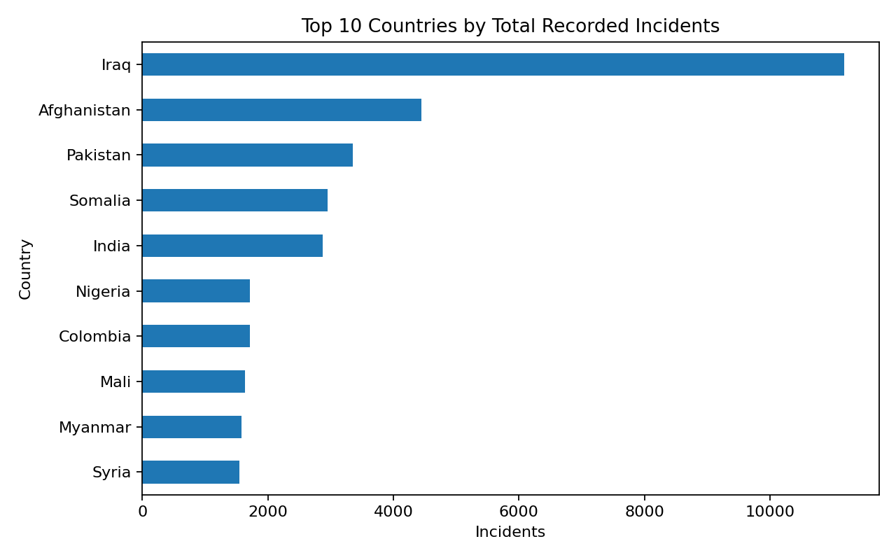
RESULTS
Key Dataset Results
• Total country-year records: 1,793
• Period covered: 2012–2022
• Total recorded incidents: 47,873
• Total recorded fatalities: 95,993
• Total recorded injuries: 133,738
• Year-wise and country-wise aggregation highlights meaningful variations in recorded impact across the dataset.
Demo Link: https://github.com/Pranav-3003/Assignment/tree/main/Project5

Slide 7
Thank you
.
.

