Slide 1
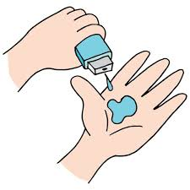
Healthcare Analytics for Doctor Visits
Pranav Shelke

Slide 2

PROBLEM STATEMENT
The healthcare sector generates large amounts of patient data, but extracting useful patterns is challenging.
This project analyzes doctor visits and health-related factors to:
• Understand patterns in doctor visits.
• Examine the relationship between illness, chronic conditions and visits.
• Compare healthcare utilization across demographic and insurance-related groups.
• Generate insights that can support healthcare planning and resource allocation.

Slide 3
Project Description
This project performs exploratory data analysis on a dataset containing 5,190 healthcare records and 13 attributes.
The analysis examines doctor visits in relation to gender, age, income, illness level, reduced activity, health status, private insurance, free medical coverage and chronic conditions.
Using Python-based data analytics and visualization, the project transforms raw healthcare data into understandable insights about factors associated with healthcare utilization.

Slide 4

WHO ARE THE END USERS?
• Healthcare administrators and hospital managers
• Doctors and healthcare professionals
• Healthcare data analysts
• Insurance and public health organizations
• Researchers and students studying healthcare utilization
The insights can help stakeholders understand patient visit patterns and identify important health-related factors.

Slide 5

Technology Used
Programming & Analysis
• Python
• Pandas
• NumPy
Visualization
• Matplotlib
Development Environment
• Jupyter Notebook / Python Environment
Dataset Format
• CSV (Healthcare Analytics for Doctor Visits)

Slide 6
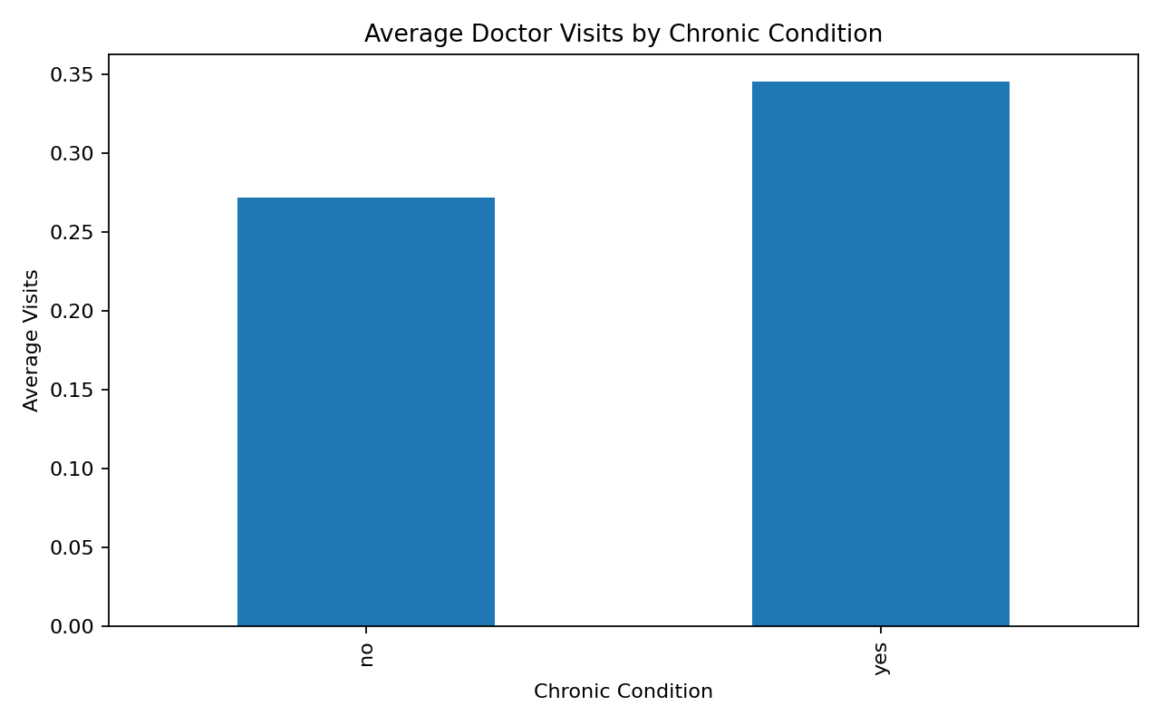
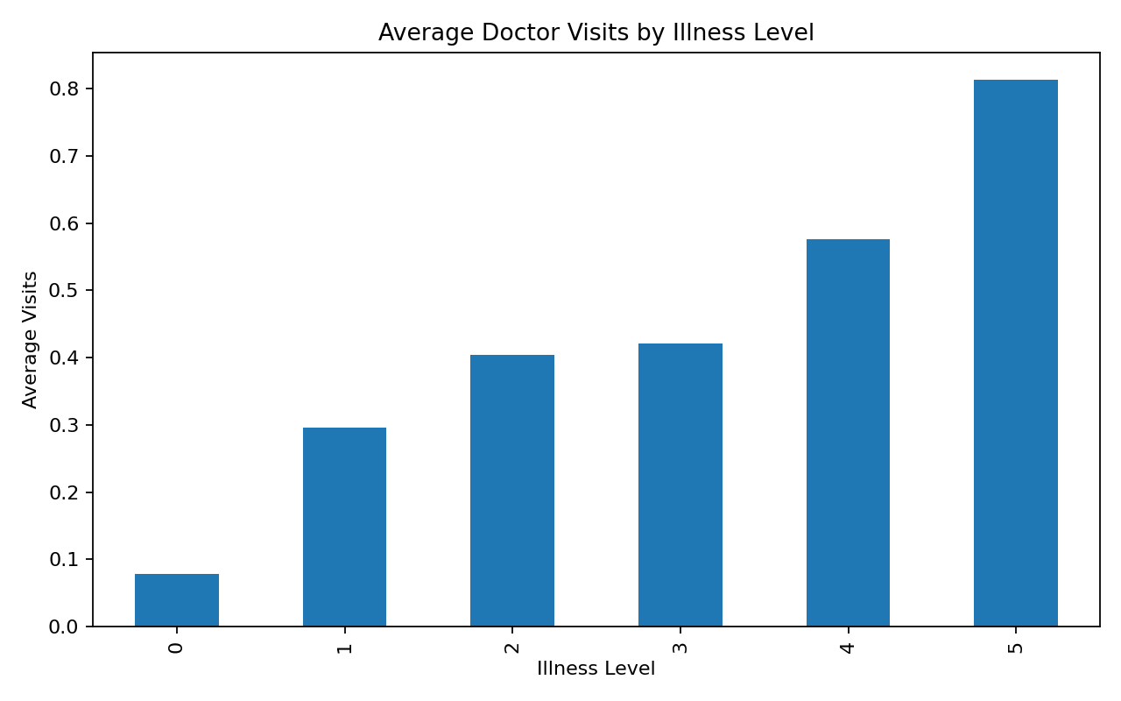
RESULTS
Key Dataset Insights
• Total records analyzed: 5,190
• Average doctor visits: 0.30
• Median doctor visits: 0
• Maximum doctor visits recorded: 9
• Chronic-condition status shows a clear difference in average visit patterns.
• Doctor visits also vary across illness levels and demographic groups.
Code Link: https://github.com/Pranav-3003/Assignment/tree/main/Project2

Slide 7
Thank you
.
.

