Slide 1

Retail Insights from Superstore Data
Pranav Shelke

Slide 2

PROBLEM STATEMENT
Retail businesses generate large volumes of transactional data, making it difficult to quickly identify profitable products, regions and business segments.
This project analyzes Superstore sales data to:
• Understand overall sales, quantity and profit performance.
• Compare performance across categories, sub-categories and regions.
• Identify profitable and loss-making areas.
• Generate actionable insights to support business decisions.

Slide 3
Project Description
This project performs exploratory data analysis on 9,994 retail transactions with 13 business attributes.
The dataset contains information about shipping mode, customer segment, location, product category, sub-category, sales, quantity, discount and profit.
Using Python data analytics and visualization techniques, the project identifies sales trends, regional performance, category-wise results and opportunities for improving profitability.

Slide 4

WHO ARE THE END USERS?
• Retail business owners and managers
• Sales and marketing teams
• Business and data analysts
• Inventory and operations managers
• Students and researchers interested in retail analytics
The analysis helps stakeholders understand business performance and make more data-driven decisions.

Slide 5

Technology Used
Programming & Analysis
• Python
• Pandas
• NumPy
Visualization
• Matplotlib
Development Environment
• Jupyter Notebook / Python Environment
Dataset Format
• CSV – Superstore Retail Data

Slide 6
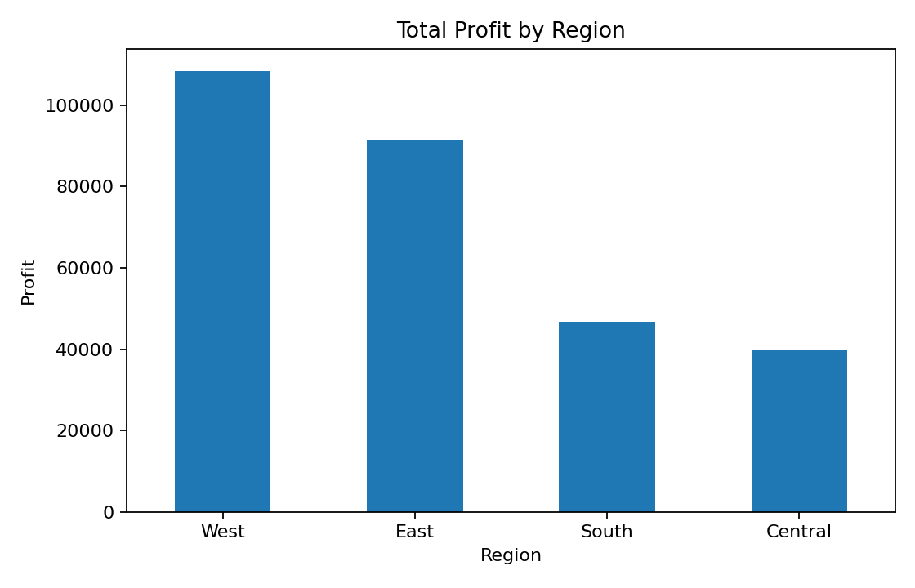
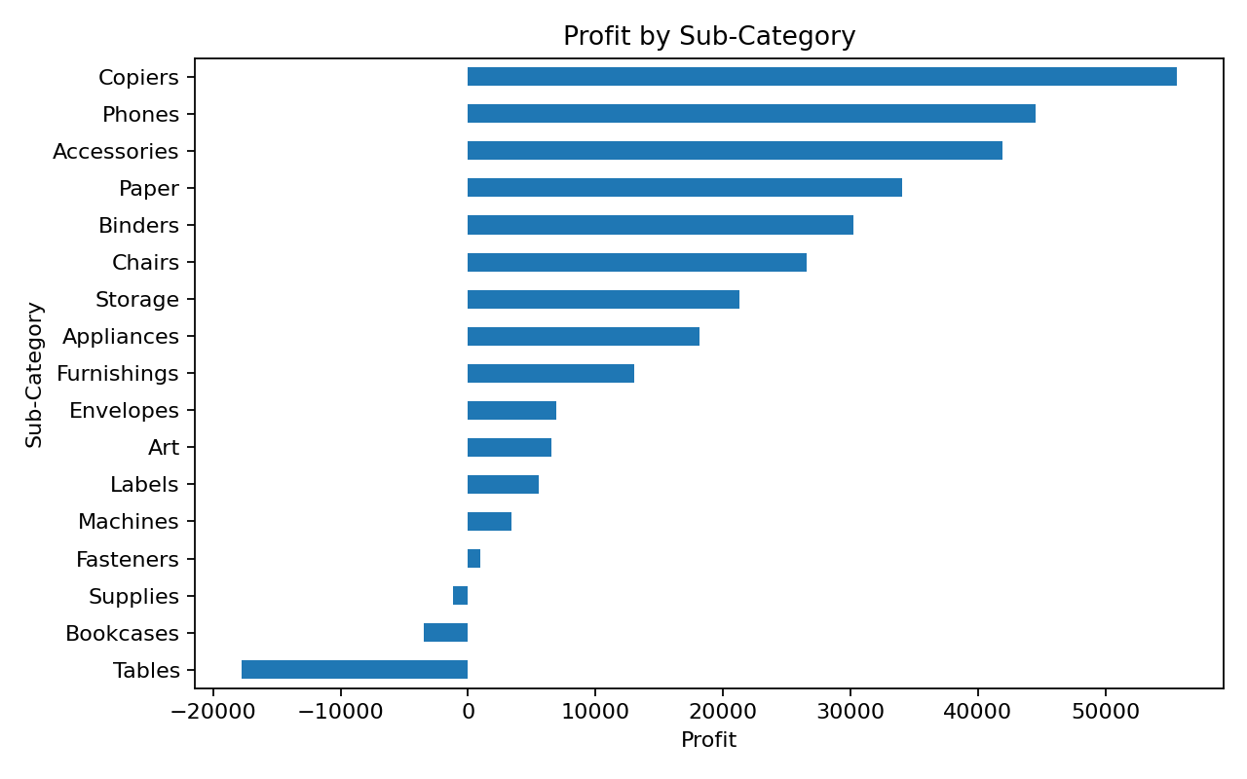
RESULTS
Key Results
• Total transactions analyzed: 9,994
• Total sales: $2,297,200.86
• Total profit: $286,397.02
• Average profit per transaction: $28.66
• Category and regional analysis reveals clear differences in sales and profitability.
• Sub-category analysis helps identify both high-performing and loss-making product areas.
Demo Link: https://github.com/Pranav-3003/Assignment/tree/main/Project3

Slide 7
Thank you
.
.

