Slide 1
OBE Implementation
Module:Departments
Submitted By:
Syntax Squad
K.Pranav Rithwik[AP22110010337]
Ch.Yaswanth[AP22110010383]
K.Vishnu[AP22110010391]
P.Balaji[AP22110010384]
Hasith Nagendra[AP22110010359]

Slide 2
Introduction to Project
Our University (herewith considered as SRM-AP) is going to implement OBE(Outcome Based Education) in their university and you are assigned in the project to develop a CURD(Create,Update,Retrieve and Delete) windows and mobile application using JAVA programming and Android studio for the same.

Slide 3
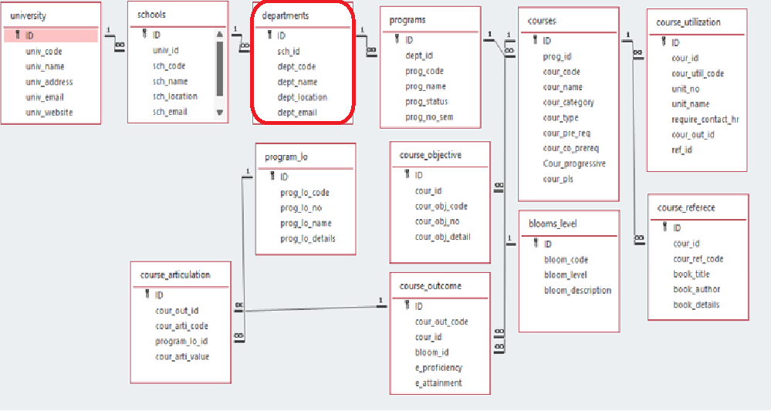
Architecture Diagram

Slide 4
Module Description : University Setting
This module is used to create,Update,Retrieve,Delete(hereafter known as CURD) details of the module and storing the details in the mysql table.

Slide 5
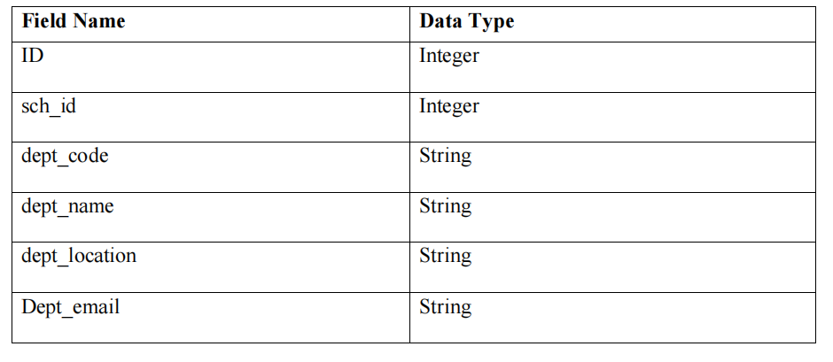
University Setting:Field/table details

Slide 6
University Setting:Programming Details
File name: SyntaxSquad_departments
Function/method name
Create: AP22110010337_departments_create
Update: AP22110010337_departments_update
Retrieve: AP22110010337_departents_retrive
Delete: AP22110010337_departments_delete

Slide 7
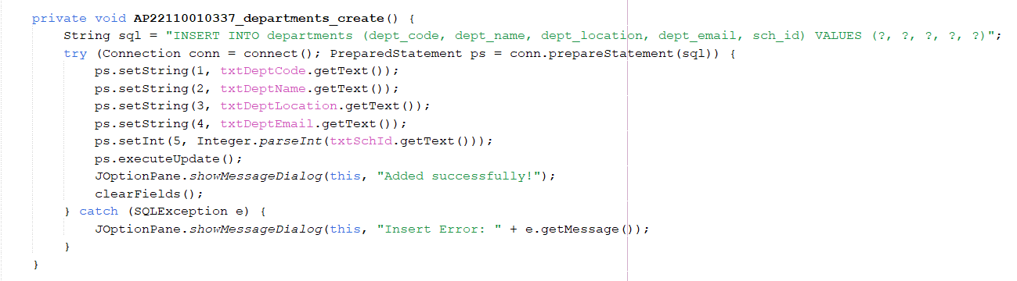
Sample Source Code Create:

Slide 8
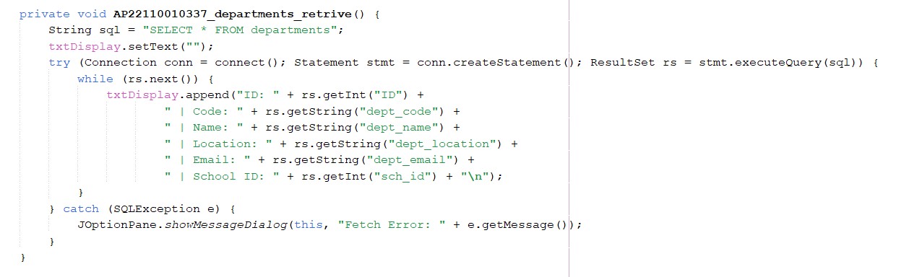
Sample Source Code Retrieve:

Slide 9
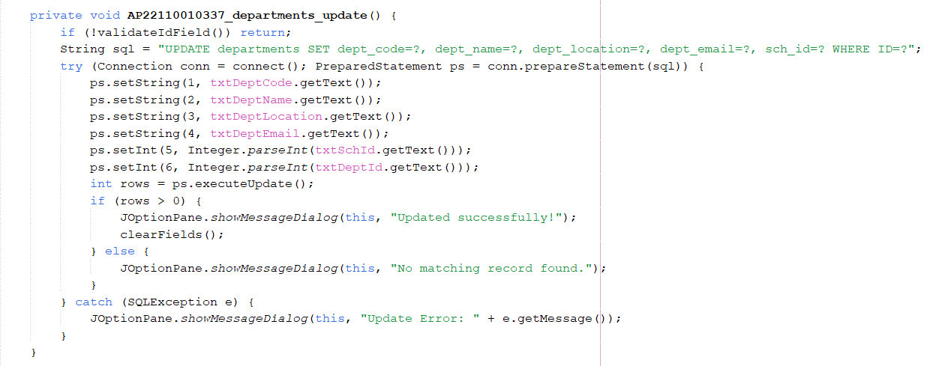
Sample Source Code Update:

Slide 10
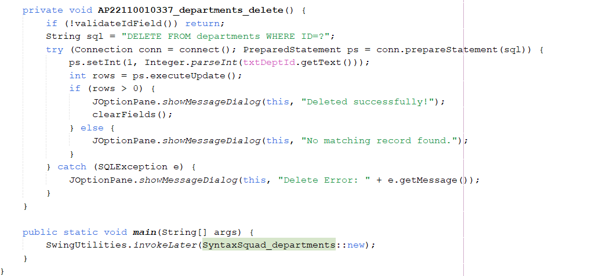
Sample Source Code Delete:

Slide 11
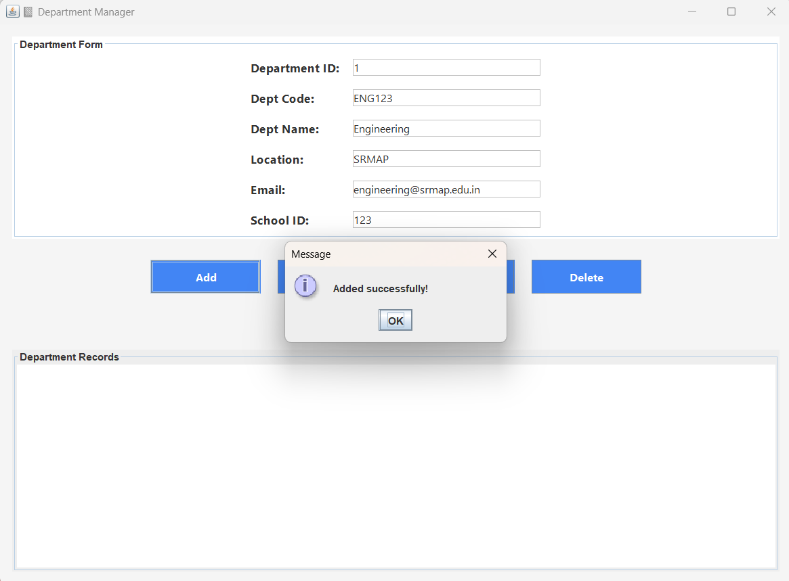
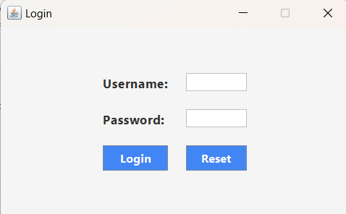
Sample Screen Shots

Slide 12
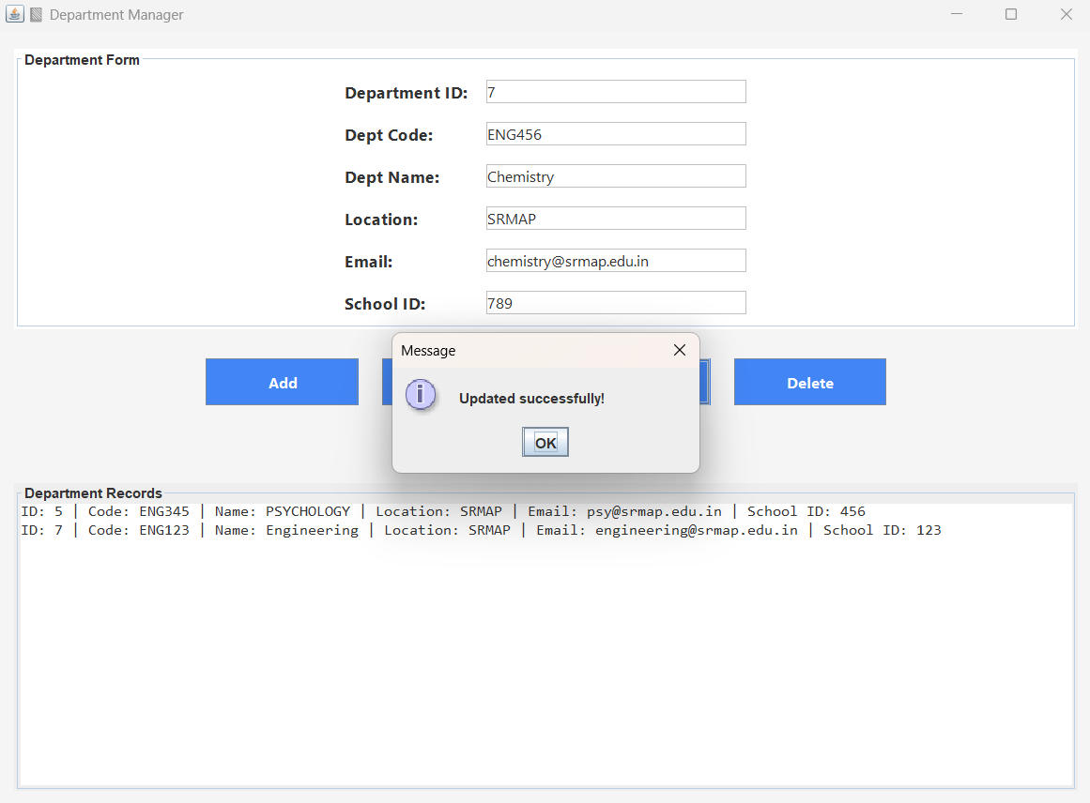
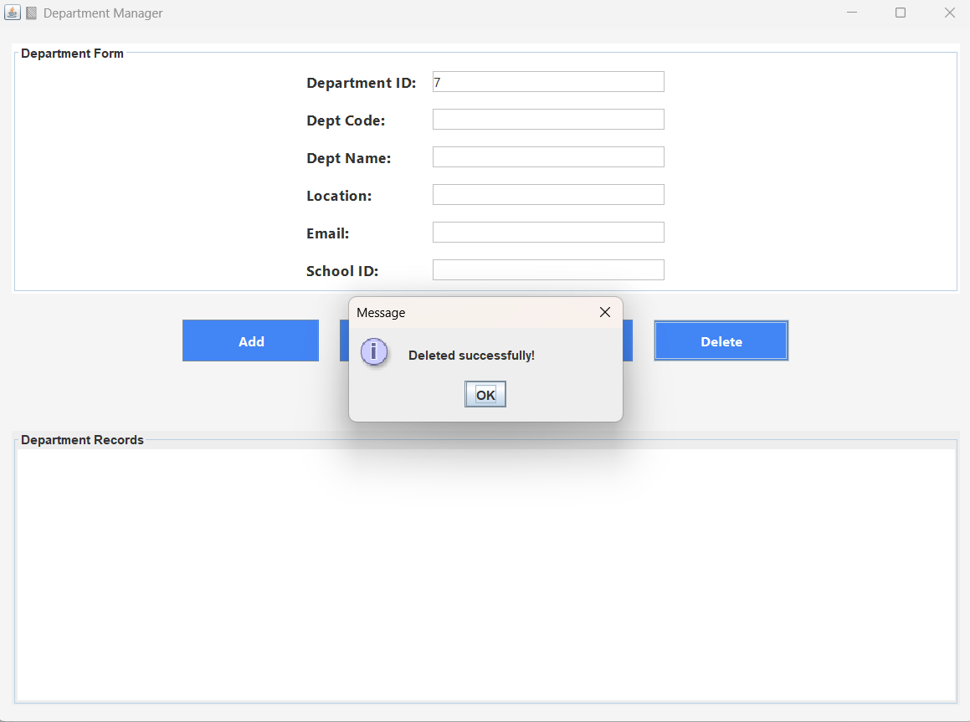
Sample Screen Shots

Slide 13
Conclusion
This project successfully demonstrates the design and development of a desktop
based Academic Department Management System using Java Swing and SQLite. It
incorporates essential CRUD (Create, Read, Update, Delete) functionalities that allow
users to manage departmental records efficiently. The integration of a secure login
system adds an additional layer of authentication, ensuring that only authorized users
can access and manipulate the data.The use of Java Swing provided a user-friendly
graphical interface, while SQLite offered a lightweight, yet powerful, backend database
suitable for standalone applications.Overall, the project lays a strong foundation for
further development, such as adding roles (Admin/User), enhancing UI design,
implementing validation checks, and scaling up to networked or cloud-based systems
for larger institutions.

Slide 14
Thank You

