Slide 1

Smart Society Security System
Group No. 14
Group members: Student ID:
Pranav Chauhan 17204004 Sachin Gupta 17204001 Rohit Arava 17204017
Dr. Sameer Nanivadekar Prof. Poonam Dhawale
Project Guide Co-Guide

Slide 2
Contents
Abstract
Introduction
Objectives
Litrature Review
Problem Definition
Existing System Architecture/Working
Proposed System Architecture/Working
Conclusion
References
Publication

Slide 3
Abstract
Dynamic vehicle and human detection and tracking can provide essential data to solve the problem of society planning and road management. Using this model, we will obtain Human candidates, vehicle probabilities, vehicle number and their coordinates in real-time. The detection speed of our model will be fast enough to process streaming video. Our proposed model will be on real-time footage, accurate human and vehicle detection, making it ideal for computer vision application and safer for society.

Slide 4
Introduction
Scope of Smart Society Security System is basically notifying the vehicle owners about the check-in and check-out of their respective vehicle into their apartments.
The project will work as a security system for vehicle parking.
Proper Details of the outsider will be maintained.

Slide 5
Objective
The objective of this system is to develop an efficient and intelligent security system which everyone can afford and everyone can rely on it.
To track and monitor all the suspects In the premises and classify them and store it for further consequences.
After satisfying all these constraints the algorithm will generate the best possible log which can be understood at a ease. And will be globally acceptable as a benchmark for security.

Slide 6
Sr. No | Topic | Published | Description | Drawbacks
1 | REAL-TIME VEHICLE DETECTION AND TRACKING USING DEEP NEURAL NETWORKS | 2016 | Dynamic vehicle detection using CNN. Trained using ImageNet dataset | Needs High processing power to run the get the output file. Includes less features
2 | A New Approach For Vehicle Number Plate Detection | 2018 | Firstly Grayscale conversion of the footage and then CCA for segregating and then noise reduction. After this character is segmented and applied OCR for fetching number plate. | Suitable for detecting vehicles at fixed places only. Includes less features
3 | Forward Vehicle Detection Based on Incremental Learning and Fast R-CNN | 2017 | Used CNN for re-training on ImageNet dataset. And recognized real-time traffic which including cars of all type. | Only the vehicles are detected. No case of storing identity. Includes less features

Slide 7
Sr. No | Topic | Published | Description | Drawbacks
4 | Video Based License Plate Recognition of Moving Vehicles Using Convolutional Neural Network | 2018 | Uses AlexNet for training the ImageNet along with OpenALRP for detecting number plates. | Needs GPU computation to run. Output varies on any funky stickers on number plate. Includes less features
5 | A Hidden Markov Model for Vehicle Detection and Counting | 2015 | Tracking and counting number of vehicles. Used matlab for hidden line. | Using maltab is not that convenient for such task. Accuracy can be varied if the driver drives in half lane. Includes less features

Slide 8
Literature Review
Paper: 1
REAL-TIME VEHICLE DETECTION AND TRACKING USING DEEP NEURAL NETWORKS
Published in 2016
Authors: Xiao-Feng Gu, Zi-Wei Chen, Ting-Song Ma, Fan Li, Long Yan
Method/Algorithm Used: Dynamic vehicle detection using CNN. Trained using ImageNet dataset
Drawbacks: Needs High processing power to run the get the output file. Includes less features

Slide 9
Paper: 2
A New Approach For Vehicle Number Plate Detection
Published in 2018
Authors: Sarthak Babbar, Saommya Kesarwani, Navroz Dewan, Kartik Shangle, Sanjeev Patel
Method/Algorithm Used: Firstly Grayscale conversion of the footage and then CCA for segregating and then noise reduction. After this character is segmented and applied OCR for fetching number plate.
Drawbacks: Suitable for detecting vehicles at fixed places only. Includes less features

Slide 10
Paper: 3
Forward Vehicle Detection Based on Incremental Learning and Fast R-CNN
Published in 2017
Authors: KaijingShi, Nan Ma, Hong Bao
Method/Algorithm Used: Used CNN for re-training on ImageNet dataset. And recognized real-time traffic which including cars of all type.
Drawbacks: Only the vehicles are detected. No case of storing identity. Includes less features

Slide 11
Paper: 4
Video Based License Plate Recognition of Moving Vehicles
Using Convolutional Neural Network
Published in 2018
Authors: Sanghyeop Lee, Keum-Young Son, Byung-Woo Yoon, Jangsik Park
Method/Algorithm Used: Uses AlexNet for training the ImageNet along with OpenALRP for detecting number plates.
Drawbacks: Needs GPU computation to run. Output varies on any funky stickers on number plate. Includes less features

Slide 12
Paper: 5
A Hidden Markov Model for Vehicle Detection and Counting
Published in 2015
Authors: Nicholas Miller, Mohan A. Thomas, Justin A. Eichel, Akshaya Mishra
Method/Algorithm Used: Tracking and counting number of vehicles. Used matlab for hidden line.
Drawbacks: Using maltab is not that convenient for such task.Accuracy can be varied if the driver drives in half lane. Includes less features

Slide 13
Problem Statement
1. Security is one off the major problem faced in societies
2. Boundaries of the society are less secure.
3. Many outsider/salesman enter without permission.
4. IN and OUT of the residential vehicle needs to be managed.
5. No more information of the outsider is available.
6. Many society face problem of illegal vehicle parking.
7. Current technologies that have the similar functionality are costlier and not that capable.

Slide 14
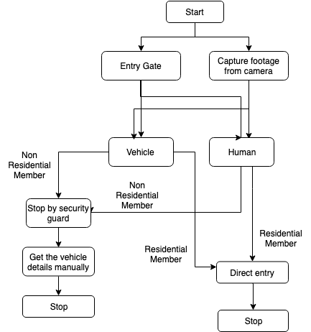
Existing System

Slide 15
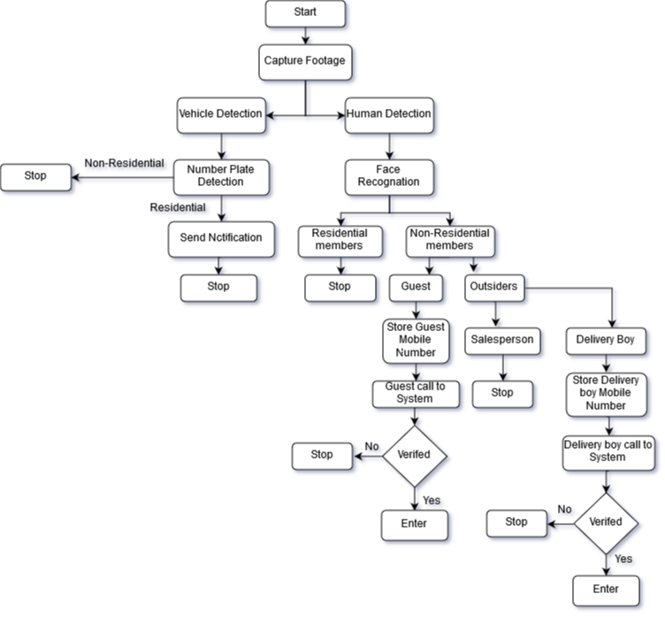
Proposed System

Slide 16
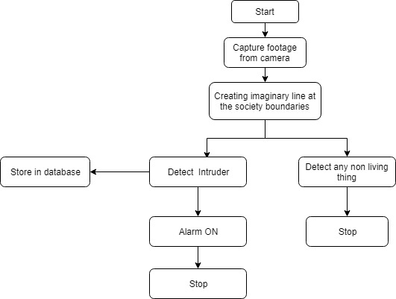
Imaginary Line

Slide 17
Scope of the Project
1. Detect residential and non-residential vehicle through vehicle number plate.
2. Send a message to owner about his vehicle actions.
3. Need of watchman will be overcome.
4. Detect residential and non-residential member through face detection.
5.Any intruder penetrating wall will be captured

Slide 18
Project Limitations
1. If a residential member suffering from viral disease will be triggered as a non-residential member.
2. Mulitlinguistic number plates would not recognized.

Slide 19
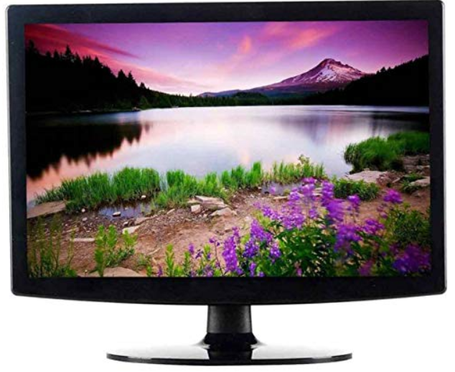
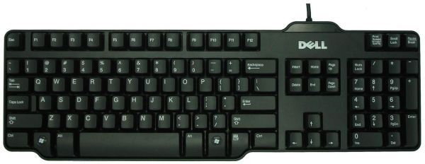
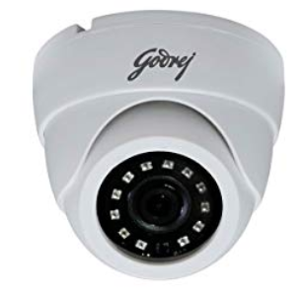
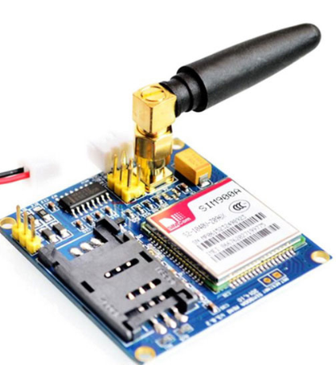

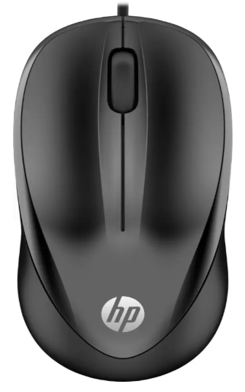
Project Estimation
Camera
Rs. 999
Keyboard
Rs. 250
Monitor
Rs. 2,700
Approx.
Rs. 8,000
DVR
Rs. 1,775
GSM Module
Rs. 1,500
Mouse
Rs. 250

Slide 20
Technology Stack
Hardware Requirements
• Laptop or PC with minimum 4GB of RAM.
Software Requirements
• Machine Learning(Python)
• Neural Networks(RCNN)

Slide 21
Conclusion
The proposed system will avoid security concerns in the real-time scenario. Boundaries of the society will be free from intruders. IN and OUT on the vehicles will be notified to the owner. Detailed information of all the non residential members will be stored. Will reduce the chances of illegal parking. Our system will we cost effective that every society can afford.

Slide 22
Reference
1.Wang W, Gee T, Price J, et al. Real time multi-vehicle tracking and counting at intersections from a fisheye camera[C]//2015 IEEE Winter Conference on Applications of Computer Vision. IEEE, 2015: 17-24.
2.H. Saghaei, “Proposal for Automatic License and Number Plate Recognition System for Vehicle Identification,” arXiv preprint arXiv:1610.03341, Oct 2016.
3.Zhang Quanfa,et al. "Engineering vehicle inspection based on HOG feature and machine learning." Computer system application ,2013:104-107.
4.Ala Mhalla, Thierry chateau, Sami Gazzah, Najoua Essoukri Ben Amara, “A Faster R-CNN Multi-Object Detector on a Nvidia Jetson TX1 Embedded System,” Proceedings of the 10th International Conference on Distributed Smart Camera, pp. 208-209, 2016.
5.Girshick,Ross."Fast R-CNN."IEEE International Conference on Computer VisionIEEE Computer Society, 2015:14401448.

Slide 23
Thank You...!!

