Slide 1
B
P
T
AdaptPro
AI intelligence for enhanced cross-functional decision making
Rehearsal demo for Pranav Kalwad — October 2026

Slide 2
THE PROBLEM
Three correct answers. Three different products.
B
P
T
Business
Product
Tech
promises something
to a customer
plans something
to ship
decides what's
actually buildable
THE PATTERN
Each one can pass review entirely on its own. Nobody compares the three until a sprint is already underway, or a customer is already on a call — and by then, fixing it is expensive.
The problem
AdaptPro

Slide 3
SAMPLE — ILLUSTRATIVE ONLY
Here's exactly that pattern, made concrete. Veridion Chemicals (a sample company) wants a chat tool for its plant staff:
“What's OEE for Line 3 right now, and what's driving any drop?”
OEE — Availability × Performance × Quality — is the single number this plant runs on.
One sentence. It sounds simple. Three teams still answered it differently — that's the whole talk.
The setup
AdaptPro

Slide 4
THE FORK
What each side actually said
WHAT SALES PROMISED THE CUSTOMER
“See real-time OEE for any line, and automatically generate a corrective work order the moment OEE drops below target.”
WHAT PRODUCT PLANNED TO BUILD
WHAT TECH ACTUALLY DECIDED
“Any write action — creating or triggering a work order — from the chat is out. There is no path back out to the source system scoped here.”
“Explicitly rejected building a 'generate work order' capability for now — no work-order system, no agreed OEE threshold, exists to build it against.”
Unresolved, nobody owns it yet — written down verbatim in the shared project record.
The fork
AdaptPro

Slide 5
WHAT WE BUILT
One shared record. Agents that check each other.
B
P
T
ONE SHARED RECORD
Not three separate notes that each look fine on their own — one place, and a record of exactly where the three sides disagree.
It's built using the LLM Wiki pattern: sources get compiled into living pages once, then read and compared — never re-derived from scratch.
A meeting catches this once. This catches it every time, automatically.
Business
Product
Tech
What's promised
to the customer
What's actually
planned to ship
What's actually
buildable
— Three agents explain each side's view to the others, in plain language, in their own voice.
— A fourth agent checks any new decision against all three before it's made.
— All four only read — none can quietly rewrite the record to make a disagreement disappear.
What we built
AdaptPro

Slide 6
THE SOLUTION, IN DETAIL
What's actually inside the knowledge base
SCHEMA.md
The rulebook — how the three sides are read, voiced, and checked.
personas/
One page per side. Business's page says only what Business's own source says — never blended with Product's or Tech's.
glossaries/
Each side's vocabulary, written in plain terms for the other two to read, not for itself.
synthesis/
The disagreement record — plus any brief saved before a meeting.
THE LOOP THAT KEEPS IT HONEST
A source changes → only its one page updates. Someone asks a question → the right pages get read, nothing else. Either way → the pages get compared, and any disagreement goes on the record.
The solution, in detail
AdaptPro

Slide 7
LIVE, FROM AN ACTUAL AGENT RUN
Ask it to check a decision
“Add a tool that automatically creates a work order when Line 3's OEE drops below 70%.”
Business:
supports it — “this is overdue, not new.”
Product:
out of scope — write actions were explicitly excluded in the plan.
Tech:
explicitly ruled out — the engineering decision rejected this exact tool.
VERDICT: NOT ALIGNED
Maps to the disagreement already on record — it did not invent a new one.
Demo
AdaptPro

Slide 8
HONEST FRAMING
Where this honestly stands
1
2
3
Shared record
Agents that check each other
A fully automatic, scale-proof check
DONE
PARTIAL
NOT PURSUED
Three viewpoints, one disagreement record, built and working.
Separate voices, a lightweight checker. Still re-reads everything each time.
Would need a permanent, dated sign-off system — out of scope right now.
Also open: nobody can yet sign off and date acceptance of a known gap, and a new check needs a fresh session before it's available.
Honest framing
AdaptPro

Slide 9
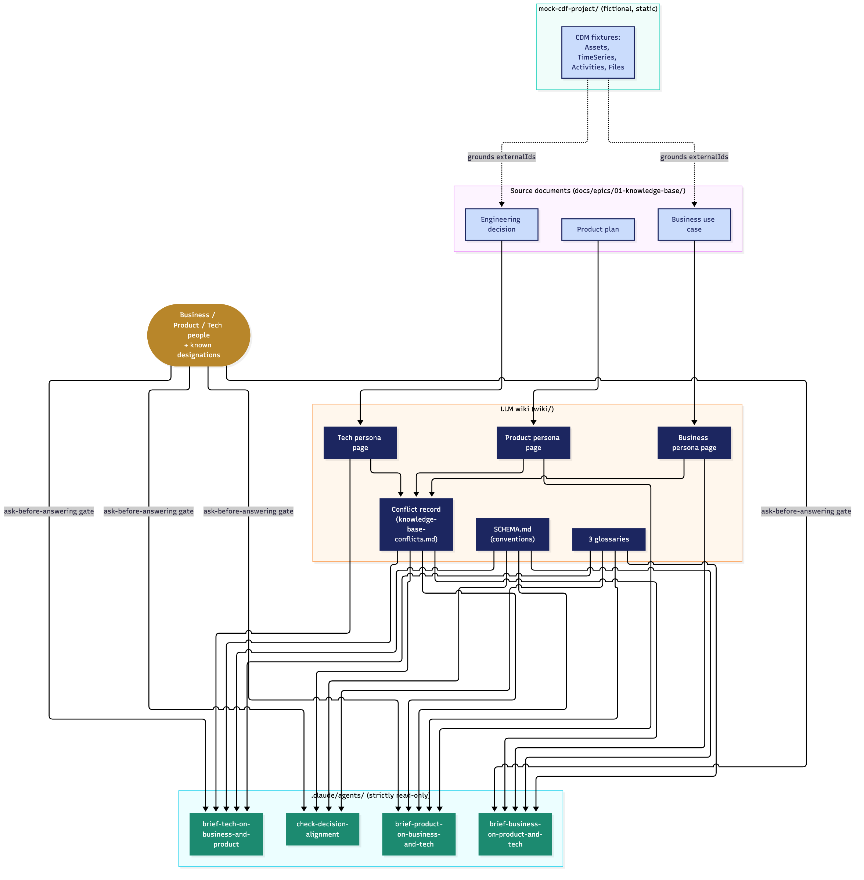
APPENDIX · DIAGRAMS
Architecture — current implementation
Rendered from docs/architecture/current-implementation.md (mermaid source, versioned).
Appendix · Diagrams
AdaptPro

Slide 10
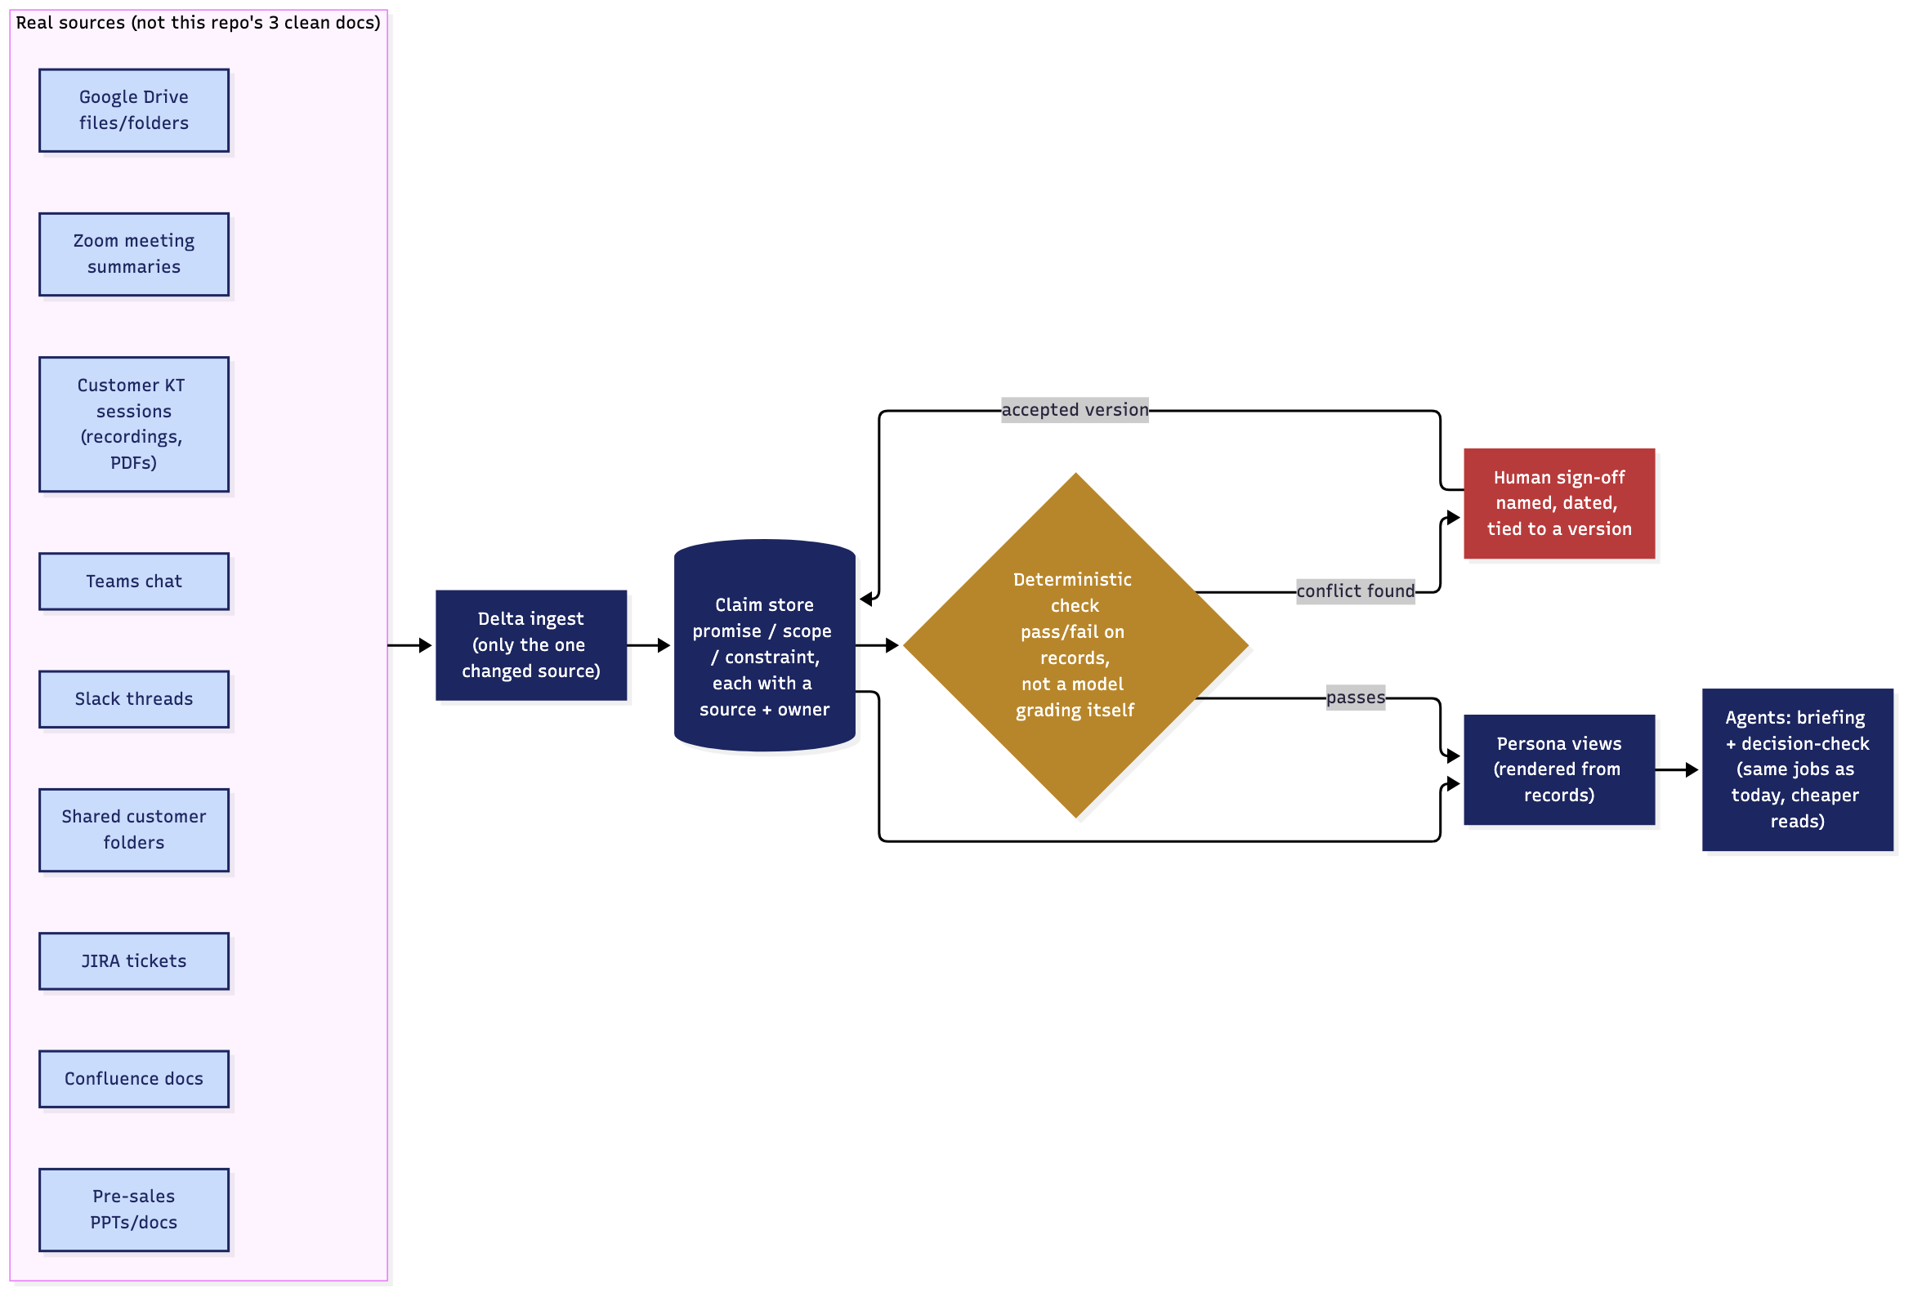
APPENDIX · DIAGRAMS
Architecture — for scale (not built)
STAGE 3 — NOT IMPLEMENTED
Rendered from docs/architecture/for-scale.md (mermaid source, versioned).
Appendix · Diagrams
AdaptPro

Slide 11
APPENDIX · SCALING TO REAL DATA
Where a real knowledge base would draw from
Today's wiki ingests 3 clean markdown documents. A real deployment would have to ingest this instead:
Zoom meeting summaries
Slack threads
Google Drive files/folders
JIRA tickets
Confluence documentation
Customer KT sessions (recordings, PDFs)
Teams chat
Shared customer folders (MS Teams)
Pre-sales PPTs and documents
Appendix · Scaling to real data
AdaptPro

Slide 12
APPENDIX · STATED PLAINLY
Current implementation limitations
— Built from off-the-shelf Claude Code plugins — not production-grade.
— A deliberately simple use case; lacks real-world chaos and edge cases.
— Mock CDF project, not a real deployed use case.
— The wiki is simple and doesn't yet include real-world sources.
— Fails on scale — ironic, given this is this year's DevCon theme.
— Agents aren't optimized for token efficiency.
— Personas aren't rigidly implemented yet; needs a more mature model.
Appendix · Stated plainly
AdaptPro

Slide 13
APPENDIX · WHERE THIS COULD GO
Opportunities to integrate into CDF
C
A
F
CDF
Atlas AI
Flows Apps
Swap the mock project for a real CDF project — ground every persona page in live assets, time series, and activities instead of static fixtures.
Run the briefing and decision-check agents as Atlas AI agents inside CDF, so any persona can query them directly, no separate coding session needed.
Build a lightweight Flows app where someone picks their persona and sees their brief or a decision verdict in a real UI, not a terminal conversation.
Appendix · Where this could go
AdaptPro

Slide 14
APPENDIX · RECAP
Product use cases, as of now
— Homework for a cross-functional team meeting.
— Exploration of what the other line of business does.
— Bigger-picture understanding — how one person's work integrates into the grand scheme of things.
— Intelligent decision-aligning assistant — surfaces gaps within cross-functional teams before decisions are made.
Appendix · Recap
AdaptPro

Slide 15
A THING TO CONSIDER
This agent is only as good as the questions the user actually asks.
That's what makes it a product of real use across levels — from an intern's first question to a CXO's — and also the sharpest limit on how good an answer can be.
Appendix · Guiding principle
AdaptPro

Slide 16
Questions
Pranav Kalwad — AdaptPro
P
B
T

