Slide 1
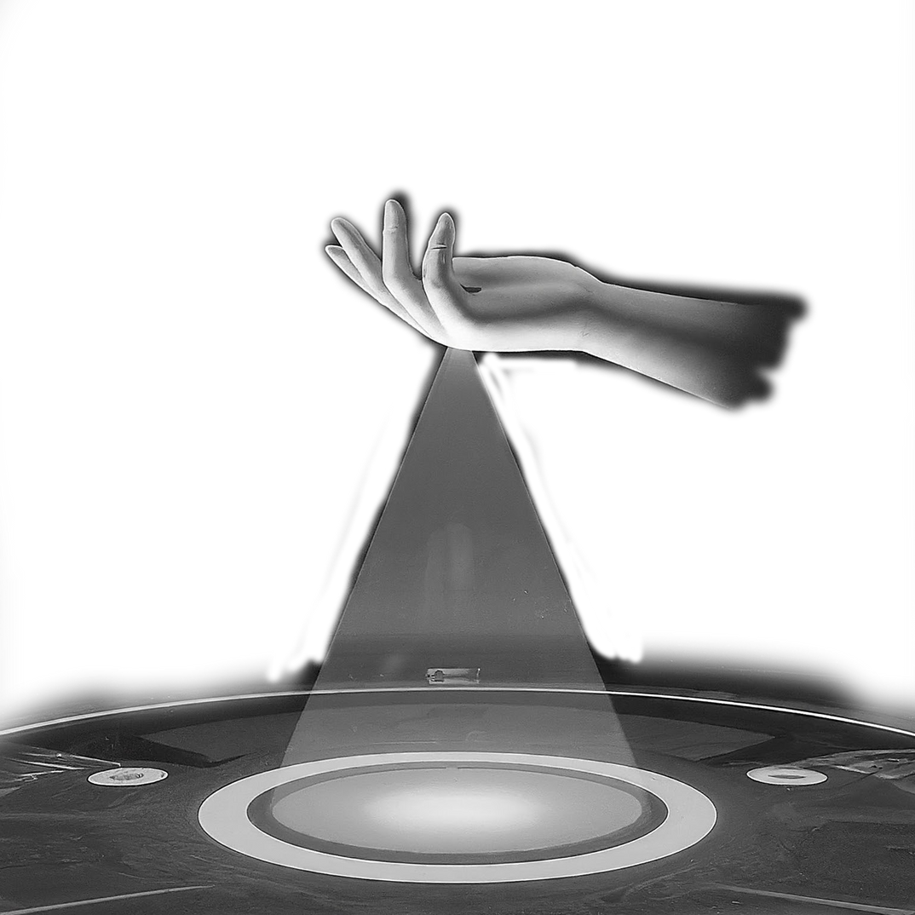
CONTROLLING POWERPOINT PRESENTATION USING HAND GESTURES
PRANAV T (KMC21CS042)
MUHAMMED DANISH A P (KMC21CS033)
MUHAMMED ROSHAN K R (KMC21CS036)
NIHAL (KMC21CS041)
GUIDED BY : -
Mrs. MUHSINA K
Asst. professor
CSE department
KMCTCE

Slide 2
INTRODUCTION
PowerPoint is like the universal language of presentations,
making it easy for you and your audience to follow along.
It allows integration of text, images, illustrations, audio, video, and
charts, fostering dynamic presentations.
The visual structure facilitates comprehension and audience interest.
Reliance on mouse, keyboard, or remote restricts movement and
confines the presenter to a specific location.
1

Slide 3
OBJECTIVE
To develop a cost-effective, touchless hand gesture recognition (HGR) system using a standard laptop camera for
controlling and interacting with PowerPoint presentations.
Enhance presenter mobility
Improve audience engagement
Provide a cost-effective solution
2

Slide 4
LITERATURE
SURVEY
3

Slide 5
(1) Development of a Real Time Vision-Based Hand Gesture Recognition System for Human-Computer Interaction (2023)
Arijit Das; Kaulik Maitra; Shayan Roy; Biswarup Ganguly; Meghna Sengupta; Shreya Biswas
Focus on real-time hand gesture recognition for human-computer interaction.
Utilizes American Sign Language dataset and YOLO-v5 algorithm model.
Uses 700 sign language images in experiment
4

Slide 6
(2)Marker-enhanced Hand Tracking with Deep Learning (2022)
Donghao Yang; Xian Cao; Yazui Liu; Shuhong Xu
Hand tracking method with markers and multiple RGB cameras.
CNN predicts hand joint positions for marker labeling.
Image restoration algorithm for high accuracy hand joint prediction.
5

Slide 7
(3)Image processing technology based on computer vision algorithm(2022)
Mengxia Fan; Yunna Liu
Discusses image processing technology based on computer vision algorithm.
Highlights stereo matching in binocular vision and its applications.
Emphasizes the use of deep learning in stereo matching algorithms.
6

Slide 8
EXISTING SYSTEM
Requires physical contact: Presentation control relies on tools like mouse, keyboard, or remote, needing physical interaction.
Limited mobility: Presenter's movement is restricted due to dependence on control tools.
Distraction potential: Using external controls can break eye contact and distract the audience.
Learning curve: Operating unfamiliar controls like a new remote might require practice.
Cost: Additional hardware like remotes can add to the presentation setup cost.
7

Slide 9
PROPOSED SYSTEM
Touchless control: Operates through hand gestures captured by a laptop camera, eliminating physical contact.
Increased mobility: Allows presenters to move around freely while controlling the presentation.
Enhanced engagement: Eye contact remains uninterrupted, fostering better audience interaction.
Intuitive interaction: Utilizing natural hand gestures offers a familiar and user-friendly experience.
Cost-effective: Leverages existing laptop camera, eliminating extra hardware expenses.
8

Slide 10
ARTITECTURE
user
Hand
detector
gesture
recognition
webcam
presentation
controller
slide
manager
annotation
manager
presentation
slides
9

Slide 11
DATAFLOW
DIAGRAM
10

Slide 12
DATA FLOW DIAGRAM - LEVEL 0
control
signals
webcam
gestures
presentation
control
presentation slides
11

Slide 13
DATA FLOW DIAGRAM - LEVEL 1
send
video frames
hand
gesture
recognition
hand
landmarks
control
signals
webcam
presentation
control
presentation slides
12

Slide 14
DATA FLOW DIAGRAM - LEVEL 2
send
video frames
webcam
capture
send hand
data
webcam
hand
processing
send
hand landmarks
identified
gesture
presentation
control
gesture
recognition
control
signals
control
signals
annotation
presentation slides
apply
annotation
13

Slide 15
USE CASE
DIAGRAM
14

Slide 16
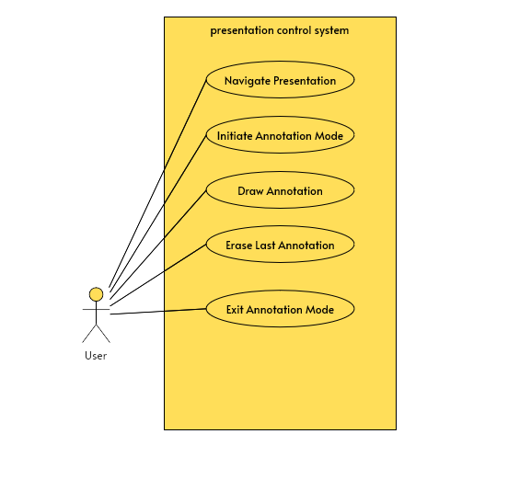
15

Slide 17
CLASS
DIAGRAM
16

Slide 18
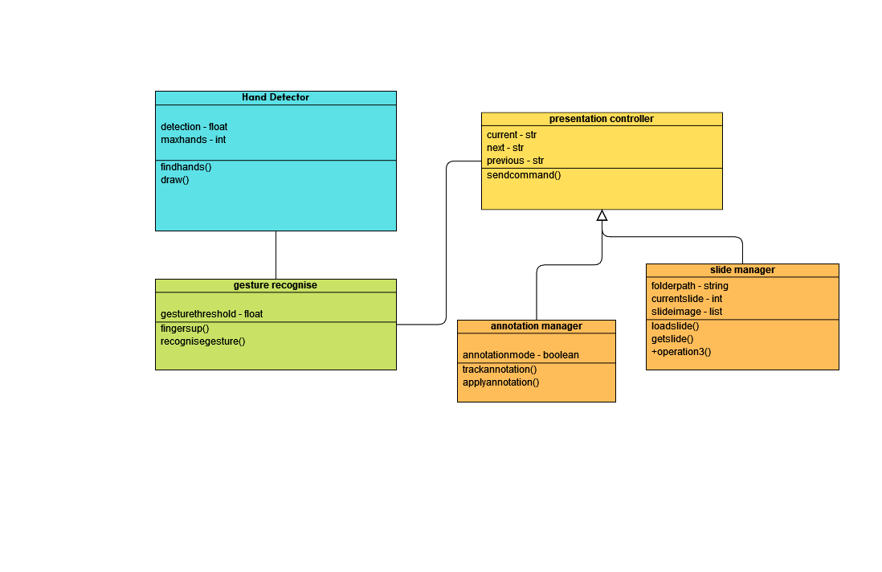
17

Slide 19
ACTIVITY
DIAGRAM
18

Slide 20
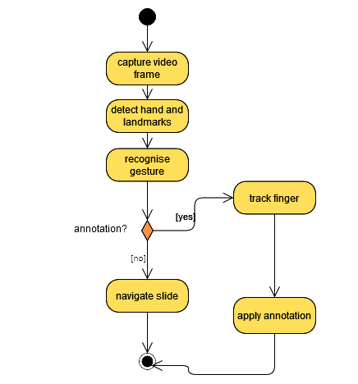
19

Slide 21
SEQUENCE
DIAGRAM
20

Slide 22
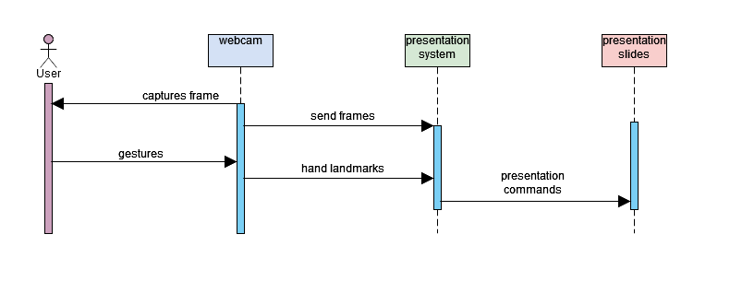
21

Slide 23
METHODOLOGIES
OpenCV (Open Source Computer Vision Library): OpenCV is a widely used library for real-time computer vision tasks. This project leverages OpenCV for capturing video frames from the webcam (cv2.VideoCapture), displaying images (cv2.imshow), and performing basic image processing operations like flipping (cv2.flip).
Hand Landmark Detection: The code imports a module called HandTrackingModule (media pipe). This module is responsible for detecting the hand region in the video frame and identifying specific landmark points on the fingers and palm. These landmarks provide information about the hand posture and finger movements
22

Slide 24
METHODOLOGIES
Gesture Recognition: Based on the detected hand landmarks and their relative positions, the code implements basic gesture recognition logic. It identifies gestures like raising the index finger (interpreted as "Left") or raising the pinky finger (interpreted as "Right") to control navigation between presentation slides.
User Interface (UI): The code utilizes OpenCV's windowing capabilities (cv2.imshow) to display two main windows
23

Slide 25
HARDWARE REQUIREMENTS
Processor: Dual-core processor (or equivalent) with decent processing power. Real-time hand detection and gesture recognition can be computationally demanding.
Memory (RAM): Minimum 4GB RAM. More RAM can be beneficial for smoother performance.
Webcam: A standard webcam with a resolution of at least 720p (1280x720) is recommended.
Storage: Enough storage space to accommodate the Python script, OpenCV library, and the presentation images folder.
24

Slide 26
SOFTWARE REQUIREMENTS
Python 3.x: a recent version of Python 3.x installed on your system.
OpenCV library: utilizes the OpenCV library for computer vision tasks like hand detection and landmark identification. You'll need to install OpenCV following the instructions for your specific operating system.
HandTrackingModule: a custom module or library for hand tracking functionalities. You might need to download or install this module separately
25

Slide 27
IMPLEMENTATION
PHASE 1: System Design and Requirements Gathering
PHASE 2: Development and Implementation
PHASE 3: Integration and Testing
PHASE 4: Deployment and Maintenance
26

Slide 28
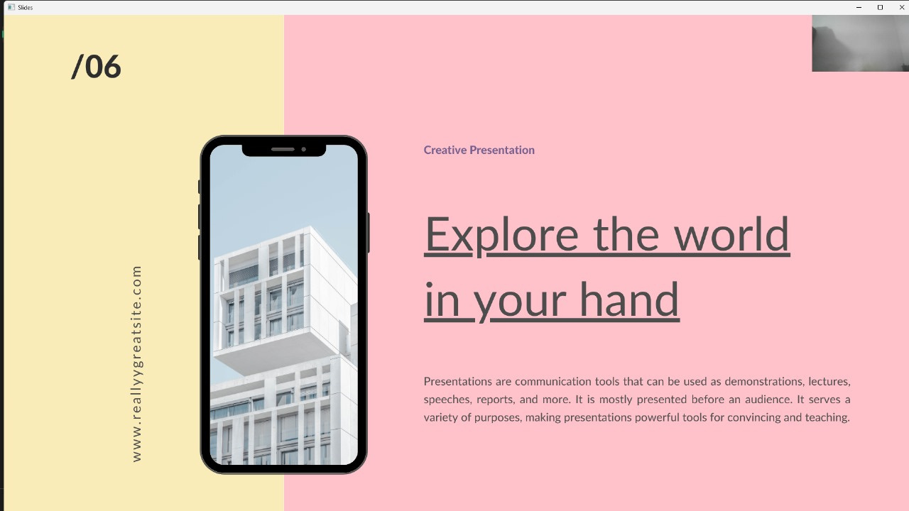
USER INTERFACE
27

Slide 29
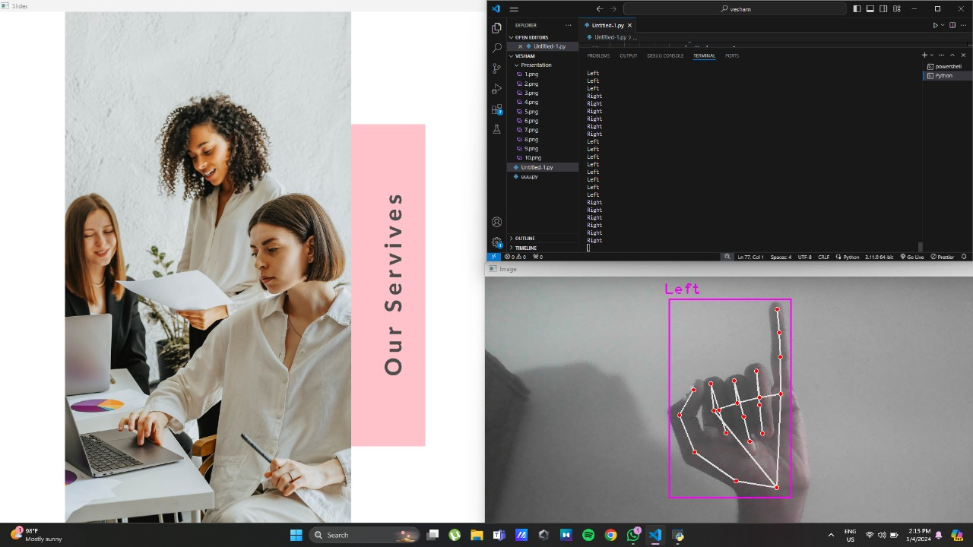
FORWARD
28

Slide 30
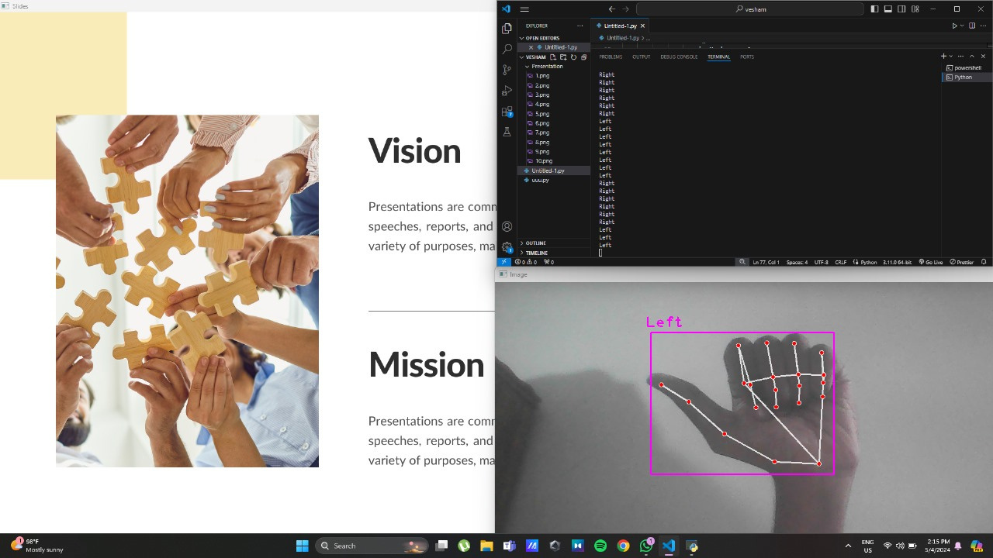
BACKWARD
29

Slide 31
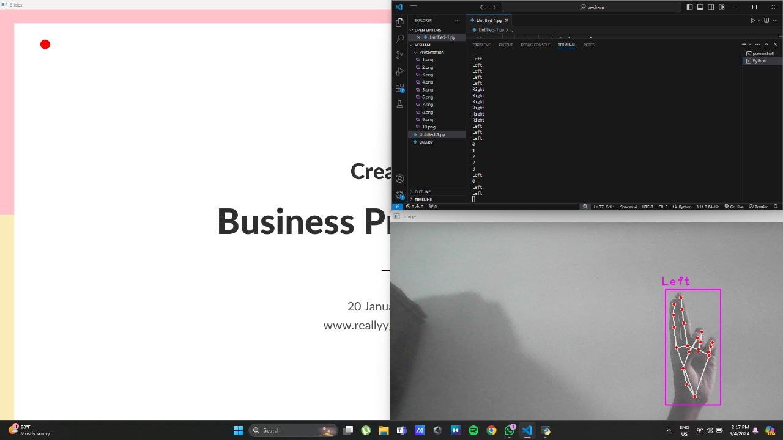
MOVE POINTER
30

Slide 32
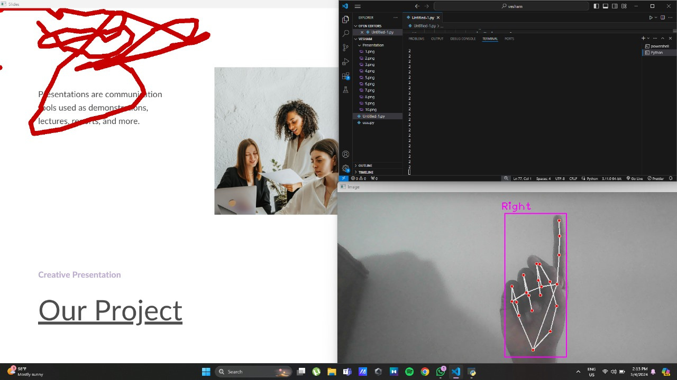
DRAW
31

Slide 33
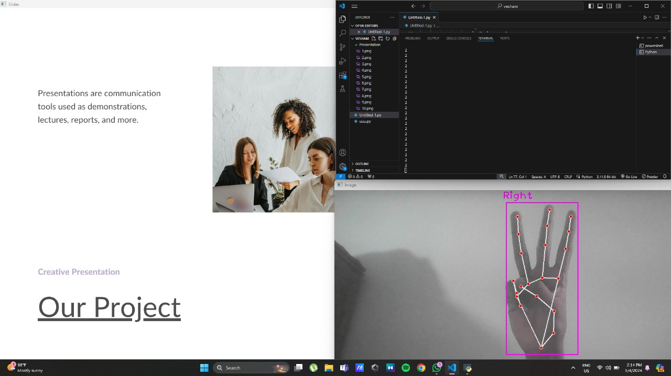
UNDO
32

Slide 34
CONCLUSION
Enhanced Engagement: Hand gestures create a dynamic and interactive environment, captivating the audience's attention and fostering participation.
Increased Accessibility: The system can be a valuable tool for users with limitations in using physical controls, promoting inclusivity in presentations.
Improved Efficiency: Navigating slides through gestures can streamline the presentation flow, allowing presenters to focus on delivering their message.
Intuitive Control: The use of natural hand gestures provides a user-friendly experience, reducing reliance on memorizing keyboard shortcuts.
33

Slide 35
REFERENCES
Development of a Real Time Vision-Based Hand Gesture Recognition System for Human-Computer Interaction (2023) Arijit Das; Kaulik Maitra; Shayan Roy; Biswarup Ganguly; Meghna Sengupta; Shreya Biswas
Marker-enhanced Hand Tracking with Deep Learning (2022)
Donghao Yang; Xian Cao; Yazui Liu; Shuhong Xu
Image processing technology based on computer vision algorithm (2022)
Mengxia Fan; Yunna Liu
34

Slide 36
Thank you :)
35

