Slide 1




Satellite & IoT Pipeline Leak Monitoring
Revolutionizing Water Loss Reduction System
By Pranav Khatade

Slide 2



The Water Leakage Crisis
Problem Statement
Water loss crisis: 30–40% of water in pipelines is lost to leaks globally.
Costly detection: Traditional methods (manual inspection, sensors) are slow, expensive, and limited in coverage.
Impact: Wastage of billions of liters annually, infrastructure damage, and increased costs for utilities.

Slide 3
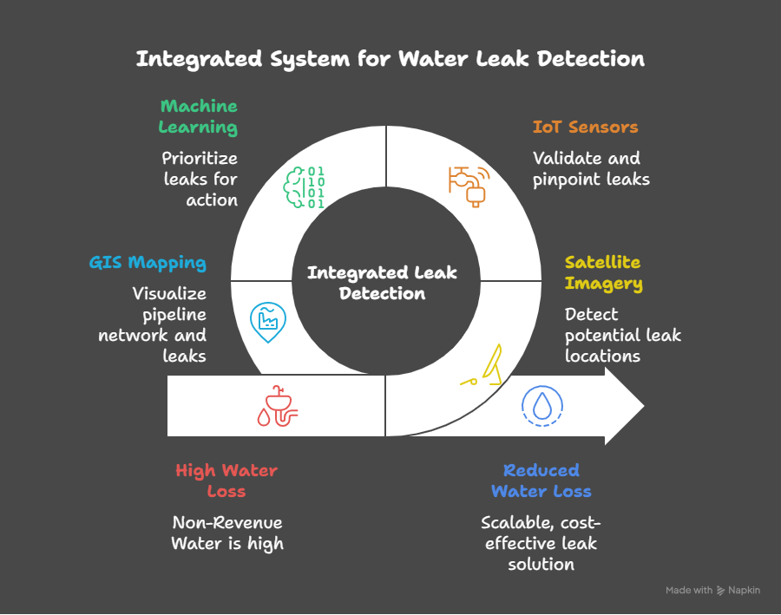
SATELLITE + IOT LEAK DETECTION APP
Our system combines satellite imagery and IoT sensors to detect water pipeline leaks more effectively. Satellites like SAR, thermal, and multispectral provide a broad view of pipeline conditions, while IoT sensors give real-time, ground-level data such as pressure, flow, and sound changes. Using machine learning, the system analyzes this data to spot and prioritize leaks. A GIS map shows the pipelines, past maintenance, and detected leaks. Finally, a real-time dashboard alerts utility teams and helps them quickly send field workers to repair leaks, reducing water loss and saving costs.

Slide 4


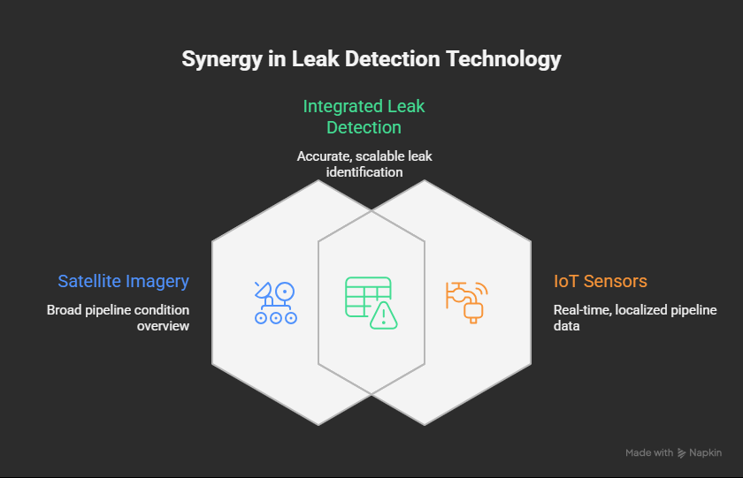
CORE SYSTEM FEATURES
SATELLITE DATA
IOT SENSORS
SAR: Detects soil moisture changes near pipelines.
Thermal: Identifies temperature anomalies from leaks.
NDVI: Monitors vegetation health affected by water leaks.
Pressure: Detects pressure drops signaling leaks.
Flow: Tracks water flow discrepancies.
Acoustic: Pinpoints leaks using sound patterns.
DIAGRAM :-
ML ANALYTICS
GIS MAPPING
AI algorithms analyze combined satellite + IoT data.
Improves accuracy & reliability of leak detection.
Shows pipeline routes, maintenance history, and leak locations.
Helps utilities plan efficient repairs.

Slide 5
Unique Fusion
Scalable
Satellite + IoT for higher accuracy than single-source systems.
Covers large areas vs. manual or IoT-only solutions.
What
Sets
US
Apart
Cutting Edge
Cost Effective
Outperforms manual methods; rivals Utilis with IoT validation.
Uses public data (Sentinel-1, Landsat) + targeted IoT.

Slide 6





Our Audience
Focus: India (Jal Jeevan Mission, Smart Cities), Asia, developing regions.
Market Size: $10B global NRW market; 500,000+ km of pipelines in India.
Users: Water utilities, municipal corporations, government agencies.

Slide 7

Pilot Rollout
For the pilot implementation, we will select a 5–30 km section of pipeline with known historical leaks to validate the system. The project will use Sentinel-1 SAR, Landsat multispectral, and ECOSTRESS thermal imagery, combined with 6–12 strategically placed IoT sensors along the pipeline to provide ground truth data. Within three months, we will build the end-to-end pipeline and develop a machine learning model capable of detecting and prioritizing leak alerts. To ensure accuracy, the system’s top alerts will be verified through weekly field inspections by maintenance teams. Performance will be evaluated using Precision@N to measure how accurate the top alerts are, along with tracking the rate of false positives to ensure the system is reliable for real-world deployment.

Slide 8

TECHNICAL FOUNDATION
IMPACT AND FEASIBILITY
• Impact: 10–20% NRW reduction, saving millions in water/costs.
• Environmental: Conserves water, reduces energy in treatment.
• Practicality: 3-month pilot for 5–30 km pipeline area.
• Metrics: Precision@N, time-to-repair, NRW reduction.
• Storage: AWS S3 / MinIO
• Processing: Python, GDAL, SNAP, rasterio
• ML: PyTorch, scikit-learn
• GIS: PostGIS
• Dashboard: React + Leaflet
• IoT: MQTT, LoRaWAN/NB-IoT

Slide 9



CONCLUSIONS
our system offers a smart and scalable solution to the global problem of water loss by integrating satellite imagery, IoT sensors, and machine learning. By combining wide-area monitoring with real-time ground data, it enables early leak detection, reduces repair costs, and ensures reliable water supply. With its practicality and potential for expansion, this approach can play a key role in building sustainable and resilient water infrastructure worldwide.

Slide 10

THANK
YOU!
For any query contact : pranavkhatade02@gmail.com

