Slide 1
Opinion-Based Decentralized Malicious Intent Detection in Intelligent Transport Systems(ITS)
Prepared by:
Pranav Kumar (2021UCA1910)
Rohan Kumar Mishra (2021UCA1919)
Chirag Rajput (2021UCA1921)
Mentored by: Dr. Rashmi Chaudhry
Date: September 23, 2024

Slide 2
Table of Contents
Introduction
Motivation
Problem Statement
Objectives
Literature Survey
Attack on Networks
Proposed Methodology
Opinion Formation Techniques
Simulation Tools
Simulation Results
Future Work
Conclusion

Slide 3
Introduction
Overview of ITS:
Intelligent Transport Systems (ITS) integrate wireless technologies to enable Vehicle-to-Vehicle (V2V) and Vehicle-to-Infrastructure (V2I) communication.
Vehicles exchange data to improve road safety, traffic management, and driving efficiency.
Wireless protocols used: DSRC, Cellular Networks, Wi-Fi.
Key Challenge: Distinguishing between trustworthy and untrustworthy information in vehicular networks to ensure safe driving and avoid disruptions caused by malicious data.

Slide 4
Motivation
WAVE Protocols: Vehicles equipped with Wireless Access in Vehicular Environment (WAVE) devices based on the IEEE 802.11p standard.
Each vehicle has an On-Board Unit (OBU), which broadcasts position, speed, and event data, but is vulnerable to malicious messages.
Challenges:
Dynamic topology: Constant changes due to vehicle movement.
Security vulnerabilities: Sybil attacks, key/certificate replication, and fake positions.
Impact on safety: Secure protocols are needed for reliable data dissemination.
Goal: Build a robust security framework to support efficient and secure communication, enabling better traffic management and driver safety.

Slide 5
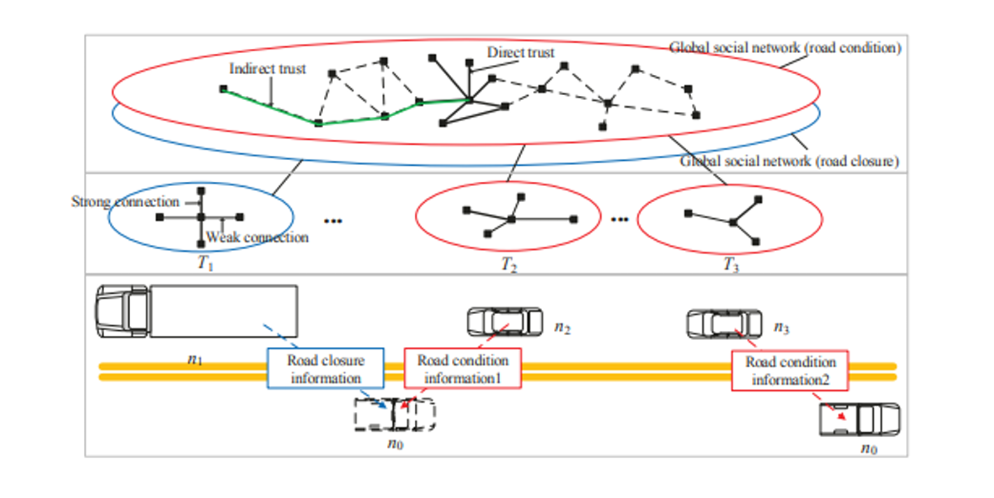
pictorial representation

Slide 6
Problem Statement
Objective: Improve the security of Intelligent Transport Systems (ITS) to prevent attacks that:
Spread false or altered information.
Disrupt the network (e.g., Denial of Service).
Impersonate multiple identities (Sybil attacks).
Aim: The aim is to enhance driver safety, improve traffic efficiency, and secure information sharing among vehicles.

Slide 7
Objective
Strengthen Communication Security: Secure V2V and V2I communications against attacks such as bogus information, Sybil attacks, and tunneling.
Enhance Opinion Evaluation: Implement decentralized hybrid opinion evaluation (direct and indirect feedback from vehicles) to assess the trustworthiness of data.
Leverage Blockchain: Utilize blockchain technology to verify and record message transmissions securely.
Promote Safety and Efficiency: Ensure safe driving through secure data dissemination and effective traffic management.

Slide 8
Literature Survey
Previous Research:
Studies have explored Opinion Management in VANETs (Vehicular Ad Hoc Networks) using various techniques (e.g., direct/indirect trust evaluation).
Clustering techniques have been proposed to improve scalability and reliability by grouping vehicles into sub-networks.
Security Challenges: Common attacks like bogus information, alteration, and Sybil attacks have been the focus of multiple research efforts to secure communication in ITS.
Research Gap: Current opinion evaluation mechanisms need to be more decentralized and robust against evolving attacks.

Slide 9
Attacks on networks
Sybil Attacks: A vehicle uses multiple fake identities to mislead others, causing network confusion and disrupting communication.
Mitigation: Opinion-based trust detection reduces false identity success.
Position Faking: Vehicles send incorrect location data, leading to wrong decisions about traffic and safety.
Mitigation: Trust propagation through neighboring vehicles helps identify false data.
Denial of Service (DoS):Attackers overwhelm the network with requests, causing system slowdowns or failures.
Mitigation: Decentralized architecture distributes load, minimizing the impact.
Eavesdropping: Malicious actors intercept data between vehicles and infrastructure to steal information.
Mitigation: Encryption ensures secure communication and prevents data theft.

Slide 10
Proposed Methodology
Decentralized Opinion-Based Architecture:
Vehicles are organized into dynamic groups, each governed by a Group Representative (GR), which manages the group’s security and communication.
Group Communication: Vehicles periodically broadcast beacons containing data like position, velocity, and GPS to assess the trustworthiness of messages.
Blockchain Integration for Security:
Blockchain is employed to record key exchanges and opinion evaluations, ensuring tamper-proof data and preventing malicious alterations.
Key Management:
GRs generate private, public, and symmetric keys for encrypted communication within the group.
Keys are stored and validated on the blockchain, creating a transparent history of group membership.

Slide 11
Proposed Methodology
Dynamic Group Formation:
Group Formation: The GR creates keys for new members and verifies their identities against blockchain records to ensure authenticity.
Membership Updates: As vehicles enter or leave the group, the GR updates the blockchain, ensuring all members have access to valid keys.
Malicious Node Detection:
Vehicles with a consistently low comprehensive opinion score are flagged as malicious and are excluded from further communication.
The decentralized opinion system ensures resilience against attacks like Sybil, position faking, and bogus information.

Slide 12
Opinion Formation Techniques
Opinion Metrics:
Vehicles constantly exchange beacons that include information like position, velocity, and GPS data.
Each vehicle forms a First Opinion based on this data.
Second Opinion: Calculated from feedback collected from other vehicles in the group.
Comprehensive Opinion Calculation:
Geometric mean of the First Opinion.
Arithmetic mean of Second Opinions from all neighboring vehicles.
Vehicles are classified as trustworthy or malicious based on this final opinion score.

Slide 13
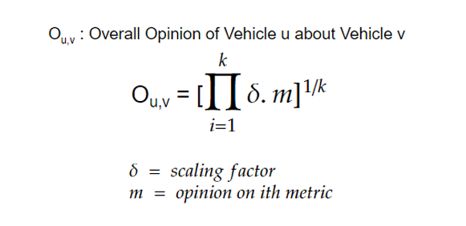
Overall Opinion

Slide 14
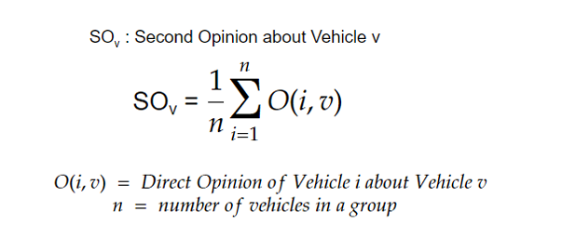
Second Opinion

Slide 15
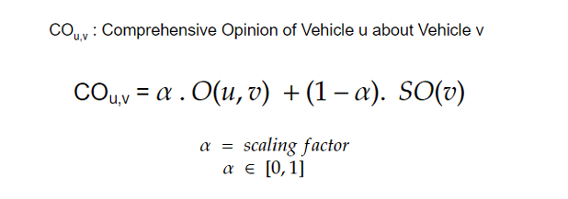
Comprehensive Opinion

Slide 16
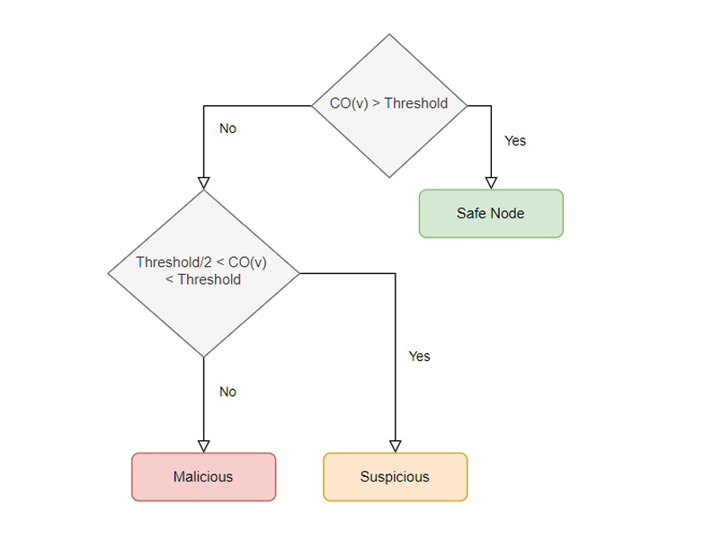
final evaluation

Slide 17
Simulation Tools
SUMO: Simulation of Urban Mobility for realistic traffic flow and vehicular behaviour modelling.
OMNeT++: Open-source discrete event simulation framework, commonly used for simulating communication networks.
Veins: Framework integrating SUMO and OMNeT++ to simulate both vehicular mobility and communication networks.

Slide 18
Simulation Results
Opinion Evaluation:
The simulation shows that the proposed system efficiently identifies malicious vehicles by analyzing direct and indirect opinions.
Group-based architecture: Reduces network overhead by allowing vehicles to communicate with group leaders instead of verifying all other vehicles individually.
The system efficiently handled large volumes of vehicles while detecting malicious intent in real time.

Slide 19
Future Work
Explore Machine Learning to automatically detect malicious and selfish nodes based on the patterns of opinion scores.
Expand opinion formation to a global level across groups, not just within a single group.
Address scalability challenges as the number of vehicles increases in dense traffic environments.
Implement dynamic re-election mechanisms when a Group Representative exits the group due to range limitations.

Slide 20
Conclusion
The proposed decentralized, opinion-based malicious intent detection system enhances the security and reliability of ITS.
Blockchain provides transparency and ensures that communication records are tamper-proof.
Group-based architecture allows for scalable and secure data transmission in a rapidly changing vehicular environment.
This solution is a step toward safer, more efficient, and secure traffic management for smart cities.

