Slide 1


POWERED BY TCOE INDIA
Hackathon 2026
Project Submission Template
Emerging Technologies
MediLink AI
MediLink AI — AI-assisted connected ambulance system for rapid triage, routing and emergency coordination.

Slide 2
About the Team
Solo submission focused on clarity of presentation, strong problem framing, and a demo-ready AI solution.
Team / Individual Name
Pranav Mahesh Palled
Institute / Organisation
KLS Gogte Institute of Technology
Technology Vertical
AI + Communication Tech / HealthTech
Team Members (1–5, with Role, Experience and Expertise)
Pranav Mahesh Palled — Full-stack builder, AI workflow design, front-end development, hackathon presentation, and deployment coordination.

Slide 3
Problem Statement & Innovation
Focused on a single, high-impact emergency response problem where AI and telecom can reduce delay.
Problem Statement
Emergency response is slowed when a caller cannot clearly explain symptoms, ambulances are dispatched without structured triage, and hospitals do not receive the right patient context early enough. This leads to avoidable delay, poor routing, and fragmented communication during the most critical minutes.
Your Solution & Its Novelty
MediLink AI combines symptom-based AI triage, nearest-appropriate hospital recommendation, live location sharing, and emergency status updates in one mobile-first flow. The novelty is the end-to-end coordination layer: one input creates a structured case, prioritises urgency, prepares the hospital, and supports the ambulance team with a clean dashboard.

Slide 4
Technical Feasibility & Implementation Readiness
Designed as a practical MVP that is easy to demo, easy to deploy, and ready to extend.
Architecture & Design
1) User reports symptoms through a web/mobile form.
2) AI triage engine assigns urgency, suggests next actions, and tags required department.
3) Dispatch dashboard shows case priority, live location, ETA, and hospital recommendations.
4) Hospital view receives pre-arrival details and can confirm readiness.
The design is modular so the triage model, maps layer, and communication layer can evolve independently.
Implementation Approach
Frontend: React / Next.js-style responsive UI.
Backend: FastAPI or Node.js API for case creation, triage, and status updates.
AI: lightweight rules + LLM prompt layer for symptom categorisation and urgency scoring.
Data: SQLite/Postgres for cases; mocked hospital list for prototype; maps API for routing.
Deployment: Vercel/Render/Railway for a live demo.
Prototype Maturity
TRL 3 - Proof of concept demonstrated with a clear path to a functional prototype and live deployment.

Slide 5
Market Readiness & Commercialisation Plan
Built for emergency services, hospitals, NGOs, and public health deployments.
Target Market
Citizens, ambulance operators, emergency helplines, hospitals, district health systems, and public safety agencies.
Industry Alignment
Supports existing EMS workflows with structured triage, dispatch logging, location sharing, and pre-arrival notifications.
Go-to-Market Strategy
Pilot with one ambulance service or hospital, gather feedback, then expand city-by-city with role-based dashboards.
Adoption Roadmap
Start with triage + dispatch, then add hospital bed visibility, integrations, multilingual voice support, and analytics.

Slide 6
Economic Viability & Scalability
Low-cost deployment with high social impact and a clear scaling path.
Economic Viability
Prototype can run on low-cost cloud hosting with open-source components and a usage-based AI API. Initial build cost is small and suitable for a student MVP.
Cost-Benefit Summary
Benefits include faster response time, better ambulance utilisation, and improved hospital preparedness compared with manual coordination.
Scalability Plan
Scales geographically by adding more hospitals and ambulances, and technically through APIs, role-based access, and modular services.
Long-Term Business Success
Revenue can come from hospital/EMS SaaS subscriptions, deployment support, and premium analytics dashboards.

Slide 7
Security, Privacy & Compliance
Emergency data must be protected, traceable, and resilient.
Security Features
Role-based access, OTP/login, HTTPS, audit logs, and restricted access to emergency records.
Data Privacy
Collect only essential patient details, minimise retention, and apply privacy-by-design so sensitive data is shared only with authorised responders.
Compliance & Standards
Designed to align with basic health-data handling, accessibility, and privacy principles suitable for Indian digital deployment.
System Resilience
If AI or network services are unavailable, the system falls back to manual case logging, cached hospital data, and direct call coordination.

Slide 8
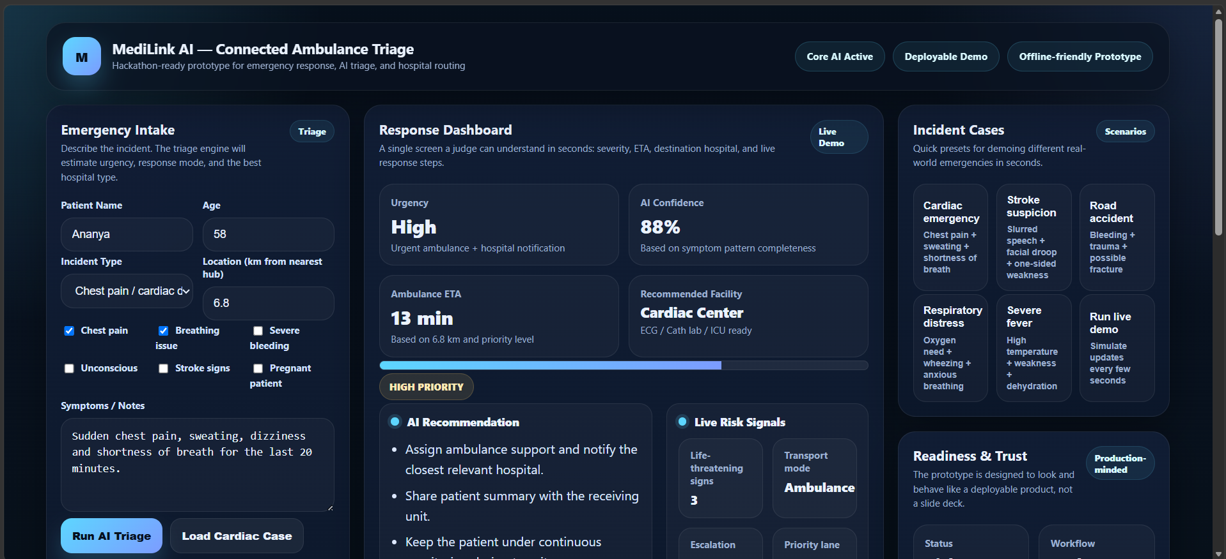
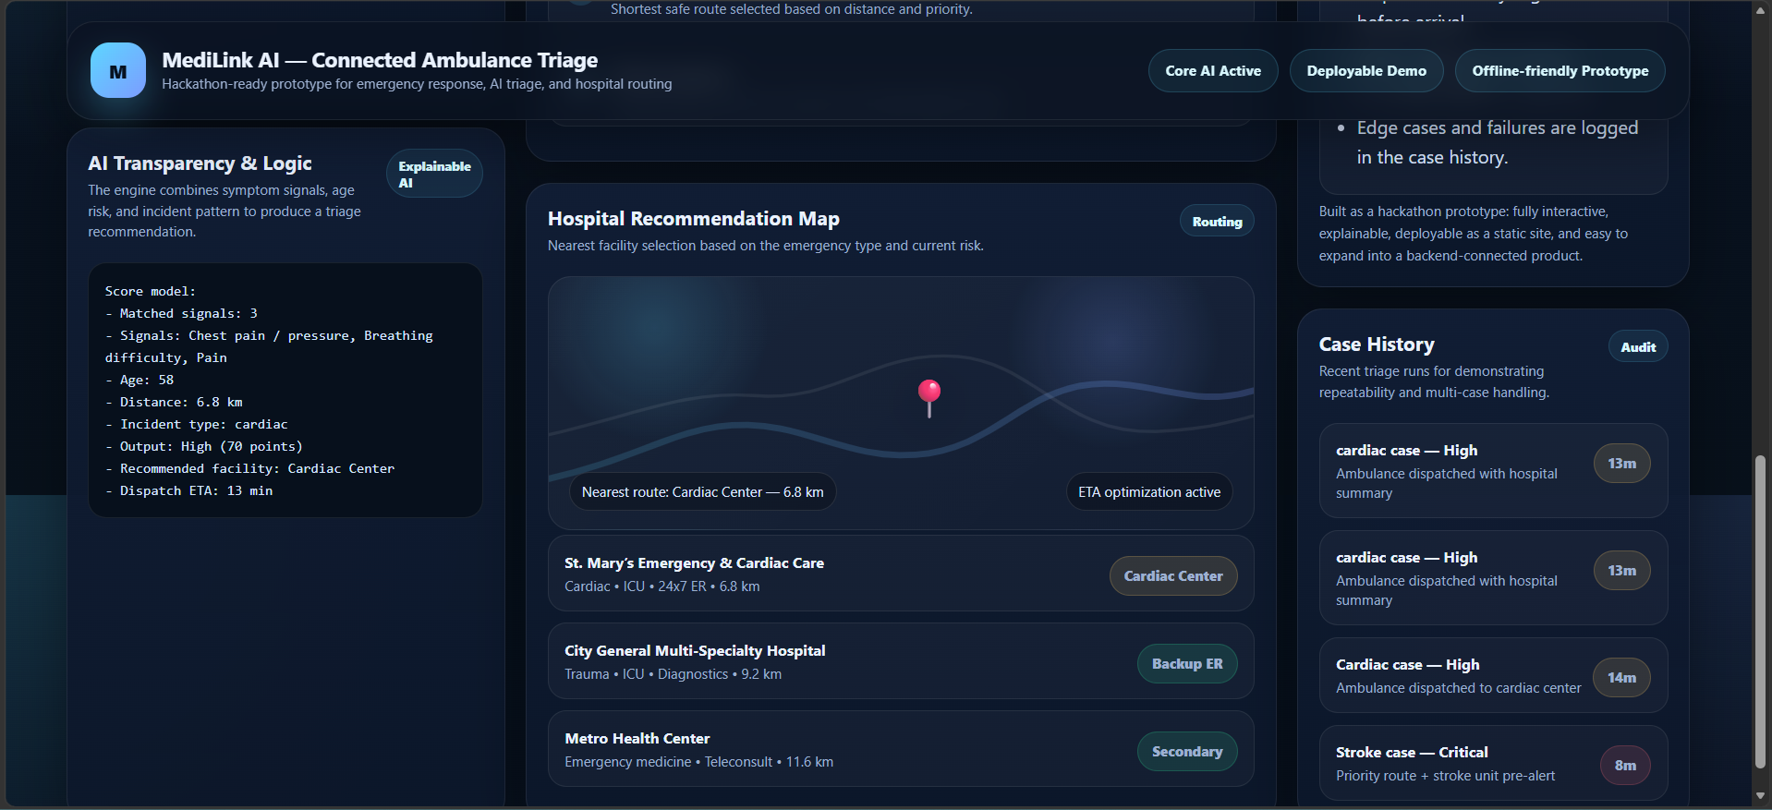
Prototype Demonstration & Functionality
Product / Solution Images
Demo Details
Pranav_Mahesh_Palled_MediLink_AI_ScreenCast.mp4 - Google Drive
Key Functionalities to be Demonstrated
AI triage, urgency classification, nearest hospital recommendation, live case tracking, dispatcher actions, and emergency status updates.

Slide 9
Additional Information & Closing
A focused solo build with a strong social impact story and a deployable product path.
Additional Details
Prepared as an individual submission for the Crisis Management, HealthTech & Emergency Response theme. The solution is intentionally narrow and practical, focusing on AI-assisted ambulance triage, emergency prioritization, and hospital coordination. The prototype is built as a deployable, demo-ready proof of concept with AI at the core.
References & Links
GitHub repository: Pranav-Mahesh-Palled/MediLink_AI
Deployed prototype: MediLink AI — Connected Ambulance Triage
Demo video: Pranav_Mahesh_Palled_MediLink_AI_ScreenCast.mp4 - Google Drive
Thank you for your submission.
TCOE India · Emerging Technologies Hackathon 2026

