Slide 1

B.TECH PROJECT REPORT | PHASE I / II / III
Sentiment Analysis of IMDb Movie Reviews Using ModernBERT with Attention Pooling
Polawar Pranav Shirish (24U020088)
Satyam Raj (24U020098)
Supervisor: Dr. Amit Kumar Nandanwar
Assistant Professor, Computer Science and Engineering
Indian Institute of Information Technology, Bhopal (M.P.) | October 2026
Notes:
Good morning. We are Pranav and Satyam. Our project classifies IMDb movie reviews as positive or negative using ModernBERT with an attention-pooling head, under Dr. Amit Kumar Nandanwar. In the next 15 minutes we cover the problem, our method, the results, and the limits of what those results prove.

Slide 2
Outline
Introduction and motivation
Model architecture
1
5
Literature review
Implementation and tools
2
6
Problem and objectives
Results and comparison
3
7
Dataset and methodology
Conclusion and future scope
4
8
Notes:
The talk follows the structure of the report: motivation and related work first, then our design and implementation, and finally results with an honest discussion of limitations.

Slide 3



Why Sentiment Analysis Matters
Opinions at scale
Reviews, ratings and comments pile up daily. Automatic polarity labels replace manual reading.
92.36%
Long reviews are hard
published accuracy of RoBERTa-BiLSTM on IMDb [3]
Negation, mixed praise and criticism, and plot summaries hide the real opinion.
The number to beat, without a recurrent layer.
A gap in hybrid models
RoBERTa-BiLSTM adds a sequential layer after the encoder. Is it needed?
Notes:
Sentiment analysis turns free text into a label that businesses can aggregate. Movie reviews are hard because opinion words are mixed with plot description. The reference study, RoBERTa-BiLSTM, reached 92.36 percent accuracy using an extra recurrent layer. We ask whether a lighter attention-pooling head on a newer encoder can do better.

Slide 4
How the Field Evolved
Classical ML
Recurrent nets
Transformers
RoBERTa-BiLSTM
This work
Naive Bayes, SVM, Logistic Regression on TF-IDF
LSTM and BiLSTM read tokens one by one
BERT and RoBERTa, pretrained then fine-tuned
Encoder plus BiLSTM and dense layers [3]
ModernBERT plus attention pooling
87.12%
91.32%
92.36%
95.93%
IMDb accuracy
IMDb accuracy
IMDb accuracy
IMDb accuracy
First three results as reported in [3]; the last is this project, under a different setup.
Notes:
Early systems used hand-made features such as TF-IDF and reached about 87 percent. Pretrained transformers jumped to 91 percent. Adding a BiLSTM on top pushed the published result to 92.36 percent but adds sequential computation. Our model replaces the BiLSTM with attention pooling and uses ModernBERT as the encoder. Note that the last number is from our own run, not from the same study.

Slide 5
Problem and Research Gap
Problem
Research gap
Classify an IMDb review as positive or negative
Context, negation and mixed opinions make long reviews hard
Hand-made features miss context
Hybrid RoBERTa-BiLSTM adds a recurrent layer and extra sequential cost
No reported test of ModernBERT with attention pooling on IMDb
Contribution of each part is still unclear
Research question Can ModernBERT with attention pooling match or beat RoBERTa-BiLSTM on IMDb without any recurrent layer?
Notes:
The problem is binary sentiment classification of long reviews. The gap: the published hybrid model needs a recurrent layer, and nobody has reported the combination we propose. That gives our research question.

Slide 6
Objectives
1
2
3
Study the reference
Prepare the data
Build the model
Method, setup, results and limits of RoBERTa-BiLSTM
Remove duplicates, encode labels, split train, validation, test
ModernBERT-base with attention pooling and a [CLS] vector
4
5
6
Measure performance
Compare honestly
Identify improvements
Accuracy, precision, recall, F1, confusion matrix
Against the reference, with ablations planned
Hyperparameters, sequence length, dropout, architecture
Notes:
Six objectives. The third one is the core build; the fifth, comparing honestly, shapes how we word every claim later in the talk.

Slide 7
Dataset and Preprocessing
1
Load
50,000 labelled IMDb reviews [12]
2
Deduplicate
418 exact duplicates removed, 49,582 remain
3
Split
About 80 / 10 / 10, test set held out
4
Tokenize
ModernBERT BPE tokenizer, 512 tokens, attention mask
Notes:
We start from 50,000 labelled reviews and remove 418 exact duplicates so the same review cannot appear in both training and test. That leaves 49,582, split roughly 80, 10, 10. The test set of 4,959 reviews is only used once, at the end.

Slide 8
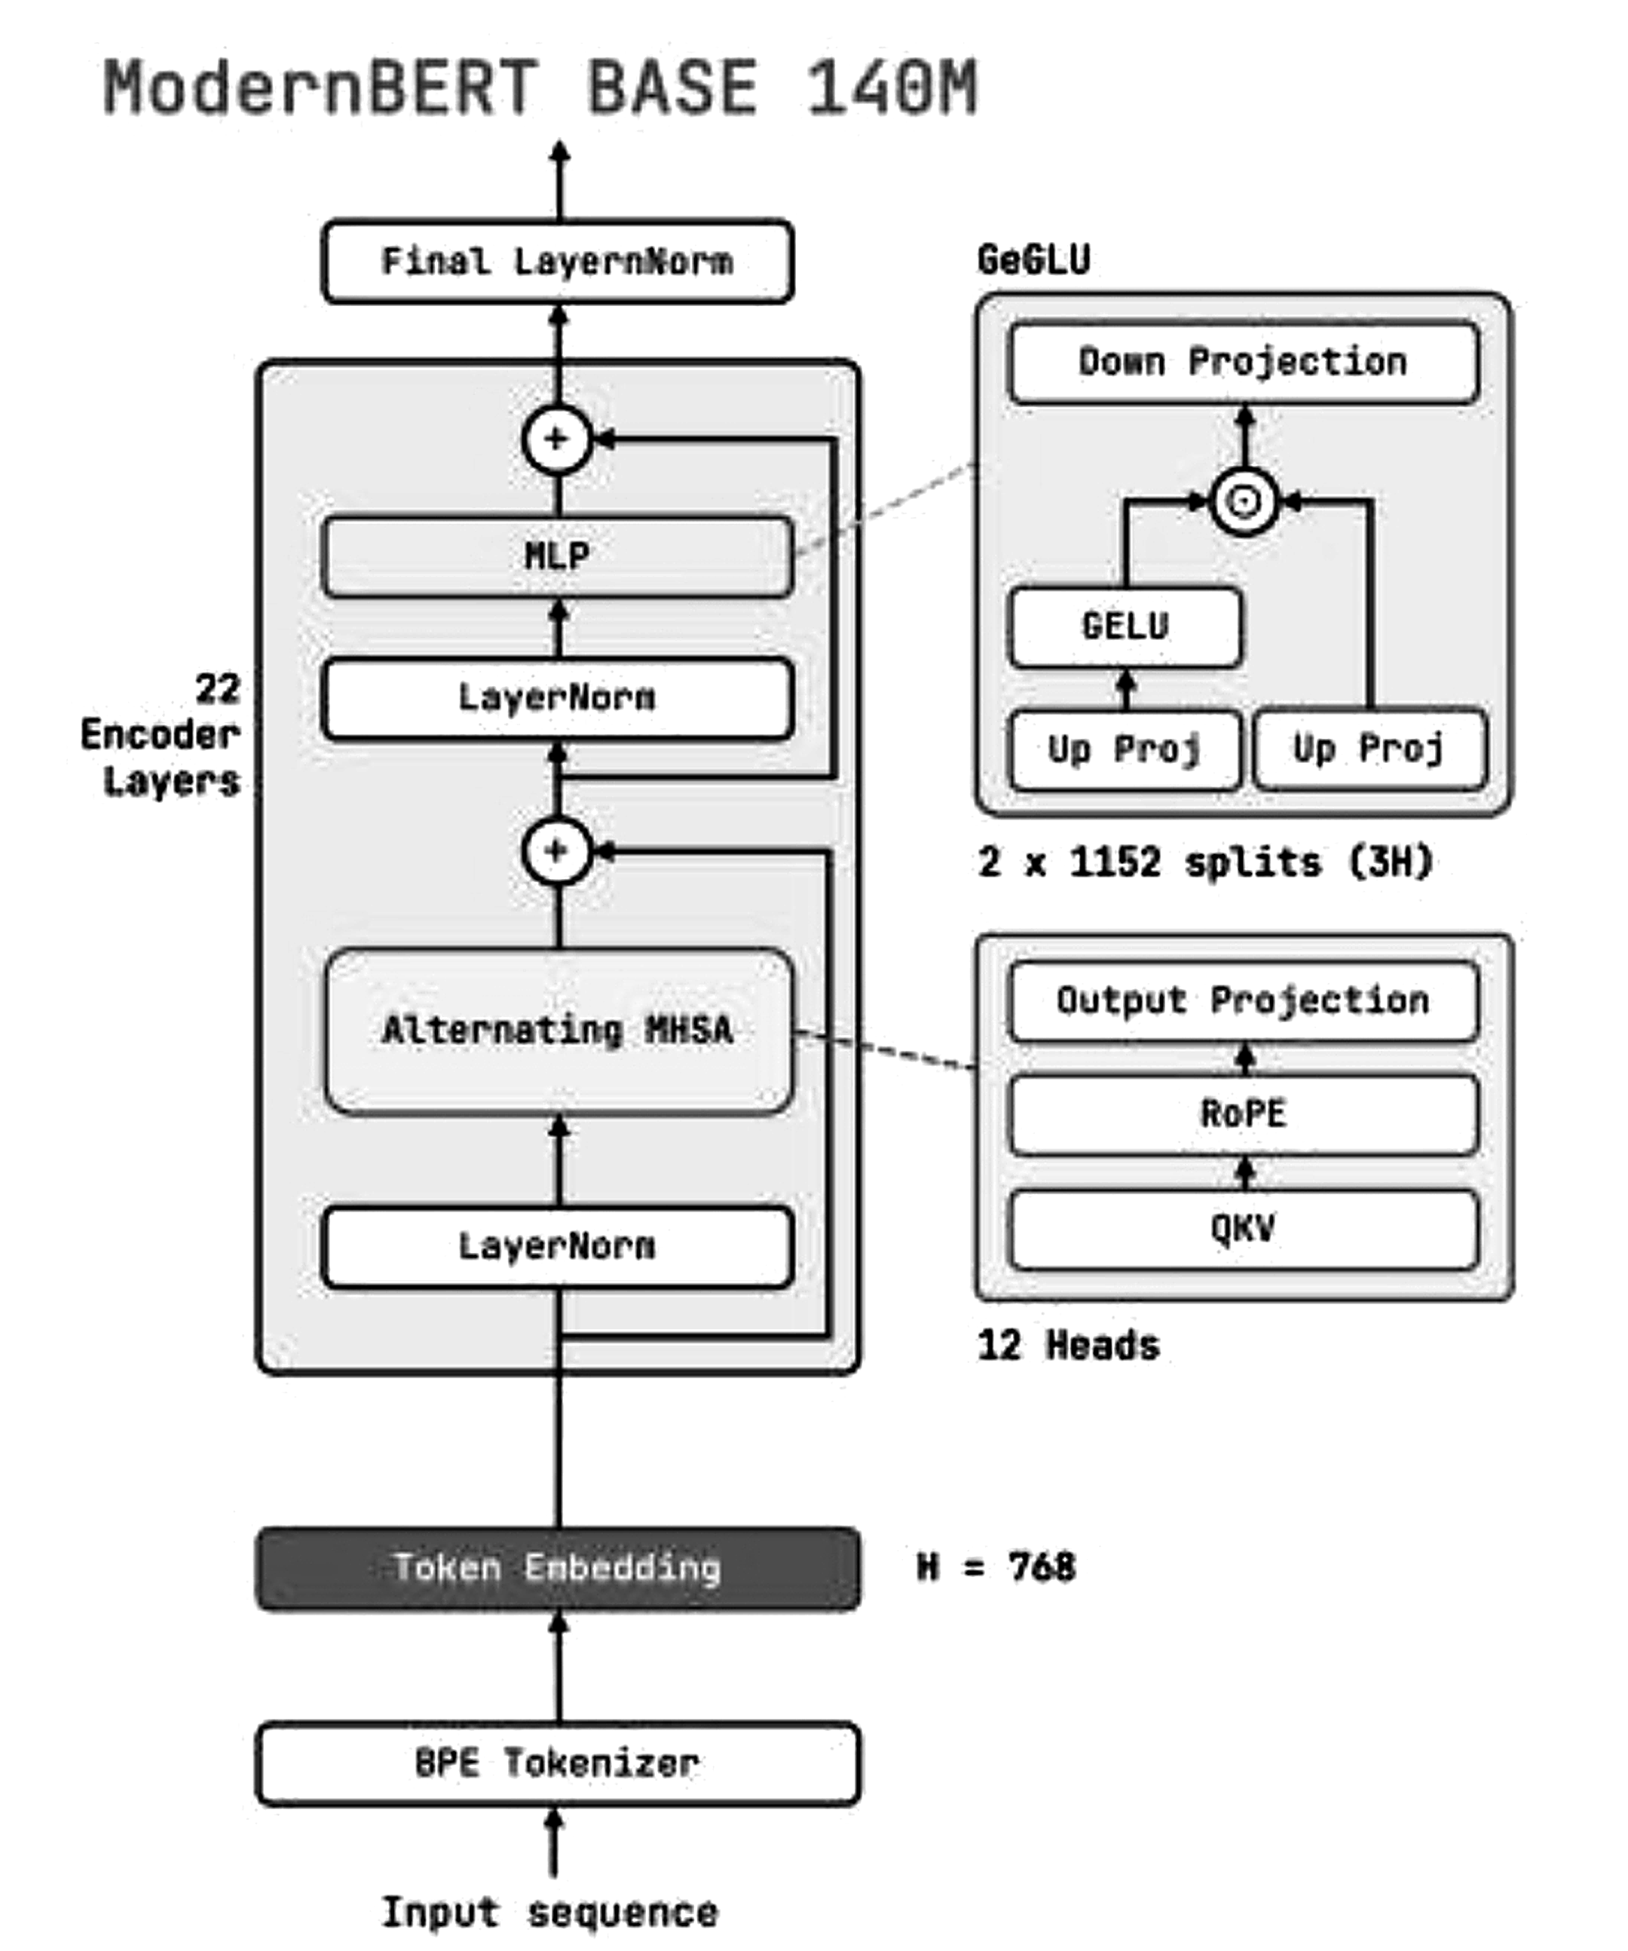
ModernBERT-base Encoder
22 layers, H = 768
12 attention heads per layer
Rotary position embeddings
Relative position, longer inputs [19]
GeGLU feed-forward
Gated unit with GELU activation [20]
Alternating attention
Mostly local windows, every third layer global
Built for efficiency
FlashAttention-style kernels, up to 8,192 tokens [11]
Notes:
This is the encoder we fine-tune, from the ModernBERT paper. Twenty-two layers, hidden size 768. Each layer has an attention block with rotary embeddings and a GeGLU feed-forward block, both with residual connections. Most layers use local attention and every third layer attends globally, which keeps long inputs cheap.

Slide 9
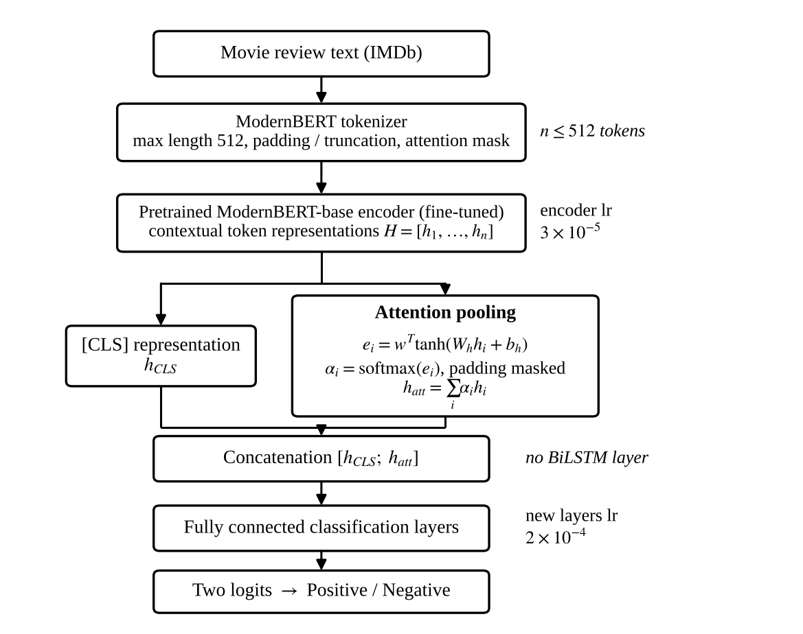
Proposed Architecture
Attention pooling
Score each token, then weight it
Softmax ignores padding
[CLS] vector plus pooled vector gives 1,536 features
Two logits, no BiLSTM
e_i = wᵀ tanh(W_h h_i + b_h)
α_i = softmax(e_i)
h_att = Σ α_i h_i
h = [h_CLS ; h_att]
Notes:
The review is tokenized and passed through ModernBERT. Two branches run in parallel: the CLS vector, and the attention-pooling branch that learns a score for each token and forms a weighted sum. We concatenate them into a 1,536-dimensional vector and classify with fully connected layers. The attention weights let strong opinion phrases count more than filler text.

Slide 10
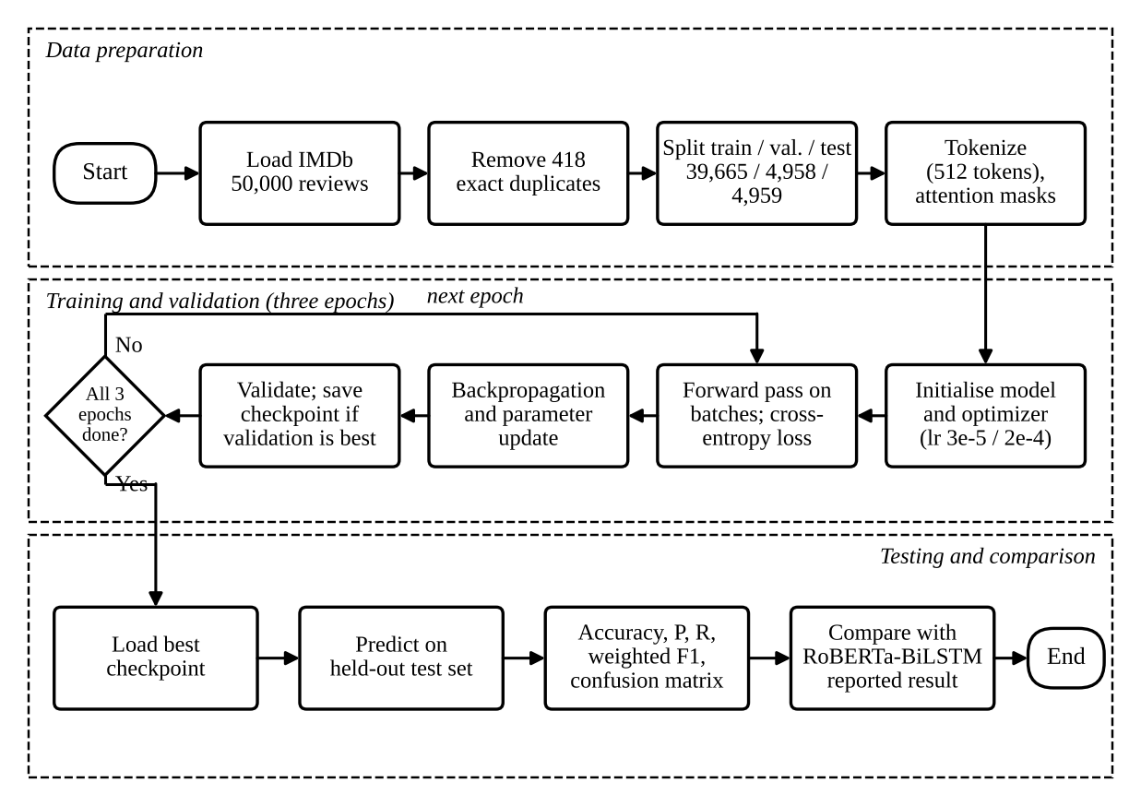
Training Pipeline
Setting | Value
Epochs | 3
Max length | 512 tokens
Encoder learning rate | 3×10⁻⁵
New layers learning rate | 2×10⁻⁴
Loss | Cross-entropy
Checkpoint | Best on validation
Hardware | Tesla T4, Colab
Notes:
Training runs for three epochs. The pretrained encoder gets a small learning rate so it adapts gently; the new pooling and classification layers start from scratch so they get a larger one. After every epoch we validate and keep the best checkpoint. Only that checkpoint ever touches the test set.

Slide 11






Tools and Technology
Python
PyTorch
Hugging Face
One language for data, model and evaluation
Attention-pooling layer, loss, backpropagation [23]
Pretrained ModernBERT-base and tokenizer [24]
Google Colab
Pandas, NumPy
Scikit-learn, Matplotlib
Notebook with Tesla T4 GPU, Drive for checkpoints
Loading, duplicate removal, arrays [25], [26]
Splits, metrics, confusion matrix, plots [22], [27]
Notes:
Everything is standard open-source tooling, so the experiment can be repeated on free cloud hardware. The Tesla T4 has 16 GB of memory, which is why we cap sequences at 512 tokens.

Slide 12
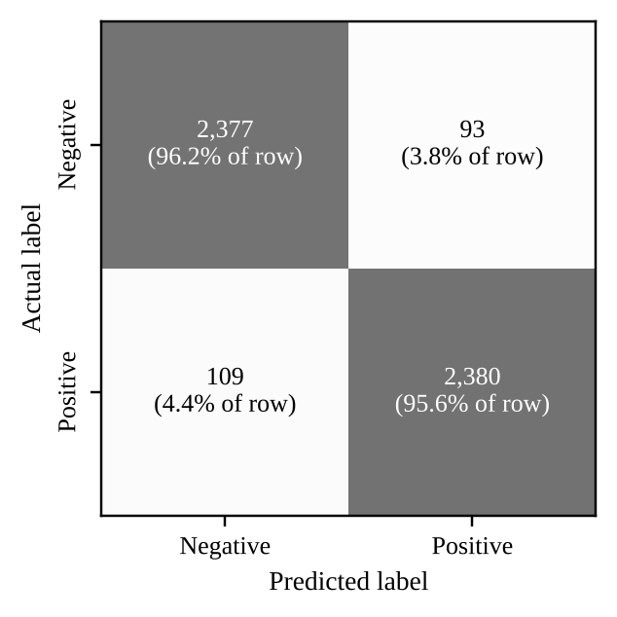
Results on the IMDb Test Set
95.93%
Class | P | R
Negative | 95.62 | 96.23
Positive | 96.24 | 95.62
Test accuracy
95.93%
Precision (P) and recall (R), in %
202 errors
93 false positives, 109 false negatives. Balanced across both classes.
Weighted F1-score
96.07%
Confusion matrix, 4,959 reviews
Best validation accuracy
Notes:
On the 4,959 held-out reviews the model reaches 95.93 percent accuracy and the same weighted F1. Validation accuracy was 96.07 percent, so the gap is only 0.14 points. Precision and recall are about 96 percent for both classes, and the 202 errors split almost evenly: 93 negative reviews called positive, 109 positive called negative.

Slide 13
Comparison with Prior Work
+3.57 pp
over RoBERTa-BiLSTM
+4.61 pp
over RoBERTa-base
+8.81 pp
over Logistic Regression
Read with care Separately reported experiments. Encoders and setups differ.
Notes:
Our accuracy is 3.57 percentage points above the published RoBERTa-BiLSTM, which is roughly 47 percent fewer errors. But the baselines come from the reference paper, with a different encoder, different split and different environment. So this shows our model performs well, not that attention pooling alone caused the gain.

Slide 14


Discussion and Limitations
What the evidence supports
What it does not prove
Validation 96.07% vs test 95.93%: no sign of overfitting to validation
Balanced precision and recall in both classes
95% confidence interval about ±0.55 points on 4,959 reviews
Which part helped: encoder, pooling, or setup
Lower training cost: per-epoch time is of similar size
One split, one run, one English dataset
Next step Reproduce the baseline and ablate the pooling head on the same split.
Notes:
We want to be clear about claims. The validation and test numbers agree, and the classes are balanced. But we compared against published numbers, not a reproduced baseline, so we cannot say which component produced the gain, and we cannot claim better efficiency. These are the limits the future work addresses.

Slide 15
Conclusion and Future Scope
Conclusion
Future scope
ModernBERT-base with attention pooling reaches 95.93% accuracy and weighted F1 on IMDb
3.57 points above the published RoBERTa-BiLSTM, with no recurrent layer
A strong, practical classifier, trained on free cloud hardware
Reproduce RoBERTa-BiLSTM on the same split
Ablate pooling: [CLS]-only vs attention
Several seeds and more datasets
Measure latency and GPU memory
Thank you Questions are welcome
Notes:
To conclude: ModernBERT with attention pooling gives 95.93 percent accuracy on IMDb without any recurrent layer. The next step is a controlled study, with a reproduced baseline on the same split, ablations of the pooling head and multiple seeds, to show which component really matters. Thank you, we are happy to take questions.

