Slide 1
Placement Mirror
Real-time on-device interview delivery coach for Snapdragon PCs
Pranav Ram, IIT Gandhinagar
All performance numbers were measured on Snapdragon X Elite hardware through Qualcomm AI Hub.
Built without a Snapdragon laptop, using Qualcomm AI Hub hosted devices for all compile, profile and benchmark jobs, with a Windows ARM64 build verified in CI.
Notes:
Placement Mirror. Real-time on-device interview delivery coach for Snapdragon PCs. Pranav Ram, IIT Gandhinagar. All performance numbers were measured on Snapdragon X Elite hardware through Qualcomm AI Hub. Built without a Snapdragon laptop, using Qualcomm AI Hub hosted devices for all compile, profile and benchmark jobs, with a Windows ARM64 build verified in CI. Code: https://github.com/Pranav-Ram-R/placement-mirror

Slide 2
Interviewers hear how you answer, not just what you answer. Students almost never get to practice that part.
Students rehearse what to say, rarely how they say it.
Mock interviews happen once or twice.
Watching your own recording alone is hard.
Cloud coaching sends your face and voice off the device.
Notes:
Every placement season, students rehearse what to say and rarely rehearse how they say it. A mock interview with a senior happens once or twice, if at all, and recording yourself means watching it back alone. I am preparing for internship interviews myself, and I built Placement Mirror so that any student with a laptop gets a coach that watches their delivery live, for as many practice rounds as they need, without their face or voice ever leaving the device.

Slide 3
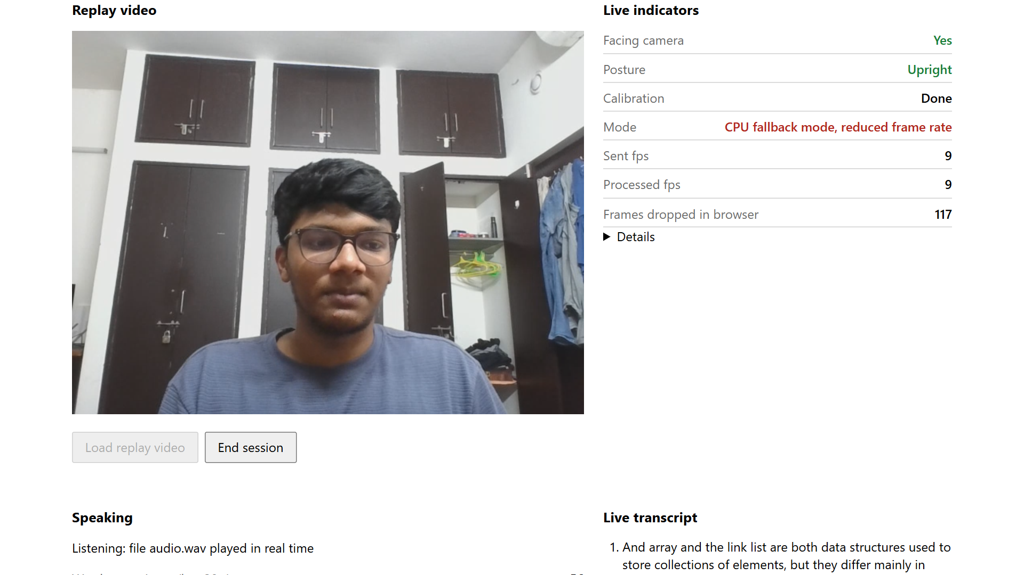
What it does
Four live indicators while you answer:
facing the camera, posture, words per minute, fillers.
Everything runs on the laptop.
Screenshot: development machine in CPU fallback mode, replay of a recorded answer.
Notes:
Pick a question from HR, software or core hardware, sit as in an interview and calibrate while looking at the camera, then answer. The indicators update live. Everything runs on the laptop. Screenshot: development machine in CPU fallback mode, replay of a recorded answer.

Slide 4
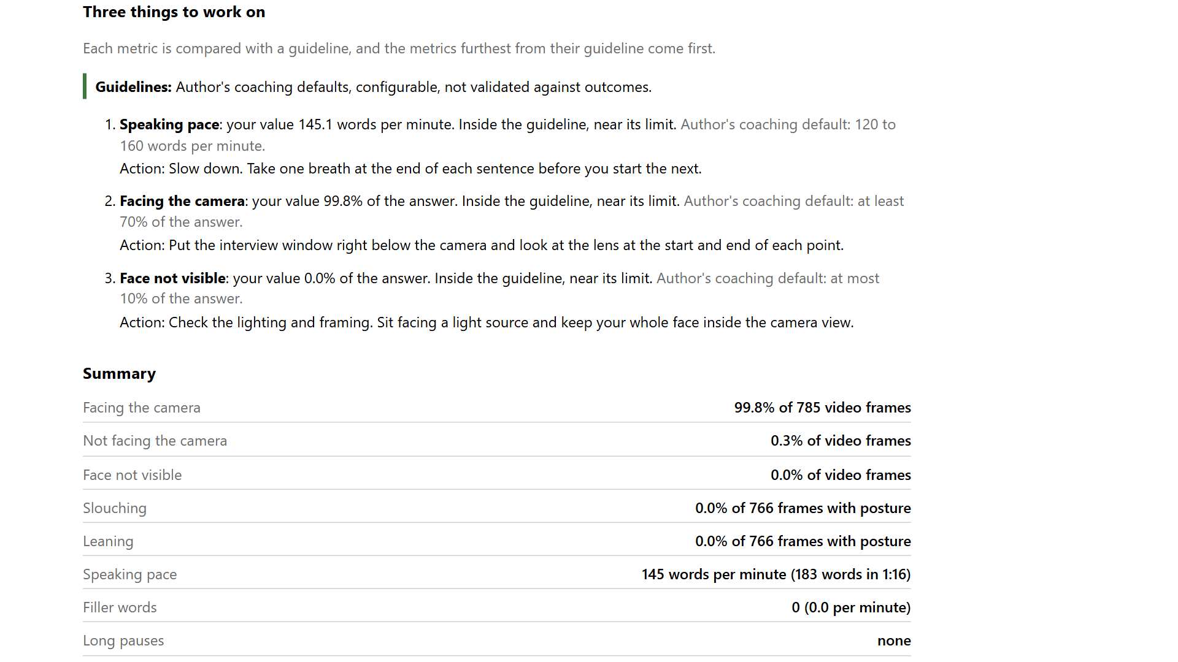
The report
Each metric per 10 s window.
Transcript with fillers and pauses marked.
Three things to work on.
History tracks the trend.
Screenshot: development machine in CPU fallback mode, replay of a recorded answer. Window length: app/config.py ReportConfig.window_s = 10 s.
Notes:
After the answer the report charts facing the camera, face not visible, posture and words per minute per 10 s window, shows the transcript with fillers and long pauses marked, and lists three things to work on. Guidelines: author's coaching defaults, configurable, not validated against outcomes. The history page tracks the trend across answers. Screenshot: development machine in CPU fallback mode, replay of a recorded answer.

Slide 5
Why the NPU
61.77x
CPU p50 / NPU p50, same whisper_tiny encoder
Vision runs every frame while speech recognition runs per segment.
Video and audio stay on the laptop, and it works offline.
Encoder p50 in ms, log scale
Source: AI Hub hosted Snapdragon X Elite, onnx float32 whisper_tiny encoder, jobs j57eeo9rp (CPU), jp4yye3lp (GPU), jpxll0x9p (NPU). Ratio Derived: CPU p50 / NPU p50.
Notes:
The camera models run on every frame while speech recognition runs on each speech segment, both for the whole answer. For the same onnx float32 whisper_tiny encoder, the p50 is 1,449.791 ms on the CPU, 392.299 ms on the GPU and 23.470 ms on the NPU, so the CPU takes 61.77x as long (Derived: CPU p50 / NPU p50). Running on the device keeps video and audio on the laptop, and the app works with the network off. The GPU run placed 6 ops on the CPU. The shipping encoder (23.739 ms) is on the performance slide.

Slide 6
Architecture
Camera
30 fps
Face detector
NPU, on track loss
Face landmarks
NPU, every frame
Head pose, facing
CPU
Live indicators, report, history
Browser on localhost
Camera
30 fps
Pose detector and landmarks
NPU, 15 fps
Posture
CPU
Microphone
16 kHz
Silero VAD
CPU
Whisper tiny
NPU, per segment
Pace, fillers, pauses
CPU
Planned placement. Not yet validated on device.
Source: app/config.py (camera 30 fps, pose 15 fps, audio 16 kHz), docs/architecture.md.
Notes:
Planned placement from the AI Hub results, not yet validated on device. The face detector runs only when the landmark track is lost, the face landmarks run on every frame, pose runs at 15 fps. Voice activity detection owns the timing and Whisper tiny runs once per speech segment. Head pose, posture and the speech metrics are numpy rules on the CPU.

Slide 7
Performance on Snapdragon X Elite
Model (shipping) | p50 ms | p95 ms
Whisper tiny encoder | 23.739 | 24.641
Whisper tiny decoder, one call | 2.375 | 2.888
Face detector | 0.579 | 0.650
Face landmark | 0.184 | 0.225
Pose detector | 0.899 | 0.933
Pose landmark | 0.837 | 0.916
1.81 %
of the 33.3 ms frame for vision on the NPU (0.603 ms)
Speech per segment
23.739 + n x 2.375 ms
n = decoder calls
Source: AI Hub hosted Snapdragon X Elite, benchmarks/TABLE.md. Budgets Derived, benchmarks/raw/budgets_derived.json.
Notes:
Shipping configuration, p50 and p95 over 100 iterations, AI Hub hosted Snapdragon X Elite. Vision per frame, steady state: face landmark p50 + pose landmark p50 x 15 / 30 = 0.603 ms, 1.81 % of the 33.3 ms frame interval at 30 fps (Derived). The detectors run only when tracking is lost and are left out. Speech recognition per segment: encoder p50 + n x decoder p50 = 23.739 + n x 2.375 ms, where n is the number of decoder calls (Derived, n left open). Encoder jp0mxyj2g, decoder j57e8z9qp, face detector jpe776l05, face landmark jgzllz465, pose detector jp2rrvorg, pose landmark jpyoo7885.

Slide 8
Optimization: runtime format and storage precision
p50 ms | onnx | precompiled
float32 encoder | 23.083 | 23.739
float16 encoder | rejected | 25.009
float32 decoder | 3.454 | 3.587
float16 decoder | rejected | 2.375
-33.78 %
decoder p50, float16 vs float32 storage
Encoder: +5.35 %.
23.5 MB vs 11.8 MB per decoder call (Derived from tensor shapes).
Extra float32 time: cross attention cache inputs.
Unexplained: float16 encoder slowdown, decoder peak memory.
Red: shipped. onnx float32 is the fallback.
Source: AI Hub hosted Snapdragon X Elite, benchmarks/optimization.md, benchmarks/raw/day3_derived.json and day3_decoder_io_bytes.json (Derived).
Notes:
2x2 grid of whisper_tiny encoder and decoder p50 on the NPU, one profile job per cell. onnx float16 was rejected at compile submission: the --quantize_full_type option is not supported for target_runtime ONNX. Storage effect within precompiled: decoder -1211.5 us (-33.78 %), encoder +1269.5 us (+5.35 %), Derived. Bytes per decoder call: 23,530,892 against 11,765,450 bytes (Derived from tensor shapes, not measured). In the layer profile, from a separate 2-iteration instrumented run with an undocumented unit, the extra float32 time sits at the graph input and output layers and at the first layer that reads each cross attention cache. Not explained: the float16 encoder slowdown, the float16 decoder's higher peak memory, and why precompiled float32 is slower than onnx float32.

Slide 9
Accuracy and deployment
Accuracy
Eye contact: balanced accuracy 0.966 on 589 held-out frames.
Fillers: not yet evaluated.
Pace: not yet evaluated.
Recorded clips, development machine.
Deployment
ARM64 build verified in CI, 365.6 MB.
Fallback: precompiled NPU, onnx NPU, onnx CPU.
Offline: 0 of 14 app requests off loopback.
Sources: eval/RESULTS.md, docs/evidence/arm64_build.json (CI run 36465028091), docs/evidence/offline_check.json.
Notes:
Eye contact was measured on a recorded clip on the development machine, using the shipped ONNX models and the app's head pose code: one scripted recording of one speaker, 1781 labeled frames, threshold 15.32 degrees chosen on the first half of every segment, balanced accuracy 0.966 on 589 held-out frames (368 facing, 221 not facing) on the second halves. Filler detection and speaking pace are measured on recorded clips on the development machine, using the same ONNX models and processing code that ship: filler detection not yet evaluated, speaking pace not yet evaluated. Never run on a Snapdragon device yet. Built without a Snapdragon laptop, using Qualcomm AI Hub hosted devices for all compile, profile and benchmark jobs, with a Windows ARM64 build verified in CI. ARM64 package 365,552,874 bytes (CI run 36465028091). In an offline check on the development machine, the app pages made 14 requests, 0 off loopback, and the app server attempted 0 connections off loopback (docs/evidence/offline_check.json).

Slide 10
Limitations and next milestone
Next milestone: validation on a physical Snapdragon laptop
Context binary loading
NPU shared by Whisper and vision
NPU float16 transcripts
Fallback chain on real hardware
Limits
One speaker, one room, small samples.
Head pose: camera and screen overlap.
Guidelines not validated.
Future: on-device content feedback.
Notes:
Not yet validated on device: loading the AI Hub context binaries with the bundled QNN runtime, the app's own latency with Whisper and the vision models sharing the NPU, NPU float16 transcripts, and the fallback chain on real hardware. Other limits: one speaker in one room, small samples, head pose cannot separate camera from screen, coaching guidelines not validated against outcomes. Future work: content feedback from an on-device language model, more speakers.

