Slide 1
Traffic Oracle
Can a road network learn to see congestion coming?
Graph attention vs. per-segment machine learning on the METR-LA freeway network
TEAM T042 · Pranav Singh · Kunal · Himanshu · Kanchan · Vaibhav
Notes:
Open on the image: long-exposure traffic at night. Every streak is a car; every car is a data point. Our question is simple: when congestion starts somewhere on a freeway, can a model that looks at neighbouring sensors see it coming before a model that only looks at one road segment?

Slide 2
207 sensors are listening
LOS ANGELES · WEEKDAY, 8:00 AM
At rush hour, 26.9% of readings fall below 40 mph — off-peak it is only 5.8%. Forecasting is easy when traffic flows; the hard part is the jam.
Notes:
Set the stakes. Congestion is the minority case overall but dominates errors: at weekday peaks more than a quarter of readings are below 40 mph. A forecaster is only useful if it handles the jam.

Slide 3
The question behind every slide
HYPOTHESIS
Congestion travels. A jam starts at a bottleneck and its tail moves upstream, so downstream sensors know an upstream sensor's future.
Traffic flows downstream →
A
B
C
D
E
A per-segment model sees only its own history
A graph model can read its neighbours directly
Expected gain: larger at long horizons and at peaks
← The congestion wave moves upstream
Sensors D and E slow down first; C, B and A follow minutes later.
Notes:
This is the physical intuition. Traffic moves forward, but the jam's tail moves backwards. If D and E slow down now, C will slow down soon. A model that sees D and E can warn C; a model that only sees C has to guess. Everything that follows tests whether that intuition survives contact with real data.

Slide 4
Listening to 207 sensors
CHAPTER 01
Four months of Los Angeles freeway speeds — and what the silence in the data means.
Notes:
Chapter one: what we actually have, and the traps hidden in it.

Slide 5
METR-LA in four numbers
207
34,272
8.1%
1,515
loop-detector sensors on LA County freeways
5-minute timestamps · Mar 1 – Jun 27, 2012 (119 days)
of readings are 0 mph — sensor outages, not stopped cars
directed road links in the sensor graph
WHAT THAT MEANS FOR MODELLING
Speed only (mph) — no flow, no occupancy; maximum observed speed 70 mph
Zeros are masked in every loss and metric and never used as targets
Source: DCRNN benchmark (Li et al., ICLR 2018); files verified by SHA-256 on download
Notes:
Four numbers to remember. 207 sensors, 34 thousand five-minute steps, 8.1 percent missing, 1,515 directed road links. The data is speed only, which matters later for the control experiment. The single most important rule: a zero is an outage, not a traffic jam.

Slide 6
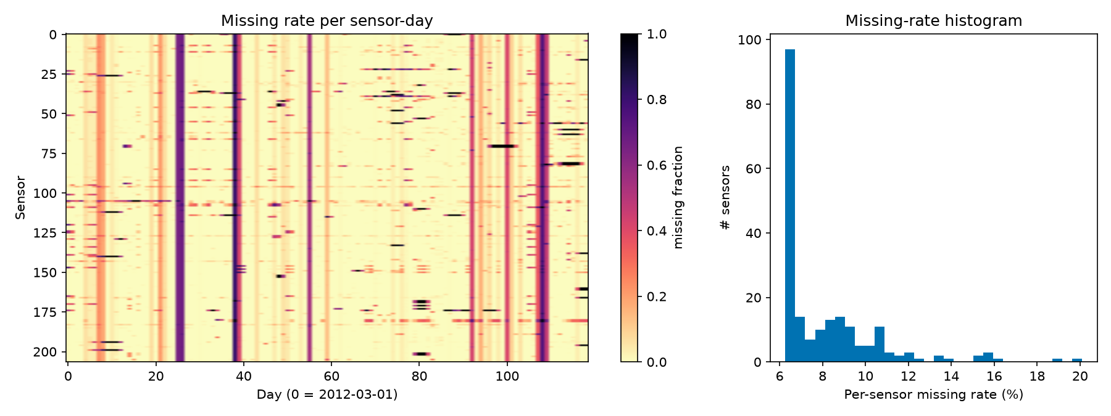
Silence is not a traffic jam
2,148
timestamps where ≥ 90% of sensors are silent
12.1%
missing in the test period vs 7.1% in training
Inputs: forward-fill up to 30 minutes (past only), then the training-period average for that sensor and time of day, plus an is_missing flag
Targets: never imputed — a model is only scored where the sensor actually reported
Notes:
The heatmap shows outages are clustered: whole-network blackouts on 61 days. The test period is noticeably noisier than training. Our rule: fill inputs with past-only information and flag them; never invent targets.

Slide 7
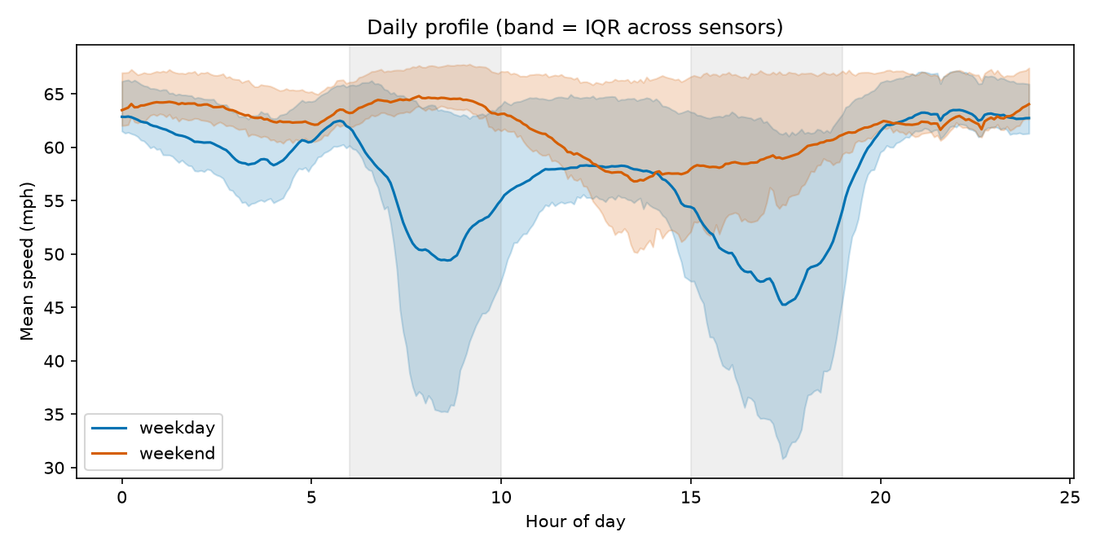
The city breathes twice a day
45.3 mph
weekday low, around 17:30
56.8 mph
weekend low — rush hours vanish
42.5–65.7
mph range of weekly time-slot averages
Notes:
Two rush hours on weekdays, almost none at weekends. Across the week, time-slot averages range from about 42 to 66 mph. This is why every model gets time-of-day and day-of-week features.

Slide 8
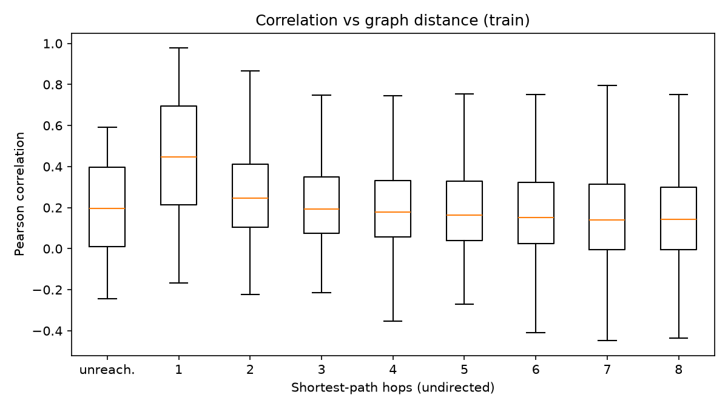
Turning roads into a graph
THRESHOLDED GAUSSIAN KERNEL
Wᵢⱼ = exp(−(dᵢⱼ / σ)²) if ≥ κ, else 0
dᵢⱼ = directed road distance (metres)
σ = 2,584 m (spread of all distances), κ = 0.1
Rebuilt matrix equals the published one to 1.0 × 10⁻⁷
Default model graph: both directions, W + Wᵀ
Neighbours really are related: median correlation 0.45 at 1 hop → 0.25 at 2 hops → 0.14 at 8 hops
Notes:
Distances become edge weights with a Gaussian kernel, exactly as in DCRNN, and our rebuild matches the published matrix to seven decimal places. On the right: sensor pairs one hop apart correlate much more strongly than distant ones. That is the case for a graph.

Slide 9
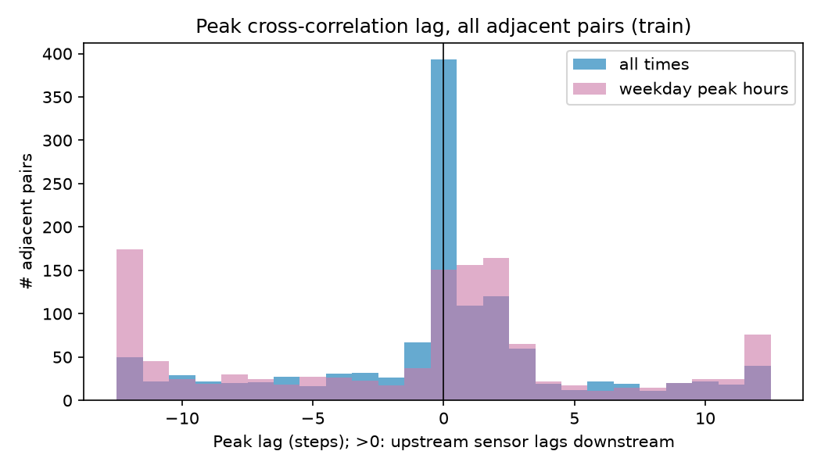
Does congestion really travel upstream?
50%
38%
of pairs: upstream reacts later
of pairs: the opposite
Peak hours, all 1,228 adjacent sensor pairs, lag measured in 5-minute steps.
Honest reading: spatial dependence is clear, directional propagation is only modestly supported. So the graph's benefit must be tested, not assumed.
Notes:
We checked the hypothesis before building anything. For every adjacent pair we found the time lag of strongest correlation. At peak hours half the pairs show the upstream sensor reacting later, as the shockwave story predicts, but 38% show the opposite. Real, but modest. That sets expectations for everything after.

Slide 10
A fair fight
CHAPTER 02
No peeking into the future, the same test for every model, and statistics that respect time.
Notes:
Chapter two is about trust. Most impressive traffic results die here, through leakage.

Slide 11
No peeking into the future
TRAIN
VAL
TEST
Mar 1 –
May 23
23,967 windows
May 23 –
Jun 4
3,404
Jun 4 –
Jun 27
6,832
CHRONOLOGICAL
TRAIN-ONLY STATISTICS
MASKED METRICS
Split by time 70/10/20. Windows are built inside each split, so no input or target crosses a boundary (unit-tested).
Scaler 58.58 ± 12.82 mph, imputation means and the history table all come from training time only.
MAE, RMSE, MAPE in mph on observed targets; sliced by horizon, peak / off-peak / weekend, congested / free-flow.
Notes:
Our split is purely chronological. A random split would put near-identical windows in train and test and make every model look great. Everything learned from data — even the scaling constants — comes from training time only. A built-in alarm fires if any model gets below 3.0 mph MAE at 60 minutes, because that would almost certainly mean leakage. It never fired.

Slide 12
Statistics that respect time
DIEBOLD–MARIANO TEST
Compares two models' error series hour by hour
Errors are autocorrelated, so the variance uses a Newey–West (HAC) estimate
Small-sample correction; for 3-seed models we report the worst p-value
DAY-BLOCK BOOTSTRAP
Resample whole days (1,000×) for 95% intervals; paired for model differences.
Historical average 4.19 mph vs 4.16 in the DCRNN paper — an external check of our pipeline.
Notes:
Two statistical tools keep us honest. Diebold–Mariano tells us whether one model really beats another, with a variance that respects autocorrelation. The day-block bootstrap gives confidence intervals. On the right are the baselines. Persistence — just repeat the last speed — is surprisingly strong at 15 minutes. Our historical average lands within 0.03 of the published number, a nice sanity check.

Slide 13
Trees that read the clock
CHAPTER 03
Gradient-boosted trees with 45–59 hand-made features: how far does per-segment learning go?
Notes:
Chapter three: the strong classical baseline. If deep learning can't beat this, it hasn't earned its complexity.

Slide 14
Four tree models, one recipe
FEATURE RECIPE
12 lags + rolling mean / std / min / max
Missing flags, cyclic time-of-day and day-of-week
Pooled: + sensor id, location, degree (50)
Spatial: + upstream / downstream neighbour speeds (59)
Optuna, 15 trials, validation only — absolute-error loss won
Notes:
Four tree models. Per-segment XGBoost trains 621 small models, one per sensor and horizon. The pooled model learns across all sensors. The forest predicts all horizons at once. XGB-spatial adds hand-made neighbour features — our bridge between classical ML and graphs. XGB-spatial is best at 15 and 30 minutes (2.820, 3.258); per-segment wins at 60 minutes (3.684). One caveat: every pooled model hit our 400-tree cap, so these numbers are conservative.

Slide 15
Do neighbours help the trees?
+0.56 mph
gain in congestion at 30 min — 3–4× the overall gain
Significant in almost every slice (DM test, paired bootstrap)
Biggest at peaks and in jams — as the hypothesis predicts
But the gain does not grow with horizon
Notes:
The bridge experiment. Adding neighbour features to the same XGBoost improves accuracy almost everywhere, and the improvement is concentrated where we expected: peaks and congestion. But the hypothesis also said the gain should grow with horizon — it doesn't, it peaks at 30 minutes. Half a win, reported honestly.

Slide 16
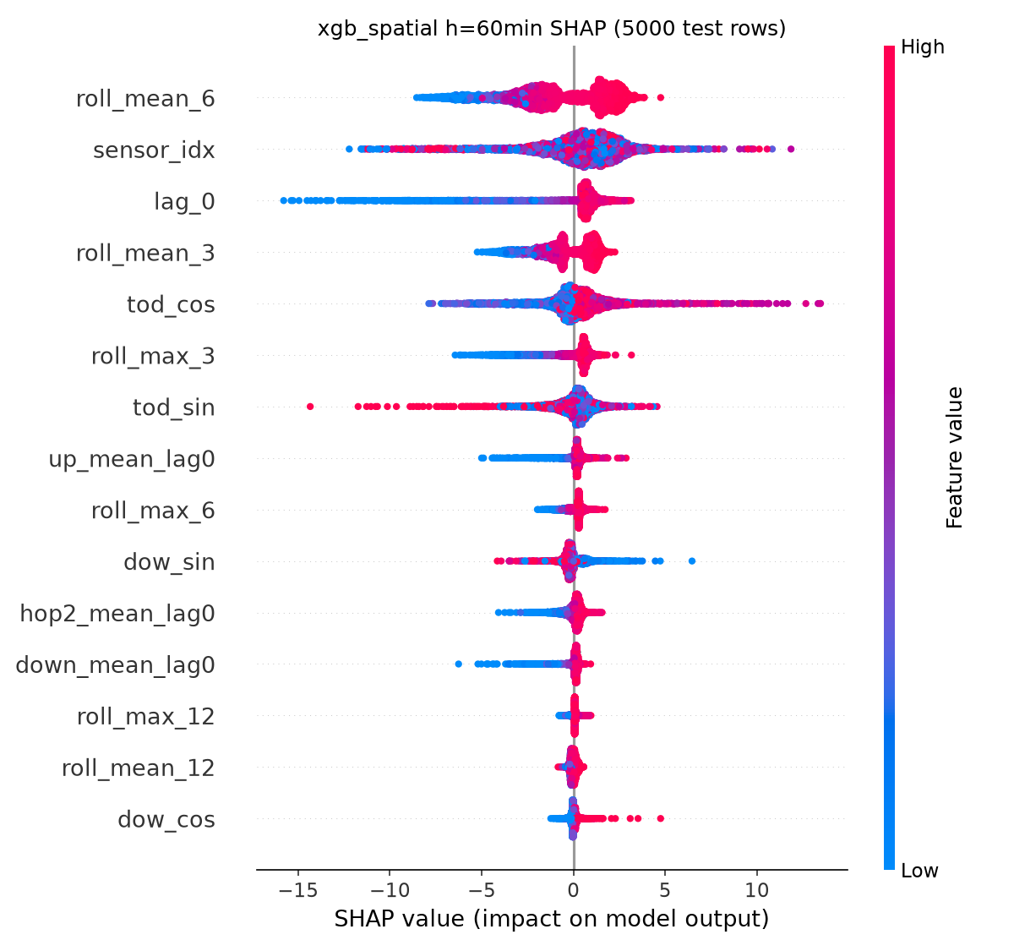
What the trees actually look at
TREESHAP, 5,000 TEST ROWS
15 min: the last half-hour average and the latest speed dominate
60 min: sensor identity and time of day take over
Neighbour speeds appear in the top features, but never dominate
Same-time-yesterday lag adds nothing (2.879 vs 2.880 mph)
Notes:
SHAP shows how the trees think. Short horizon: what is happening right now. Long horizon: which sensor this is and what time it is — essentially a learned timetable. Neighbour information is used, but as a supporting feature. And a 'same time yesterday' feature added nothing measurable.

Slide 17
Learning to look around
CHAPTER 04
A spatio-temporal graph attention network that decides, for every sensor, which neighbours to listen to.
Notes:
Chapter four: the deep model.

Slide 18
STGAT: architecture
Input
12 steps × 207
sensors × 8 ch.
Embed
linear → 64 +
node embedding
Temporal
gated causal
conv (k = 3)
Spatial
graph attention
4 heads × 16
Readout
last step +
LayerNorm
Decoder
MLP → all 12
horizons at once
× 2 blocks (dilation 1, 2) + residual
ATTENTION, IN ONE LINE
77K
10⁻⁵
eᵢⱼ = LeakyReLU(aᵀ[Whᵢ ‖ Whⱼ]) αᵢⱼ = softmaxⱼ(eᵢⱼ) hᵢ′ = Σⱼ αᵢⱼ Whⱼ
Non-neighbours are masked to −∞, so each sensor only attends to roads it is connected to.
parameters
match with PyTorch Geometric
Notes:
Read left to right. Each sensor's 60-minute history is embedded, a causal temporal convolution summarises time, then graph attention lets each sensor weigh its neighbours. We wrote the attention layer ourselves and proved it equals PyTorch Geometric's GATConv and GATv2Conv to within 1e-5. All 12 horizons come out at once. The GRU baseline is the same model with the spatial block removed.

Slide 19
Making it fit on a laptop
27.1
3.7
0.6
min / epoch
min / epoch
min / epoch
dense attention on CPU
same model on the Apple GPU (MPS)
attention on the last 4 steps + a third of windows per epoch
A neighbour-list (sparse) attention gave no speed-up — memory gathers dominate — so we simplified the schedule instead
≈ 28 minutes per seed, 3 seeds; jobs at low priority with capped threads so the laptop stayed usable
Notes:
Engineering under constraints. Full attention at every time step was 27 minutes per epoch on CPU and almost 4 on the laptop GPU. We profiled, found attention was memory-bound, and applied it to the most recent 20 minutes of neighbour state while sampling a third of the highly overlapping windows per epoch. Six times faster. This is documented as a decision record.

Slide 20
Graph vs. no graph
2.90 vs 2.89
15 min: a tie — the graph adds nothing yet
3.67 vs 3.76
60 min: graph wins, statistically significant
Same inputs, width and decoder (77K vs 69K params) — so the gap is the graph.
Notes:
The key controlled comparison. STGAT versus the identical model without the graph. At 15 minutes they tie. At 60 minutes the graph clearly wins, and the Diebold–Mariano test says the difference is significant. So the graph helps exactly where the shockwave story says it should — at long range. STGAT also overtakes pooled XGBoost from 30 minutes onwards.

Slide 21
Two minds are better than one
CHAPTER 05
Let the trees handle the clock and the graph handle the neighbours.
Notes:
Chapter five: if trees and graphs are good at different things, combine them — carefully.

Slide 22
The residual hybrid — and the leak we avoided
FORWARD-CHAINING OUT-OF-FOLD FORECASTS
IDEA
ŷ = ŷ_XGB + g_θ(history, ŷ_XGB, graph)
dropped
STGAT learns only what XGBoost misses
Last layer starts at zero → training begins exactly at the XGBoost forecast
Residuals must be out-of-fold: in-sample tree errors are unrealistically small
train
predict
train
train
predict
train
train
train
predict
train
train
train
train
predict
5 chronological blocks of training windows · 23-step gap between train and predicted block · block 1 has no forecast (80% coverage)
Notes:
The hybrid's subtle trap. If you train the graph on XGBoost's errors on XGBoost's own training data, those errors are tiny — the trees memorised that data — and the graph learns almost nothing useful. So we generate out-of-fold forecasts: each block is predicted by a tree trained only on earlier blocks, with a gap so no target leaks. The first block can't be predicted, so it's dropped.

Slide 23
The scoreboard
15 MIN
2.82 mph
best · residual hybrid · persistence 3.49
30 MIN
3.22 mph
best · residual hybrid · persistence 4.20
60 MIN
3.61 mph
best · gated hybrid · persistence 5.37
Notes:
The final scoreboard. The residual hybrid is best at 15 and 30 minutes; a learned gate that blends XGBoost and STGAT is best at 60 minutes, 3.607 mph. Against persistence that is a 33 percent error reduction at an hour ahead. All hybrids beat XGBoost at every horizon, significantly.

Slide 24
Where the hybrid earns its keep
The gate trusts the graph model more at peaks and at longer horizons — exactly the hypothesis, learned from data.
Notes:
Where do the gains come from? Almost entirely from congestion: 1.54 mph better in jams at 60 minutes, slightly worse in free flow. On the right, the gate we trained — nobody told it the hypothesis, yet it learned to trust the graph model more at peaks and at longer horizons.

Slide 25
Breaking our own model
CHAPTER 06
Ablations, maps and attention — what really matters, and where.
Notes:
Chapter six: we tried to break our own story.

Slide 26
Ablations: one change at a time
+0.63 / +0.69
remove node embedding / calendar features
−0.14
no-neighbour graph — not worse under this budget
1 seed, 12 epochs each (laptop budget): differences under ~0.05 mph are noise. The 3-seed GRU comparison is the stronger evidence.
Notes:
Nineteen ablations, each changing one thing. The clear lesson: sensor identity and calendar context are what the model can't live without. The uncomfortable one: under this short budget, removing the graph entirely didn't hurt, while a random graph did. So wrong edges hurt, right edges are roughly neutral at 12 epochs. We report that as is; the longer three-seed comparison is where the graph's benefit shows.

Slide 27
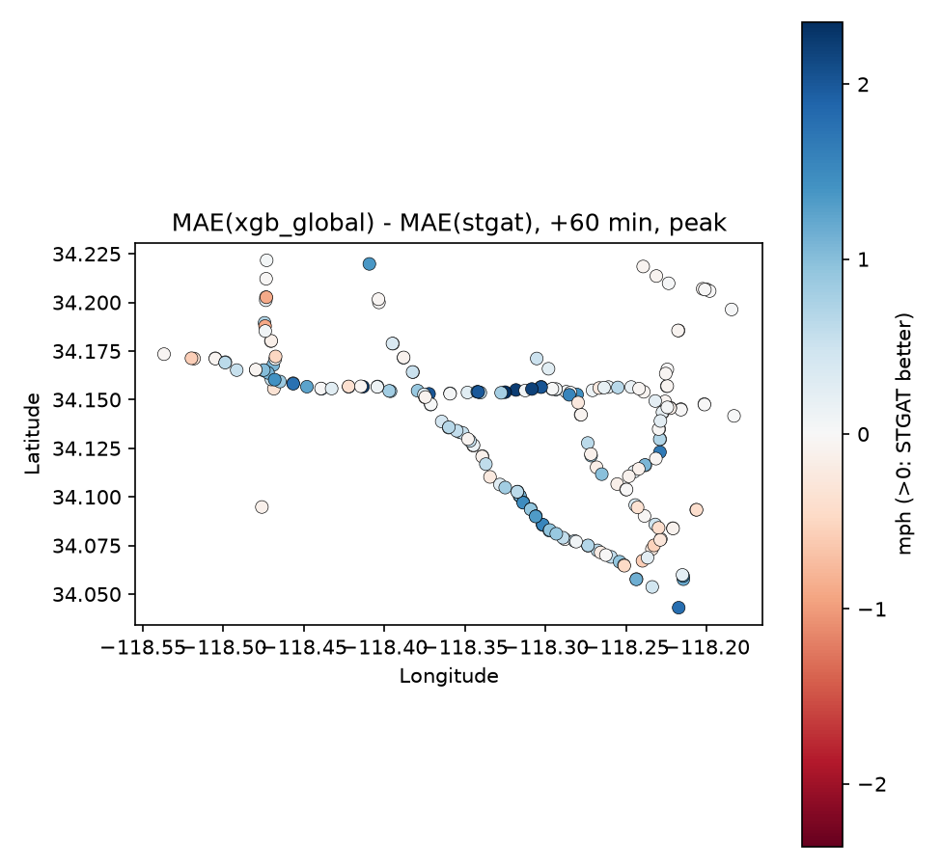
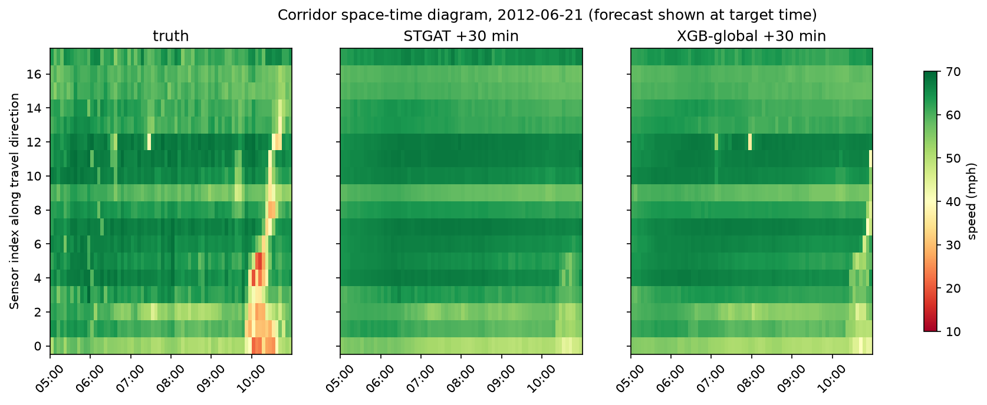
Where the graph helps, on the map
Left: blue sensors are where STGAT beats XGBoost at 60 min during peaks — gains cluster on specific freeway segments
Right: 18-sensor corridor, June 21 — neither model anticipates the sudden 10:00 breakdown; onset is the hardest event to forecast
Interactive maps: results/maps/*.html
Notes:
Two views of the same question. The map shows which sensors gain from the graph — it's not uniform, it's specific stretches of freeway. The space-time diagram is the honest one: a breakdown appears out of nowhere around 10am and neither model sees it coming. Forecasting onset remains the open problem.

Slide 28
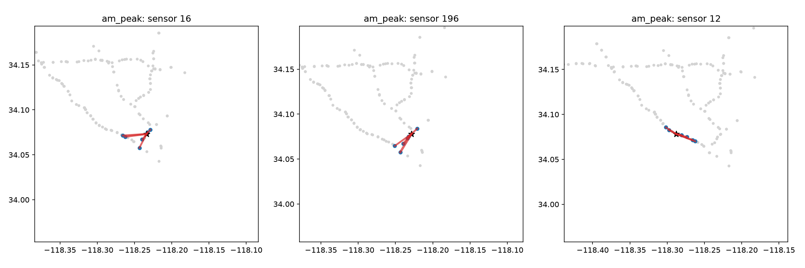
What does attention look at?
39% / 39%
39% / 39%
No peak-specific shift. Attention is a probe, not proof of causation.
downstream / upstream attention at the AM peak
the same split at night
Notes:
We looked inside the attention for the three most congested sensors. Lines show which neighbours each sensor listens to. We hoped attention would swing upstream or downstream at rush hour. It doesn't — the shares are identical at peak and at night. We say so plainly.

Slide 29
From forecast to action
CHAPTER 07 · OFFLINE SIMULATION
Freeways have no traffic lights — so we simulated on-ramp metering. Synthetic network; no real-world control is performed or claimed.
Notes:
Chapter seven, with a clear disclaimer: everything here is an offline simulation on a synthetic corridor.

Slide 30
Ramp metering in a simulated corridor
Cell Transmission Model: 12 cells, 3 ramps, bottleneck, 12% capacity drop; demand shaped by real METR-LA congestion; 5 test weekdays
ALINEA cuts mainline congestion ~40% — but total time is unchanged: delay moves to the ramps
Forecasts gave no measurable benefit in this simulation.
Notes:
Freeways have no signals, so the realistic lever is ramp metering. In a cell-transmission simulation, ALINEA — a classic feedback controller — cuts congestion on the mainline by about 40 percent, but total time spent doesn't move: the delay shifts onto the ramps. Feeding forecasts in, either directly or through a 15-minute look-ahead, didn't help, even with perfect future knowledge. Again: synthetic network, offline simulation, no real control.

Slide 31
What we learned
01
Leak-free or it doesn't count
Chronological splits, train-only statistics and masked metrics — the leakage alarm never fired.
02
Neighbours help where it hurts
Spatial features and graphs pay off at peaks and in congestion, not uniformly.
03
The graph wins at long range
STGAT ties the no-graph GRU at 15 min and beats it at 60 (3.67 vs 3.76).
04
Trees + graph beat either alone
Best: 2.82 · 3.22 · 3.61 mph at 15/30/60 min.
05
Honest nulls are results too
Ablations, attention and control did not confirm everything — and we report it.
Notes:
Five takeaways. Trust first. Neighbours matter where congestion is. The graph's edge appears at long range. Combining trees and graphs gives the best numbers. And when the data says no, we say no.

Slide 32
Limits and what comes next
LIMITATIONS
NEXT
One city, one season (Mar–Jun 2012), speed only
Laptop budgets: 15 tuning trials, 400-tree cap always reached, 40 epochs
Ablations on one seed; STGAT attention on the last 4 steps
Control demand is synthetic and open loop
Full-budget training and 3-seed ablations
Adaptive (learned) adjacency instead of a fixed distance graph
Flow and occupancy from PeMS; literature-protocol comparison
Closed-loop control where forecasts react to the controller
Notes:
Being clear about limits makes the results credible. Most of these are compute budget, not method. The most interesting next step is an adaptive graph, which might find connections the distance graph misses.

Slide 33
Thank you
Questions welcome — every number is in the repository.
TEAM T042
Pranav Singh · Kunal · Himanshu · Kanchan · Vaibhav
github.com/Pranav-Singh-Devloper/traffic-oracle
Notes:
Close. Invite questions. Each team member owns a part of the system and can go deep on it.

