Slide 1
Traffic Oracle
Phase 1: how far can per-segment machine learning go?
Baselines, tuned trees and hand-made neighbour features on the METR-LA freeway network
TEAM T042 · Pranav Singh · Kunal · Himanshu · Kanchan · Vaibhav
Notes:
Open on the image: long-exposure traffic at night. Every streak is a car; every car is a data point. Our question is simple: when congestion starts somewhere on a freeway, can a model that looks at neighbouring sensors see it coming before a model that only looks at one road segment?

Slide 2
207 sensors are listening
LOS ANGELES · WEEKDAY, 8:00 AM
At rush hour, 26.9% of readings fall below 40 mph — off-peak it is only 5.8%. Forecasting is easy when traffic flows; the hard part is the jam.
Notes:
Set the stakes. Congestion is the minority case overall but dominates errors: at weekday peaks more than a quarter of readings are below 40 mph. A forecaster is only useful if it handles the jam.

Slide 3
The question behind every slide
HYPOTHESIS
Congestion travels. A jam starts at a bottleneck and its tail moves upstream, so downstream sensors know an upstream sensor's future.
Traffic flows downstream →
A
B
C
D
E
A per-segment model sees only its own history
A model with neighbour features can read the roads around it
Phase 1 tests how far hand-made neighbour features get us
← The congestion wave moves upstream
Sensors D and E slow down first; C, B and A follow minutes later.
Notes:
This is the physical intuition. Traffic moves forward, but the jam's tail moves backwards. If D and E slow down now, C will slow down soon. A model that sees D and E can warn C; a model that only sees C has to guess. Everything that follows tests whether that intuition survives contact with real data.

Slide 4
Listening to 207 sensors
CHAPTER 01
Four months of Los Angeles freeway speeds — and what the silence in the data means.
Notes:
Chapter one: what we actually have, and the traps hidden in it.

Slide 5
METR-LA in four numbers
207
34,272
8.1%
1,515
loop-detector sensors on LA County freeways
5-minute timestamps · Mar 1 – Jun 27, 2012 (119 days)
of readings are 0 mph — sensor outages, not stopped cars
directed road links in the sensor graph
WHAT THAT MEANS FOR MODELLING
Speed only (mph) — no flow, no occupancy; maximum observed speed 70 mph
Zeros are masked in every loss and metric and never used as targets
Source: DCRNN benchmark (Li et al., ICLR 2018); files verified by SHA-256 on download
Notes:
Four numbers to remember. 207 sensors, 34 thousand five-minute steps, 8.1 percent missing, 1,515 directed road links. The data is speed only, which matters later for the control experiment. The single most important rule: a zero is an outage, not a traffic jam.

Slide 6
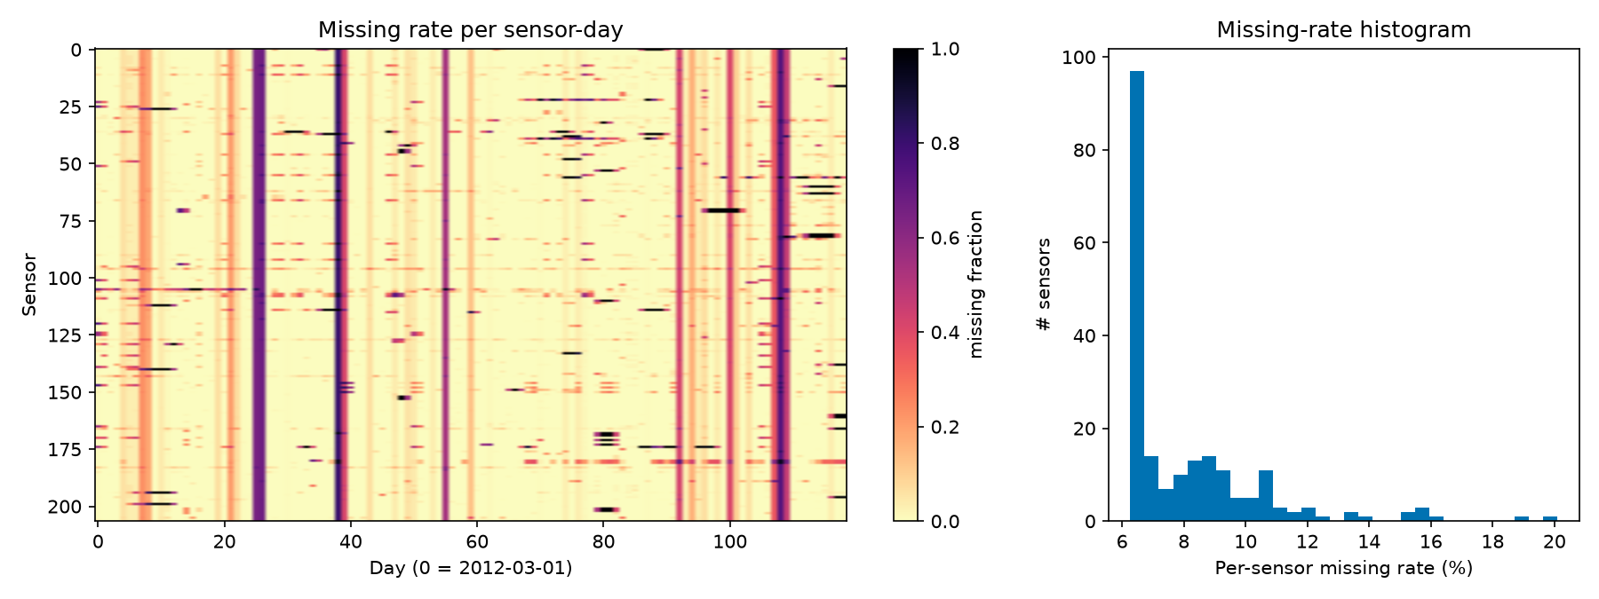
Silence is not a traffic jam
2,148
timestamps where ≥ 90% of sensors are silent
12.1%
missing in the test period vs 7.1% in training
Inputs: forward-fill up to 30 minutes (past only), then the training-period average for that sensor and time of day, plus an is_missing flag
Targets: never imputed — a model is only scored where the sensor actually reported
Notes:
The heatmap shows outages are clustered: whole-network blackouts on 61 days. The test period is noticeably noisier than training. Our rule: fill inputs with past-only information and flag them; never invent targets.

Slide 7
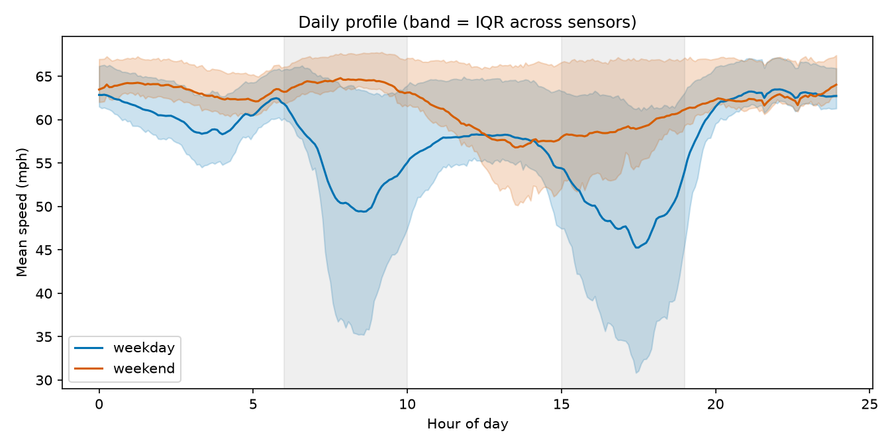
The city breathes twice a day
45.3 mph
weekday low, around 17:30
56.8 mph
weekend low — rush hours vanish
42.5–65.7
mph range of weekly time-slot averages
Notes:
Two rush hours on weekdays, almost none at weekends. Across the week, time-slot averages range from about 42 to 66 mph. This is why every model gets time-of-day and day-of-week features.

Slide 8
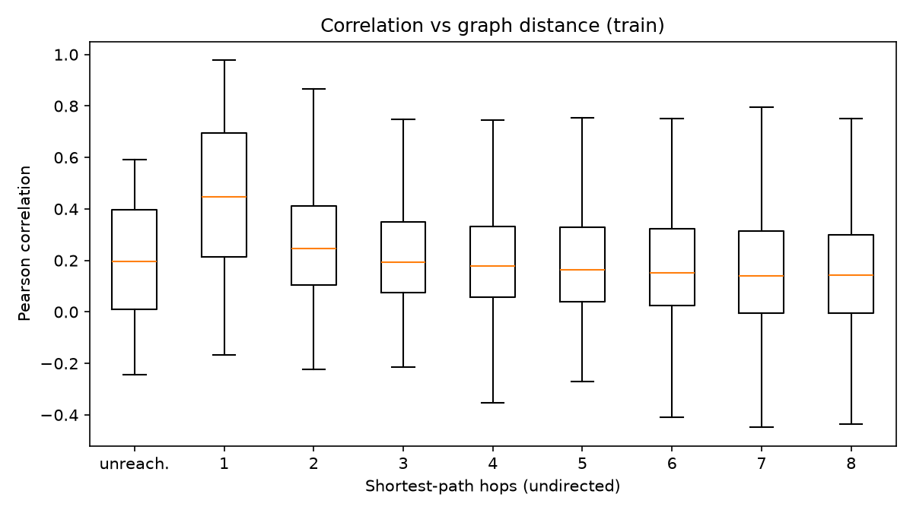
Turning roads into a graph
THRESHOLDED GAUSSIAN KERNEL
Wᵢⱼ = exp(−(dᵢⱼ / σ)²) if ≥ κ, else 0
dᵢⱼ = directed road distance (metres)
σ = 2,584 m (spread of all distances), κ = 0.1
Rebuilt matrix equals the published one to 1.0 × 10⁻⁷
Phase 2 will use it in both directions, W + Wᵀ
Neighbours really are related: median correlation 0.45 at 1 hop → 0.25 at 2 hops → 0.14 at 8 hops
Notes:
Distances become edge weights with a Gaussian kernel, exactly as in DCRNN, and our rebuild matches the published matrix to seven decimal places. On the right: sensor pairs one hop apart correlate much more strongly than distant ones. That is the case for a graph.

Slide 9
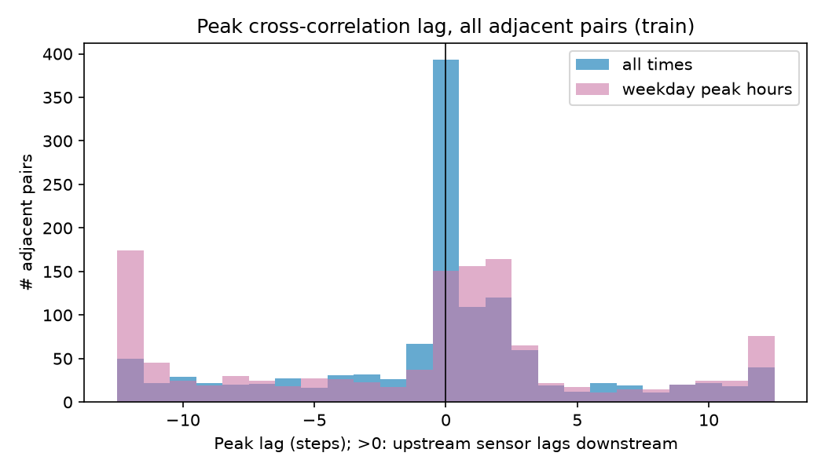
Does congestion really travel upstream?
50%
38%
of pairs: upstream reacts later
of pairs: the opposite
Peak hours, all 1,228 adjacent sensor pairs, lag measured in 5-minute steps.
Honest reading: spatial dependence is clear, directional propagation is only modestly supported. So the graph's benefit must be tested, not assumed.
Notes:
We checked the hypothesis before building anything. For every adjacent pair we found the time lag of strongest correlation. At peak hours half the pairs show the upstream sensor reacting later, as the shockwave story predicts, but 38% show the opposite. Real, but modest. That sets expectations for everything after.

Slide 10
A fair fight
CHAPTER 02
No peeking into the future, the same test for every model, and statistics that respect time.
Notes:
Chapter two is about trust. Most impressive traffic results die here, through leakage.

Slide 11
No peeking into the future
TRAIN
VAL
TEST
Mar 1 –
May 23
23,967 windows
May 23 –
Jun 4
3,404
Jun 4 –
Jun 27
6,832
CHRONOLOGICAL
TRAIN-ONLY STATISTICS
MASKED METRICS
Split by time 70/10/20. Windows are built inside each split, so no input or target crosses a boundary (unit-tested).
Scaler 58.58 ± 12.82 mph, imputation means and the history table all come from training time only.
MAE, RMSE, MAPE in mph on observed targets; sliced by horizon, peak / off-peak / weekend, congested / free-flow.
Notes:
Our split is purely chronological. A random split would put near-identical windows in train and test and make every model look great. Everything learned from data — even the scaling constants — comes from training time only. A built-in alarm fires if any model gets below 3.0 mph MAE at 60 minutes, because that would almost certainly mean leakage. It never fired.

Slide 12
Statistics that respect time
DIEBOLD–MARIANO TEST
Compares two models' error series hour by hour
Errors are autocorrelated, so the variance uses a Newey–West (HAC) estimate
Small-sample correction; for 3-seed models we report the worst p-value
DAY-BLOCK BOOTSTRAP
Resample whole days (1,000×) for 95% intervals; paired for model differences.
Historical average 4.19 mph vs 4.16 in the DCRNN paper — an external check of our pipeline.
Notes:
Two statistical tools keep us honest. Diebold–Mariano tells us whether one model really beats another, with a variance that respects autocorrelation. The day-block bootstrap gives confidence intervals. On the right are the baselines. Persistence — just repeat the last speed — is surprisingly strong at 15 minutes. Our historical average lands within 0.03 of the published number, a nice sanity check.

Slide 13
Trees that read the clock
CHAPTER 03
Gradient-boosted trees with 45–59 hand-made features: how far does per-segment learning go?
Notes:
Chapter three: the strong classical baseline. If deep learning can't beat this, it hasn't earned its complexity.

Slide 14
Four tree models, one recipe
FEATURE RECIPE
12 lags + rolling mean / std / min / max
Missing flags, cyclic time-of-day and day-of-week
Pooled: + sensor id, location, degree (50)
Spatial: + upstream / downstream neighbour speeds (59)
Optuna, 15 trials, validation only — absolute-error loss won
Notes:
Four tree models. Per-segment XGBoost trains 621 small models, one per sensor and horizon. The pooled model learns across all sensors. The forest predicts all horizons at once. XGB-spatial adds hand-made neighbour features — our bridge between classical ML and graphs. XGB-spatial is best at 15 and 30 minutes (2.820, 3.258); per-segment wins at 60 minutes (3.684). One caveat: every pooled model hit our 400-tree cap, so these numbers are conservative.

Slide 15
The Phase 1 scoreboard
15 MIN
2.82 mph
best tree · persistence 3.49
30 MIN
3.26 mph
best tree · persistence 4.20
60 MIN
3.68 mph
best tree · persistence 5.37
Notes:
Every learned model beats persistence. XGBoost with neighbour features is best at 15 and 30 minutes (2.820, 3.258); per-segment XGBoost wins at 60 minutes (3.684). The Random Forest is the weakest tree model, and at an hour ahead it loses even to the historical average. No model gets near the 3.0 mph leakage alarm.

Slide 16
Do neighbours help the trees?
+0.56 mph
gain in congestion at 30 min — 3–4× the overall gain
Significant in almost every slice (DM test, paired bootstrap)
Biggest at peaks and in jams — as the hypothesis predicts
But the gain does not grow with horizon
Notes:
The bridge experiment. Adding neighbour features to the same XGBoost improves accuracy almost everywhere, and the improvement is concentrated where we expected: peaks and congestion. But the hypothesis also said the gain should grow with horizon — it doesn't, it peaks at 30 minutes. Half a win, reported honestly.

Slide 17
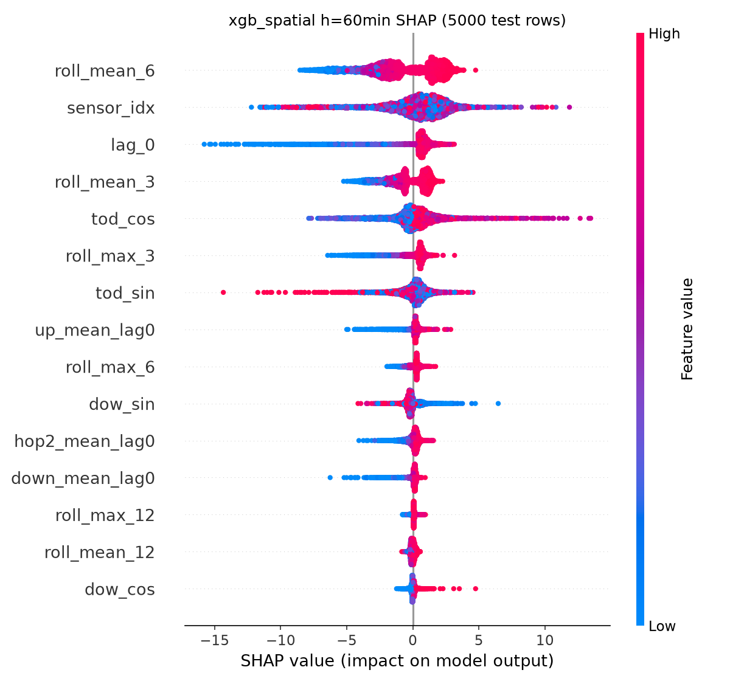
What the trees actually look at
TREESHAP, 5,000 TEST ROWS
15 min: the last half-hour average and the latest speed dominate
60 min: sensor identity and time of day take over
Neighbour speeds appear in the top features, but never dominate
Same-time-yesterday lag adds nothing (2.879 vs 2.880 mph)
Notes:
SHAP shows how the trees think. Short horizon: what is happening right now. Long horizon: which sensor this is and what time it is — essentially a learned timetable. Neighbour information is used, but as a supporting feature. And a 'same time yesterday' feature added nothing measurable.

Slide 18
What Phase 1 taught us
01
Leak-free or it doesn't count
Chronological splits, train-only statistics and masked metrics — the leakage alarm never fired.
02
Trees are a strong baseline
Every tree beats persistence; best 2.82 · 3.26 · 3.68 mph at 15/30/60 min.
03
Neighbours help where it hurts
Neighbour features pay off at peaks and in jams — not more at longer horizons.
04
Time and identity dominate
At an hour ahead the trees mostly use the sensor and the clock; neighbours are a supporting actor.
05
Evidence for the graph is modest
Spatial dependence is clear; upstream propagation is only weakly asymmetric (50% vs 38%).
Notes:
Five takeaways from Phase 1. Trust first. Trees are a strong baseline. Neighbours help in jams. At long horizons the trees mostly use identity and time. And the evidence that a learned graph will help is real but modest, which is exactly what Phase 2 tests.

Slide 19
Limits, and what Phase 2 tests
LIMITATIONS
PHASE 2
One city, one season (Mar–Jun 2012), speed only
Laptop budgets: 15 tuning trials, pooled models on 25% of rows, 400-tree cap always reached
Hand-made neighbour features, fixed distance graph
Test period has more sensor outages than training
Learn the neighbour weighting: graph attention (STGAT)
A no-graph twin to isolate the graph's effect
A leakage-safe hybrid of trees and graph
Ablations, maps and a ramp-metering simulation
Notes:
Be clear about limits: most are compute budget, not method. Then hand over to Phase 2: replace hand-made neighbour features with learned attention, test it against a no-graph twin, and combine it with the trees.

Slide 20
Thank you
Questions welcome — every number is in the repository.
TEAM T042
Pranav Singh · Kunal · Himanshu · Kanchan · Vaibhav
github.com/Pranav-Singh-Devloper/traffic-oracle
Live demo: traffic-oracle.streamlit.app
Notes:
Close Phase 1 and invite questions.

