Slide 1

Analysis of Algorithms

Slide 2
Types of Analysis
Worst case
Provides an upper bound on running time
An absolute guarantee that the algorithm would not run longer, no matter what the inputs are
Best case
Provides a lower bound on running time
Input is the one for which the algorithm runs the fastest
Average case
Provides a prediction about the running time
Assumes that the input is random
2

Slide 3
How do we compare algorithms?
We need to define a number of objective measures.
(1) Compare execution times?
Not good: times are specific to a particular computer !!
(2) Count the number of statements executed?
Not good: number of statements vary with the programming language as well as the style of the individual programmer.
3

Slide 4
Ideal Solution
Express running time as a function of the input size n (i.e., f(n)).
Compare different functions corresponding to running times.
Such an analysis is independent of machine time, programming style, etc.
4

Slide 5
Example
Algorithm 3 Cost
sum = 0; 1
for(i=1; i<=N; i++) n+1
for(j=1; j<=N; j++) n(n+1)
sum += arr[i][j]; nn
------------
Total frequency count
1+n+1+n(n+1)+nn
1+n+1+n2+n+n2
2+2n+2n²
5

Slide 6
Asymptotic Analysis
To compare two algorithms with running times f(n) and g(n), we need a rough measure that characterizes how fast each function grows.
Hint: use rate of growth
Compare functions in the limit, that is, asymptotically!
(i.e., for large values of n)
6

Slide 7
Rate of Growth
The low order terms in a function are relatively insignificant for large n
n⁴ + 100n² + 10n + 50 ~ n⁴
i.e., we say that n⁴ + 100n² + 10n + 50 and n⁴ have the same rate of growth
7

Slide 8
Asymptotic Notation
O notation: asymptotic “less than”:
f(n)=O(g(n)) implies: f(n) “≤” g(n)
Ω notation: asymptotic “greater than”:
f(n)= Ω (g(n)) implies: f(n) “≥” g(n)
Θ notation: asymptotic “equality”:
f(n)= Θ (g(n)) implies: f(n) “=” g(n)
8

Slide 9
Big-O Notation
We say f_{A}(n)=30n+8 is order n, or O (n) It is, at most, roughly proportional to n.
f_{B}(n)=n²+1 is order n², or O(n²). It is, at most, roughly proportional to n².
In general, any O(n²) function is faster- growing than any O(n) function.
9

Slide 10
Visualizing Orders of Growth
On a graph, as you go to the right, a faster growing function eventually becomes larger...
f_{A}(n)=30n+8
Value of function →
f_{B}(n)=n²+1
Increasing n →
10

Slide 11
More Examples …
n⁴ + 100n² + 10n + 50 is O(n⁴)
10n³ + 2n² is O(n³)
n³ - n² is O(n³)
constants
10 is O(1)
1273 is O(1)
11

Slide 12
Asymptotic notations
O-notation
12

Slide 13
Big-O example, graphically
Note 30n+8 isn’t less than n anywhere (n>0).
It isn’t even less than 31n everywhere.
But it is less than 31n everywhere to the right of n=8.
cn = 31n
30n+8
30n+8 ∈O(n)
Value of function →
n
n>n₀=8 →
Increasing n →
13

Slide 14
Asymptotic notations (cont.)
Ω - notation
Ω(g(n)) is the set of functions with larger or same order of growth as g(n)
14

Slide 15
Asymptotic notations (cont.)
Θ-notation
Θ(g(n)) is the set of functions with the same order of growth as g(n)
15

Slide 16
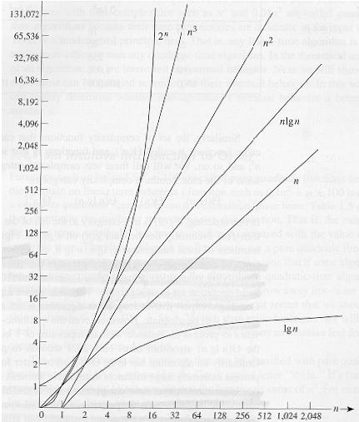
Common orders of magnitude
16

Slide 17
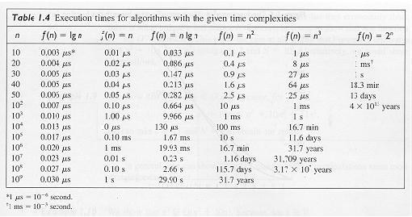
Common orders of magnitude
17

Slide 18
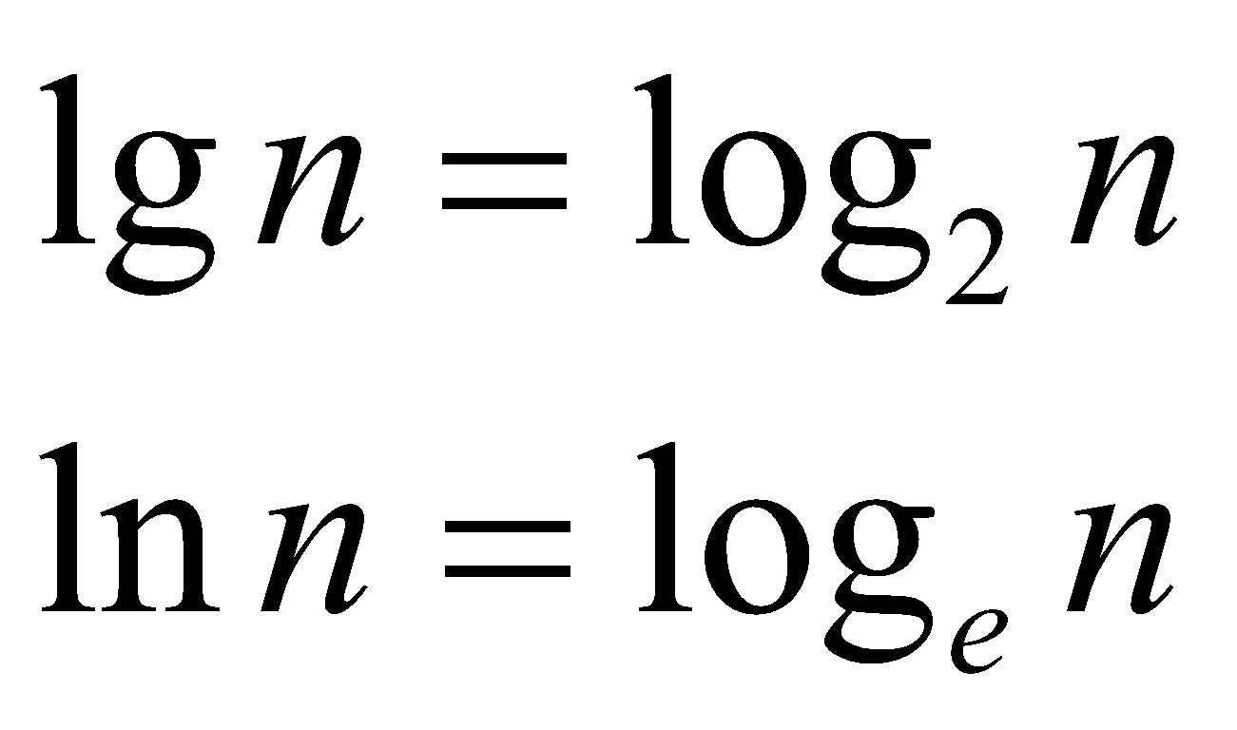
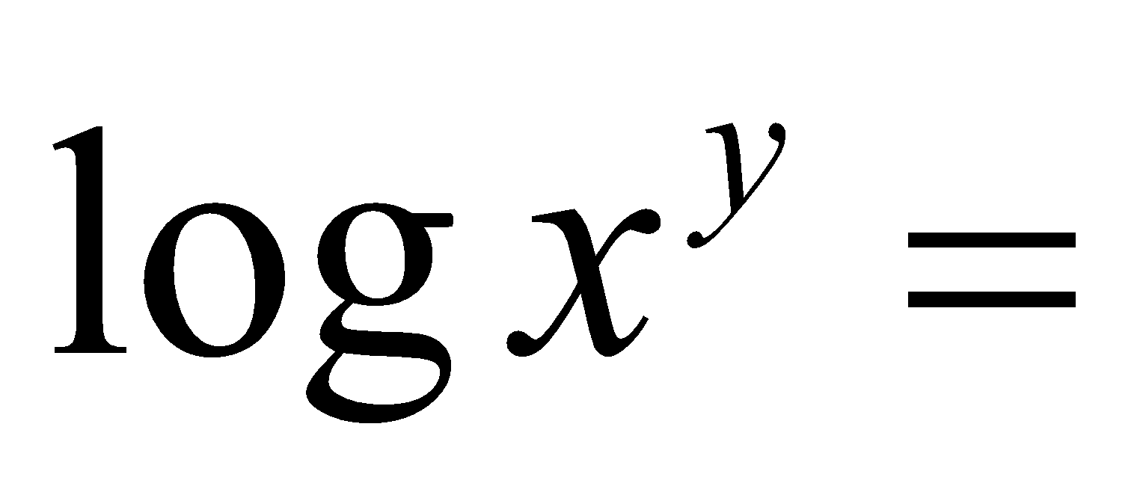
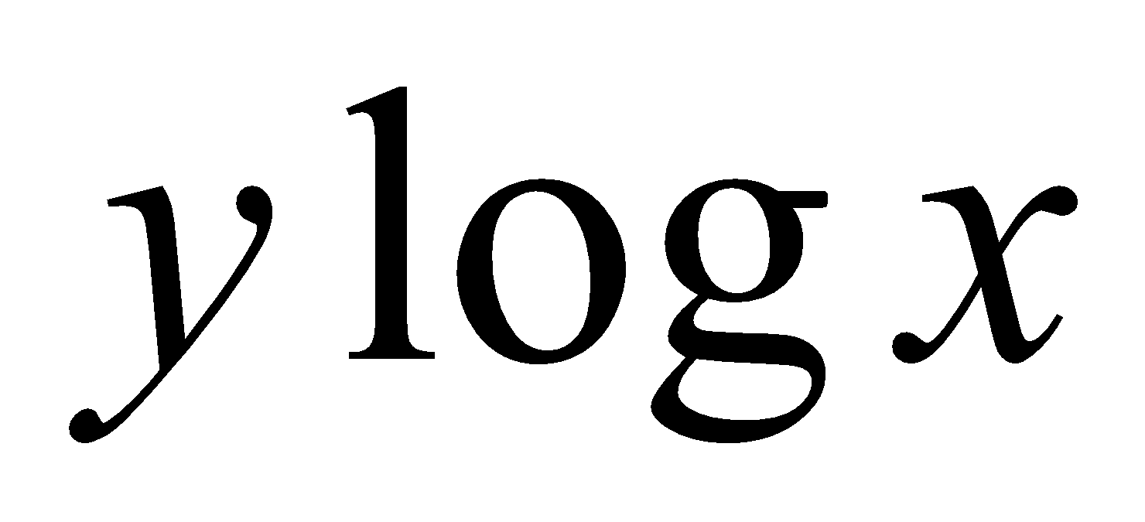
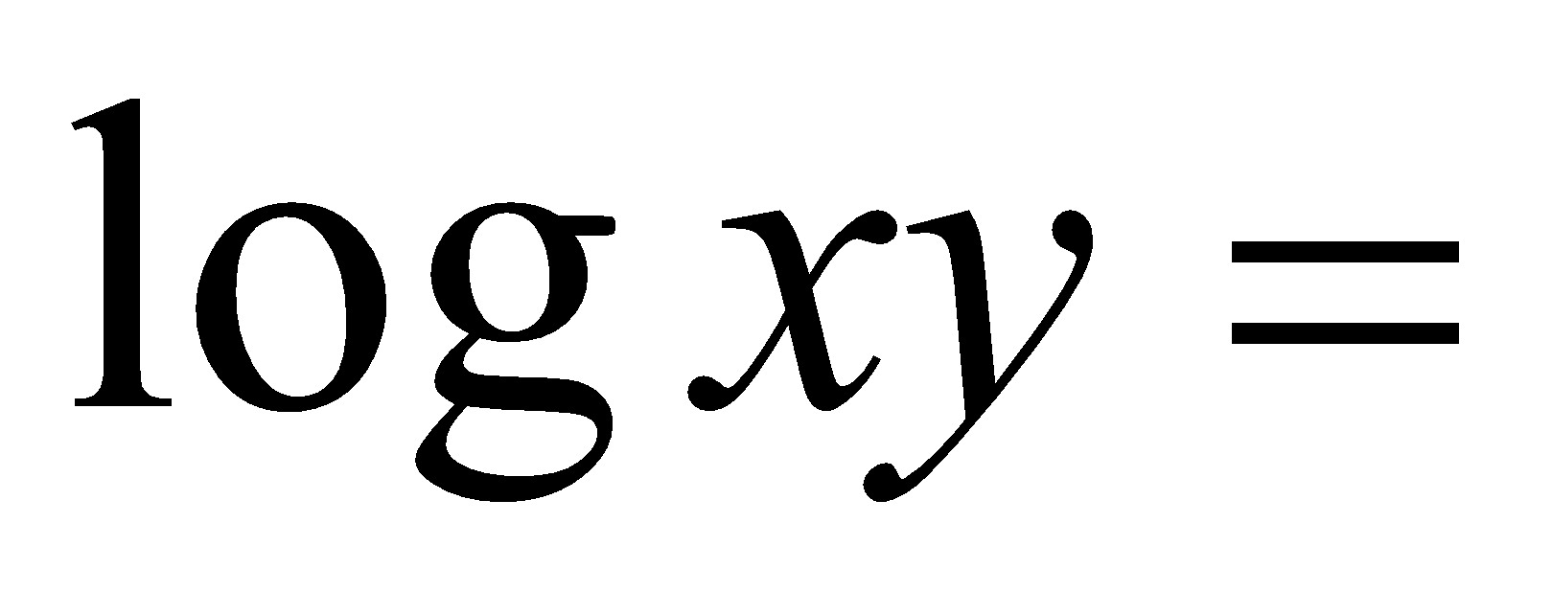
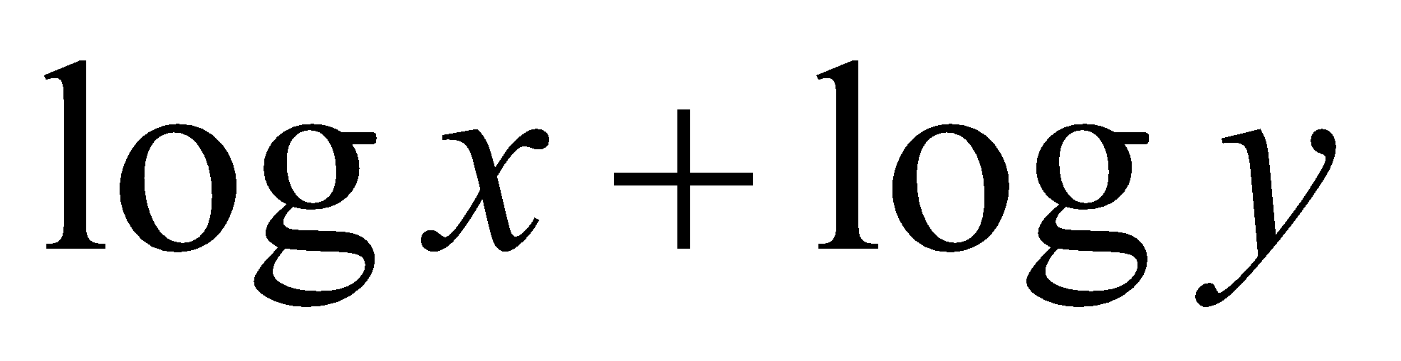
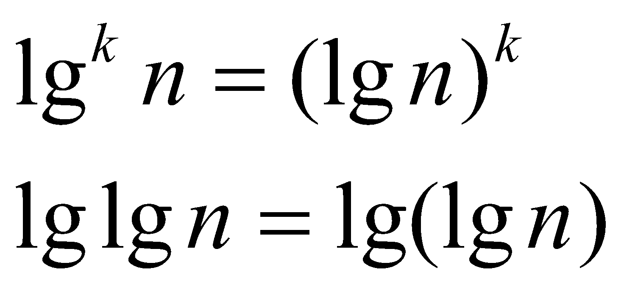
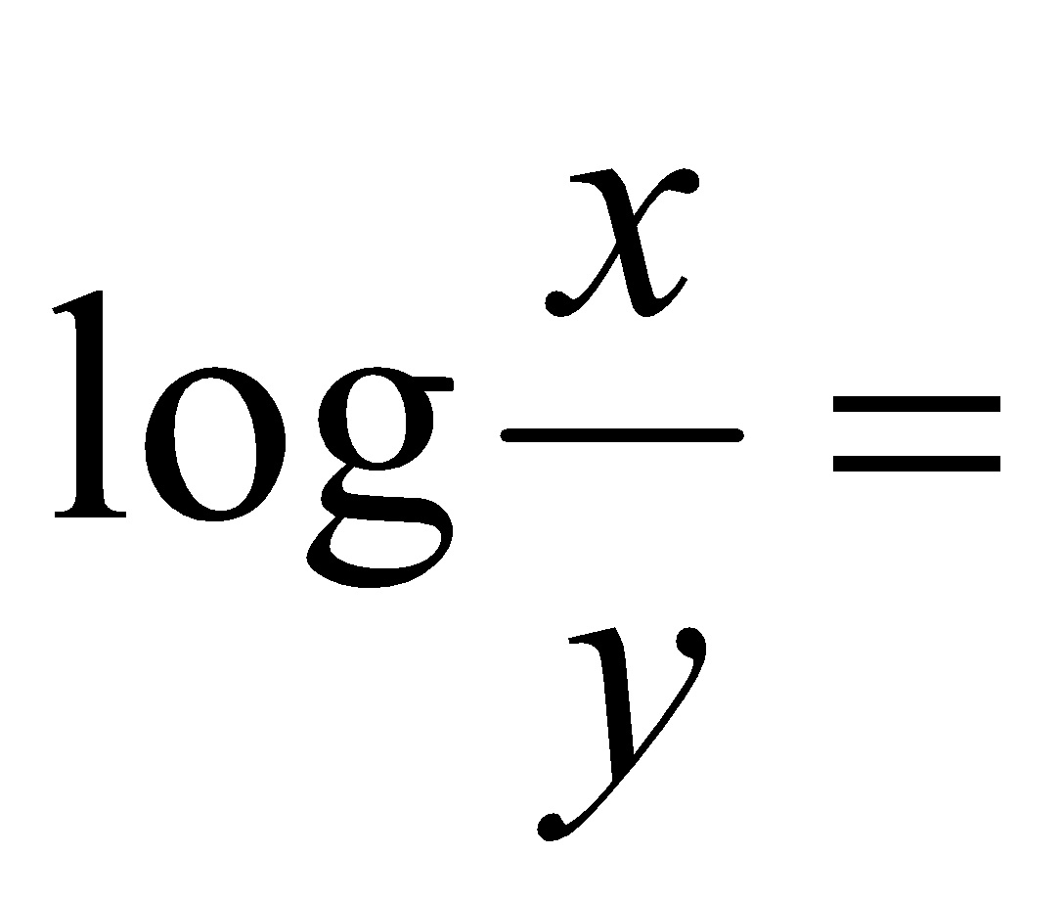
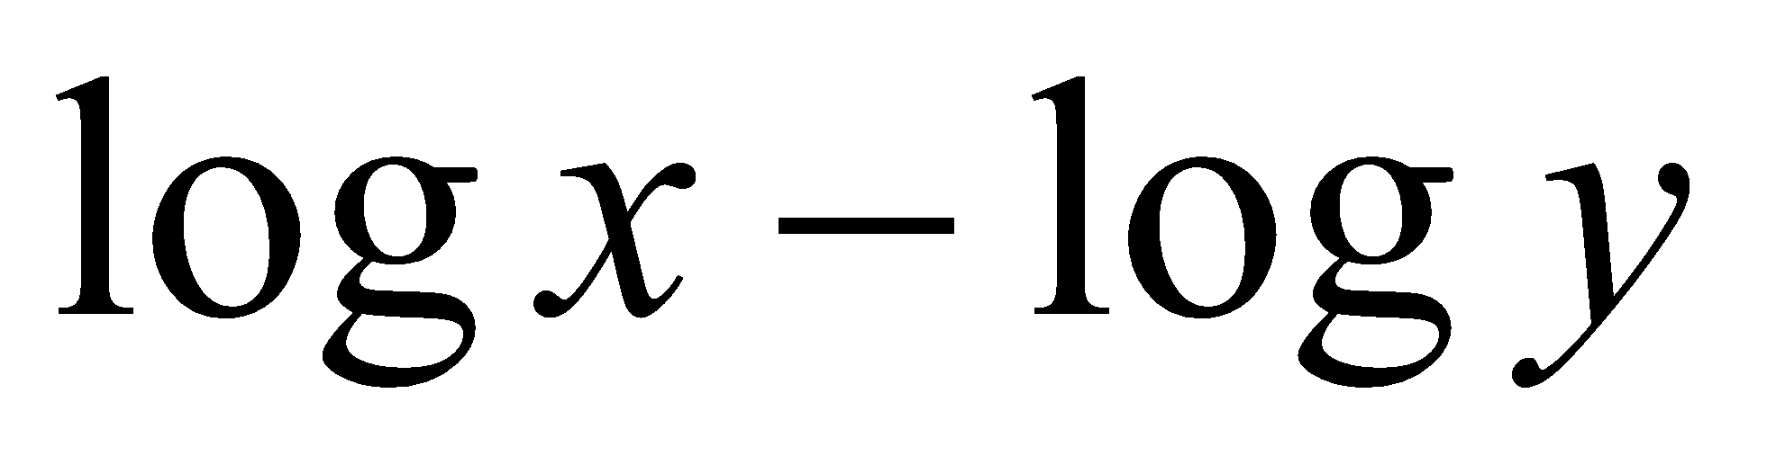
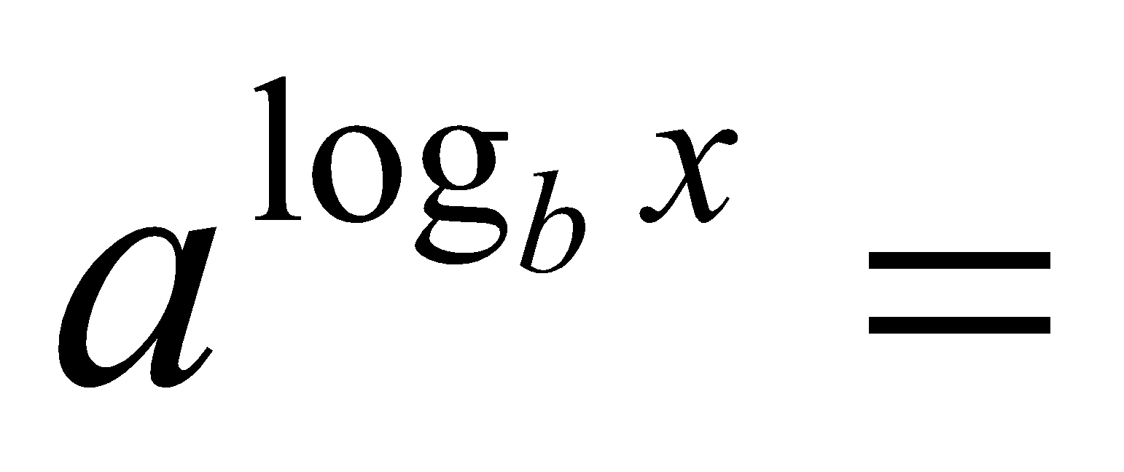
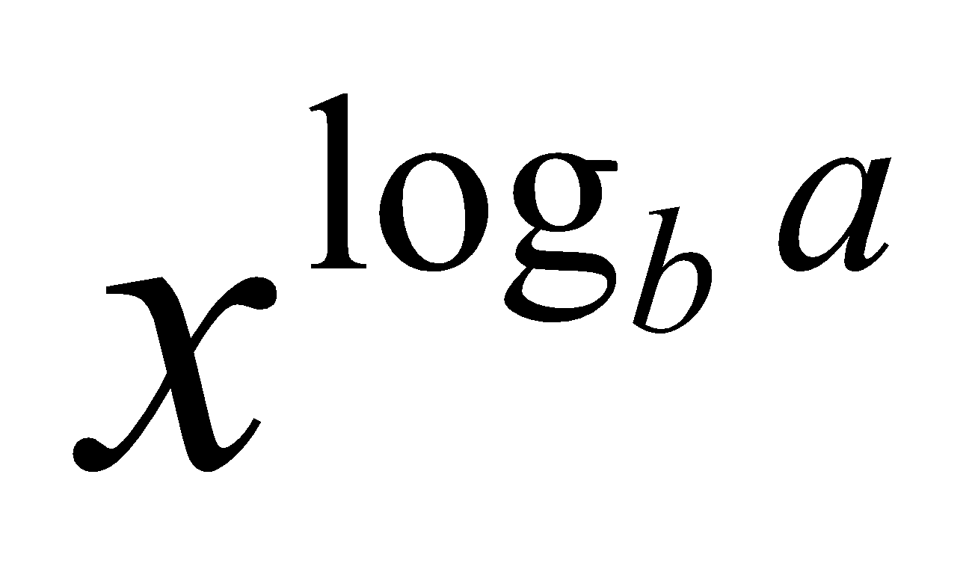
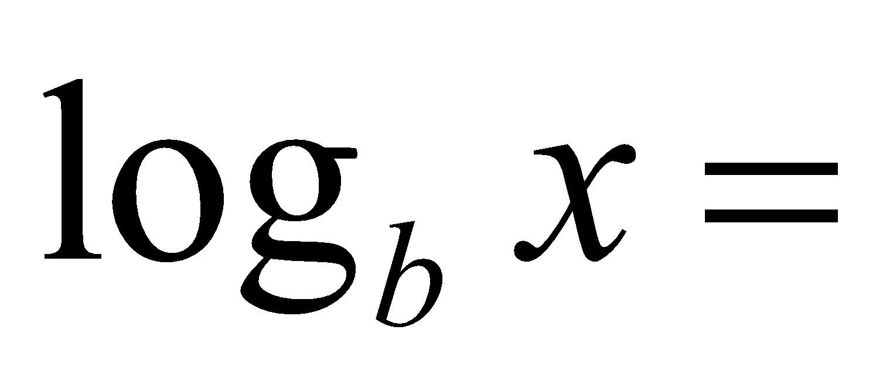
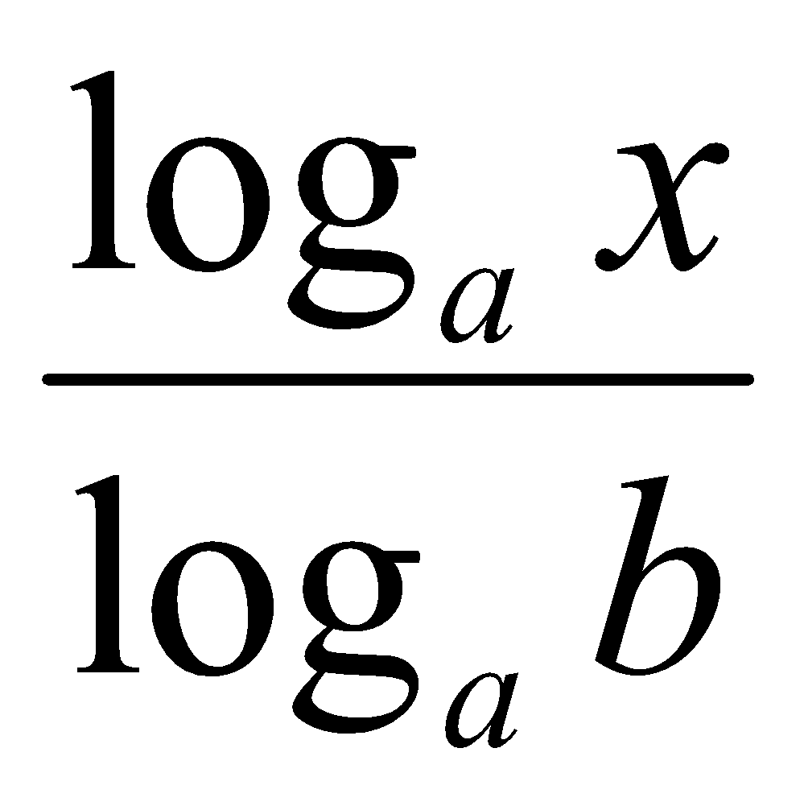
Logarithms and properties
In algorithm analysis we often use the notation “log n” without specifying the base
Binary logarithm
Natural logarithm
18

