Slide 1
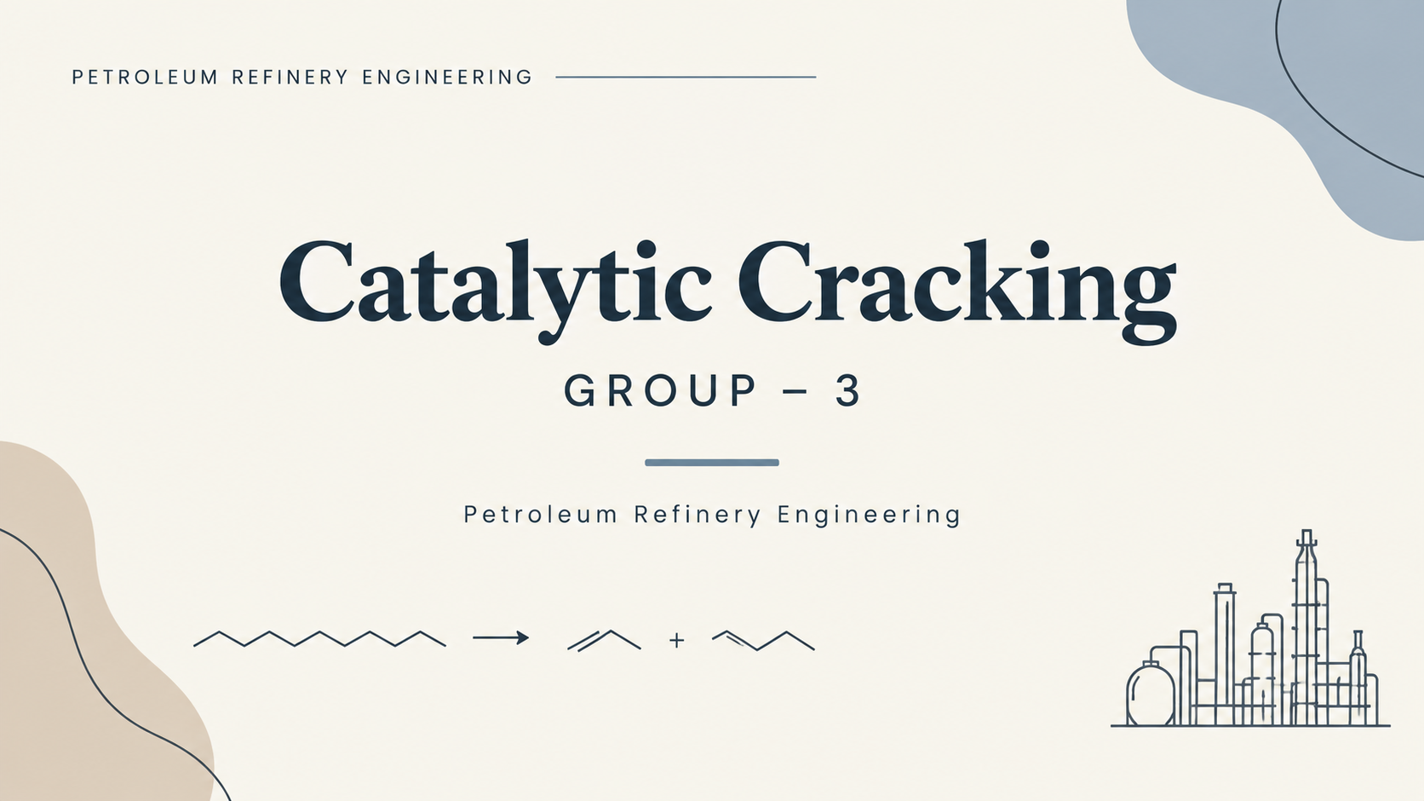

Slide 2
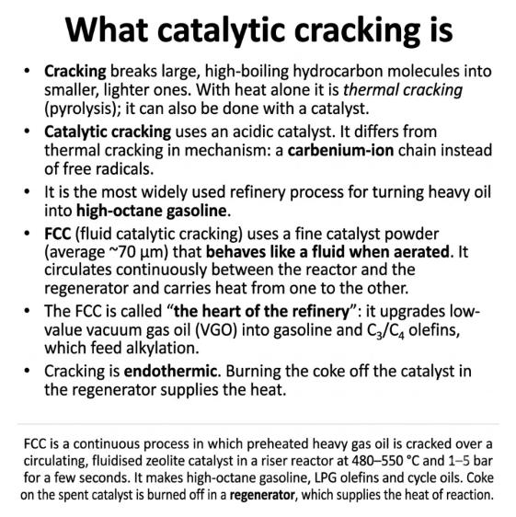

Slide 3
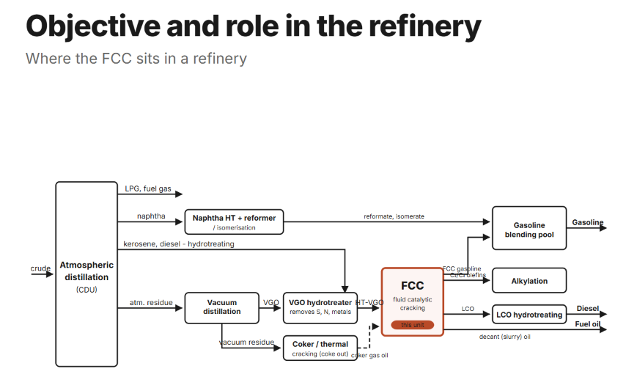
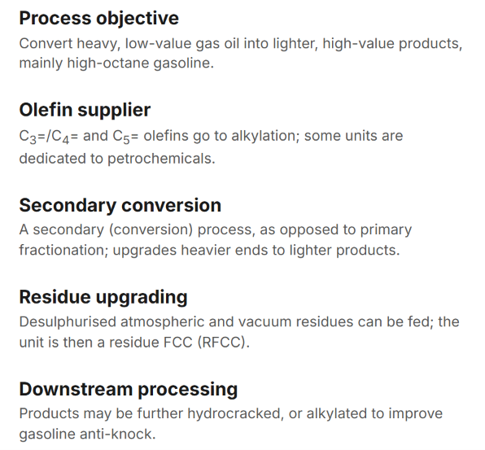
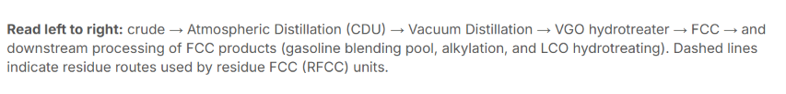

Slide 4
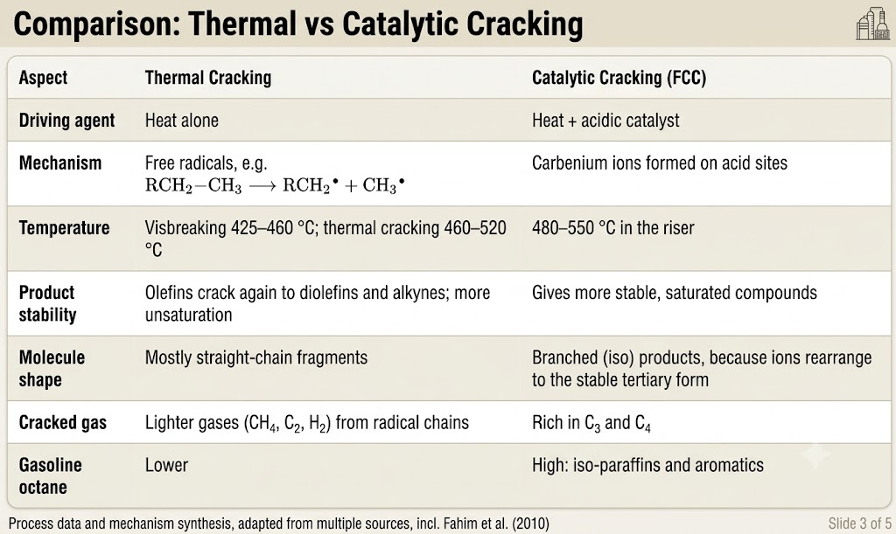

Slide 5
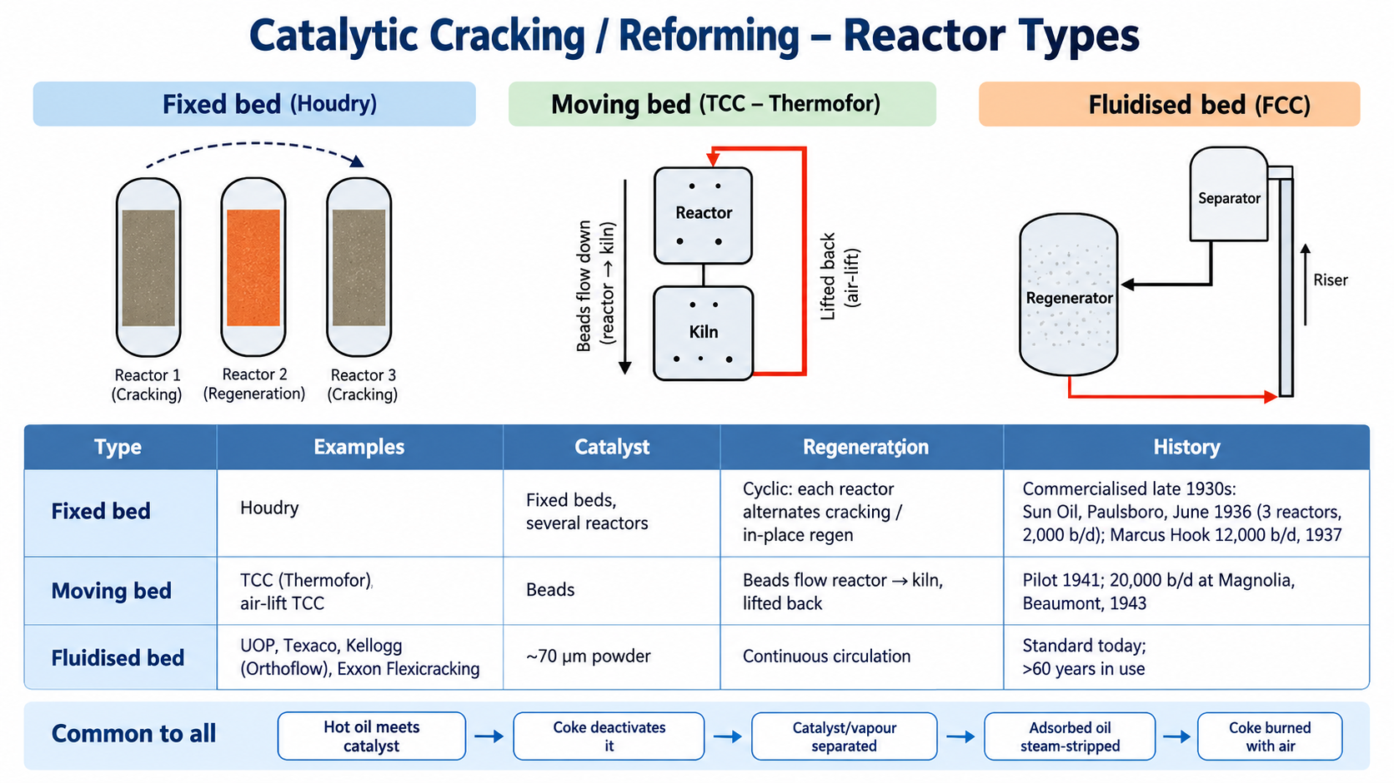

Slide 6
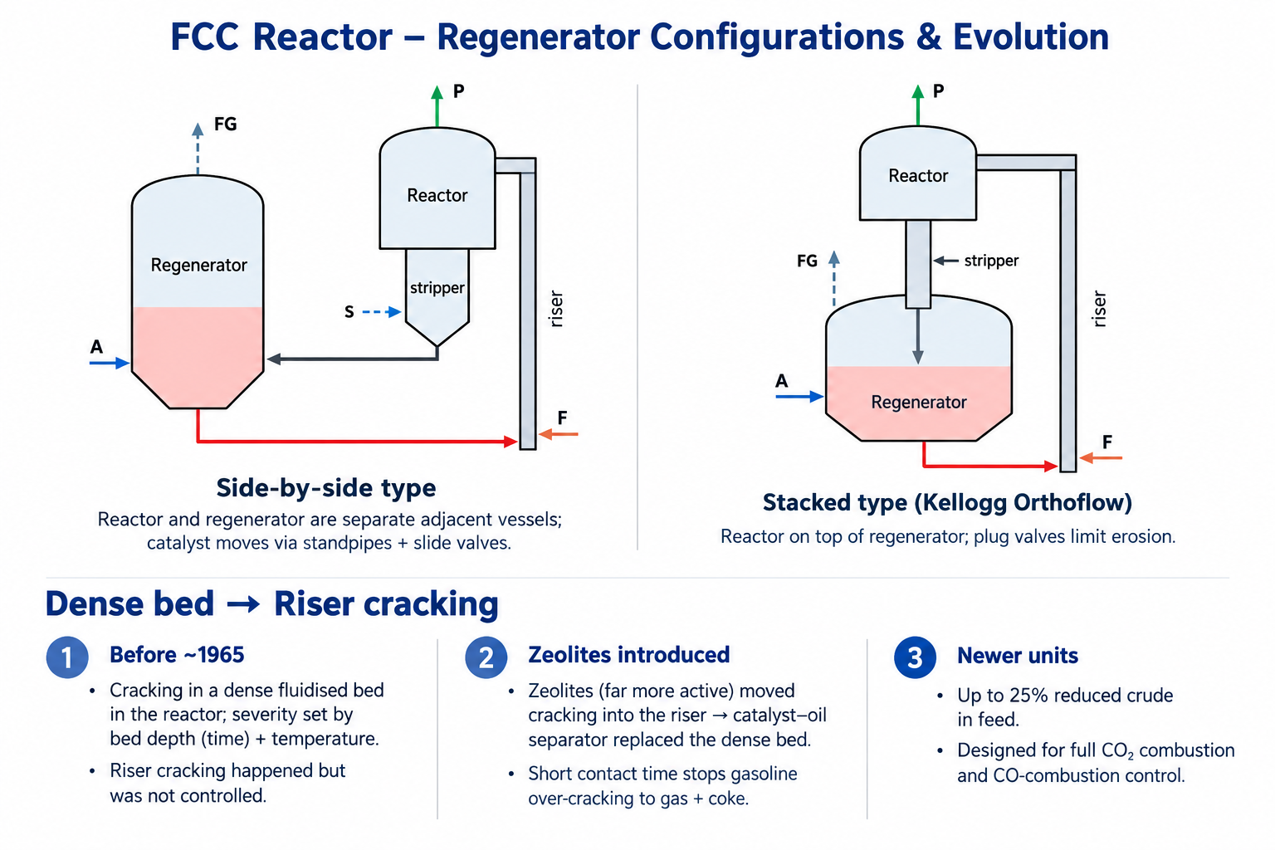

Slide 7
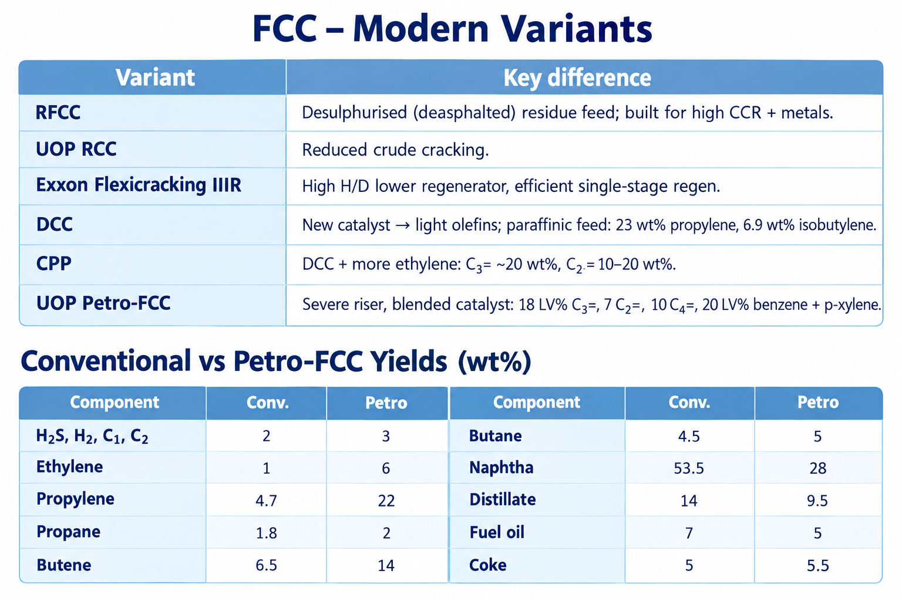

Slide 8
FCC Operating Conditions
A analysis of critical pressure, temperature and material profiles for optimization of the conversion of heavy gas oil and continuous catalyst regeneration.
Riser Reactor
Regenerator
480–550 °C
660–760 °C
1–5 bar
1–3 bar
VGO Feed
Zeolite
316–566 °C
~70 μm
BOILING RANGE
AVERAGE SIZE

Slide 9
REFINERY PROCESS SPECIFICATIONS
Fluid Catalytic Cracking (FCC)
Key operating window, catalyst regime, and yield distribution
650–750°C
1.5–3 bar
2–5 s
65–80%
REGENERATOR TEMP
OPERATING PRESSURE
RISER CONTACT TIME
TYPICAL CONVERSION
Coke combustion & catalyst reheating
Vapor expansion & riser transport
Suppresses secondary overcracking
Gas oil conversion to lighter fractions
Catalyst System
Steam Medium
Main Products
Zeolite-Based (USY)
Feed Atomization
Gasoline & LPG / Propylene
Ultrastable Y-zeolite active cracking matrix
Disperses heavy feed into micro-droplets
High-octane fuels & petrochemical olefins
4–10 : 1 Cat-to-Oil Ratio
Hydrocarbon Stripping
Heavy Cuts & Off-Gas
Weight-based continuous circulation rate
Recovers entrapped oil before regeneration
Light cycle oil, fuel gas, and coke byproduct

Slide 10
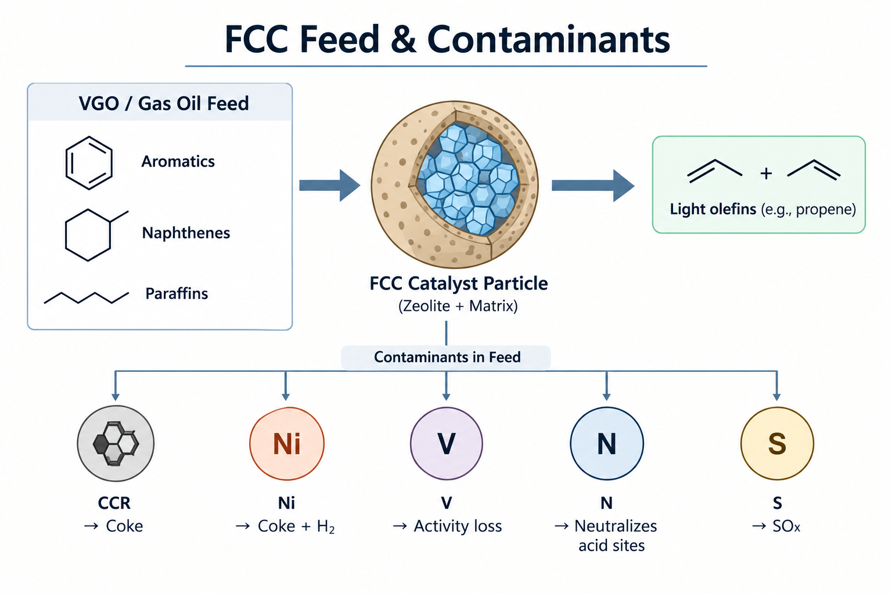
Feed & catalsyt :-
Feed :-
Main feed: gas oil, 316–566 °C (600–1050 °F); aromatic + naphthenic + paraffinic.
Primary: AGO, VGO. Others: atmospheric, coker, visbreaker distillates; desulphurised AR; desulphurised + deasphalted VR.
Contaminants (S, N, metals) concentrate in heavier fractions → feed normally hydrotreated.
Economics: residual fuel is worth far less than cracking feed → refiners blend AR/VR bottoms into FCC feed.
CONTAMINANT | EFFECT
CCR | Coke on catalyst
NICKEL | More coke + H₂ (dehydrogenation)
VANADIUM | Main metal cause of activity loss
NITROGEN | Neutralises acid sites
SULPHUR | coke → SOₓ in flue gas
ORGANOMETALLICS | Deposit metals during desulphurisation

Slide 11
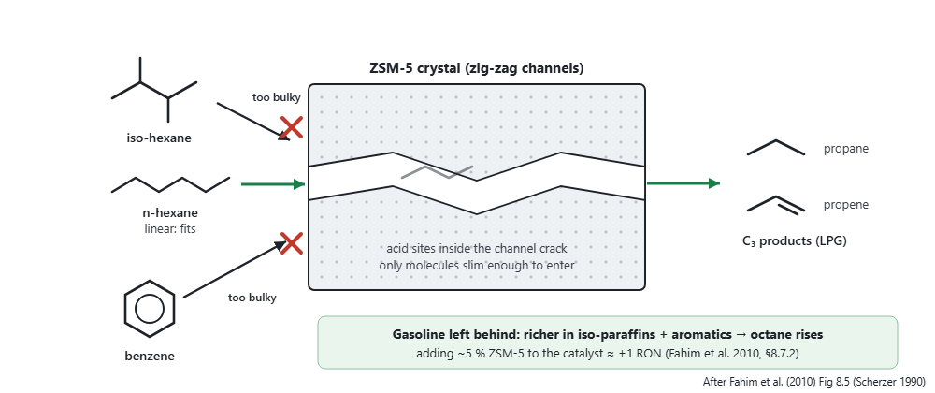
CATALYST :-
Must be acidic: supplies a proton (Brønsted); Lewis acids (BF₃, AlCl₃, FeCl₃) also form carbenium ions.
Cracking needs the strongest acid sites of all acid reactions
Generations: ① acid-treated natural aluminosilicates (clays) → ② amorphous synthetic silica–alumina → ③ crystalline zeolites (molecular sieves: more active sites + adsorption → faster cracking)
ZEOLITE :-
Zeolite Y is the active component of FCC catalyst. It is a synthetic form of faujasite and helps break large hydrocarbons into smaller useful products.
Sodium form (Na-Y) has low acidity, so Na⁺ is replaced by rare-earth ions like lanthanum/cerium to increase acidity and cracking activity.
Zeolite Y has tiny pores and a large surface area (~800 m²/g), allowing VGO molecules to enter and react at the acidic sites.
Matrix supports the zeolite: binder acts like glue, while kaolin acts as a filler/body, giving strength and resistance to attrition.
Additives control unwanted effects: some help convert CO → CO₂ in the regenerator, while metal oxides capture SOx, which is later released mainly as H₂S in the reactor.

Slide 12

Petroleum Refining Engineering
Reactions in FCC
1 Primary cracking
Also occurring
Isomerisation
Branched products
Side-chain cracking
Aromatics + olefins
Condensation
Polyaromatics + coke
Large paraffin gives smaller paraffin + olefin.
2 Hydrogen transfer
Olefin + naphthene donor give paraffin + aromatic.
3 Coke combustion in the regenerator
[L] pp. 9–13, 24 · [B] §§8.5–8.6, pp. 202–208
Notes:
Lecture: Cracking and Reforming 1, supplied course PDF, pp. 9–13 and 24. Fahim, M. A., Al-Sahhaf, T. A., and Elkilani, A. S. (2010). Fundamentals of Petroleum Refining. Elsevier. Chapter 8, pp. 199–235. Printed page numbers are used. PDF page = printed page + 17., sections 8.5 and 8.6. The equations are representative balanced examples rather than a unique overall FCC stoichiometry. Cracking of paraffins yields a smaller paraffin and olefin. Hydrogen transfer is illustrated using three propene molecules and a cyclohexane donor: three propane molecules plus benzene result. Isomerisation enriches branched hydrocarbons. Aromatic side chains can crack while aromatic rings are comparatively resistant. Condensation and hydrogen loss lead to polyaromatic coke. Regeneration equation treats coke as carbon for simplicity; real coke contains hydrogen and other elements and partial CO combustion can occur. Overall cracking is endothermic and coke combustion is exothermic.

Slide 13
Petroleum Refining Engineering
Reaction mechanism
01
Protonation
Olefin accepts a proton from H–Z.
02
β-scission
A C–C bond breaks to form an olefin + smaller ion.
03
Hydride transfer
Paraffin forms and a new carbenium ion continues the chain.
04
Proton return
Olefin leaves and the acid site regenerates.
H–Z = Brønsted acid site. Rearrangements favour more stable ions and branched products.
[L] pp. 11–12 · [B] Eqs. 8.1–8.3, 8.10 · Penn State FSC 432, “Ionic Chain Reactions”
Notes:
Lecture: Cracking and Reforming 1, supplied course PDF, pp. 11–12. Fahim, M. A., Al-Sahhaf, T. A., and Elkilani, A. S. (2010). Fundamentals of Petroleum Refining. Elsevier. Chapter 8, pp. 199–235. Printed page numbers are used. PDF page = printed page + 17., equations 8.1–8.3 and 8.10, pp. 204–205. Supplement: Semih Eser, Penn State FSC 432, Ionic Chain Reactions, https://courses.ems.psu.edu/fsc432/node/721 (accessed 29 September 2026). H–Z denotes a Brønsted acid site and Z− the conjugate framework site. The equations illustrate the olefin/carbenium route: protonation, beta scission, hydride transfer and proton return. Initial olefins may come from mild thermal cracking. Direct paraffin activation and carbonium-ion paths also exist. Beta scission breaks the C–C bond between the alpha and beta carbons relative to the charged carbon, creating an olefin and a smaller carbenium ion. Rearrangements via hydride/alkyl shifts favour more stable secondary/tertiary ions and help explain branched products. Hydride transfer propagates the ionic chain, whereas deprotonation restores a Brønsted site. Carbonium and carbenium are distinguished in modern terminology; the lecture sometimes uses carbonium broadly.

Slide 14
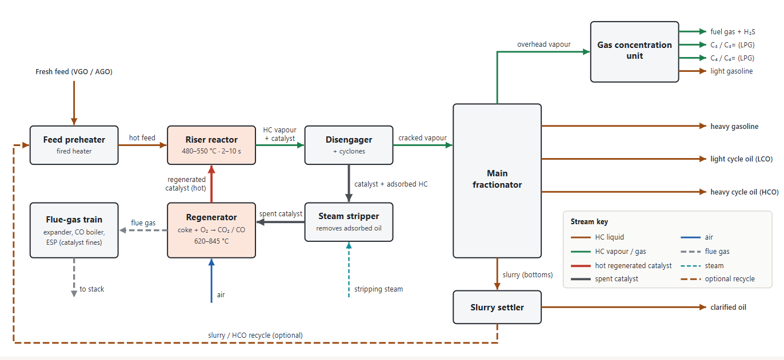
FCC block flow diagram

Slide 15
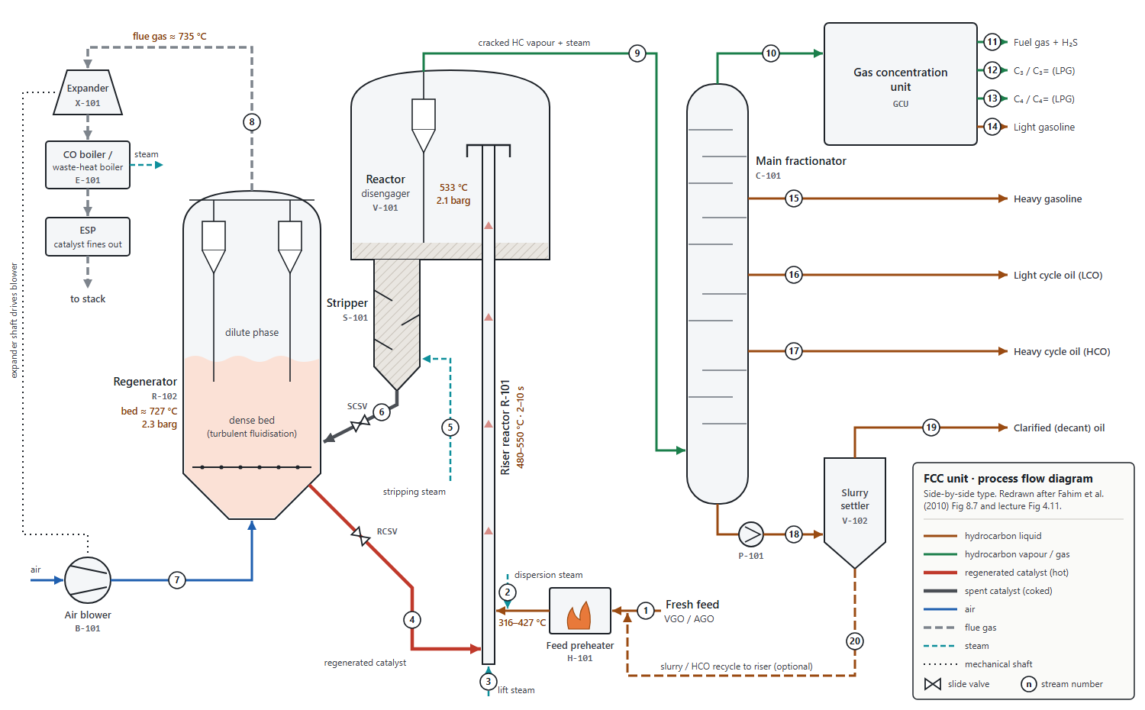
FCC process flow diagram, side-by-side type

Slide 16







Optimising Catalytic Cracking: control the severity, control the product slate
FCC optimisation is a balance: maximise valuable liquids while avoiding over-cracking, coke and catalyst deactivation.
1. Severity: temperature + time
Higher severity → more conversion, but excessive severity over-cracks gasoline to gas/coke.
2. Catalyst activity & selectivity
Zeolite is highly active; short contact time helps prevent over-cracking and supports gasoline yield.
OPTIMISATION TARGET
High-value
liquid yield
3. Feed quality
Metals (Ni, V), sulfur and high carbon residue reduce activity, increase coke and can lower gasoline yield.
4. Regeneration
Burn coke with controlled air flow; lower residual coke gives a more reactive/selective regenerated catalyst.
↑ gasoline
↑ desired olefins
↓ coke & dry gas

Slide 17
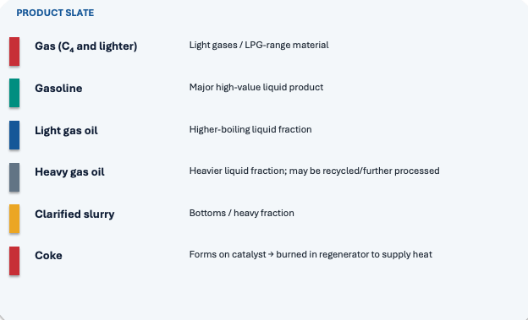
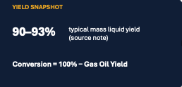
FCC Products: What comes out and what we are trying to maximise?

