Slide 1
🌿
HERB-VAULT
INDUSTRY INTEREST
Himalaya Drug Company has evaluated and expressed commercial interest
Blockchain-Based Ayurvedic Herb Traceability System
Software Architecture: READY
📜 PATENT APPLIED — Indian Patent Office
sih-blockchain.vercel.app
CMTI Design & Innovation Clinic 2026 | April 16–18, Bengaluru
Hyperledger Fabric Blockchain Network Designed & Tested
• R Sai Pranav | CSE — Software Lead
• Kartik Jarali | CSE — Software
• Harshal Y Kumar | Mechatronics — Hardware Lead
• Karanam Nayan | Mechatronics — Hardware

Slide 2
The Real Crisis — Billions Lost, Trust Broken
🌿 HERB-VAULT | CMTI DIC 2026 | REVA University
₹15,000 Cr+
47+
26%
40%
68%
3–5×
Annual export revenue LOST to fraud & rejections
EU/US border rejections of Indian herbs (2023 alone)
Ayurvedic products FAIL FSSAI quality sampling
Herbs in Indian market adulterated or mislabeled
Urban consumers DON'T trust herbal product labels
Farm gate vs. shelf price gap due to middlemen
🇪🇺 WHY EU & US REJECT INDIAN HERBS
👤 WHY CONSUMERS DON'T TRUST HERBAL MEDICINES
• Pesticide residues above MRL limits — no field record to prove safe practices
• "How do I know this is real Ashwagandha?" — no way to verify at point of purchase
• Microbial contamination (Salmonella, E.coli) — no temperature/handling chain record
• Multiple fake product scandals: turmeric with lead chromate, curcumin substitution
• Incorrect species labeling — Brahmi sold as Gotu Kola, no DNA-verifiable origin
• No visibility into where herbs were grown, by whom, or under what conditions
• Falsified certificates of origin — paper-based, easy to forge without blockchain proof
• No lab test results accessible to the buyer — they must trust the brand blindly
• Heavy metal contamination — no soil/zone restriction at point of collection
• Global trend: 72% of consumers pay 15–20% premium for traceable products (Nielsen 2023)
⚠ Result: India loses ₹15,000 Cr+ annually in rejected herb exports
• Coffee (Rainforest Alliance QR), wine (blockchain provenance) — premium pricing proven
• EU RASFF portal: 47+ rapid alerts for Indian spices & herbs in 2022–23 alone
★ When a consumer SEES the complete journey, credibility of the product becomes unquestionable
• Germany, Netherlands, UK are top rejection origin countries for Indian herbs
★ With HERB-Vault QR: farm → collector ID → GPS zone → grade → lab → product

Slide 3
How QR Traceability Rebuilds Consumer Trust
🌿 HERB-VAULT | CMTI DIC 2026 | REVA University
Scan once — see everything. Farm to pharmacy, immutably on blockchain.
THE QR JOURNEY — What a consumer sees when they scan the product QR code
📍 COLLECTION EVENT
🏭 PROCESSING STEP
🧪 QUALITY TEST
💊 FINAL PRODUCT
Ashwagandha Collected: 14 Apr 2026 Location: Nagaur, Rajasthan GPS: 27.2°N 73.7°E GPS ZONE: ✓ VERIFIED
Facility: Herbal Pro Pune, Maharashtra Process: Sun Drying Duration: 72 hours Date: 18 Apr 2026
Lab: NABL Certified Test Date: 22 Apr 2026 Moisture: 9.2% ✓ Pesticide: PASS ✓ Heavy Metals: PASS ✓
Himalaya Ashwagandha Capsules 500mg Batch: HIM-ASH-2026-042 Mfg: 25 Apr 2026 Exp: Apr 2028
→
→
→
Collector: COL-Ramesh Weight: 12.4 kg Moisture: 10.8% Grade: A (Premium) Blockchain TX: 3f9a2b...
Operator: Suresh K Input: 12.4 kg Output: 9.8 kg Loss (normal): 21% Blockchain TX: 8c1d4e...
Microbial: PASS ✓ Withanolides: 2.5% EU MRL: COMPLIANT US FDA: COMPLIANT Blockchain TX: 2e7f9c...
Certifications: • AYUSH GMP • ISO 22000 • EU Organic Blockchain TX: 1a4b5c...
★ Every field above is immutable on Hyperledger Fabric blockchain — no one can alter it after submission. The consumer isn't trusting a brand. They're reading a cryptographic record.

Slide 4
Market Opportunity & Competitive Landscape
🌿 HERB-VAULT | CMTI DIC 2026 | REVA University
MARKET OPPORTUNITY
COMPETITIVE LANDSCAPE
₹50,000 Cr+
Solution
GPS Zone
Block- chain
Grade Record
EU Compliance
Consumer QR
India Ayurvedic domestic market (2024)
Paper Records
✗
✗
✗
✗
✗
8.5% CAGR
Annual growth rate through 2030
Generic ERP (SAP/Tally)
✗
✗
✓
✗
✗
₹15,000 Cr+
Export potential by 2030 (AYUSH target)
AgriChain / TraceX
✗
Partial
✓
✗
✗
$150 Bn
Global herbal supplement market by 2026
QR-Label solutions
✗
✗
✓
✗
✓
2.5 Lakh+
Licensed Ayurvedic manufacturers in India
IBM Food Trust
✗
✓
✓
✗
Partial
5 Cr+
Farming families in medicinal herb supply
HERB-VAULT ★
✓
✓
✓
✓
✓
₹15,000 Cr
Annual losses from fraud & rejections (TAM)
Who needs HERB-Vault:
★ HERB-Vault is the ONLY solution with GPS zone enforcement on blockchain AND EU compliance readiness
Herb farmers • Aggregators • Processors • Quality labs Himalaya, Dabur, Patanjali • AYUSH / FSSAI • EU importers • Consumers

Slide 5
HERB-Vault — The Solution
🌿 HERB-VAULT | CMTI DIC 2026 | REVA University
One device + one platform = tamper-proof herb certification from the moment of collection.
🌐 Blockchain Ledger
📍 GPS Zone Validation (Patent)
📱 Field Collector Device
📊 Full Supply Chain
🇪🇺 Export Compliance
• Hyperledger Fabric — permissioned,
• Collection GPS validated INSIDE
• ESP32-S3 reads weight + moisture
• Processing facility logs on mobile app
• GPS zone + lab test records on chain
• enterprise-grade blockchain
• the smart contract — not server
• Neo-6M captures live GPS fix
• Quality lab submits test results
• EU RASFF-ready audit trail
• Every herb batch gets a permanent,
• Haversine formula on-chain
• Trained collector selects A/B/C grade
• Manufacturer links batch to product
• FSSAI, AYUSH, EU GACP aligned
• immutable record across 2 orgs
• Fake location = blockchain rejects
• OLED shows result in seconds
• Consumer scans QR — sees everything
• Pesticide & contaminant records
• No single party controls the data
• Patent applied at Indian Patent Office
• No smartphone needed in the field
• Himalaya audits entire chain
• Eliminates rejection root causes
WHY THIS WORKS
• Farmer cannot be cheated — weight and grade are locked to their identity on blockchain
• Middlemen cannot change grades — it's on-chain before they touch the batch
• Pharma company (Himalaya) gets cryptographic proof of source — no paper trust
• Consumer scans QR and sees the complete journey — credibility becomes unquestionable
• Regulators get automated audit trail — no manual inspection of paper records

Slide 6
Complete System Workflow — Pin to Pin
🌿 HERB-VAULT | CMTI DIC 2026 | REVA University
1
2
3
4
5
6
7
8
COLLECTION (Farm/Forest)
SENSOR READ (Automatic)
GRADE INPUT (Collector)
GPS VALIDATE (Patent)
BLOCKCHAIN WRITE
PROCESSING & QA
FINAL PRODUCT
CONSUMER VERIFY
Collector places herb batch on device platform
→
Weight via HX711 Moisture % GPS coordinates
→
Trained collector inspects visually Presses A / B / C
→
Haversine check runs INSIDE the smart contract
→
Immutable record: weight+moisture +grade+GPS+ID
→
Worker logs steps Lab submits tests via Mobile App
→
Pharma links batch to product, QR code generated
→
Scan QR on phone See full history Trust verified
Hardware Device
IoT Sensors Auto-capture
3 Buttons On Device
Blockchain On-Chain
Hyperledger Fabric
React Native Offline-First
Web Dashboard Vercel
Public QR Trace Page
STAKEHOLDER ROLE MAP — Who Uses Which Tool
🌾 Herb Collector
🏭 Processing Worker
🧪 Quality Lab Tech
Hardware Device (ESP32 + sensors + grade buttons)
Mobile App (Android/iOS, offline-first)
Mobile App (Same app, different role)
Submits: weight, moisture, GPS, grade No smartphone required in field
Logs: drying, grinding, storage Works without internet
Submits: moisture %, pesticide, microbial NABL-certified results on chain
💊 Pharma (Himalaya)
👤 Consumer
🏛 AYUSH / FSSAI
Web Dashboard (sih-blockchain.vercel.app)
QR Code Scan (Any phone, no install)
Web Dashboard (Regulator access)
Views: full audit trail, analytics Export compliance reports
Sees: complete journey farm→shelf Builds product credibility
Views: compliance reports Audit trail for certification

Slide 7
Hardware Device — Field Collector Module
🌿 HERB-VAULT | CMTI DIC 2026 | REVA University
No smartphone. No app. No internet dependency. Just the device.
COMPONENTS
COLLECTOR STEP-BY-STEP WORKFLOW
ESP32-S3
Main controller — WiFi, processing, API calls
1
Place herb batch on device platform
Neo-6M GPS Module
Live GPS coordinates — location proof (UART)
2
HX711 auto-reads weight in grams
3
Moisture sensor auto-reads %
HX711 + Load Cell
Weighs herb batch accurately
4
Neo-6M captures live GPS coordinates
Moisture Sensor
Reads moisture % of herbs (analog pin)
5
Collector visually inspects herb quality
OLED Display 0.96"
Shows grade, batch ID, status to collector
6
Collector presses [A] [B] or [C] grade button
3 Grade Buttons A/B/C
Collector presses after visual inspection
7
ESP32 sends all data to POST /api/intake
8
Backend validates GPS zone (patent feature)
Green + Red LEDs
Instant accepted / rejected visual feedback
9
If valid: blockchain record written + batch ID
✓ ACCEPTED
Power Bank (USB-C)
Portable power — works in remote fields
Grade: A (Premium)
10
OLED: ACCEPTED | Grade A | Batch ID
ASH-A-20260416-3F9A2B
11
Green LED on — collector hands batch forward
OLED Display Output
12
If rejected: Red LED + OLED shows reason

Slide 8
Patent Applied — The Core Innovation
🌿 HERB-VAULT | CMTI DIC 2026 | REVA University
📜 PATENT APPLICATION FILED — Indian Patent Office | Innovation: GPS Zone Validation Executed Inside Blockchain Smart Contract
Important: The patent protects the METHOD and INNOVATION — not the prototype.
The idea of performing Haversine GPS validation as a smart contract transaction is patent-protected regardless of the hardware used.
WHAT THE PATENT PROTECTS
BLOCKCHAIN ARCHITECTURE
✓
Collection GPS validated INSIDE the smart contract, not the application server
Platform:
Hyperledger Fabric 2.4.x — enterprise permissioned blockchain
✓
Haversine formula calculates great-circle distance within chaincode execution
Channel:
herblock — dedicated Ayurvedic herb supply chain
Orgs:
Org1MSP (Govt/Regulator) + Org2MSP (Industry) — both must endorse
✓
If collector is outside approved zone → blockchain REJECTS at consensus level
Consensus:
Raft (Crash Fault Tolerant) — no single point of failure
✓
No backend bypass possible — all network nodes enforce the rule simultaneously
Chaincode:
Node.js — GPS Haversine validation executes here (patent)
✓
Each herb species has species-specific approved zones encoded in the contract
World State:
CouchDB — queryable ledger state + MongoDB app cache
✓
Collector identity, GPS proof, and grade are cryptographically linked in one TX
Security:
TLS 1.3 on all peer communication
✓
First known on-chain geospatial herb zone enforcement in permissioned blockchain
Hashing:
SHA-256 fingerprint per record + Merkle root per batch
No competitor can replicate this — the patent protection covers the method, not just the implementation.
Immutability:
No record can be altered after commitment — by anyone

Slide 9
Software Architecture — Designed & Ready
🌿 HERB-VAULT | CMTI DIC 2026 | REVA University
The full platform is architected, built, and tested. CMTI is where hardware meets it.
We did not bring a ready-made product. We built the software architecture so the hardware team has a working platform to integrate with — from day one of the build.
CLIENT LAYER
• React 19 Web Dashboard — sih-blockchain.vercel.app
• React Native Mobile App — Android/iOS, offline-first SQLite
• Public QR Trace Page — no install, any phone
• Hardware Device UI — OLED + LEDs on ESP32
↕
API LAYER
• FastAPI (Python) — REST endpoints for all supply chain events
• POST /api/intake — hardware device endpoint (built for CMTI)
• JWT + Google OAuth2 authentication
• GPS zone validation, QR generation, analytics dashboard
← Hardware device connects here via POST /api/intake with X-Device-Key auth
↕
BLOCKCHAIN LAYER
• Hyperledger Fabric 2.4.x — herblock channel
• Node.js Chaincode — GPS Haversine validation (patent applied)
• 2 Orgs (Govt + Industry) — Raft consensus endorsement
• Immutable records: CollectionEvent, ProcessingStep, QualityTest, Product
↕
DATA LAYER
• MongoDB — application data (fast queries, analytics)
• CouchDB — Fabric world state (blockchain ledger state)
• Expo SQLite — mobile offline storage
• SHA-256 hash chain + Merkle root per batch

Slide 10
What We Are Building at CMTI — April 16–18
🌿 HERB-VAULT | CMTI DIC 2026 | REVA University
SOFTWARE ARCHITECTURE (came in with this)
🔧 BUILDING HERE (hardware — the last mile)
This is our platform — like a startup's app before it launches.
This is what completes the product. Built from scratch at CMTI.
✓ Hyperledger Fabric blockchain network — 2 orgs, Raft
★
ESP32-S3 firmware — written from scratch here
✓ Node.js chaincode with on-chain GPS validation (patent applied)
★
HX711 load cell wiring + weight calibration
✓ FastAPI backend — all supply chain REST endpoints
★
Moisture sensor wiring + analog reading
✓ POST /api/intake endpoint — ready for hardware connection
★
Neo-6M GPS module integration + live satellite fix
✓ React 19 web dashboard — live on Vercel
★
3-button grade selection logic (A / B / C)
✓ React Native mobile app — offline-first, SQLite sync
★
OLED display output — grade + batch ID + status
✓ JWT + Google OAuth2 authentication
★
Green / Red LED feedback circuit
✓ QR code generation + consumer trace page
★
WiFi connection + HTTP POST to /api/intake
✓ Analytics dashboard with real-time statistics
★
End-to-end: device → API → blockchain → dashboard
The hardware + firmware integration IS the build. It happens here, live.

Slide 11
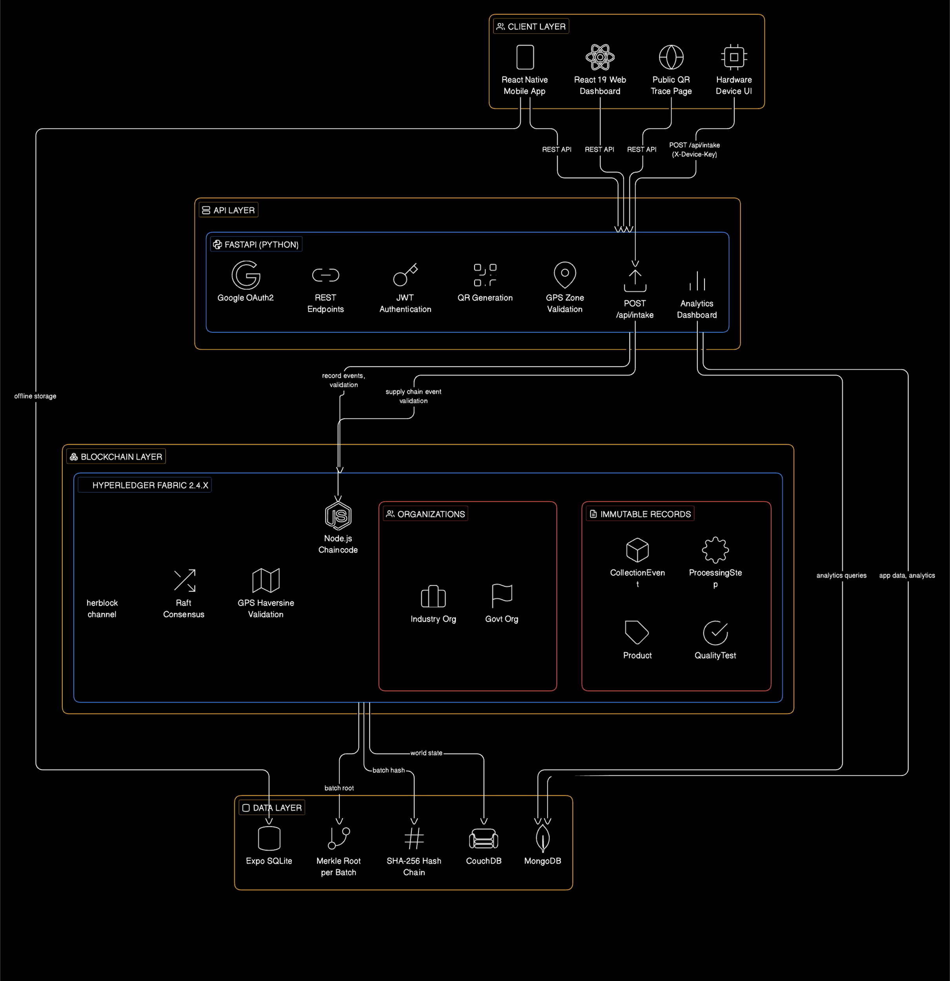

Slide 12
Business Model & Industry Validation
🌿 HERB-VAULT | CMTI DIC 2026 | REVA University
🏆 HIMALAYA DRUG COMPANY
Evaluated HERB-Vault and expressed commercial interest. Request: "Show us working hardware." — That is exactly what we are building at CMTI.
REVENUE MODEL
Device Sales
SaaS Dashboard
Per-TX Fee
Compliance Data
₹8,000–15,000 per unit
₹2,000–5,000 /month/org
₹2–5 per batch record
₹50K–2L/year
Hardware device sold to cooperatives / pharma cos
Web + API access for manufacturers
Blockchain write fee charged to processor
Harvest & audit reports for AYUSH/exporters
GO-TO-MARKET
WHY HERB-VAULT WINS
→ Phase 1 (Now): Pilot — 10 collectors, 1 herb zone, with Himalaya
★ Only blockchain + hardware integration targeting Ayurveda sector
→ Phase 2 (6 mo): 5 herb species, 3 processors, mobile app rollout
★ Patent applied — GPS on-chain method cannot be copied legally
★ Solves EU rejection root cause — verifiable audit trail from farm
→ Phase 3 (1 yr): License platform to Dabur, Patanjali, export labs
★ Consumer QR trust — credibility built by transparency, not branding
→ Phase 4 (2 yr): EU/US compliance module — capture export market
★ Himalaya validation — real commercial interest, not hypothetical
★ ₹50,000 Cr market + ₹15,000 Cr annual loss = proven, measurable need

Slide 13
Live Demo — What Judges Will See
🌿 HERB-VAULT | CMTI DIC 2026 | REVA University
STEP 1
STEP 2
STEP 3
STEP 4
STEP 5
STEP 6
STEP 7
STEP 8
Place herb sample on device platform
Sensors auto-capture readings
Collector selects grade A / B / C
ESP32 POSTs to /api/intake + Device Key
GPS validated ON blockchain (patent live)
OLED + LED feedback to collector
Dashboard updates in real time
Consumer scans QR on phone
→
→
→
→
→
→
→
Collector places a bag of herbs on the load cell
Weight: HX711 Moisture: sensor GPS: Neo-6M fix
Visual inspection Press grade button on the device
JSON: weight + moisture + GPS + grade sent
Haversine runs inside chaincode Not our server
ACCEPTED Grade: A Batch ID shown
New blockchain record appears Open the laptop
Full journey: farm → lab → shelf Trust verified
JUDGE Q&A — EXPECTED QUESTIONS & ANSWERS
Q: Isn't this already built?
Q: How is this different from a QR label?
A: The software architecture is ready — like a startup's platform before launch. The hardware device and its full firmware integration is being built live here at CMTI.
A: A QR label is a sticker. HERB-Vault is a cryptographic proof. The GPS, weight, grade and collector identity are on a tamper-proof blockchain — no one can change it.
Q: Can someone fake the GPS?
Q: Who will pay for this?
A: The GPS validation runs inside the Hyperledger Fabric smart contract — not our server. All network nodes enforce it simultaneously. This is the patent. It cannot be bypassed.
A: Himalaya Drug Company has already shown interest. They pay for supply chain certification today via paper — we replace that with a ₹2–5 per batch blockchain record.

Slide 14
🌿 HERB-VAULT
WHAT WE'RE BUILDING HERE
From Farm to Pharmacy — Trustless, Transparent, Traceable
★ ESP32-S3 firmware
PATENT APPLIED
HIMALAYA INTEREST
₹15,000 Cr ANNUAL LOSS
★ HX711 weight calibration
GPS On-Chain Validation Indian Patent Office
Commercial interest expressed Awaiting hardware demo
To fraud & rejections We solve the root cause
★ Moisture sensor reading
★ Neo-6M GPS integration
★ A/B/C grade button logic
The Ayurvedic herb supply chain loses ₹15,000 Cr annually because there is no verifiable record at point of collection. HERB-Vault is the only solution that enforces authenticity with patented on-chain GPS validation — backed by hardware.
★ OLED display output
★ Full API connection
★ End-to-end demo loop
Software Architecture: READY | Patent: APPLIED | Industry: INTERESTED
github.com/Pranav-error/SIH-blockchain | REVA University | CMTI DIC 2026

Slide 15
System Architecture — Complete Data Flow
🌿 HERB-VAULT | CMTI DIC 2026 | REVA University
① FIELD DEVICE (ESP32-S3)
② BACKEND (FastAPI + MongoDB)
③ HYPERLEDGER FABRIC
⚖️
Weight sensor (HX711 + load cell)
🔑
Validate Device API Key → db.devices
⛓️
Channel: herblock
💧
Moisture % (capacitive sensor)
📍
GPS Geo-Fence (Haversine) ★ PATENT ★
🏛️
Org1MSP — Government node
★ PATENT APPLIED ★
📍
GPS coordinates (Neo-6M module)
POST /api/intake + X-Device-Key
📅
Harvest Season (NMPB calendar)
peer chaincode invoke (CLI)
🏭
Org2MSP — Industry node
▶
▶
🅰
Collector presses Grade A / B / C
✅
Compute Grade from collector input
✍️
Both orgs must endorse TX (consensus)
🆔
Generate Batch ID ASH-A-YYYYMMDD-XXXX
📜
Chaincode: recordCollection (Node.js)
🔑
Device authenticates with API Key
💾
Store event in MongoDB (collection_events)
📍
GPS Haversine runs INSIDE chaincode
📟
OLED: ACCEPTED / REJECTED + Batch ID
🔗
Invoke Fabric chaincode (recordCollection)
🔒
SHA-256 hash → immutable record
🟢🔴
Green LED (accept) | Red LED (reject)
📱
Generate QR code (base64 PNG)
🌍
Raft ordering | CouchDB world state
▼
batch_id + QR code
Field / Hardware
Backend / API
Blockchain
▼
Consumer Layer
④ WEB / MOBILE APP
⑤ DATA STORE (MongoDB)
⑥ CONSUMER TRUST
→ React 19 web + React Native mobile
GET /api/trace /{batch_id}
collection_events
Raw intake: weight, GPS, grade, hash
QR scan result
✓ Batch ID → collection GPS verified
→ Consumer scans QR code with phone
◀
processing_steps
Processing stages from mobile app
◀
✓ Collector ID + Grade (A/B/C) visible
→ GET /api/trace/{batch_id} → backend
quality_tests
Lab test results (QA mobile screen)
✓ Processing plant + date stamp
→ Full journey: Farm → Lab → Shelf
products
Final product + QR code link
✓ Lab quality test results on-chain
→ Displays GPS map + grade + lab results
blockchain_txns
Fabric TX id + block number log
✓ Zero trust required — blockchain proof

