Slide 1

SMART INDIA HACKATHON 2026
TITLE PAGE
Problem Statement ID – SIH26231
Problem Statement Title – Digital Companion for Field Drug Testing
Theme – MedTech / BioTech / HealthTech
PS Category – Software
Team ID – «TEAM ID»
Team Name – «TEAM NAME as registered on the portal»

Slide 2
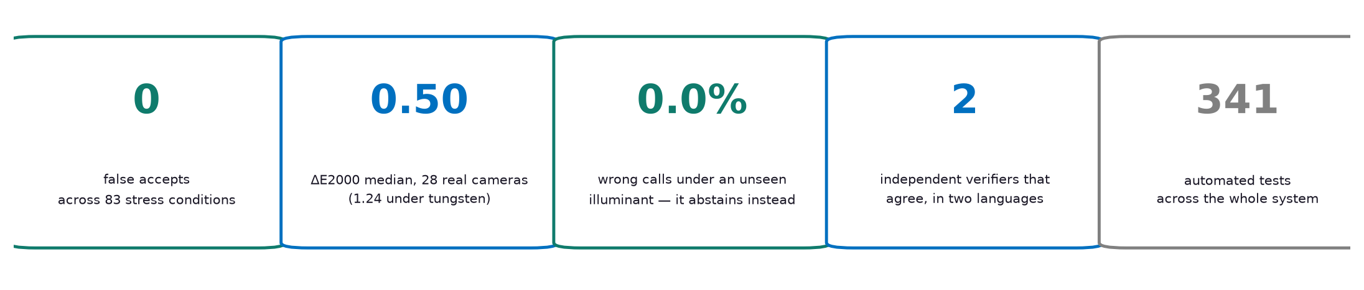
THE RECORD IS THE PRODUCT
«TEAM NAME as registered on the portal»
not the colour reading — that part is an undergraduate exercise
THE PROBLEM IS NOT THE COLOUR. The problem statement says it plainly: a field test "leaves no verifiable record… outcomes cannot presently be relied upon as documentary evidence." Reading a colour is an undergraduate exercise — and the naive app already ships commercially (DetectaChem MobileDetect).
OUR SOLUTION. The measurement is bound, at the instant of capture, into a hardware-attested, append-only record that anyone can re-derive offline — and that emits a Bharatiya Sakshya Adhiniyam Section 63 certificate and hands off to eSakshya / CCTNS-2.0.
WHAT IS ACTUALLY NEW:
  Kit-agnostic — reagent is declared, not read from a vendor's serialised pouch, as the PS requires
  "Inconclusive" carries a stated error bound (conformal prediction), not a softmax confidence a court cannot cross-examine
  Two independently written verifiers that agree — a single implementation agreeing with itself proves nothing
  The statutory certificate is emitted, not left as an exercise
No new hardware: a printed colour card and the phone already issued.

Slide 3
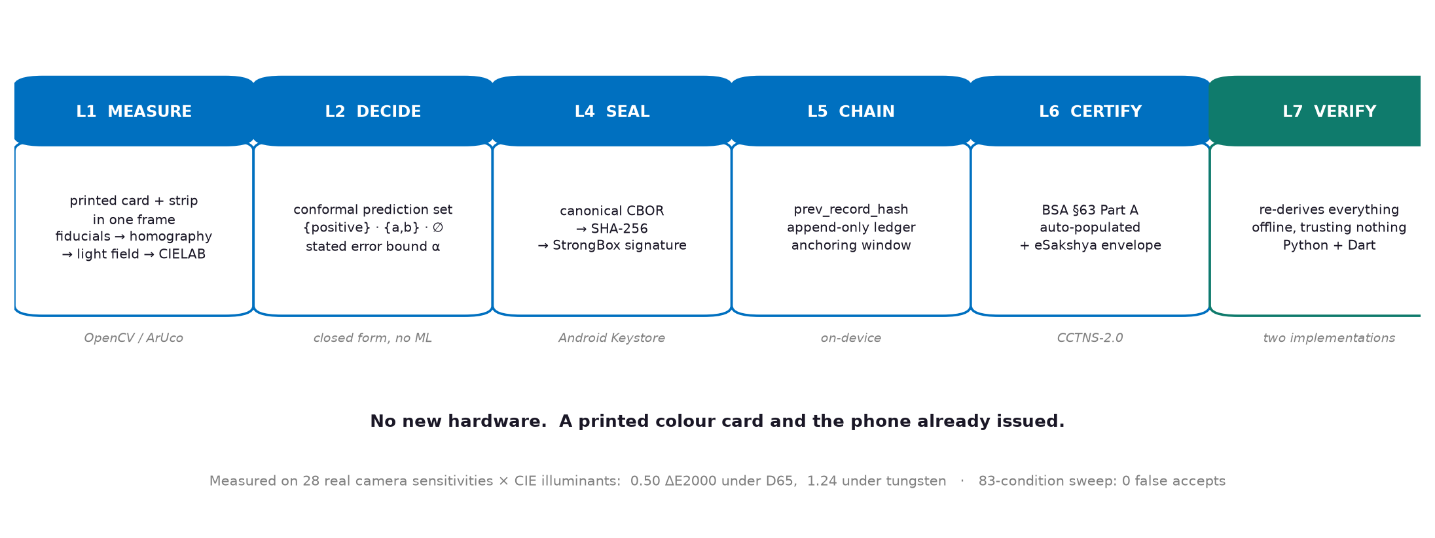
TECHNICAL APPROACH
«TEAM NAME as registered on the portal»
Flutter (Android) · OpenCV/ArUco · CIELAB + CIEDE2000 · conformal prediction · canonical CBOR + SHA-256 · ECDSA P-256 in StrongBox/TEE · verifiers in Python and Dart
WHY DETERMINISTIC, NOT A NEURAL NETWORK: a least-squares colour transform is auditable and defensible in court. We ablated a learned classifier against it on 8,064 measurements rendered from 28 measured camera sensitivities — the closed-form score won on every split, so there is no learned component and no TFLite dependency.

Slide 4
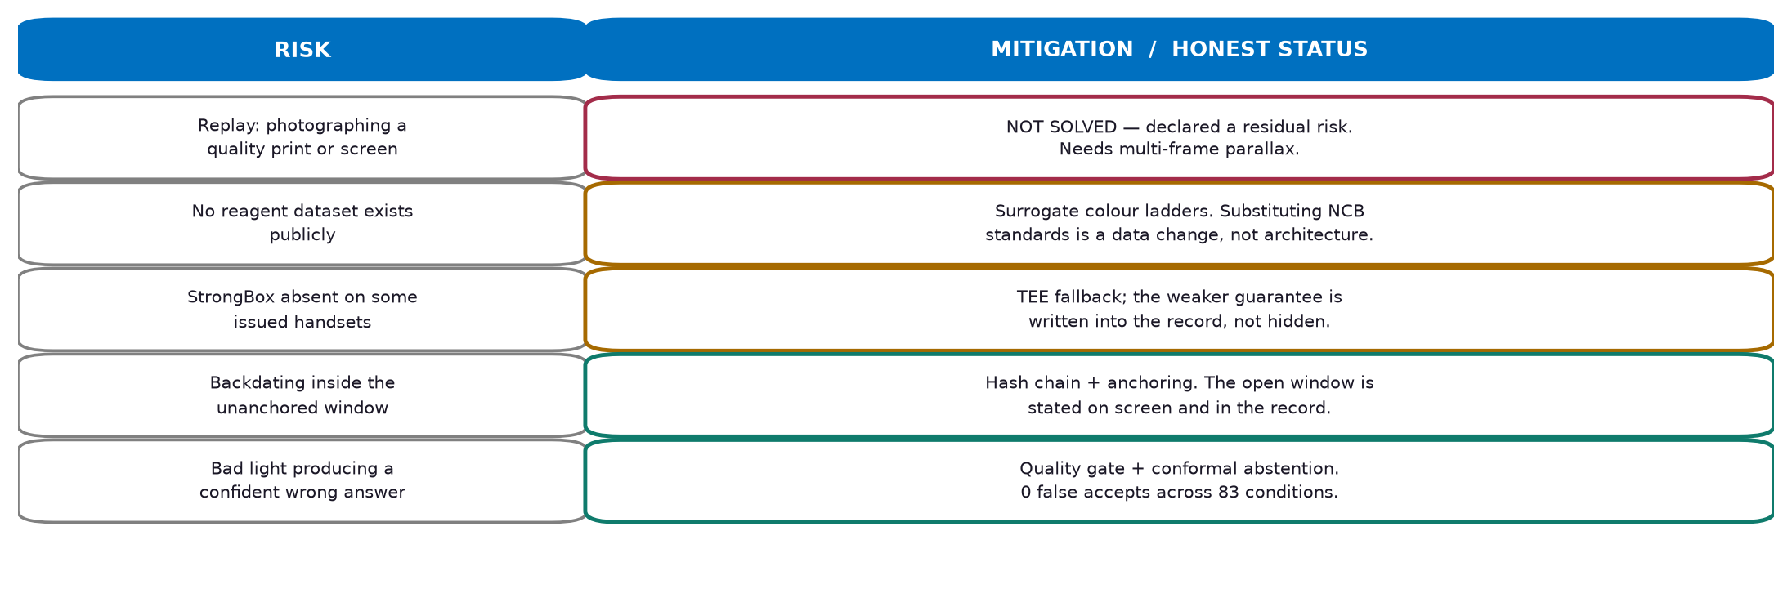
FEASIBILITY AND VIABILITY
«TEAM NAME as registered on the portal»
FEASIBLE TODAY: no new hardware, works with kits already purchased, runs fully offline, and a working core already exists — 341 automated tests, both verifiers agreeing on every record.
We list the attack we have NOT solved. A threat model that overstates its defences is worth less than none — a judge who finds the gap first concludes we never looked.

Slide 5
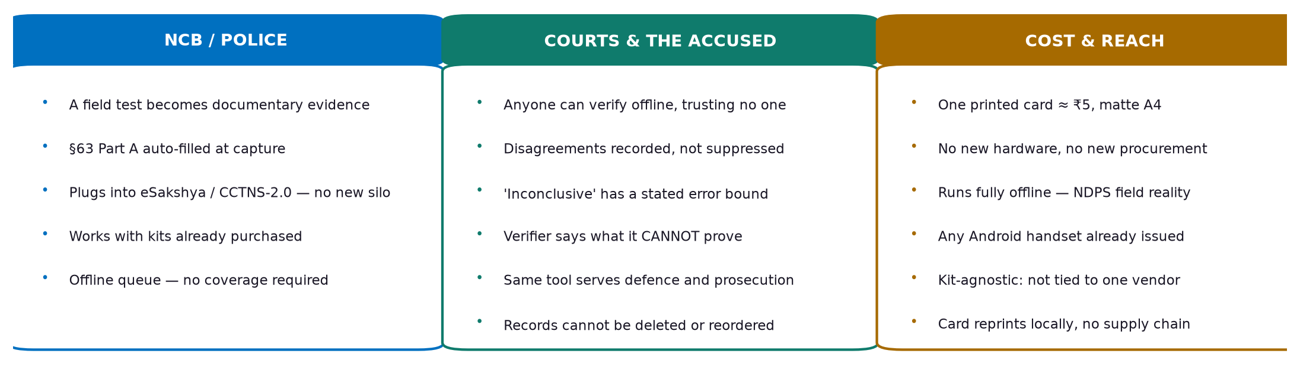
IMPACT AND BENEFITS
«TEAM NAME as registered on the portal»
Turns a presumptive field test from an unusable note into an artefact a court can test — without building a second evidence store for the State to maintain.
Deliberately NOT built: a confirmatory test, a national database of results, or any scoring of persons. CCTNS-2.0 stays the system of record; a parallel silo would add a surveillance surface and a liability for no benefit.

Slide 6
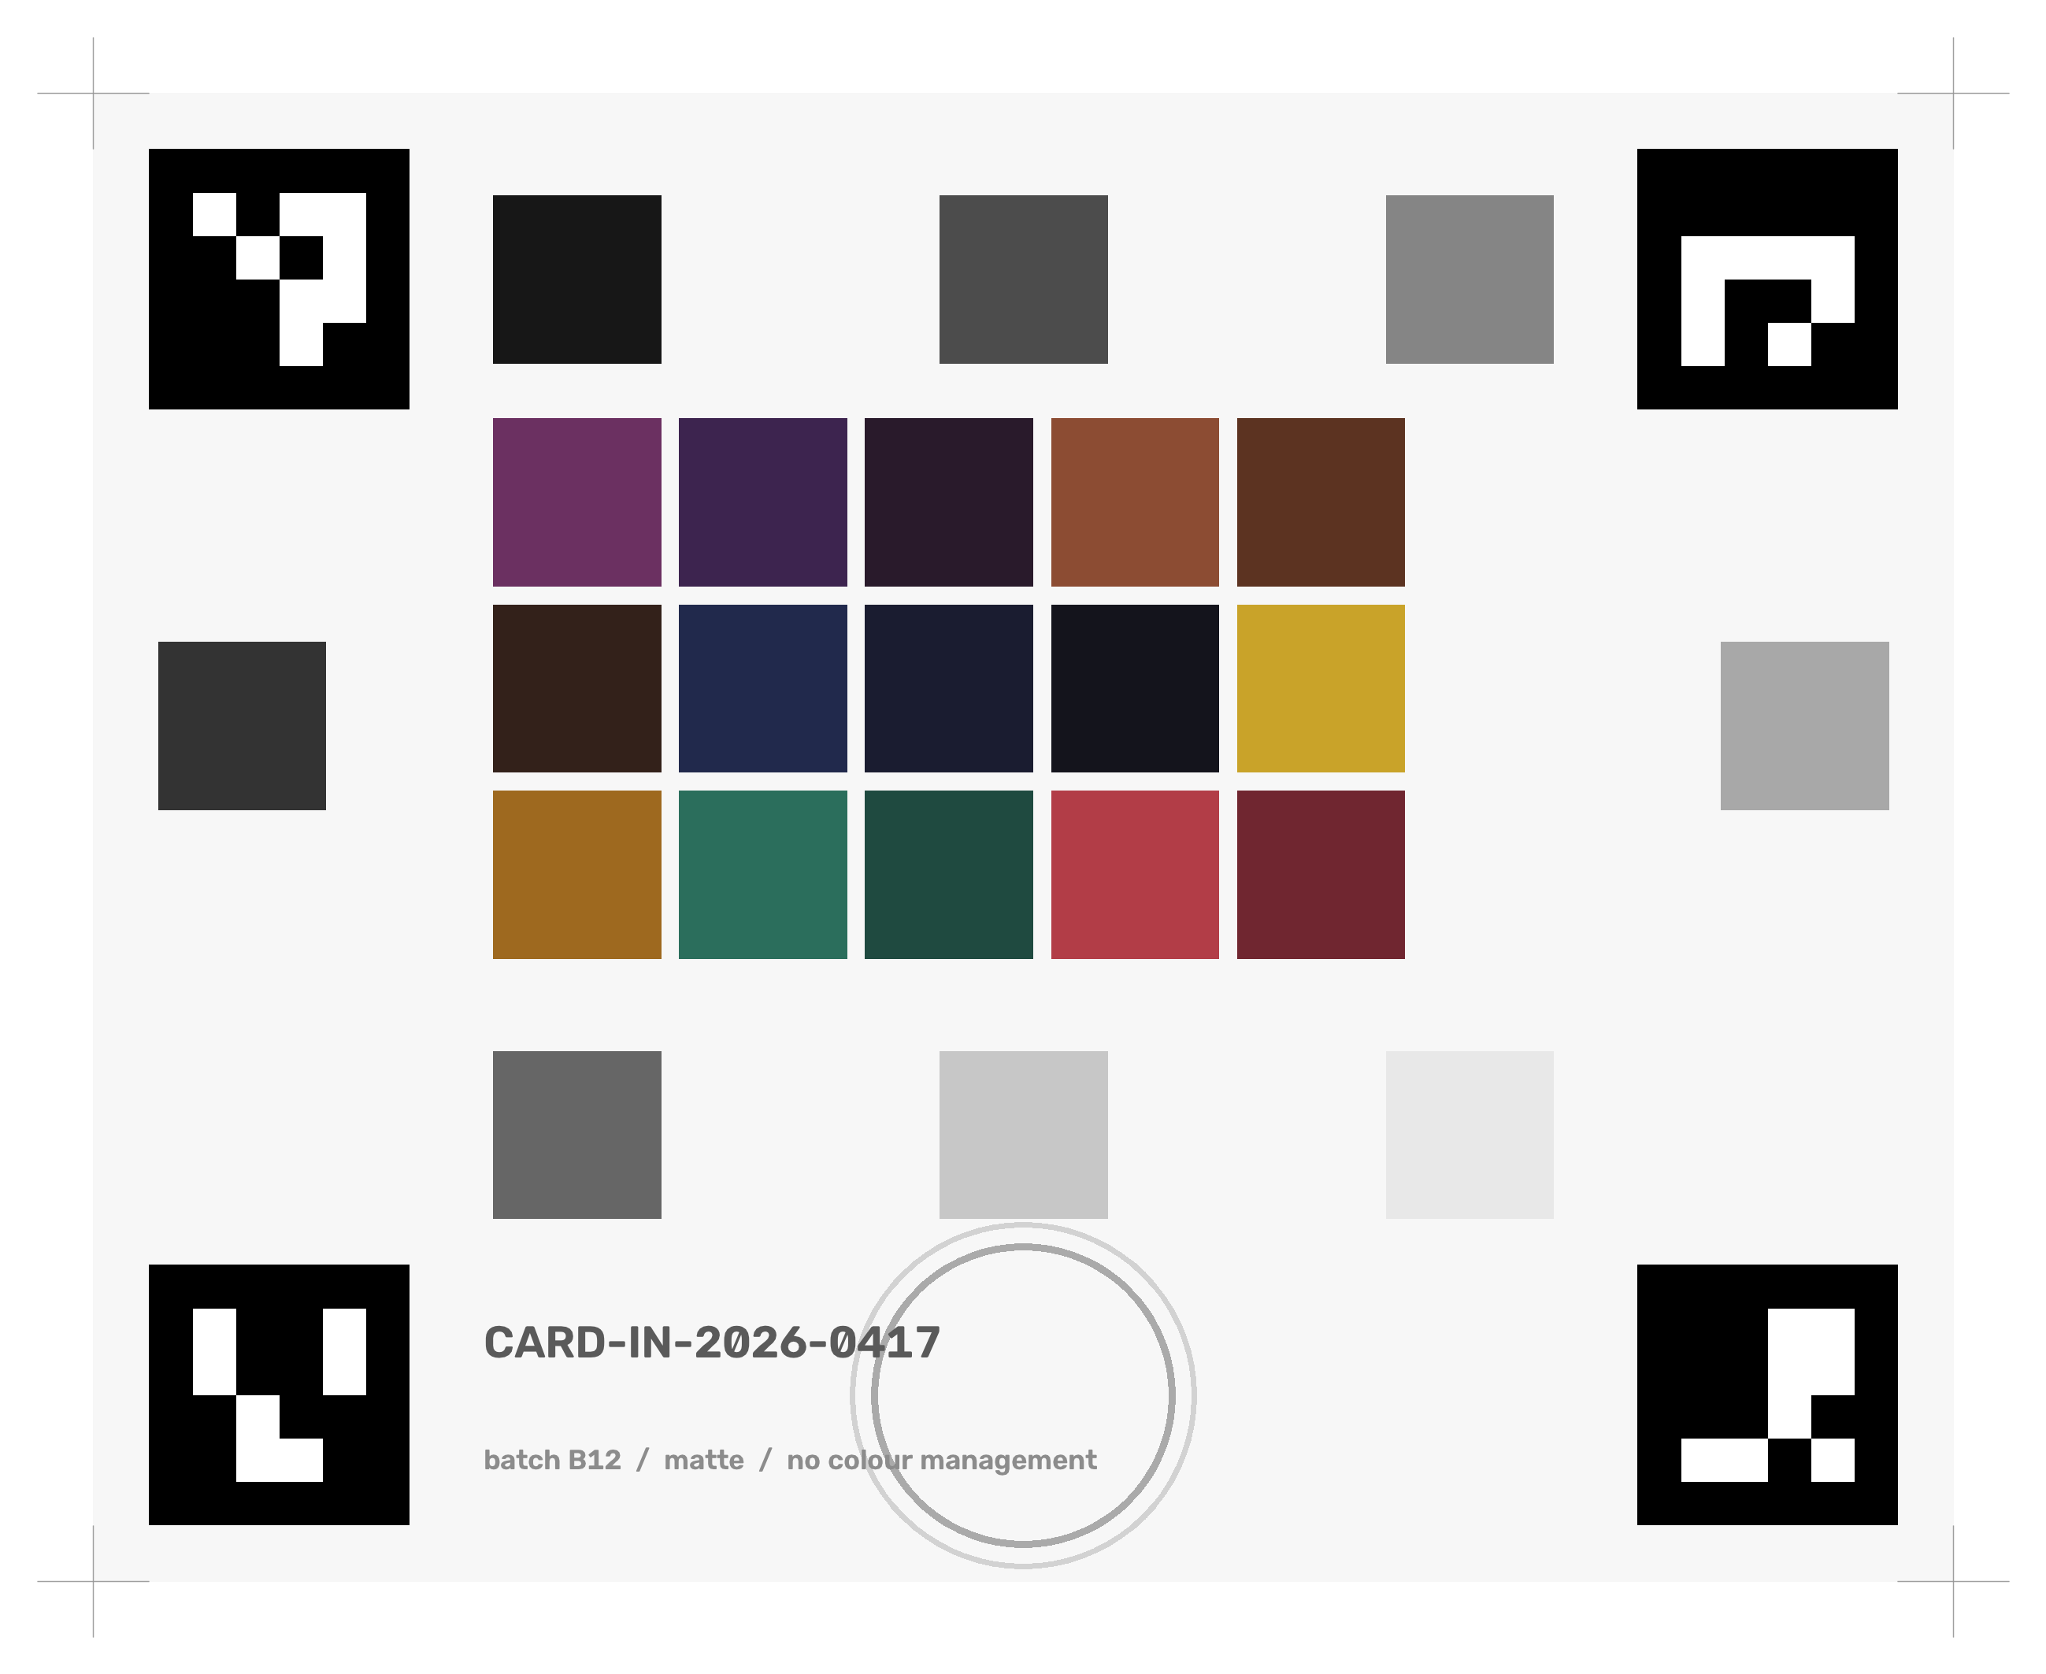
RESEARCH AND REFERENCES
«TEAM NAME as registered on the portal»
STATUTE & GOVERNMENT SYSTEMS
  Bharatiya Sakshya Adhiniyam 2023, Section 63 + the Schedule (certificate, Parts A and B; hash value and algorithm required) · indiankanoon.org/doc/125020475
  NDPS (Seizure, Storage, Sampling and Disposal) Rules 2022 — GSR 899(E) · eSakshya, NCRB / CCTNS-2.0 · informatics.nic.in
PRIOR ART — CONCEDED, NOT IGNORED
  DetectaChem MobileDetect: smartphone + colorimetric pouches, GPS-tagged PDF reports. The naive solution is a shipping product; our claim is narrower and sits in the binding, the abstention bound and the verifiability.
METHOD
  Finlayson et al., root-polynomial colour correction (exposure-invariant) · Sharma, Wu & Dalal (2005), CIEDE2000 conformance data · Vovk et al., conformal prediction · Android key attestation & StrongBox (AOSP)
MEASURED DATA USED IN OUR EVALUATION
  Jiang, Liu, Gu & Süsstrunk (2013) camera spectral sensitivity database, 28 cameras — Zenodo 3245883, CC BY-NC-SA 4.0 · CIE illuminant SPDs, 1931 observer and ColorChecker reflectances via colour-science (BSD-3)
STATED LIMITATION
  No public dataset of colorimetric drug-test images exists, and no spectral library of NDPS reagent developments. Our classifier is calibrated on surrogate colour targets. Substituting NCB reagent standards is a DATA change, not an architecture change: L1 and L3–L7 are substance-independent by construction.
The only physical artefact: a matte A4 print — fiducials, 15 reagent-gamut patches, 8 neutrals, reaction well.
REPRODUCIBILITY
Working code, 341 automated tests, and every figure on these slides regenerable from one command.
Every number here is measured on synthetic frames or measured spectral data — none is a field accuracy. The physical capture set is the critical path, and we say so.

