Slide 1

Predictive Shipment Delay Analytics
for Logistics Decision Support
DA3 Completion and Presentation
BCSE402L Big Data Analytics | 20 October 2026
Pranav Satish Khadse 23BLC1237 • Rishi Jain 23BLC1242
Anmol Kapil 23BLC1229 • Abhinav Kumar Singh 23BLC1209
Notes:
Introduce the final end-to-end application and team. Explain that all figures use the latest order-level pipeline, not the earlier DA-2 item-row population. The PDF supplies the academic cover format and team details.

Slide 2
Problem and completed scope
Estimate late-delivery risk when an order is placed, explain the warning and support an operator’s next review.
Completed application
Integrated demonstration
Real PySpark preparation and Spark SQL
Chronological LR and RF comparison
Order-time prediction with genuine SHAP
Predefined operator recommendations
Filterable dashboard and delay heatmap
On-demand Groq operator summary
Direct SQL and natural-language SQL
35 backend tests and browser checks
Final target: 1 when actual days exceed scheduled days; otherwise 0.
BCSE402L Big Data Analytics | DA3 | 20 October 2026
02
Notes:
Why DataCo? It is already integrated and supports the promised-time lateness label. Completion was prioritised over an unvalidated dataset migration. The objective is order-time late-delivery risk conditional on shipment proceeding, not fraud or cancellation. Explain the distinction between analytics of completed orders and prediction of future outcomes.
Evidence: current local implementation and saved API responses on 20 October 2026; branch feature/shipment-analytics-enhancements. PDF reference used for visual format and submitted team details only.

Slide 3
Complete project architecture
DataCo CSV
PySpark data pipeline
Spark SQL view
Local OR Docker HDFS
NameNode + DataNode
Validate items and whole orders
62,897 eligible order proxies
Cached shipments view
Aggregates and heatmap
Joblib artifact
scikit-learn LR / RF
FastAPI service
Pipeline + UUID + fingerprint
Threshold + metrics + SHAP
Bounded chronological extraction
Tree SHAP + action rules
State and Spark locks
Predict, explain, analytics, SQL
React and Vite dashboard
Optional Groq API
Filters, heatmap, evaluation, order form, SHAP, recommendations and SQL
Requested summary / candidate SQL
Validated server-side
Spark processing is distributed-capable; model training runs on the Python driver.
BCSE402L Big Data Analytics | DA3 | 20 October 2026
03
Notes:
Walk through every boundary. HDFS or a local file supplies Spark; there is no silent storage fallback. Spark performs distributed preparation and SQL. Only bounded allowlisted rows reach Pandas and scikit-learn. The fitted model and SHAP cache are versioned together. FastAPI owns locking and validates all generated SQL. Optional Groq has no authority to invent predictions or query results. This demonstration is local and single-DataNode; do not claim multi-node performance.
Evidence: current local implementation and saved API responses on 20 October 2026; branch feature/shipment-analytics-enhancements. PDF reference used for visual format and submitted team details only.

Slide 4
Processed dataset and analytical grain
Processing stage | Count
Raw item rows | 181,169
Exact duplicates removed | 650
Distinct orders | 65,752
Excluded non-transit orders | 2,855
Eligible order proxies | 62,897
57.31% delayed
42.69% on time or early
Item-level duplicates are removed before whole-order validation and aggregation.
BCSE402L Big Data Analytics | DA3 | 20 October 2026
04
Notes:
Why not 181,169 shipments? These are item rows; an order can contain several items. There is no physical shipment ID, so one eligible order is a declared proxy. Canceled shipping, canceled orders and suspected fraud are removed from completed-transit denominators. Missing dimensions use a consistent value from the same order or Unknown. The label is checked against actual > scheduled; zero target-mismatch orders remain.
Evidence: current local implementation and saved API responses on 20 October 2026; branch feature/shipment-analytics-enhancements. PDF reference used for visual format and submitted team details only.

Slide 5
Time-aware modelling and leakage control
Development population
Separate explanation block
Final test
50,266 earlier orders
Two expanding validation folds
7,540 orders excluded from fitting
Global SHAP sample: 96
12,631 later orders
No test-based selection
Feature choice | Validation evidence and decision
Order-time inputs | Schedule, basket, calendar, market, region, segment and payment
Cyclical weekday/month | Forest AUC 0.73969; rejected versus numeric 0.73993
Basket ratios | Forest AUC 0.74048; gain below required 0.002
Model configuration | 200 trees; depth 16; minimum leaf 5; threshold 0.50
Actual shipping duration and delivery status are labels/analytics inputs only.
BCSE402L Big Data Analytics | DA3 | 20 October 2026
05
Notes:
Describe both expanding folds: train 22,619 then validate 10,053; train 32,672 then validate 10,054. The latest 15% of development is reserved for explanation. Final fit is 42,726 orders; test is 12,631. The model is standard RandomForestClassifier, with preprocessing and selection customised for the task. Compare features only on the same validation population. No actual duration, delivery status or post-outcome field enters the feature matrix. Historical holdout results were seen in earlier versions, so fresh confirmation needs new orders.
Evidence: current local implementation and saved API responses on 20 October 2026; branch feature/shipment-analytics-enhancements. PDF reference used for visual format and submitted team details only.

Slide 6
Model comparison and final evaluation
Model on validation | Mean ROC-AUC | Accuracy at 0.50
Logistic Regression | 0.70520 | 69.25%
Random Forest selected | 0.73993 | 68.96%
Final chronological test n = 12,631
Actual / predicted | On time | Delayed
On time | 4,294 | 1,073
Delayed | 2,784 | 4,480
ROC-AUC 0.74816
Accuracy 69.46%
Precision 80.68%
Recall 61.67%
F1 69.91%
Test majority-class accuracy: 57.51%. Missed delays remain a material limitation.
BCSE402L Big Data Analytics | DA3 | 20 October 2026
06
Notes:
Mean validation AUC selects the forest, not thresholded accuracy. LR has mean validation AUC .70520, RF .73993; both use the same forward-validation orders. The later test metrics belong only to the selected forest. Explain counts: 4,294 true on-time, 1,073 false alarms, 2,784 missed delays, 4,480 detected delays. Precision is 4,480/5,553; recall is 4,480/7,264. More AUC does not guarantee more accuracy. Do not claim major improvement versus the DA-2 numbers because populations and splitting differ.
Evidence: current local implementation and saved API responses on 20 October 2026; branch feature/shipment-analytics-enhancements. PDF reference used for visual format and submitted team details only.

Slide 7
Delay heatmap by region and shipping mode
Region | First Class | Same Day | Second Class | Standard Class | Unknown
Western Europe | 100.00% n = 1,513 | 50.00% n = 498 | 80.75% n = 1,870 | 40.64% n = 5,665 | 66.67% n = 6
Central America | 100.00% n = 1,382 | 49.89% n = 467 | 78.81% n = 1,746 | 40.02% n = 5,397 | 0.00% n = 1
South America | 100.00% n = 724 | 50.99% n = 253 | 79.31% n = 899 | 39.51% n = 2,860 | —
Oceania | 100.00% n = 566 | 47.53% n = 263 | 79.15% n = 849 | 40.74% n = 2,489 | 50.00% n = 4
Southeast Asia | 100.00% n = 650 | 44.90% n = 196 | 80.10% n = 809 | 41.12% n = 2,512 | 0.00% n = 3
Northern Europe | 100.00% n = 528 | 41.00% n = 200 | 79.30% n = 686 | 39.07% n = 2,145 | 66.67% n = 3
Six largest regional populations shown. Darker = higher delay rate; n = eligible orders.
BCSE402L Big Data Analytics | DA3 | 20 October 2026
07
Notes:
The slide shows the six regions with the largest eligible populations, chosen by order count rather than delay rate. The report and website contain the full matrix. The native table is editable. Each cell is delayed orders / eligible orders for that region and mode, not model probability. Color is only a redundant cue because the numeric rate and n are printed. Filters affect the website matrix. Small samples do not establish strong regional evidence.
Evidence: current local implementation and saved API responses on 20 October 2026; branch feature/shipment-analytics-enhancements. PDF reference used for visual format and submitted team details only.

Slide 8
Global SHAP explains the fitted forest
Real fitted pipeline
32 reference orders
96 validation explanations
8 original feature groups
No final-test orders
No causal claims
No static importance data
Mean absolute grouped SHAP is in probability units. Schedule has the strongest attribution.
BCSE402L Big Data Analytics | DA3 | 20 October 2026
08
Notes:
Tree SHAP uses interventional probability output, 32 deterministic training-reference observations and 96 dedicated explanation-validation observations. Mean absolute SHAP measures average model output magnitude, not AUC gain. Categorical output contributions are summed back to original groups. Standard deviation in the API is across observations, not repeat uncertainty. Correlated features share attribution; SHAP is not causal. A separate permutation ROC-AUC diagnostic remains available. Source: https://shap.readthedocs.io/en/latest/generated/shap.TreeExplainer.html
Evidence: current local implementation and saved API responses on 20 October 2026; branch feature/shipment-analytics-enhancements. PDF reference used for visual format and submitted team details only.

Slide 9
Individual prediction and operator recommendations
89.69% modeled delay probability
Predefined review actions
Check dispatch readiness
Review fulfilment capacity
Review the destination route
Reference probability 55.02%; class delayed at threshold 0.50.
Signed SHAP explains this prediction. Suggested actions are not proven risk reductions.
BCSE402L Big Data Analytics | DA3 | 20 October 2026
09
Notes:
Demonstration input: 15 Jan 2018 at 12:00, scheduled days 1, quantity 2, net sales 125.50, two item lines, Europe / Western Europe, Consumer, DEBIT. This is a submitted input, not an observed new outcome. Base 55.024% plus signed grouped contributions reconstructs the actual output. Explain that positive SHAP means higher model risk relative to baseline. The three actions are deterministic existing rules triggered by positive actionable groups and predicted delay. They do not estimate the causal benefit of intervention.
Evidence: current local implementation and saved API responses on 20 October 2026; branch feature/shipment-analytics-enhancements. PDF reference used for visual format and submitted team details only.

Slide 10
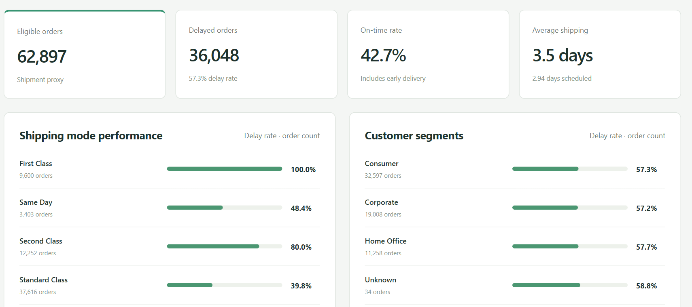
Integrated dashboard demonstration
Overview → Delay Analytics → Model Evaluation → Model Explainability → SQL Analytics
BCSE402L Big Data Analytics | DA3 | 20 October 2026
10
Notes:
Suggested demonstration sequence: Overview confirms eligible count; Delay Analytics shows region/mode heatmap and filters; Model Evaluation shows validation versus final test and predicts an order; Model Explainability shows cached global SHAP; SQL Analytics compares direct versus natural language. Data Quality displays exclusions and missing-value audit. Explain dataset-wide model metrics versus filtered historical analytics. Screenshot is actual current application, not a mockup.
Evidence: current local implementation and saved API responses on 20 October 2026; branch feature/shipment-analytics-enhancements. PDF reference used for visual format and submitted team details only.

Slide 11
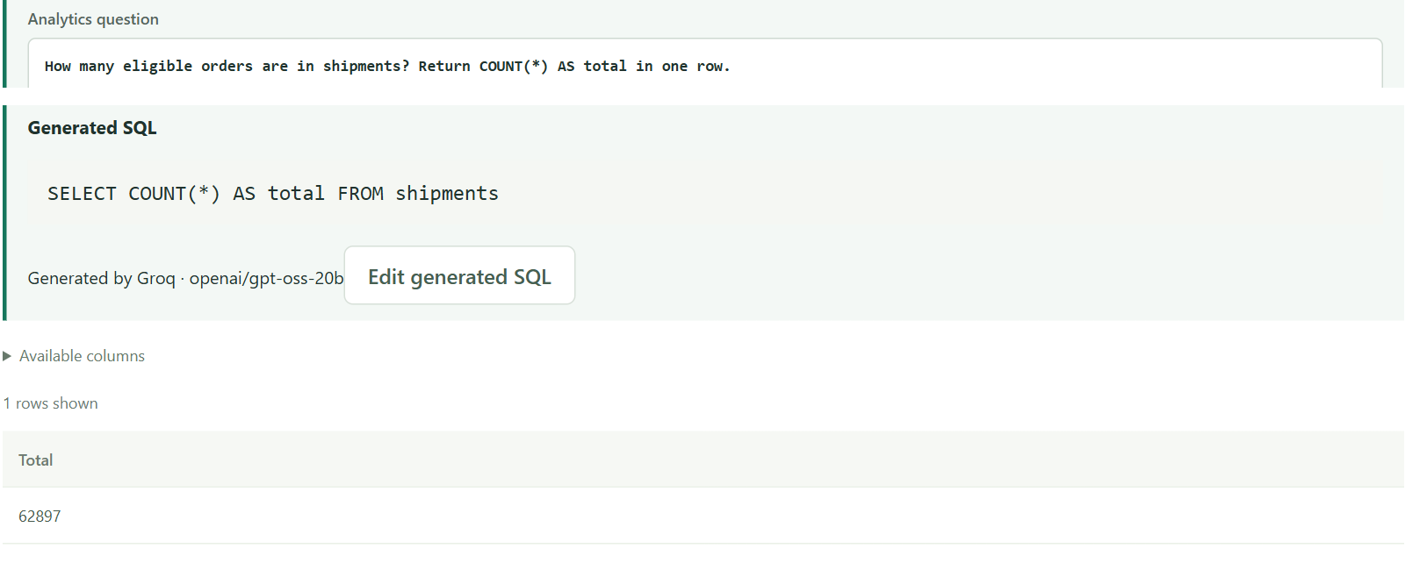
Groq assistance and validated Spark SQL
Operator summary
Requested explicitly
Grounded in prediction,
SHAP and predefined rules
API key stays on backend
Natural language → Groq SQL → validation → Spark execution → actual results
BCSE402L Big Data Analytics | DA3 | 20 October 2026
11
Notes:
The operator summary is generated only by a separate button after a prediction. The server recomputes model, SHAP and recommendation facts and rejects stale model identity. Natural language provides schema and categories to Groq; returned SQL must pass the same read-only guard as direct SQL before Spark executes it. Result 62,897 comes from Spark. No API keys reach the frontend. Groq failures leave local predictions and direct SQL functional. The configured model is openai/gpt-oss-20b. Source: https://console.groq.com/docs/openai
Evidence: current local implementation and saved API responses on 20 October 2026; branch feature/shipment-analytics-enhancements. PDF reference used for visual format and submitted team details only.

Slide 12
Conclusion and Q and A
Delivered
Evidence and limits
Real order-level Big Data pipeline
Integrated analytics and heatmap
Chronological model evaluation
Genuine SHAP and operator actions
Optional summaries and SQL assistance
35 backend tests and build passed
Live browser workflow verified
69.46% accuracy; 61.67% recall
Single-node demonstration
Fresh data needed for confirmation
Next: carrier and capacity signals, calibration assessment, cost-based thresholds and new forward evaluation.
BCSE402L Big Data Analytics | DA3 | 20 October 2026
12
Notes:
Q: Why is accuracy below 80%? A: Overlapping order-time features and unobserved operational factors limit discrimination; the report does not claim a formal ceiling. Q: Is schedule importance leakage? A: A known promise is legitimate input; actual duration/status is not. Q: Does SHAP recommend causal fixes? A: No; deterministic review rules use associations. Q: Is fitting distributed? A: Spark prepares data, scikit-learn fits a bounded driver sample. Q: What changed from DA-2? A: Order grain, chronology, fitted RF, genuine SHAP and an integrated app. Q: Are days 3/5/6/7 validated? A: They are accepted inputs with explicit coverage notices, not new training evidence. Q: What remains? A: Fresh forward evaluation, calibration, real capacity/carrier features, cost-based thresholds and production security/scaling. Q: Did HDFS run today? A: HDFS passed earlier; this revision reran local Spark, not the HDFS demo.
Evidence: current local implementation and saved API responses on 20 October 2026; branch feature/shipment-analytics-enhancements. PDF reference used for visual format and submitted team details only.

