Slide 1

NU Chronicles
INFO6150 20821 Web Design/User Experien Engr SEC 07 Fall 2022
Final Project

Slide 2
Team Members
Makarand Madhavi (NUID – 002747771)
Pranav Khismatrao (NUID – 002746375)
Bhavya Prakash (NUID – 002774235)
Deep Shah(NUID – 002766755)

Slide 3
Project Description
NU Chronicles is a one-stop solution for all new international students at Northeastern University.
It provides students with a list of the most cost-effective options for accommodation, grocery stores, seasonal shopping, and places to dine, among other things, that have been verified and approved by NU alumnus, so benefiting them while also protecting them.
Each option has been examined and rated by NU alumnus, making it the most reputable and accurate source of information for all incoming international NU students.

Slide 4







Tech Stack
Frontend
Backend

Slide 5
Roles
ADMIN
STUDENT
ALUMNI

Slide 6
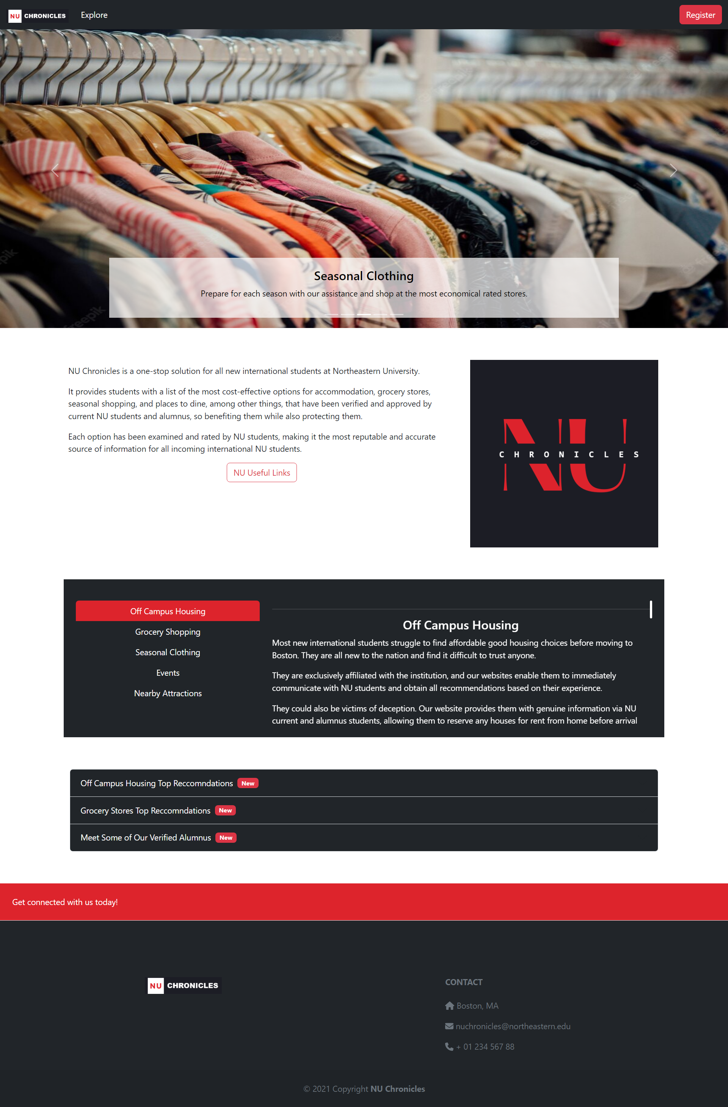
Home Page

Slide 7
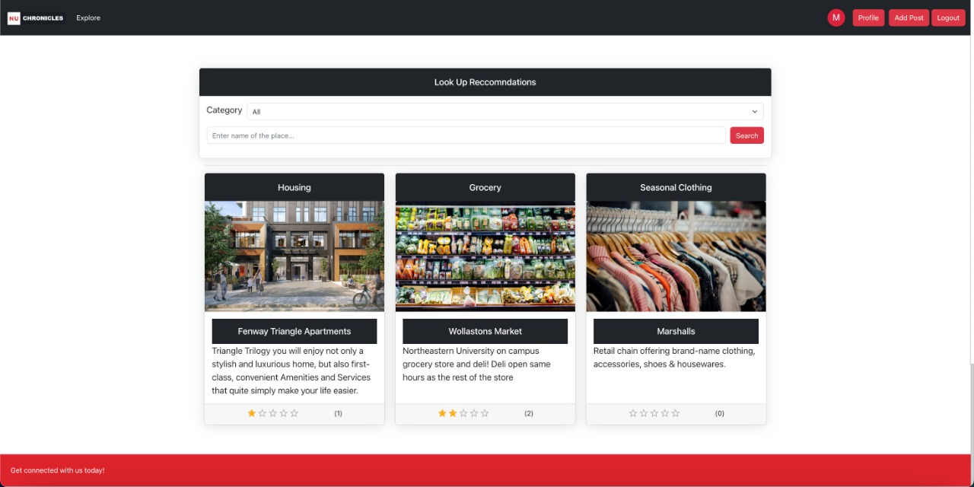
Explore page

Slide 8
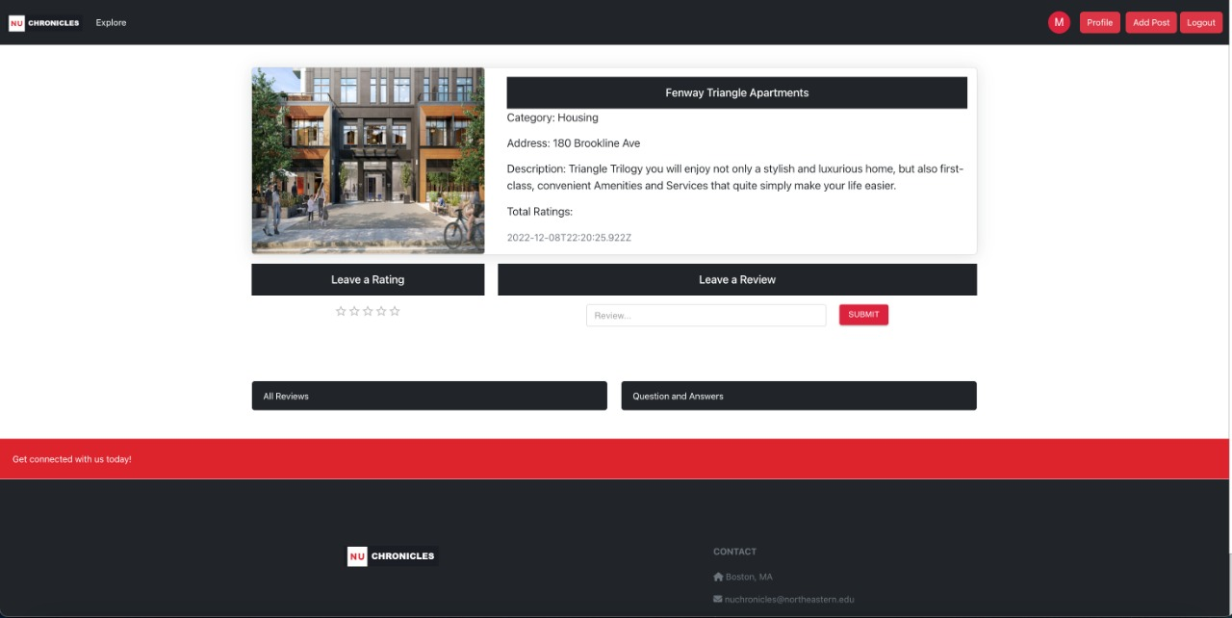
View post page

Slide 9
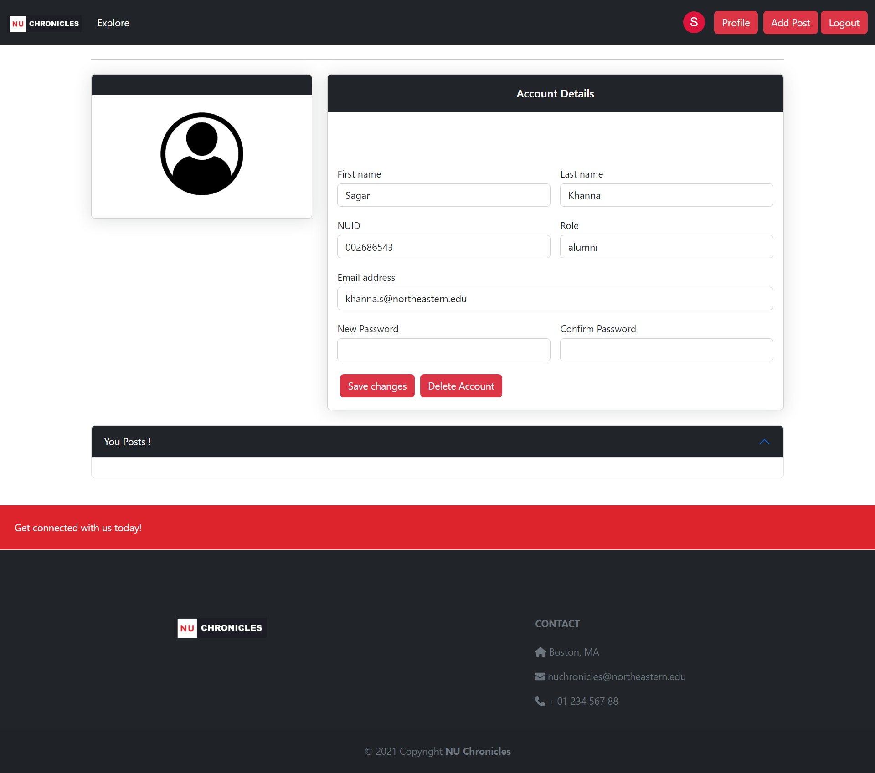
Profile page

Slide 10
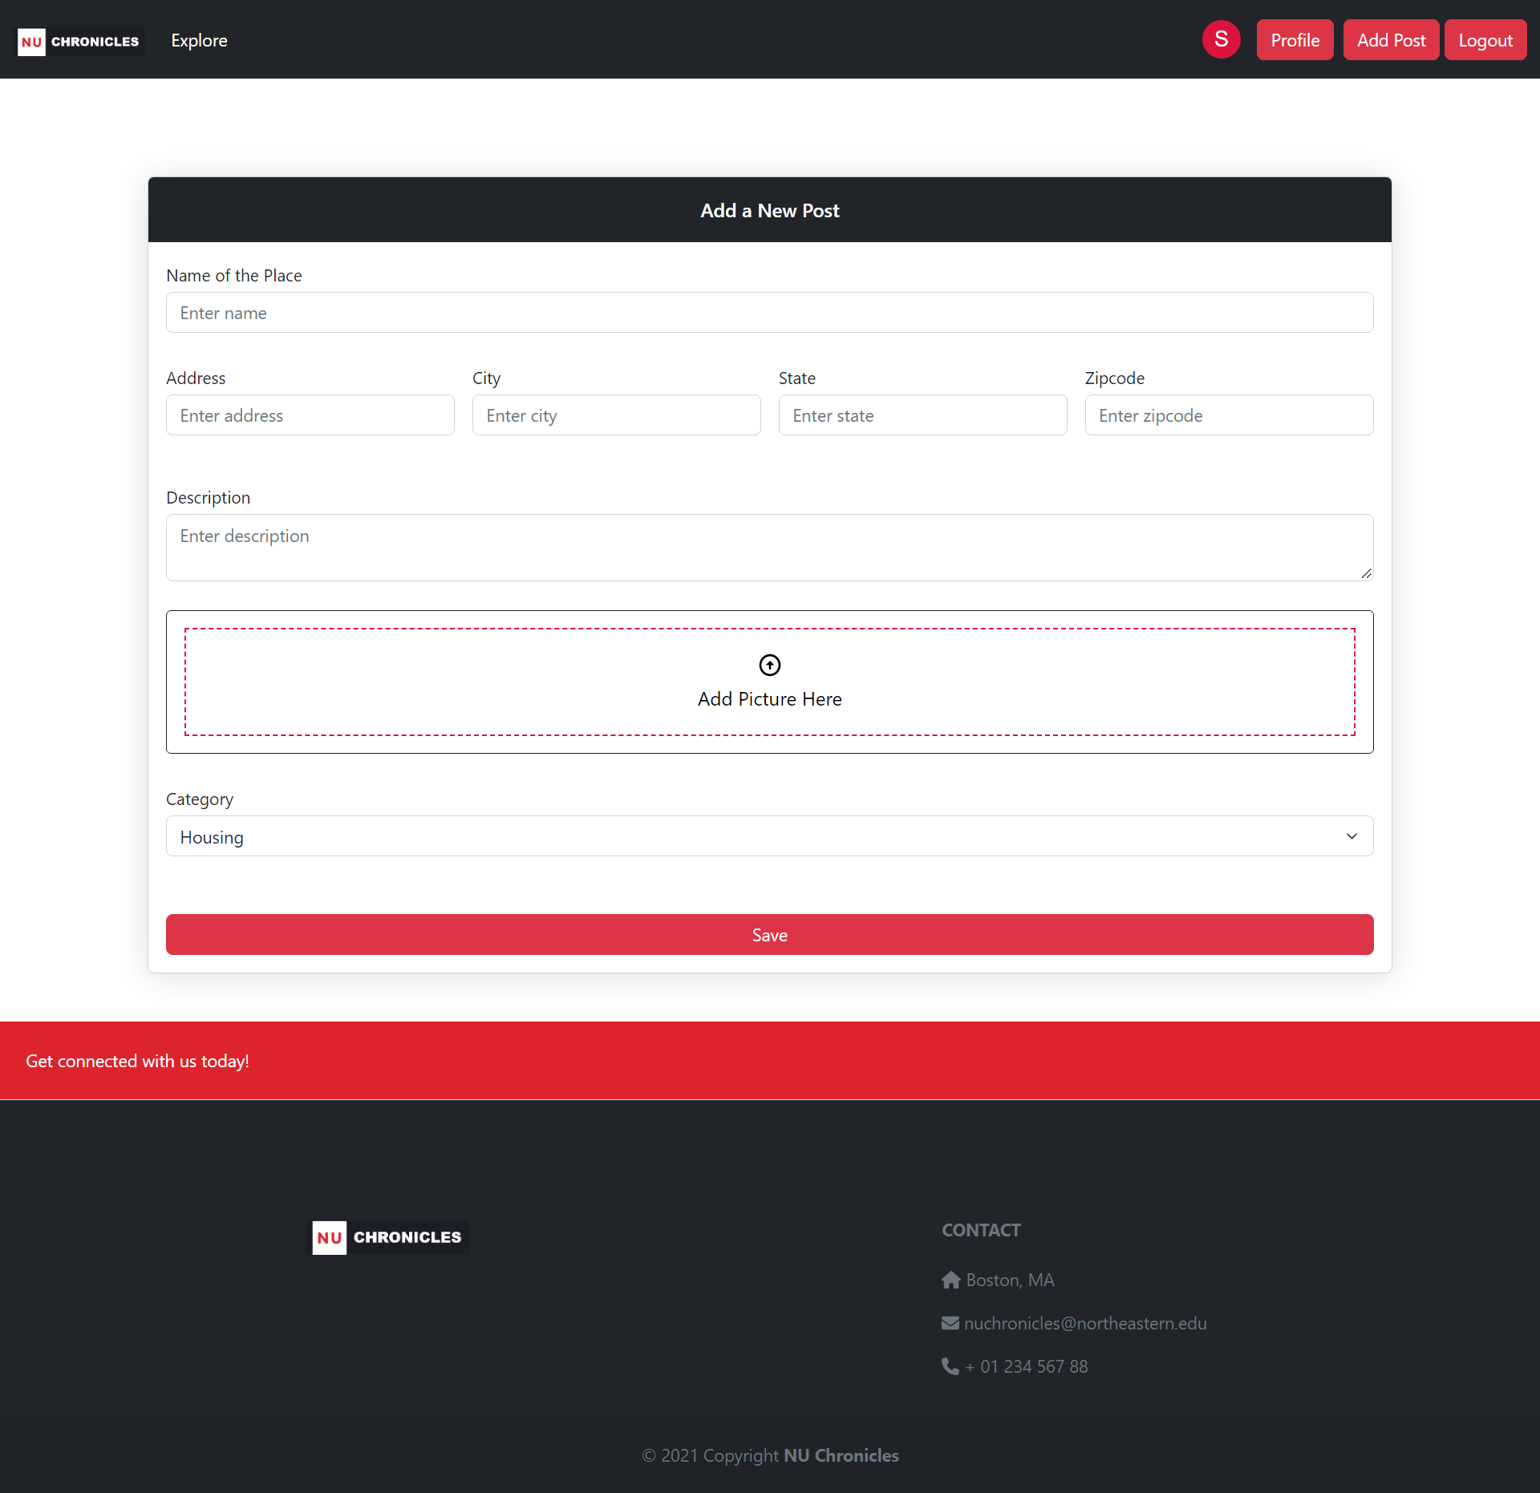
ADD Post page

Slide 11
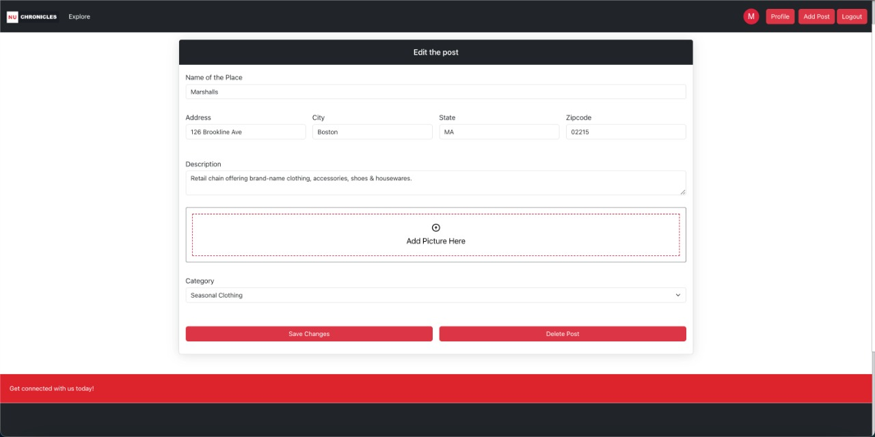
edit Post page

Slide 12
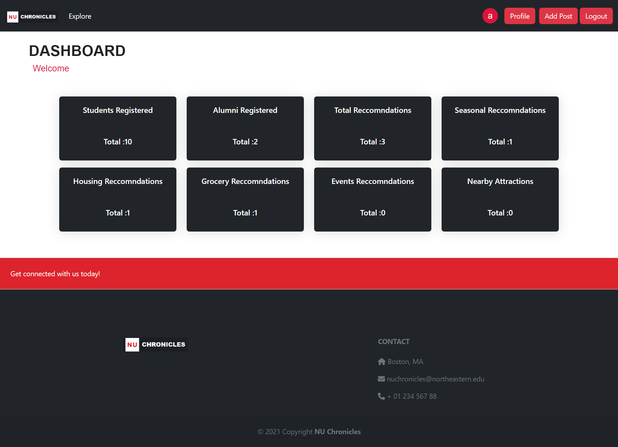
Admin dashboard page

