Slide 1


CampusRide
Shared cab coordination system for students
DBMS PROJECT
DATABASE SYSTEMS
Rachit Malik (25BCE5140) · Pranav Agarwal (25BCE5204) · Shayan Rustomji (25BCE5546)

Slide 2
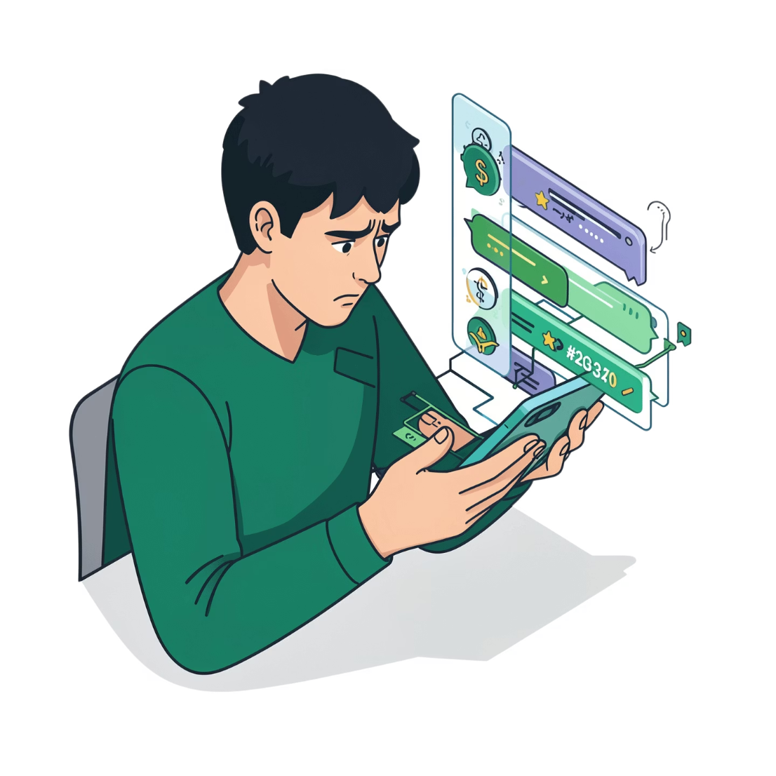

Problem Statement
Students often book cabs separately, even when others from the same campus are going the same way at the same time.
Informal methods like WhatsApp groups make it hard to:
Find similar routes
Match shared ride interest
Check seat availability
Coordinate timings
Verify ride details
Track past shared rides
How can we build a centralized, database-driven platform for route, time, availability, and preference-based ride sharing?

Slide 3

Why CampusRide?
Student-Focused
Built for students sharing cabs.
Centralized Info
Routes, timings, seats, cab details and riders in one place.
Better Coordination
Find students going the same way at the same time.
Flexible Booking
Book now or later through an external cab service.

Slide 4
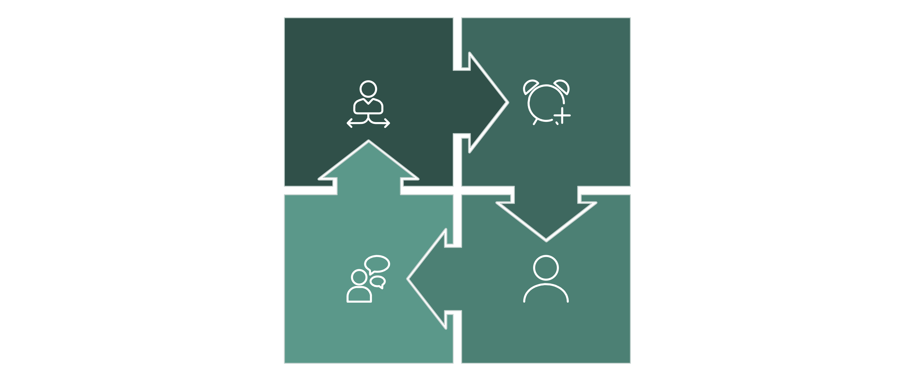
How Will It Work?
Choose Option
Create Ride
Coordinate
Join Ride
Database-powered updates keep rides current, consistent, and fully tracked.

Slide 5
Core Application Components
User
Create Ride
Join Ride
Ride Members
Students create profiles and join rides.
Enter journey, time, seats, and cab details.
Search rides with filters and join one.
Includes the creator and other students.
Cab Information
Ride History & Rating
Optional cab, fare, and booking details.
Review past rides and share feedback.

Slide 6
DBMS Concepts Used
Relational Model
Keys & Constraints
Data is stored in related tables like Users, Rides, and Ride Members.
Primary and foreign keys protect relationships and integrity.
Normalization
SQL / DML
Reduces redundancy where needed.
Used to create, update, delete, and retrieve data.
Joins & Aggregation
Transactions & Consistency
Combines ride data and summarizes results.
Keeps multi-step actions like joining a ride in sync.
These concepts align with Database Systems coursework.

Slide 7


Preliminary Database Design
Core Entities
User — student details
Ride — route, schedule, seats, preferences
RideMember — ride participation
Location — reusable pickup/dropoff points
CabInformation — cab and booking details
Rating — ride feedback
CabInformation
Ride
Key Relationships
User
RideMember
USER creates RIDE · USER joins RIDE via RIDE_MEMBER · RIDE links to LOCATION and CAB_INFORMATION · RIDE generates RATING
Location
Schema may evolve during implementation.

Slide 8


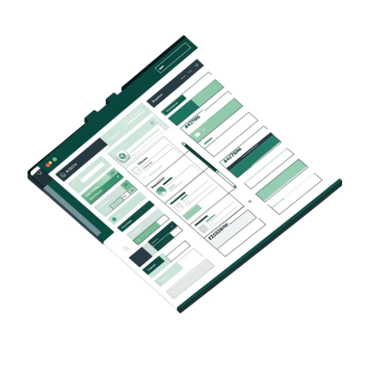
Work Distribution
Pranav Agarwal (25BCE5204)
Shayan Rustomji (25BCE5546)
Rachit Malik (25BCE5140)
Database & Data Design
Backend & Application Logic
Frontend & User Interface
Data requirements
Relational schema
Keys & constraints
MySQL setup
Sample data
SQL queries
Documentation
Backend setup
DB connectivity
API development
Ride logic
Validation
Business logic
UI/UX design
Create Ride screen
Join/Search screen
Ride details
Frontend integration
All Members: Testing · Integration · Documentation · Presentation

Slide 9
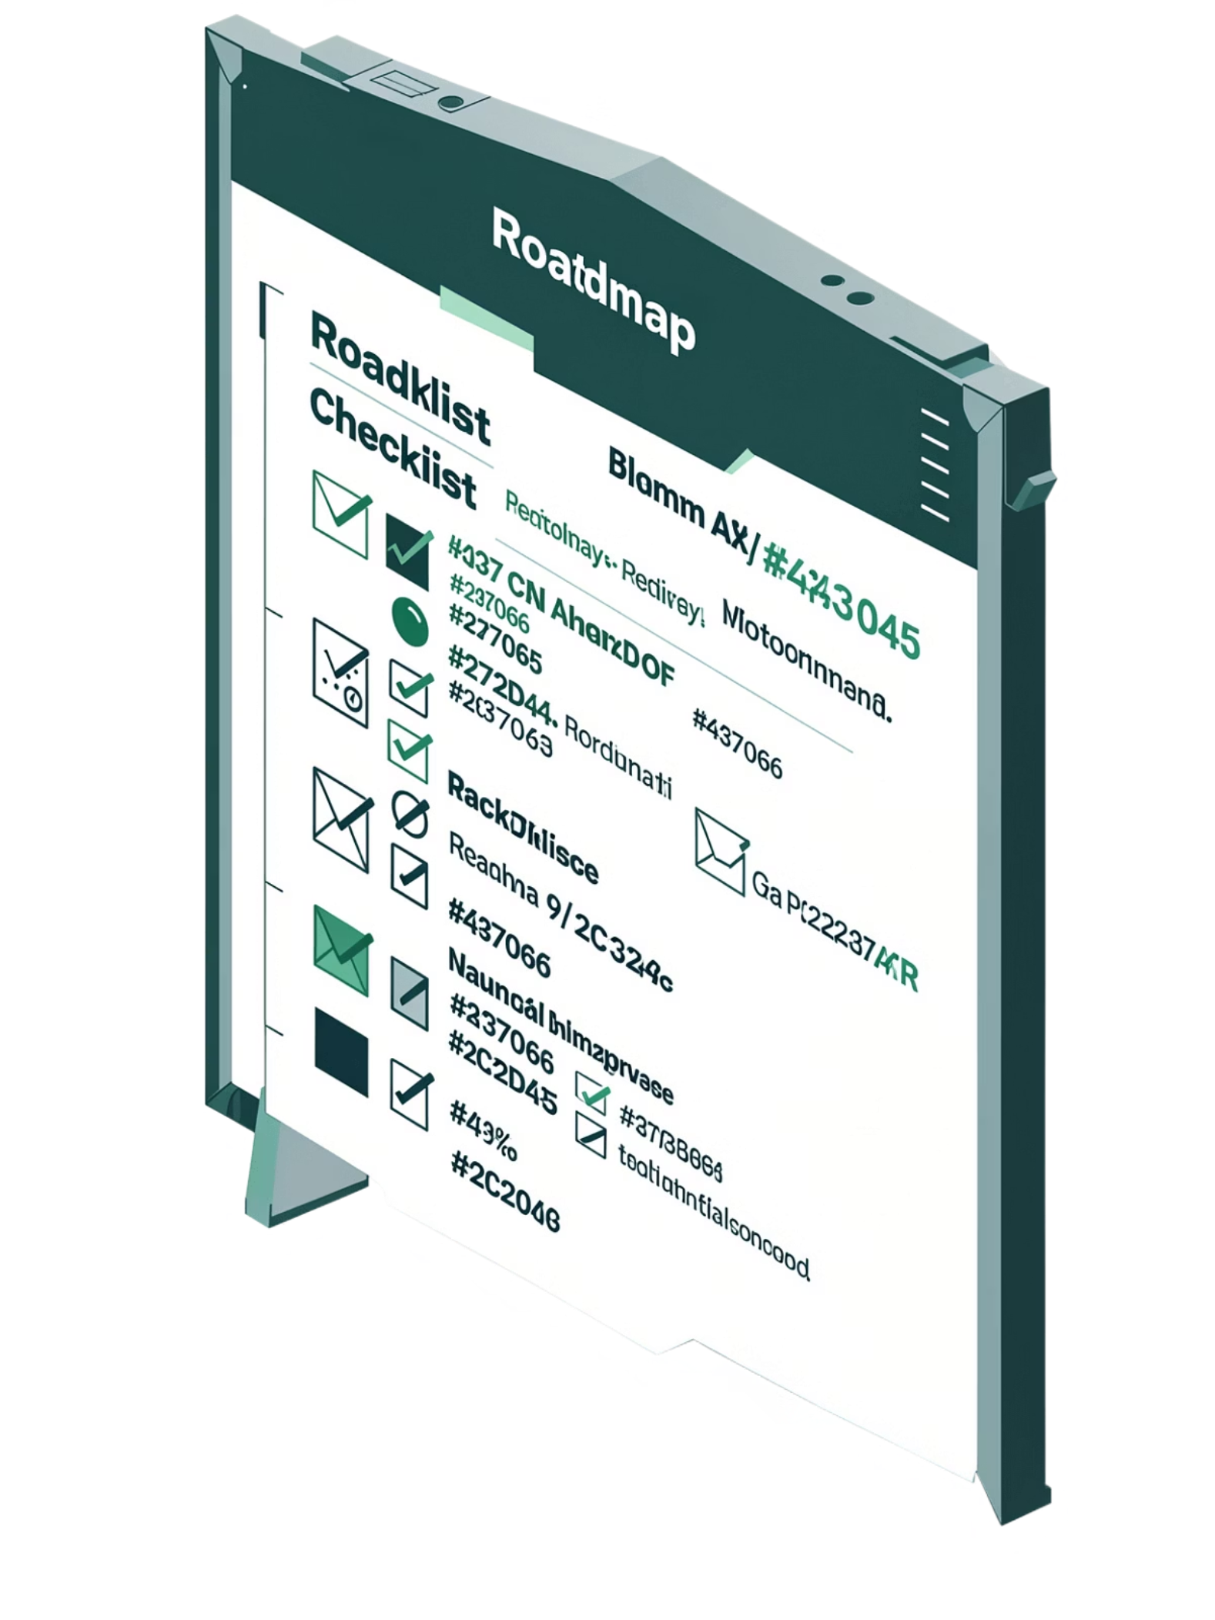
Next Steps
Database
Application
Finalize schema
Add constraints
Load sample data
Write SQL queries
Create views
Build Create Ride
Build Join Ride
Add ride filters
Manage seat availability
Check time conflicts
Integrate all layers
Future Enhancements
Screenshot verification
Member chat
Ratings & feedback
Safety info

Slide 10

Expected Outcome
A database-driven platform that helps students coordinate shared cab rides by destination, timing, seats, and preferences.
The system will allow students to:
Create shared rides
Join rides
View members
Track seats
Store ride details
Avoid timing conflicts
Share cab costs

