Slide 1

DrCatalyst EHR(Electronic Health Record)
Pranav Chanpara (20CEUBD018)
Shyam Mendapara (20CEUOD016)
Guided By:
Prof. Jigar Pandya
Assistant Professor
Dept. of Comp. Engg.
Meditab Software (India)

Slide 2


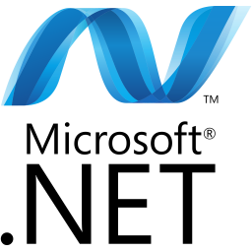

What is DrCatalyst EHR?
DrCatalyst EHR(Electronic Health Record) is basically an Intelligent Electronic Medical Office, a Medical billing software and it is mainly used for faceless appointment booking , medical insurance and all types of billing. This web Application is made with Angular which is used for front end development and for backend in this application ASP.NET with C#. For database PostgreSQL is used and hosts a web application on server AWS is used.

Slide 3
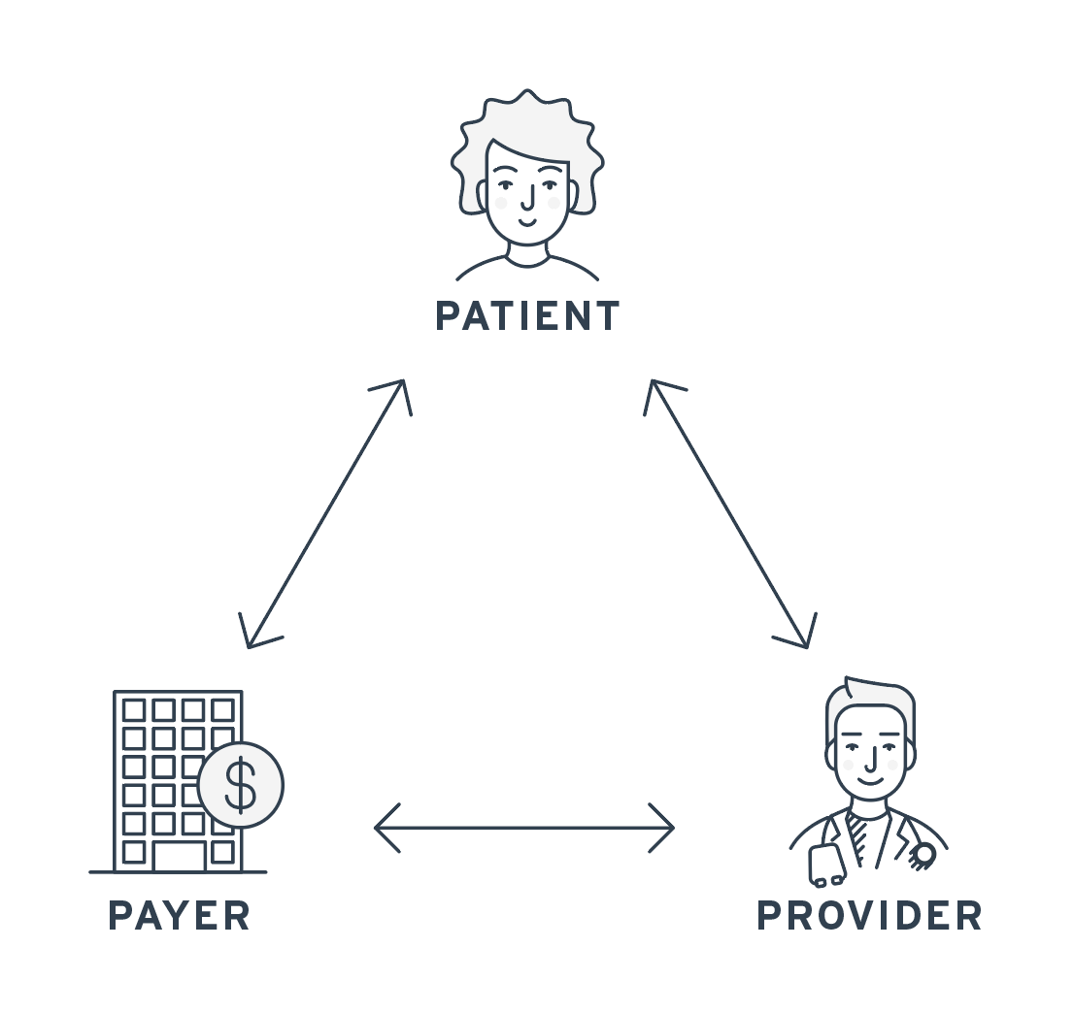
Why Intelligent Electronic Medical Office?
The main objective of this project is to manage the details of patients, Medicine, Medicine Company, Facility, Medicine Stock, Sells, Super Bill, Patient Insurance, Provider etc.
It manages all the information about customers, suppliers, sales, and patients.
It is mainly used for billing purposes - The medical billing process is a process that involves a third party payer, which can be an insurance company or the patient. Medical billing results in claims.
The claims are billing invoices for medical services rendered to patients. The entire procedure involved in this is known as the billing cycle sometimes referred to as Revenue Cycle Management. A patient can make appointments remotely, and take insurance from any medical company.

Slide 4
Motivation
Improved patient care: EHR software can help improve patient care by providing healthcare providers with accurate and up-to-date patient information. This can lead to better diagnoses, treatment plans, and outcomes.
Increased efficiency: EHR software can automate many administrative tasks, such as appointment scheduling and billing, which can save time and reduce errors. This can lead to increased efficiency and productivity for healthcare providers.
Better data management: EHR software can help healthcare organizations manage large amounts of patient data more effectively. This can lead to better analysis of patient information, improved decision-making, and more effective treatments.
Improved communication: EHR software can facilitate communication between healthcare providers, patients, and other stakeholders. This can lead to better coordination of care and improved patient outcomes.

Slide 5
Objectives To Achieve
Patient safety: EHR software should improve patient safety by reducing errors in medication administration, laboratory tests, and diagnostic procedures.
Clinical efficiency: EHR software should improve clinical efficiency by automating routine tasks such as appointment scheduling, charting, and billing. This allows healthcare providers to spend more time with patients and less time on administrative tasks.
Information sharing: EHR software should allow healthcare providers to share patient information securely and efficiently across different healthcare settings, including hospitals, clinics, and primary care offices.
Patient engagement: EHR software should provide patients with access to their health information, allowing them to take a more active role in their care and make informed decisions about their health.

Slide 6
Application of Electronic health record
Patient care: EHR software can be used to manage patient health information, including medical history, medications, allergies, and laboratory results. This information can be accessed by healthcare providers in real-time to make informed decisions about patient care.
Clinical documentation: EHR software can be used to document patient encounters, including notes from examinations, diagnoses, and treatment plans. This documentation can be easily shared among healthcare providers, ensuring continuity of care.
Order management: EHR software can be used to manage orders for diagnostic tests, medications, and other treatments. This can help reduce errors and improve patient safety.
Prescription management: EHR software can be used to manage prescriptions, including sending them directly to the pharmacy and tracking medication adherence.

Slide 7
Comparative with other existing works
BillrMD (IEMO) | eClinicalWorks | PracticeFusion
billrMD is a user-friendly cloud-based practice management & medical billing software platform. | eClinicalWorks is a patient management software designed to help businesses in the healthcare sector maintain electronic medical records and engage patients. The HIPAA-compliant platform enables managers to handle bookings and automate campaigns to send appointment reminders. | Practice Fusion is a cloud-based electronic health record management solution offering features such as e-prescription, charting, scheduling and lab integration
Platforms supported Web Based | Platforms supported Web Based | Platforms supported Web Based iPhone App
Typical Customers Small Sized Clinics Mid Sized Businesses Large Scale Hospitals | Typical Customers Small Sized Clinics Mid Sized Businesses Large Scale Hospitals | Typical Customers Small Sized Clinics Mid Sized Businesses Large Scale Hospitals
Customer Support Phone Online | Customer Support Phone Online Video Tutorials | Customer Support Phone Online
Training Options Live Online | Training Options Live Online Documentation In Person Webinars | Training Options Live Online Webinars Documentation Videos
Price: ~$195/Month | Price: ~$449/Month | Price: ~$149/Month
Customer Rating: 4.5/5 ⭐ | Customer Rating: 3.3/5 ⭐ | Customer Rating: 3.7/5 ⭐

Slide 8
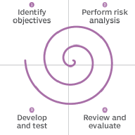
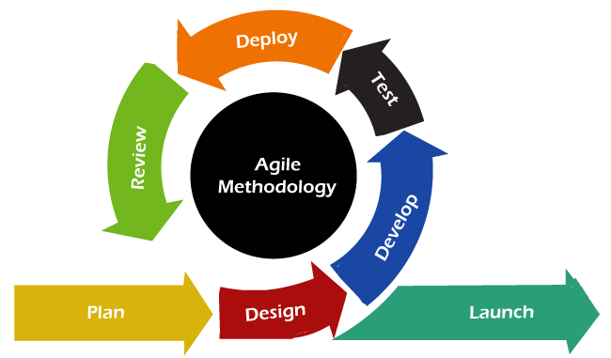
Project Planning & Methodology
The spiral model is mainly used for DrCatalyst EHR. An adapted Agile development methodology works well for most healthcare solution projects because it enables the product team to more accurately capture the elements and features that matter most to end users (whether it be medical clinic staff or patients) and prioritize the delivery of those features.
The concept of agile project management has gone on to spark several specific sub frameworks and methodologies such as lean, Kanban and scrum. Because agile project management methodologies have some principles : It’s quick, It’s open to data-driven change.
As such, with agile project methods, all of the work to be done is added to a backlog so that teams can prioritize the backlog so teams know what to focus on first.

Slide 9
Survey on Similar Products
Available In Market

Slide 10
Assumptions And Dependencies
Each User Must Have Valid User ID and Password
Server must be running for the system to function.
Users must log in to the system to access any record.
Only the administrator can delete the records (soft delete).

Slide 11
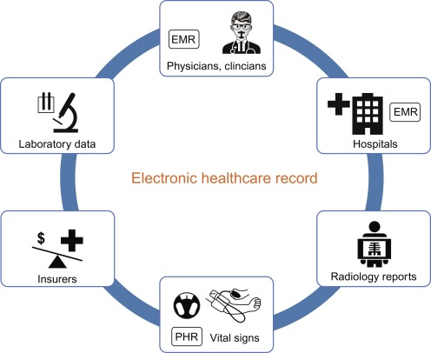
Functional Requirements
Registration Process
Adding Patients : The Medical Billing and Electronic Health record management system enables the staff in the front desk to include new patients to the system
Assigning an ID to the Patient: The Medical Billing and Electronic Health record management system enables the staff in the front desk to provide a unique ID as known as patient chart for each patient and then add them to the record sheet of the patient. The patients can utilize the ID throughout their Appointment Booking time or any time.
Providing Employee/Providers: The Medical Billing and Electronic Health record management system enables the staff in the Employee for a patient to provide a Provider according to patient Emergency and Provider availability.

Slide 12
Non Functional Requirements
There are a lot of software requirements specifications included in the non-functional requirements of Medical Billing and Electronic Health record management system, which contains various process, namely Security, Performance, Maintainability, and Reliability.
Security:
Patient Identification: The system requires the patient to see themselves using the phone.
Login Id: Any users who use the system need to hold a Logon ID and password depending on the location.
Modification: Any modification such as adding, deleting, renewing, etc. on the website can be synchronized quickly and done by the site manager only.
Front Desk Staff Safety Rights: The front desk staff can view any data throughout the Medical Health Record, add a new patient record as they enter, rather than the safety of a particular screen of every patient, so the administrator can assign rights to their clinic staff.
Administrative rights: The administrator may view and modify any information in the Medical Billing and Electronic Health system for records management.

Slide 13
Continue…
Performance and Maintainability:
Response Time: The system provides one-second consent once 'patient information has been checked after booking.
Strengths: The program needs to support at least 1000 people at a time.
User interface: User interface agrees within five seconds.
Backup: The system provides efficient backup of data.
Errors: The system will track all errors and maintain its own log. If the data does not come correctly the email task you have to do.
Reliability:
Availability: The system is available all the time.

Slide 14
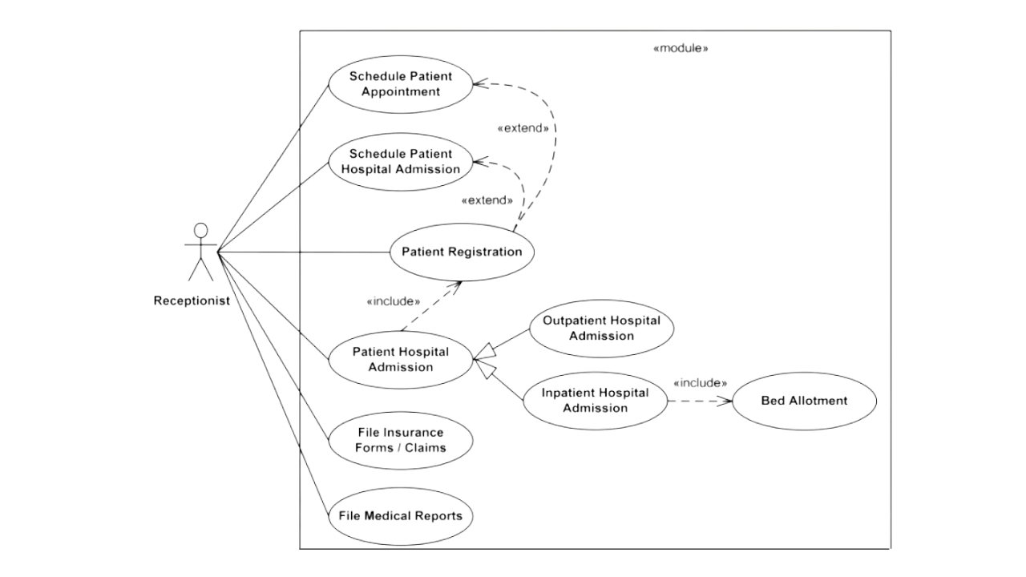
Use Case Diagram
Use Case Diagram

Slide 15
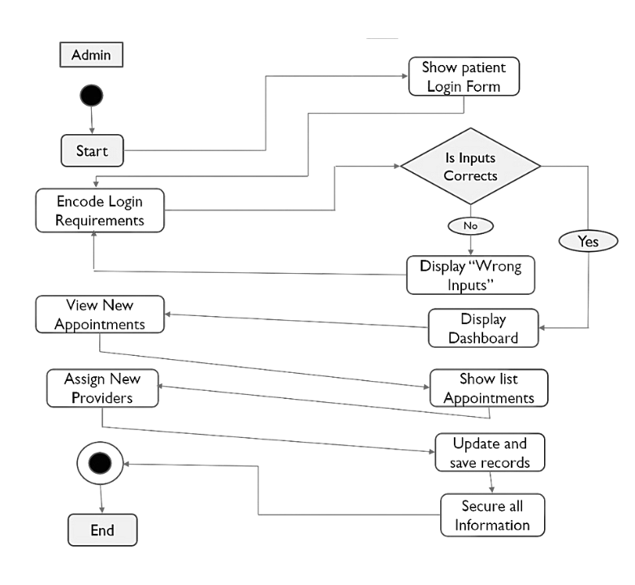
Activity Diagram
Activity Diagram for admin

Slide 16
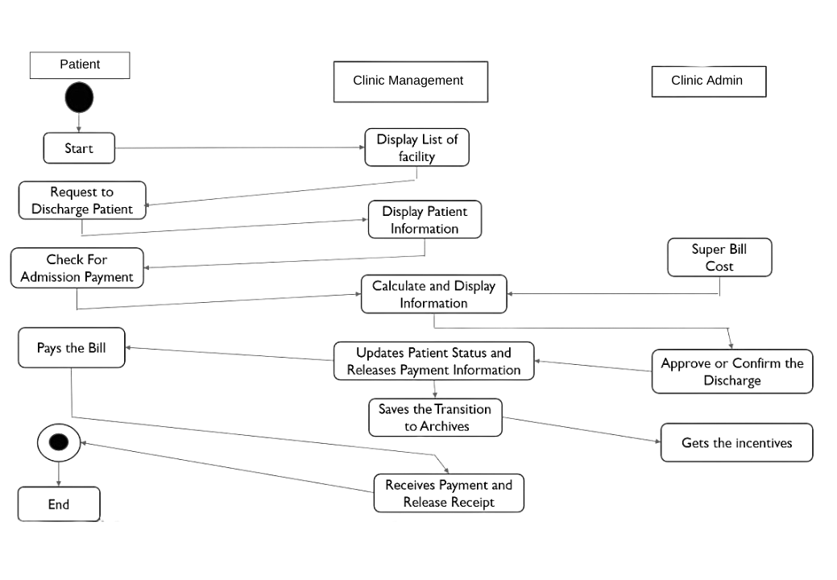
Activity Diagram
Activity Diagram for Multiple users

Slide 17
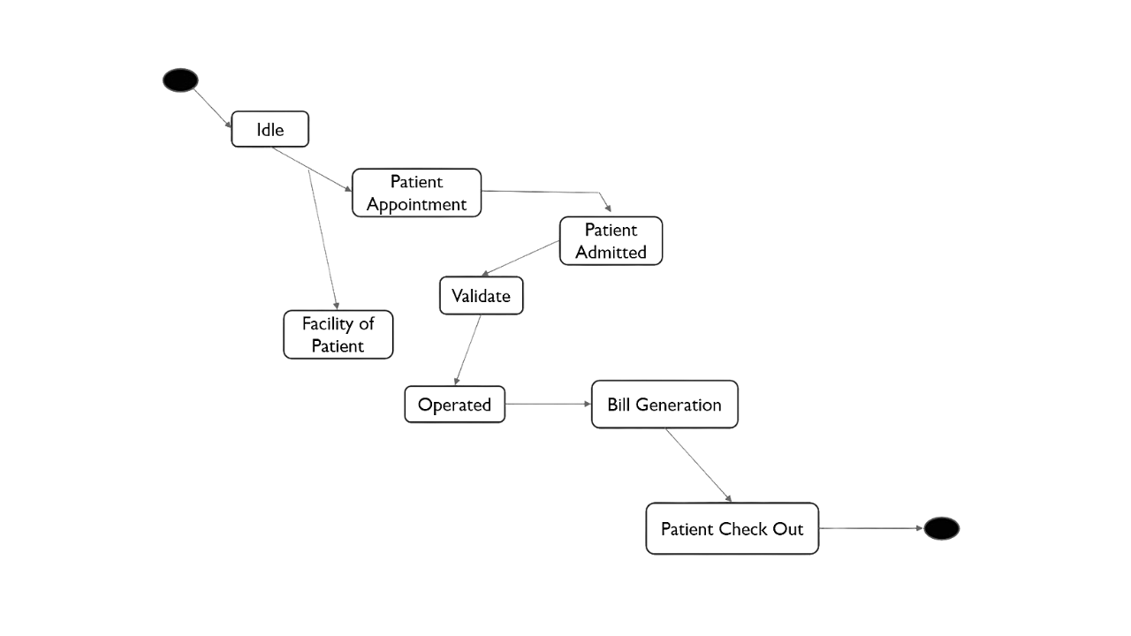
State Chart Diagram
State Chart Diagram

Slide 18
Internship Project

Slide 19
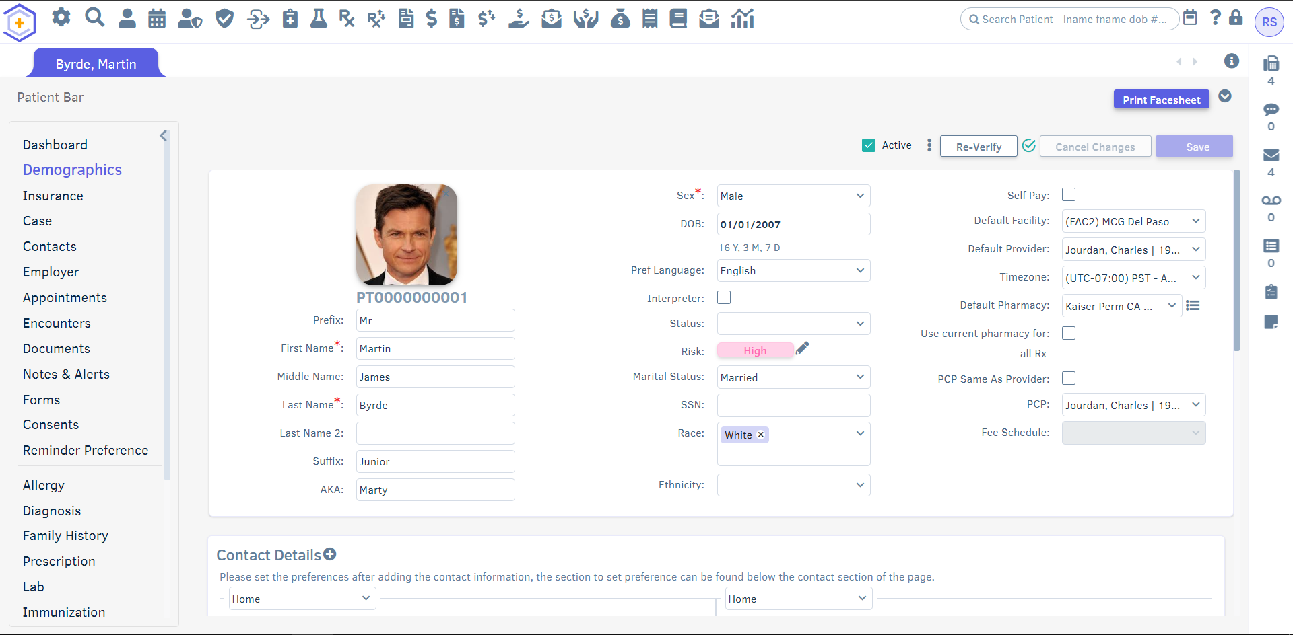
Clone of Patient Demographics Module

Slide 20
Conclusion
In conclusion, the development of an electronic health record maintaining intelligent medical software is a significant step towards improving healthcare delivery. The software has the potential to revolutionize the way medical records are maintained and accessed, thus enhancing the quality of patient care.
The software incorporates artificial intelligence and machine learning technologies to analyze patient data, diagnose illnesses, and make treatment recommendations. It also enables healthcare providers to share patient information seamlessly, improving collaboration and ensuring continuity of care.
With the increasing need for accurate and timely medical information, the electronic health record maintaining intelligent medical software will undoubtedly become an essential tool for healthcare providers. It has the potential to save time, reduce errors, and improve patient outcomes, making it an indispensable asset in the healthcare industry.
However, the implementation of such technology also presents challenges, such as data privacy and security concerns. It is, therefore, crucial to address these challenges and ensure that the software is compliant with relevant laws and regulations.
Overall, the electronic health record maintaining intelligent medical software is a promising technology that can significantly improve healthcare delivery. As it continues to evolve, it is essential to keep in mind the potential benefits and challenges that come with its implementation.

Slide 21


